Slide 1
Sustainability and Climate Physics
1b
Climate
5 EC
Generation
5 EC
Electrification
5 EC
Note that this is a deepening minor

Slide 2
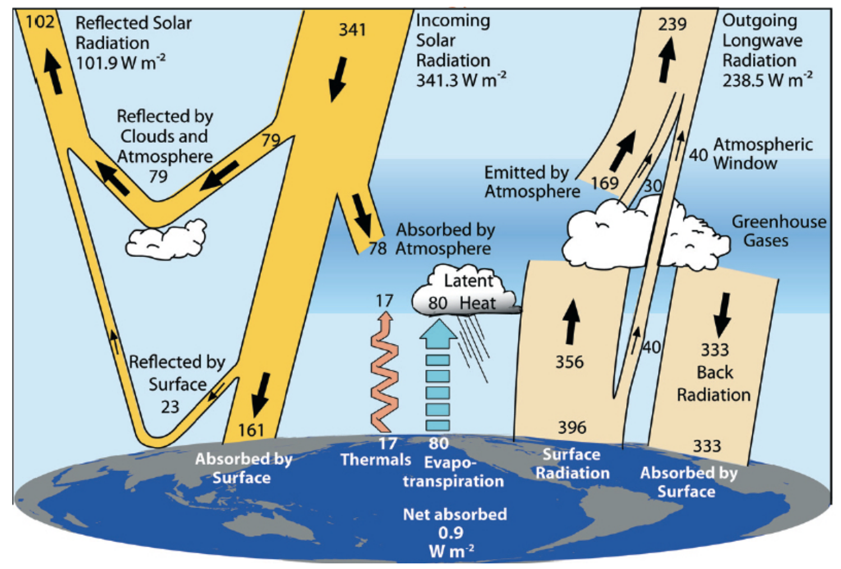
Physics of the Atmosphere and Climate Change
Frieder Mugele
Course content
Overview of the climate system
Solar radiation and energy budget of the earth
Atmosphere and climate
Clouds and aerosols
Ocean and climate
Radiative transfer and greenhouse effect
Atmospheric chemistry and ozone layer
Climate change: models, sensitivity, predictions
The goal of the course is to provide an overview of the physical principles and basic models underlying climate change to students from physics, chemistry, and technology as well as others who are interested in quantitative descriptions.
Ghil, Lucarini,
Rev. Mod. Phys. 2020

Slide 3
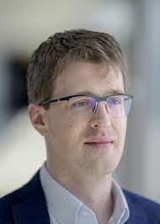
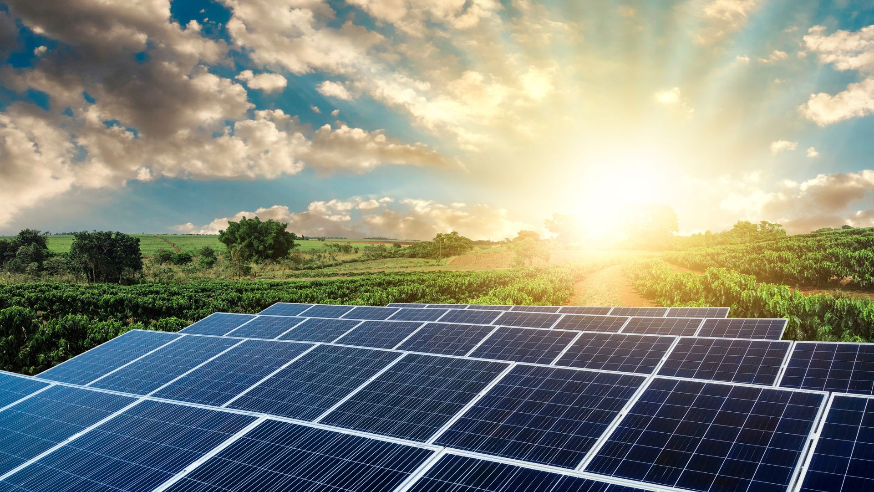
R. Saive
M. Morales-Masis
R. Stevens
L. Leppert (coordinator)
Sustainable Energy Generation and Conversion
Overview of renewable energy technologies
Fundamentals of wind and solar energy
Material science for renewable energy
Practical sessions on solar and wind

Slide 4
Physical principles of electrochemistry for the energy transition
Serge Lemay
The course has two facets:
Fundamental concepts
- Ionic transport, electron transfer, electrocatalysis
- Starting point is known physics (ex: Fermi-Dirac)
Application areas
- Energy storage (supercapacitors, batteries, hydrogen)
- Energy generation (fuel cells)
In practice, the applications are introduced in parallel with the concepts

