Slide 1


Computational Physics
Claudia Filippi, Geert Brocks (CCP), Jeroen Verschuur (SLT)
11/12/2023
Title: to modify choose 'View' then 'Heater and footer'
1
Notes:
1

Slide 2
What is Computational Physics ?
Physics on the computer:
use computer calculations to solve physics problems
make your own (computer) models
computational experiments
For whom? – affinity with physical modeling
- affinity with computer work
Philosophy: no black boxes (think inside of the box)
H&S ware: (your own) laptop & python/matlab
Assessment: written reports for each assignment

Slide 3
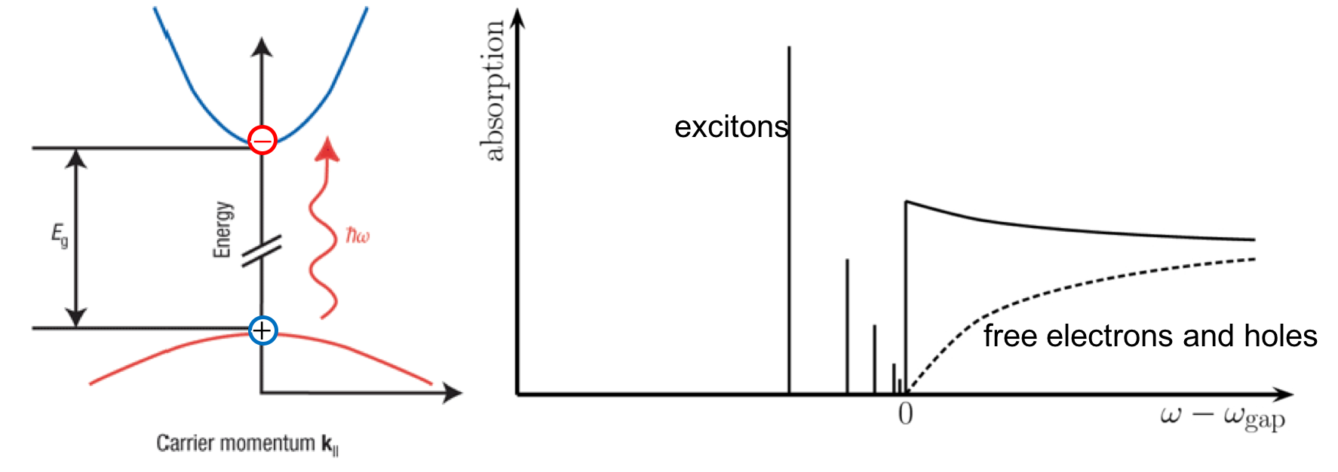
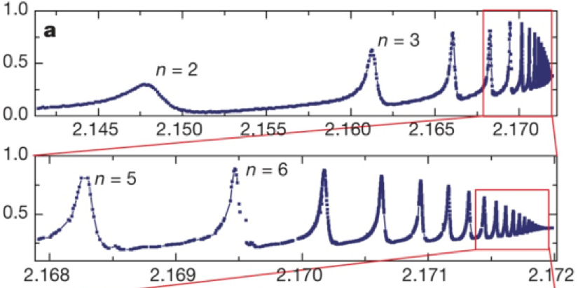

Project 1: Excitons (quantum)
$$\hat{H} ψ\left(r\right)=E ψ(r)$$
optical absorption of a semiconductor
Excitons in Cu₂O
Kazimierczuk et al,
Nature 514, 343 (2014)

Slide 4
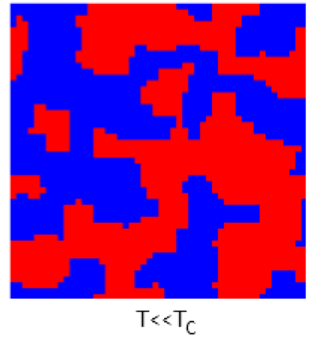
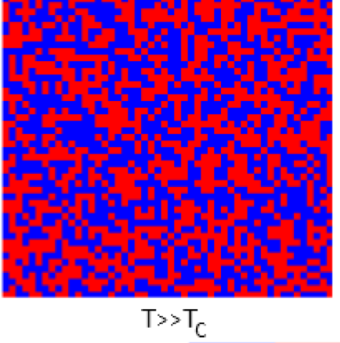


Project 2: magnetism (statistical)
$$\overline{E}=Σ_{i}E_{i}e^{−E_{i}/k_{B}T}/Z$$
magnetization
M(T)
continuous
phase transition
T_{C}
T
Monte Carlo
simulation
rolling the dice
and assembling statistics

Slide 5
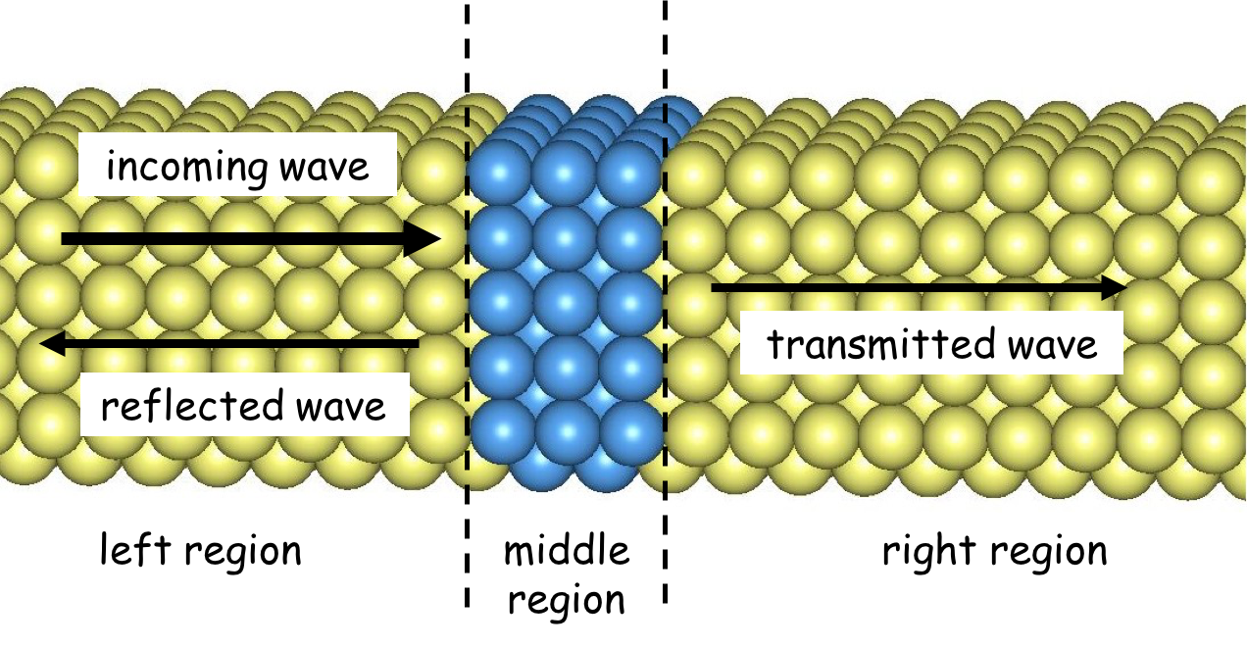

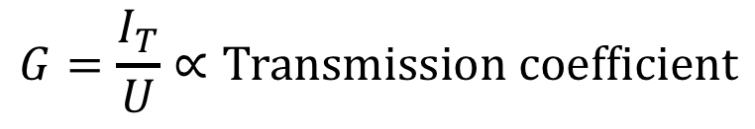
Project 3: waves (quantum)
$$M=M\left(x_{1}\right)M\left(x_{2}\right)…M(x_{n})$$
tunnel junction:
U
electron
I_{T}
(tunnel) current
metal
insulator
metal
conductance
$$G=\frac{I_{T}}{U}∝Transmission coefficient$$

Slide 6
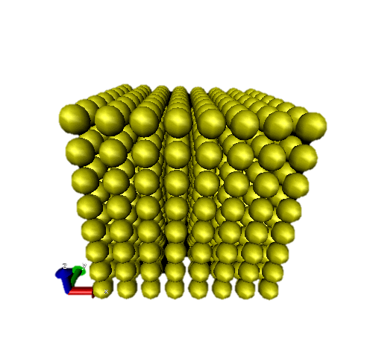
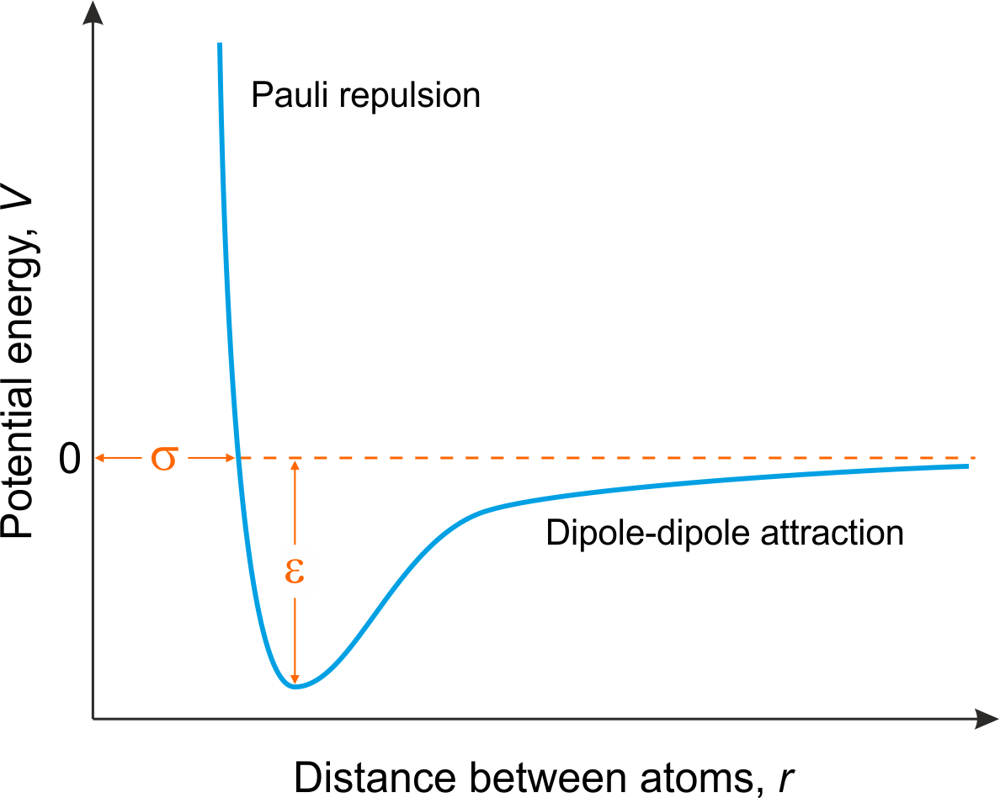
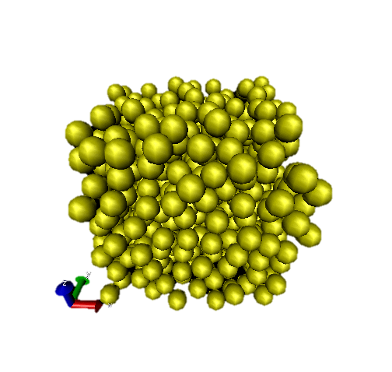
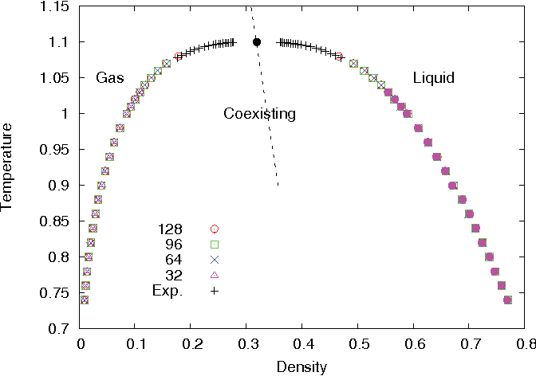
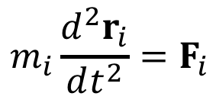
Project 4: molecular dynamics (classical/statistical)
inter-atomic potential
molecular
dynamics
melting
$$m_{i}\frac{d^{2}r_{i}}{dt^{2}}=F_{i}$$
Gas
Liquid
Coexisting
fluid

