Slide 1
Soft Matter Physics in 2024
Rao Vutukuri
Active Soft Matter group
H.R.Vutukuri@utwente.nl
Zuidhorst 156
Michel Duits
Physics of Complex Fluids group
M.H.G.Duits@utwente.nl
Meander 158

Slide 2
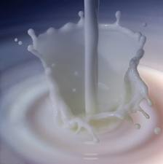
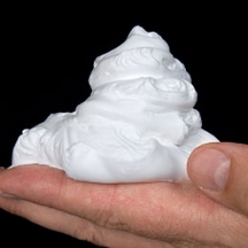
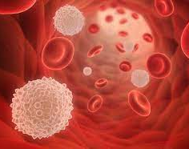
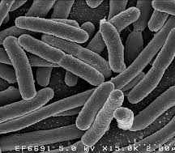
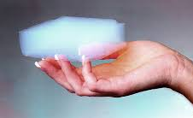
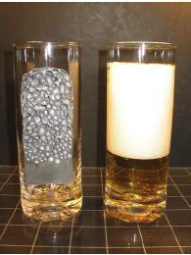
Soft Matter Physics
Passive Materials
Living systems
Blood
Gut Bacteria

Slide 3
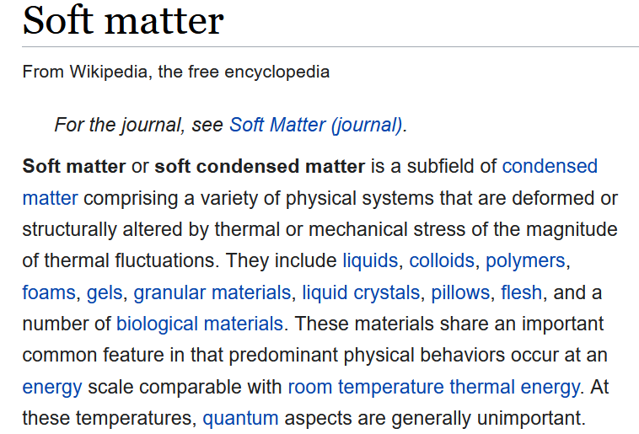
Soft Matter Physics
-Easy to deform (soft)
-Reversible assembly
-Relaxation time(s)
Variety of macroscopic behaviors, originating from microscopic properties

Slide 4
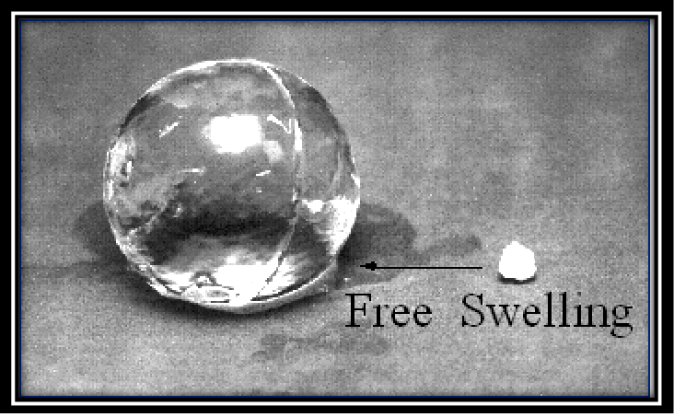
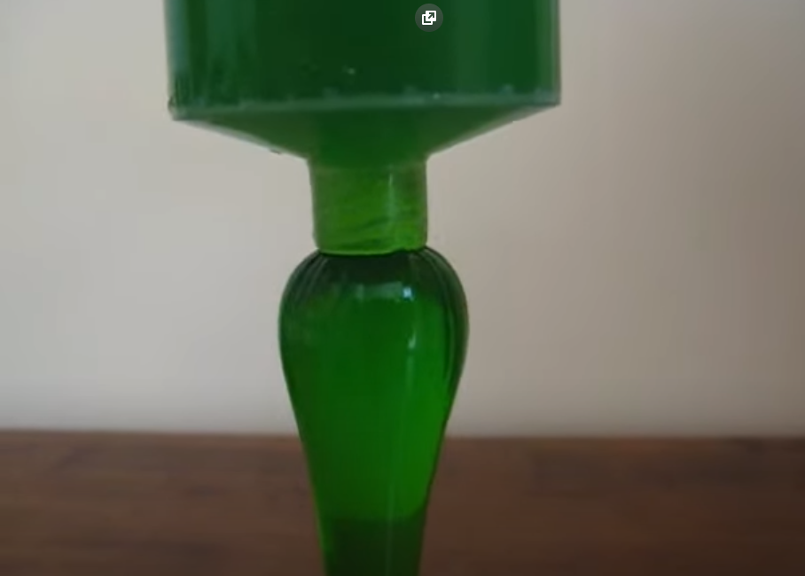
Soft Matter Physics
Dependence on flow rate?
How to model the physics?
Driving force for water uptake?
Equilibrium state?
Role of dissolved ions, elasticity?

Slide 5
Soft Matter Physics
Which propulsion mechanisms?
How to describe motion?
Role of particle geometry?
How to describe dynamics?
Fluctuation-Dissipation theorem
Influence of external field?

Slide 6
Main Topics
Thermal fluctuations
Brownian motion
Molecular machines
Out of equilibrium
Active soft matter
Self-Assembly
Particle aggregates
Polymer gels
Rheology
Visco-elasticity
Charges in liquids
(electricity, salt and water!)
Colloids
Polyelectrolytes

Slide 7
Study Format and Material
Study Format:
-book club or lecture
-tutorials
-paper discussion
-exam
-elements of StaFy
-elements of Fluid mechanics
-book of Doi (+handouts)

Slide 8
Learning Goals
After passing this course you will be able to:
Explain the link between microscopic descriptions of Brownian motion and macroscopic diffusion laws.
Describe and solve common physical models of soft matter systems such as (viscoelastic) polymers, surfactants and ionic solutions.
Describe the key physical characteristics of active soft matter.
Interpret basic experimental data for techniques such as rheology

