Slide 1
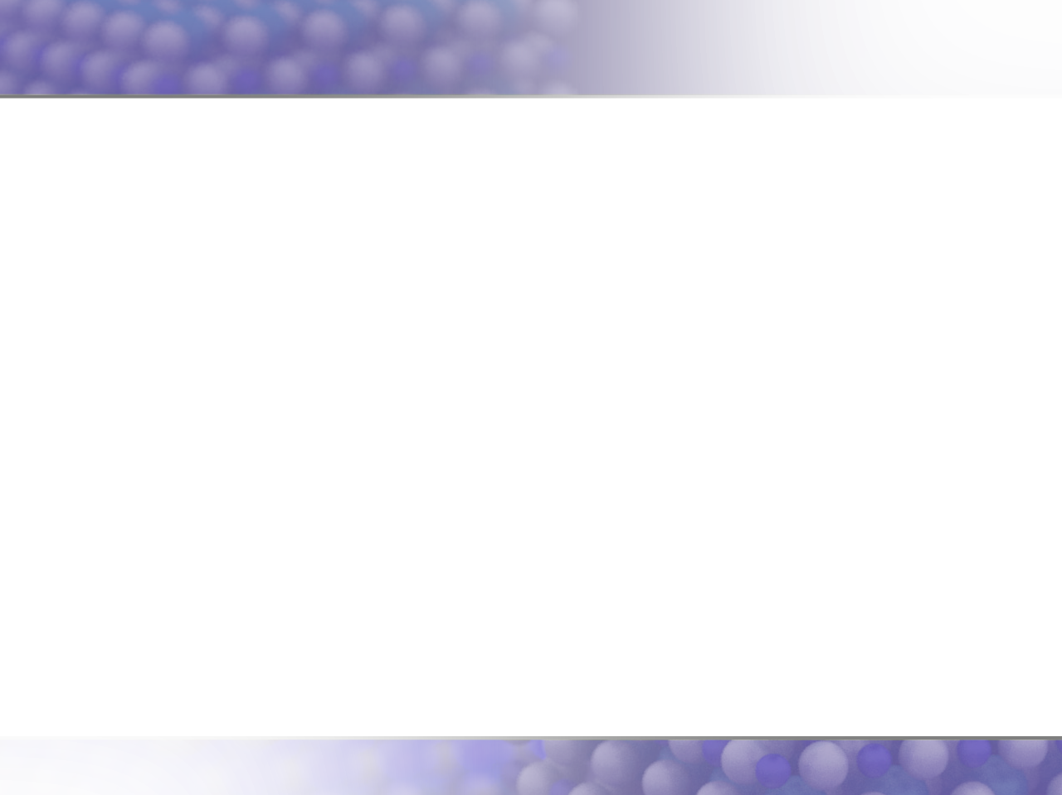
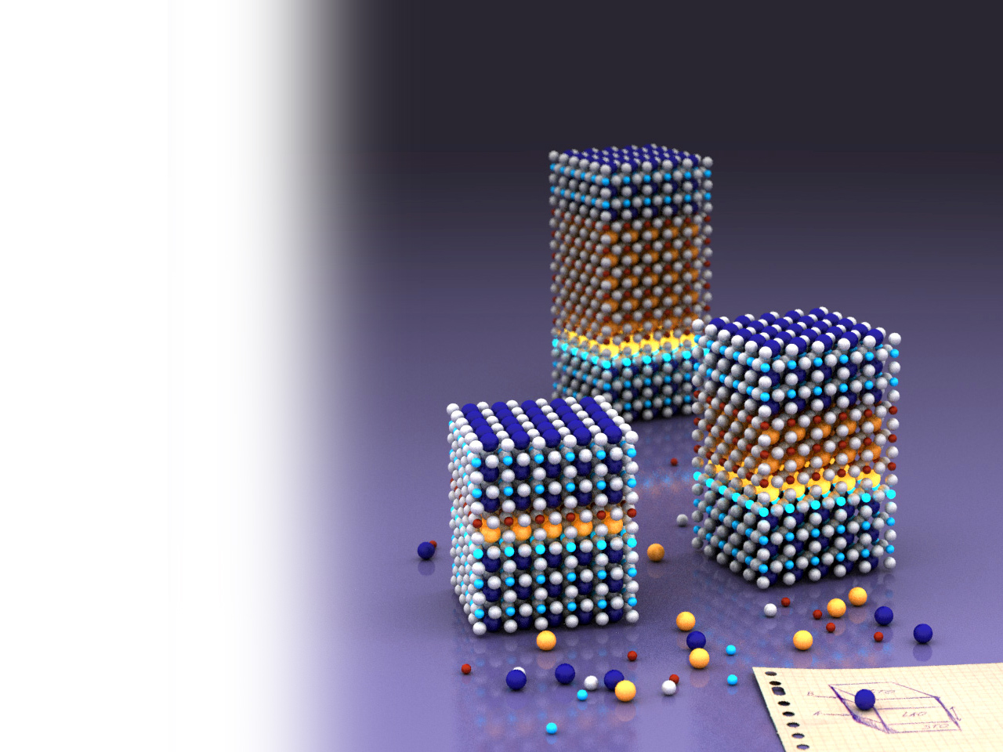

Fysische
Materiaalkunde
UNIVERSITY OF TWENTE.
Alexander Brinkman
Hans Hilgenkamp
Quantum Transport in Matter (QTM)
Interfaces and Correlated Electrons (ICE)

Slide 2
Master-vakken
Fysische Materiaalkunde
Bachelorvak Fysische Materiaalkunde
(Hans Hilgenkamp & Alexander Brinkman)
Ter voorbereiding op Nano-Electronic Materials richting:
Surfaces and Thin Layers
Theoretical Solid State Physics
Nanophysics
…en ter algemene technisch-fysische ontwikkeling!
Notes:
2

Slide 3
Nano-Electronic Materials cluster
PIN: Physics of Interfaces and Nanomaterials (Zandvliet, Bampoulis)
CCP Computational Chemical Physics (Filippi, Leppert, Brocks, Bokdam)
ICE/QTM: Interfaces & Correlated Electron systems / Quantum Transport in Matter (Hilgenkamp, Brinkman, Li, Golubov)
IMS: Inorganic Materials Science (Rijnders, Huijben, Koster, Morales, Saive)
NE: Nano Electronics (Vd Wiel, Zwanenburg, )
XUV: Extreme UV lithography (Ackermann, Makhotkin, Sturm, Bayraktar)
Notes:
3

Slide 4
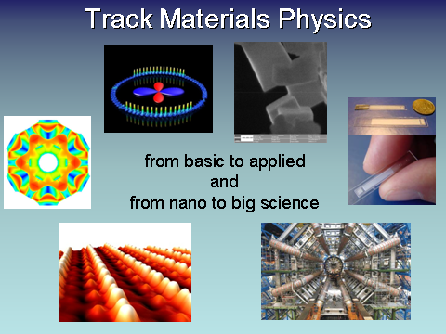
The track…
Topic examples:
Solar cells
Superconductivity
Nuclear fusion
Hydrogen technology
Neuromorphic computing
Satellite sensors
Beyond Moore electronics & storage
CERN magnets
Thin film technology
Particle detectors
Battery technology
Quantum computation
etc. …

Slide 5
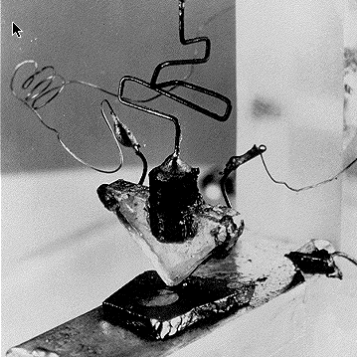
Notes:
5

Slide 6
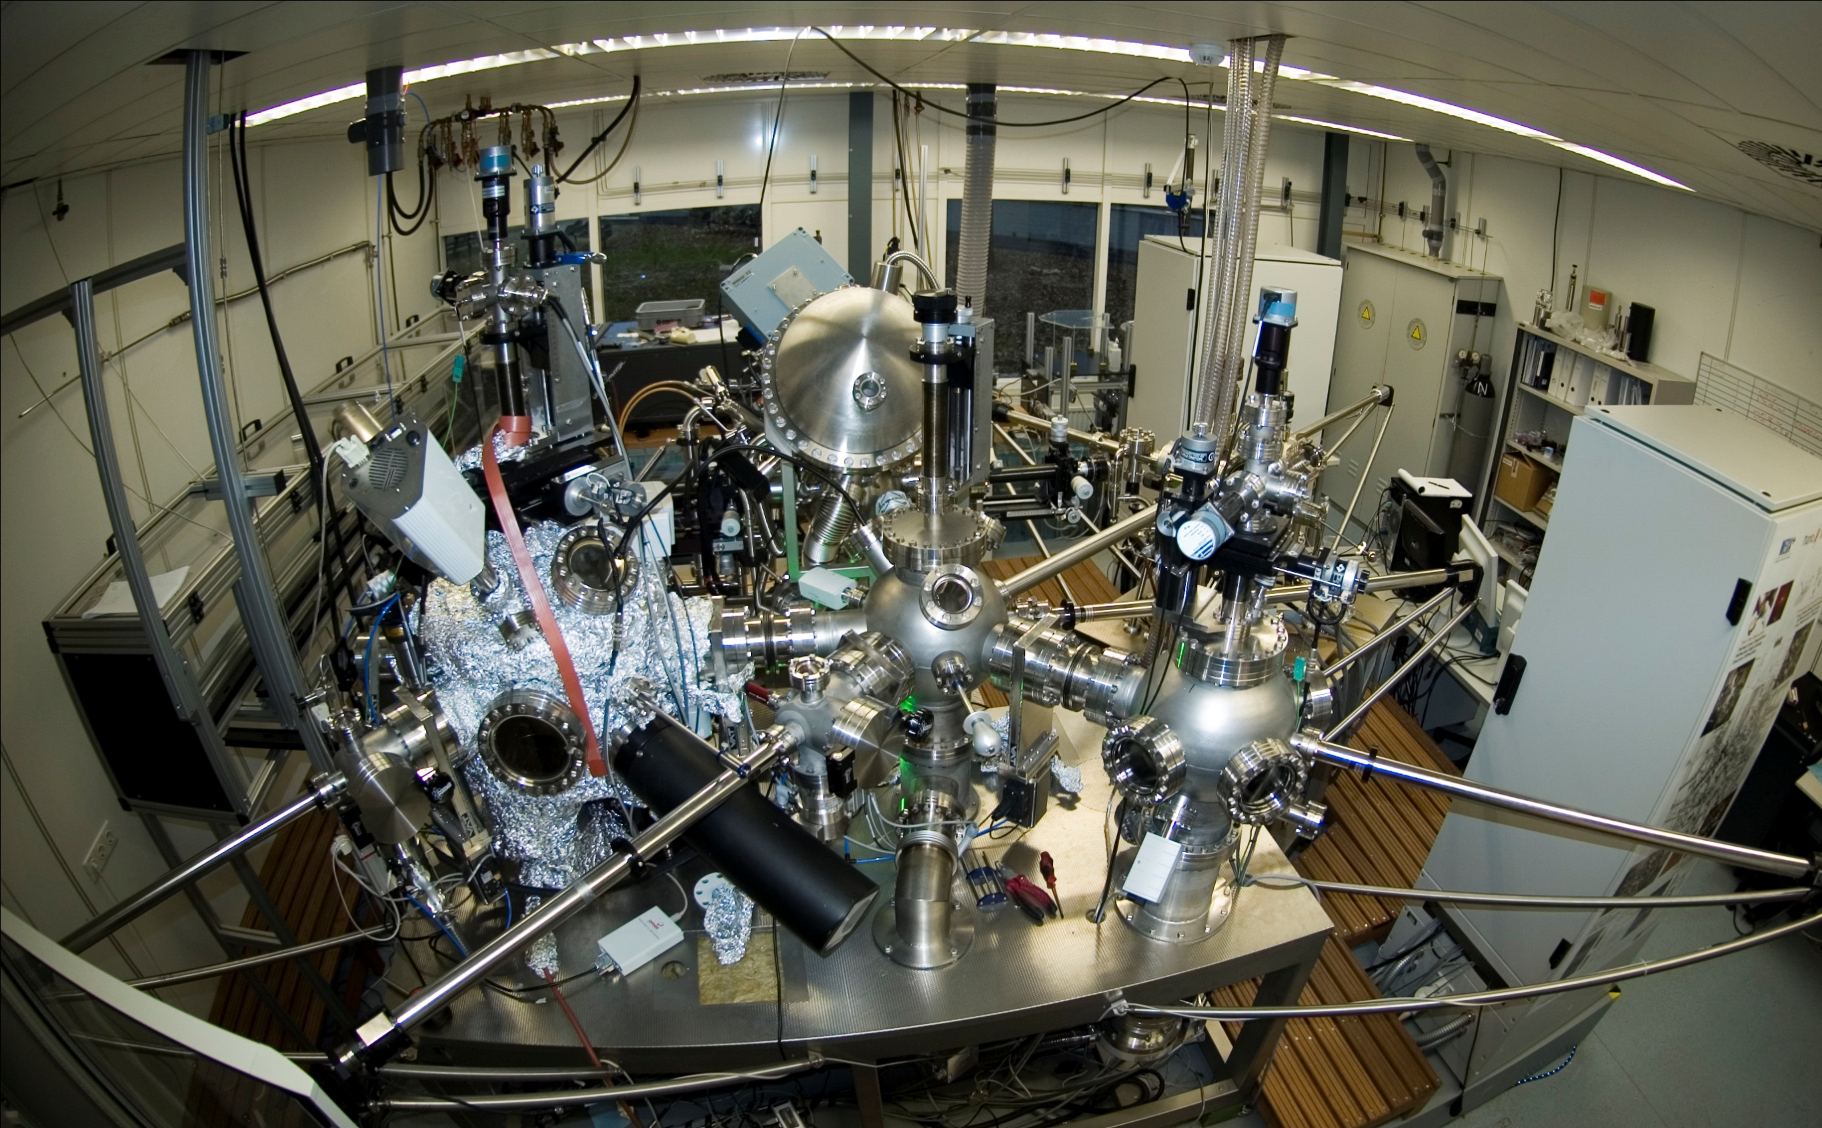
Notes:
6

Slide 7
Opzet van het vak FMK
Hoorcolleges & gastsprekers (bijv. kunst of industrie)
Consultancy opdracht + presentatie
- Bijv. materiaalkundige aspecten van batterijen
- Hoe maak je de volgende generatie zonnecellen?
Cursus elektronenmicroscopie
Cursus dunne-filmlab/cleanroom
Notes:
7

