Slide 1

Tactical Planning in Healthcare using Approximate Dynamic Programming
(tactisch plannen van toegangstijden in de zorg)
Peter J.H. Hulshof, Martijn R.K. Mes, Richard J. Boucherie, Erwin W. Hans
Center for Health care Operations Improvement and Research (CHOIR)
University of Twente
Friday, January 24, 2014
CHOIR Seminar – University of Twente

Slide 2


OUTLINE
Introduction
Problem formulation
Solution approaches
  Integer Linear Programming
  Dynamic Programming
  Approximate Dynamic Programming
Results
Conclusions
This research is partly supported by the Dutch Technology Foundation STW, applied science division of NWO and the Technology Program of the Ministry of Economic Affairs.

Slide 3

MOTIVATION & FOCUS
Motivation
  Long access times due to lacking match of supply and demand
    Varying demand (e.g., seasonality)
    Varying resource availability (e.g., holidays, cancellations)
  Limited control of serving the strategically agreed number of patients.
  Opportunities to improve resource utilization.
Focus
  Integrated decision making on the tactical planning level:
    Patient care processes connect multiple departments and resources, which require an integrated approach.
    Operational decisions often depend on a tactical plan, e.g., tactical allocation of blocks of resource time to specialties and/or patient categories (master schedule / block plan).

Slide 4
CARE PROCESS & ACCESS TIME
Care process: a chain of care stages for a patient, e.g., consultation, surgery, or a visit to the outpatient clinic.
Access time is the delay between the request for an appointment or treatment and the actual appointment or treatment.

Slide 5

OBJECTIVES OF TACTICAL PLANNING
To control access times and care pathway durations
  To ensure quality of care for the patient and to prevent patients from seeking treatment elsewhere
  Decreasing care pathway duration decreases the delay between costs invested and revenues incurred
To serve the strategically agreed number of patients
To achieve high resource utilization and to balance workload
Decreased costs and increased staff satisfaction
Tactical planning requires coordinated decision making between multiple resources, multiple time periods, and multiple care pathways.

Slide 6
TACTICAL PLANNING IN OUR STUDY
Typical setting: 8 care processes, 8 weeks as a planning horizon, and 4 resource types.
Current way of creating/adjusting tactical plans: biweekly meeting with decision makers using spreadsheet solutions.
Our objective: to provide an optimization step that supports rational decision making in tactical planning.
  Allocate resource capacities to care pathways, considering the variations in patient demand and resource availability.
  Determine a patient admission plan for each stage in every care pathway.

Slide 7
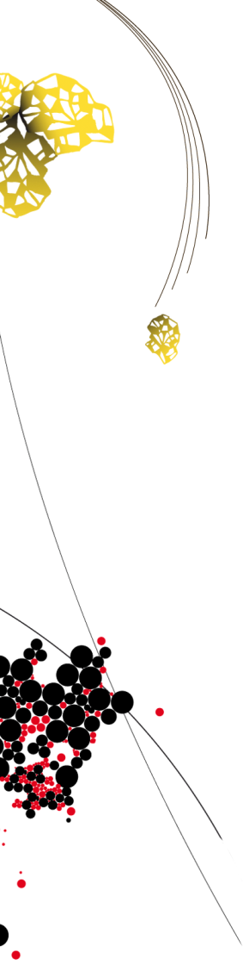
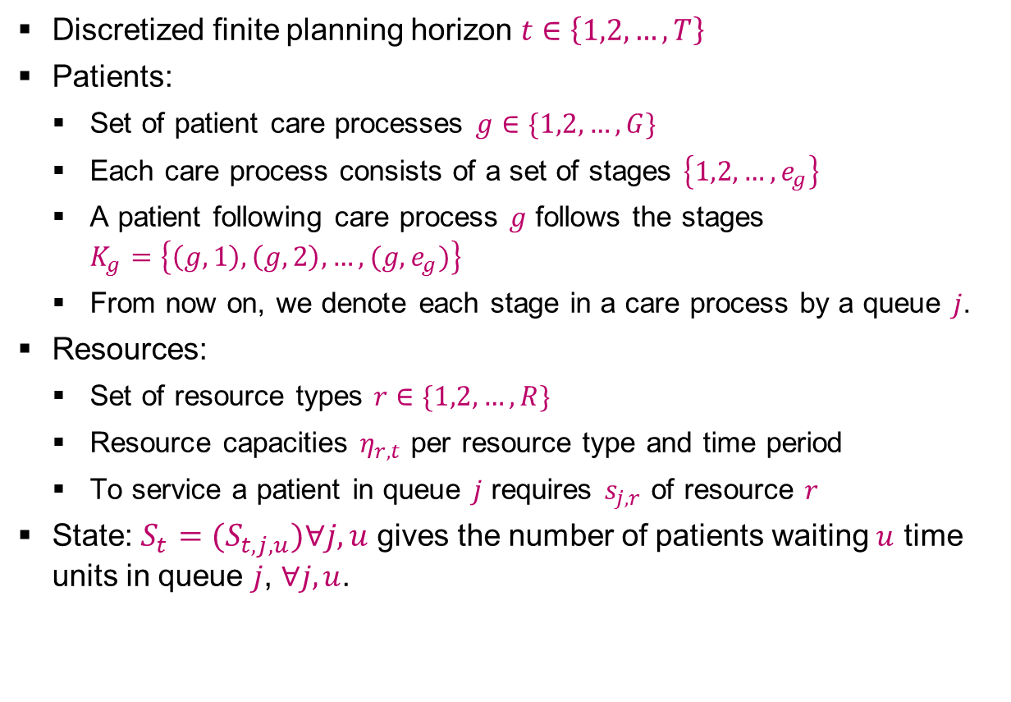
PROBLEM FORMULATION [1/2]
Discretized finite planning horizon $t∈\left\{1,2,…,T\right\}$
Patients:
  Set of patient care processes $g∈\{1,2,…,G\}$
  Each care process consists of a set of stages $\left\{1,2,…,e_{g}\right\}$
  A patient following care process $g$ follows the stages $K_{g}=\left\{\left(g,1\right),\left(g,2\right),…,(g,e_{g})\right\}$
  From now on, we denote each stage in a care process by a queue $j$.
Resources:
  Set of resource types $r∈\{1,2,…,R\}$
  Resource capacities $η_{r,t}$ per resource type and time period
  To service a patient in queue $j$ requires $s_{j,r}$ of resource $r$
State: ${S_{t}=(S}_{t,j,u})∀j,u$ gives the number of patients waiting $u$ time units in queue $j$, $∀j,u$.

Slide 8
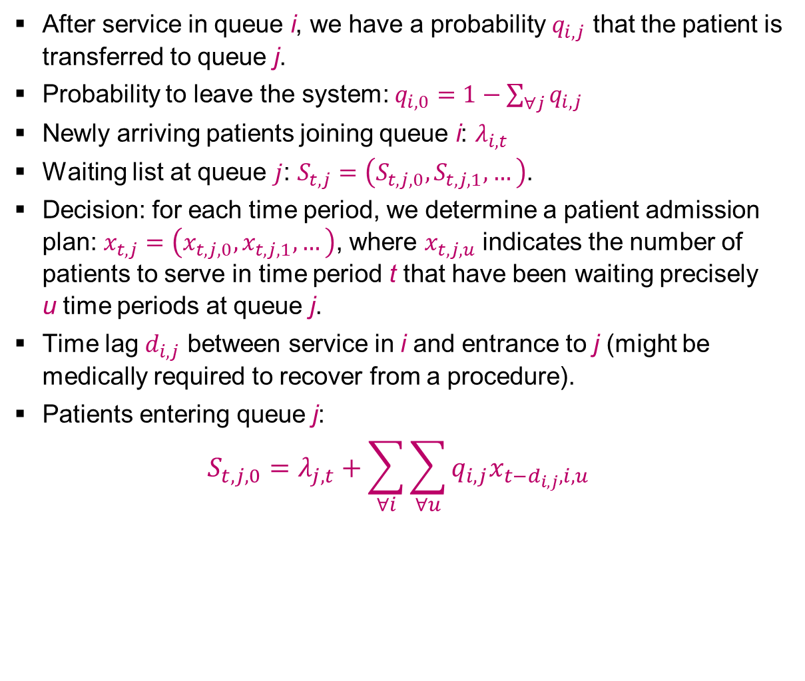
PROBLEM FORMULATION [2/2]
After service in queue i, we have a probability $q_{i,j}$ that the patient is transferred to queue j.
Probability to leave the system: $q_{i,0}=1−\sum_{∀j}{q_{i,j}}$
Newly arriving patients joining queue i: $λ_{i,t}$
Waiting list at queue $j$: $S_{t,j}=\left(S_{t,j,0},S_{t,j,1},…\right)$.
Decision: for each time period, we determine a patient admission plan: $x_{t,j}=\left(x_{t,j,0},x_{t,j,1},…\right)$, where $x_{t,j,u}$ indicates the number of patients to serve in time period t that have been waiting precisely
u time periods at queue j.
Time lag $d_{i,j}$ between service in i and entrance to j (might be medically required to recover from a procedure).
Patients entering queue j:
$$S_{t,j,0}=λ_{j,t}+\sum_{∀i}{\sum_{∀u}{q_{i,j}x_{t−d_{i,j},i,u}}}$$

Slide 9

ILLUSTRATION
1 queue (1 care process with 1 stage), 0/1 waiting time
(2,2)
(1,2)
(0,2)
(2,1)
(1,1)
States →
(0,1)
(2,0)
(1,0)
(0,0)
Time →
0
1
2
3
4

Slide 10
SOLUTION APPROACHES
Mixed Integer Linear Program (MILP):
  Deterministic
Dynamic Programming (DP):
  Able to incorporate uncertainty, but not scalable to realistic problem sizes
Approximate Dynamic Programming (ADP):
  Alternative way to solve DPs, scalable to realistic problem sizes

Slide 11
ILLUSTRATION MIXED INTEGER LINEAR PROGRAM Deterministic problem - expected values: 1 arrival
(2,2)
(1,2)
(0,2)
(2,1)
(1,1)
States →
(0,1)
(2,0)
(1,0)
(0,0)
Time →
0
1
2
3
4

Slide 12
MIXED INTEGER LINEAR PROGRAM (MILP)
Evaluate costs for all possible sequences of decisions
(2,2)
(1,2)
(0,2)
(2,1)
(1,1)
States →
(0,1)
(2,0)
(1,0)
(0,0)
Time →
0
1
2
3
4
(transitions only serve as illustration, not always feasible)

Slide 13
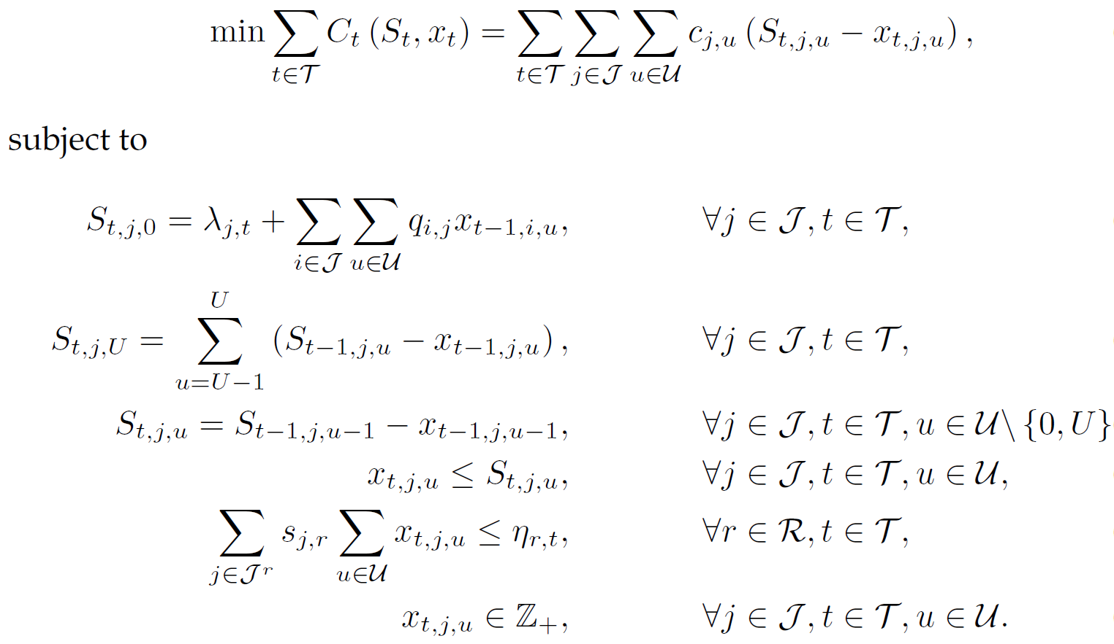

MIXED INTEGER LINEAR PROGRAM (MILP)
Number of patients in queue j at time t with waiting time u
Number of patients to treat in queue j at time t with a waiting time u
[1]
Assume time lags $d_{i,j}=1$
Updating
waiting list &
bound on u
Assume upper bound U on u
Limit on the decision space
[1] Hulshof PJ, Boucherie RJ, Hans EW, Hurink JL. (2013) Tactical resource allocation and
elective patient admission planning in care processes. Health Care Manag Sci. 16(2):152-66.

Slide 14
PROS & CONS OF THE MILP
Pros:
  Suitable to support integrated decision making for multiple resources, multiple time periods, and multiple patient groups.
  Flexible formulation (other objective functions can easily be incorporated).
Cons:
  Quite limited in the state space.
  Rounding problems with fraction of patients moving from one queue to another after service.
  Model does not include any form of randomness.

Slide 15
DYNAMIC PROGRAMMING (DP)
Calculate the exact cost-to-go backwards
(2,2)
V₀(2,2)
V₁(2,2)
V₂(2,2)
V₃(2,2)
V₄(2,2)
(1,2)
V₀(1,2)
V₁(1,2)
V₂(1,2)
V₃(1,2)
V₄(1,2)
(0,2)
V₀(0,2)
V₁(0,2)
V₂(0,2)
V₃(0,2)
V₄(0,2)
(2,1)
V₀(2,1)
V₁(2,1)
V₂(2,1)
V₃(2,1)
V₄(2,1)
(1,1)
V₀(1,1)
V₁(1,1)
V₂(1,1)
V₃(1,1)
V₄(1,1)
States →
V₀(0,1)
V₁(0,1)
V₂(0,1)
V₃(0,1)
V₄(0,1)
(0,1)
(2,0)
V₀(2,0)
V₁(2,0)
V₂(2,0)
V₃(2,0)
V₄(2,0)
(1,0)
V₀(1,0)
V₁(1,0)
V₂(1,0)
V₃(1,0)
V₄(1,0)
(0,0)
V₀(0,0)
V₁(0,0)
V₂(0,0)
V₃(0,0)
V₄(0,0)
Time →
0
1
2
3
4
(transitions only serve as illustration, not always feasible)

Slide 16
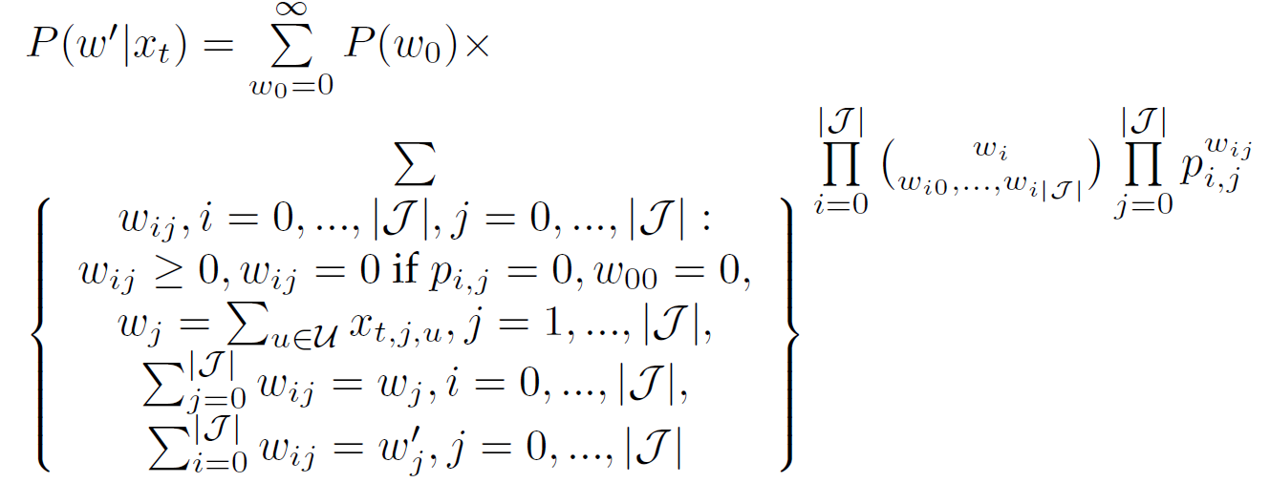
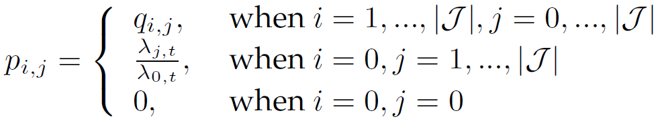
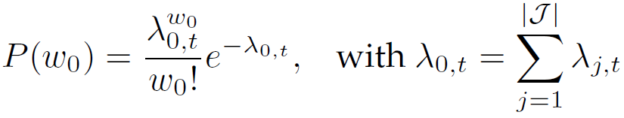
DYNAMIC PROGRAMMING FORMULATION
Solve:
Where
By backward induction.

Slide 17
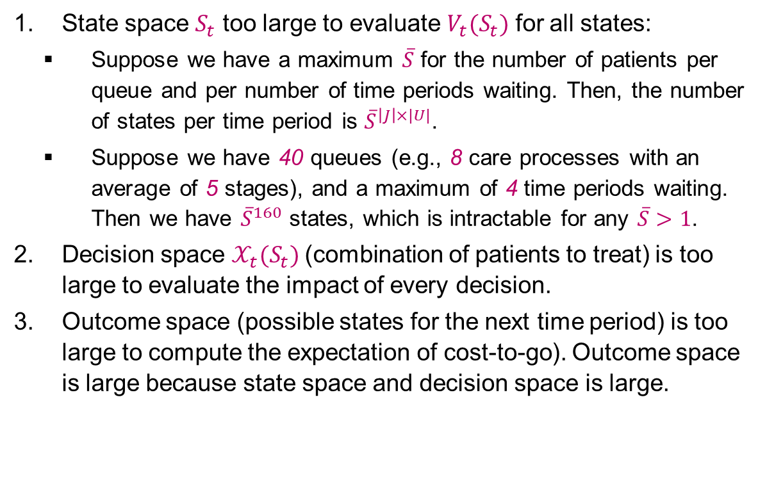
THREE CURSUS OF DIMENSIONALITY
State space $S_{t}$ too large to evaluate $V_{t}(S_{t})$ for all states:
  Suppose we have a maximum $\overline{S}$ for the number of patients per queue and per number of time periods waiting. Then, the number of states per time period is ${\overline{S}}^{\left|J\right|×|U|}$.
  Suppose we have 40 queues (e.g., 8 care processes with an average of 5 stages), and a maximum of 4 time periods waiting. Then we have ${\overline{S}}^{160}$ states, which is intractable for any $\overline{S}>1$.
Decision space $𝒳_{t}(S_{t})$(combination of patients to treat) is too large to evaluate the impact of every decision.
Outcome space (possible states for the next time period) is too large to compute the expectation of cost-to-go). Outcome space is large because state space and decision space is large.

Slide 18
APPROXIMATE DYNAMIC PROGRAMMING (ADP)
Learn cost-to-go forwards iteratively
(2,2)
V₀(2,2)
V₁(2,2)
V₂(2,2)
V₃(2,2)
V₄(2,2)
(1,2)
V₀(1,2)
V₁(1,2)
V₂(1,2)
V₃(1,2)
V₄(1,2)
(0,2)
V₀(0,2)
V₁(0,2)
V₂(0,2)
V₃(0,2)
V₄(0,2)
V₁(2,1)
V₄(2,1)
(2,1)
V₀(2,1)
V₁(2,1)
V₂(2,1)
V₃(2,1)
(1,1)
V₀(1,1)
V₁(1,1)
V₂(1,1)
V₃(1,1)
V₄(1,1)
States →
V₄(0,1)
V₀(0,1)
V₁(0,1)
V₂(0,1)
V₃(0,1)
V₄(0,1)
(0,1)
V₀(0,1)
V₃(0,1)
(2,0)
V₀(2,0)
V₁(2,0)
V₂(2,0)
V₃(2,0)
V₄(2,0)
V₁(1,0)
V₂(1,0)
V₄(1,0)
(1,0)
V₀(1,0)
V₂(1,0)
V₃(1,0)
(0,0)
V₀(0,0)
V₁(0,0)
V₂(0,0)
V₃(0,0)
V₄(0,0)
Time →
0
1
2
3
4
(transitions only serve as illustration, not always feasible)

Slide 19
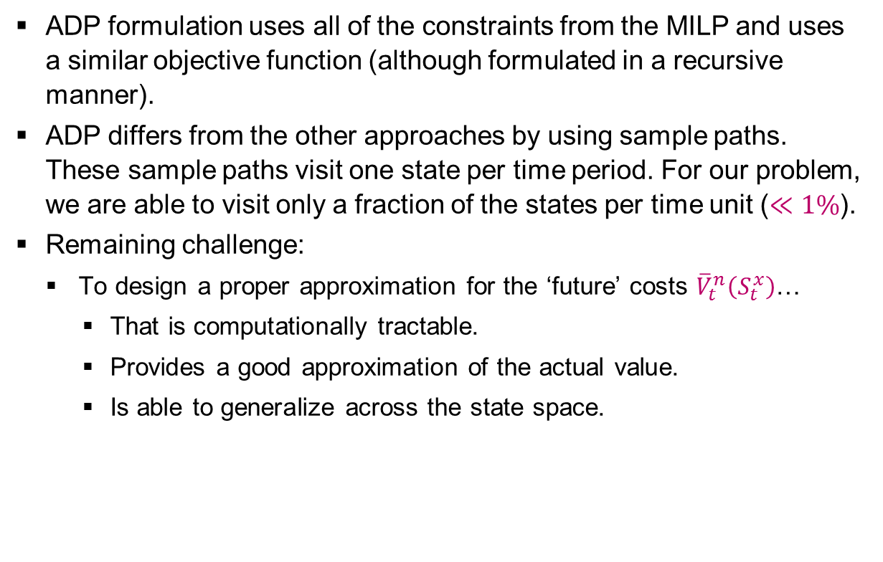
ADP FORMULATION
ADP formulation uses all of the constraints from the MILP and uses a similar objective function (although formulated in a recursive manner).
ADP differs from the other approaches by using sample paths. These sample paths visit one state per time period. For our problem, we are able to visit only a fraction of the states per time unit ($≪1\%$).
Remaining challenge:
  To design a proper approximation for the ‘future’ costs ${\overline{V}}_{t}^{n}\left(S_{t}^{x}\right)$…
    That is computationally tractable.
    Provides a good approximation of the actual value.
    Is able to generalize across the state space.

Slide 20
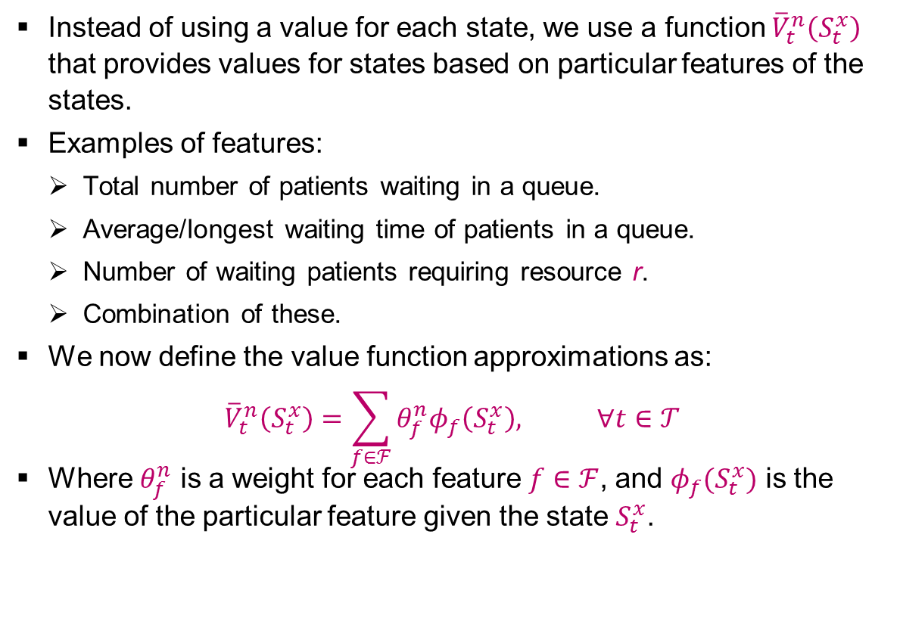
VALUE FUNCTION APPROXIMATION [1/2]
Instead of using a value for each state, we use a function ${\overline{V}}_{t}^{n}\left(S_{t}^{x}\right)$ that provides values for states based on particular features of the states.
Examples of features:
  Total number of patients waiting in a queue.
  Average/longest waiting time of patients in a queue.
  Number of waiting patients requiring resource r.
  Combination of these.
We now define the value function approximations as:
$${\overline{V}}_{t}^{n}\left(S_{t}^{x}\right)=\sum_{f∈ℱ}{θ_{f}^{n}φ_{f}\left(S_{t}^{x}\right), ∀t∈𝒯}$$
Where $θ_{f}^{n}$ is a weight for each feature $f∈ℱ$, and $φ_{f}(S_{t}^{x})$ is the value of the particular feature given the state $S_{t}^{x}$.

Slide 21
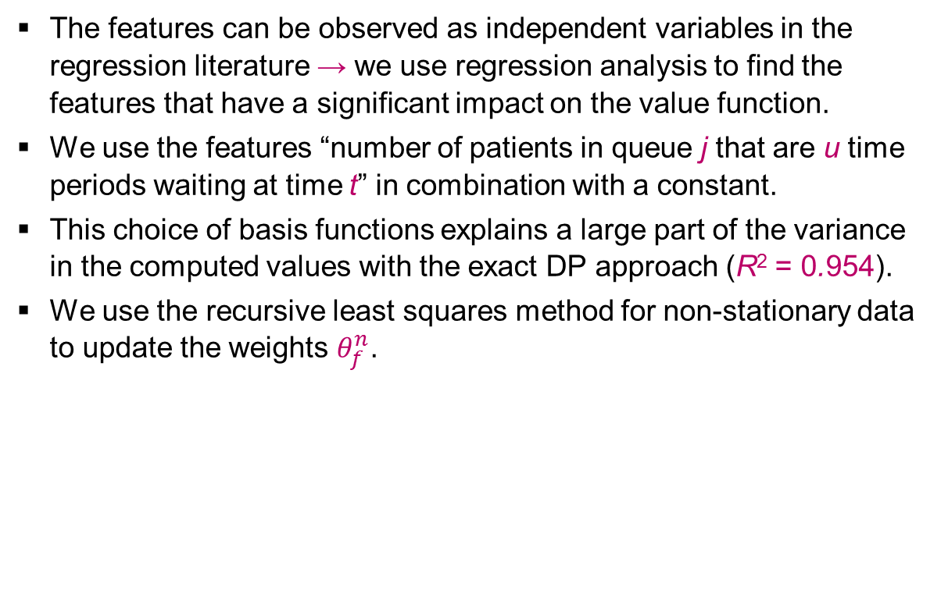
VALUE FUNCTION APPROXIMATION [2/2]
The features can be observed as independent variables in the regression literature → we use regression analysis to find the features that have a significant impact on the value function.
We use the features “number of patients in queue j that are u time periods waiting at time t” in combination with a constant.
This choice of basis functions explains a large part of the variance in the computed values with the exact DP approach (R² = 0.954).
We use the recursive least squares method for non-stationary data to update the weights $θ_{f}^{n}$.

Slide 22
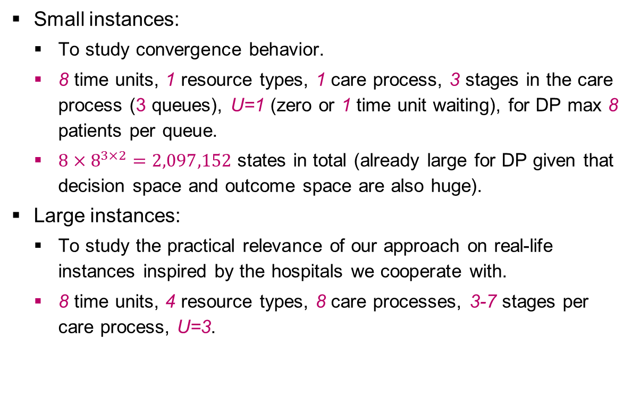
EXPERIMENTS
Small instances:
  To study convergence behavior.
  8 time units, 1 resource types, 1 care process, 3 stages in the care process (3 queues), U=1 (zero or 1 time unit waiting), for DP max 8 patients per queue.
  $8×8^{3×2}=2,097,152$ states in total (already large for DP given that decision space and outcome space are also huge).
Large instances:
  To study the practical relevance of our approach on real-life instances inspired by the hospitals we cooperate with.
  8 time units, 4 resource types, 8 care processes, 3-7 stages per care process, U=3.

Slide 23
CONVERGENCE RESULTS ON SMALL INSTANCES
Tested on 5000 random initial states.
DP requires 120 hours, ADP 0.439 seconds for N=500.
ADP overestimates the value functions (+2.5%) caused by the truncated state space.

Slide 24
PERFORMANCE ON SMALL AND LARGE INSTANCES
Compare with greedy policy: fist serve the queue with the highest costs until another queue has the highest costs, or until resource capacity is insufficient.
We train ADP using 100 replications after which we fix our value functions.
We simulate the performance of using (i) the greedy policy and (ii) the policy determined by the value functions.
We generate 5000 initial states, simulating each policy with 5000 sample paths.
Results:
  Small instances: ADP 2% away from optimum and greedy 52% away from optimum.
  Large instances: ADP results 29% savings compared to greedy (higher fluctuations in resource availability or patient arrivals results in larger differences between ADP and greedy).

Slide 25
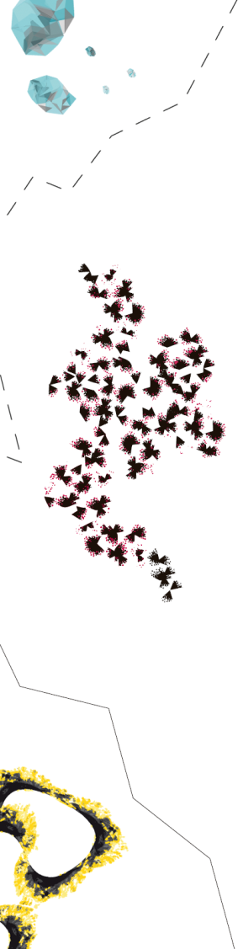
MANAGERIAL IMPLICATIONS
The ADP approach can be used to establish long-term tactical plans (e.g., three month periods) in two steps:
  Run N iterations of the ADP algorithm to find the value functions given by the feature weights for all time periods.
  These value functions can be used to determine the tactical planning decision for each state and time period by generating the most likely sample path.
Implementation in a rolling horizon approach:
  Finite horizon approach may cause unwanted and short-term focused behavior in the last time periods.
  Recalculation of tactical plans ensures that the most recent information is used.
  Recalculation can be done using the existing value function approximations and the actual state of the system.

Slide 26
QUESTIONS?
Martijn Mes
Assistant professor
University of Twente
School of Management and Governance
Dept. Industrial Engineering and Business Information Systems
Contact
Phone: +31-534894062
Email: m.r.k.mes@utwente.nl
Web: http://www.utwente.nl/mb/iebis/staff/Mes/

