Slide 1











SHAPING 2030

Slide 2
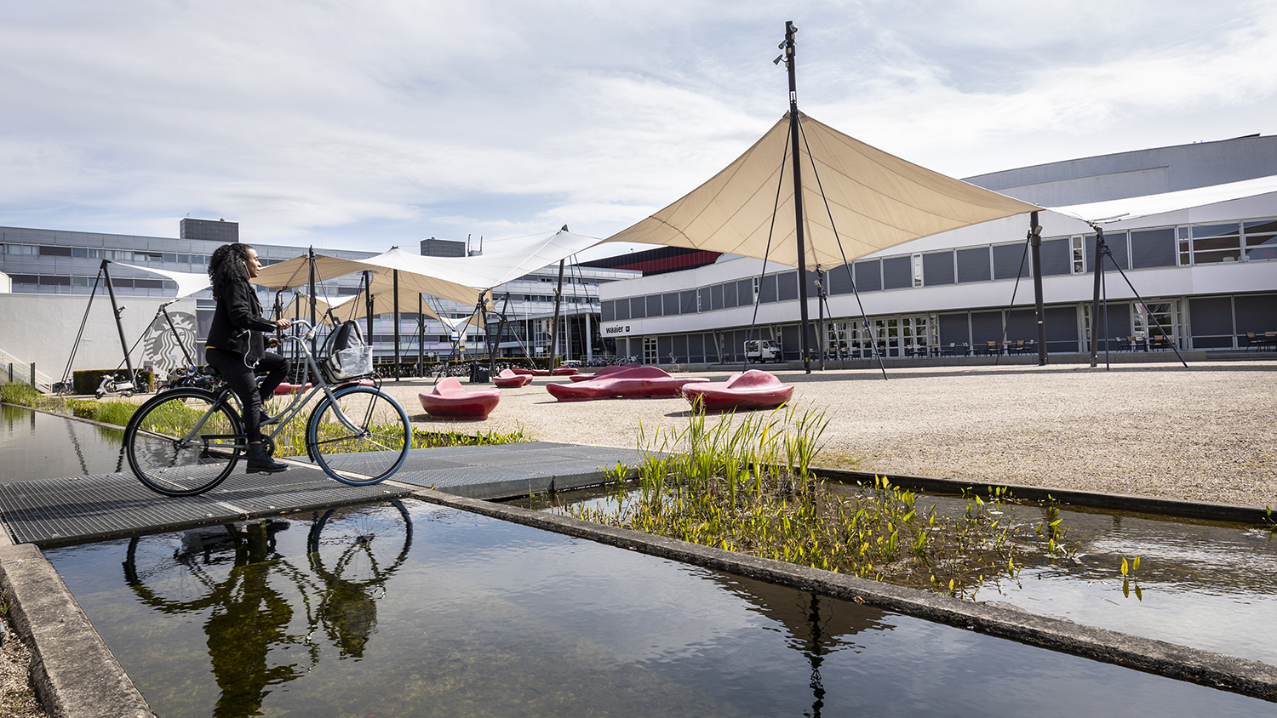
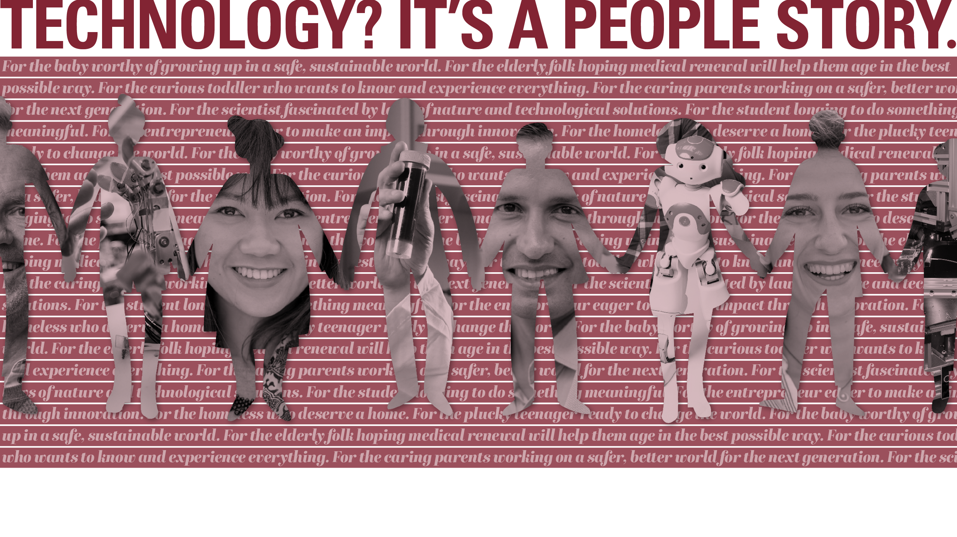


Slide 3
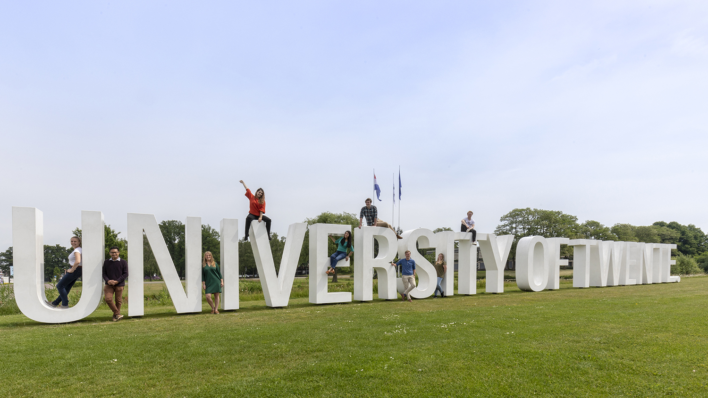
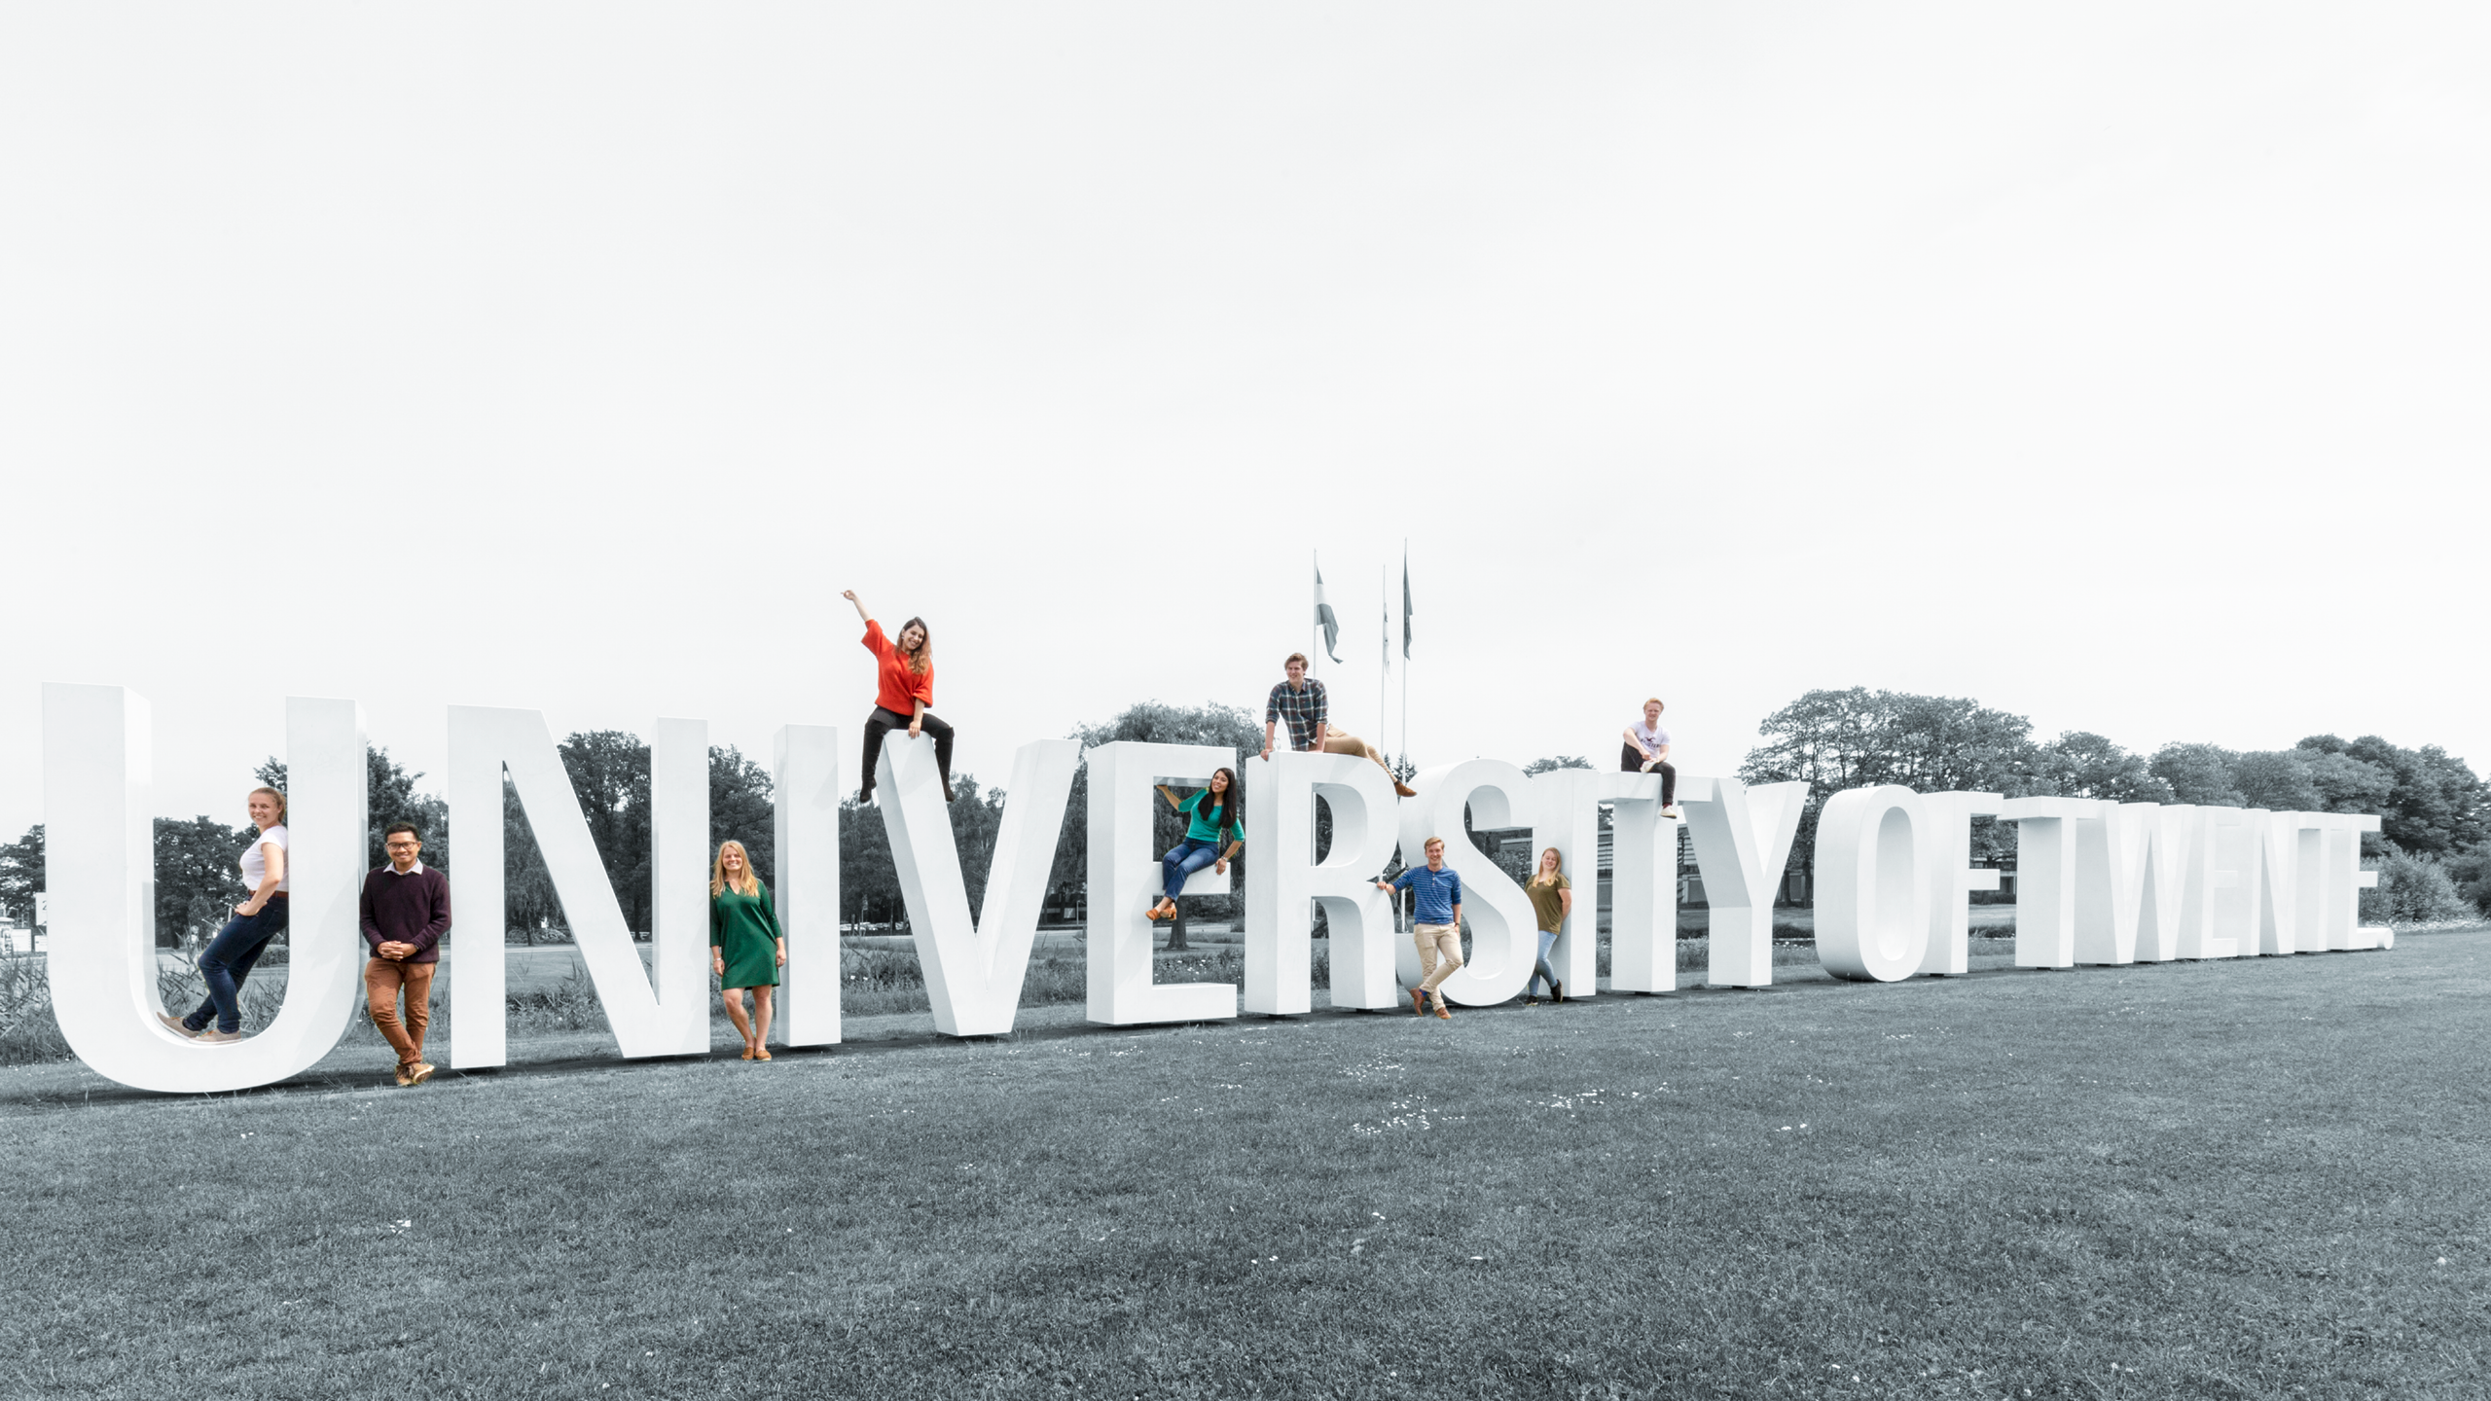
SHAPING2030
1. DEVELOPMENT PROCESS
Why Shaping2030
Those involved (internal and external)
Steps taken
2. PURPOSE OF SHAPING2030 IN 3 PARTS:
Mission
Vision
Strategy for the next 3 years

Slide 4
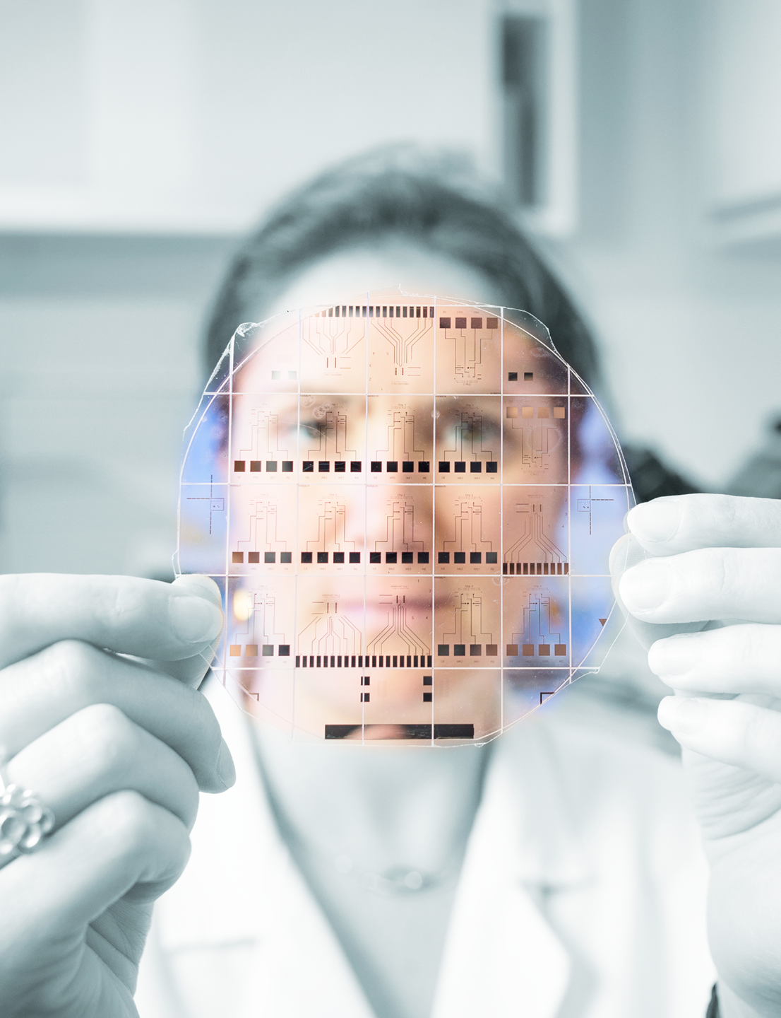
DEVELOPMENT PROCESS
Why Shaping2030?
Change of era, fundamental societal shifts
(4th Industrial Revolution):
Imbalance between humans and technology
Increasing social divides
Impact on our ecosystem
A digital revolution: new providers of scientific education, increase in competition
Increasing demand for highly technically trained personnel
Role / expectations of university in society are changing
Financial-economic impact
As the UT, we are redefining our mission, vision and strategy.
Sharper profile and increased added value.

Slide 5
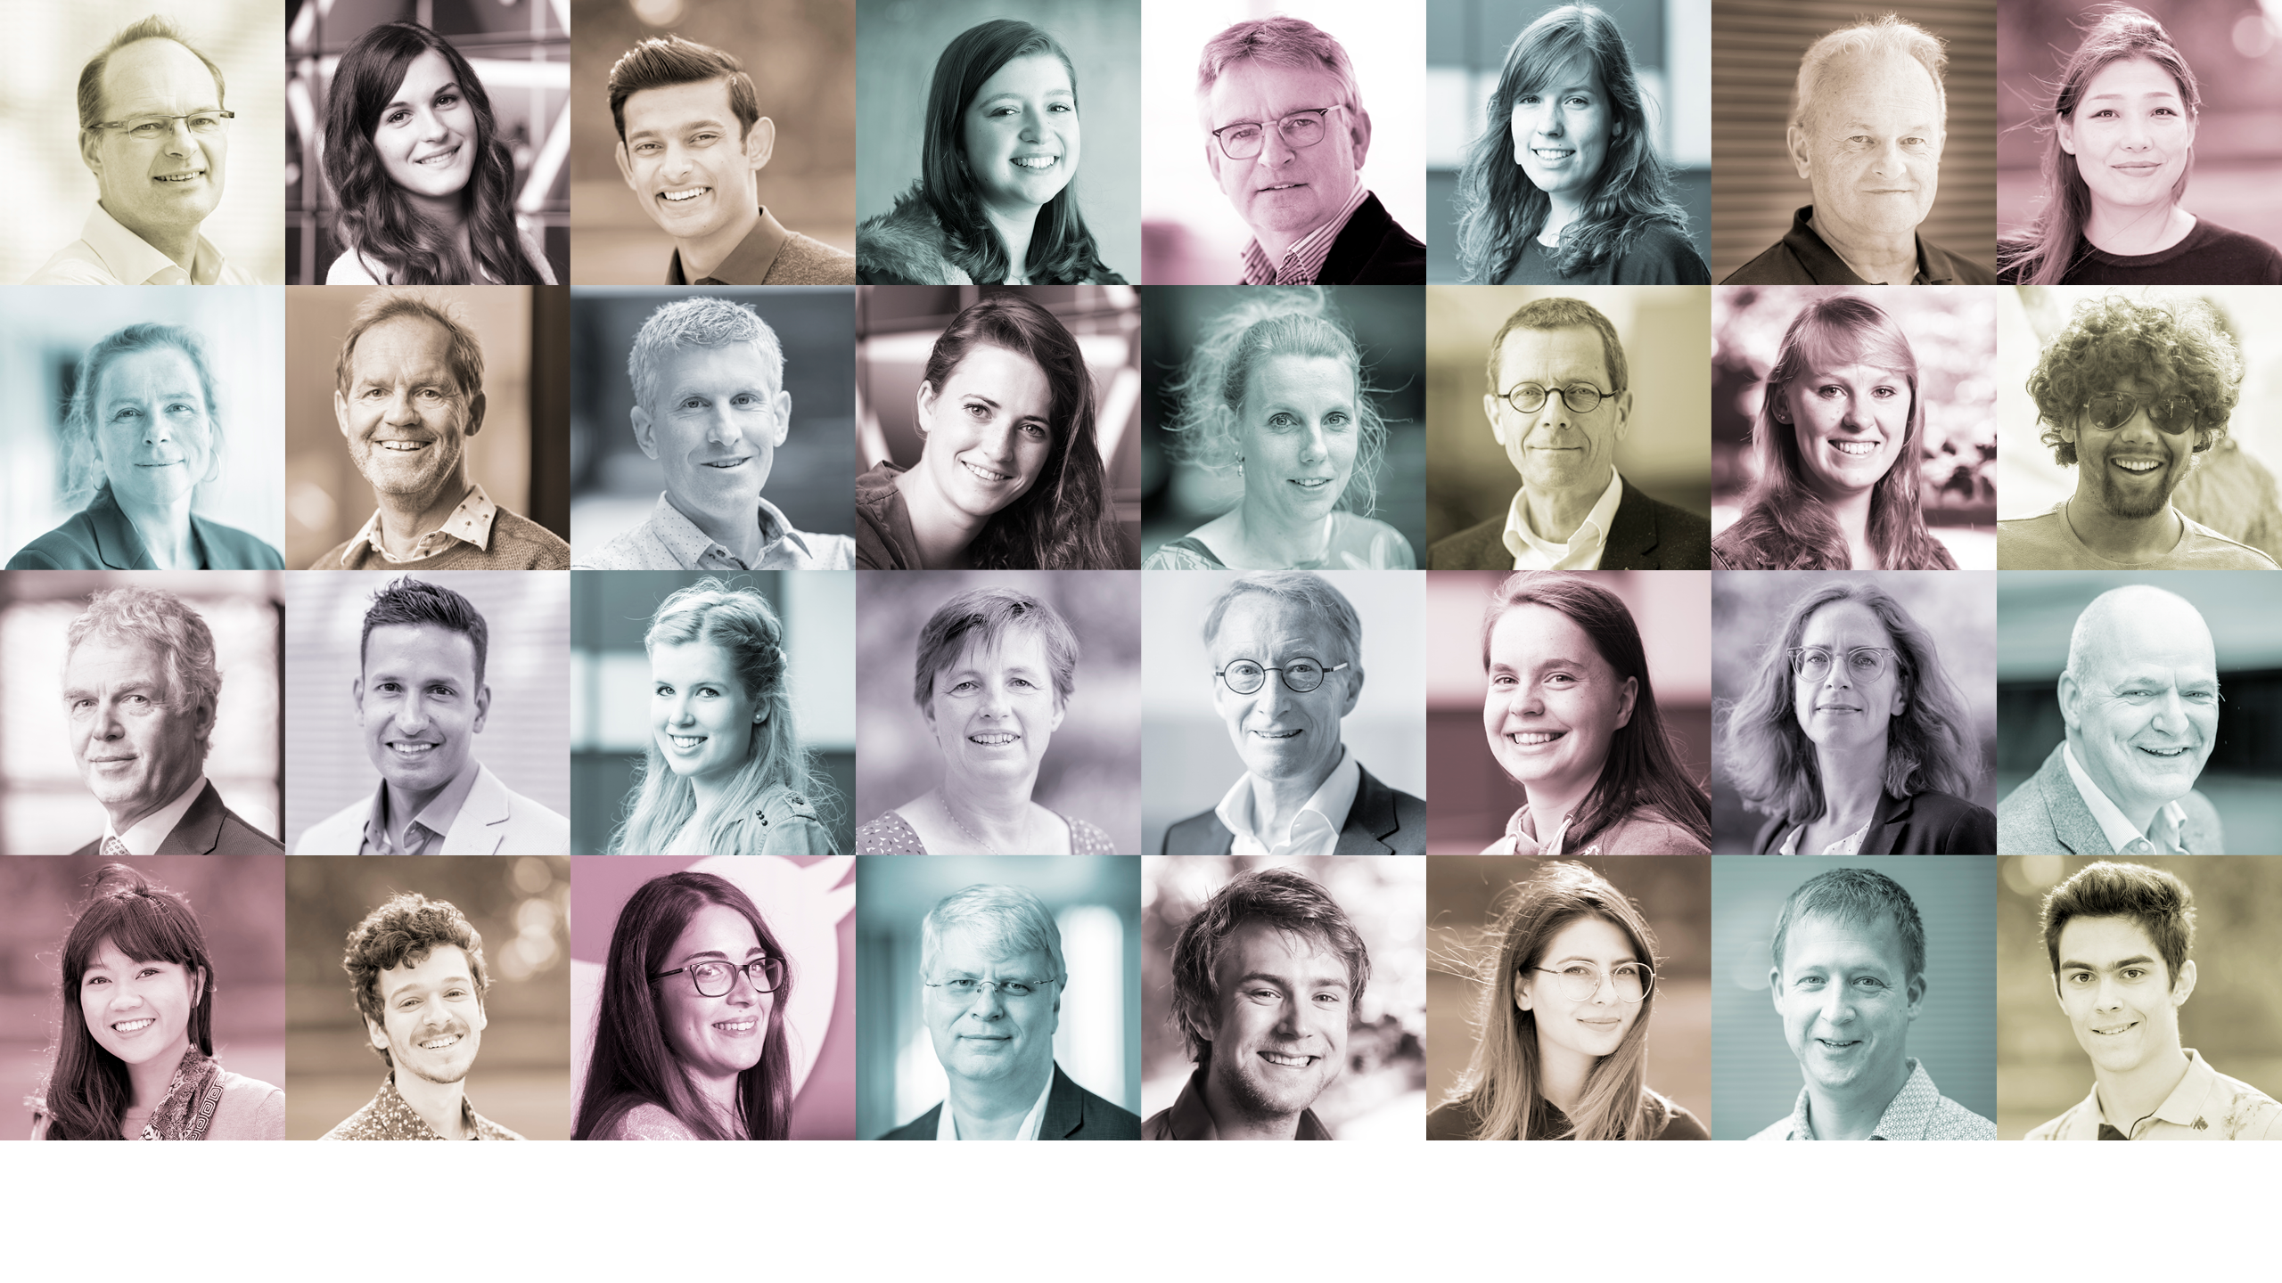
DEVELOPMENT OF
SHAPING2030: WHO?
Those involved, internally and externally:
UT community, staff and students partners in the region and further afield.

Slide 6
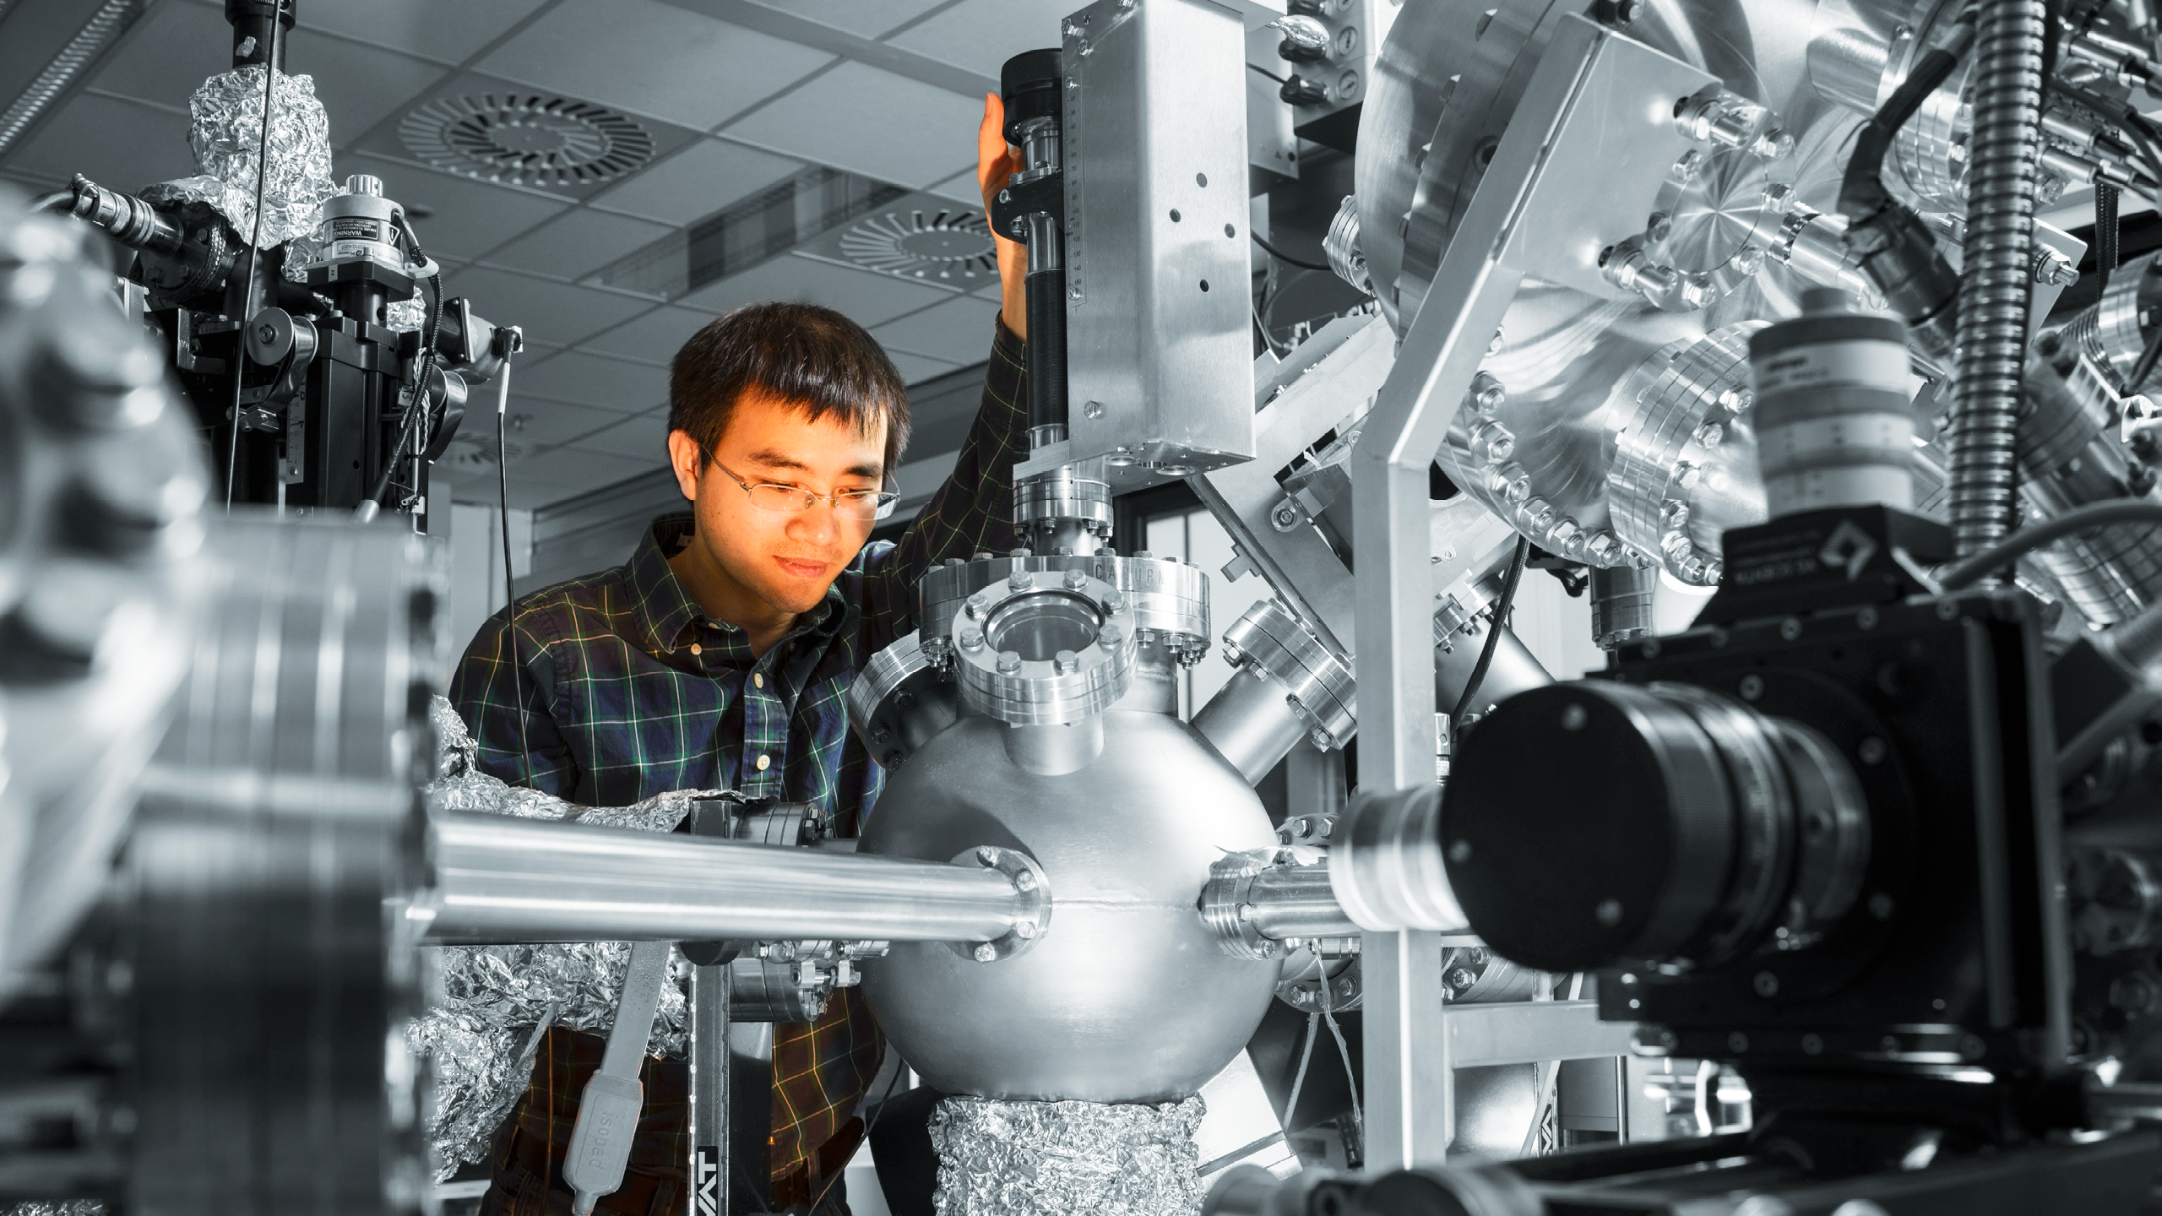
DEVELOPMENT OF
SHAPING2030: HOW?
Steps taken:
Inspiration sessions:
the world from the outside in
Meetings with external parties
Discussion panel
Strategy work groups
Writing team
Reviewers

Slide 7
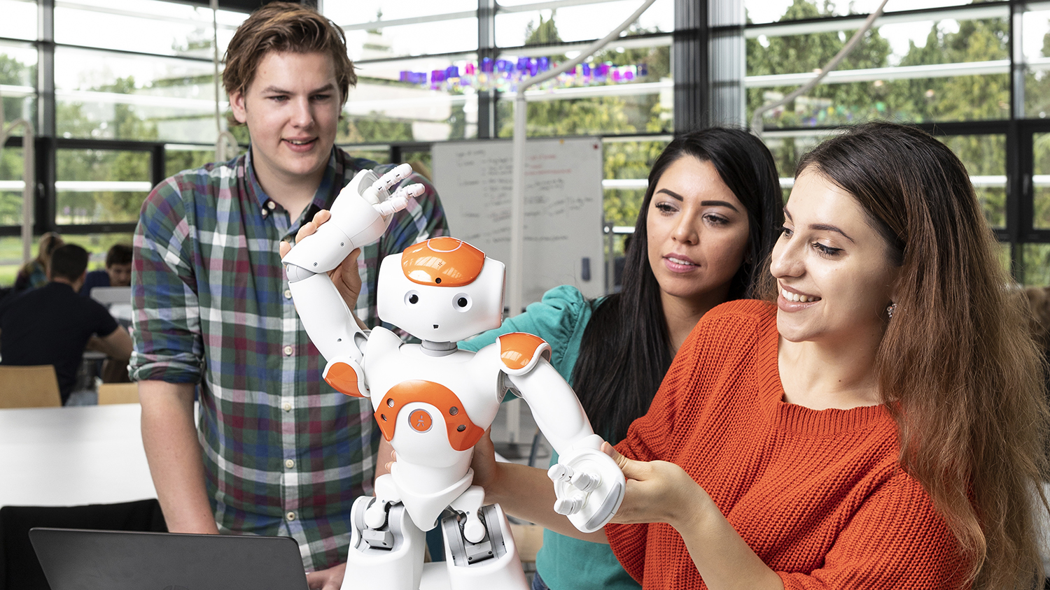
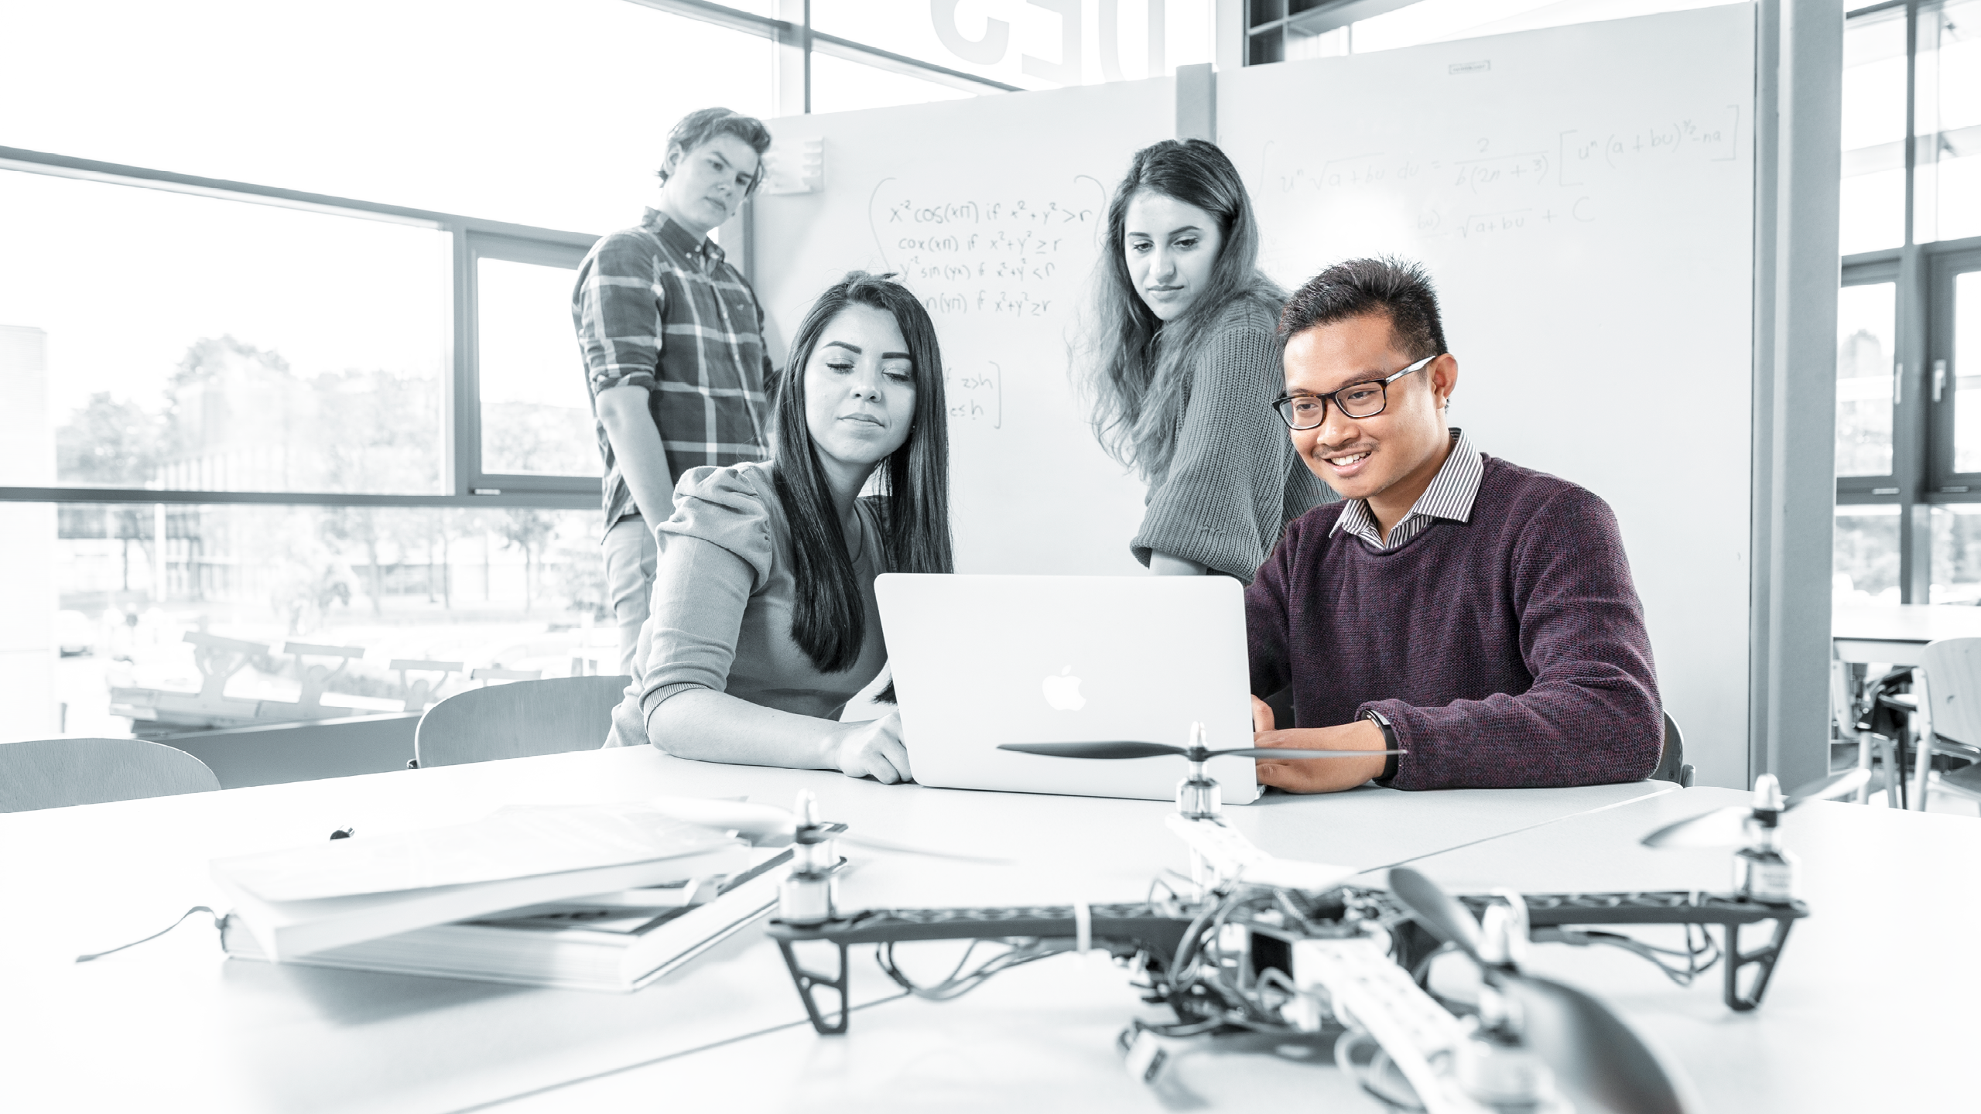
SHAPING2030
Mission 2020-2030
Vision 2020-2030
Strategy 2020-2030

Slide 8

SHAPING 2030: MISSION
THE UNIVERSITY OF TWENTE IS
THE ULTIMATE PEOPLE-FIRST UNIVERSITY OF TECHNOLOGY.
WE EMPOWER SOCIETY THROUGH SUSTAINABLE SOLUTIONS.

Slide 9
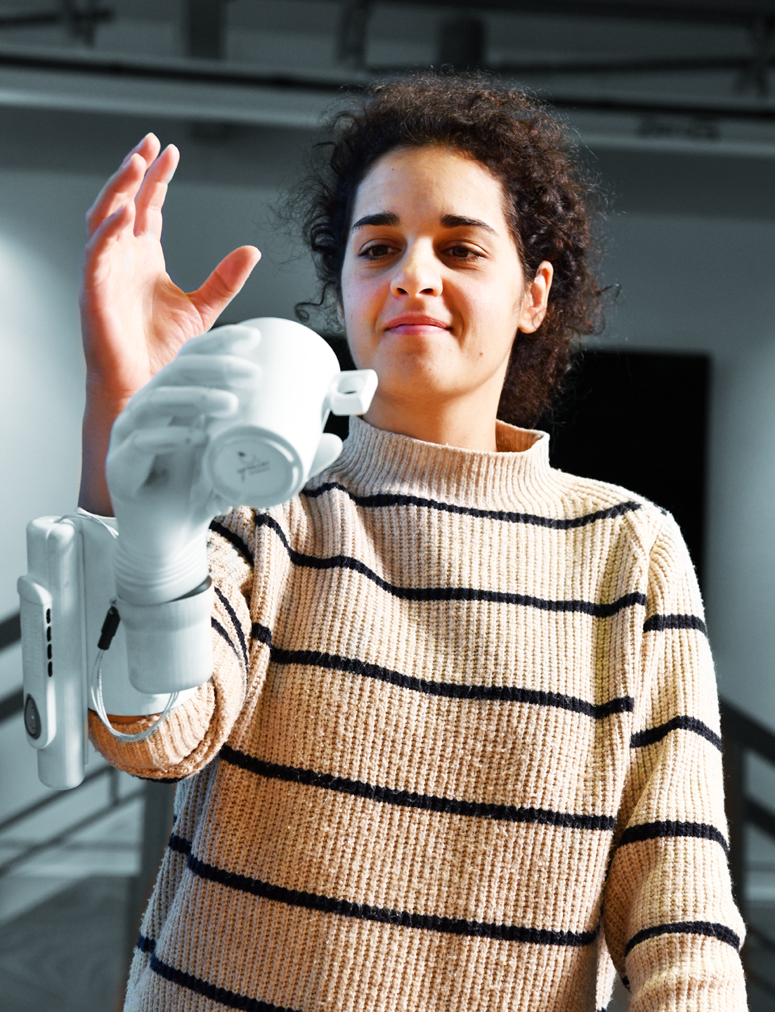
SHAPING2030: MISSION
‘PEOPLE-FIRST’
Being people-first is a deliberate decision: we serve humanity, and we are conscious of the interdependence between humans and the planet. The wellbeing of people comes first in every choice we make.
‘UNIVERSITY OF TECHNOLOGY’
We are and will continue to be a university of technology that harnesses the power of science and technology for maximum societal impact.
5 multidisciplinary research programmes:
Better, more personalized healthcare;
Intelligent production systems;
Smart materials;
Digital society;
A resilient world.

Slide 10
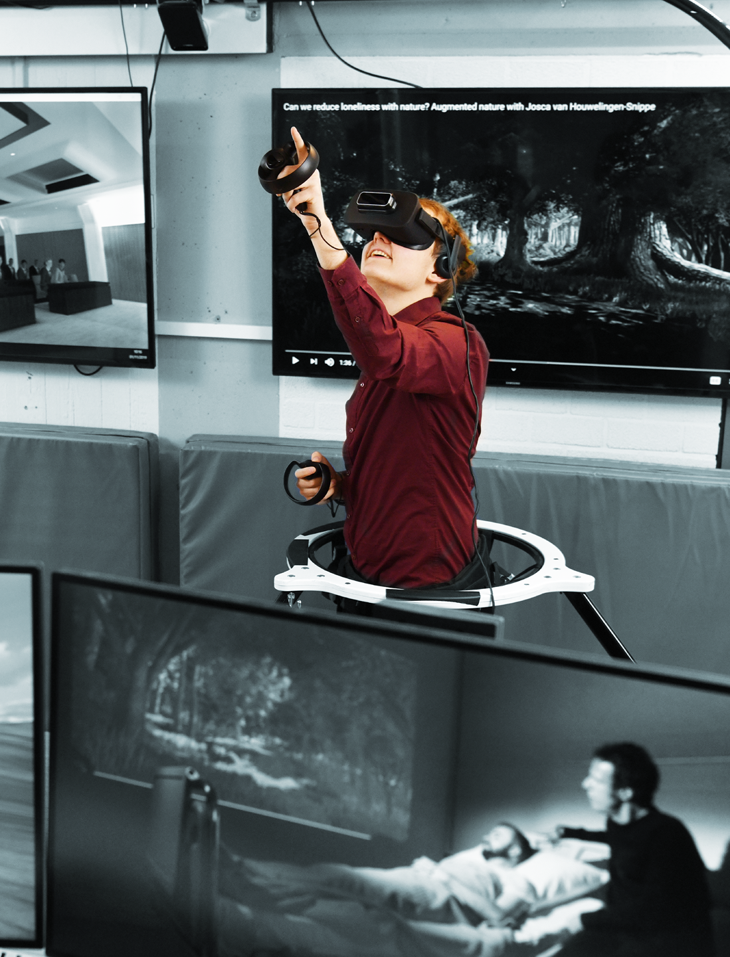
SHAPING2030: MISSION
‘WE EMPOWER’
We enable society to achieve the goals it sets itself through a wise use of science and technology. We contribute to a balanced understanding of scientific and technological developments & their impact on society and climate.
‘SUSTAINABLE SOLUTIONS’
We offer sustainable solutions:
We strive for a flourishing and resilient society, with an eye for innovation opportunities, with authoritative expertise, geared to real societal needs.

Slide 11
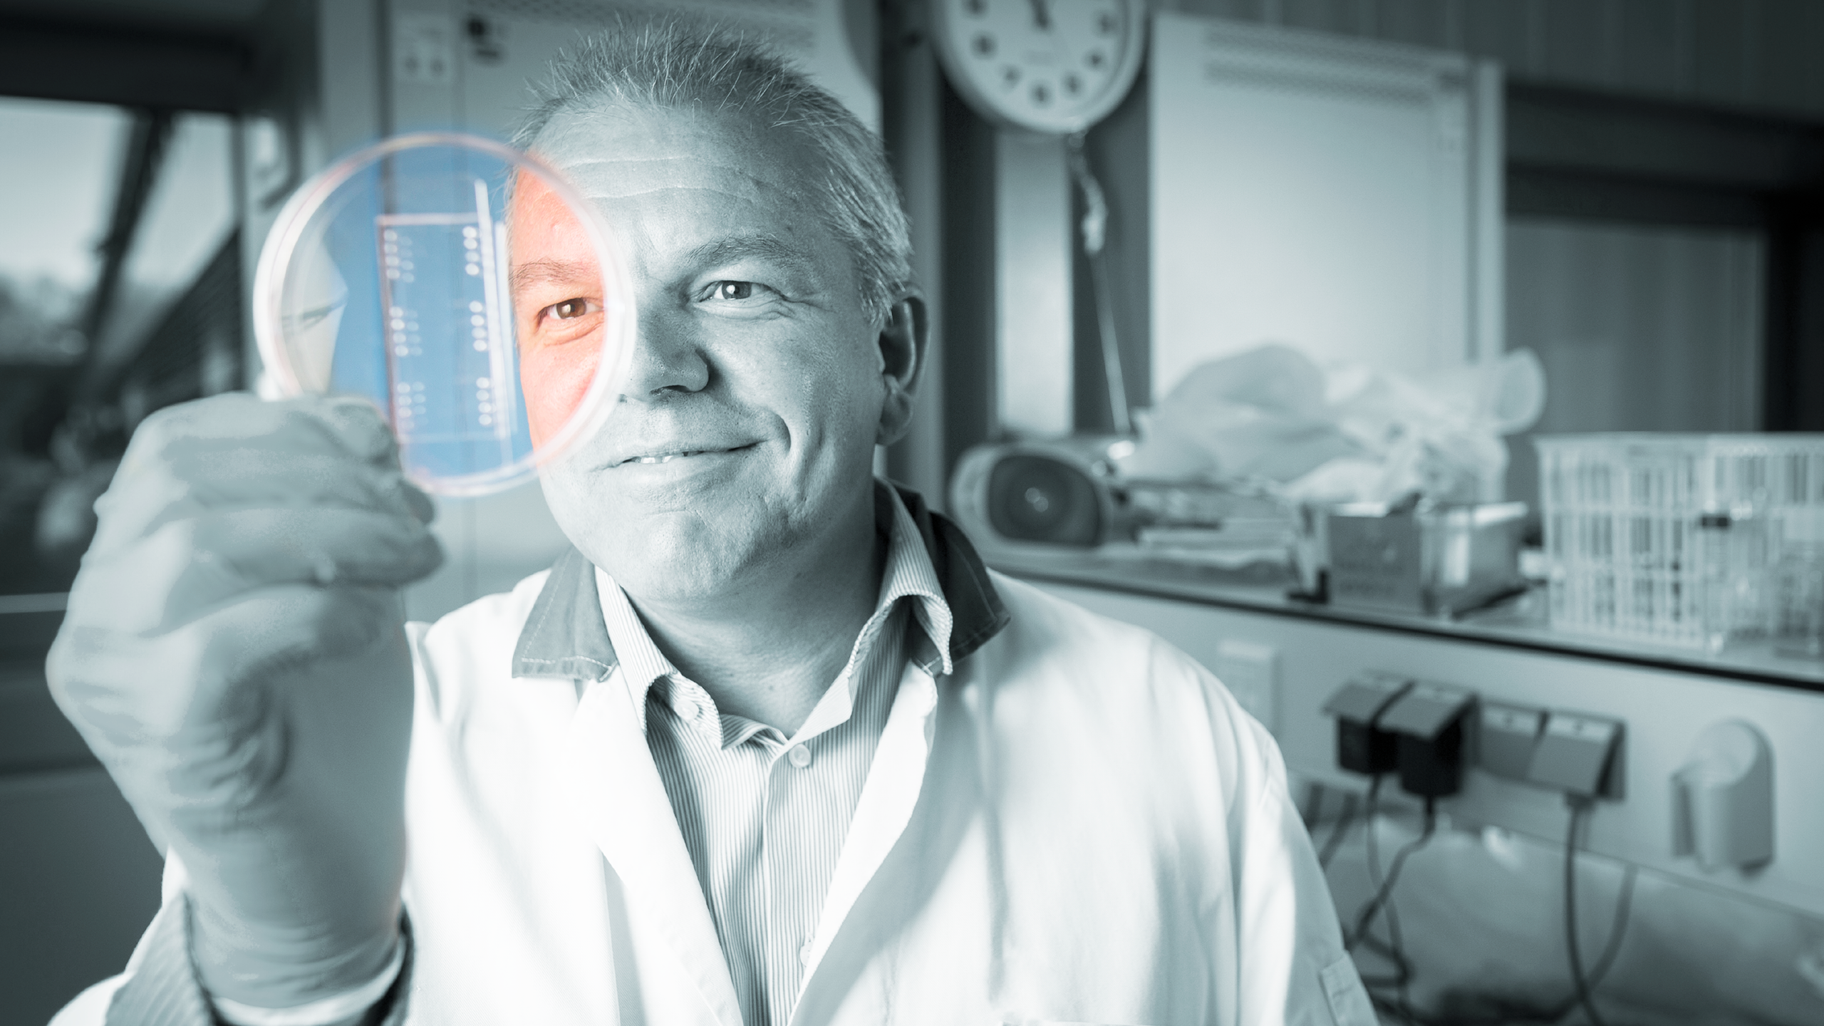
SHAPING2030: VISION
We contribute to a fair, sustainable and digital society.

Slide 12
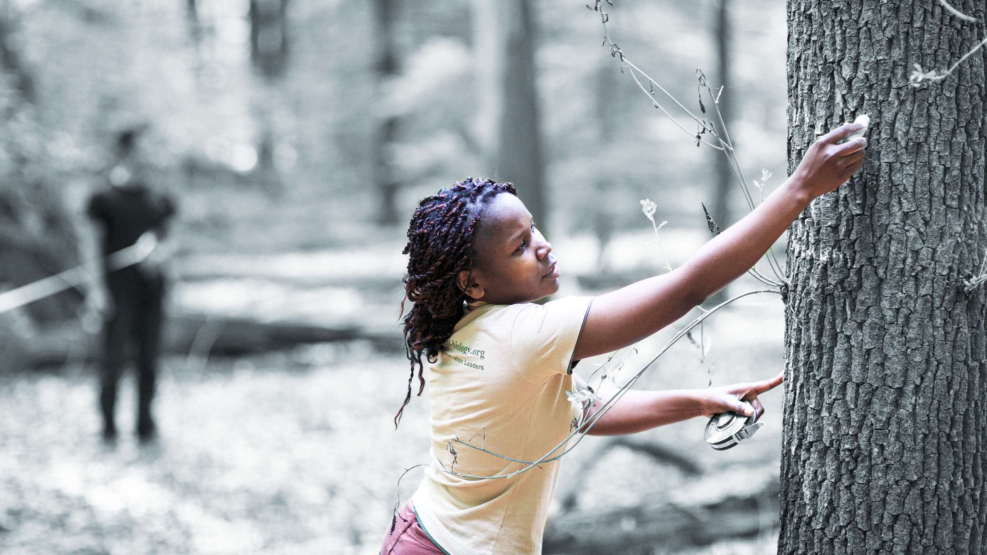
FAIR
Bridging social divides by designing technologies wisely together with society, so that they add value to people’s lives.

Slide 13
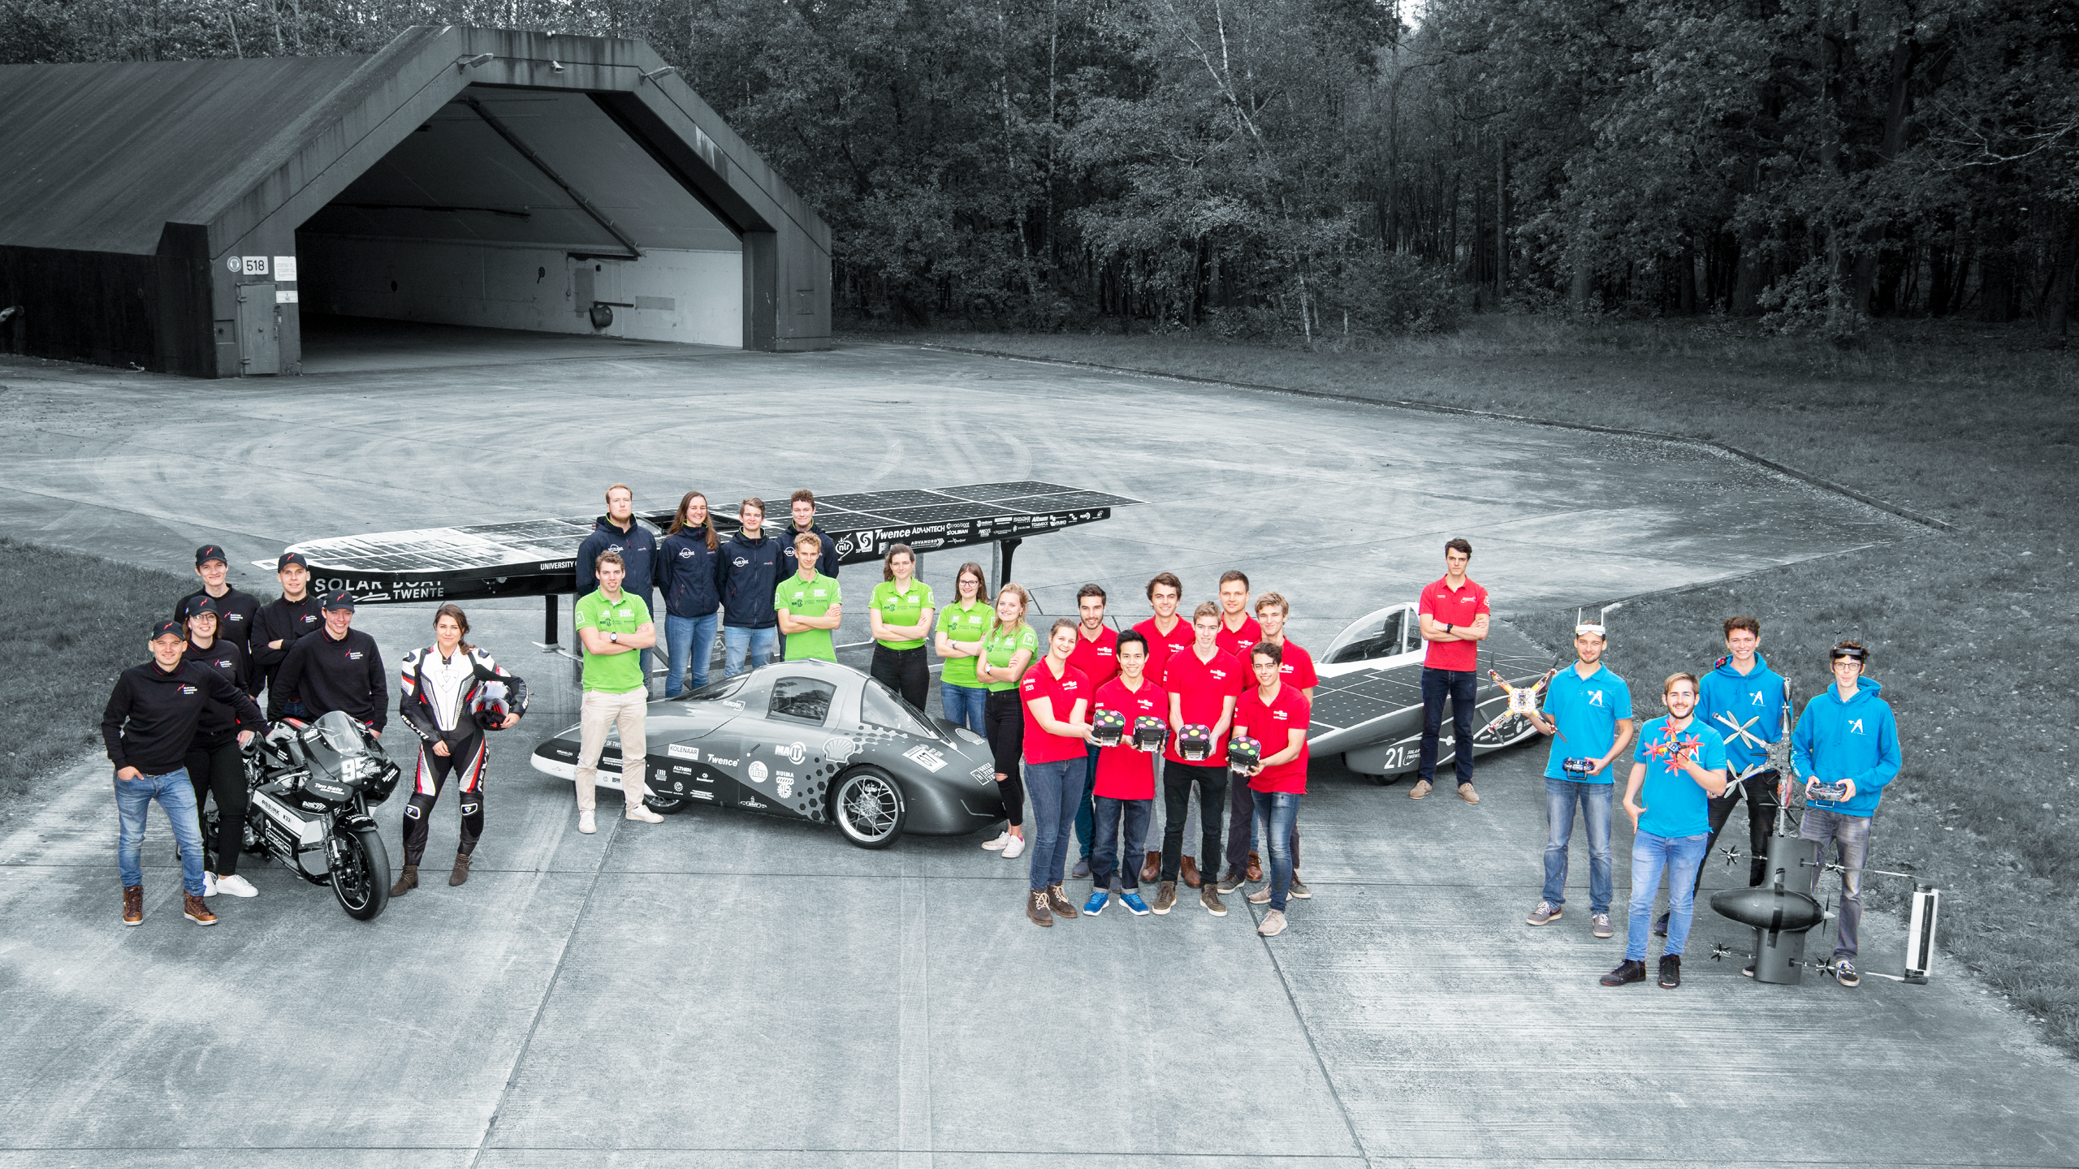
SUSTAINABLE
Education, research, innovation and organization based on ecological, social and economic sustainability.

Slide 14
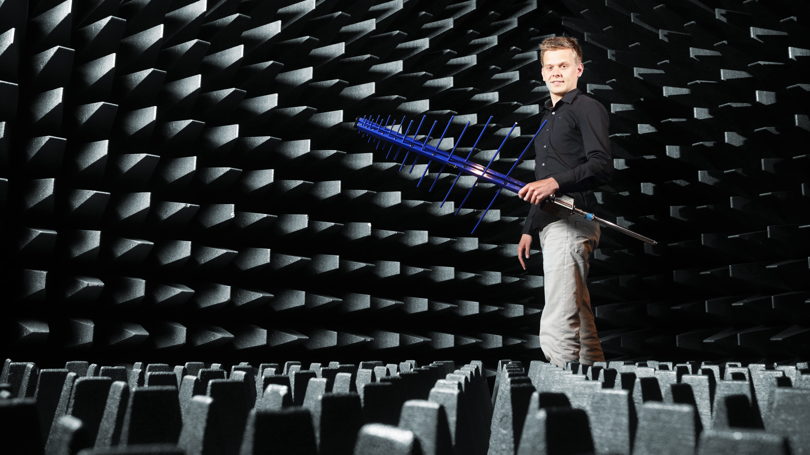
DIGITAL
Contributing to meaningful and sustainable digital innovations that contribute to society's needs and apply these for the benefit of our own research and education.

Slide 15
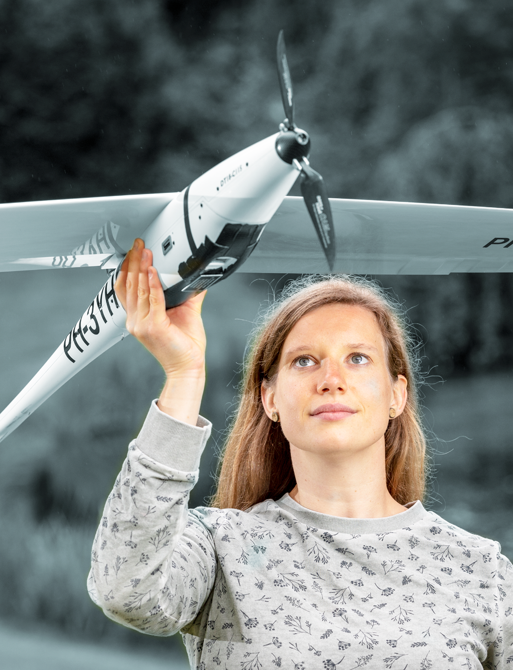
SHAPING2030: VISION
ENTREPRENEURIAL - INCLUSIVE - OPEN MINDSET
ENTREPRENEURIAL:
The UT continues to be an entrepreneurial university!
Through: experimenting, pioneering, innovating, taking risks
With: a new definition of being entrepreneurial
Leading to: new standards for collaboration with industrial
and societal organizations with maximum student involvement.

Slide 16
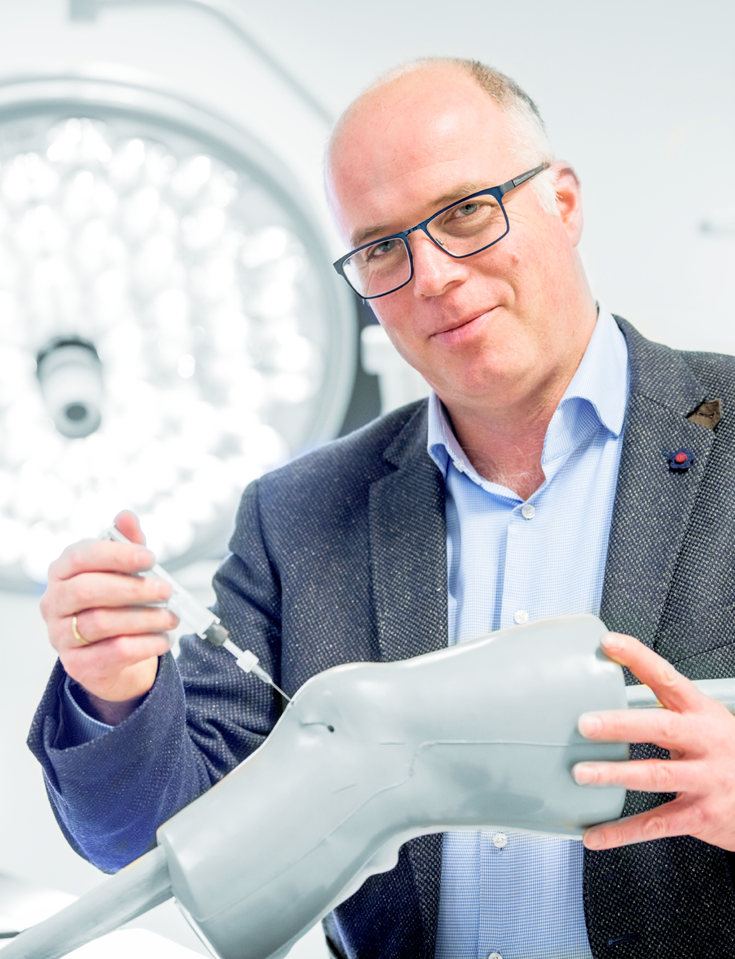
SHAPING2030: VISION
ENTREPRENEURIAL - INCLUSIVE - OPEN MINDSET
INCLUSIVE:
Recognizing, attracting, developing and keeping talent
Qualitative growth
Investing in wellbeing, talent development and transformational leadership
Personal empowerment
Optimizing conditions within our networks to develop talent
of all ages and backgrounds
Generate solutions that break through social exclusion and
reach all the groups that need them

Slide 17
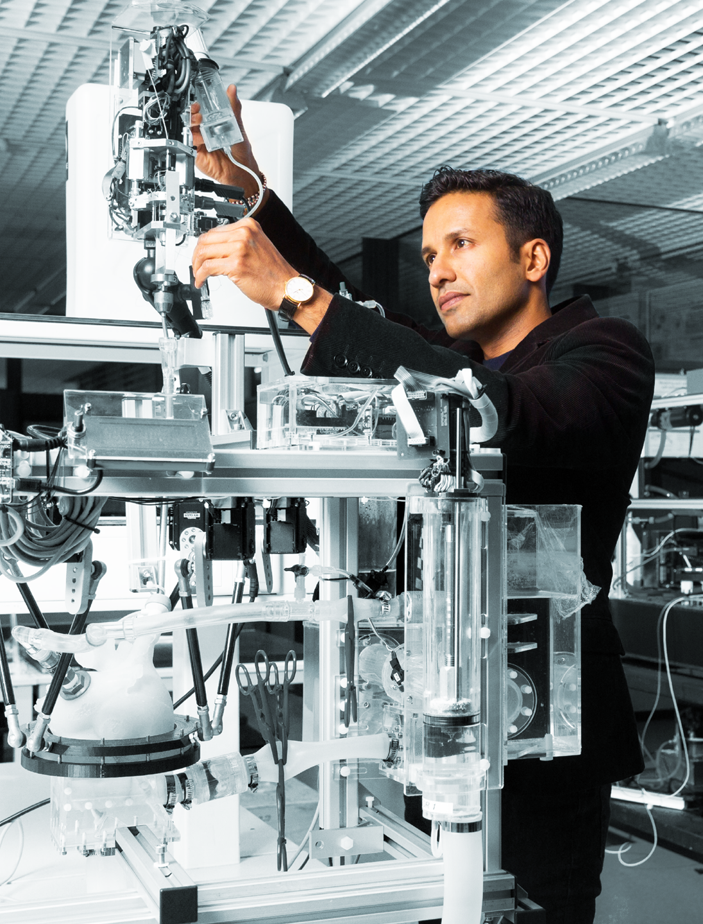
SHAPING2030: VISION
ENTREPRENEURIAL - INCLUSIVE - OPEN MINDSET
OPEN MINDSET:
Working together on social challenges
Locally or globally, physically or virtually,
with the campus as a hub
Importance of community and networking
Focus on development in the Twente region
Cooperation across the border with Germany
Reliability

Slide 18










STRATEGIC GOALS
SHAPING SOCIETY
SHAPING CONNECTIONS
SHAPING INDIVIDUALS

Slide 19










1. SHAPING SOCIETY
Focused on:
Challenge-based education and research: in 2023
R&D is mainly focused on sustainability issues
(Masters programmes + Innovation and Education Lab).
Programme for the 33,000 regional residents with a distance to the job market (Lifelong Learning programmes with PPP construction.)
Sustainable organization:
Sustainable campus solutions: food, water, waste, travel and energy use
(15% carbon footprint reduction, experimental tiny houses, no flights <800 km).
Team-based way of working, with participants from inside and outside
the university.

Slide 20
2. SHAPING CONNECTIONS
Focused on:
Strong external visibility
Satellite locations (comparable to VU mechanical engineering).
Partnerships with EdTech companies (distance learning).
Presentations at major events.
100% open access publications.
UT Citizen Movement
Involve public and private partners in determining our education and research agenda (for example, Citizen portal, experimental research facilities, scholarships from external partners, involve alumni).
Complete integration with Kennispark, a diverse and inclusive campus (UT inclusiveness programme).
European University of Innovation

Slide 21
3. SHAPING INDIVIDUALS
Focuses on:
The UT is the place to be for academic social entrepreneurship
Doubling the number of social start-ups in Twente.
Twente on the map as Europe’s go-to place for academic and entrepreneurial skills.
By 2030: two social unicorns with clear Twente roots.
UT Citizen Movement
Personalized approach.
Broad Bachelor’s programme for school students who have to chose an orientation early on:
more flexibility.
Learning from ‘successful failures’.
Room for reflection (slow spaces).
Inclusive organization to attract talent from the region.
UT must become the best place to work.
UT is known for: innovative and excellent talent development programmes, way of carrying out research, focus on acquiring meta-competences in order to be able to react to the changes in society.

Slide 22
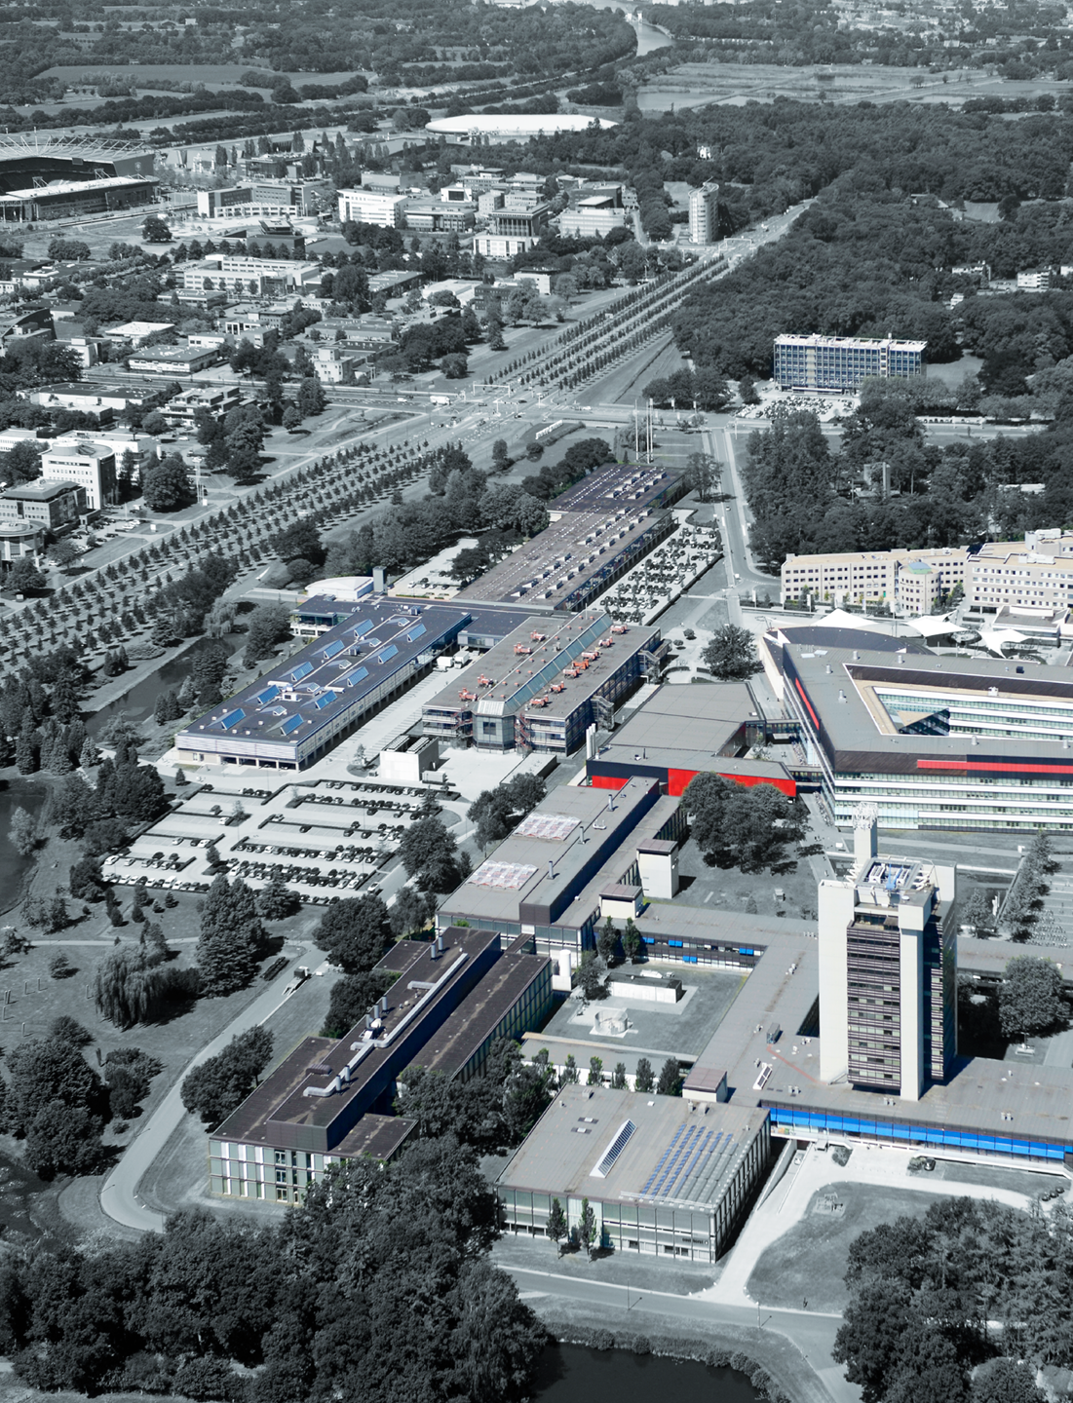
REGIONAL IMPACT
THE UT IS AND REMAINS THE UNIVERSITY OF TWENTE:
Building strategic cooperations with the regional industry.
New experiment / research facilities together with the industry.
Further development of the Fraunhofer Project Center.
Further development of the DesignLab.
Programme for the 33,000 regional residents with a distance to the job market (LLL in cooperation with Saxion and ROC).
Housing for young professionals at Kennispark.
Active lobbying of HSL for an Amsterdam-Berlin train connection.
Focused research agenda.
Agriculture as energy supplier (living lab).

Slide 23
COME SHAPE THE FUTURE WITH US.
UTWENTE.NL/SHAPING2030

Slide 24
HIGH TECH HUMAN TOUCH

