Slide 1
Coping with declining half-lifes of knowledge
implications for examination & certification values
Fons Wijnhoven, BMS/BIT
July 6 2017

Slide 2
What is the problem?
Half-life value of a trained employee is
1940: 12 years; 1970: 7 years; 2010: about 3 years
Source: https://www.slideshare.net/Duurzame_Inzetbaarheid/het-belang-van-leren-op-het-werk-door-profdr-andries-de-grip
Other evidence: Poynard et al (2002), Truth survival in clinical research, Ann Intern Med, 136 (12): 888-895
Arbesman (2012), The half-life of facts, Penguin, New York.
Discussion of this by Ronald Bailey in Reason.com, Oct 2, 2012.
So what does that mean for the value of diploma’s and certificates?
What does it mean for our way of testing and certifying?

Slide 3
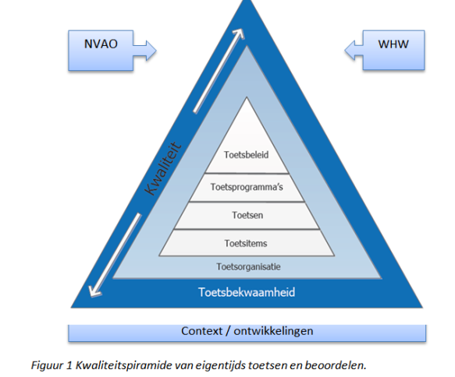
The testing pyramid
Applying the testing pyramid on this problem.
A. Testing policies
B. Testing programs
C. Tests and their quality
D. Test items
E. Test organization
F. Testing capabilities

Slide 4
A. Testing policies
The UT 2017 EER say….
Art 4.8: PERIOD OF VALIDITY
1) The validity of a result of a Unit of Study has no limitation. In case the examined
knowledge, understanding or skills are demonstrable out of date, the programme board can set restrictions on the period of validity of the said unit of study.
Needs much attention in the context of declining half-lifes and additions to the program specific appendix.

Slide 5
B. Test programs and the testing onion
 |  | Strategic value of knowledge
 |  | Low | High
Halftime of knowledge | Short | 3. Contextual knowledge | 4. Key labor market entrance knowledge
 | Long | 2. Learning capabilities Updating after new collaboration & search methods | 1. Basic foundations Updating after paradigm change
4. Labor market entrance
3.Contextual knowledge
2.Learning capabilities
1.Basic

Slide 6
C. Test quality
Testing basic knowledge: We know how to test basic knowledge
Testing learning capabilities: We have poor understanding about know how to test learning capabilities, although it is vital to the master thesis project.
Testing contextual knowledge. We test learning in practice by projects, assignments, and portfolios. We do not know well how to grade portfolios.
Testing labor market entrance qualifications. We should be able to also certify people who gain knowledge by experience, but we do not know how.

Slide 7
E. Test organization
The more contextual, the less control over the testing situation.
The more contextual, the less comparable and the less reliable.
The more testing on capabilities, the less valid (lack of criteria).
The more entrance level certification, the more an additional task for universities.

Slide 8
F. Testing capabilities
The more practice-oriented, the less basic/fundamental
Key role of university is in the first two onion roles (basic and learning capability).
A university master diploma should contain knowledge with a longer halftime than a professional diploma.

Slide 9
Summary and discussion
Define the onion (basic, learning capability, contextual, and market entrance) and make the core and learning capabilities part of first and later study years.
Regular re-certification is needed for contextual and entrance level knowledge (each 3-5 years).
Consider the development of “citizen science” as a means of certification besides of the regular programs by participation in e.g. www.openbadge.org
Define the courses and topics that fit under contextual and entrance level to implement EER Art 4.8.
Courses have half-lifes as well ➔ Need for course maintenance budgets; an obsolete course should not be part of the testing program.

Slide 10
Other implications
Course maintenance
Basic: half-life 10 year: 5% maintenance/year
Learning capabilities: half-life 7 year: 8% maintenance/year
Contextual knowledge: half-life 4 year: 12.5% maintenance/year
Labor market entrance knowledge: half-life 3: 17% maintenance/year
If less maintenance the course will be under-invested and not suitable as part of the testing program.

