Slide 1
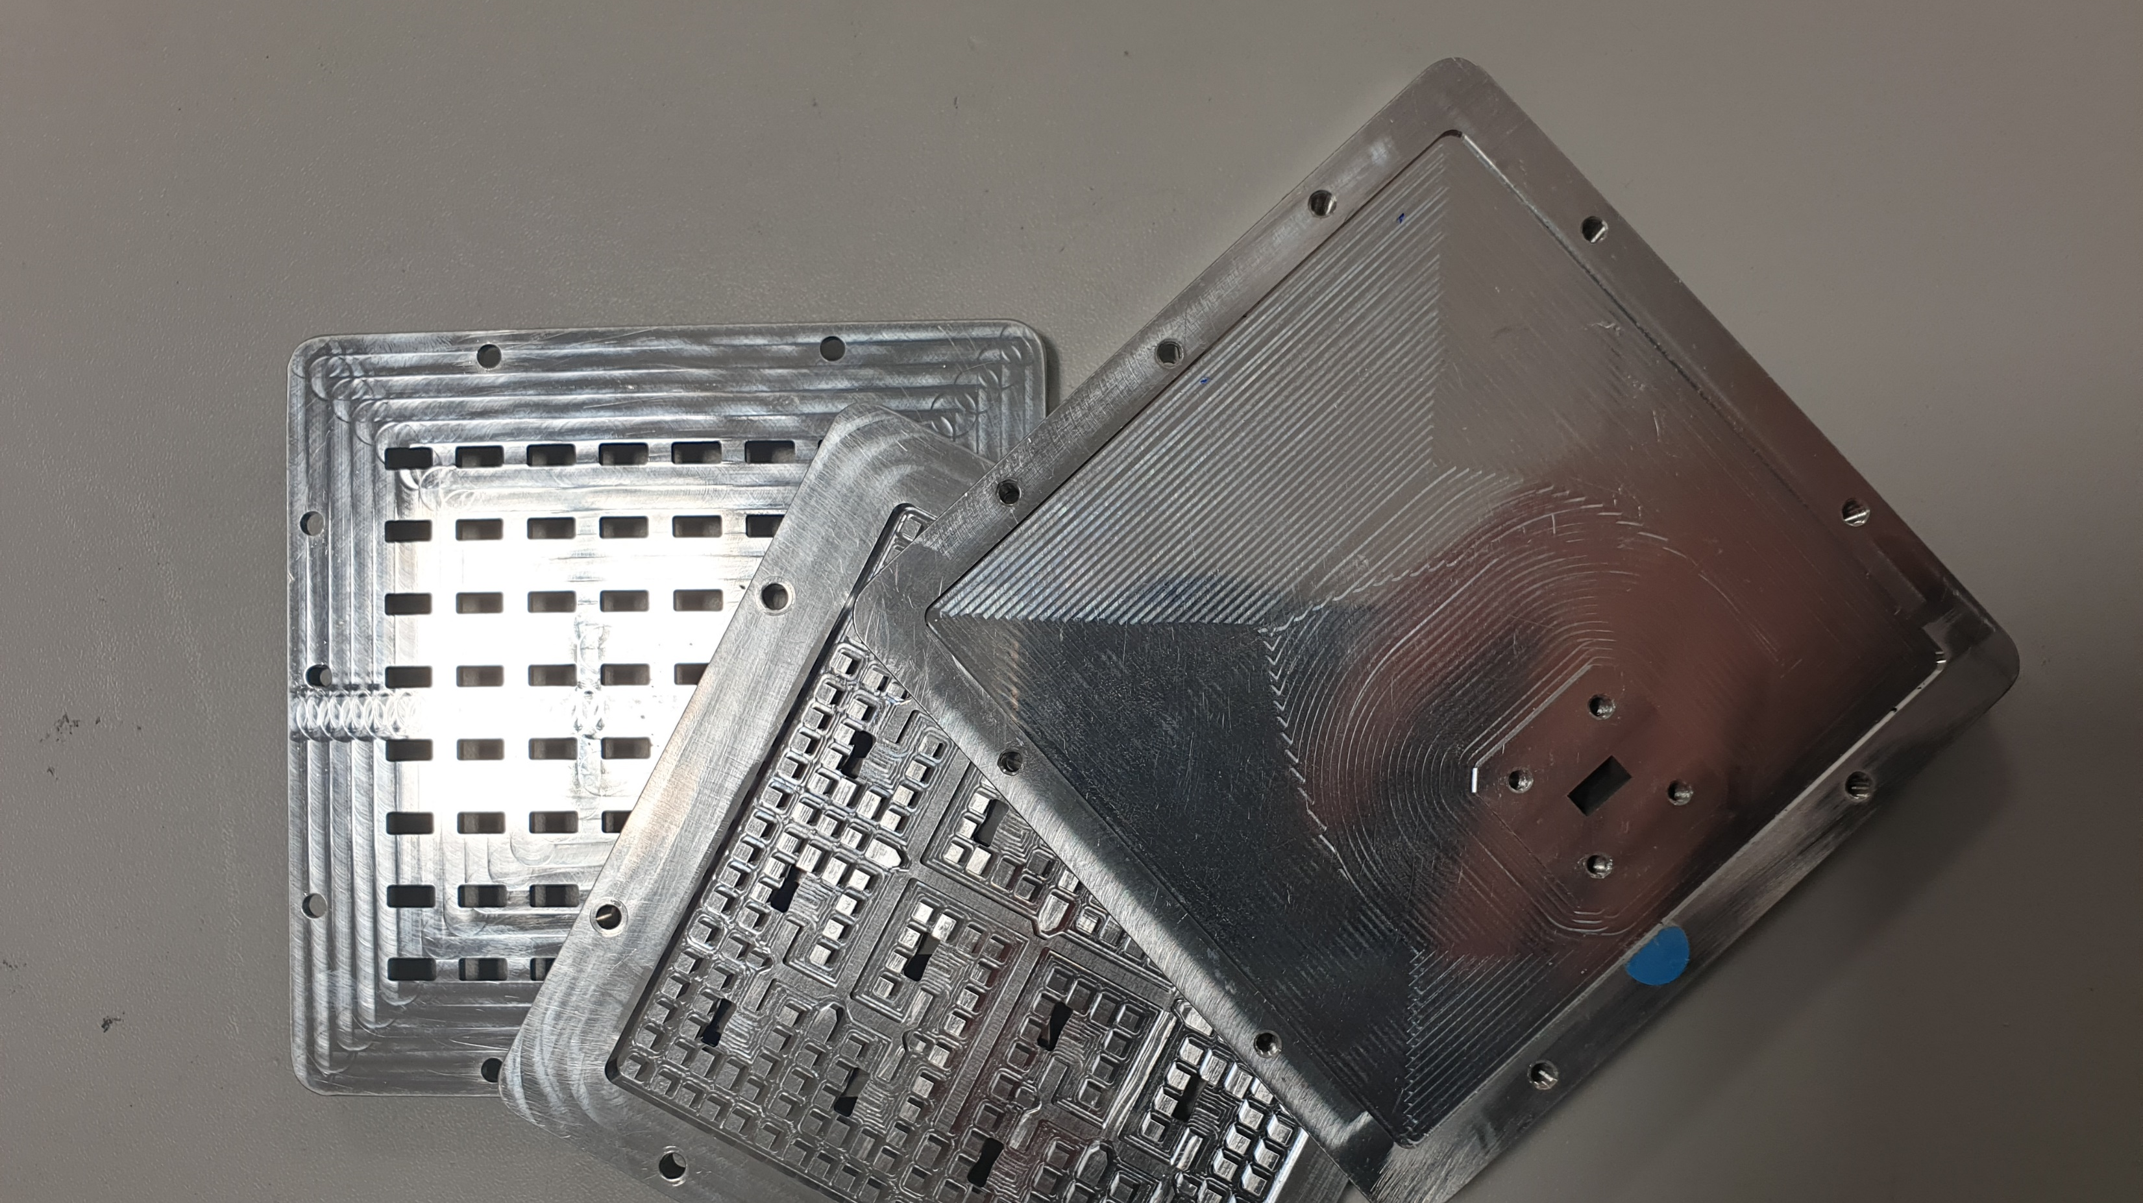

Radio Systems
EEMCS Networking Day

Slide 2
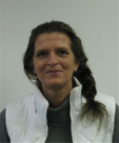
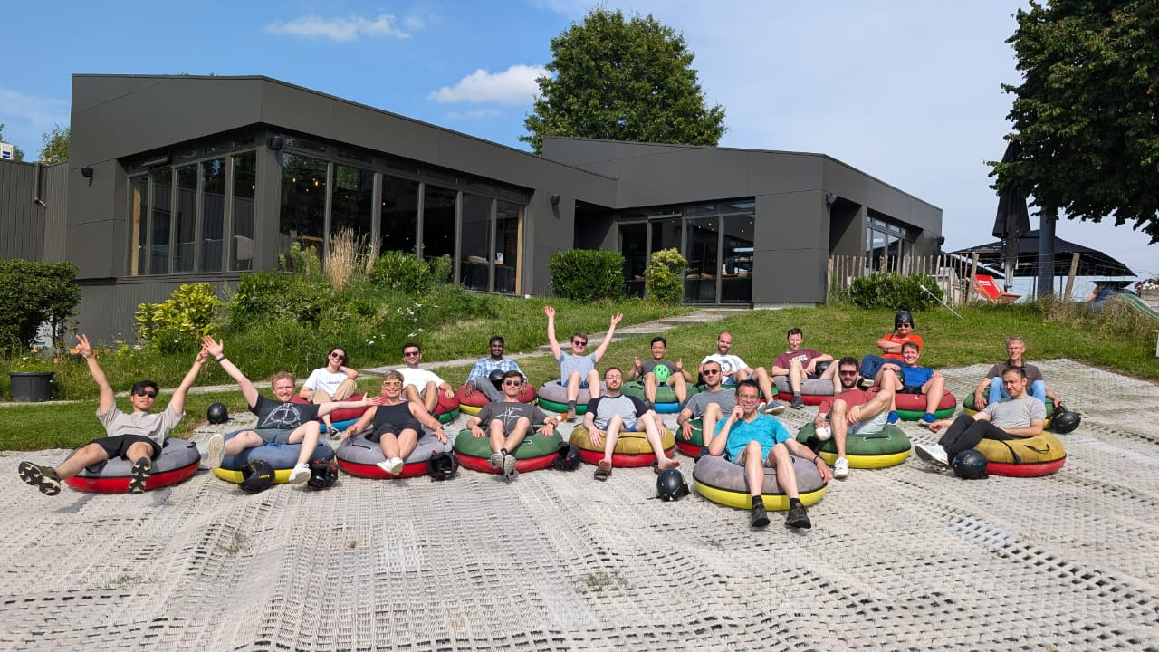
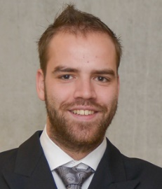
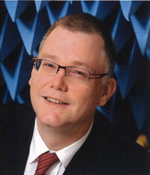
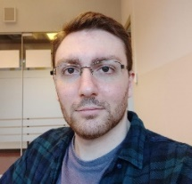
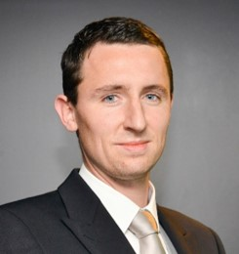

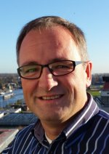
Radio Systems
Lillian Hannink
Tom Hartman
André Kokkeler (Chair)
Anastasia Lavrenko
Frank Leferink
Zaher Mahfouz
Yang Miao
Niek Moonen
Sujith Raman
Gert-Jan van Werkhoven
~25 PhD students
3 PostDocs
2
2

Slide 3
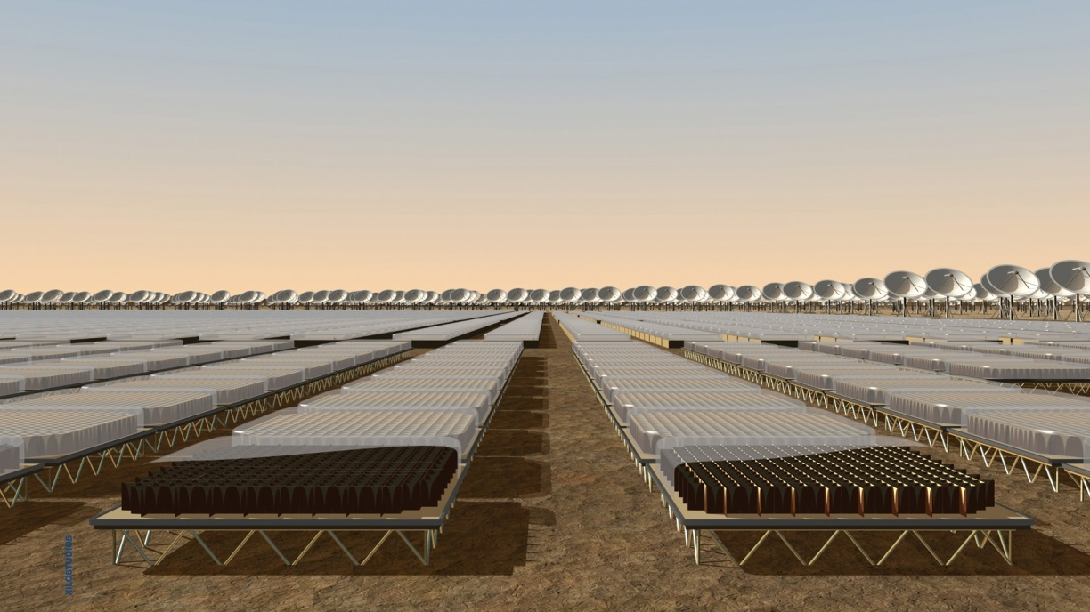

Research: Scope
Antennas and propagation
Electromagnetic Compatibility
Radio
Systems
Signal Processing

Slide 4
Research: Applications
Sustainability
Health
Radio
Systems
Connectivity

Slide 5

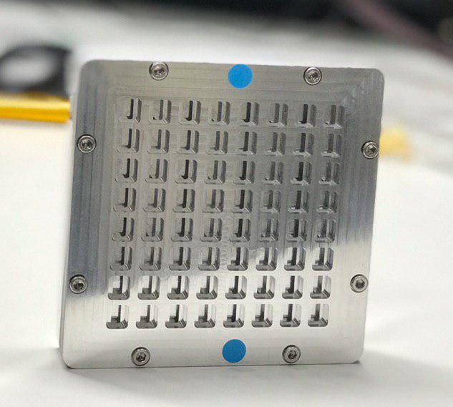
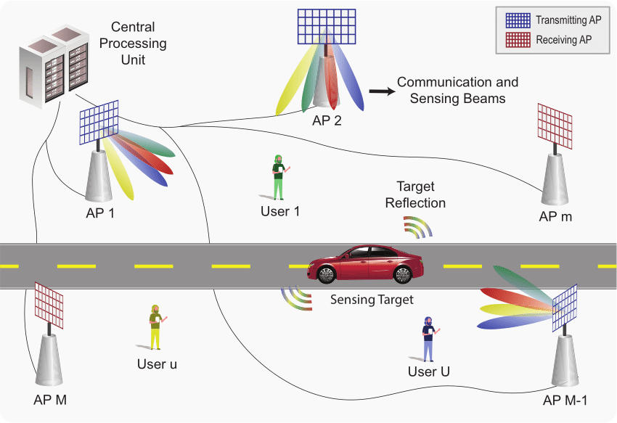

Radio Systems: Examples
Telecommunications
  => more spectrum required => higher frequencies
    => smaller antennas => less power per antenna => antenna arrays
    => more sensitive to blockage => joint communication and sensing
    => some frequency bands already in use => interference robustness
  => higher complexity => complex algorithms => AI
From:
https://www.google.com/url?sa=i&url=https%3A%2F%2Fwww.scientificamerican.com%2Farticle%2Fwill-artificial-intelligence-ever-live-up-to-its-hype%2F&psig=AOvVaw13qKPo1ji-Awvq5-fbFbeO&ust=1706781351472000&source=images&cd=vfe&opi=89978449&ved=0CBMQjRxqFwoTCMjV2buuh4QDFQAAAAAdAAAAABAD
From: https://www.google.com/url?sa=i&url=https%3A%2F%2Fappu.com.uy%2F%3Fi%3Dpdf%5D-joint-design-of-communication-and-sensing-for-beyond-vv-Jlbozrio&psig=AOvVaw1vmpB2ZAOslqXK0OFWTQRN&ust=1706781155305000&source=images&cd=vfe&opi=89978449&ved=0CBMQjRxqFwoTCLCy_MWth4QDFQAAAAAdAAAAABAI

Slide 6
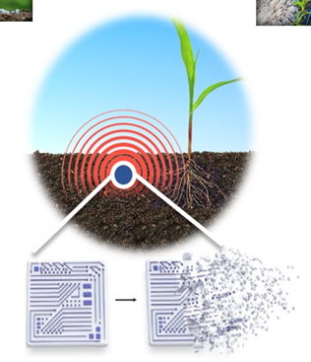
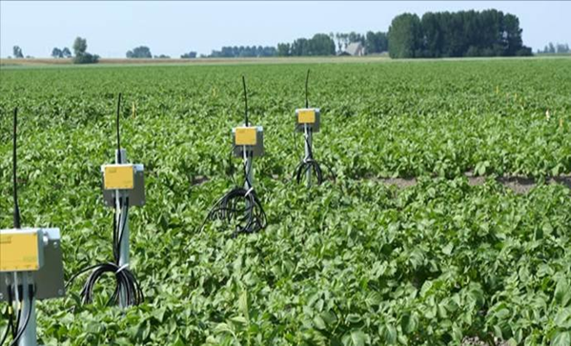
Radio Systems: Examples
Low-power and biodagradable sensor networks
  => lower data rates => more dense networks
  => low/zero power devices => wireless powering
  => biocompatibility => novel materials

Slide 7
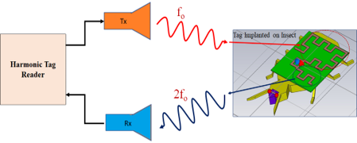
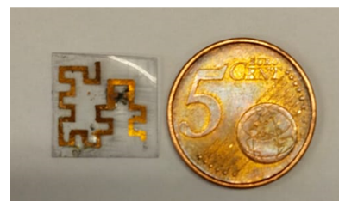
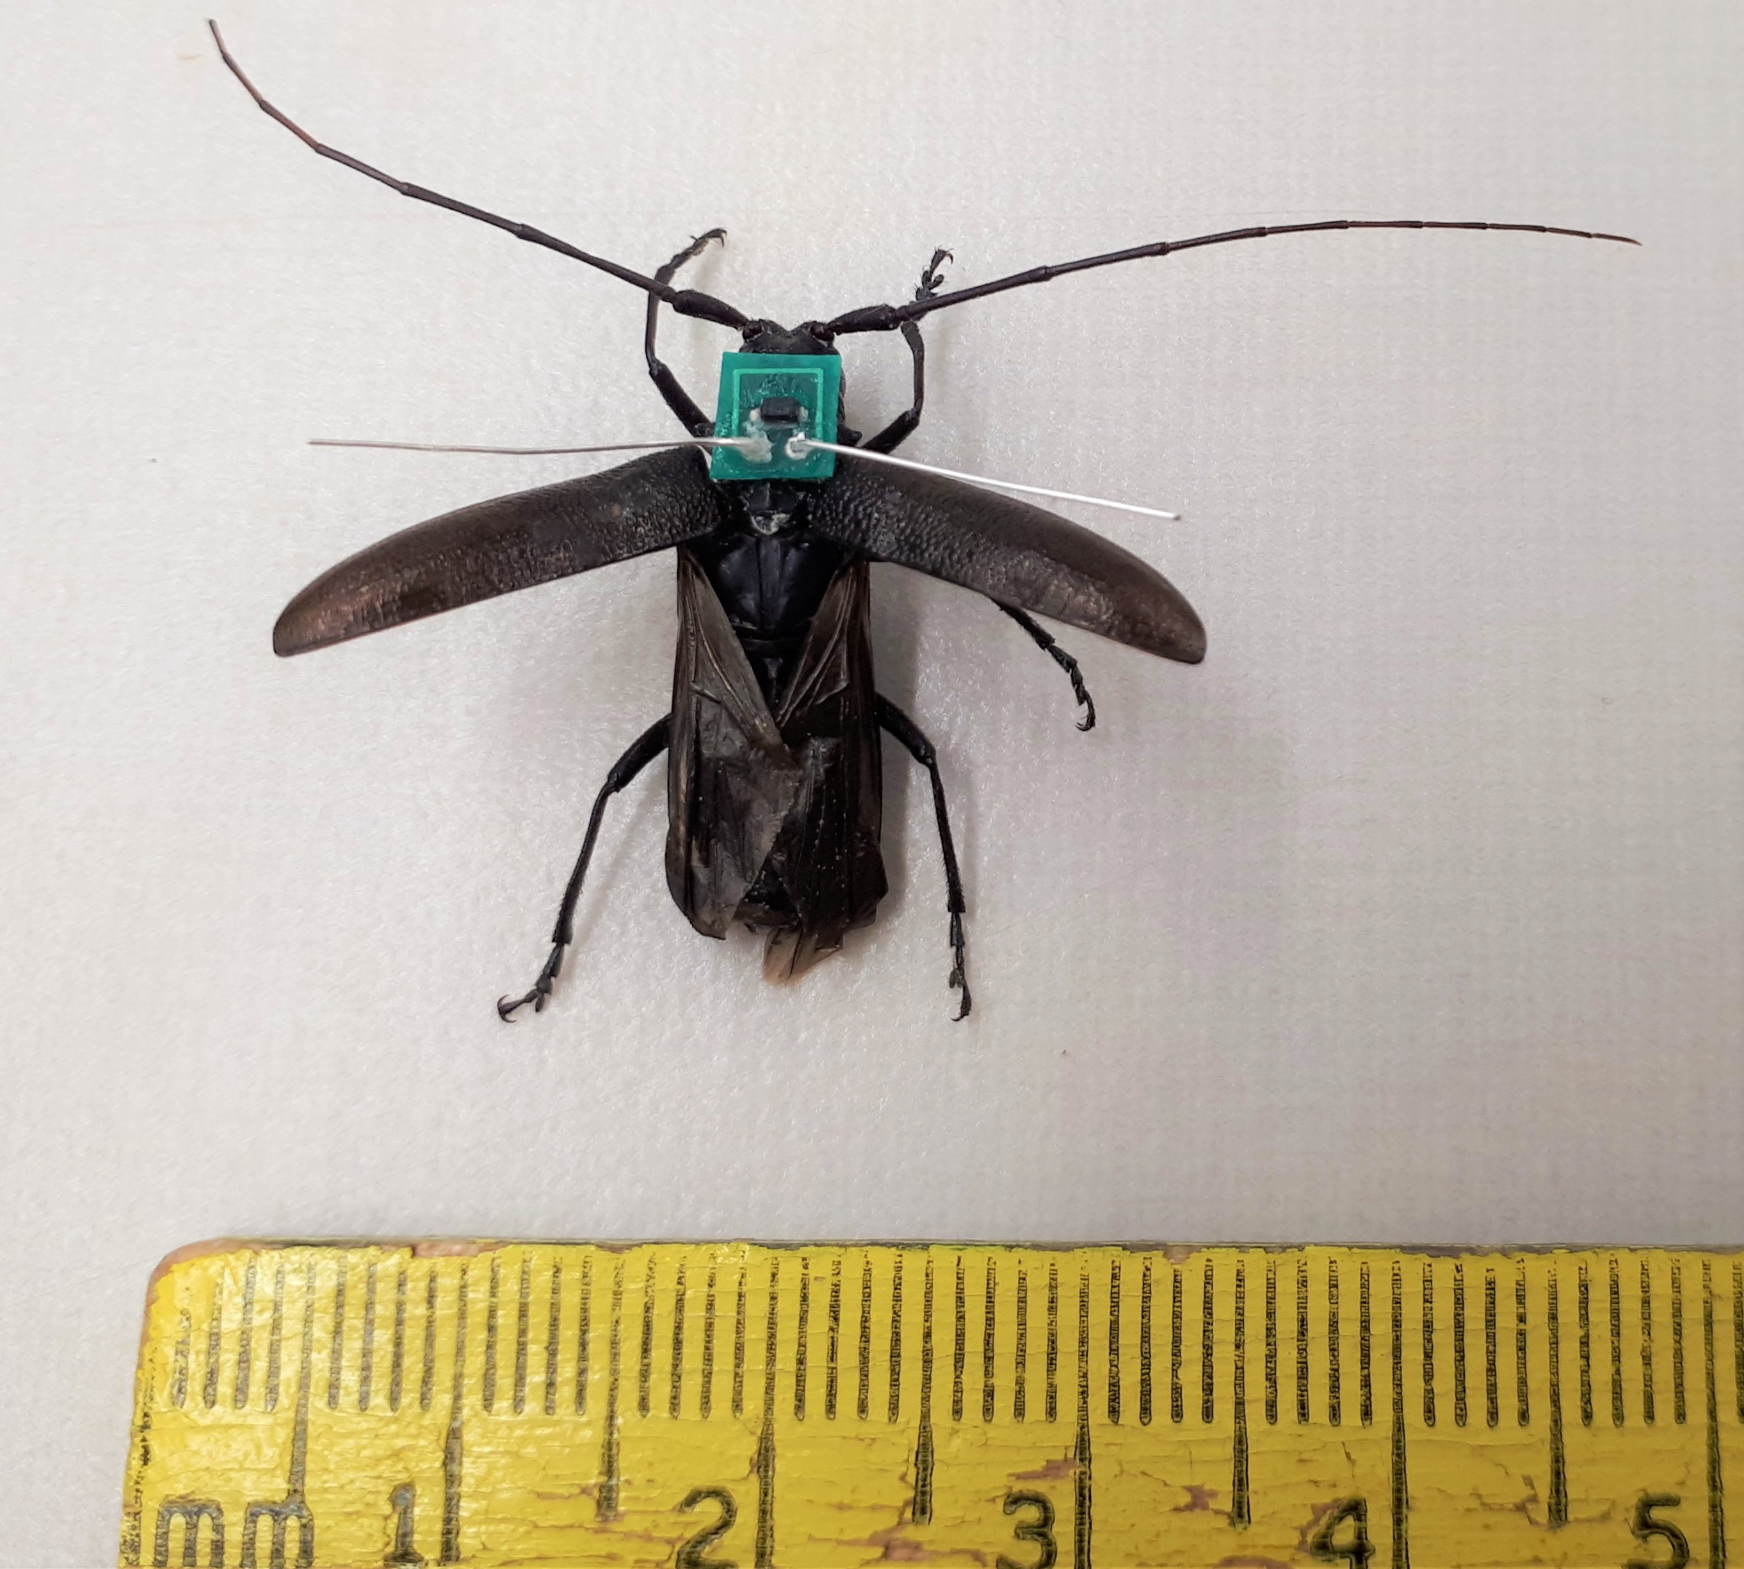
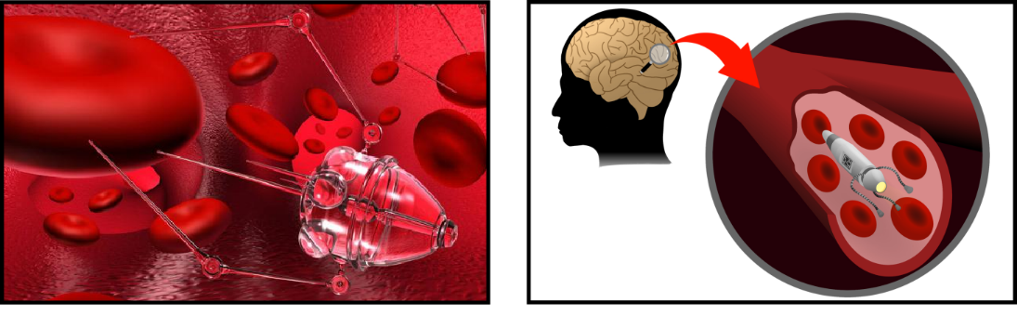
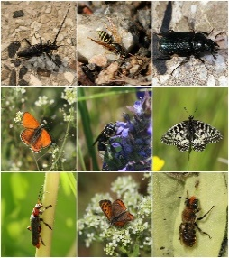
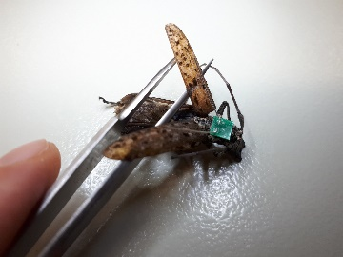
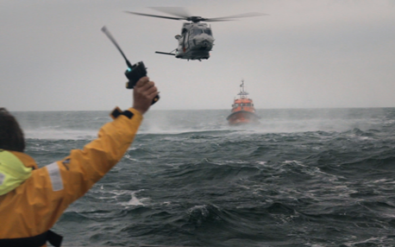
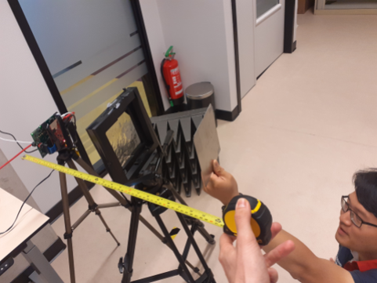

Radio Systems: Examples
Microwave sensing and monitoring
  classical and nonlinear radar
  in/out of body sensing and communication
Insect tracking
Search and rescue
Infrastructure
control

Slide 8
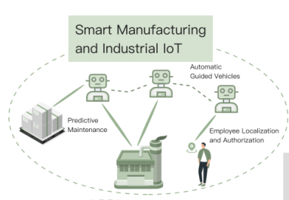
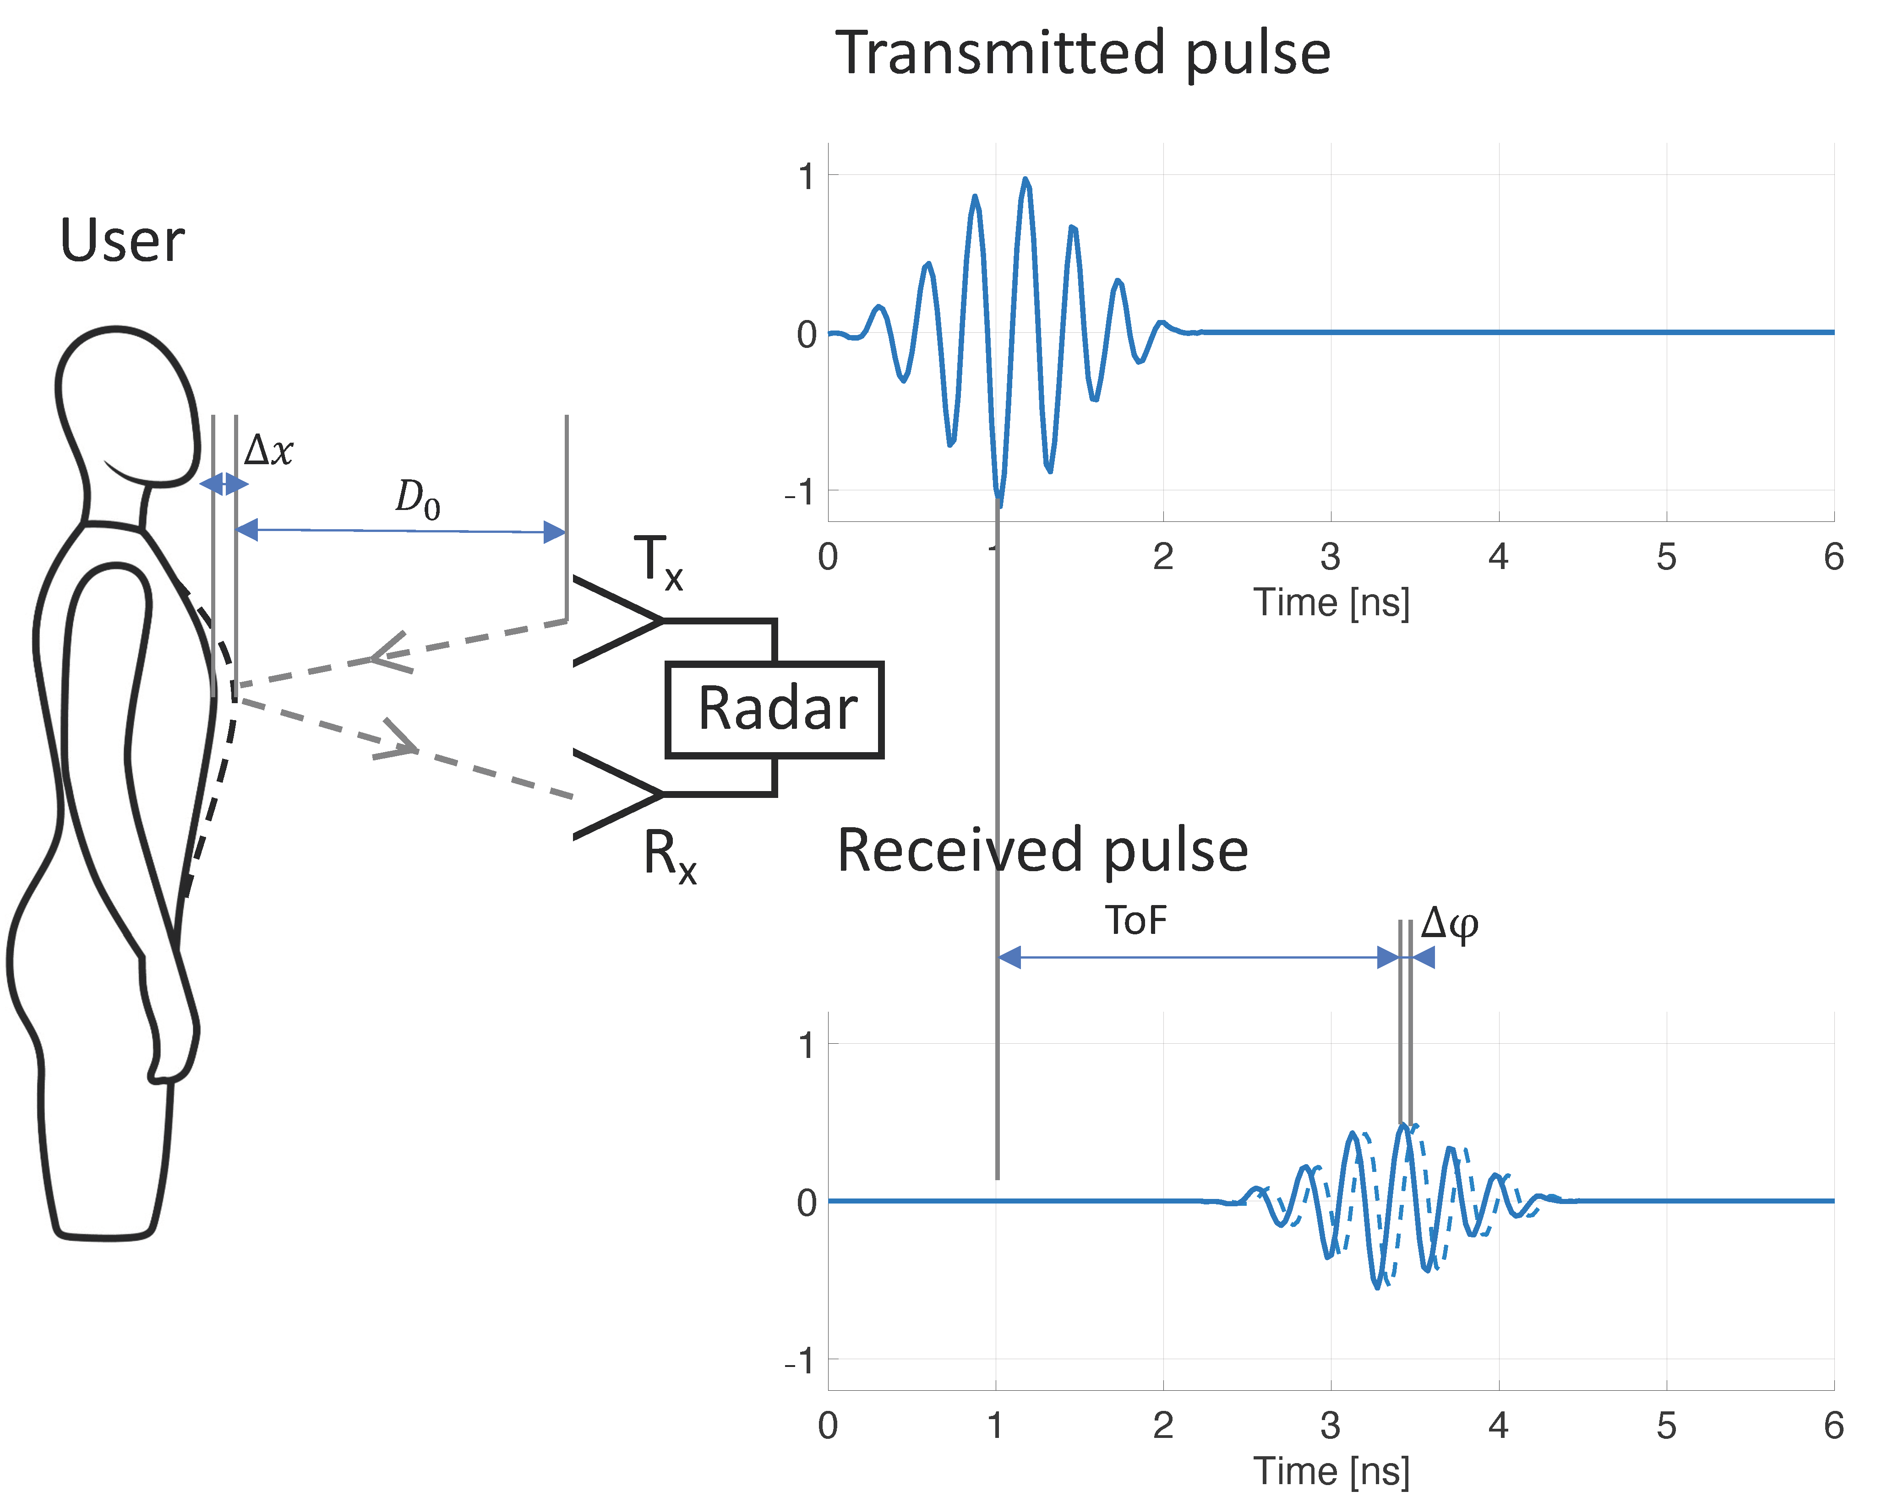
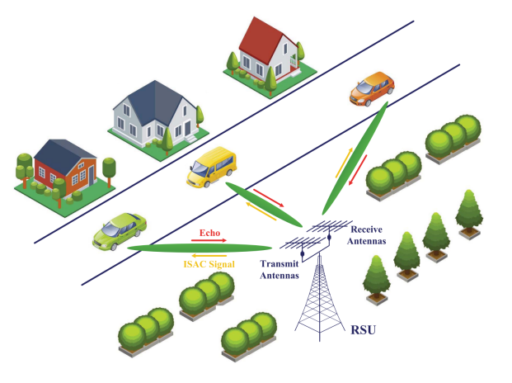
Radio Systems: Examples
Integrated Sensing and Communication (ISAC)
  => new applications
    Health (heart rate, breath rate detection, fall detection…)
    Industry (safety…)
From:Qian Yang, Hengxin Wu, Qianyi Huang, Jin Zhang, Hao Chen, Weichao Li, Xiaofeng Tao, and Qian Zhang. 2023. Side-lobe Can Know More: Towards Simultaneous Communication and Sensing for mmWave. Proc. ACM Interact. Mob. Wearable Ubiquitous Technol. 6, 4, Article 191 (December 2022), 34 pages. https://doi.org/10.1145/3569498
Both from: https://newshub.sustech.edu.cn/en/html/202301/38318.html (31-01-2024)

Slide 9
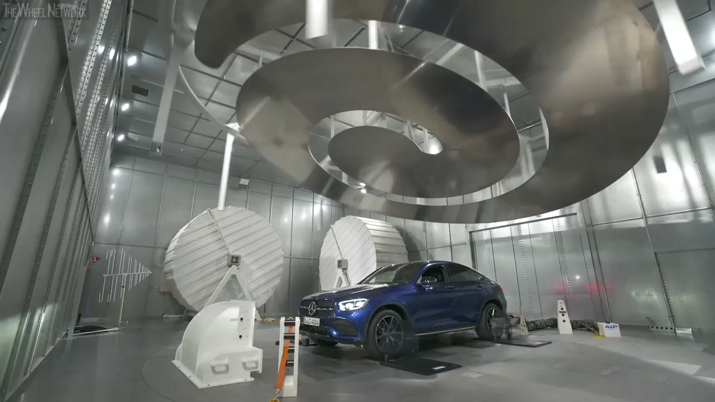
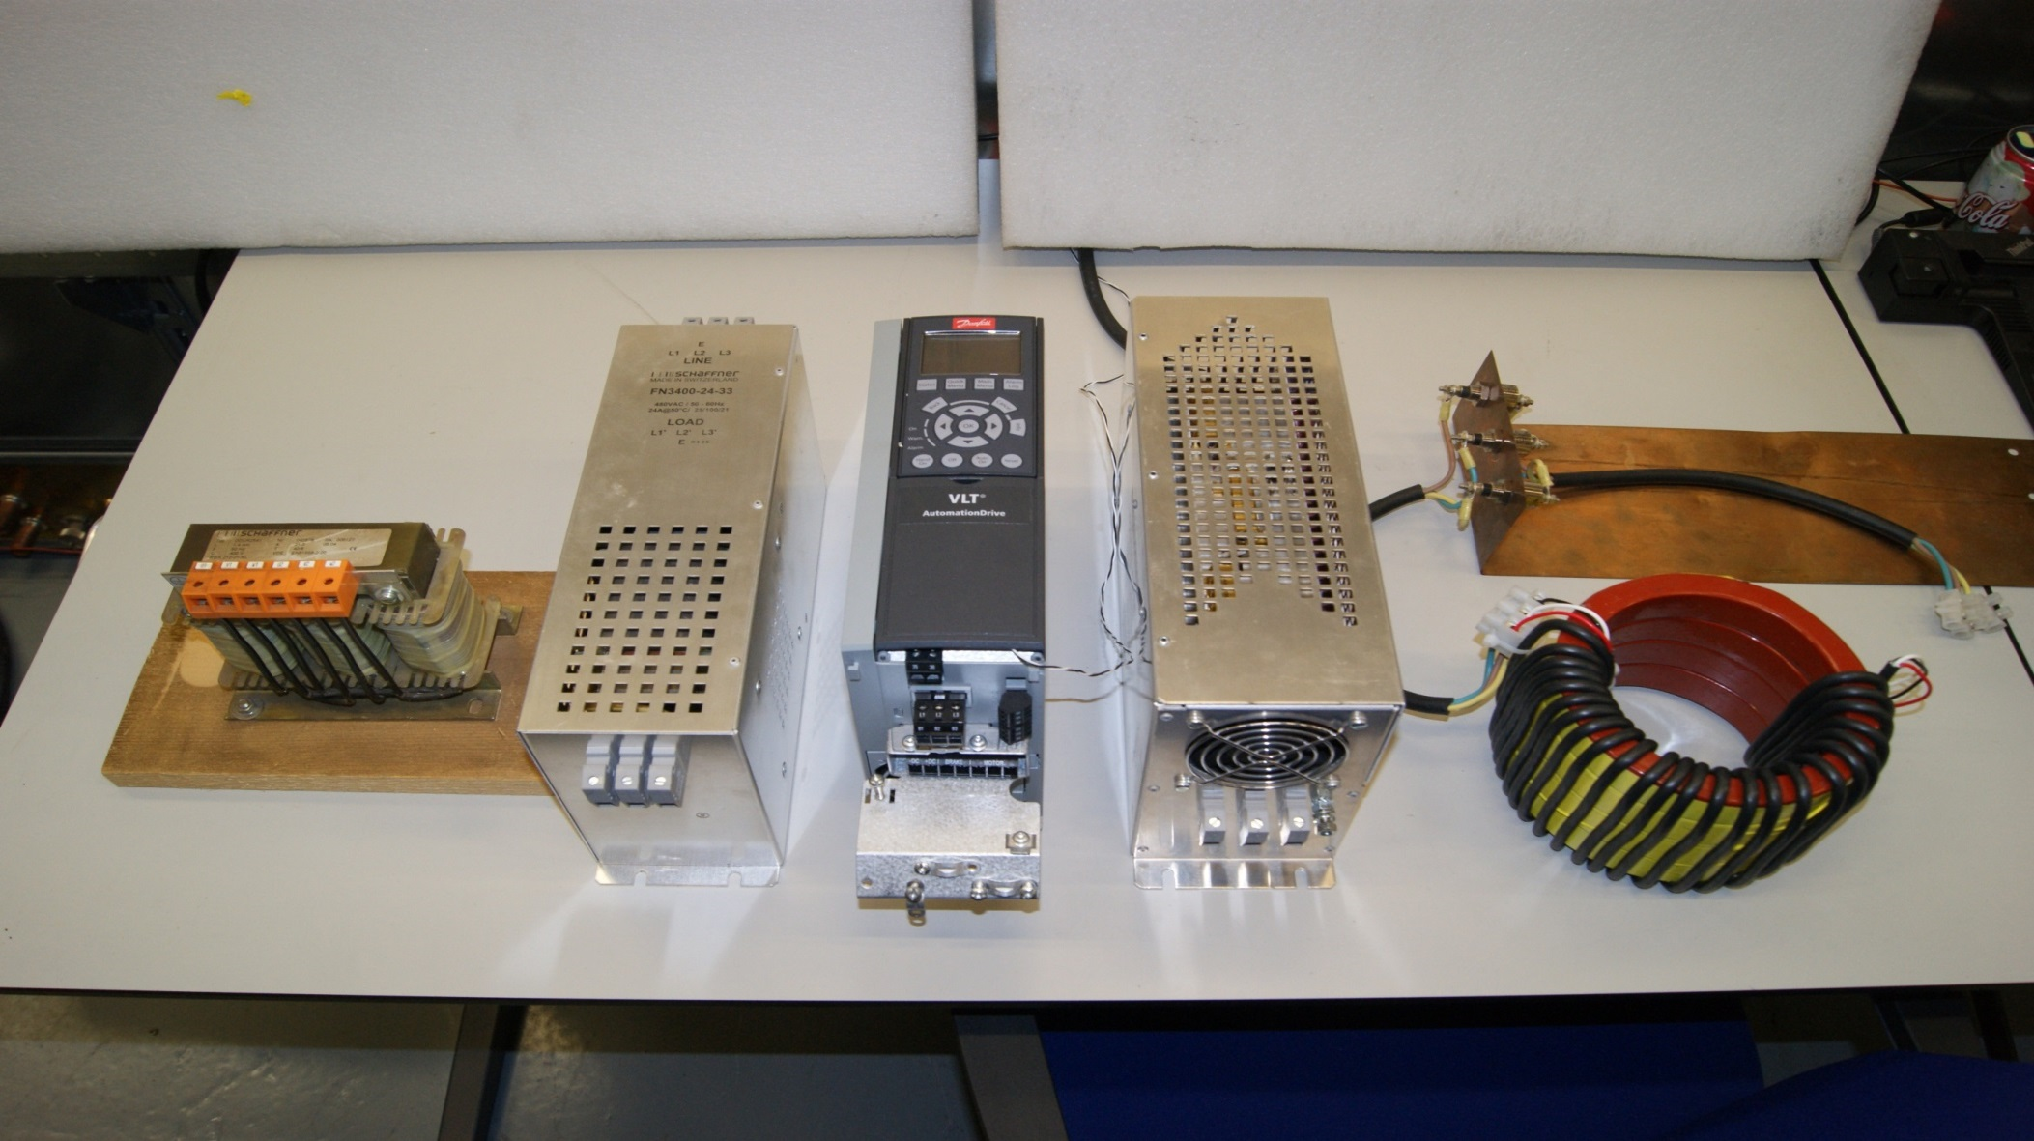
Radio Systems: Examples
ElectroMagnetic Compatibility
  Reliability
  Safety
Conducted
Radiated

Slide 10
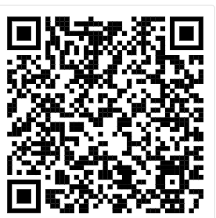
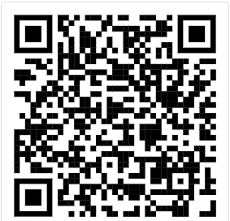
Want to know more?
Follow us on LinkeDin
Check our website
Contact us at
André Kokkeler: a.b.j.kokkeler@utwente.nl

