Slide 1
The use of learning analytics at the Bridging course
Dr. Fulya kula

Slide 2
8
443
95
5:30
3
3200
Notes:
3 is how often I run weekly.5:30 is the time in the morning I wake up to make this happen.8 is the age of my child.95 is the number of days I worked at a bilingual Dutch school as a mathematics teacher.443 is the total citation count I have on Google Scholar.3200 is the distance in kilometers from my house to my parents’.

Slide 3
95
8
443
3
3200
5:30
Notes:
But what do all these numbers mean? How do we use and interpret them? It's not just about collecting numbers; it’s about making sense of them. Whether it’s personal or professional, numbers tell a story, but they only become truly valuable when we extract insights from them.
When we look at data from students' learning, the numbers themselves are just the starting point.
The real value lies in how we interpret these numbers to improve learning outcomes.
Learning analytics helps us identify areas where students might need more support, and tailor educational experiences to each individual’s needs.

Slide 4
Bridging course
Dr. Fulya kula
Notes:
I am Fulya Kula, I am an assistant professor at the Applied Mathematics Department within the MAST group with my research interest in the didactics of mathematics at higher education. Today I will guide you through the Bridging course, which is a totally online course that aims to support first year students in guiding their mathematical transition from high school. I will also inform briefly how the course uses learning analytics to give personalized feedback to students and a class overview to teachers. My aim in this presentation is to look for feedback and collaborations.

Slide 5
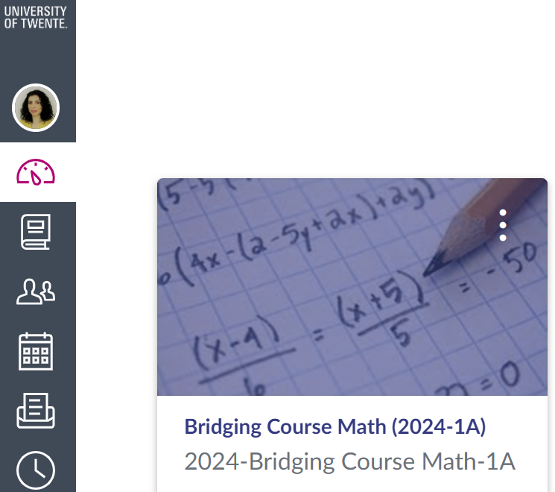
Future
Past
Now
Preliminary
Knowledge Problem
Building Foundations
Workshop
Bridging Course 1
Bridging Course 2
Notes:
I like to think and tell things in order, here is how this course evolved. Firstly, as a teacher, I was aware about students' obstacles, I think many of you would recognize this problem, regardless of the level you are teaching, dare I say. Then I found myself struggling to refer to the preliminary knowledge while I had limited time to teach mathematics but without the preliminary knowledge , I cannot build on anything and therefore cannot go beyond remote learning. Whose responsibility is this? and what could I do to help students? With the help of the module team, I was given 4 hours to help students, I prepared a 4-hour workshop with the aim of closing this gap.
Since the materials I prepared for the workshop were not exceeding 4 hours, I directed the students to various instructive videos.
They didn’t watch the videos. Then I thought, what if I had all these material collected in a platform and there were the call from the 4TU.CEE for innovative projects using learning analytics. The Bridging course came into being thanks to the support of this source. This is an online course on the learning management system Canvas and it allows students to follow this in their own pace and time. I wrote here in subscript 1 because last September was the first iteration of this course. At the moment this course is implemented to first year students in various faculties and departments. Future is yet to come. I am very interested to see the results after the second iteration.

Slide 6
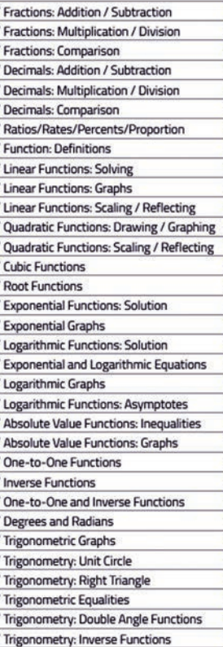
Bridging course
Content
First Calculus course
Topics
Mathematics B
at secondary school
at university
Sub-topics
Learning Objectives/sub-topic

Slide 7
Bridging course
structure
Pre-Question
Video
Post-Question

Slide 8
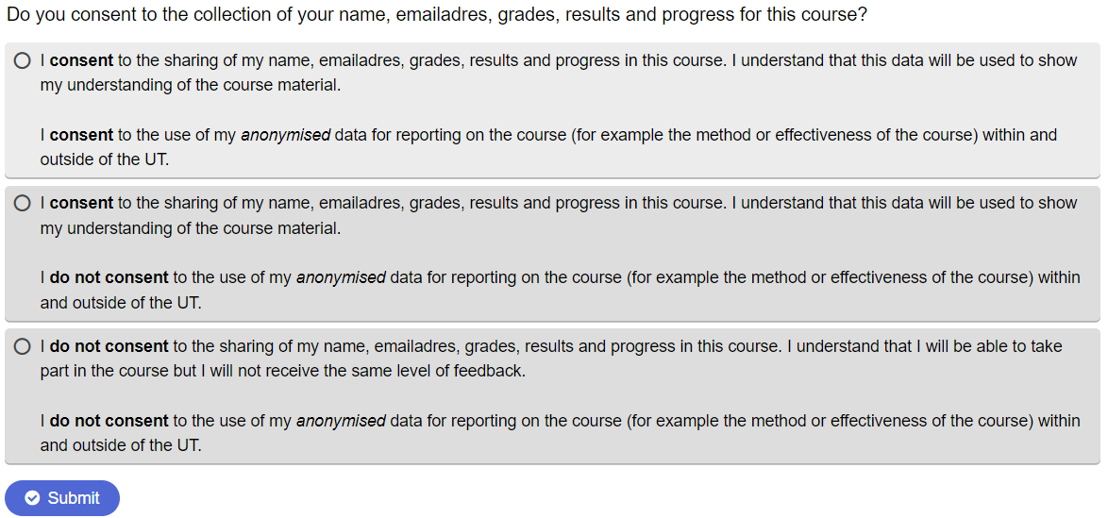
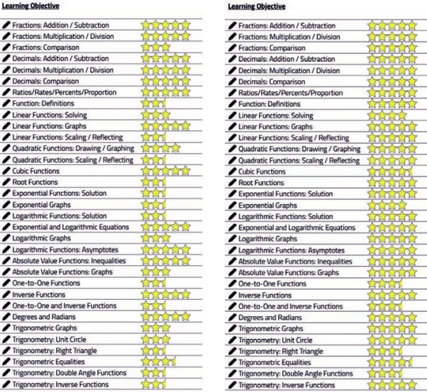
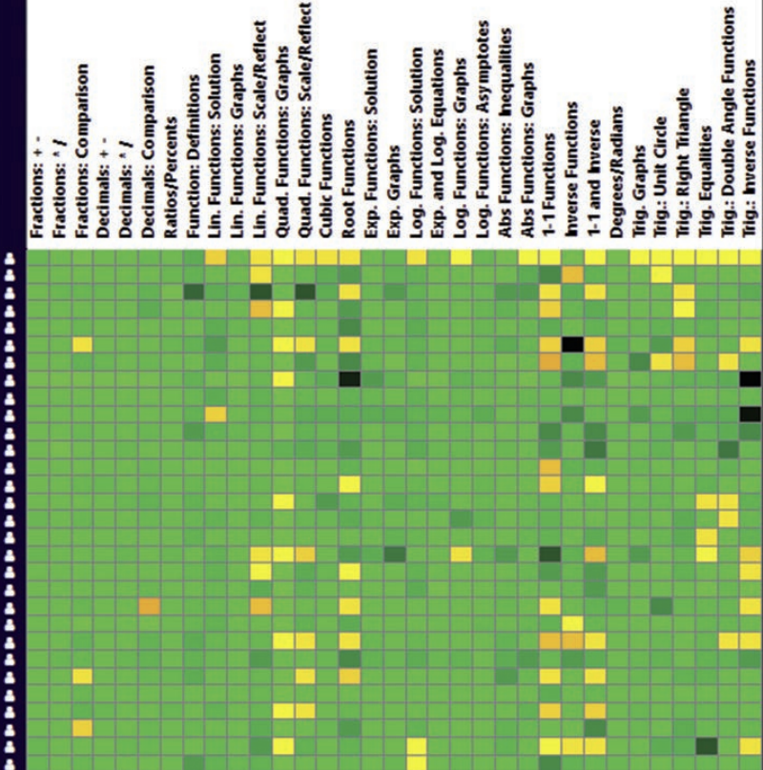
Bridging course
Ethics
Learning analytics
Data
Visualizations
Pre-Question
Video
Post-Question
For Student
For Teacher

Slide 9
Bridging course
First results
Bridging Course 1
Bridging Course 2
56/76
3 Faculties
75% pass rate
11 Departments
Positive results
Results

Slide 10
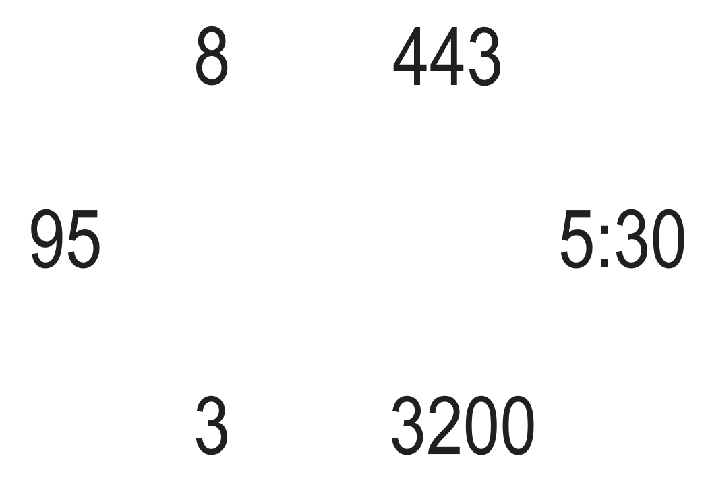
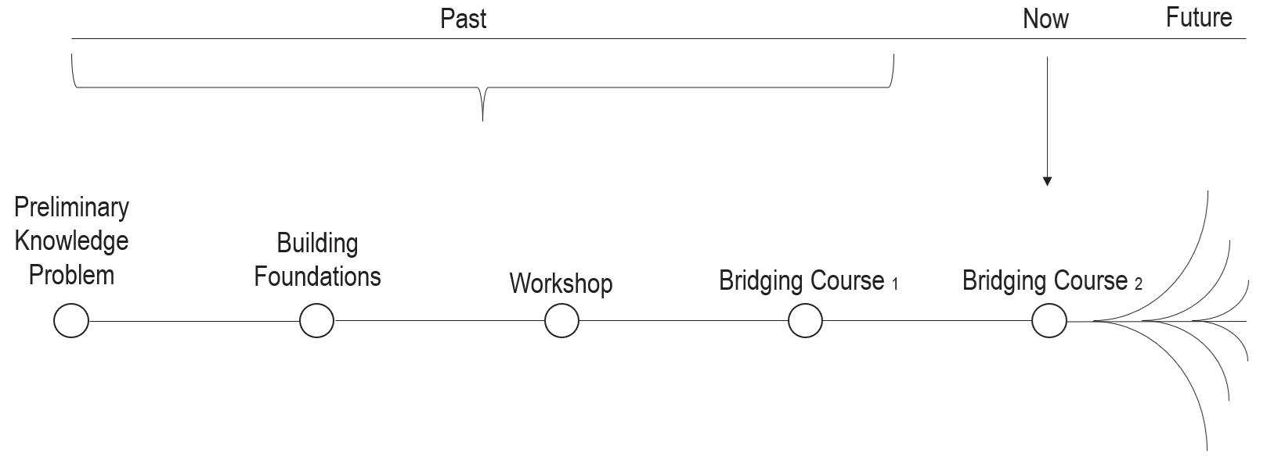
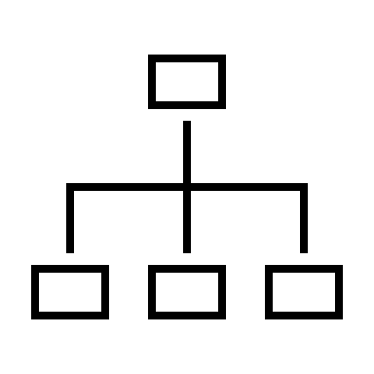
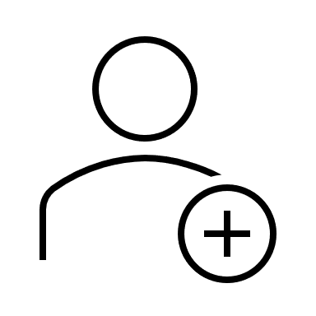
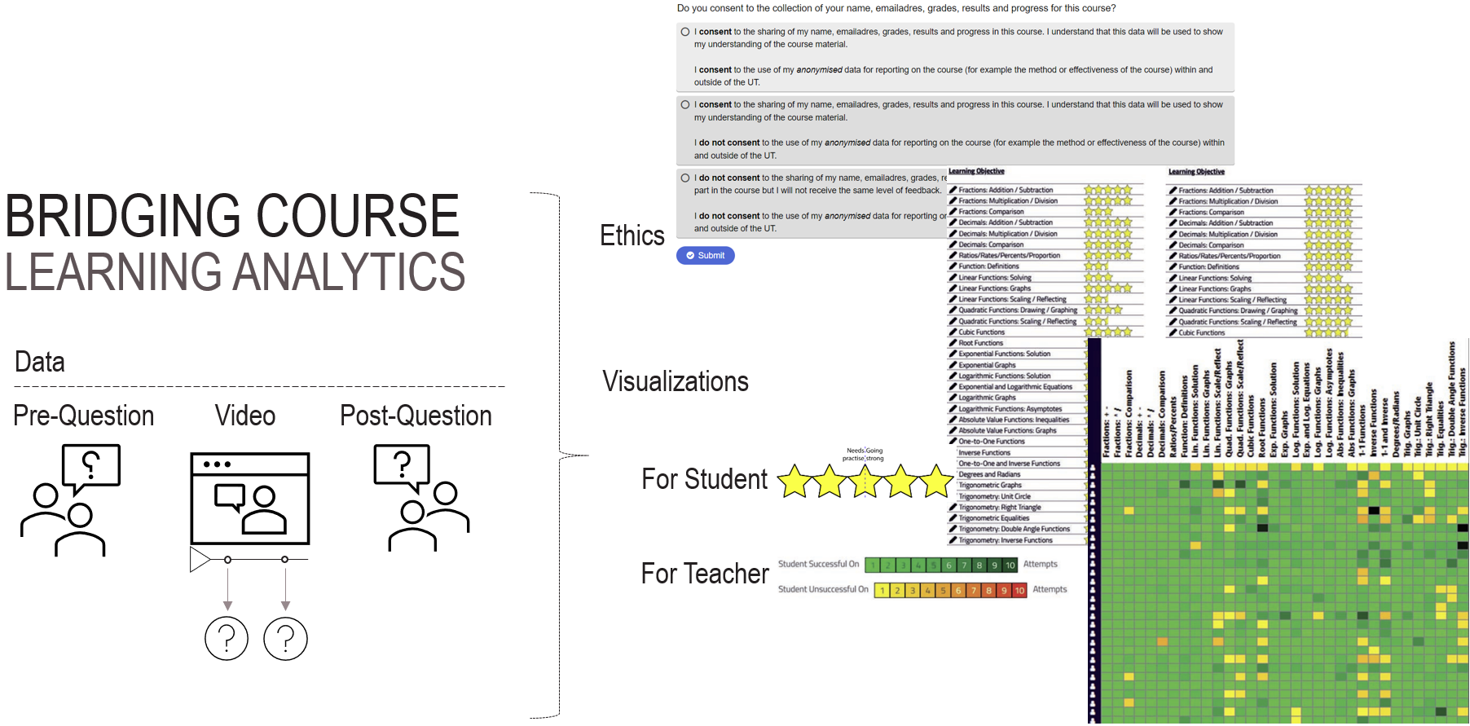
Collaboration

Slide 11
Thank you!
Dr. Fulya kula
f.kula@utwente.nl

