Slide 1
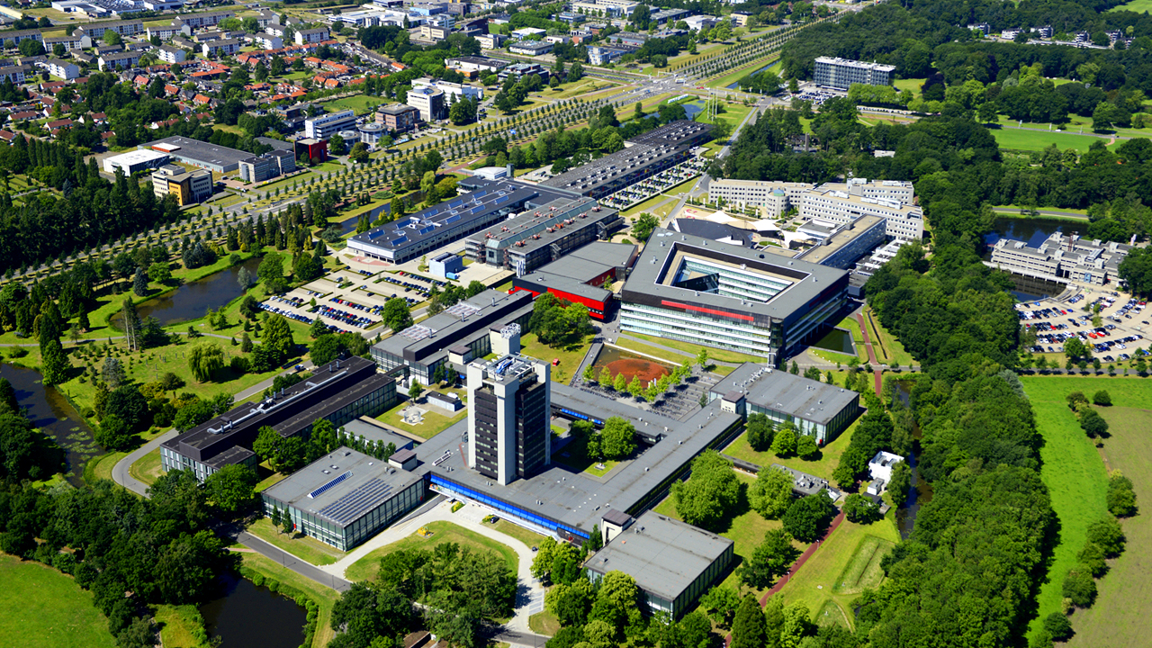

Hans Hilgenkamp
Scientific Director

Slide 2
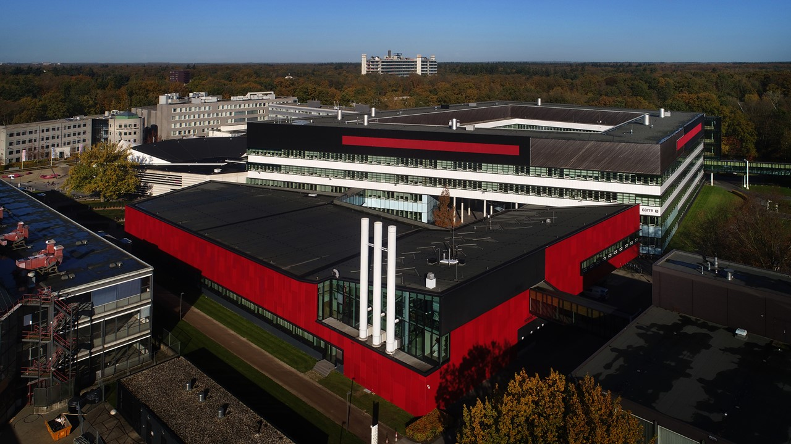

Slide 3

EEMCS
S&T
ET
BMS
ITC
CLIMATE
CENTRE
Electrical Engineering, Mathematics
and Computer Science
Behavourial, Management and
Social Science
Geo-Information Science and
Earth Observation
Science and Technology
Engineering Technology

Slide 4
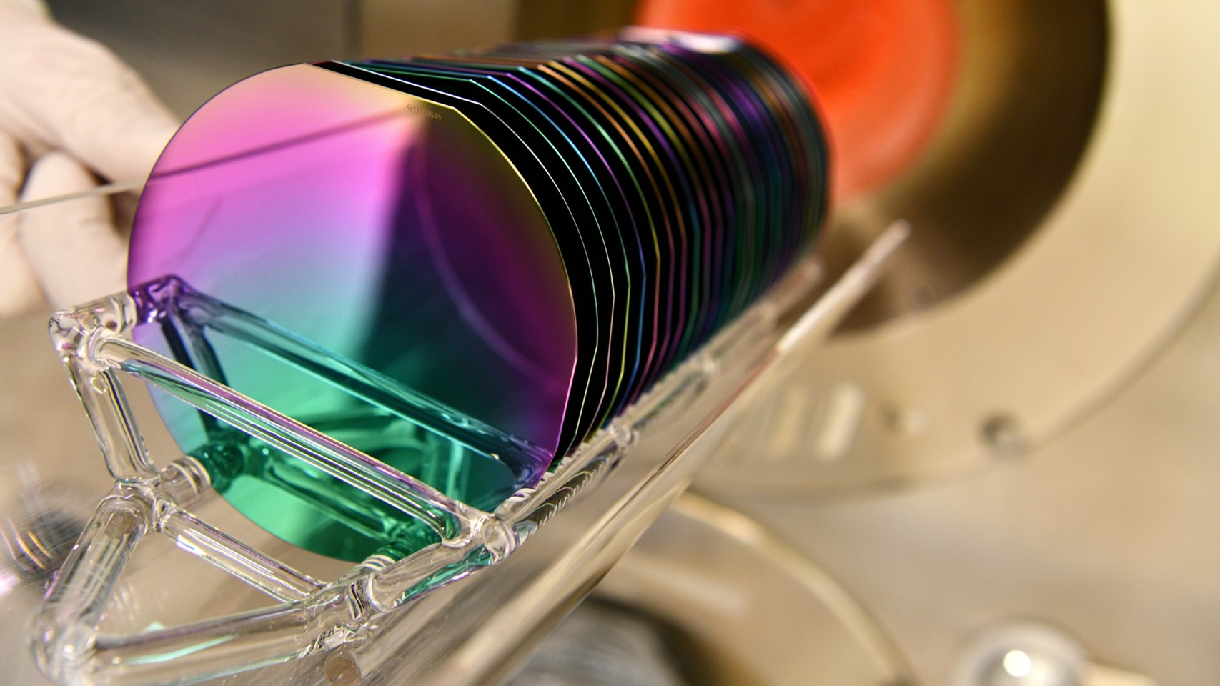

Key expertise areas:
Materials, Electronics/Photonics/Fluidics, Energy
SOLAR
INTEGRATED PHOTONICS
2D MATERIALS
QUANTUM
MOLECULAR
TECHNOLOGIES
BATTERIES
ORGANS ON CHIPS
RESOURCE- EFFICIENT ICT
PIEZO MEMS

Slide 5
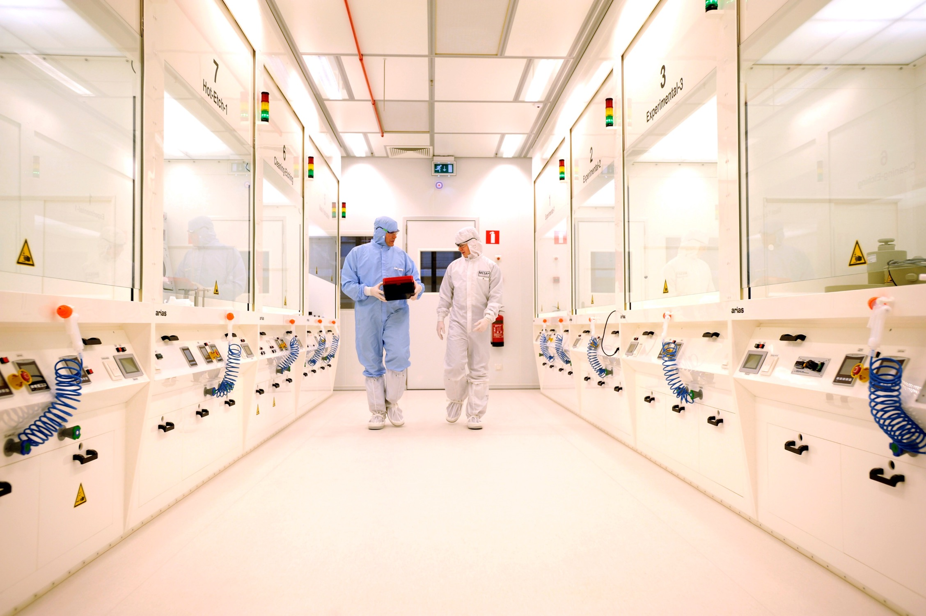
INFRASTRUCTURE
  Shared NanoLab
  Research Groups Labs
  High Tech Factory
  High Tech Foundry (New Origin)

Slide 6
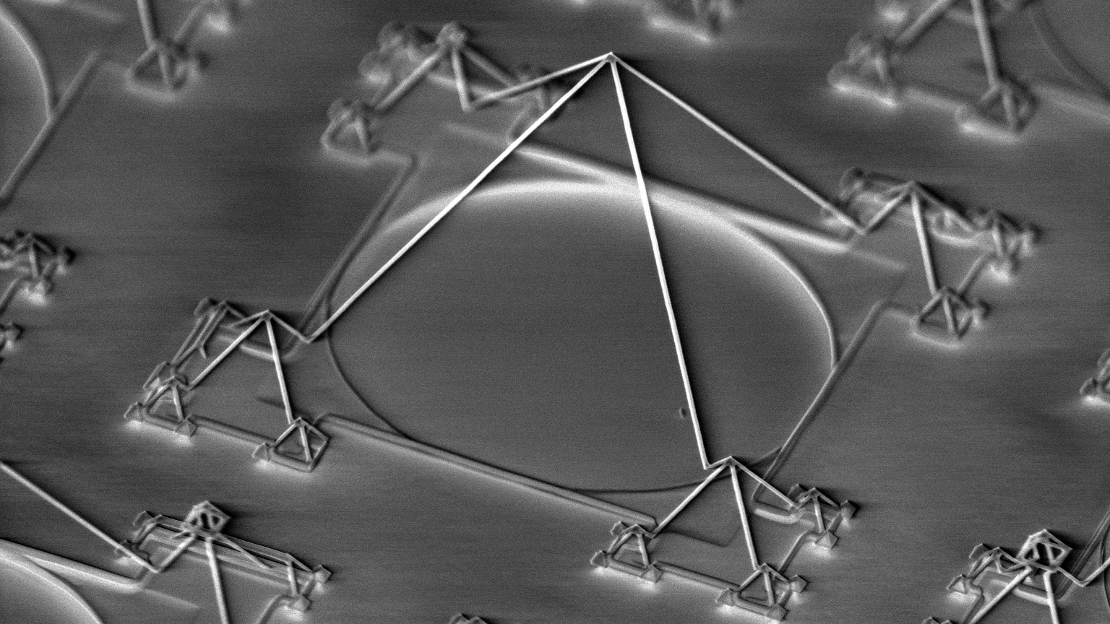
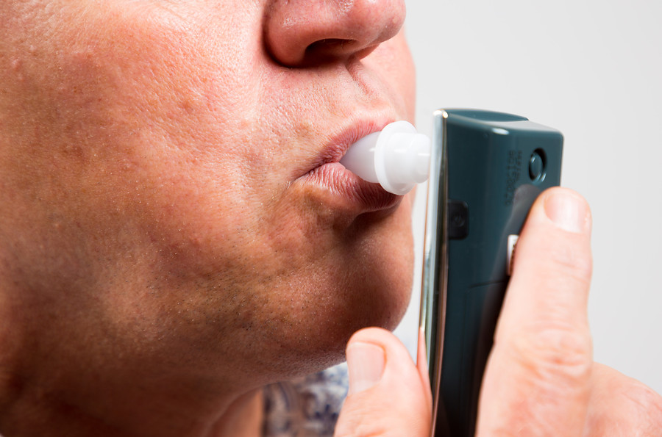
’CONTOURS OF GIZEH’
3D Integrated Nano-Systems – Mesoscale Chemical System

Slide 7

Advanced Materials Technologies
1 nm
XUV Group (Ackermann et al.)

Slide 8
Societal Challenge: Energy consumption of ICT is large and increasing
SIA/SRC Decadal Plan for Semiconductors (2021)

Slide 9

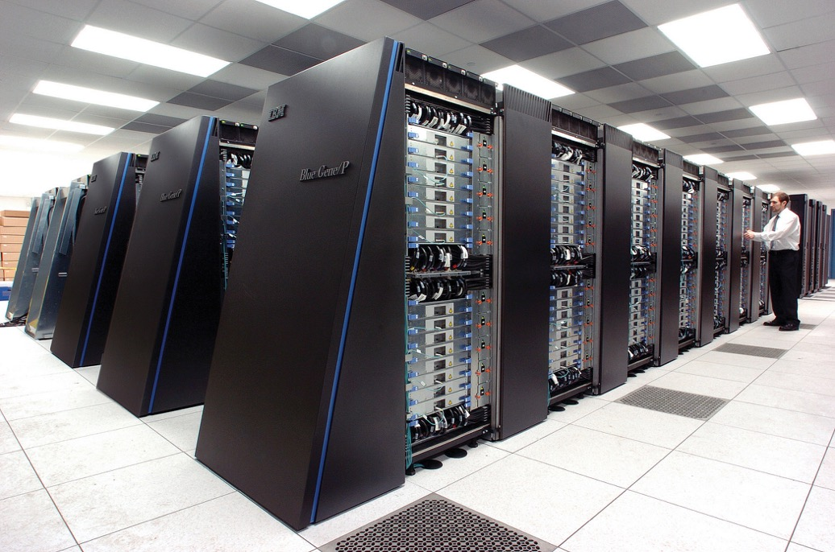
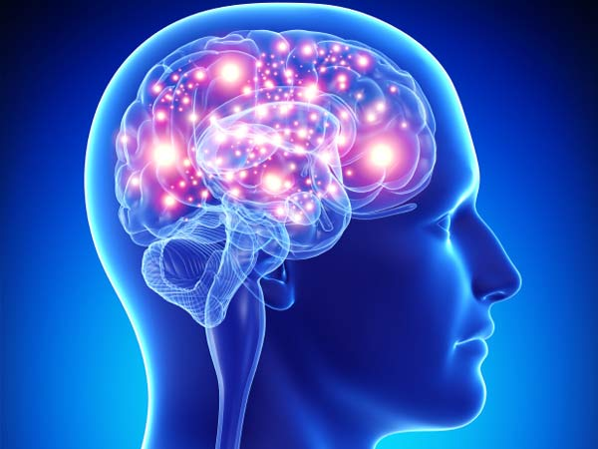
Resource-Efficient ICT
Supercomputer
Brain
20 MegaWatt
20 Watt
Neuromorphic computing

Slide 10
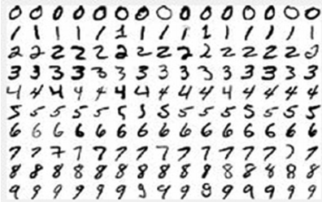
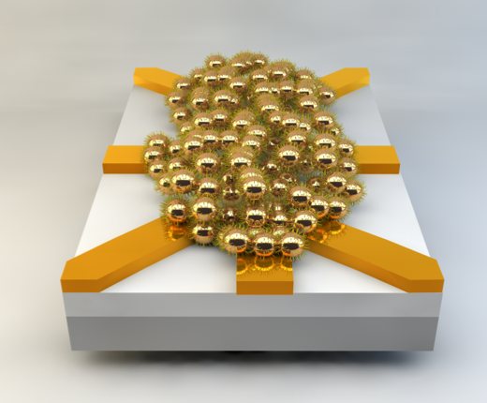
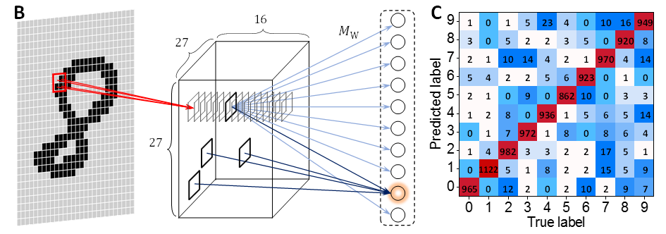
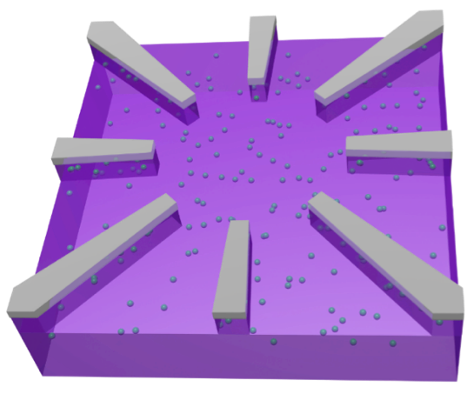
Pattern recognition
T. Chen et al., Nature (2020)
96% correct
NE Group (Van der Wiel et al.)

Slide 11
BRAINS Day, 7 October 2024 (afternoon)
U-Park

Slide 12
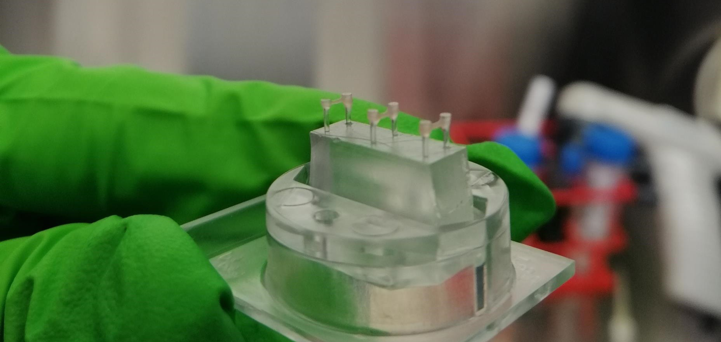
HEART ON A CHIP
Robert Passier & Andries van der Meer - AST | Loes Segerink - BIOS

Slide 13
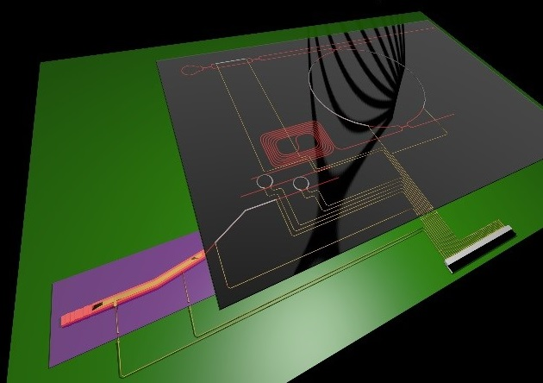

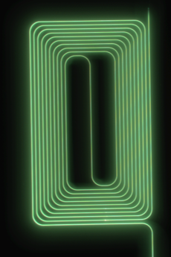
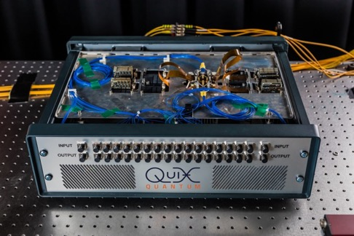
Integrated Photonics
Al₂O₃ spirals in the UV
World’s most narrow band
diode laser on a chip
UT/MESA+ and Lionix
Erbium doped Al₂O₃ spirals for on-chip amplification
UT/MESA+ and Aluvia
Photonic Quantum Computer
UT/MESA+ and QUIX Quantum

Slide 14
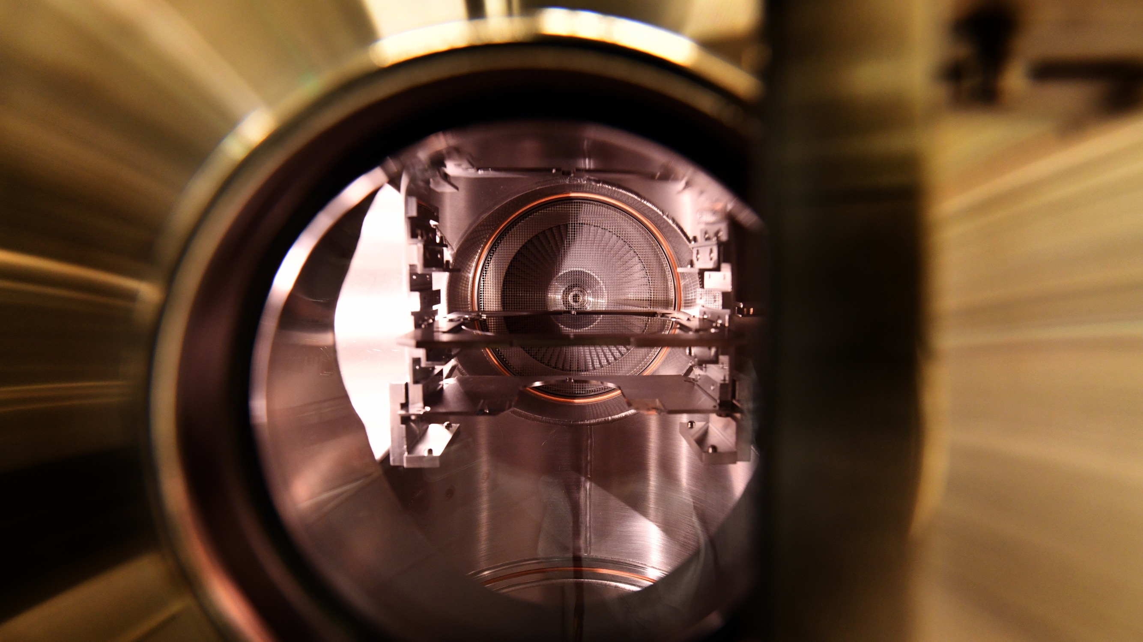
GROWTH FUNDS

Slide 15
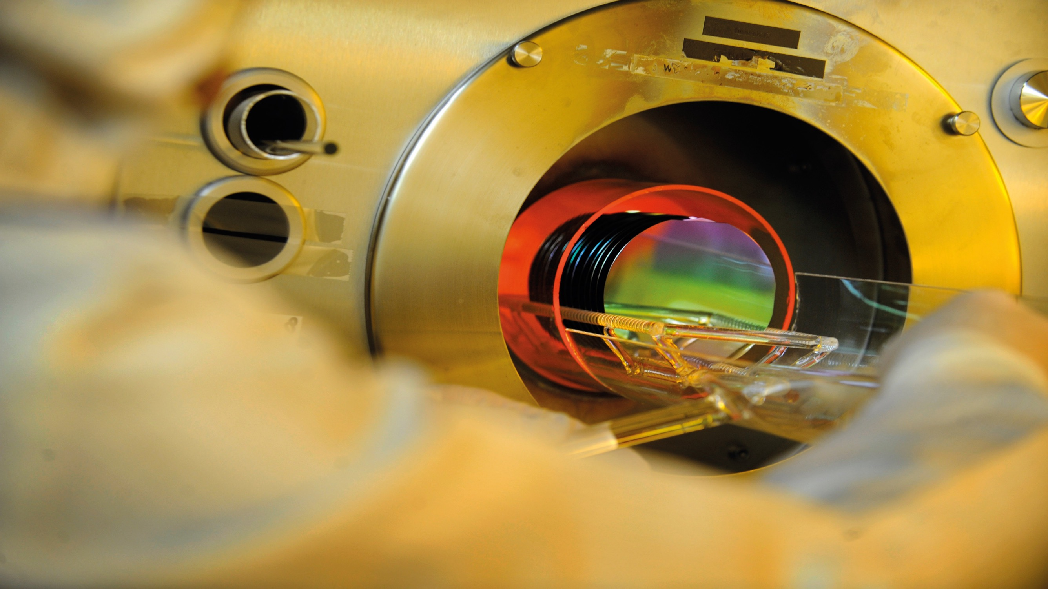
National
Growth Fund
  1st round
  Quantum Delta NL
  Groenvermogen
  2nd round
  PhotonDelta
  NXTGEN HIGHTECH
  Duurzame Materialen NL
  3rd round
  Polaris
  SolarNL
  Material Independence and Circular Batteries

Slide 16

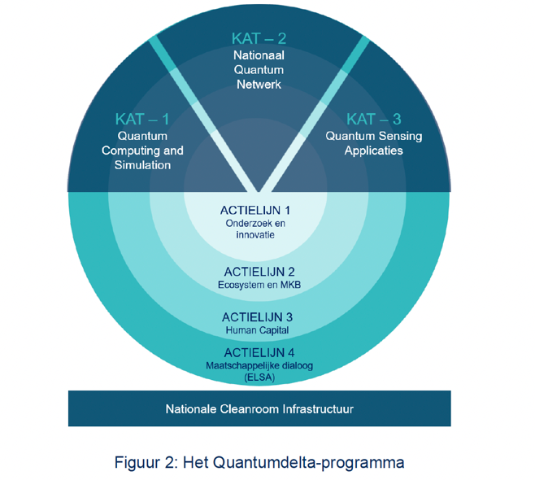
NGF
QUANTUMDELTA
  Strengthening the Dutch quantum ecosystem:
  Quantum computing
  Quantum networks
  Quantum sensing
  Public cofunding: 615M€
  UT is involved in (~40M€):
  NanoLabNL investments
  SME program
  House of Quantum
  Business development
  Talent and Learning centres

Slide 17
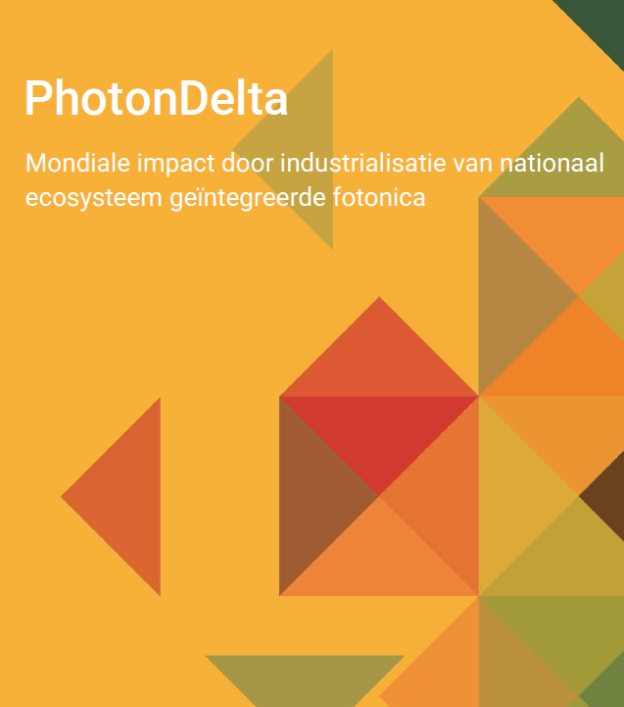
NGF
PHOTONDELTA
  Best-in-Class Dutch Ecosystem for integrated photonics:
  Ecosystem
  Application Technology
  Industrialisation
  Public cofunding: 470M€
  UT is involved in SiN platform (~70M€)
  High TRL infrastructure
  Research
  Open Calls

Slide 18
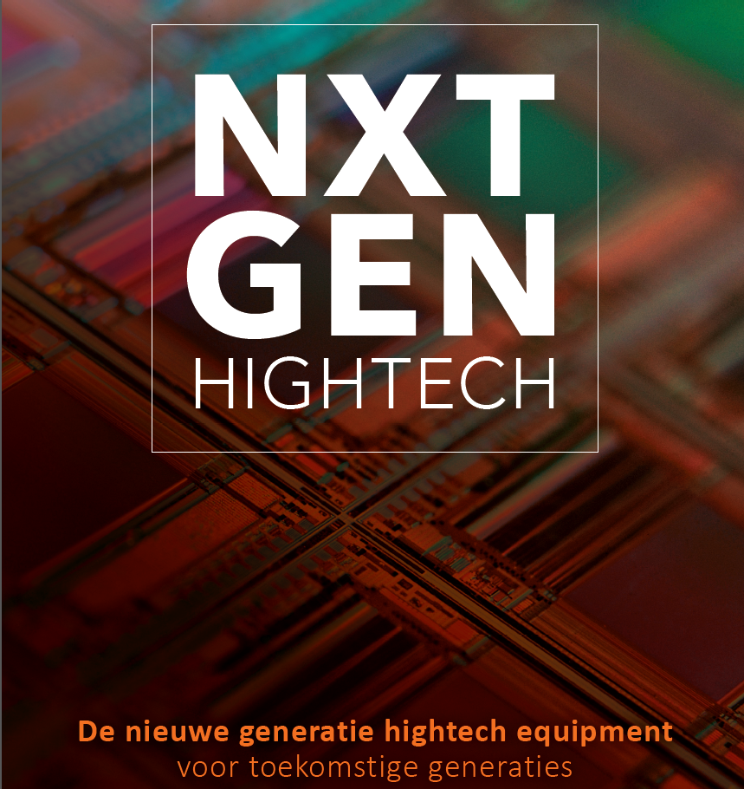
NGF
NXTGEN HIGHTECH
  Leading Dutch High Tech Equipment Ecosystem in 2030
  Application pillar
  Knowledge pillar
  Ecosystem Pillar
  Public cofunding: 450M€
  Domains (incl involvement UT ~40M€):
  LaserSatcom
  Energy
  Biomedical Production
  Semicon
  Composites
  AgriFood
  Smart Industry

