Slide 1
HOW TO ARCHIVE YOUR DATA IN 4 STEPS Iris Schutte
Data steward S&T(TNW) & ET
I.Schutte@utwente.nl

Slide 2
IN THIS PRESENTATION:
THE FOUR STEPS OF DATA ARCHIVING IN AREDA:
1. PREPARATION OF
DATA & DOCUMENTATION
2. UPLOADING DATASET
TO AREDA
3. ADDING METADATA
IN PURE
4. REVIEW BY THE DATA
STEWARD & FINAL CHECK

Slide 3
1. PREPARATION OF DATA
& DOCUMENTATION

Slide 4
1. PREPARATION OF DATA & DOCUMENTATION
AFTER DECIDING WHICH DATA NEEDS TO BE ARCHIVED
ORGANIZE FILES – IS EVERYTHING COMPLETE?
ALSO THINK ABOUT DATA-RELATED MATERIALS: SCRIPTS, MODELS, CONSENT FORMS, CODE BOOKS
CAN YOUR FILES BE OPENED AND USED AFTER SEVERAL YEARS?
USE OPEN, NON-PROPRIETARY FILE FORMATS AS MUCH AS POSSIBLE OR CONVERT IF POSSIBLE
LIST OF RECOMMENDED FILE FORMATS (4TU REPOSITORY)
ADD DOCUMENTATION TO THE DATA AND CREATE ONE/MORE ZIP OR TAR FILE(S) WITH MEANINGFUL NAME(S)

Slide 5
1. PREPARATION OF DATA & DOCUMENTATION
A BIT MORE ABOUT DOCUMENTATION….
README FILE: PROVIDES INFORMATION ABOUT THE DATASET SUCH THAT IT CAN BE UNDERSTOOD BY
OTHERS AND YOURSELF AFTER SEVERAL YEARS
ANY INFORMATION THAT IS NEEDED TO REDO THE EXPERIMENT(S)
- experimental protocols, “step-by-step recipe”
- units
- used devices and/or software
- settings
- …
JUST AS IMPORTANT AS THE DATA THEMSELVES! DATA WITHOUT PROPER DOCUMENTATION CANNOT (EASILY) BE RE-USED AND TRUSTED
TIP: LET A COLLEAGUE REVIEW YOUR README FILE
README WITHIN DATA PACKAGE AND AS SEPARATE UPLOAD IN PURE.

Slide 6
2. UPLOADING THE
DATASET TO AREDA

Slide 7
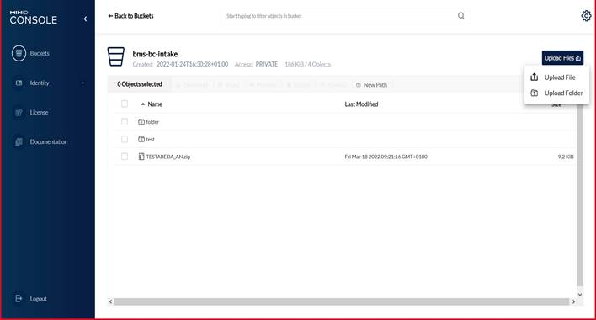
2. UPLOADING THE DATASET TO AREDA
EVERY GROUP HAS ITS OWN “BUCKET” IN AREDA
UPLOAD DATA PACKAGE INTO THE INTAKE BUCKET OF YOUR GROUP
UPLOAD 1 ZIP/TAR FILE OR A FOLDER WITH
MULTIPLE ZIP/TAR PACKAGES
DATA WILL BE MOVED TO THE FINAL BUCKET OF YOUR GROUP
BY DEFAULT, WHOLE GROUP HAS ACCESS TO DATA IN THE BUCKETS (FINAL BUCKET: READ-ONLY)

Slide 8
3. ADDING METADATA
IN PURE

Slide 9
3. ADDING METADATA IN PURE
REGISTER YOUR DATA AND ADD METADATA IN PURE
LINK TO QUICK REFERENCE CARD PURE

Slide 10
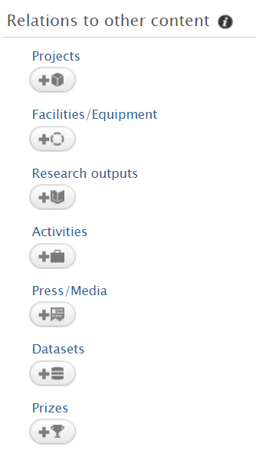
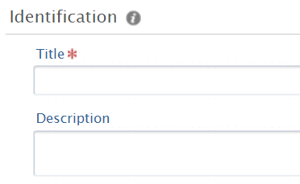
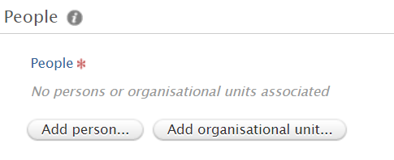
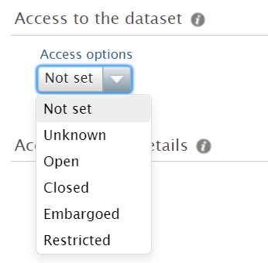
3. ADDING METADATA IN PURE
METADATA DEFINE THE CHARACTERISTICS OF THE DATASET – MAKE DATA FINDABLE
METADATA FIELDS IN PURE:
METADATA ALSO DEFINE WHO HAS ACCESS

Slide 11
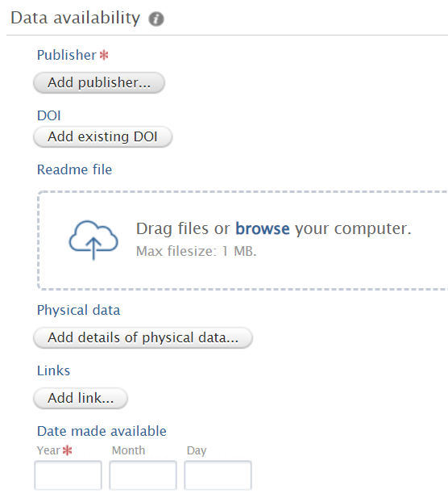
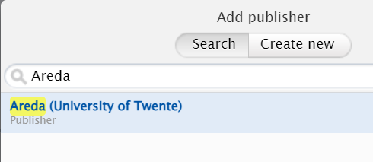
3. ADDING METADATA IN PURE

Slide 12
4. REVIEW BY THE
DATASTEWARD &
FINAL CHECK

Slide 13
4. REVIEW BY THE DATASTEWARD
& FINAL CHECK
METADATA FIELDS
AFTER SAVING METADATA IN PURE DATA STEWARD WILL BE AUTOMATICALLY NOTIFIED
CHECK BY DATASTEWARD: METADATA FIELDS OKAY? README FILE PRESENT?, DATA IN THE INTAKE BUCKET?
EVERYTHING OKAY?: DATA STEWARD MOVES DATA TO FINAL GROUP BUCKET & CREATES PERSISTENT LINK TO DATA IN PURE
DATA STEWARD CONTACTS RESEARCHER & RESEARCHER CAN CHECK THE DATA PACKAGE VIA LINK IN PURE

Slide 14
QUESTIONS?
More info?
areda.utwente.nl (areda platform & guide)
Link to: research support website
and/or ask the faculty data steward

