Slide 1
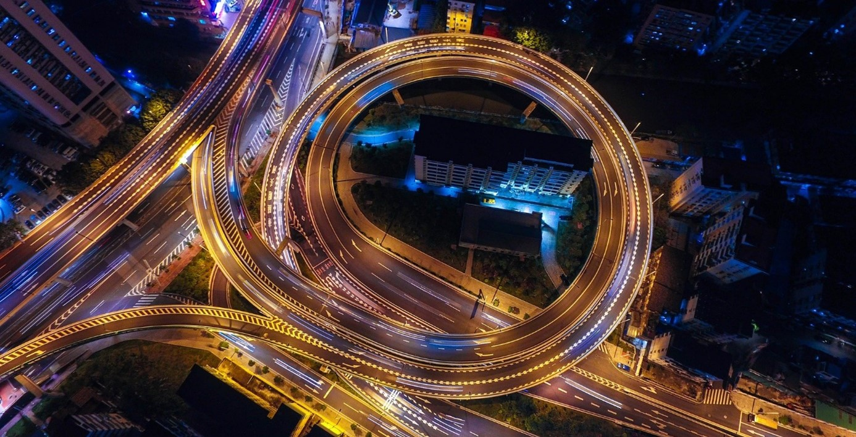
DCC network
Digital competence center (DCC network)
Maarten van Bentum, data librarian

Slide 2
Digital competence center (DCC)
Why archiving research data
The research group: the interest and challenge of keeping data for the long term
The institution: the responsibility of supporting data management (see Netherlands Code of Conduct for Research Integrity)

Slide 3
Digital competence center (DCC)
AREDA
Central UT archive for research data
Research group ‘buckets’
Currently no costs (central budget)

Slide 4
Digital competence center (DCC)
Supporting research groups to archive static datasets > AREDA
Safely storing static datasets standard for 10 years
ISO 27001 and NEN 7510 certified servers at the UT (backup at Surf)
Proper metadata and documentation for reuse (FAIR)
Immutable objects (not on p-drive…)
Access on group level
Guidance encryption when needed
External sharing

Slide 5
Digital competence center (DCC)
Which data to be archived?
Static data (and related materials), be it raw, processed or underlying publication, but not dynamic data,
needed for verification
needed for reproduction
interesting for reuse

Slide 6
Digital competence center (DCC)
And what about trusted data repositories (e.g. 4TU.RD or DANS)
Data repositories
Aim is publishing: doi, impact and worldwide reuse (with licensing)
BUT:
Not suitable for all categories of data: privacy, confidentiality
Not specific research group control and access to all their static research data
Always archive in AREDA, and publish in a data repository if possible!

Slide 7
Digital competence center (DCC)
https://www.utwente.nl/rdm, Preserving and publishing data (FAIR)
https://areda.utwente.nl

