Slide 1
Welcome
The faculty of Engineering Technology (ET)
Civil Engineering and Management
Construction Management and Engineering

Slide 2
CONTENT
PROGRAMME
COURSES
CULTURE
CONTACT

Slide 3
PROGRAMME
PROGRAMME
COURSES
CULTURE
CONTACT
|

Slide 4
pROGRAMME
Civil engineering
Education Support Staff
Programme Director: Dr. ir. Denie Augustijn
Programme Coordinator: Michelle Hamhuis
Study Advisor: ir. Monique Duyvestijn
Student Mobility Centre (exchange): dr. Dorien van de Belt
International Affairs: Marijke Stehouwer MA / Astrid Oppers - van den Berg / Elke Vinke - Dinius
Student Administration (SA&L): Riette Nuijts - Kruse

Slide 5
pROGRAMME
Civil engineering
Specializations
Construction (CEM/CME) → Dr.ir. J. Boes
Water (WEM) → M. Pezij MSc
Traffic (TEM) → Prof. Dr. ir. E.C. van Berkum
Integrated CE systems (ICES) → Dr. J.J. Warmink

Slide 6
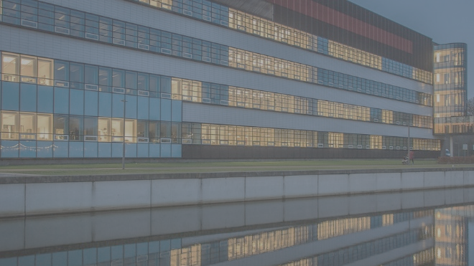
PROGRAMME WEBSITES
CEM
www.utwente.nl/cem
CME
www.utwente.nl/cme
|

Slide 7
pROGRAMME
Information (not course specific)
Main way of communication is CANVAS → Check the course organization everyday.
Enroll today via https://canvas.utwente.nl/enroll/G83NBW
Via website of CEM & CME
Via student email

Slide 8
organization
Counselling
Study Advisor (Monique): personal problems, “interface” to Examination Board
International Student Support Officers (Astrid & Elke)
Student Counselling Service (= Bureau Studentenbegeleiding)
Counsellors and psychologist
Financial issues, courses, therapy
https://www.utwente.nl/en/ces/sacc/
Also: parents, house mates, partner, friends, religious community
Phone: | +31 53 489 2035
Office: | Vrijhof 311
E-mail: | sacc@utwente.nl

Slide 9
Civil Engineering Management
Industrial Design Engineering
Mechanical Engineering
Construction Management and Engineering
Sustainable Energy Technology
“For students by students”
Study trips, excursions, lunch meetings with companies, social activities
UNIVERSITY
OF STUDY ASSOCIATIONS

Slide 10
COURSES
ORGANIZATION
COURSES
CULTURE
CONTACT
|

Slide 11
Courses
What
Decide which profile, specializations and/or courses you want to take
Discuss your choices with the track coordinator (MSc)
Make sure your programme is approved. You are responsible for the approval of your programme. If anything changes during the year, always consult with the track coordinator.
SA&L will approach you for registering your exam-programme in Osiris.

Slide 12
Courses
Educational systems
OSIRIS Course catalogue
OSIRIS Student: course, exam and grade registration
Canvas: electronic learning environment → automatic enrollment if enrolled in Osiris
Mobility online: registration of outgoing exchange and graduation
Resource Booker
Elaborate info via https://www.utwente.nl/en/educational-systems/new_students/

Slide 13
Courses
Registration
Registration for courses via OSIRIS Student ASAP
Registration for Canvas and exams, 1st attempt automatically, when you are registered in OSIRIS
Account or other ICT-problems? See www.utwente.nl/lisa/newstudents
Connection to internet (eduroam and VPN)
Printer facilities

Slide 14
Courses
Ec’s, quartiles and tests
1 EC = 28h (includes ALL)
15 EC per quartile (minimum and maximum)
1 quartile is 10 weeks, 4 quartiles per academic year; 8 quartiles during your entire programme
Automatic enrollment for test
Manual enrollment for resit

Slide 15
Courses
BOOKS and readers
Check course materials via Canvas site
Books
Study Association ConcepT (Horst basement)
www.amazon.com or www.bol.com
Readers: Union Shop (Bastille)

Slide 16
Courses
When
Time schedule
Evening classes are possible, but not common.
Breaks are 15 minutes.
Hours | Time
1 + 2 | 09.00 – 10.45
3 + 4 | 11.00 – 12.45
6 + 7 | 13.45 – 15.30
8 + 9 | 15.45 – 17.30

Slide 17
Courses
When
Schedule / timetable
Utwente.nl/timetable https://www.utwente.nl/en/educational-systems/new-students/#my-timetable
Also add the extra curricular activities: ET M 1A+1B+2A+2B

Slide 18
Courses
Exams & Grades
Grades are officially published in OSIRIS, results on Canvas are preliminary, no rights to be derived from those!
1 – 10 (very poor – excellent)
Average is just under 7
≥ 5.50 and < 6.00 → passing grade
In case of a resit: the highest obtained grade is the valid grade, registration for resits is obligatory (ultimately 2 weeks before scheduled date)
It is not (very) common to retake exams for which you scored a passing grade the first time
|

Slide 19
Courses
Student affairs & logistics (SA&L)
Organization/administration of grades and (all) educational activities
Drop in for questions regarding your programme (e.g. registration of programme in Osiris, graduation procedure) Due to COVID please ask your questions by phone or e-mail, contactinfo is to be be found later in this presentation.
|

Slide 20
CULTURE
ORGANIZATION
COURSES
CULTURE
CONTACT
|

Slide 21
CULTURE
Questions / Complaints
Lecturer / Teacher
Programme Coordinator
Programme Director
Study Association
Educational Commitee (Opleidingscommissie (OLC)) → programme and course content
Examination Board (Examencommissie) → exams & exemptions on the programme

Slide 22
CULTURE
Rules & Regulations
Student Charter and Education and Examination Rules: see programme website
Important points:
Pass / fail regulations
Fraud / plagiarism (especially in relation to assignments)
Cum laude

Slide 23
CULTURE
Rules & Regulations
Residence Permit & Study Progress (MoMi): non EU-students should pass at least 50% of the credits every academic year
Premaster students should finish their programme within 1 year
For more info on UT-wide rules and regulations see https://www.utwente.nl/en/ces/sacc/regulations/

Slide 24
CONTACT
ORGANIZATION
COURSES
CULTURE
CONTACT
|

Slide 25
Contact
CIVIl engineering
 | Name | Office | E-mail
Pre-master coordinator | Joyce Kemna | BH119 | premastercoordinator-et@utwente.nl
Programme coordinator | Michelle Hamhuis | BH115 | coordinator-ce@utwente.nl
Study Advisor | Monique Duyvestijn | BH111 | m.j.b.duyvestijn@utwente.nl
Due to COVID: mostly working from the home office

Slide 26
Contact
Faculty
Function | Name | Office | E-mail
Faculty Coordinator International Affairs | Marijke Stehouwer | BH220 | m.a.stehouwer@utwente.nl
International Support Officers | Astrid Oppers & Elke Vinke-Dinius | BH113 | a.j.vandenberg@utwente.nl e.dinius@utwente.nl
Exchange Coordinator | Dorien van de Belt | W103 | d.vandebelt@utwente.nl

Slide 27
Contact
Outside study programme
Student Services
Admission & enrollment (registration)
Visa & housing
https://www.utwente.nl/en/education/student-services/
Phone: | +31 53 489 2124
Office: | Vrijhof 239B
E-mail: | studentservices@utwente.nl

Slide 28
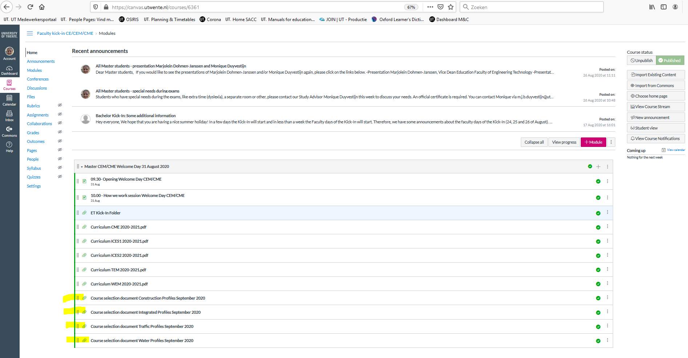
Course selection
!! Note: in case of warning: ‘this course module is not included in the fixed part of your exam programme’ → ignore warning and continue course-enrollment
Room 1: general questions
Room 2: WEM – Denie Augustijn
Room 3: ICES – Jord Warmink
Room 4: TEM – Eric van Berkum
Room 5: CME – Hans Boes

