Slide 1
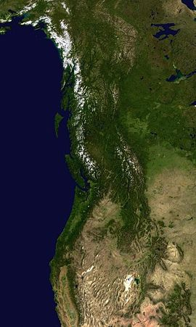



On trees and people: from climate science to climate transition
Valerie Trouet
University of Twente
Climate Event 2024

Slide 2
Why study climate history?

Slide 3
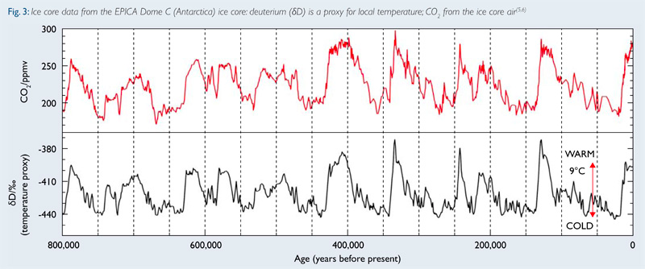
British Antarctic Survey

Slide 4
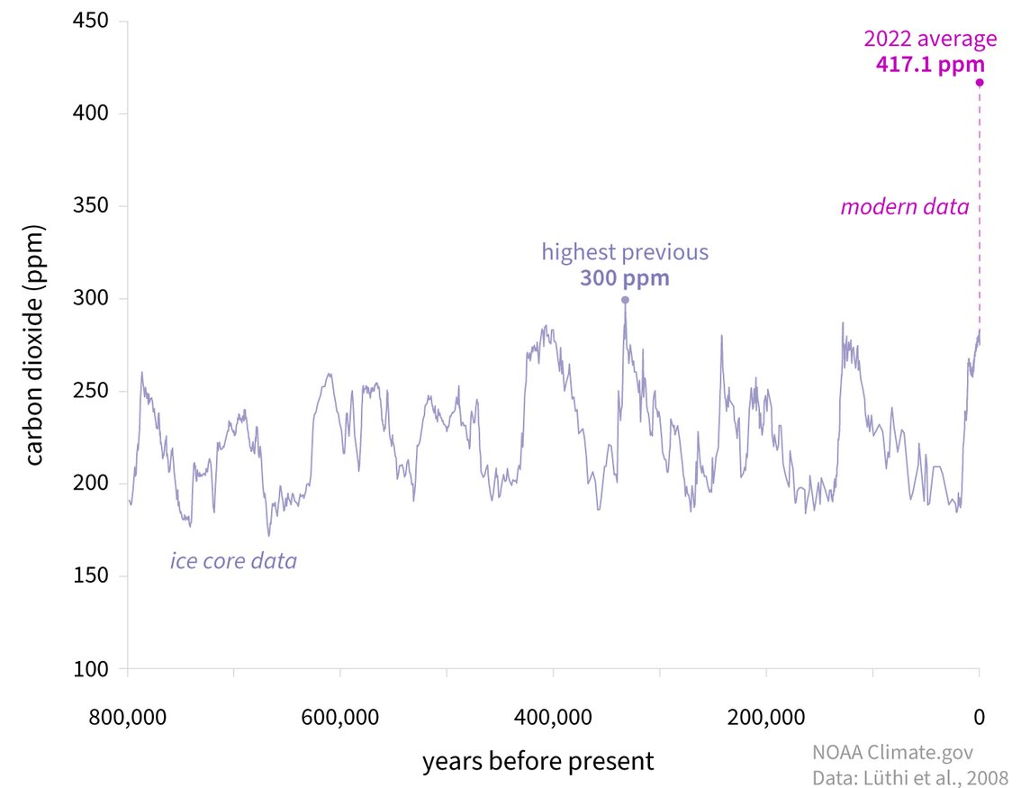
Today: 423 ppm
Notes:
Conversation Nerilie Abram

Slide 5
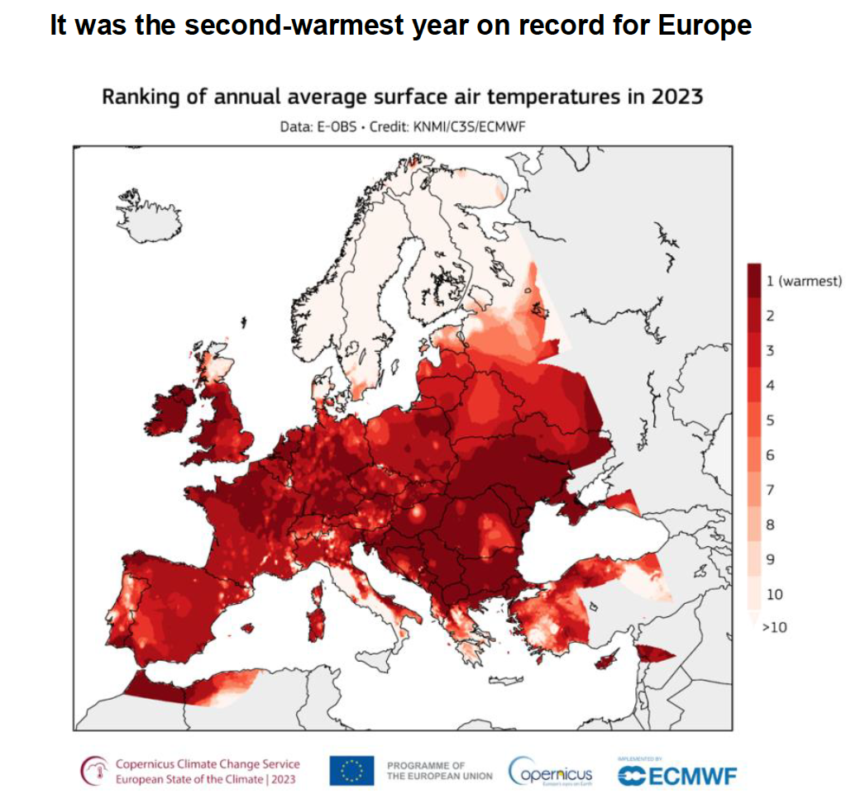

Slide 6
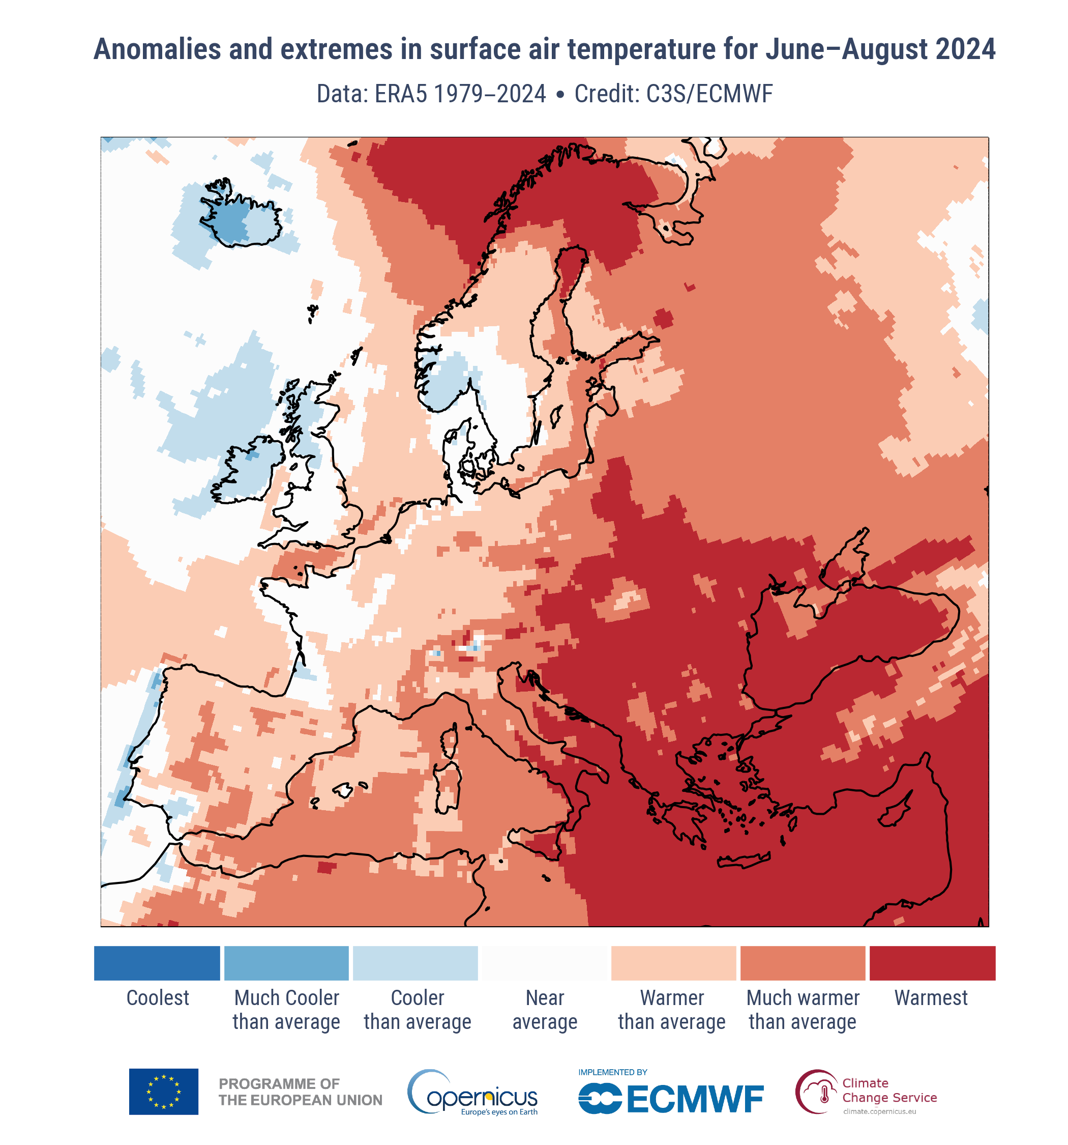
Summer 2024: hottest on record globally and in Europe

Slide 7


Slide 8
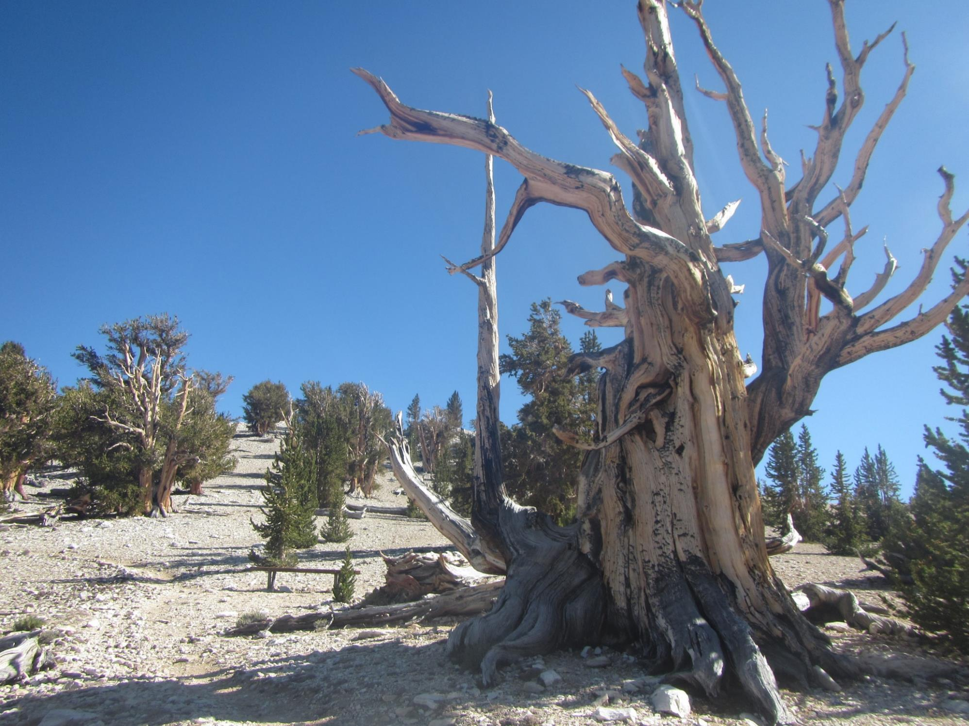
Oldest living tree
bristlecone pine
5062 years old (in 2012)
Photo: T De Mil

Slide 9
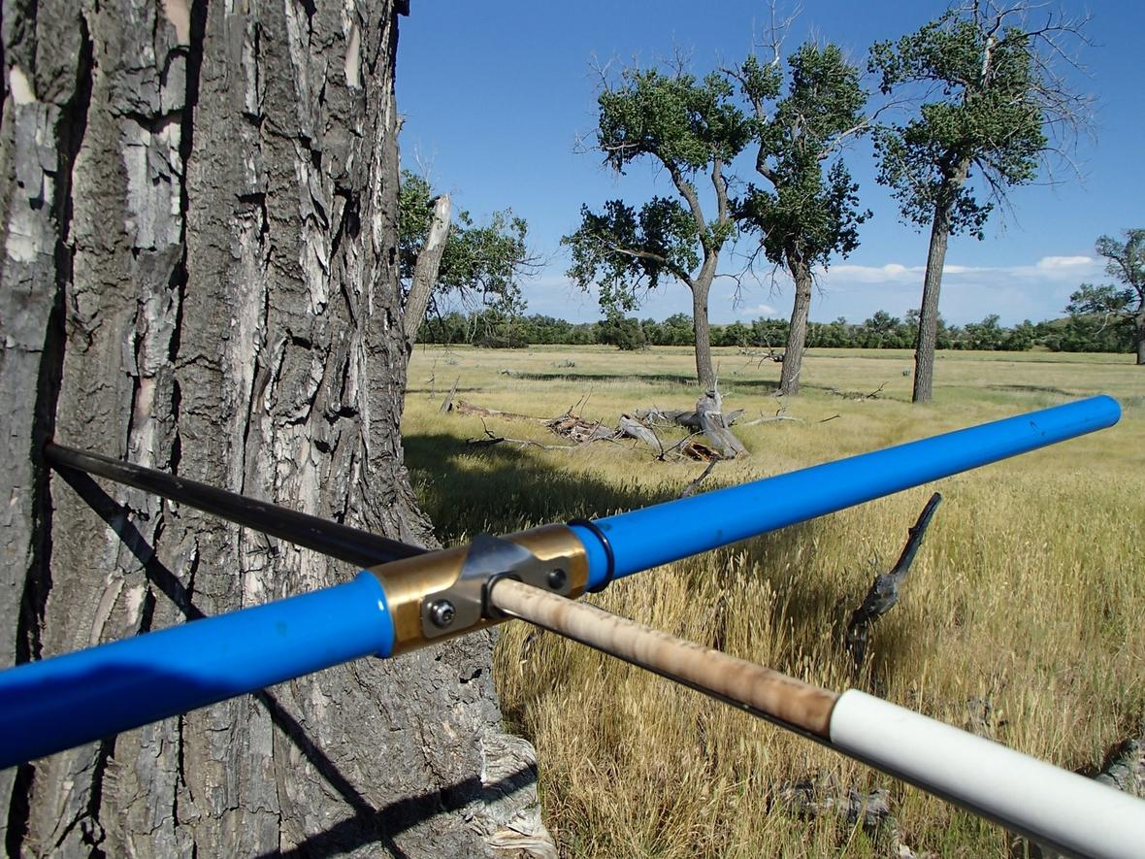
Photo: D Schook

Slide 10
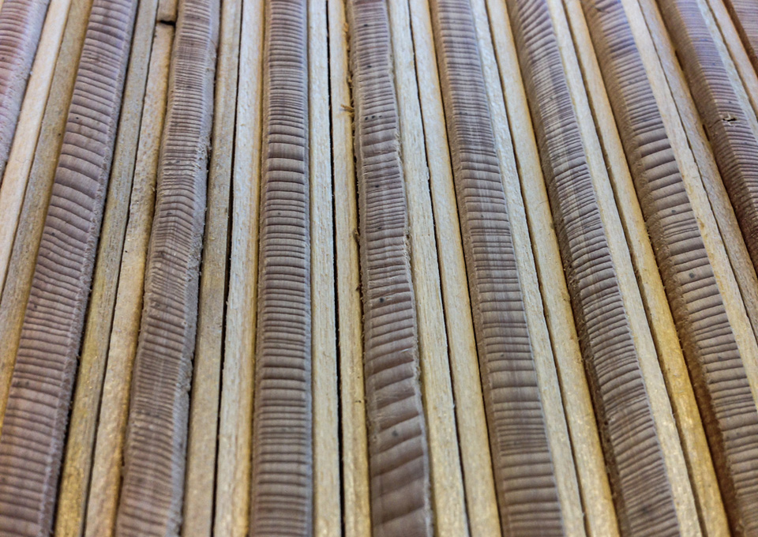
Photo: N Davi

Slide 11
Longest continuous tree-ring chronology: 12.650 years

Slide 12
Human history

Slide 13
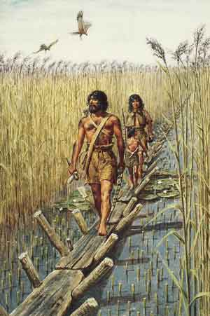
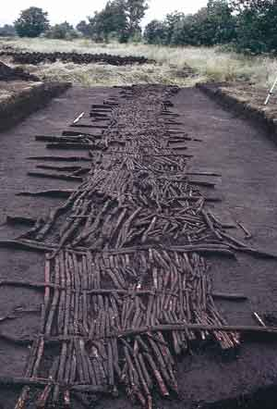
Sweet track in Somerset: 3807-3806 BCE
Notes:
13

Slide 14
California’s snowpack

Slide 15
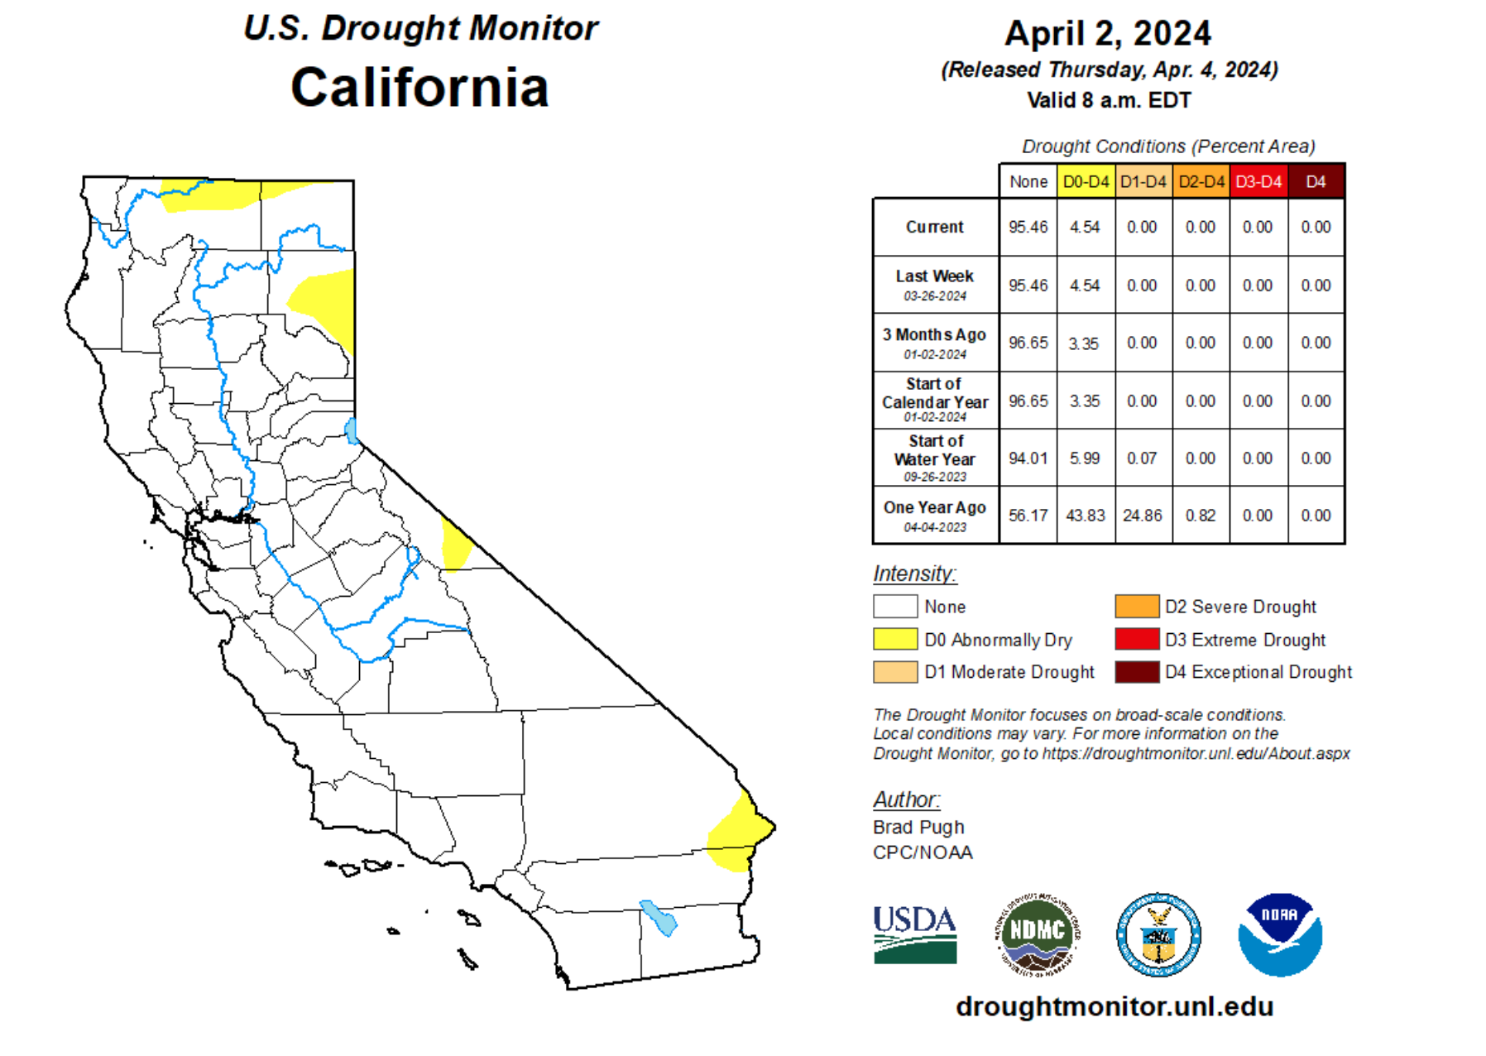

Slide 17
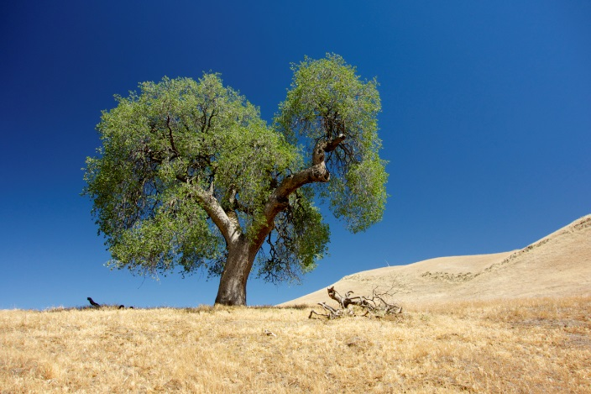
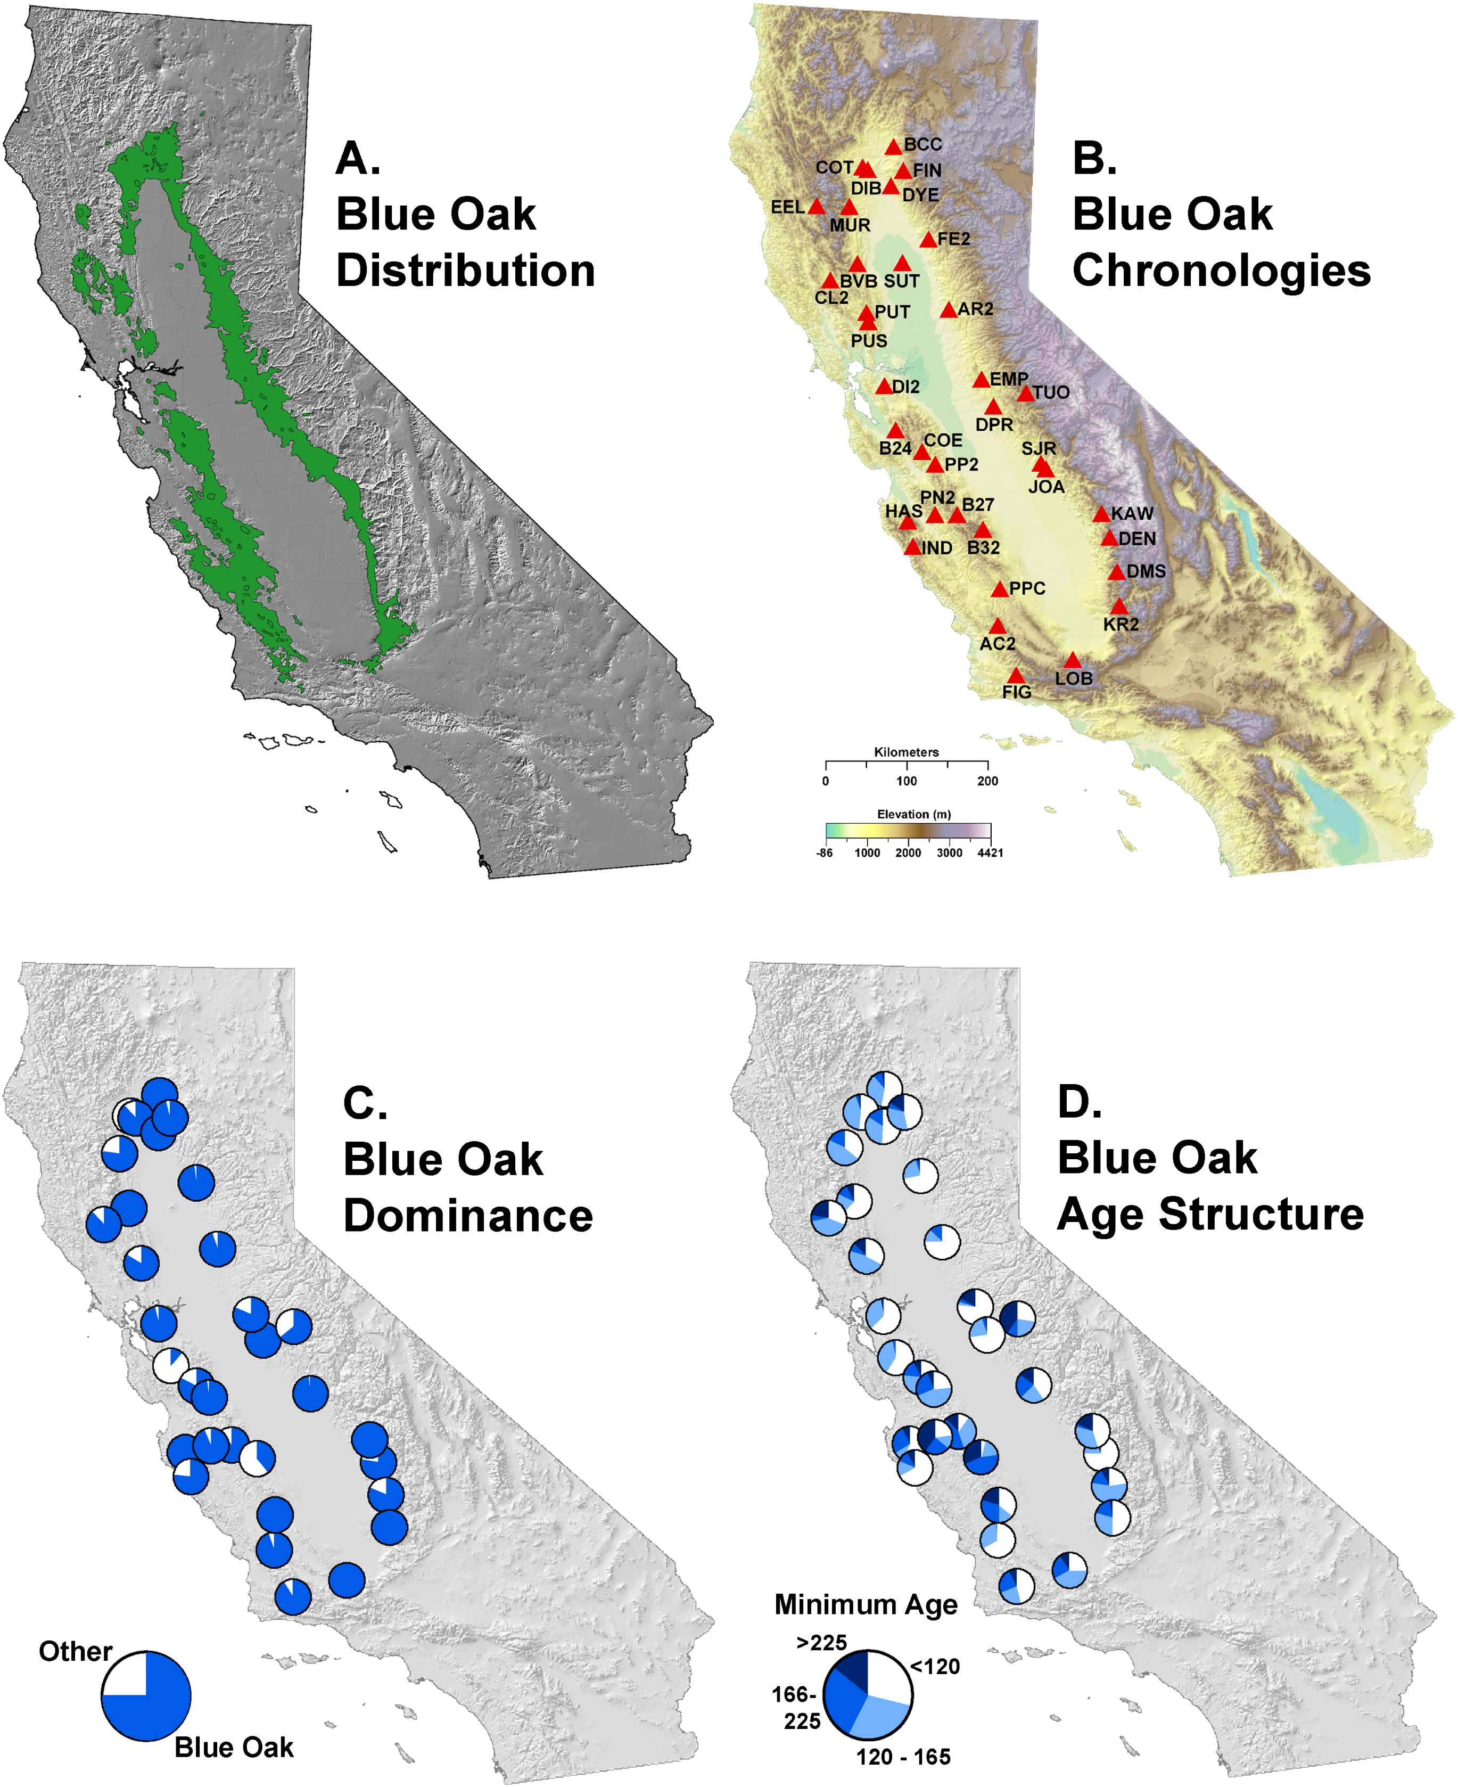
Multi-century April 1 SWE
Photo: K.J. Anchukaitis
Stahle et al. (2013) Earth Interactions
Notes:
We wanted to investigate this metric in the long term context, put 2015 ibto long-term context. We used 2 predictors: BO and Temp to develop a SWE recon…

Slide 18
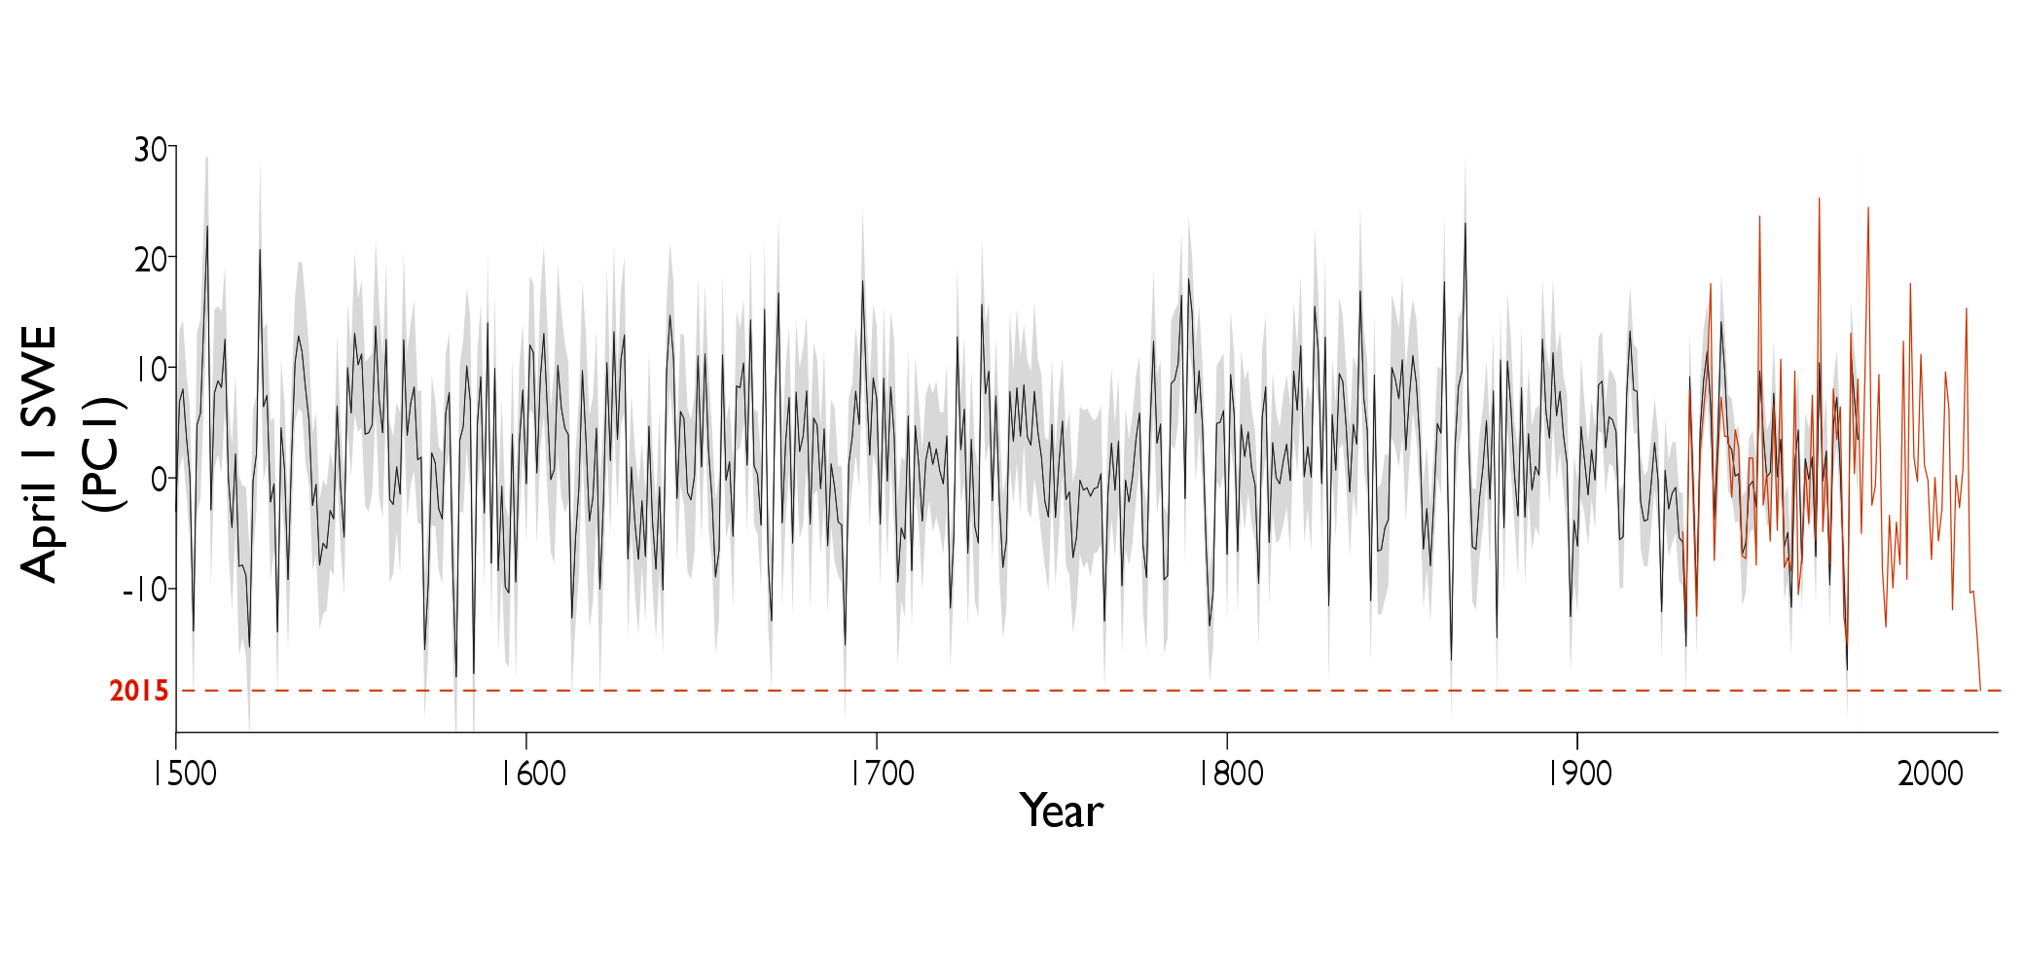

Multi-century April 1 SWE : Reconstruction
2015 Sierra Nevada snowpack was
500-year record low
Belmecheri et al (2016) Nature Climate Change
Notes:
Fig of reconstruction, explain the fig and summarize uncertainties. 2015 is lowest although few years in 16 century are as low-lower than 2015

Slide 19
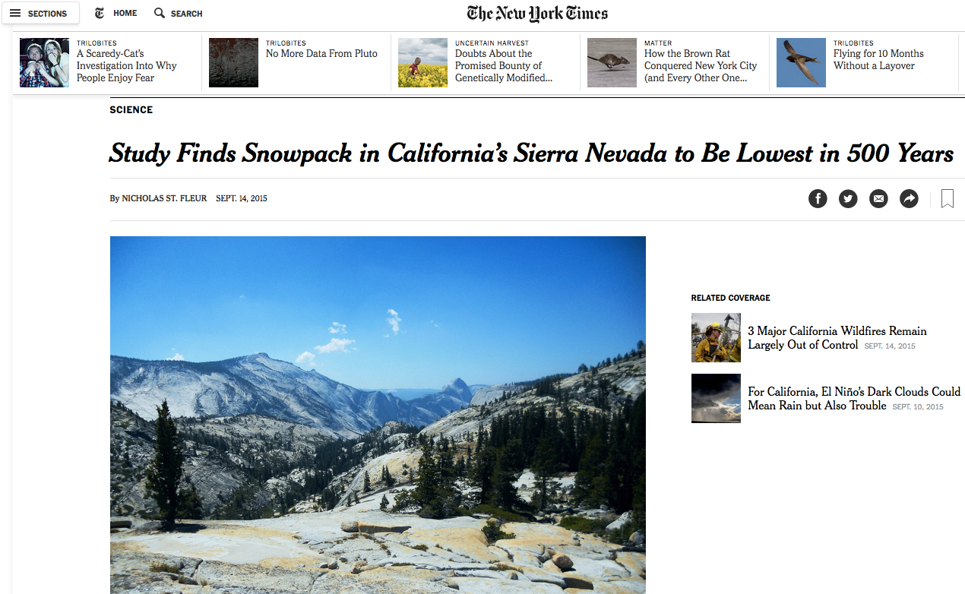
Notes:
Our results got picked up very broadly by the media and I’m showing you this headline from the New York Times last year. I want to point your attention to this sideline that appeared on the same day as our article and that talks about simultaneous major CA wildfires. Lack of snow not only impacts CA’s society, but also its ecosystems.

Slide 20
How can we optimize our tree-ring research to address the most pressing climate change issues?
Notes:
Anthropogenic forcing: particularly those that affect the troposphere.
Frequent swings of opposite extremes from one year to the next.
Greenhouse warming leads to a significant increase in the frequency of extreme La Niña events
Volcanic eruptions→ lowering temperatures in the troposphere
Both ENSO-like variability and external forcings play important roles in the year-to-year and long-term changes in tropical width.
Internal climate variability is an important driver of tropical belt variations

Slide 21
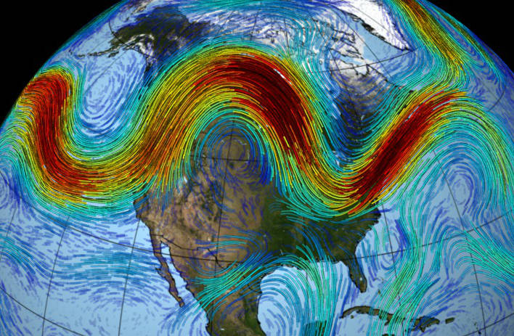
Tree-ring based reconstruction of the
North Atlantic jet stream

Slide 22
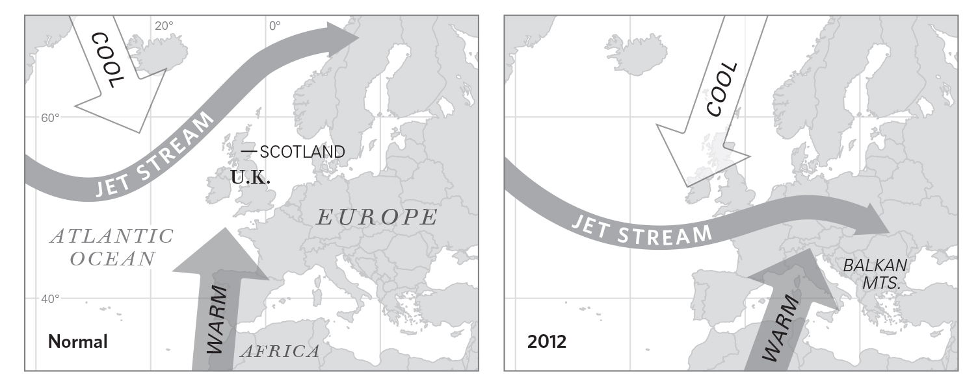
Summer North Atlantic Jet (NAJ)
reconstruction

Slide 23
Summer 2024

Slide 24
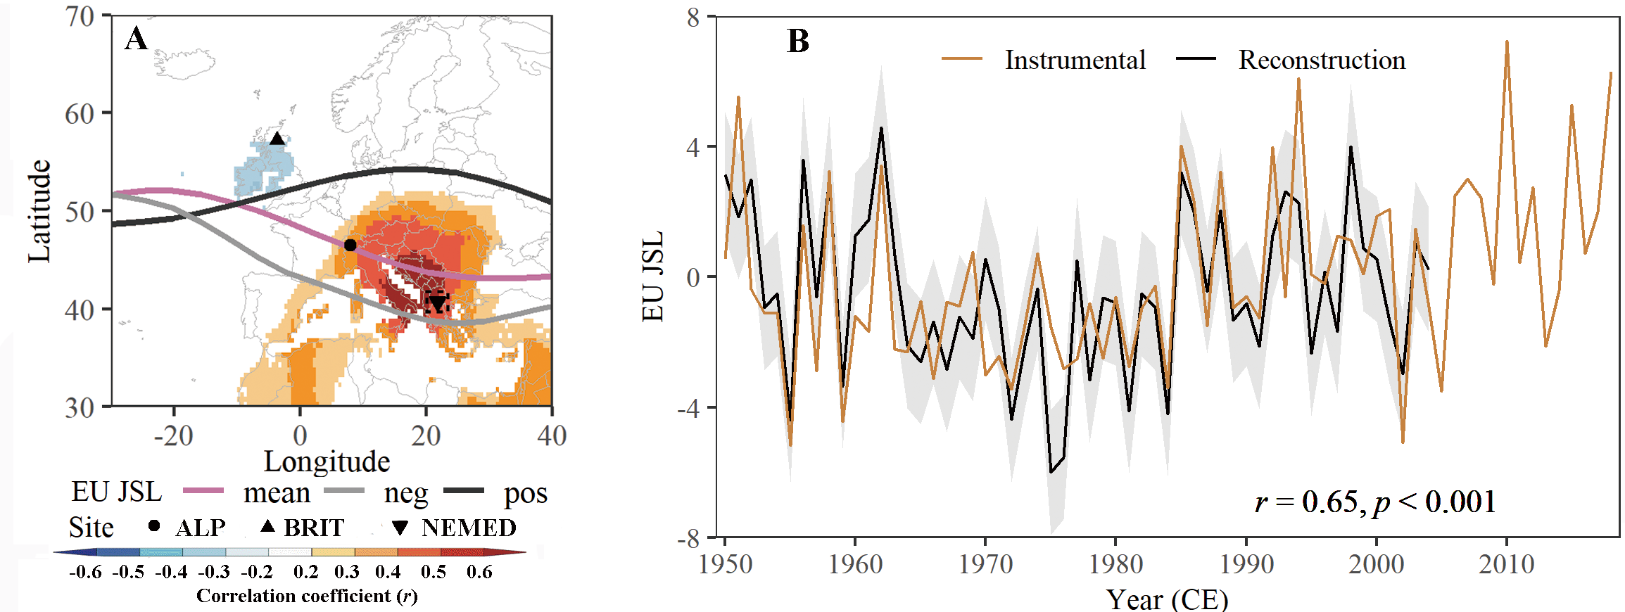
Can we use tree rings to reconstruct summer jet stream variability over Europe?
Xu et al (in prep.)

Slide 25
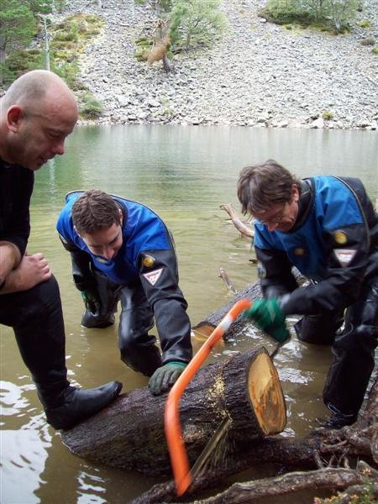
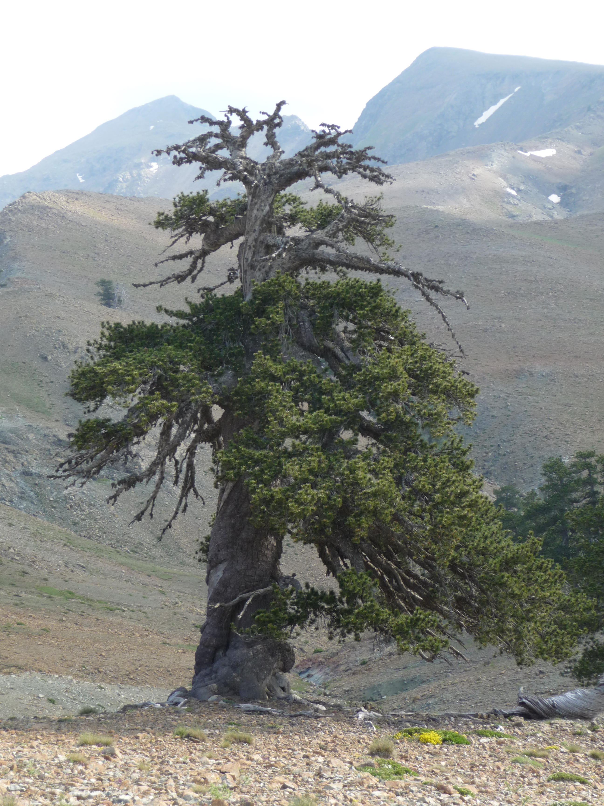

Slide 26
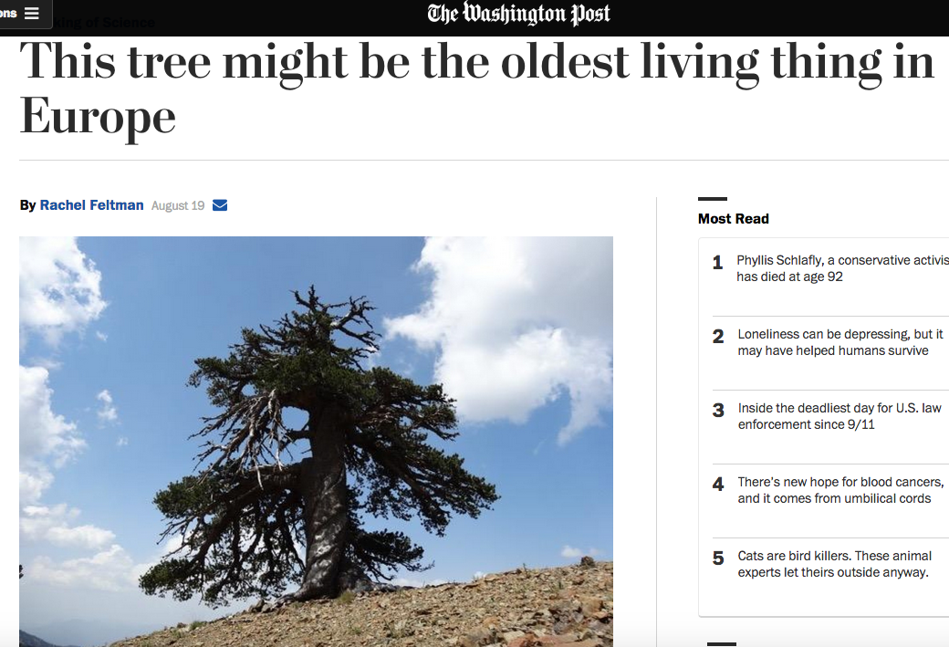

Slide 27
Combined, tree-ring records represent summer JS latitude (42% variance explained)
Trouet et al. (2018) Nature Comms.; Xu et al. (in press) Nature
Notes:
R2=0.39; r=0.63

Slide 28
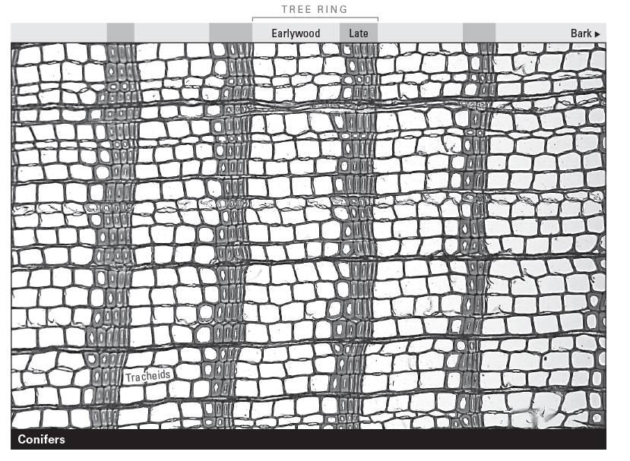

Slide 30
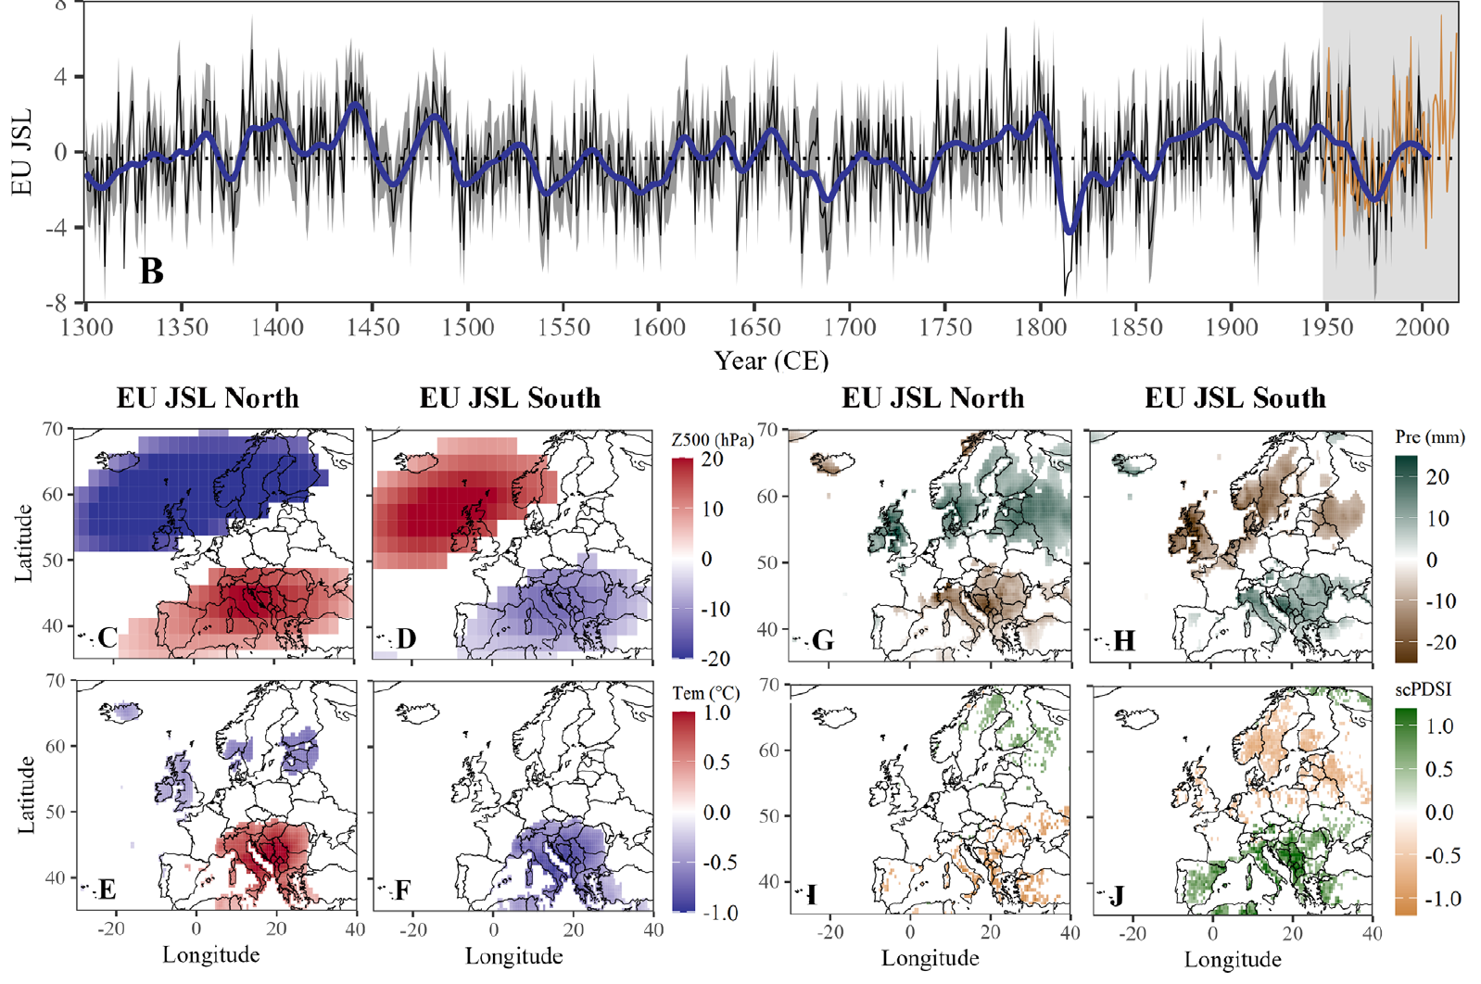
Xu et al (submitted)

Slide 31
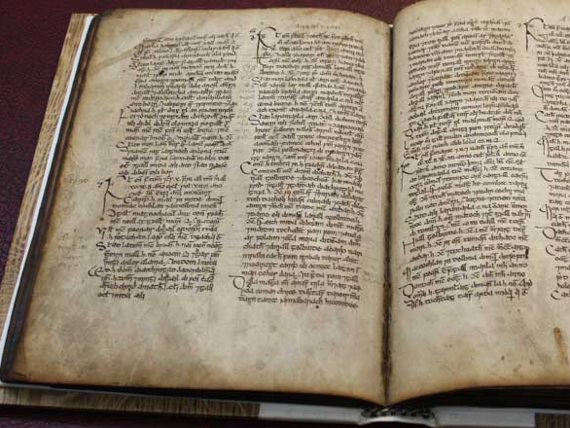

Slide 32
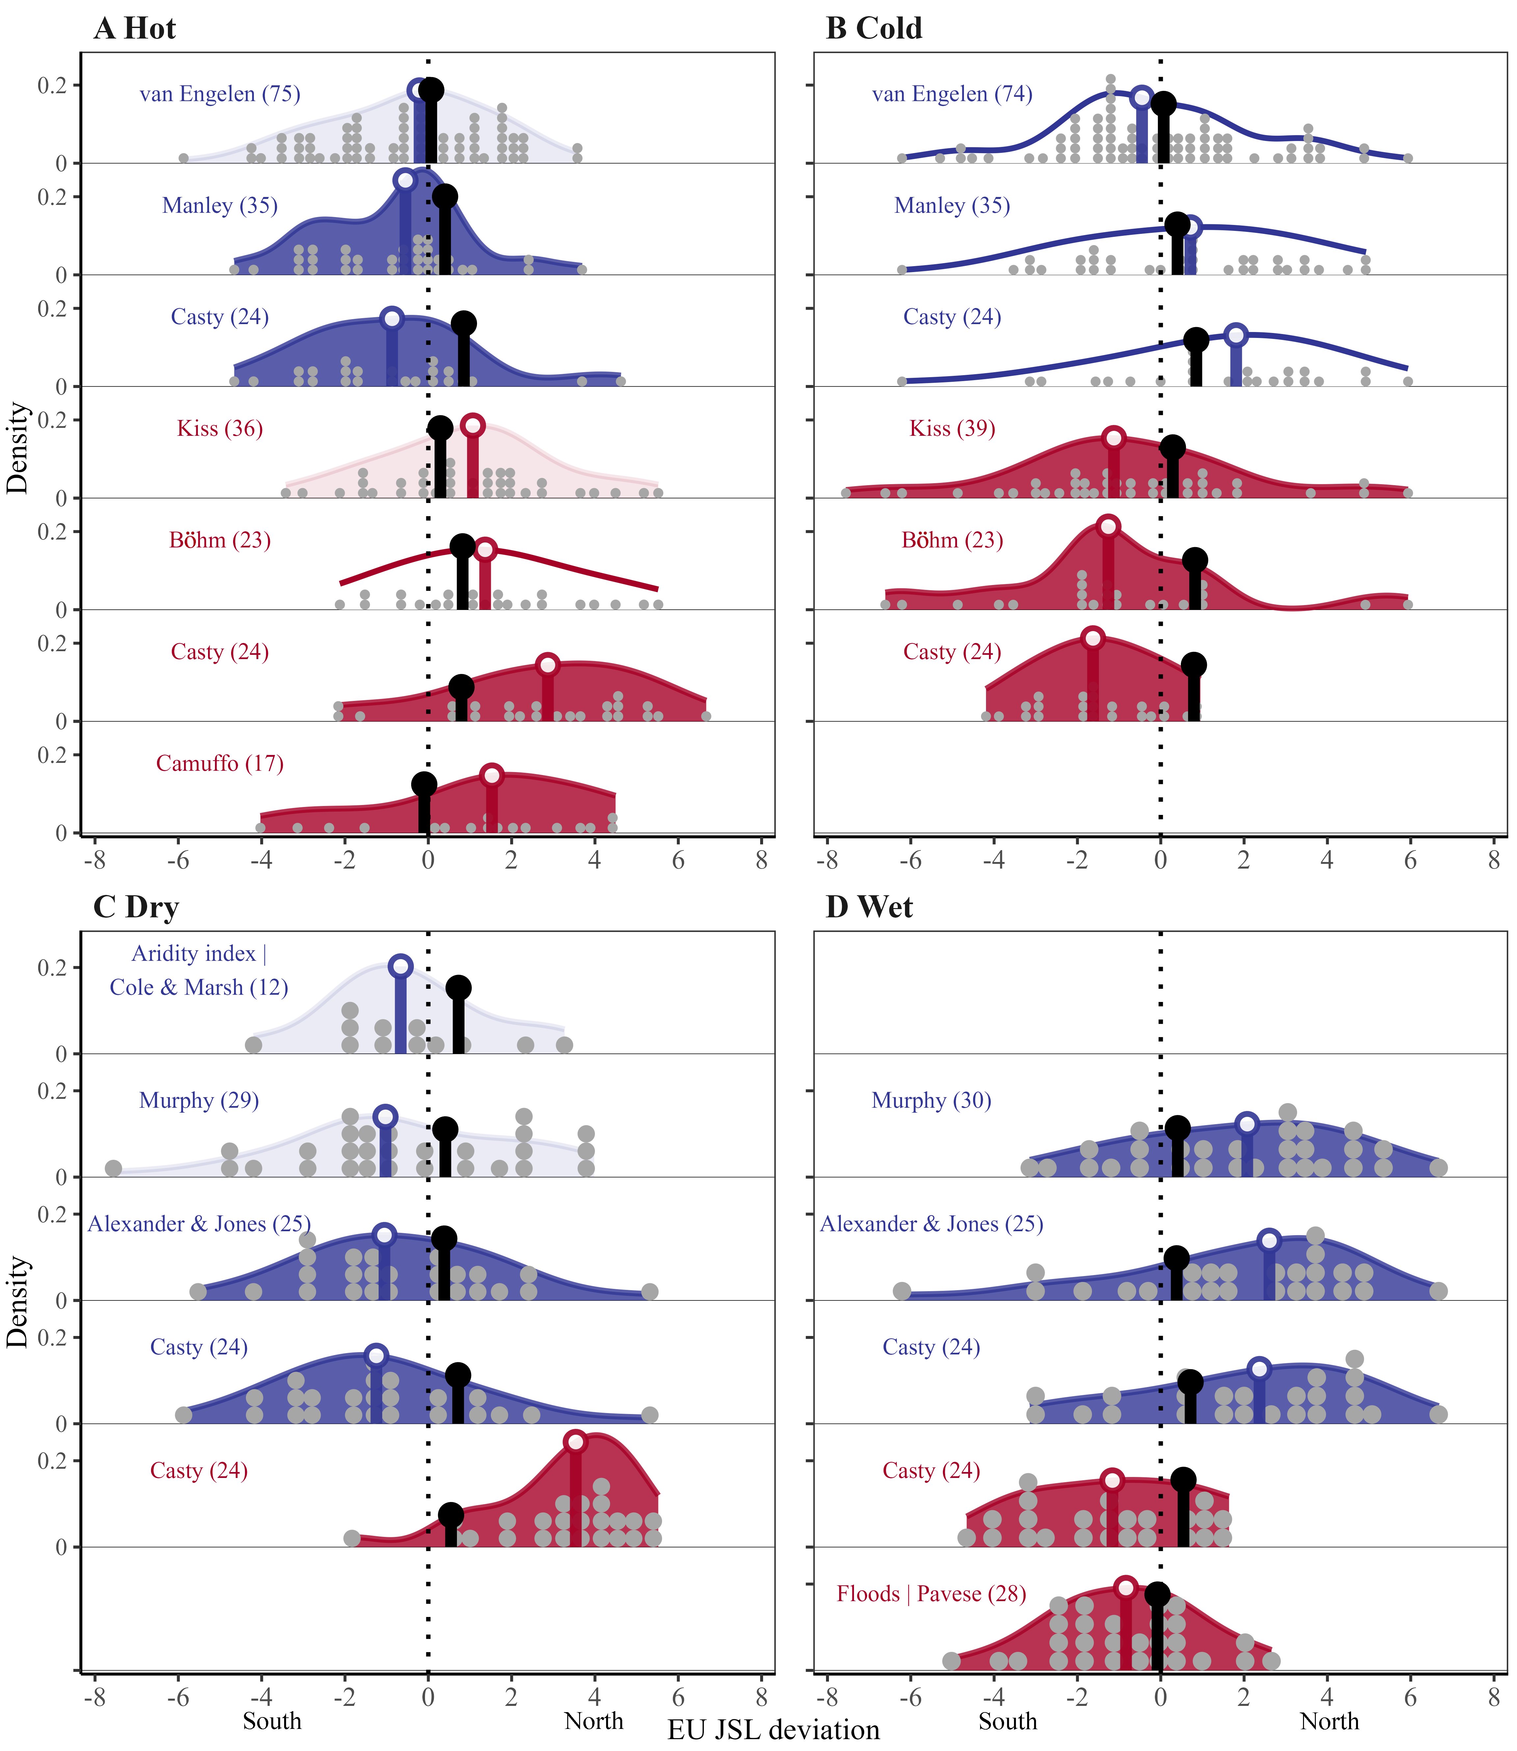
British Isles
Hot & dry
Cold & wet
Balkans & Italy
Temperature extremes
Rainfall extremes
S
N
S
N
Xu et al (2024) Nature

Slide 33
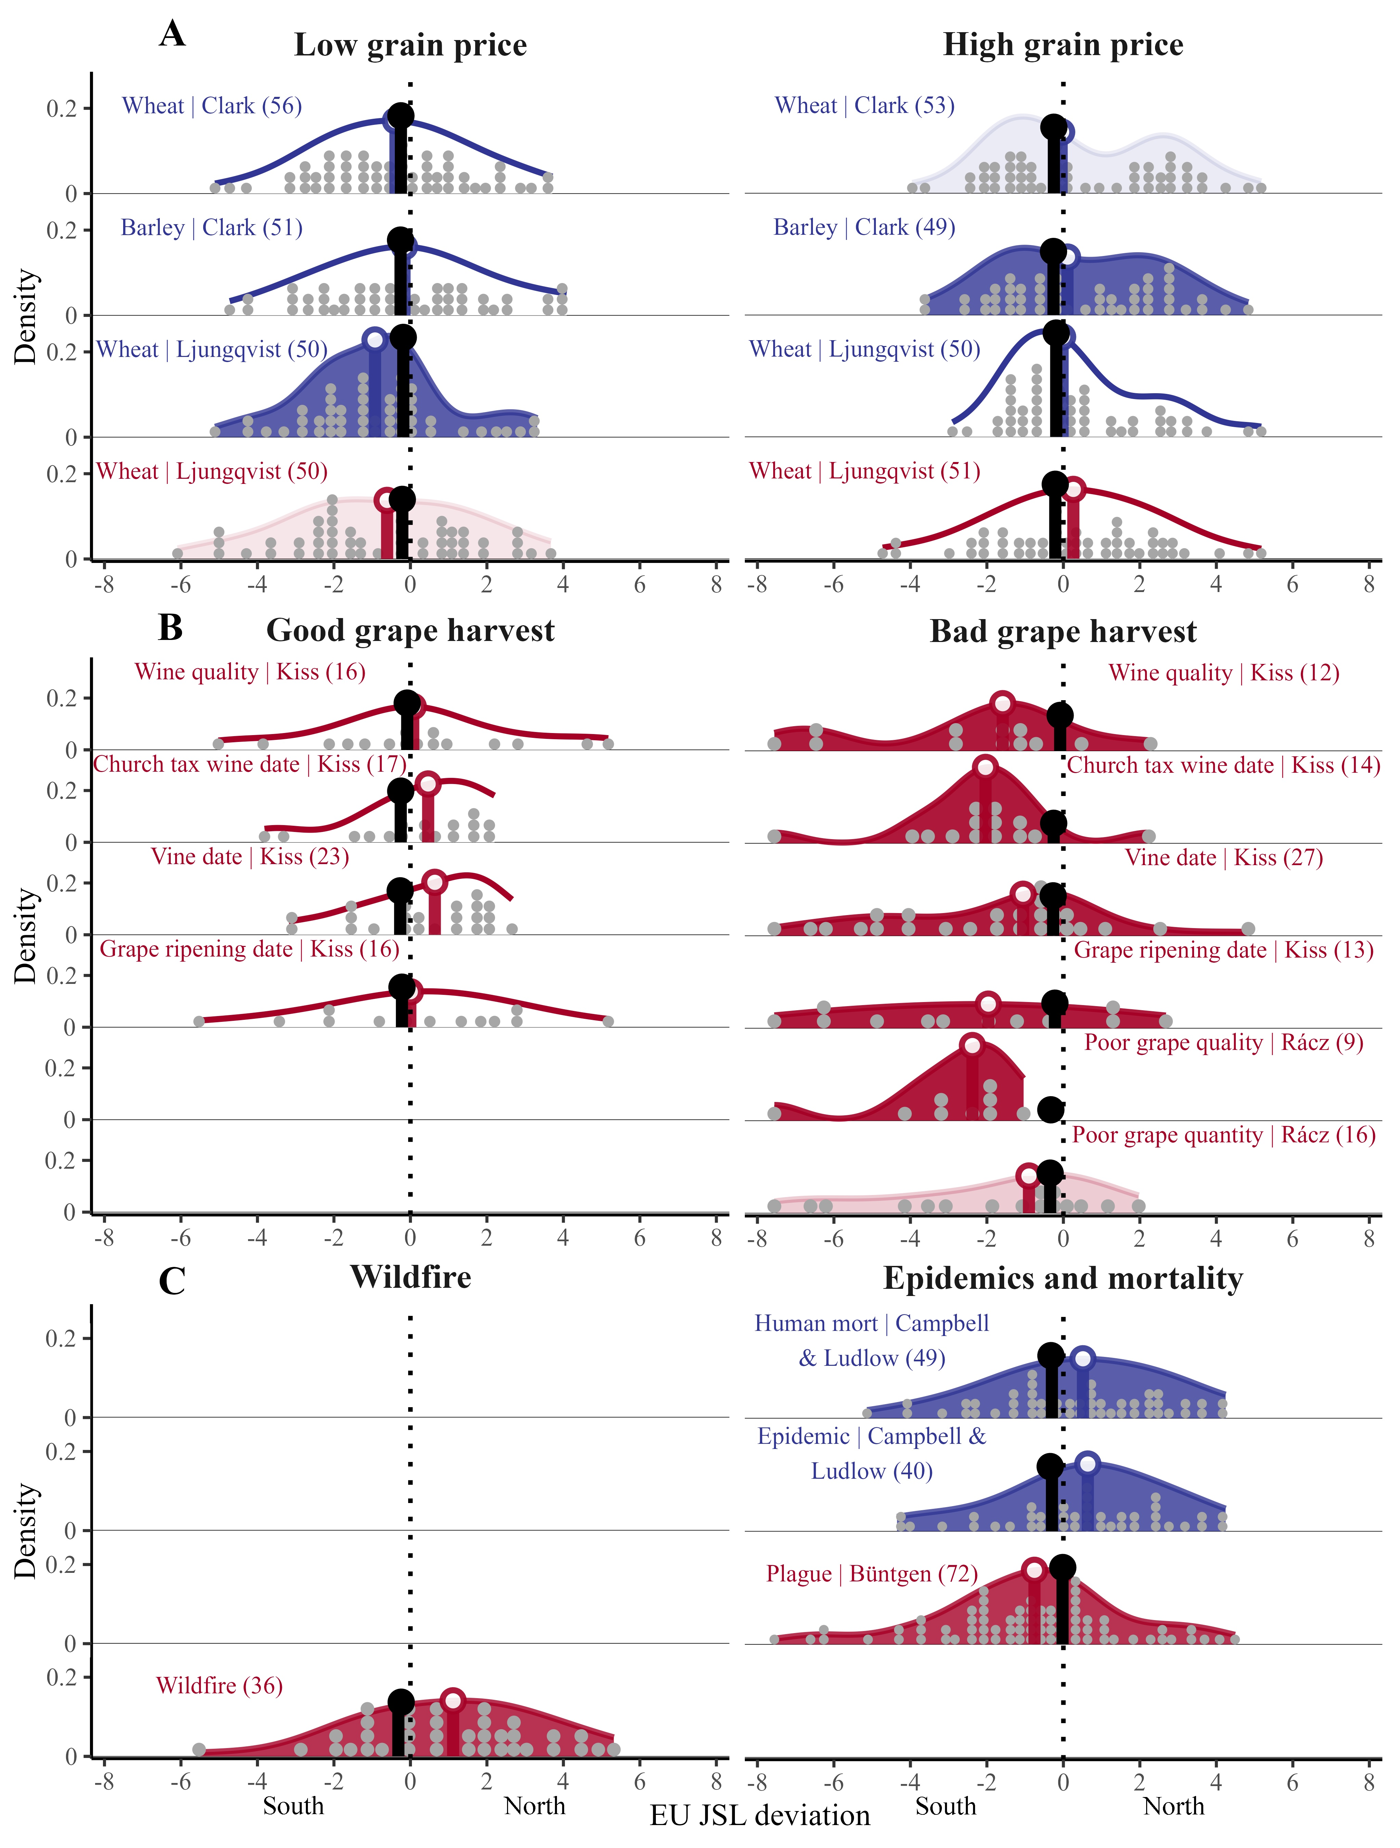
British Isles
Hot & dry
Cold & wet
Balkans & Italy
grain prizes
Grape harvest
Wildfires (L)
Epidemics (R)
S
N
S
N
Xu et al (2024) Nature

Slide 34
The Fall of Rome

Slide 35
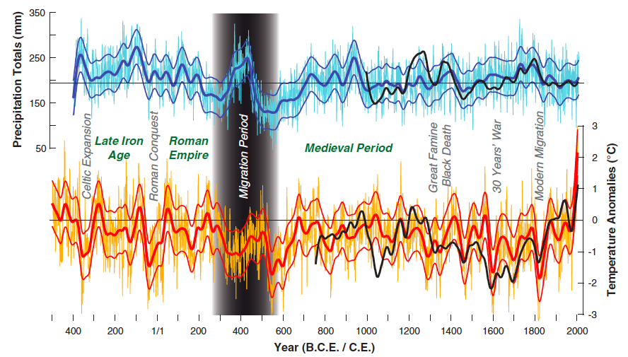
Büntgen et al. (2011) Science

Slide 36
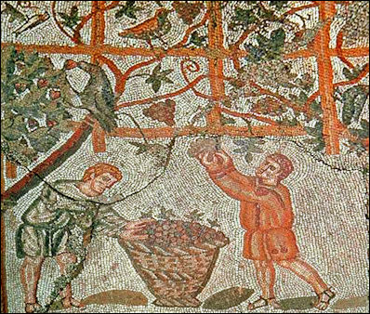

Slide 37
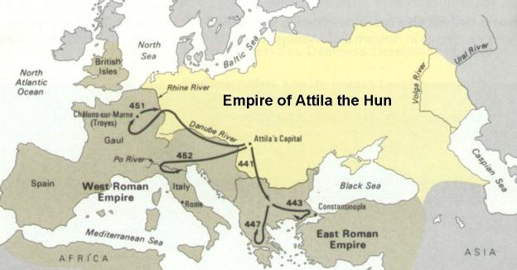
Barbarian invasions

Slide 38


Slide 39
disadvantages

Slide 40
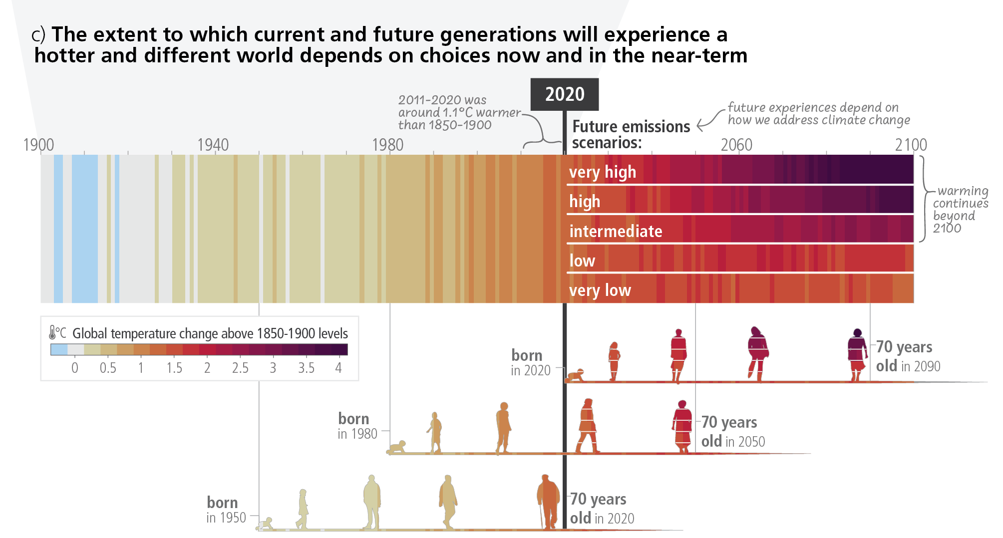
IPCC AR6 Syntheserapport (2023)

Slide 41
advantages

Slide 42
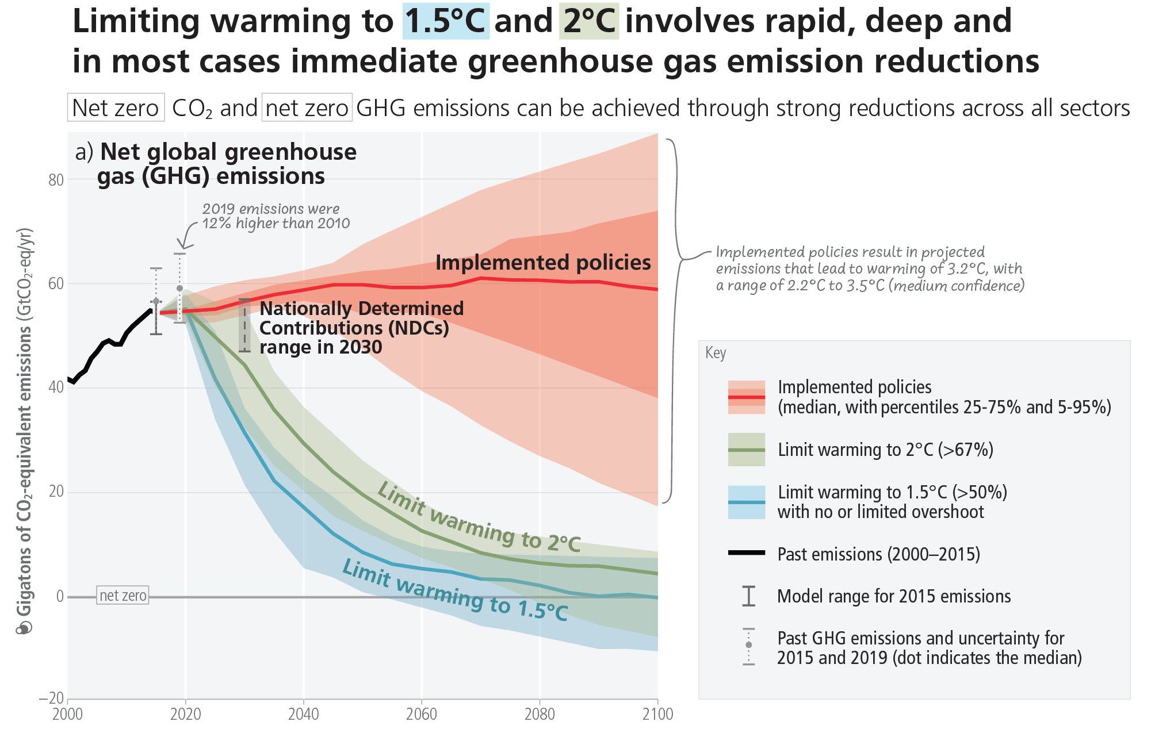
IPCC AR6 Syntheserapport (2023)

Slide 43
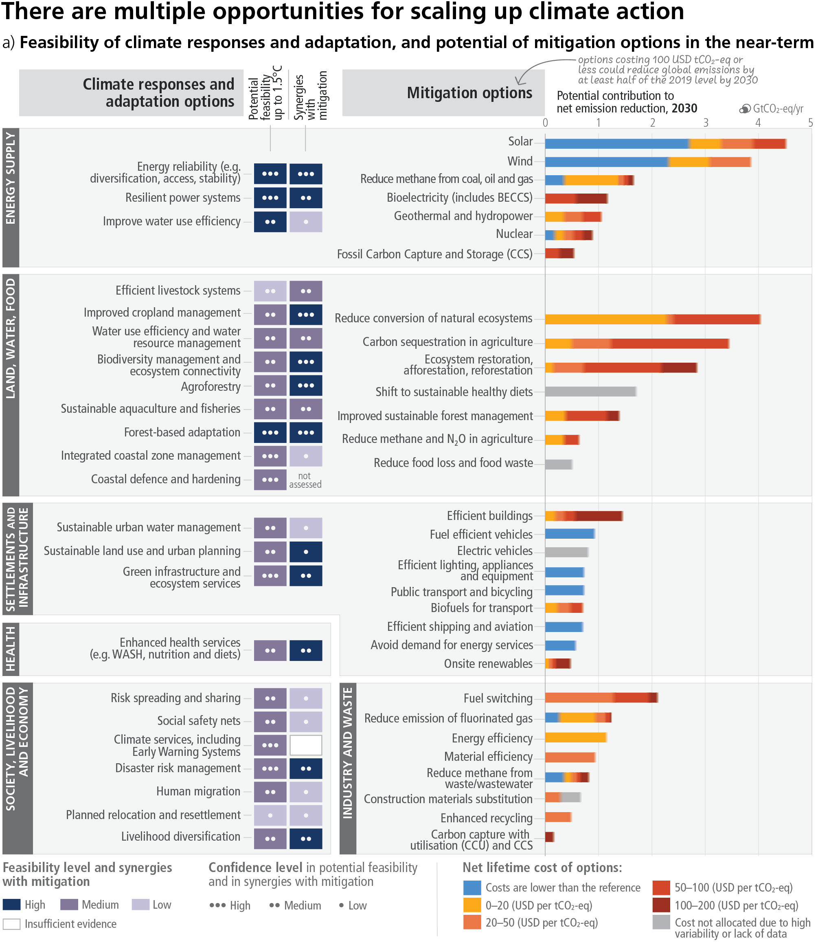

Slide 44
resilience

Slide 45
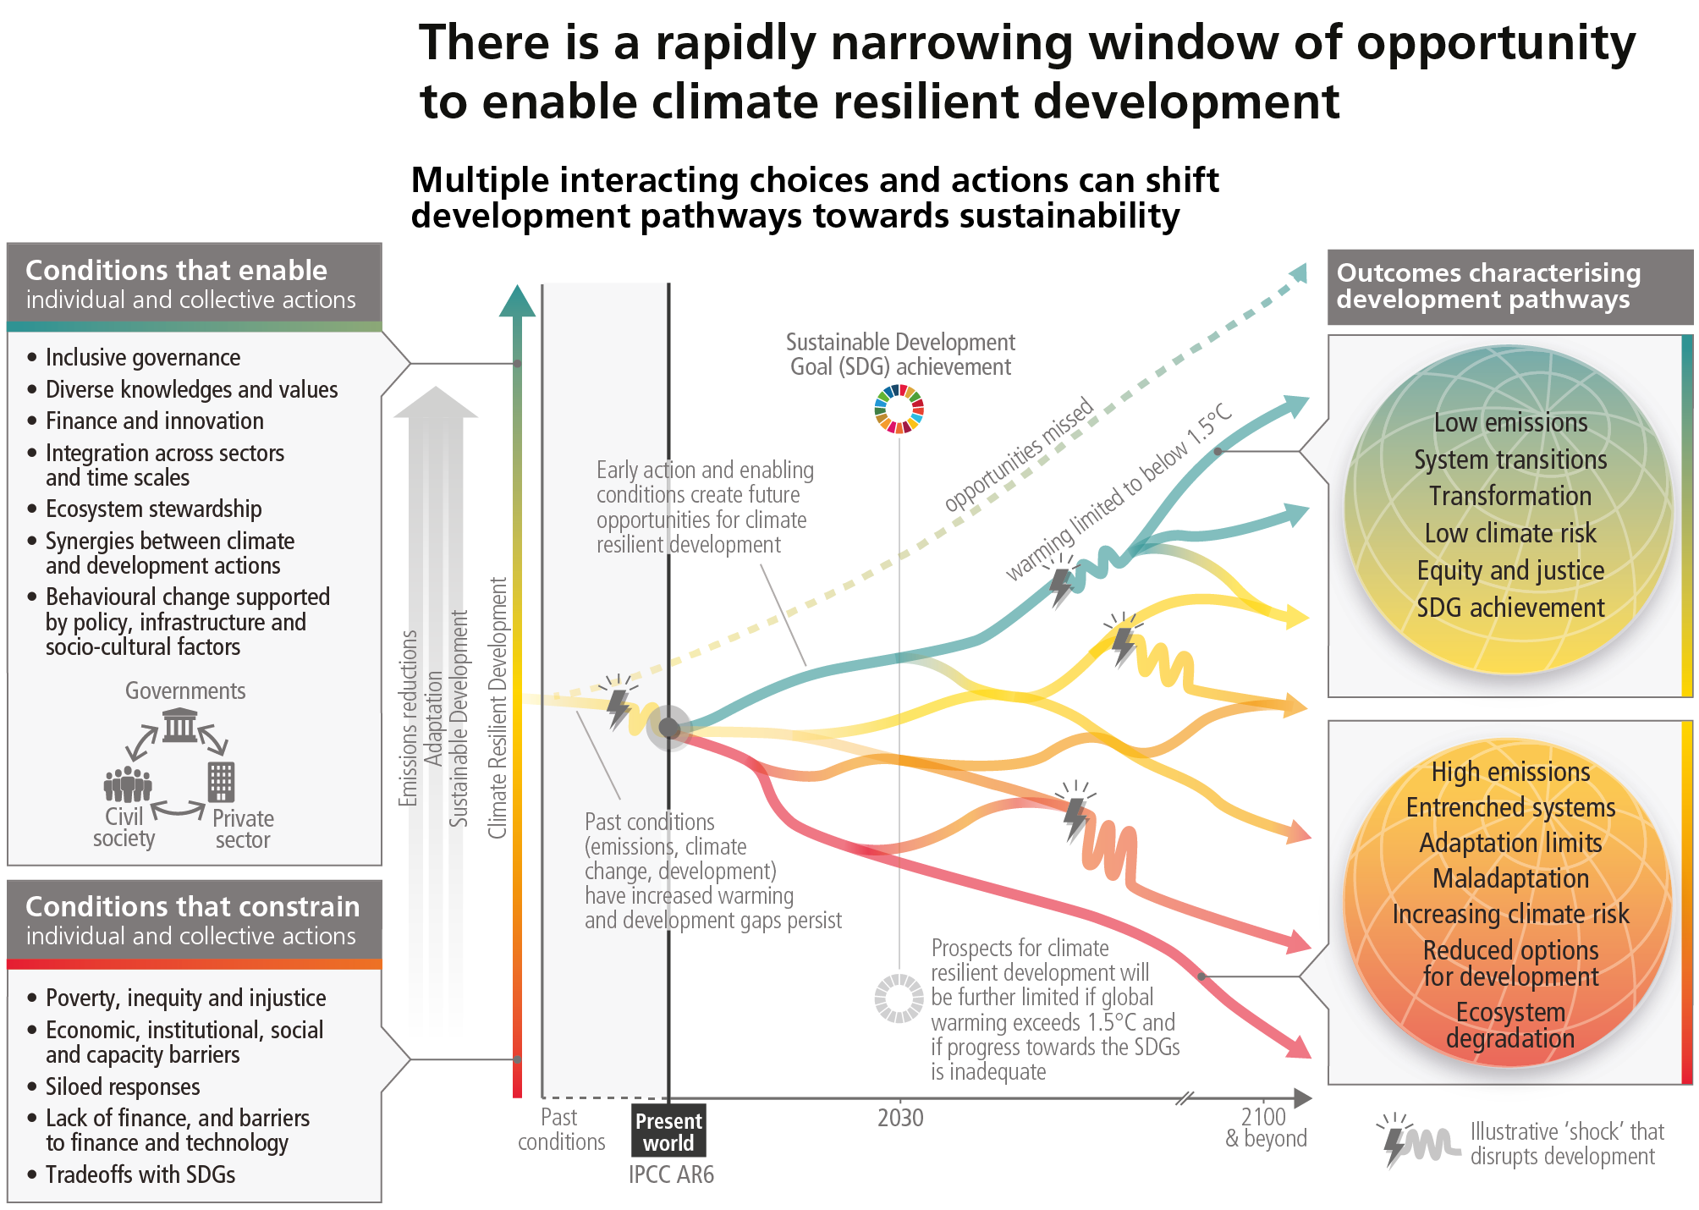

Slide 46



Slide 47




Our mission
To maximize the impact of climate science on
climate mitigation and adaptation in Belgium
Info-cc@climatecentre.be

