Slide 1
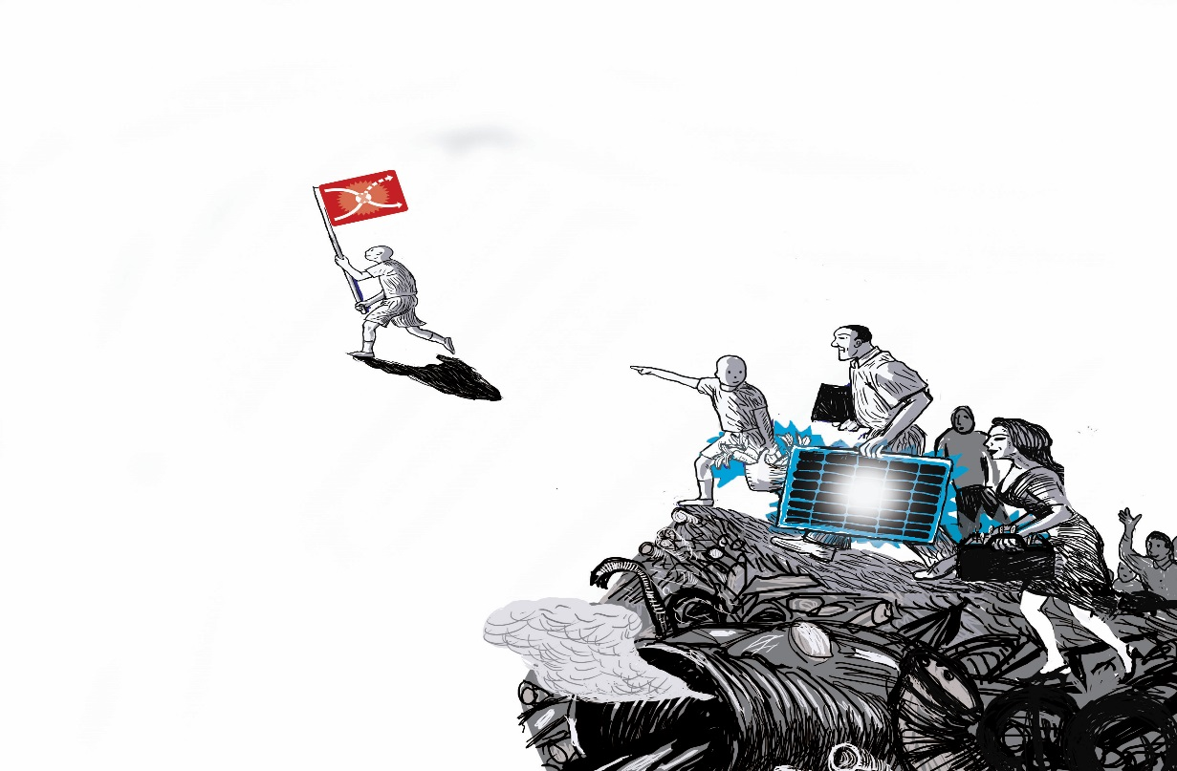
Towards transformative research environments
Prof. dr. Derk Loorbach
Twente, 05-11-2024

Slide 2
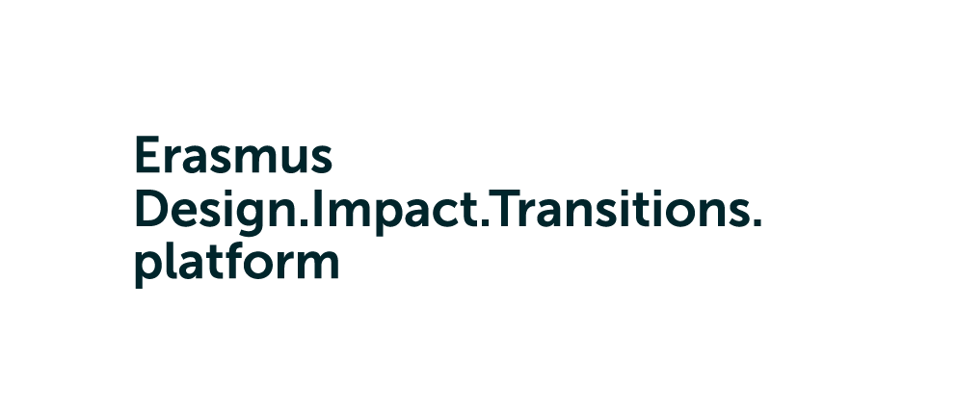

Dutch Research Institute For Transitions
Design Impact Transition platform
Dutch Climate Research Initiative
Academic research, consulting, education, activism
Social enterprise
40 employees
Founded in 2004
Transdisciplinary research, education and engagement
Strategic university platform
Core team and academics with impact assignments
2020-2024
Mission-driven, transdisciplinary research
Strategic NWO transition program
Core team and academic leads
Founded in 2023
mission
Accelerate and guide just sustainability transitions by developing knowledge in and with practice
mission
Establish an institutional space for transformative academic work at EUR
mission
Mobilise knowledge (development) in support of climate related transitions
Notes:
Wij doen actieonderzoek. Vandaag wil ik u meenemen in de manier waarop we in en met de stad onderzoek doen. Eigenlijk wil ik u allen onderdeel maken van het grote onderzoeksexperiment dat transities zijn. Ik neem u mee in het denken over transities in Rotterdam, welke vragen dat oproept, welke ideeën voor oplossingen er zijn en aan het einde een collectieve onderzoekvraag oproepen.

Slide 3
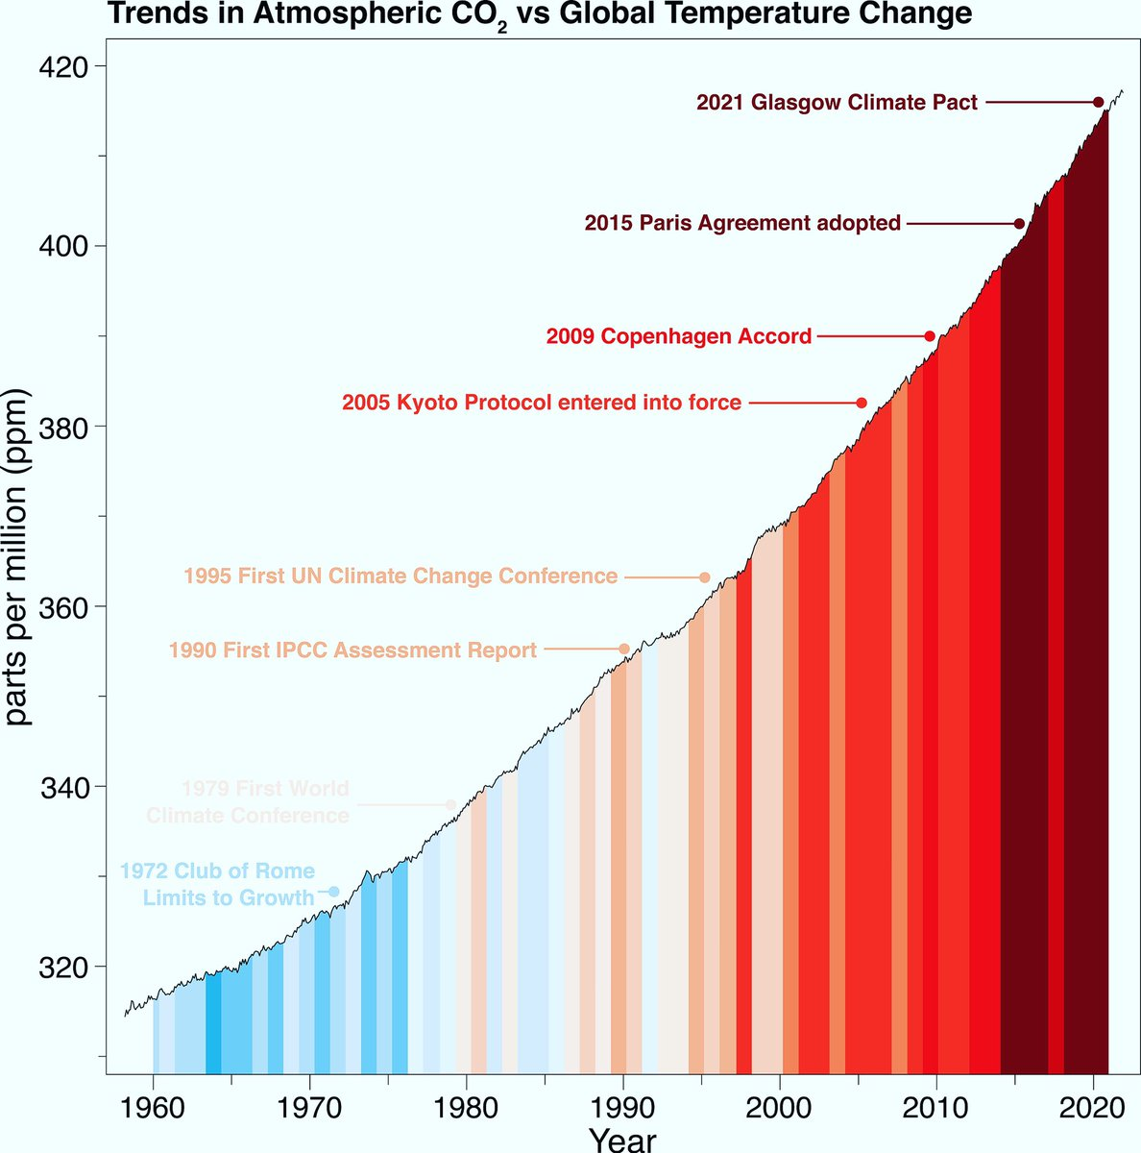
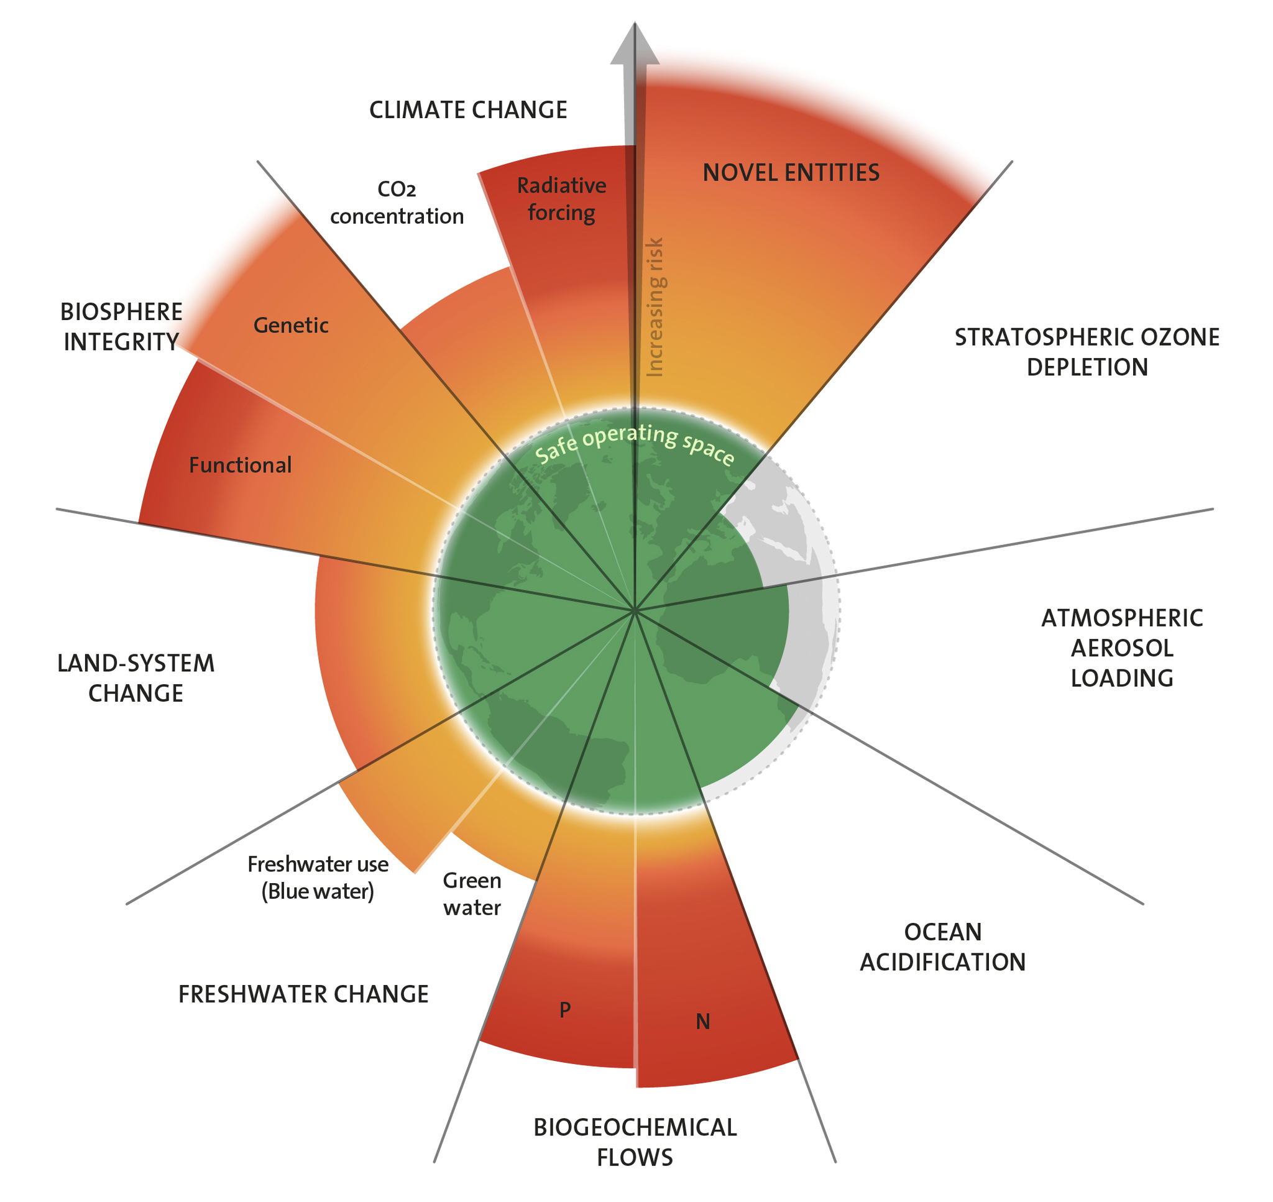

Slide 4
Regime: path dependency
  Dominant and shared ways of thinking, organising and doing in a societal (sub)system
  cultures: shared values, paradigms, worldviews, discourses
  structures: institutions, economic structures, physical infrastructures
  practices: routines, behavior, action, lifestyles

Slide 5
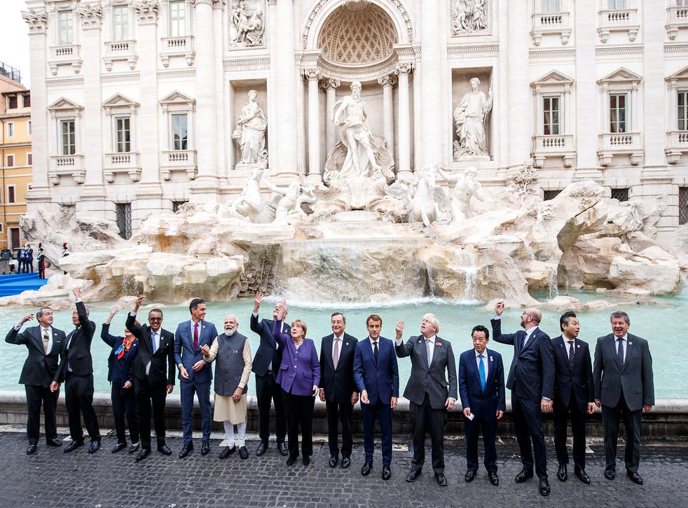
The dominant science-policy regime
Certainty illusion
Power blindness
Innovation trap
Value deficit

Slide 6
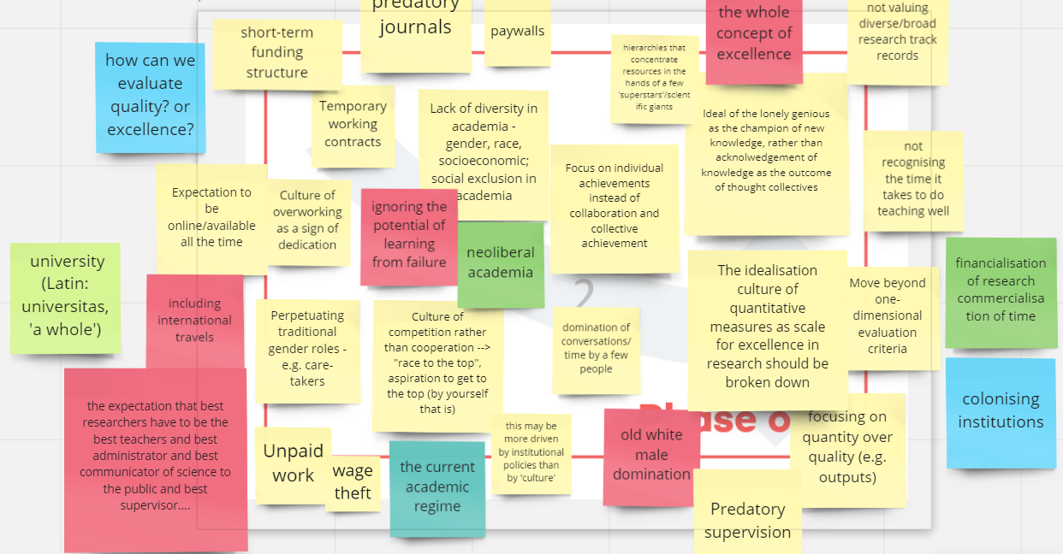

Slide 7
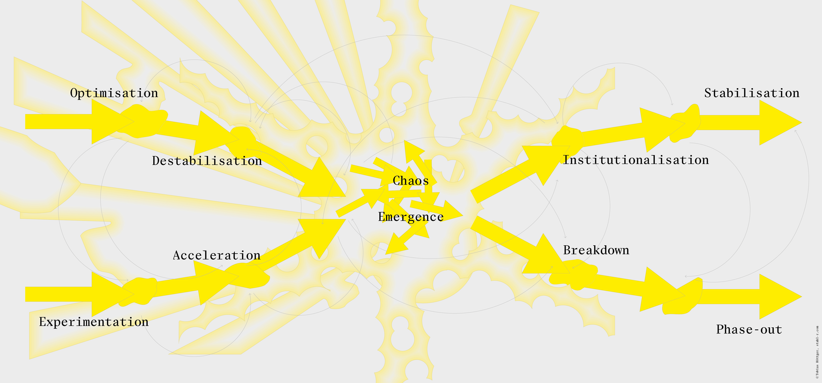
Notes:
ARTS and TRANSIT

Slide 8
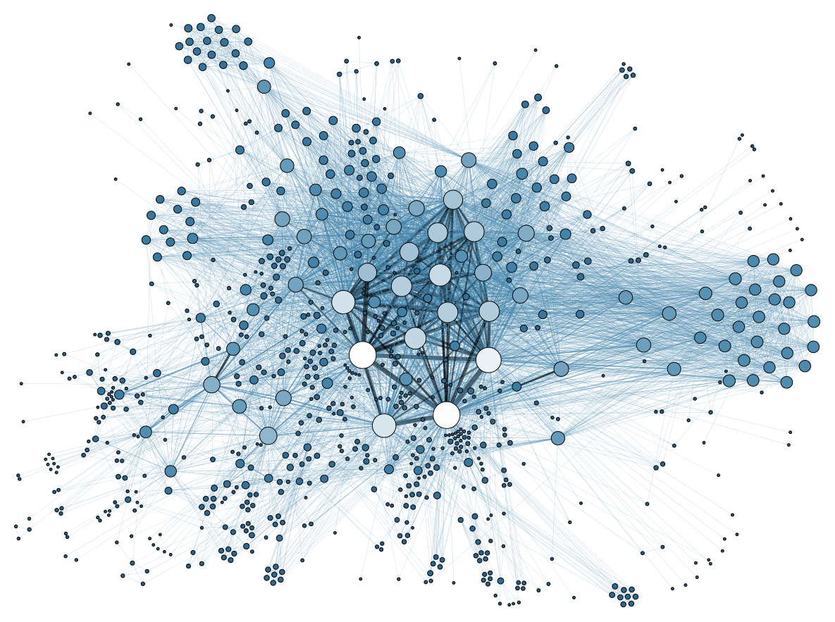
Transformative agency
Systemic
Back-casting
Selective
Adaptive
Learning-by-doing

Slide 9
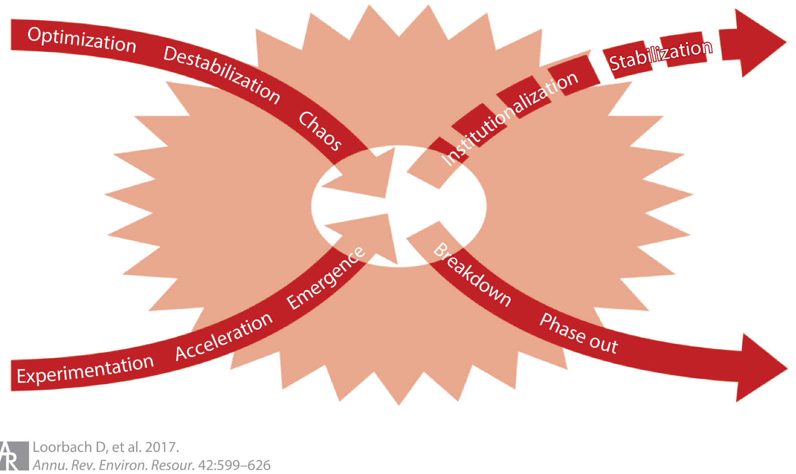
System
Institutional entrepreneurs
Transition design
Emergence
Rooting
Organisation
Change agents
Transitionagenda
Phase out
Networking
Individual
Frontrunners
Transitionarenas
Urgency
Empowerment
culture
structure
practices
Notes:
ARTS and TRANSIT

Slide 10
NATURE POSITIVE ECONOMY
Minimal use of resources, energy and space
As affordable, accesible and healthy as possible

Slide 11
Design Impact Transition platform
Education
Support the development of transformative learning and education for societal transitions at Erasmus University.
Research
Nurture a culture of design, impact and transition-oriented research and develop ecosystems of researchers, teachers and staff working collaboratively on societal challenges.
Trojan horse strategy: disciplinary, descriptive and linear academic regime is destabilizing
The alternatives (transdisciplinarity, engaged research, action research, transformative education…) are becoming more powerful
We will see increasing societal demand for new types of academic work
Transdisciplinarity for transformative change is the desired direction for transition
Engagement
Become the platform for design and transition based collaborative projects with societal partners.

Slide 12
Transformative research
‘Researches’ transitions that we want in and with practice
Is inherently normative (critical towards unsustainable and unjust status quo)
Is inherently experimental (in exploring, hypothesizing and testing potential alternatives)
Is team science that mixes methods and roles

Slide 13
NATURE POSITIVE ECONOMY
Minimal use of resources, energy and space
As affordable, accesible and healthy as possible

Slide 14
NWO - KIN as transition experiment
What normative roles can research funders take and how should they play these roles?
How to better structure and methodologically support social innovation and transformative knowledge creation?
Is it possible and desirable to support individual academics in engaging in sustainability transitions?
What are the conditions needed to allow for this in a transparent, quality ensured and democratic way?
What is needed in internal organisation of universities and research organisations to make this posible?

Slide 15
The transformative university
Institutional dimensions | 20th century model | Transformative university
Incentives | Excellence | Relevance
Career paths | Academic and hierarchical | Role diversity
Funding | Subsidized grants and basic funding | Entrepreneurial and basic funding
Organization | Schools and support | Schools and ecosystems
Positionality | Outside society | Part of society
Learning philosophy | Linear transfer | Co-creation

Slide 16
Institutional design
Organisational values
Organisational structures
Inter-organizational collaboration
Leadership
Training
Teaching and curriculum
Funding

Slide 17
Academic papers
Wittmayer, J. M., Huang, Y. S. E., Bogner, K., Boyle, E., Hölscher, K., von Wirth, T., ... & Vasques, A. (2024). Neither right nor wrong? Ethics of collaboration in transformative research for sustainable futures. Humanities and Social Sciences Communications, 11(1), 1-15.
Loorbach, D. and J. Wittmayer (2023). Transforming universities. Mobilising research and education for sustainability transitions at Erasmus University Rotterdam, The Netherlands. Sustainability Science, https://rdcu.be/dfnbG
Bogner, K., Kump, B., Beekman, M., & Wittmayer, J. (2024). Coping with transition pain: An emotions perspective on phase-outs in sustainability transitions. Environmental Innovation and Societal Transitions, 50, 100806.
Kump, B., Bogner, K., Wittmayer, J and Beekman, M. (2023). Navigating force conflicts: A case study on strategies of transformative research in the current academic system, Journal of Cleaner Production 412, https://www.eur.nl/en/media/2023-05-1-s20-s0959652623015329-main
Kump, B., Bogner, K., Wittmayer, J., & Beekman, M. (2023, September). Seizing institutional opportunities in transitions: The case of engaged scholarship at the Erasmus University Rotterdam. In 14th International Sustainability Transitions Conference, IST 2023.

Slide 18
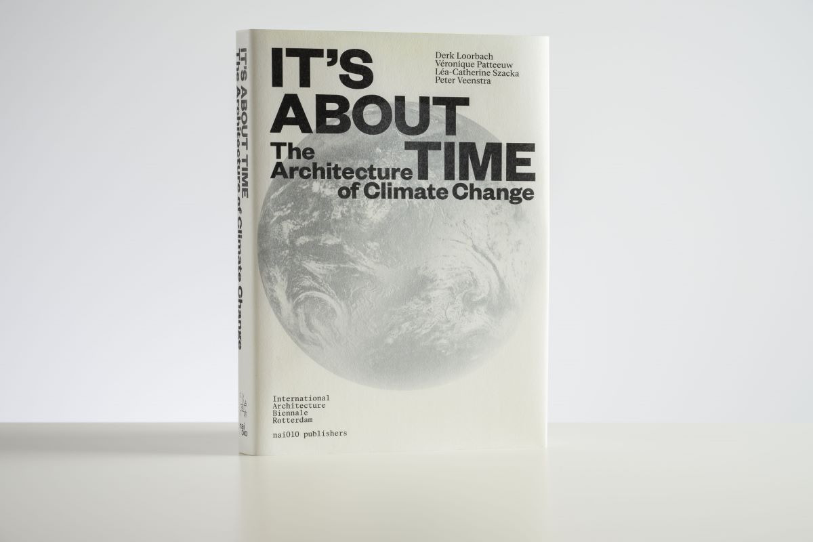

Slide 19
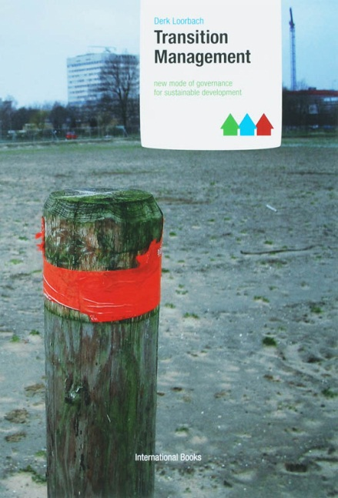
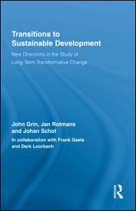
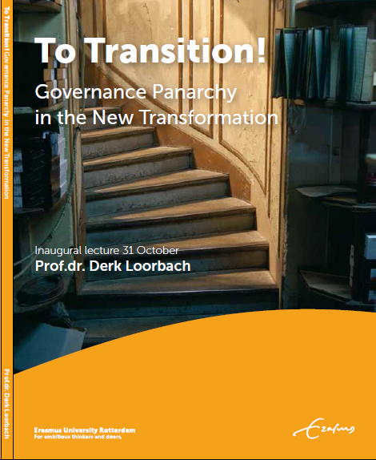
For more information and publications:
  loorbach@drift.eur.nl
  www.drift.eur.nl
  www.twitter.com/drk75

