Slide 1















SELF-ORGANIZING
LOGISTICS
MARTIJN MES

Slide 2

WHAT IS A SELF-ORGANIZING SYSTEM?
Logistics systems are becoming larger and more complex
More difficult to manage as a whole
Add more autonomy at a decentral level in the system
Add local intelligence
Self-organising Logistics

Slide 3

RELATED CONCEPTS
Internet of Things
Intelligent and active products
Cyber-physical systems
Complex adaptive systems
Multi-agent systems
Embedded systems
Holonic systems
Physical Internet

Slide 4

CHARACTERISTICS
Openness:
Actors (e.g., shippers) or assets (e.g., trucks) can easily join/leave
Connectivity (standardization, modularization, organization, IT)
Reconfigurability and adaptability
Intelligence: object-based capability of real-time communication and activeness, at different levels: nodes (e.g., customers, hubs), connections between the nodes (e.g., autonomous vehicles) and even sensor-equipped cargo (e.g., container, pallet, package)
Decentralised control: collaborative rules and communication protocols aimed at preventing unexpected or undesirable system outcomes, rather than optimal planning; planner ideally becomes exception manager

Slide 5
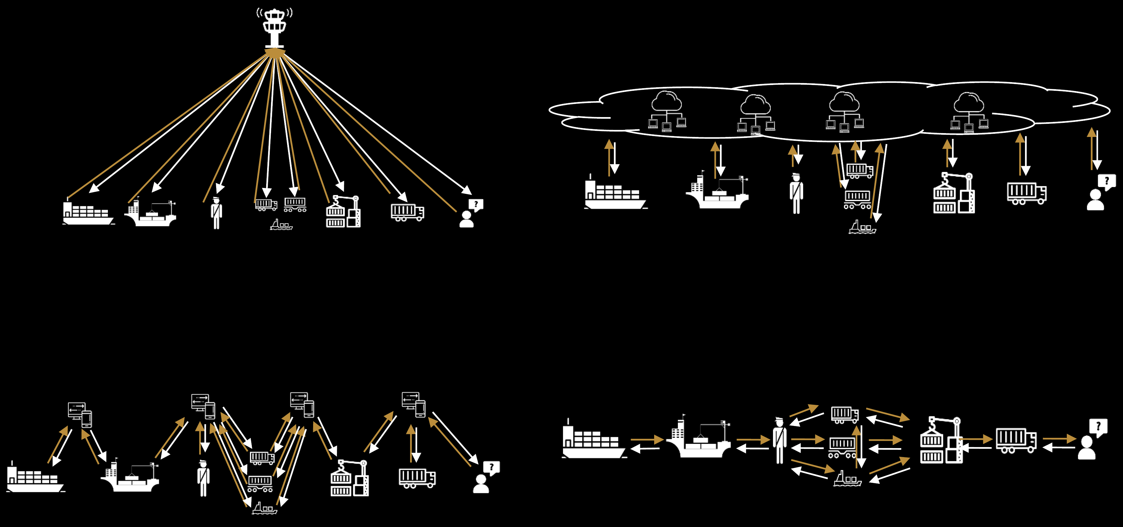
HYBRID FORMS
DECISION-MAKING
GLOBAL
LOCAL
GLOBAL
CENTRAL
DATA INFRASTRUCTURE
INFORMATION
MINI CENTRALS
DECENTRAL
LOCAL

Slide 6
SOME EXAMPLE PROJECTS
MERBA
BATMAN
CATALYST
WINGS FOR AID

Slide 7


MERBA
Self-organizing logistics in an industrial bakery

Slide 8

MERBA

Slide 9
MERBA
Which AGV?
Controller
Which barrel?
AGVs
Barrels
When?
Silo’s
What dough?
Ovens
What mixer
When?
When?
When to charge?
Mixers
Waiting
Recharge
Cleaning

Slide 10
MERBA
C
How to decompose into a multi-agent system?
C
AGVs
Barrels
Silo’s
C
Ovens
C
C
Mixers
Waiting
C
C
C
Recharge
Cleaning

Slide 11
MERBA
C
Which agents?
C
AGVs
Barrels
Silo’s
C
Ovens
C
C
Mixers
Waiting
C
C
Recharge
Cleaning

Slide 12
MERBA
C
Who communicate?
C
AGVs
Barrels
Silo’s
C
Ovens
C
C
Mixers
Waiting
C
C
Recharge
Cleaning

Slide 13
MERBA
C
Who initiate?
C
AGVs
Barrels
Silo’s
C
Ovens
C
C
Mixers
Waiting
C
C
Recharge
Cleaning

Slide 14
BATMAN
BArge Terminal Multi-Agent Network

Slide 15
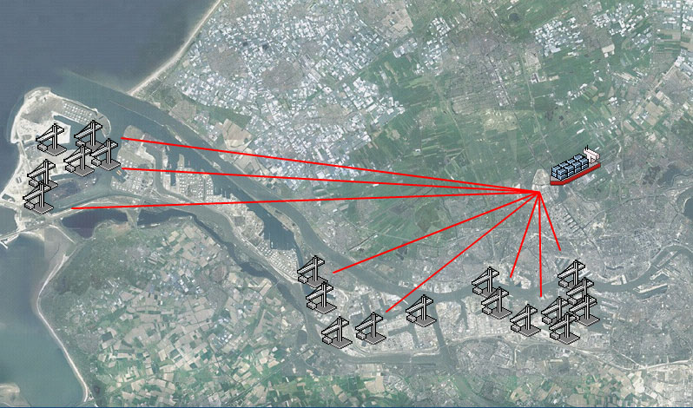
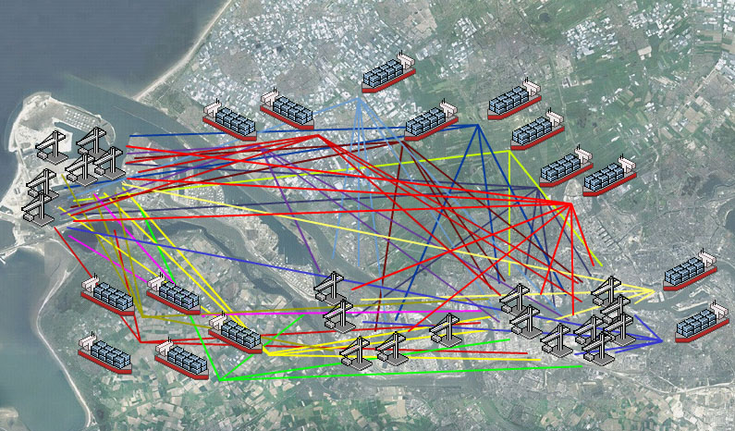
BATMAN
North Sea
Barge
Terminals
Terminals
Terminals

Slide 16
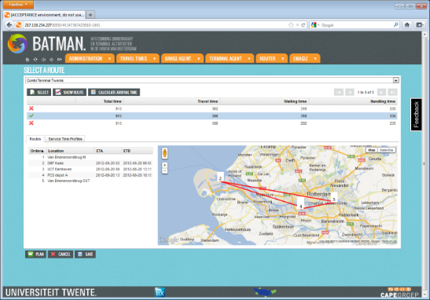
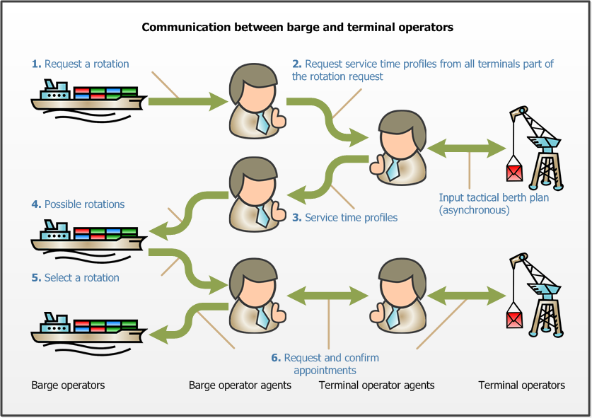
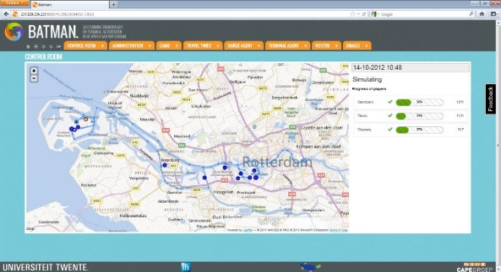
BATMAN

Slide 17
CATALYST
Connected Automated Transport and LogisticsYielding Sustainability

Slide 18
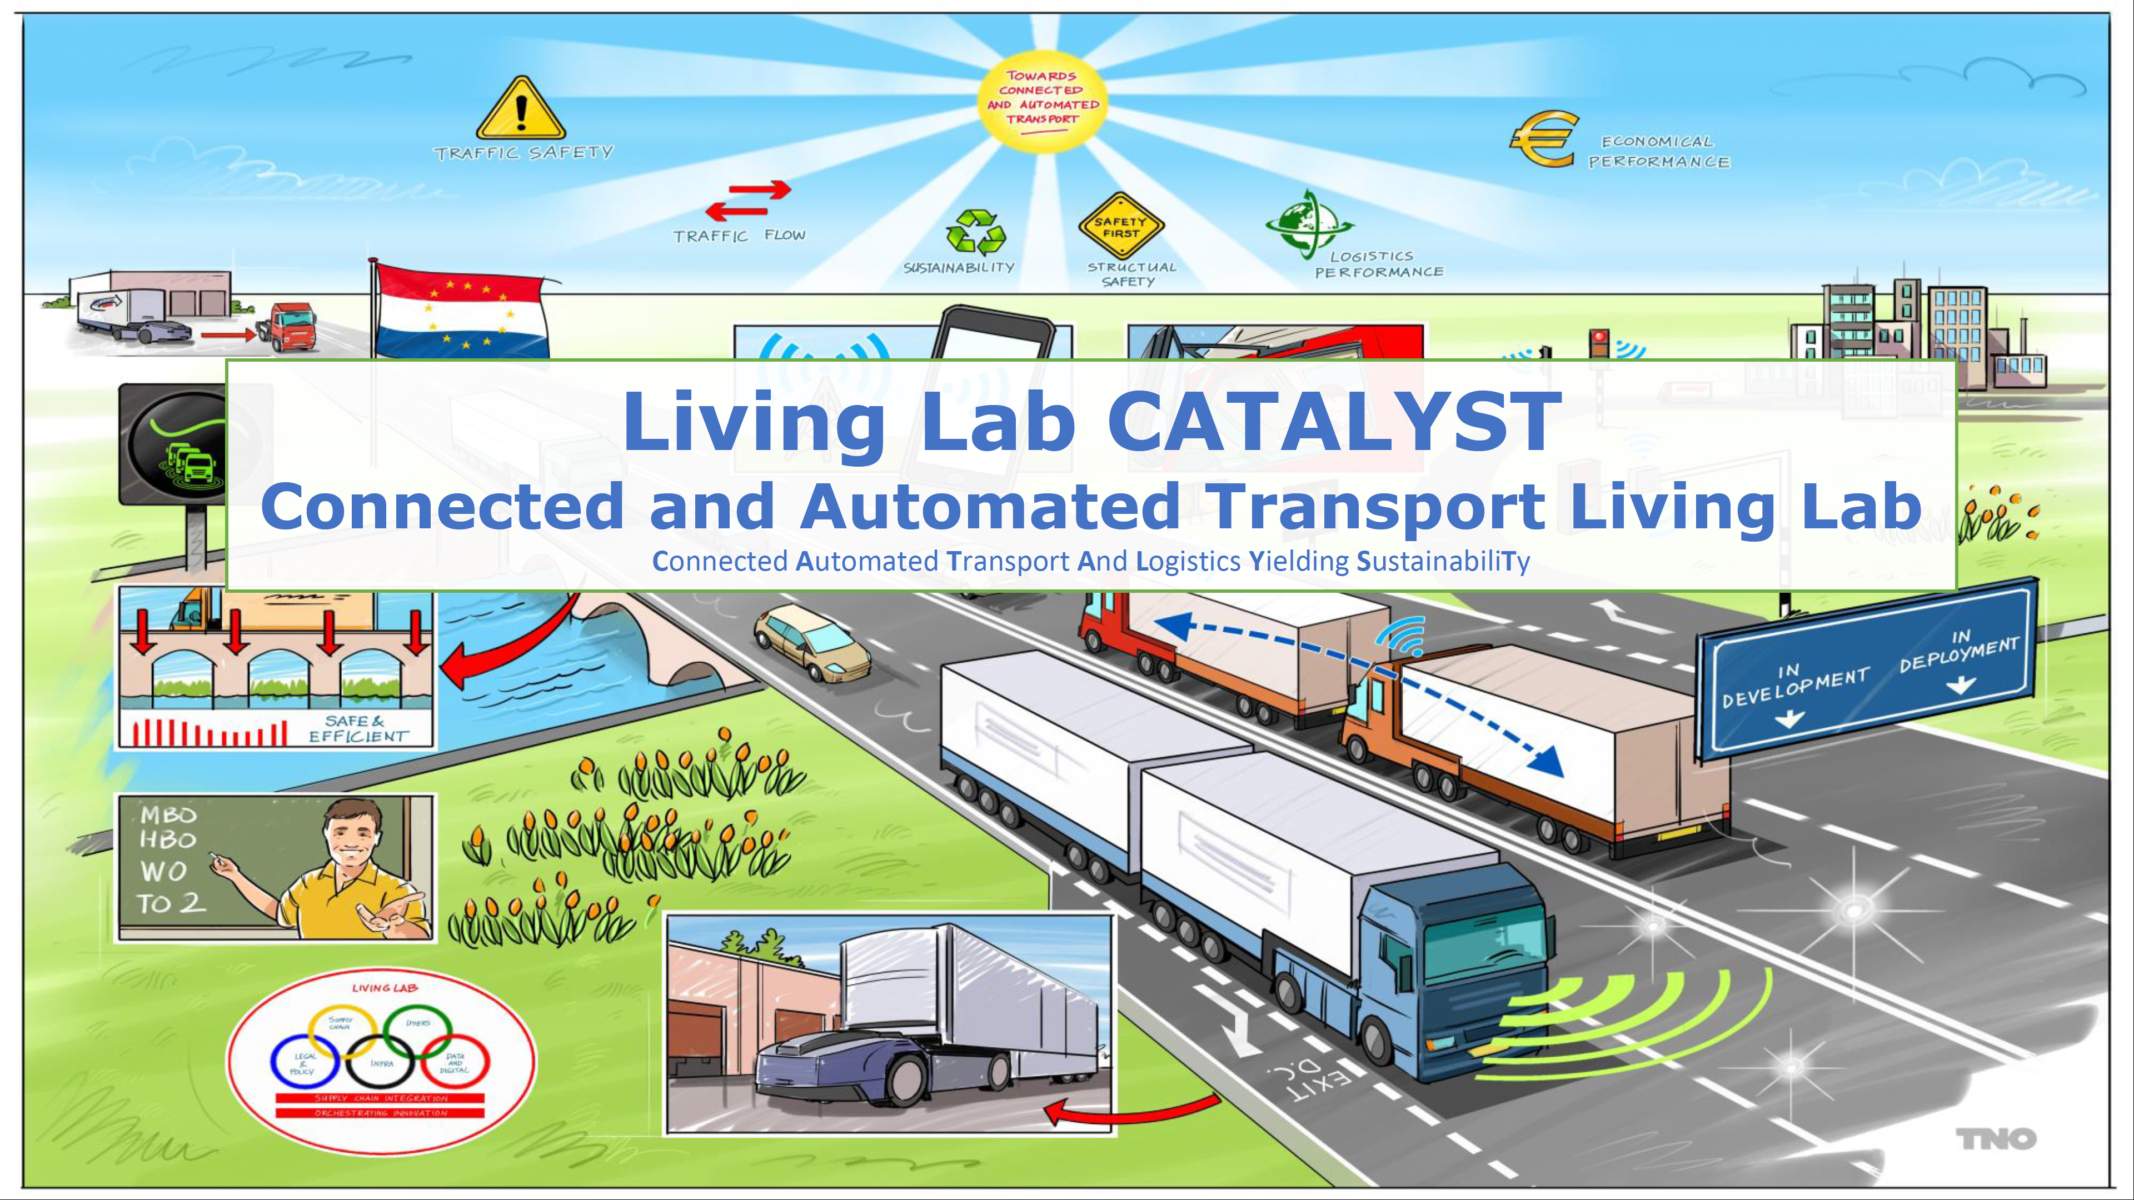
CATALYST

Slide 19
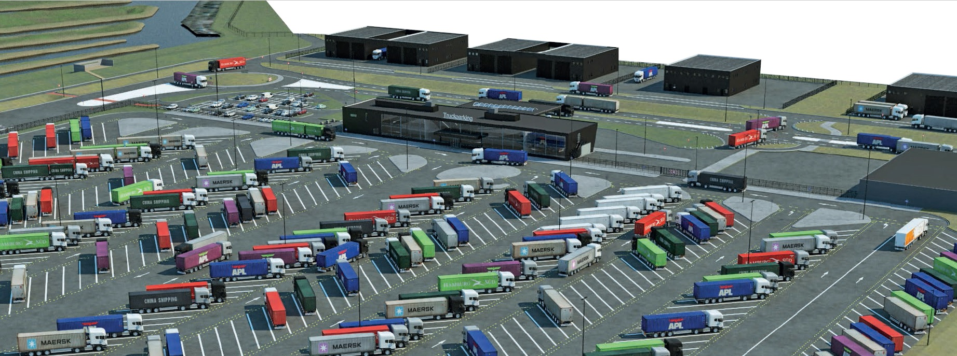
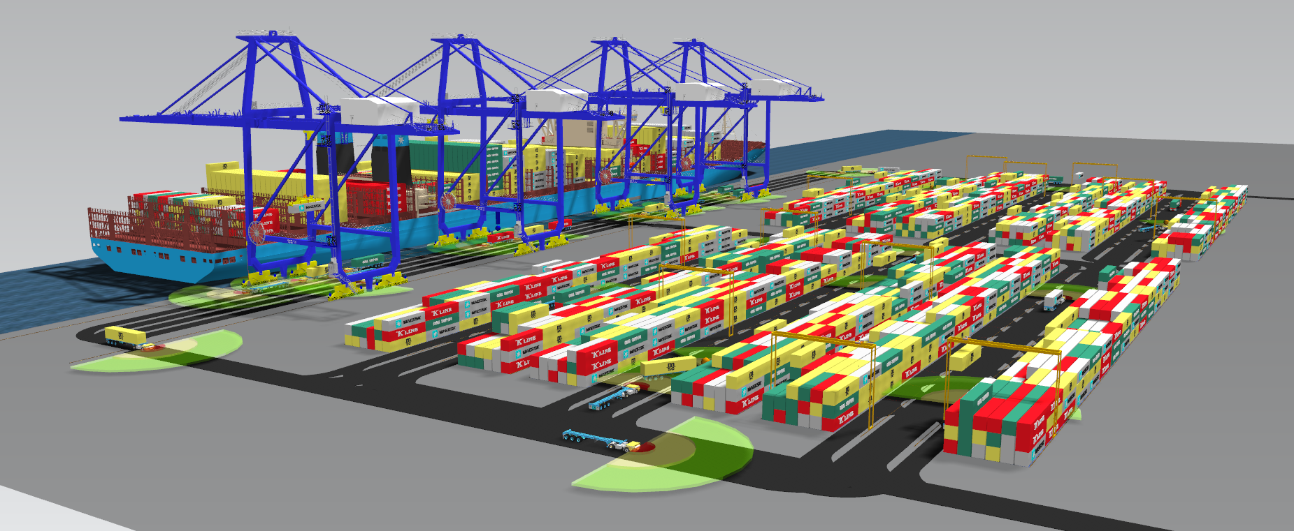
CATALYST
Platoon and truck-trailer matching:
Scheduled
Real-time
Opportunistic
Smart yards: autonomous guided vehicles at parking areas, hubs, sea/air ports, etc.

Slide 20
WINGS FOR AID
Last-mile drone logistics for humanitarian aid

Slide 21
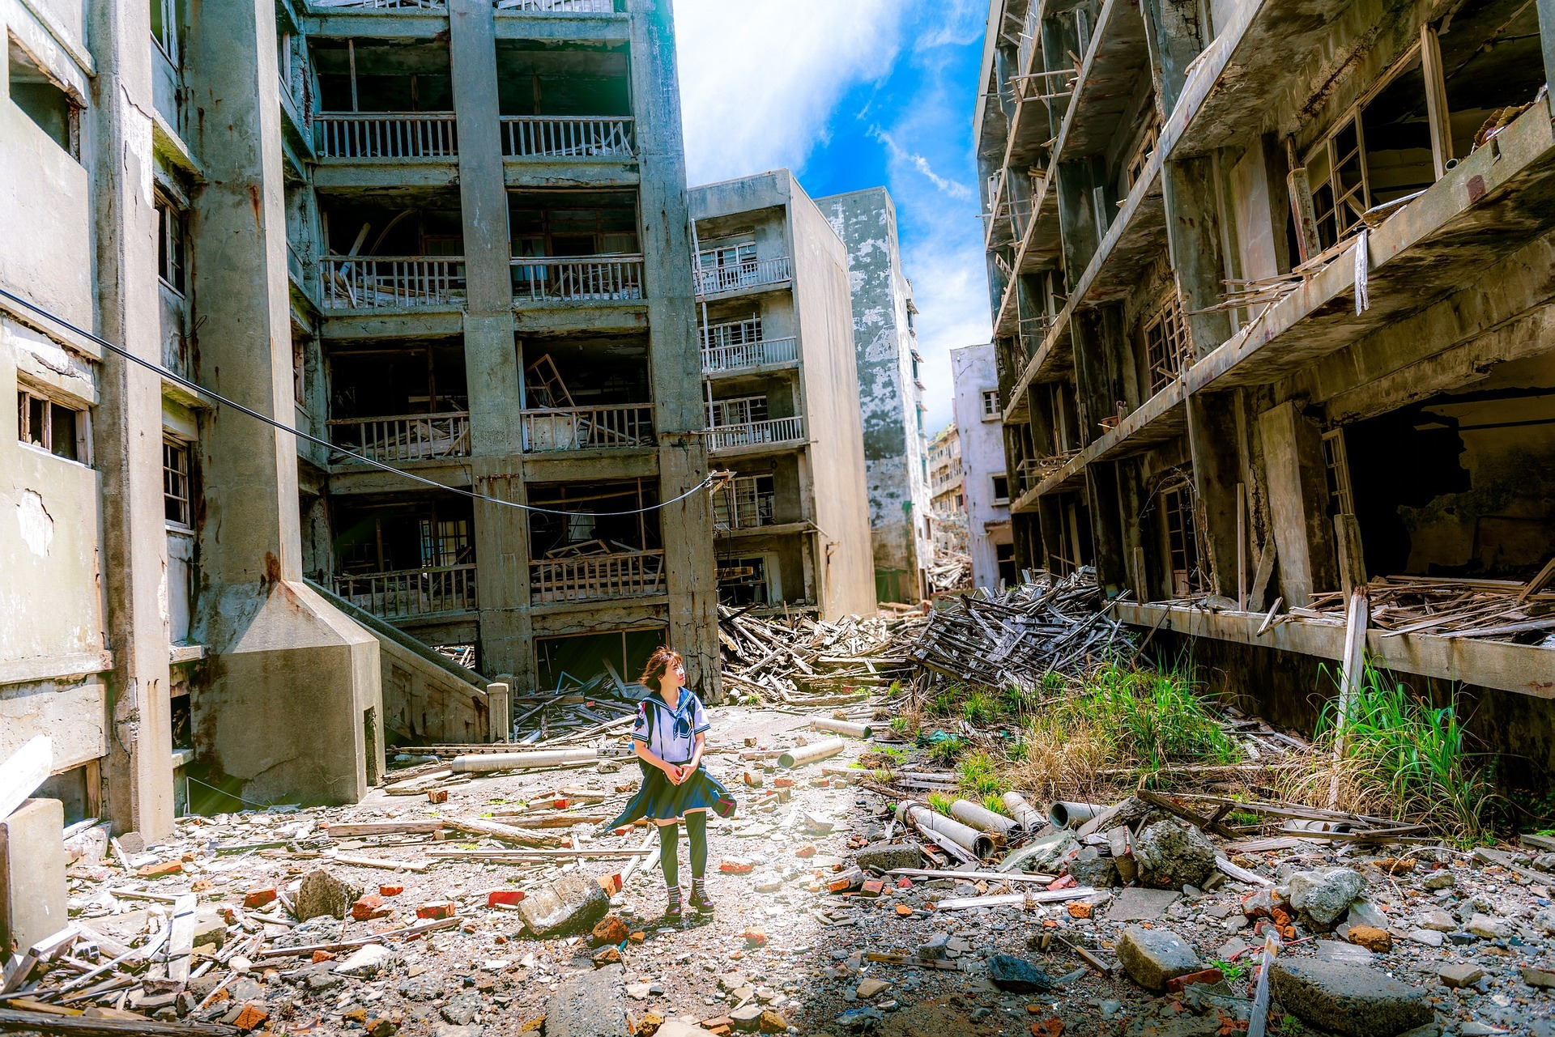



People are in need of humanitarian aid
More frequent and worse disasters (UNHCR, 2016)
Damaged communication networks, ruined infrastructures, dangerous...
Logistics forms 60%-80% of total costs in humanitarian aid (Tatham and Pettit, 2010)

Slide 22

THE SOLUTION: DRONES
Fast
Flexible
Operate regardless of the state of the infrastructure
Low-cost alternative to trucks and helicopters
Real-time information collection

Slide 23
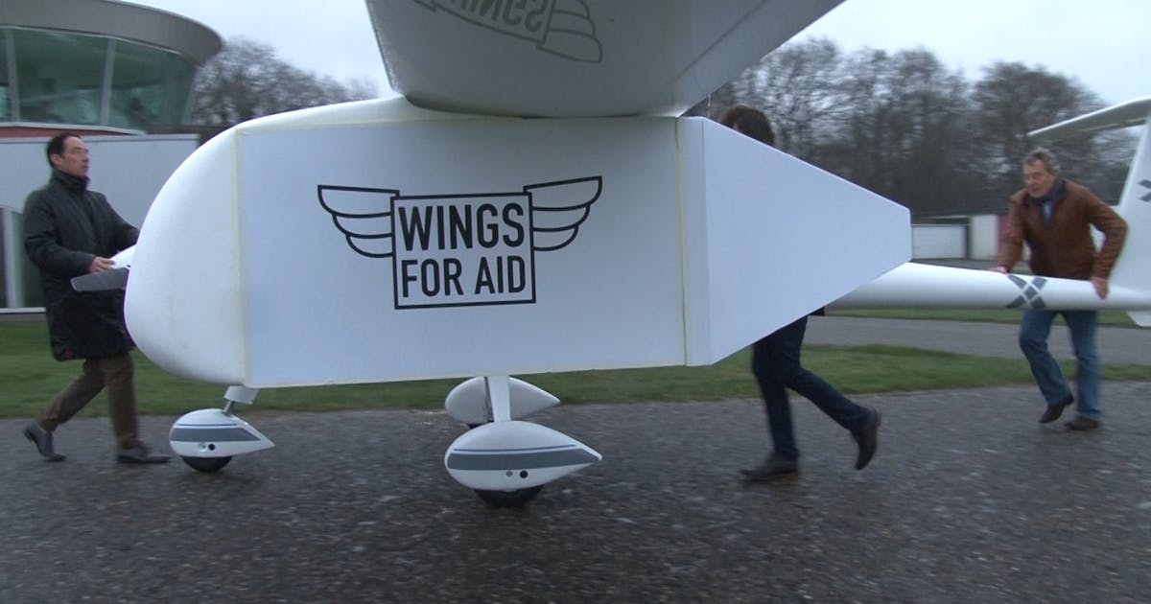


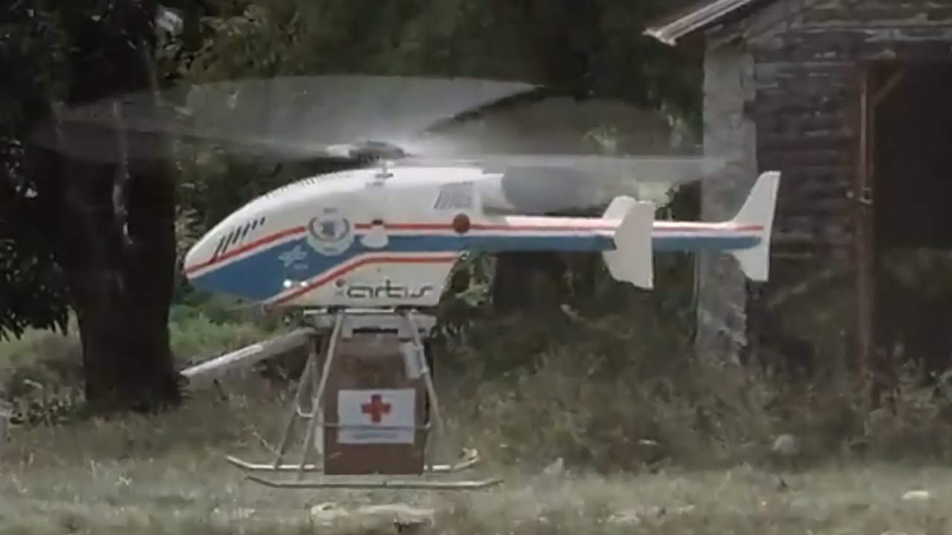

Slide 24

Large swarms of autonomous drones
Self-organizing with local intelligence
Equipped with cameras and sensors
Deliver food, medicines, clothes, blankets, etc.
But also gather information and establish a communication infrastructure

Slide 25
TO CONCLUDE
The future of self-organizing logistics…

Slide 26

Drivers for change:
Sustainability
Automation and robotization: reduction in handling costs and ability to run 24/7
Connectivity: integration of digital and physical world
But what is the ultimate form of self-organizing logistics?

Slide 27
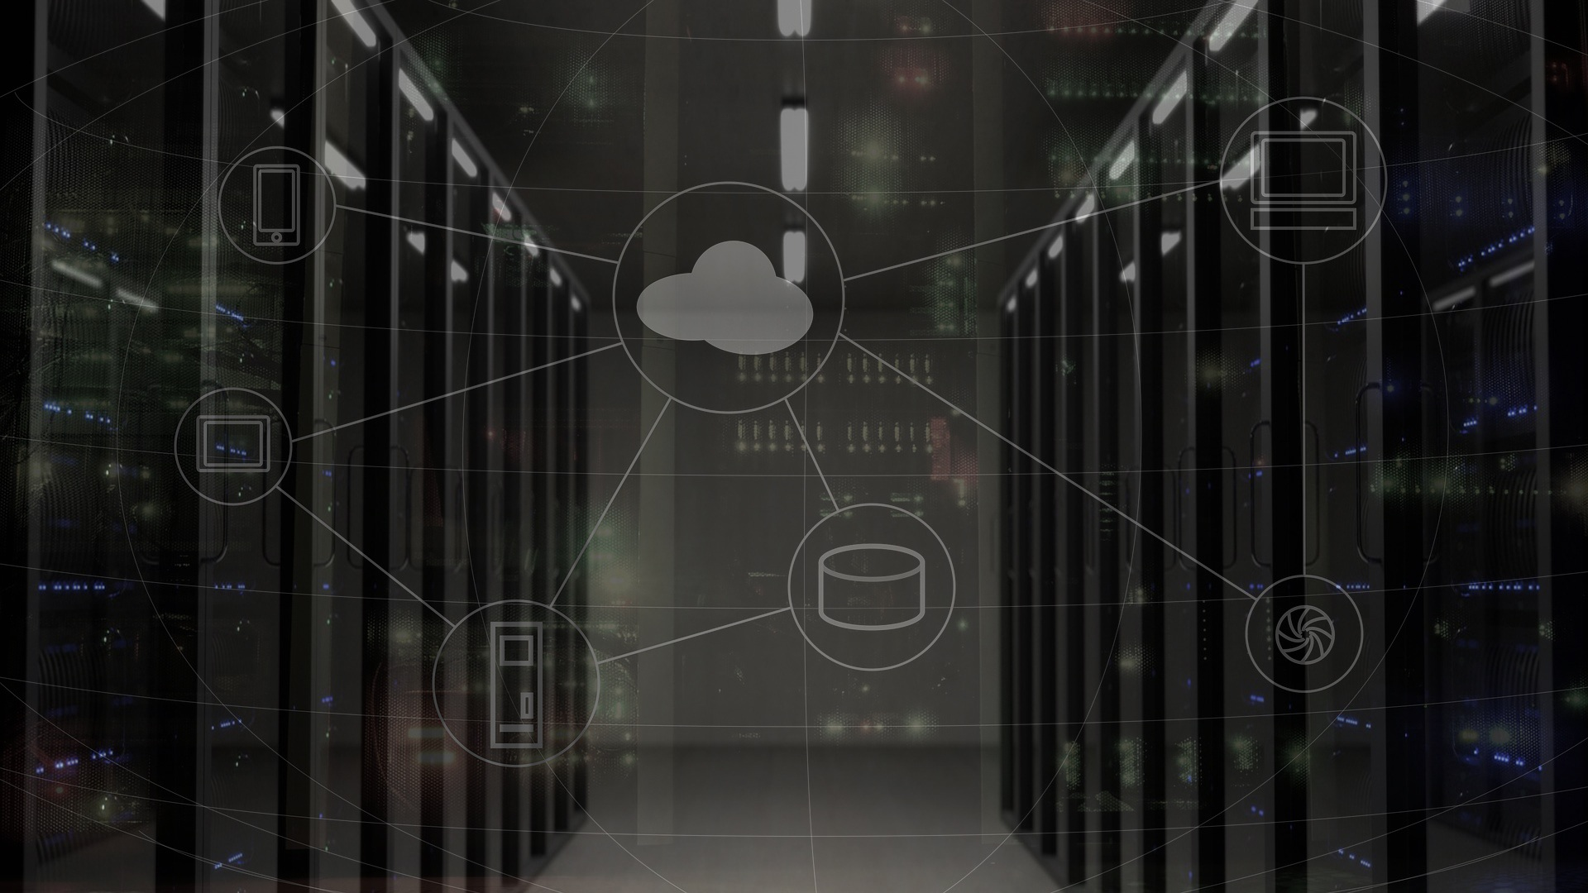
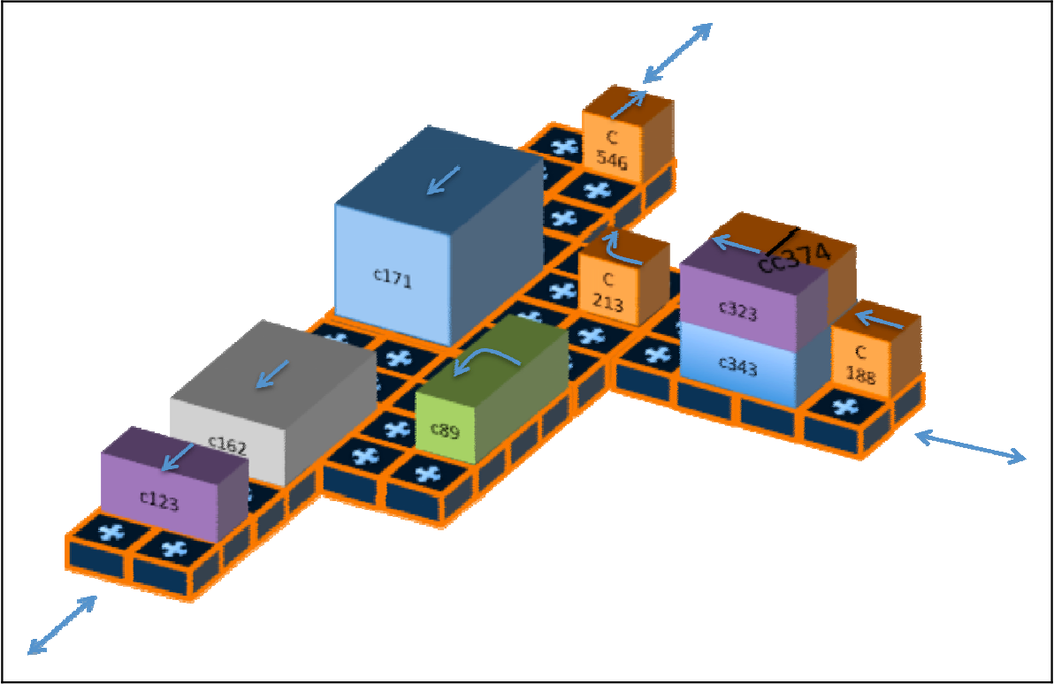
PHYSICAL INTERNET
An application of a Self-organizing Logistics System, in which physical assets, information systems and organization models are modularized and standardized to enable the connectivity (Pan et al. 2017).
Source: Montreuil et al. (2010)

Slide 28
QUESTIONS?

