Slide 1
Approximate Dynamic Programming for… Trucks & Barges
Martijn R.K. Mes University of Twente
Eindhoven Seminar 2019 | November 28, 2019

Slide 2

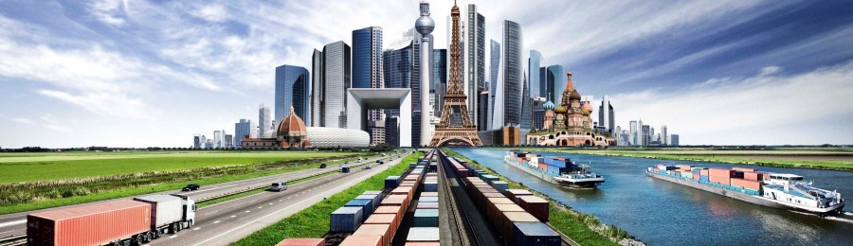
SYNCHROMODAL TRANSPORT
Source: European Gateway Services
In execution similar to intermodal transport, but essentially different in the (re)planning (made by the LSP):
Dynamic mode choice for each incoming order (mode-free booking)
Decisions can be made at all times, even during execution, based on real-time information, e.g., water levels and traffic information
Focus on network-wide performance over time

Slide 3
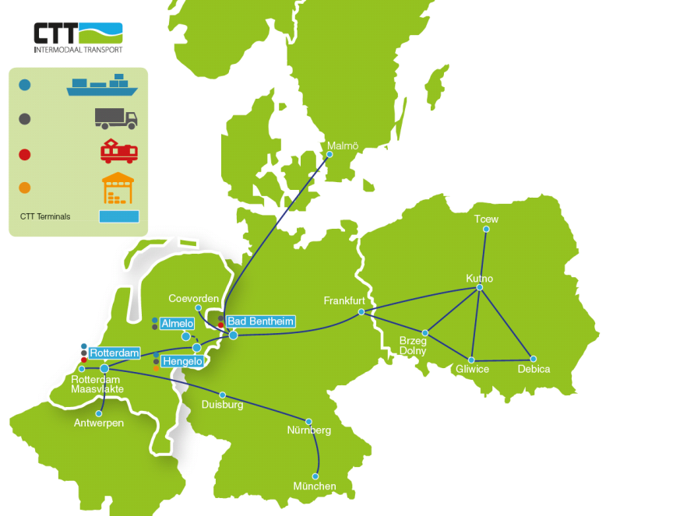
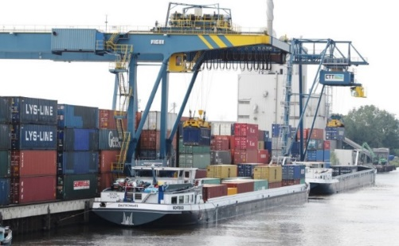
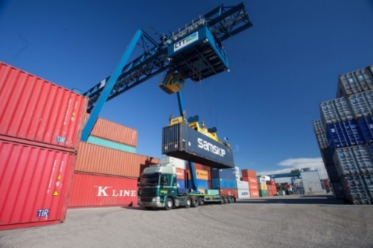
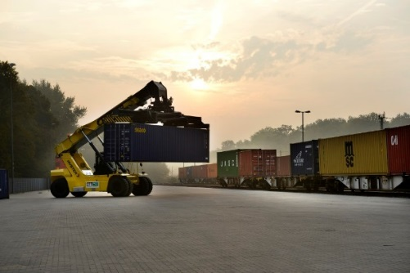
CASE STUDY: CTT NETWORK BETWEEN PORT OF ROTTERDAM AND THE HINTERLAND

Slide 4
PHASE 1: LONG-HAUL ROUND TRIPS → GAME
Balance the consolidation and postponement of freight transport through time.

Slide 5
PHASE 2: LONG-HAUL TRANSPORT WITH TRANSFERS
Balance the consolidation and postponement of freight transport through time and space.

Slide 6
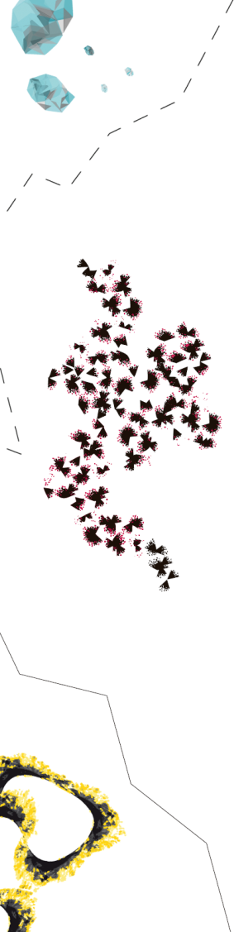
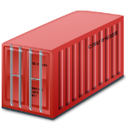
ANTICIPATORY ROUTING AND POSTPONEMENT
Train
Barge
Terminal
Origin
Destination
Assign to first train to 6 or postpone?
2
3
8
10
Or use even longer detour to combine with green till 7?
1
5
6
7
11
Use detour through 6 to combine with other reds?
0
4
9
12

Slide 7
THE OPTIMIZATION PROBLEM
Input:
The transportation network: terminals, services, schedules, durations, capacity, costs, revenues, time-horizon
Current freights and probability distributions for the arrival of freights and their characteristics, for each period of the horizon
Output:
Expected profit for each state
Policy: given the current state, which service to use for each freight
State at t: S_{t}=[F_{i,d,r,k,t} ]∀i,d,r,k:
Number of orders at (or in transit to) i, having destination d, release day r (relative to t), and time-window k (relative to r)
Finite horizon

Slide 8
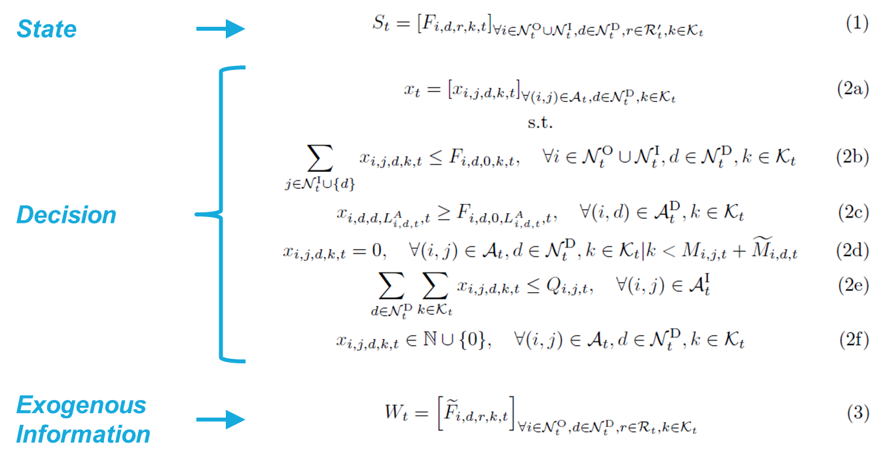
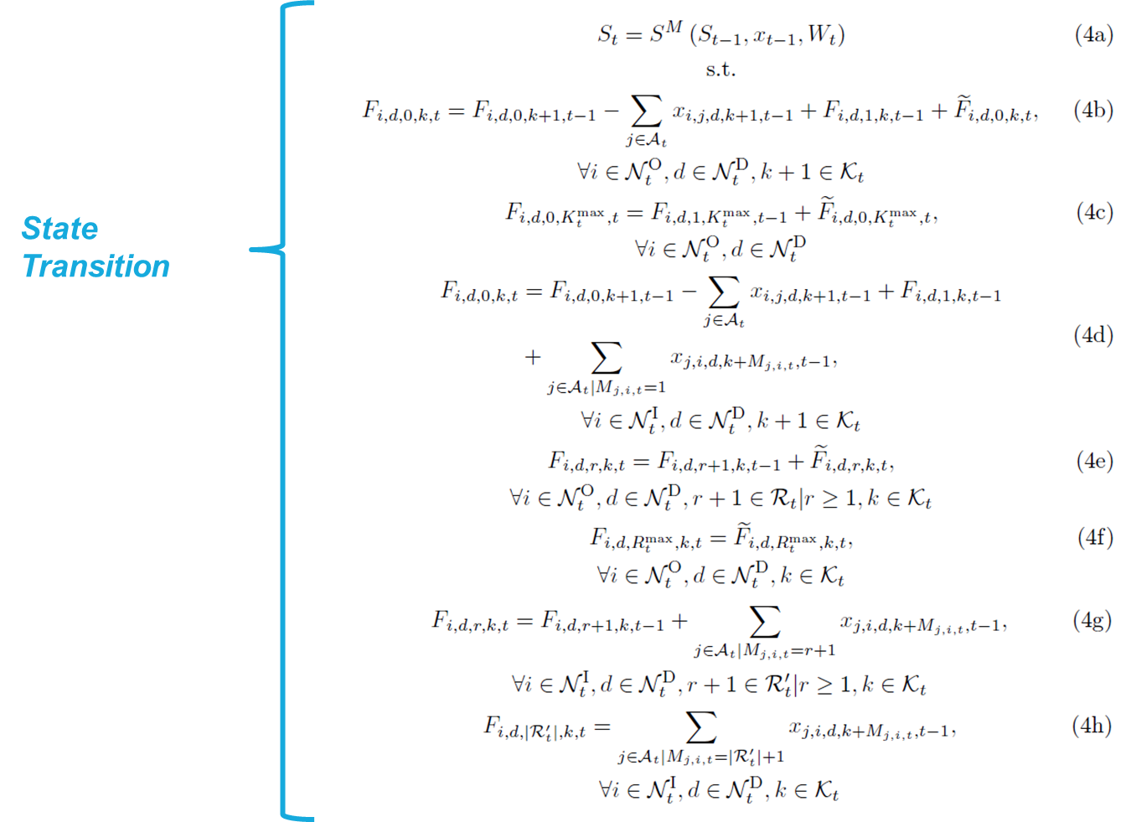
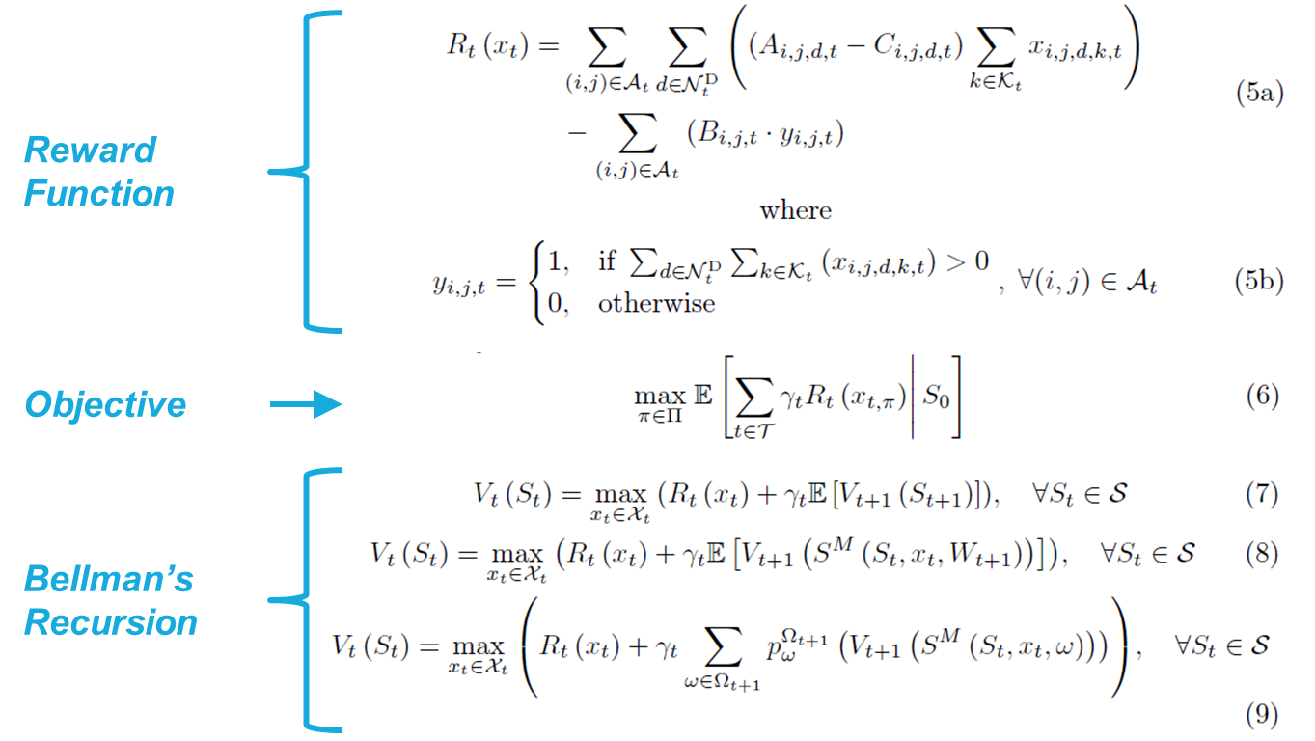
MARKOV DECISION PROCESS (MDP) MODEL
The three curses of dimensionality:
Many states
Many possible demand realizations
Many decisions
ADP
Notes:
Telefoon, fax, email
Alle partijen communiceren dus onderling en dat leidt tot problemen

Slide 9
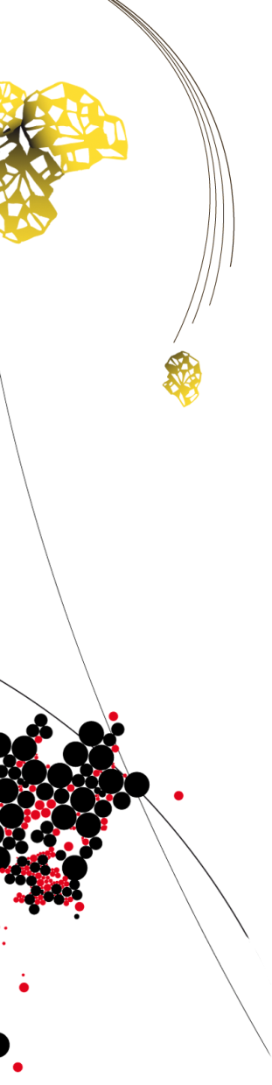
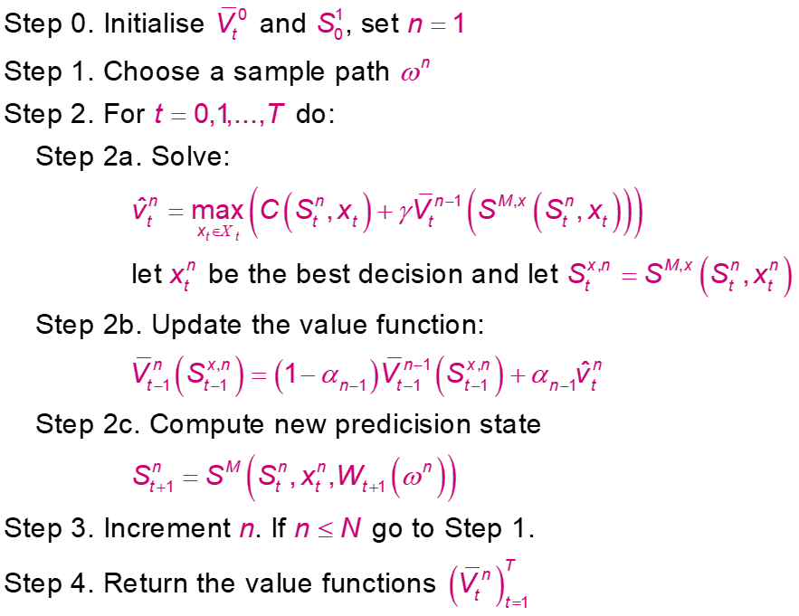
APPROXIMATE DYNAMIC PROGRAMMING
(basic structure, not what we use)
Pure exploitation
Deterministic optimization
Statistics
Simulation
Notes:
Telefoon, fax, email
Alle partijen communiceren dus onderling en dat leidt tot problemen

Slide 10
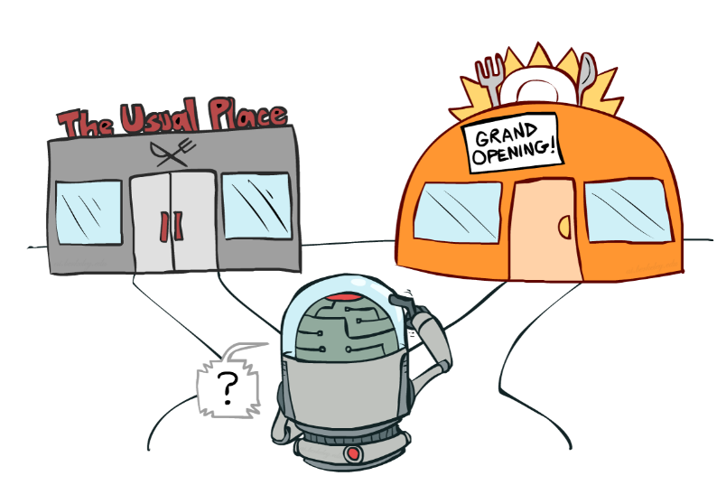
EXPLORATION VS EXPLOITATION
Exploration vs exploitation dilemma due to delayed rewards and/or costs: bring freight to nearest terminal and keep it there till it needs to be taken by truck to its destination
Necessary to explore… but how? (when, what, how long?)
Incorporate the value of information: the expected improvement in future decision quality
Dearden et al. (1999)
Gupta, S. and Miescke, K. (1996)
Frazier et al. (2008)
Source of artwork: Dan Klein and Pieter Abbeel – Reinforcement Learning (2013), University of California

Slide 11
PRINCIPLE VALUE OF PERFECT INFORMATION (VPI)
Assume you can make only one measurement, after which you have to make a final choice (the implementation decision). What choice would you make now to maximize the expected value of the implementation decision?
Values that produce a change in the decision.
Observation
Updated estimate of the value of option 5
≈ Knowledge gradient (KG): expected increase in knowledge
1
2
3
4
5

Slide 12
CHALLENGES
Difficult to apply the VPI concept due to the presence of a physical state (state dependent decisions):
Decisions have impact on the value of states in the downstream path (we learn what we measure)
Decisions have impact on the value of states in the upstream path (with on-policy control)
Need to learn the value of features/functions instead of states

Slide 13
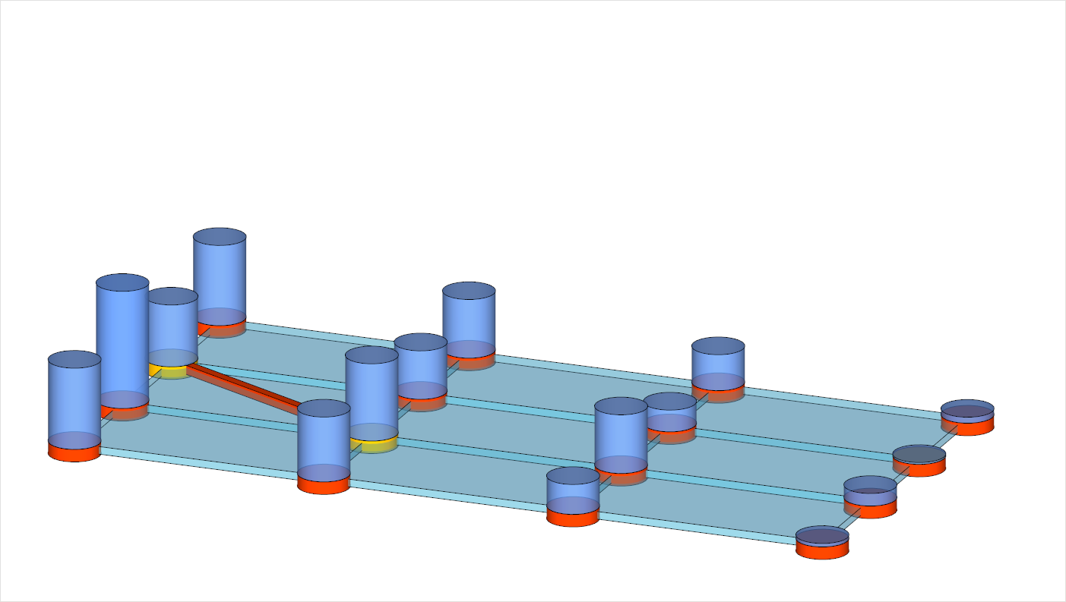
CHALLENGES
At time t-1 “present” in state B_{t-1}
Decision to “visit” state C_{t}
Decision move to state A,B,C,D
A
location →
B
t-1
time →
t
C
t+1
D
t+2

Slide 14
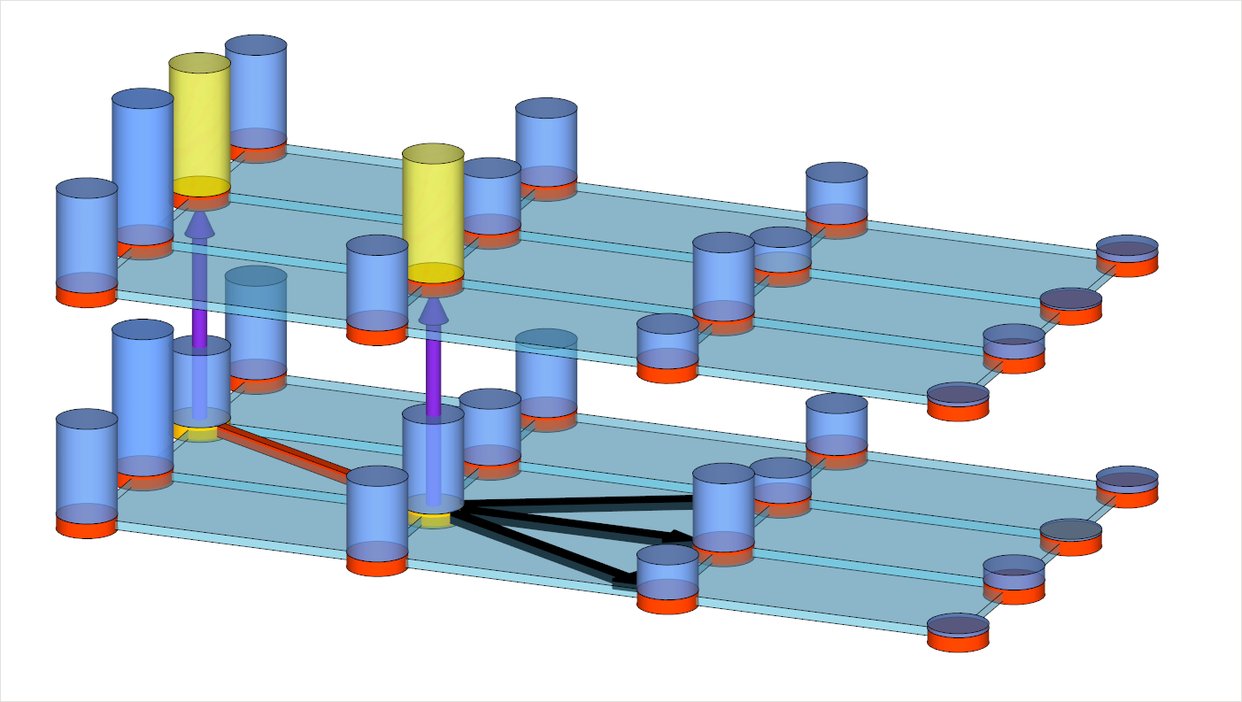
CHALLENGES
iteration →
Result in update of V(B_{t-1}) and eventually of V(C_{t})
n+1
n
A
location →
B
t-1
time →
t
C
t+1
D
t+2

Slide 15
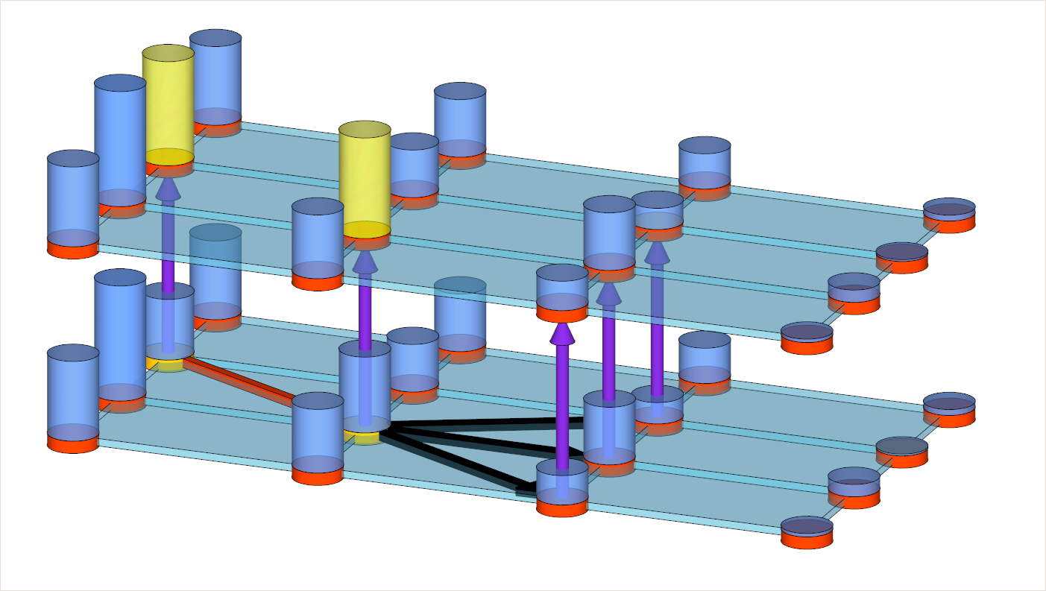
CHALLENGES
iteration →
Incorporate the value of Information
n+1
n
A
location →
B
t-1
time →
t
C
t+1
D
t+2

Slide 16
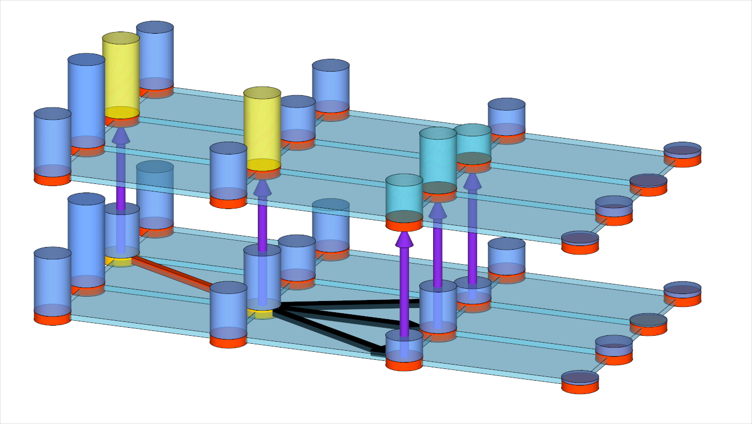
CHALLENGES
iteration →
Incorporate the value of Information
n+1
n
A
location →
B
t-1
time →
t
C
t+1
D
t+2

Slide 17
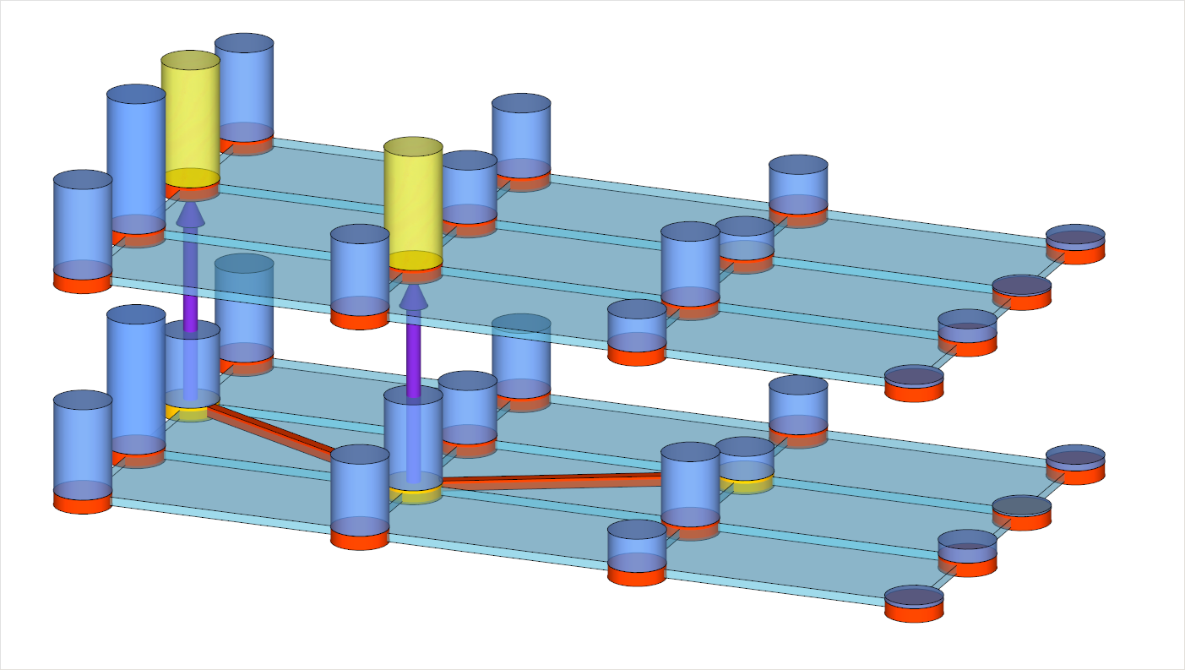
CHALLENGES
iteration →
Value of information might depend
on the direct costs of going there
n+1
n
A
location →
B
t-1
time →
t
C
t+1
D
t+2

Slide 18
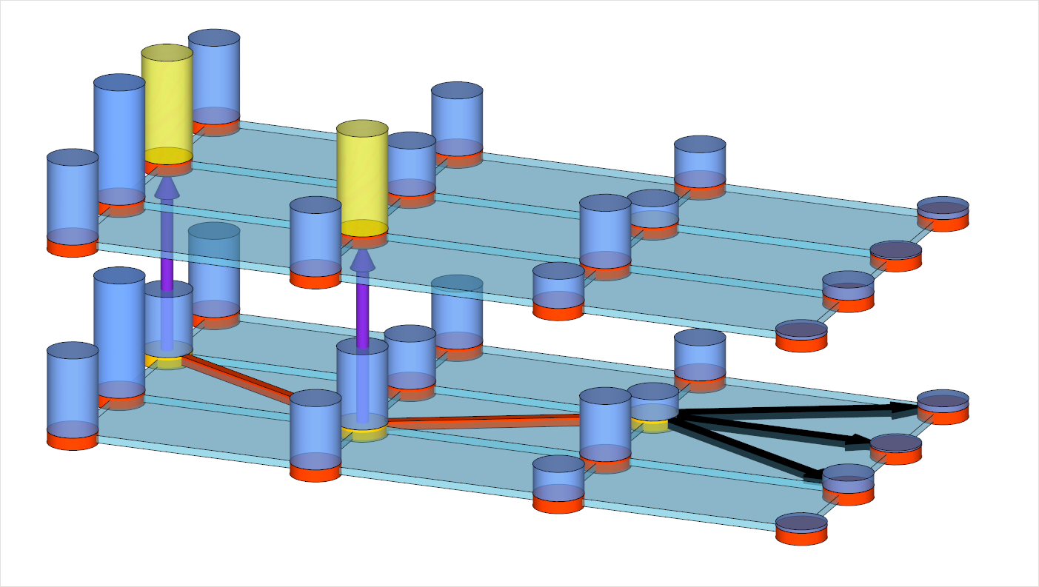
CHALLENGES
iteration →
Exploration decision might result
in deterioration of the VFA
n+1
n
A
location →
B
t-1
time →
t
C
t+1
D
t+2

Slide 19
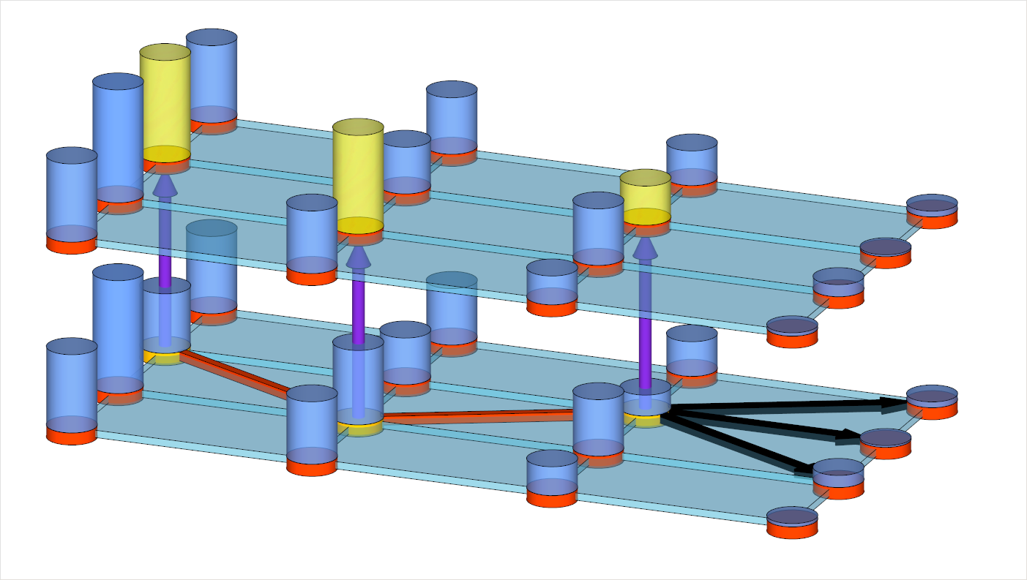
CHALLENGES
iteration →
Exploration decision might result
in deterioration of the VFA
n+1
n
A
location →
B
t-1
time →
t
C
t+1
D
t+2

Slide 20
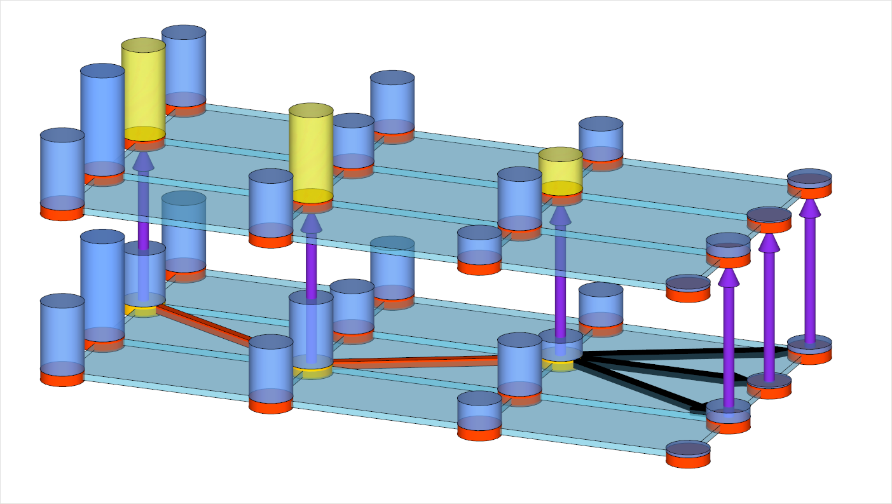
CHALLENGES
iteration →
Process continues till end of the horizon
n+1
n
A
location →
B
t-1
time →
t
C
t+1
D
t+2

Slide 21
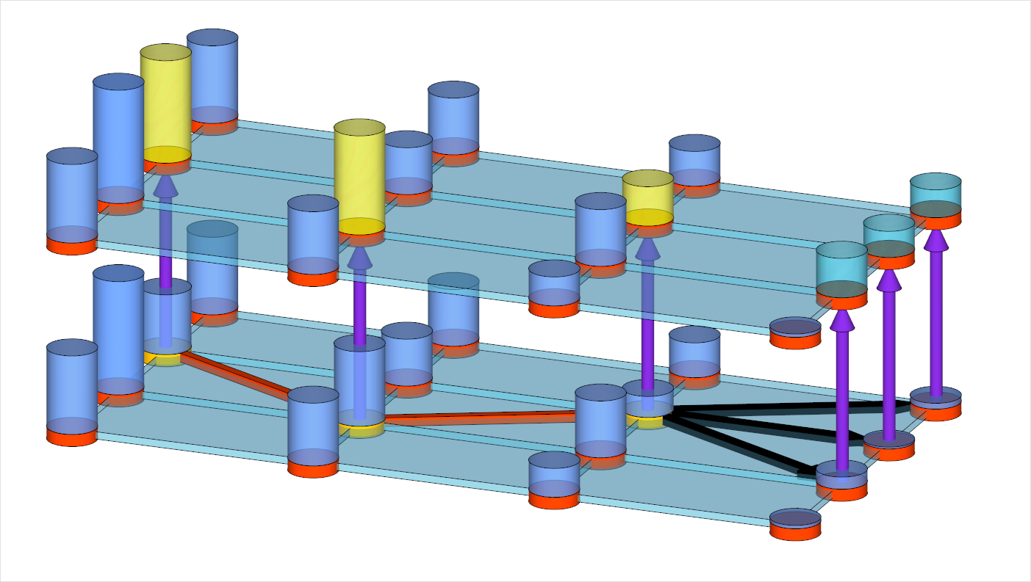
CHALLENGES
iteration →
Process continues till end of the horizon
n+1
n
A
location →
B
t-1
time →
t
C
t+1
D
t+2

Slide 22
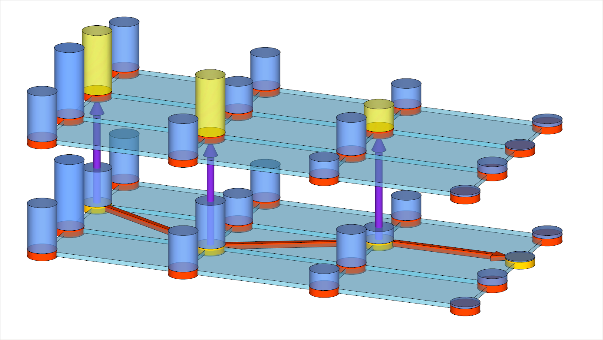
CHALLENGES
iteration →
Process continues till end of the horizon
n+1
n
A
location →
B
t-1
time →
t
C
t+1
D
t+2

Slide 23
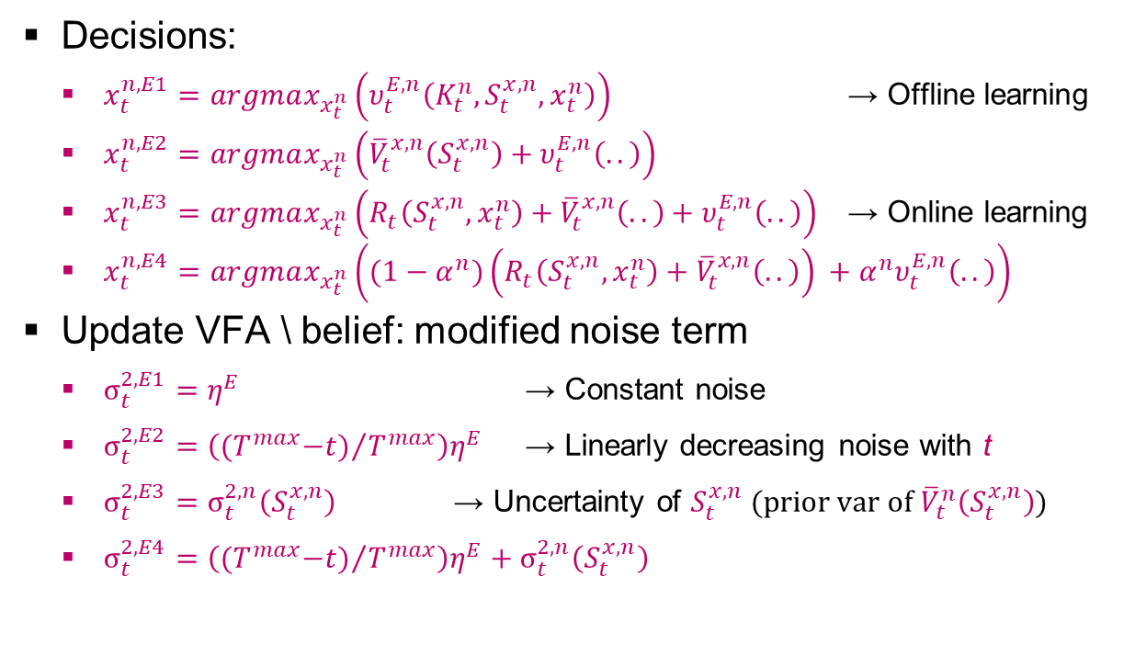
VPI MODIFICATIONS
Knowledge gradient given our current knowledge, current state and decision.
Decisions:
$x_{t}^{n,E1}=argmax_{x_{t}^{n}}\left(υ_{t}^{E,n}\left(K_{t}^{n},S_{t}^{x,n},x_{t}^{n}\right)\right)$ → Offline learning
$x_{t}^{n,E2}=argmax_{x_{t}^{n}}\left({\overline{V}}_{t}^{x,n}\left(S_{t}^{x,n}\right)+υ_{t}^{E,n}\left(..\right)\right)$
$x_{t}^{n,E3}=argmax_{x_{t}^{n}}\left(R_{t}\left(S_{t}^{x,n},x_{t}^{n}\right)+{\overline{V}}_{t}^{x,n}\left(..\right)+υ_{t}^{E,n}\left(..\right)\right)$ → Online learning
$x_{t}^{n,E4}=argmax_{x_{t}^{n}}\left((1−α^{n})\left(R_{t}\left(S_{t}^{x,n},x_{t}^{n}\right)+{\overline{V}}_{t}^{x,n}\left(..\right)\right) +α^{n}υ_{t}^{E,n}\left(..\right)\right)$
Update VFA \ belief: modified noise term
$σ_{t}^{2,E1}=η^{E}$ → Constant noise
$σ_{t}^{2,E2}={\left({{(T}^{max}−t)}/{T^{max}}\right)η}^{E}$ → Linearly decreasing noise with t
$σ_{t}^{2,E3}=σ_{t}^{2,n}\left(S_{t}^{x,n}\right)$ → Uncertainty of $S_{t}^{x,n}$ (prior var of${\overline{V}}_{t}^{n}\left(S_{t}^{x,n}\right)$)
$σ_{t}^{2,E4}={\left({{(T}^{max}−t)}/{T^{max}}\right)η}^{E}+σ_{t}^{2,n}\left(S_{t}^{x,n}\right)$

Slide 24
NUMERICAL EXPERIMENTS
Various network instances
2 freights at each terminal results in 2.6x10⁸ decisions
Benchmark heuristic: use intermodal service for a freight if the cost difference between the cheapest and 2nd cheapest intermodal path covers the setup costs of the 1st.
Tuning: best ratio of two tunable parameters (noise/(initial cov)) is 10⁴, which is in line with the optimal learning literature.
Notes:
Telefoon, fax, email
Alle partijen communiceren dus onderling en dat leidt tot problemen

Slide 25
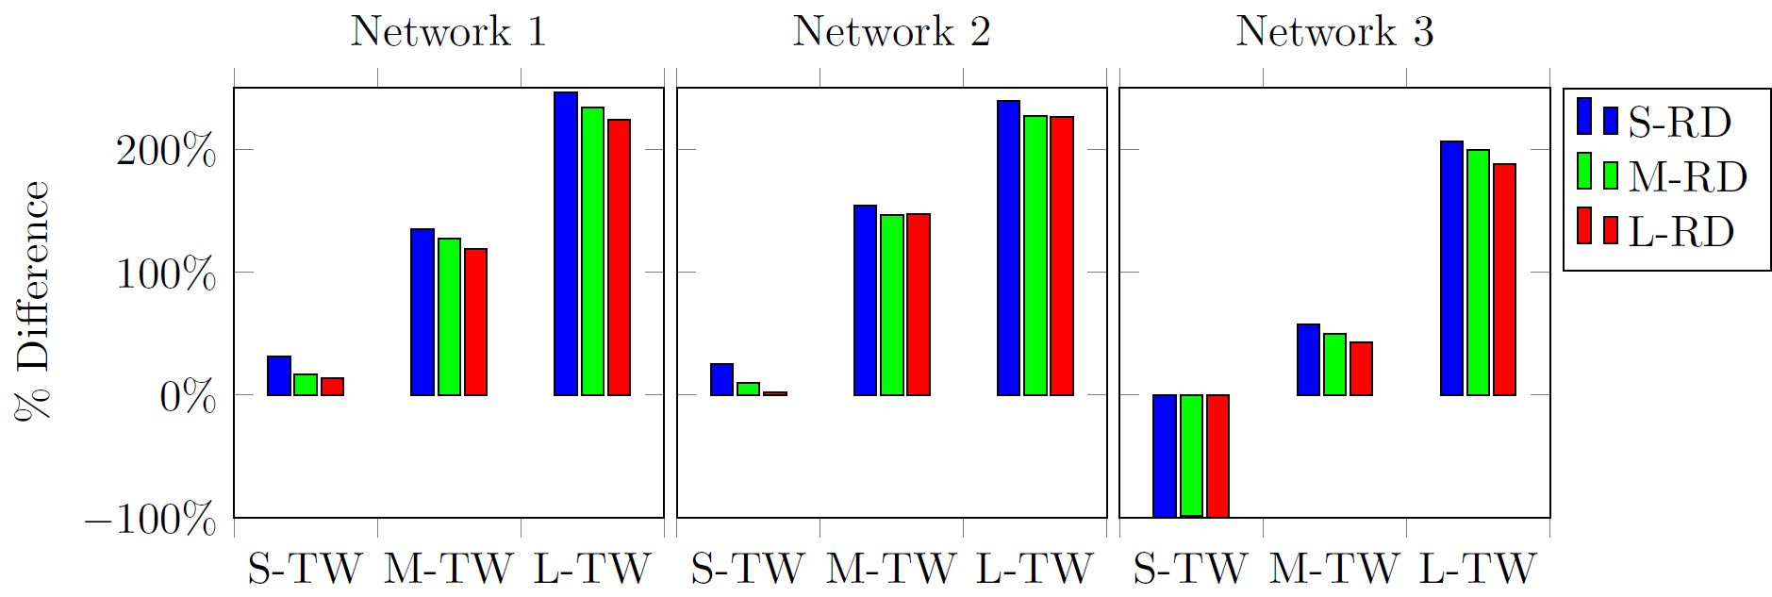

EXPERIMENTAL RESULTS
Our VPI modifications pay off:
Exploration decision: include downstream rewards
Update belief: use noise term equal to variance of ${\overline{V}}_{t}^{n}\left(S_{t}^{x,n}\right)$
Without VPI, ADP always outperformed by a benchmark
Performance ADP+VPI compared to a benchmark:

Slide 26
AND NOW?
Implementation:
Run finite horizon ADP every day using actual data (everything known and probabilities)
Run times << 1 sec (50 iterations)
Show “optimal” solution
Provide planners with estimated future costs of any possible decision
But, are LSPs going to use this?

Slide 27
SERIOUS GAME: TRUCKS & BARGES
To stimulate a mental switch of LSPs and illustrate the benefits of anticipatory planning
The game can be used to educate logistics professionals as well as students on:
the challenges involved in transportation planning
the benefits of decision support and automated planning
the way automated planning rules can be designed
Decision support in the game uses the ADP algorithm from this presentation…

Slide 28
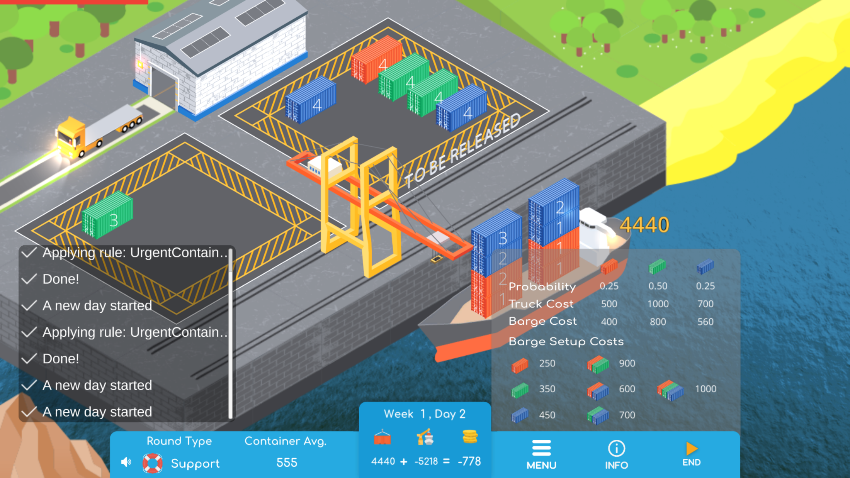
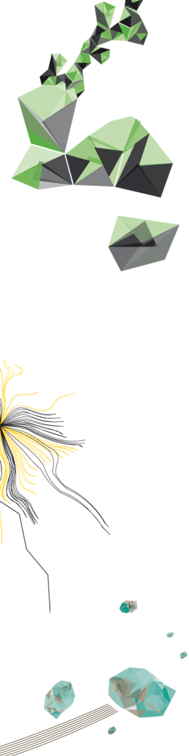

Slide 29
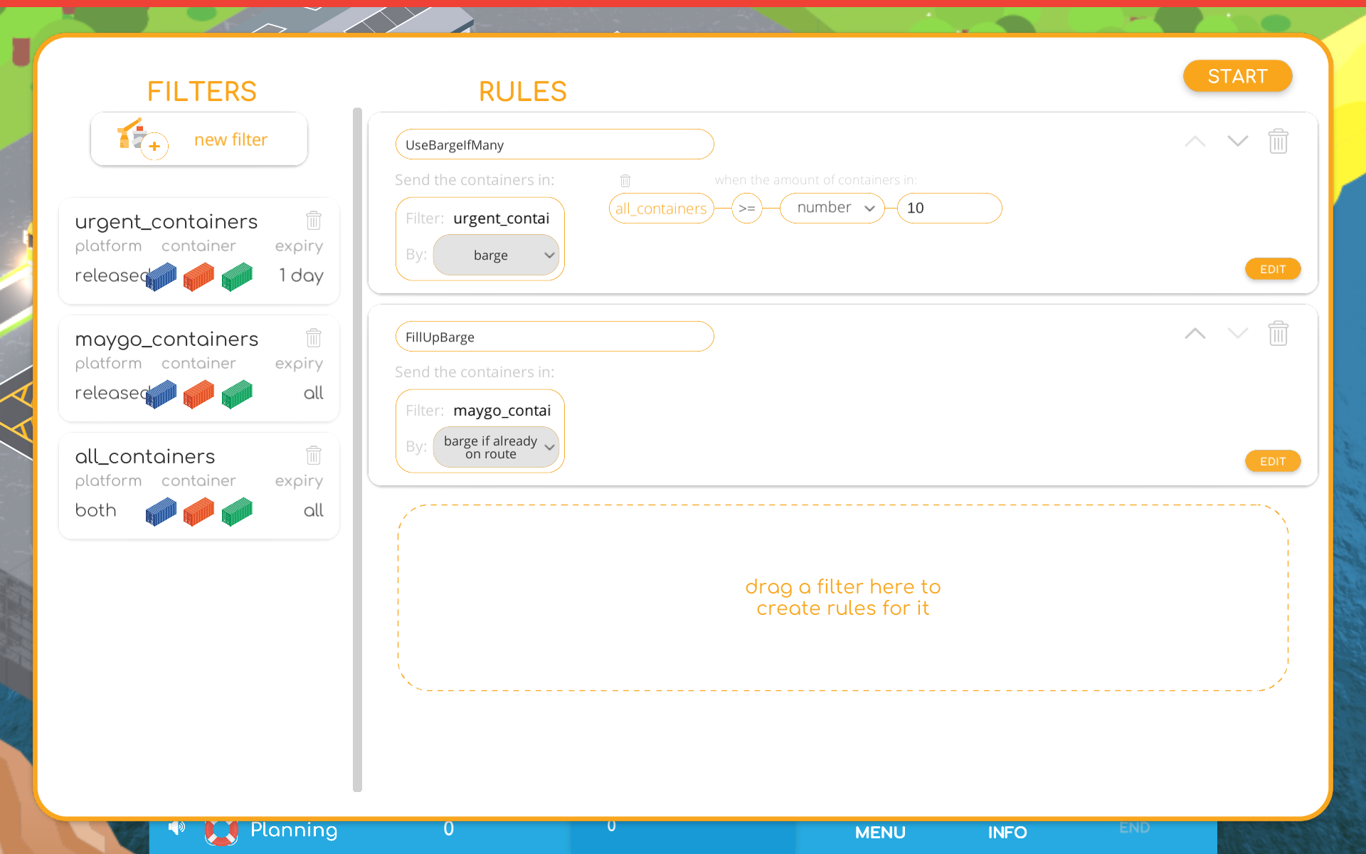

Slide 30
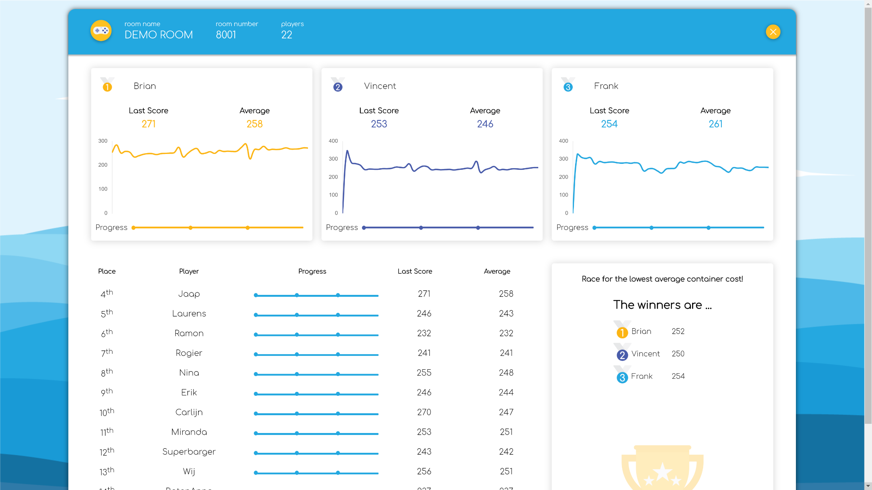

Slide 31
TRUCKS & BARGES V2.0 (APRIL 2020)
Freely available
Also for game masters (game management system)
Includes 8 algorithms:
2 heuristics
4 ADP versions: VFA-based & Neural Network-based ADP
DP & SDP versions (“optimal” solutions)
Includes an extension of the algorithm creator with more flexibility (e.g., include own Python code)
Includes extra modality (train) and extra restrictions
Includes educational material

Slide 32
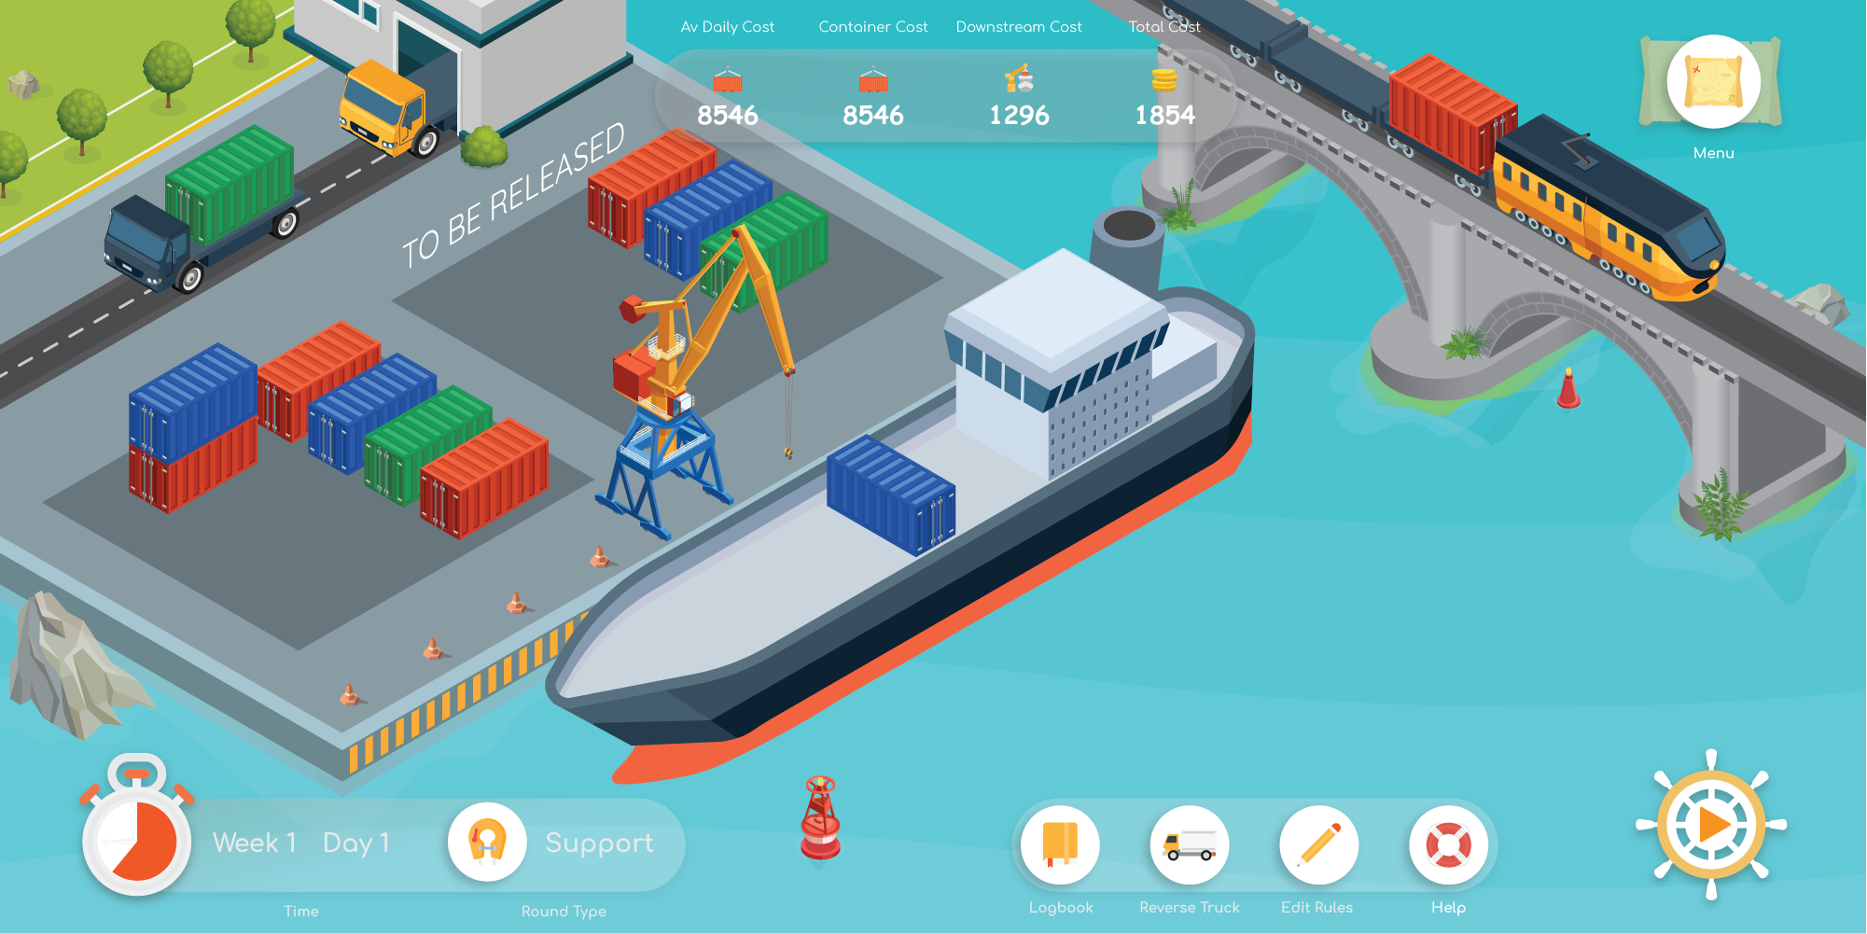

Slide 33

HOW DOES IT WORK?
Go to: www.trucksandbarges.nl and click play
Play serious using room 1022
Play 4 rounds:
Practice: just to practice
Normal: play serious
Support: play serious with support
Algorithm: create your own planning rules
Each round consists of 3 independent weeks, and each week has 5 “working” days.
Each day, drag “released” containers to the barge or trucks.

Slide 34
TO REMEMBER…
ADP+VPI for anticipatory planning
VPI significantly improves the performance of ADP
Exploring and updating with VPI should be done more conservative compared to “regular” VPI
Serious game to illustrate the benefits of anticipatory planning and gain insight into workings various algorithms

Slide 35
QUESTIONS?
Martijn Mes
Associate professor
University of Twente
School of Management and Governance
Dept. Industrial Engineering and Business Information Systems
Contact
Phone: +31-534894062
Email: m.r.k.mes@utwente.nl
Web: https://www.utwente.nl/bms/iebis/staff/mes/

