Slide 1

Integrated Tactical and Operational Planning of Police Helicopters
Martijn Mes
Department of Industrial Engineering and Business Information Systems
University of Twente
The Netherlands
Joint work with: R. van Urk, R. Vromans, K. van Hal, E. Hans, M. Schutten.
Sunday, November 9th, 2014
INFORMS Annual Meeting 2014, San Francisco, USA

Slide 2

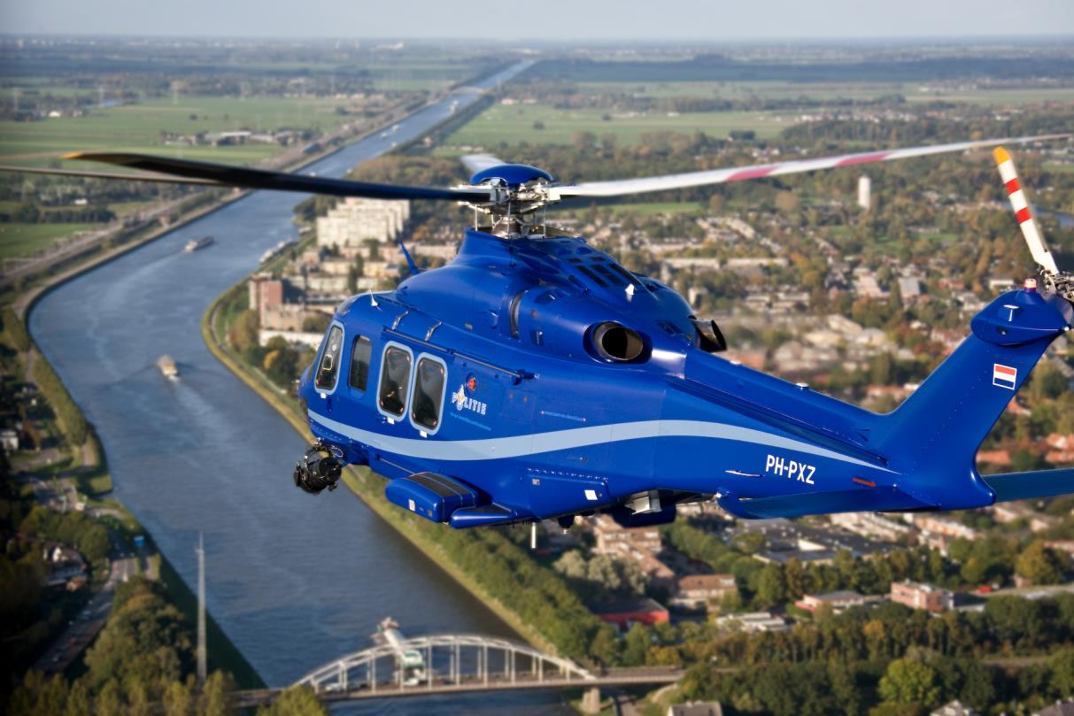
INTRODUCTION
To reduce the file size, the original movie (used to give an idea on the activities of the Dutch Aviation Police and Air Support) has been replaced by this image.
Source: Dutch Aviation Police and Air Support

Slide 3
INTRODUCTION
Dutch Aviation Police and Air Support
Renewed fleet of helicopters with state-of-the-art equipment
Planning:
Decision support
Strategic planning
Tactical planning
Operational scheduling
Nr and type of helicopters, base stations, etc.
Division of flight budget to days, shift times, etc.
When and where to fly on a given day.

Slide 4
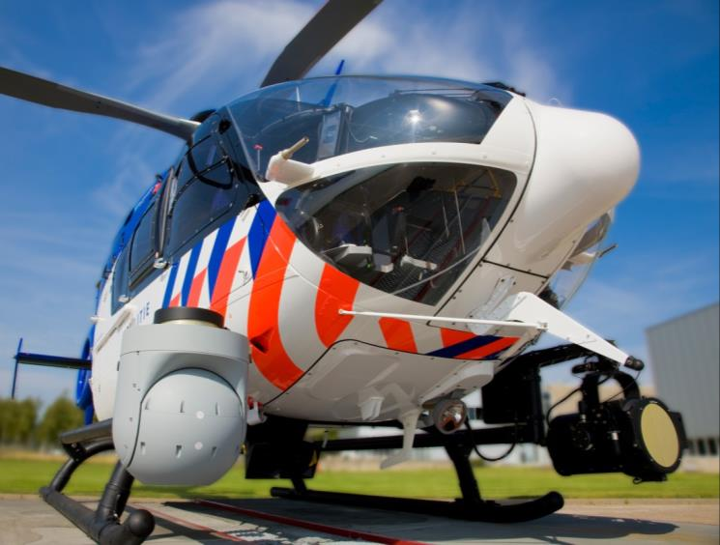
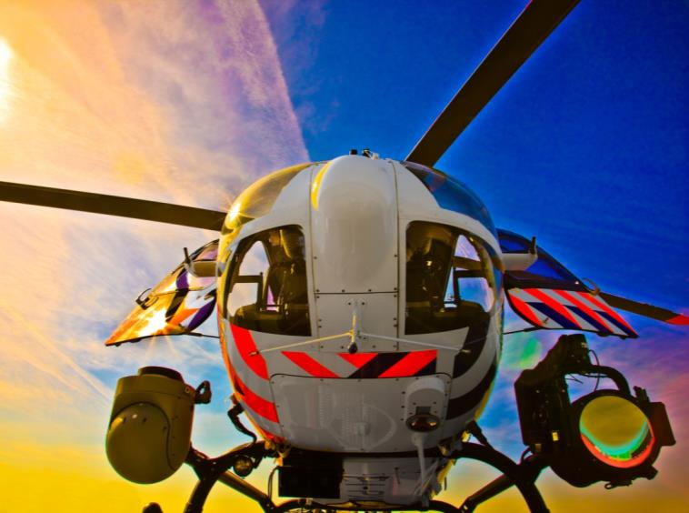
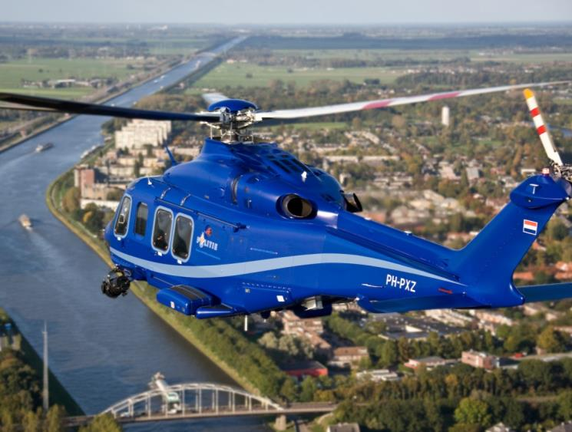
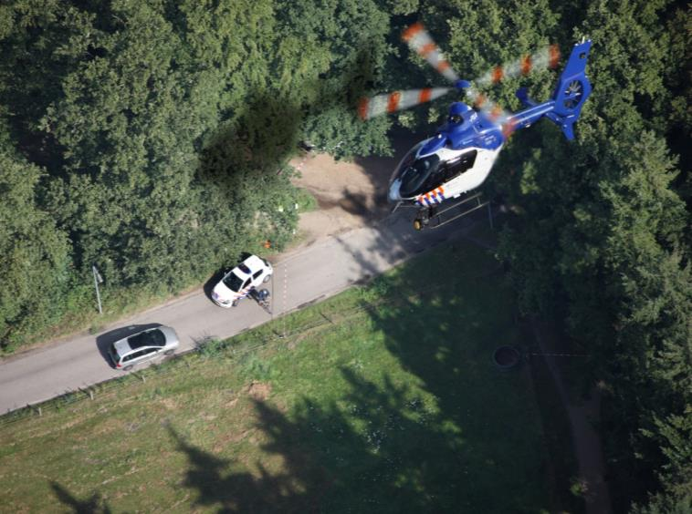
Source: Dutch Aviation Police and Air Support
Source: Dutch Aviation Police and Air Support
Source: Dutch Aviation Police and Air Support
Source: Dutch Aviation Police and Air Support

Slide 5

OPERATIONAL SCHEDULING
Decision support system for
  routing of police helicopters
  in anticipation of unknown incidents
  to maximize the weighted expected number of covered incidents
Fixed flight budget
Combination of the research fields…
  Dynamic and Anticipatory Vehicle Routing Problem
  Location Covering Problem
We split the problem in (i) forecasting and (ii) routing

Slide 6

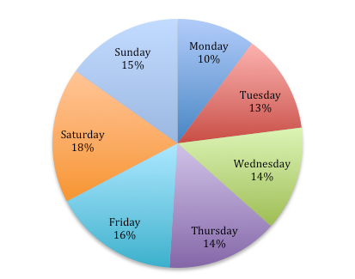
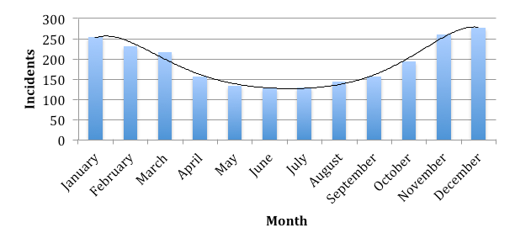
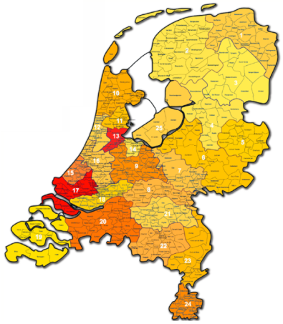
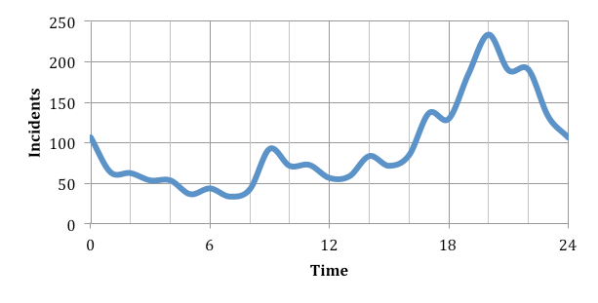
FORECASTING [1/2]

Slide 7
FORECASTING [2/2]
Forecast for today, for each time unit (2 minute periods) and each forecast area (hexagonal tiling with hexagons having 2 nautical miles inner radius).
Use all historic incidents to create this forecast for each time and place, but multiply them with a weight depending on
  Age (more weight on recent observations)
  Month (high weight if the incident is within the same month as the forecast day)
  Weekday (high weight if the incident is on a same weekday as the forecast day)
  Space (more weight if the forecast area is close to the area the incident actually occurred, many weights equal to zero)
  Time (more weight if the time-of-the-day is close to the time the incident actually occurred, many weights equal to zero)

Slide 8

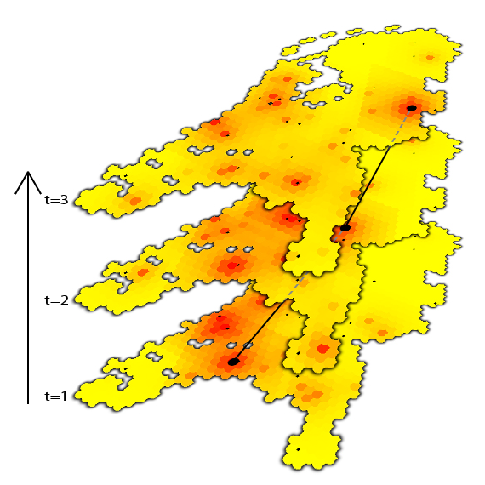
ROUTING CHALLENGE
Being at the right time at the right place
To reduce the file size, the original 3D animation (used to illustrate the idea of being at the right time at the right place) has been replaced by this image.

Slide 9
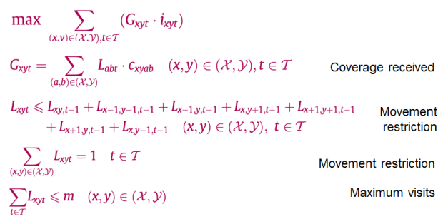
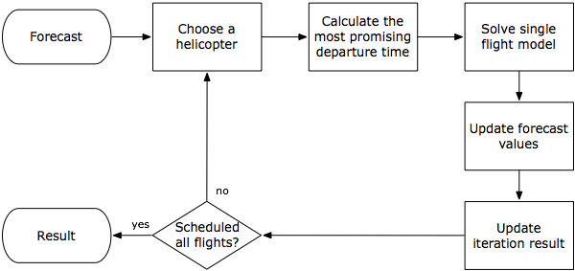
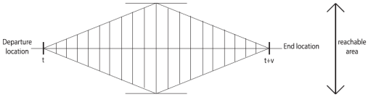
ROUTING MODEL
Exact method (MILP)
Heuristic procedure:
schedule one helicopter
at a time
Notes:
Telefoon, fax, email
Alle partijen communiceren dus onderling en dat leidt tot problemen

Slide 10

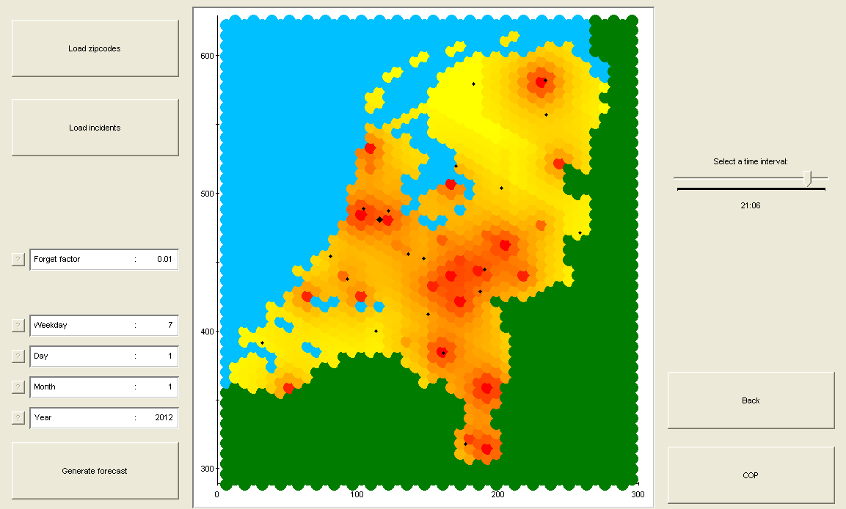
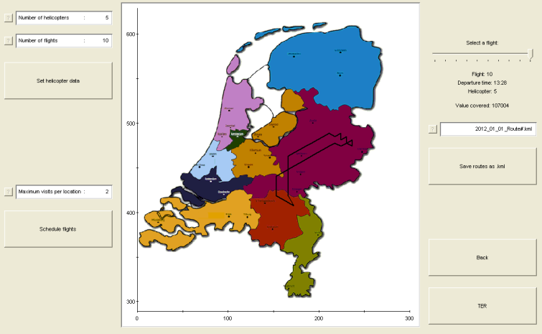
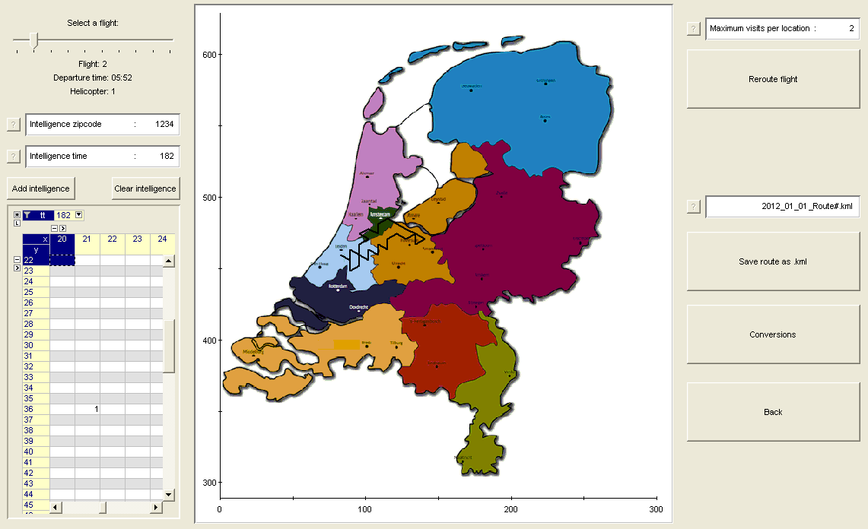
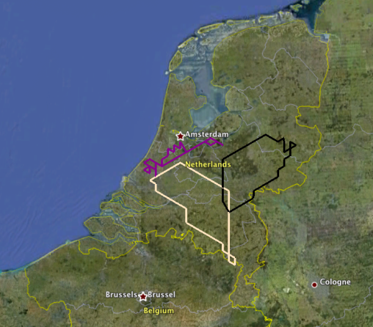
APPLICATION
Notes:
De nieuwe situatie is de Planning Apart Together situatie
Zelfstandige bedrijven
Elk bedrijf een agent
Agents communiceren digitaal: effectievere communicatie, snelle besluitvorming
Agent is een stukje software
Idee is gelijk aan wat we kennen vna de verzekeringsagent en verzekeringsbedrijf
Agent is bedrijfsspecifiek

Slide 11
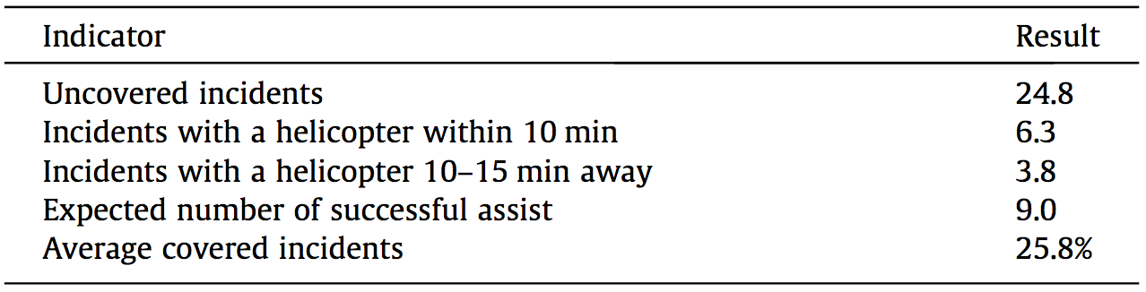
RESULTS
Historic data set of incidents for 2 years
Use year 1 for learning only
Use year 2 to simulate and learn
Results:
Normalized such that the number of successful assist of the Dutch Aviation Police & Air Support (in year 2) equals 1

Slide 12

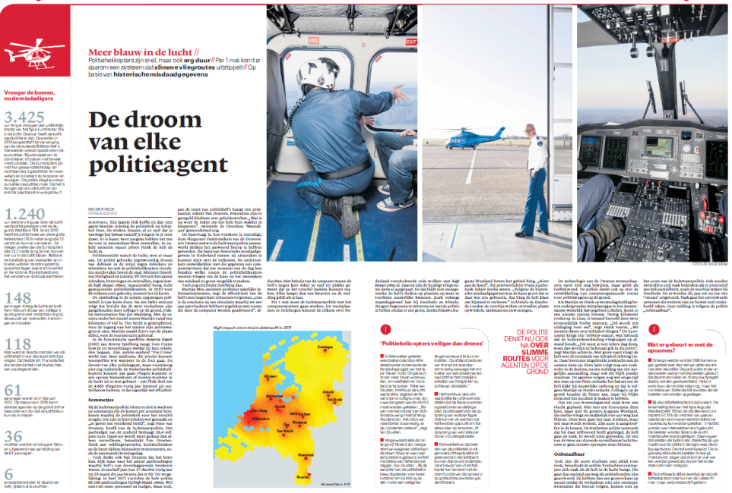
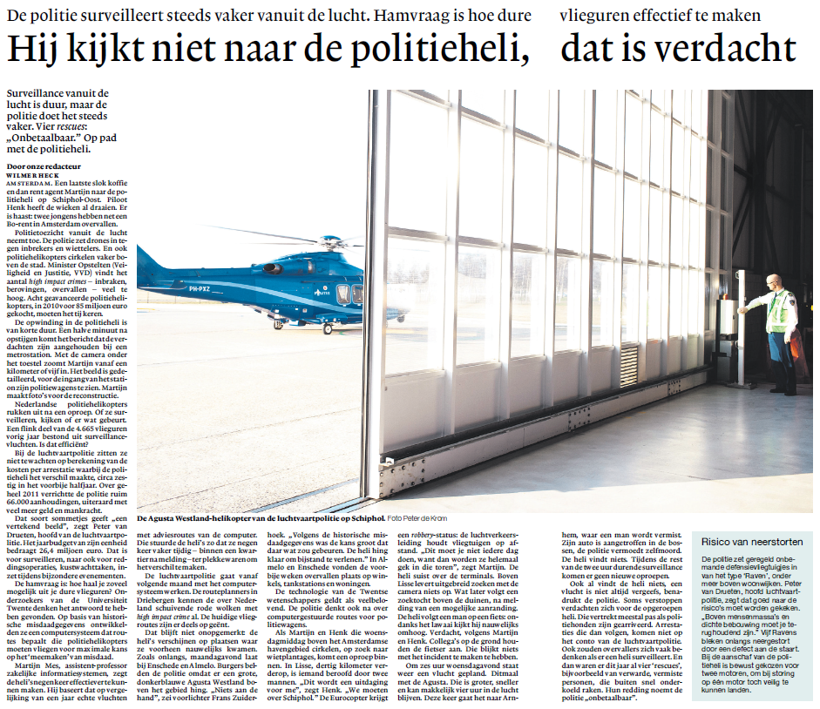
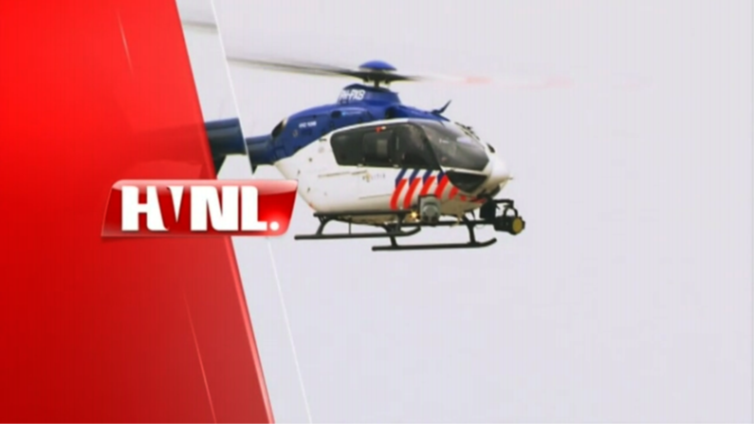
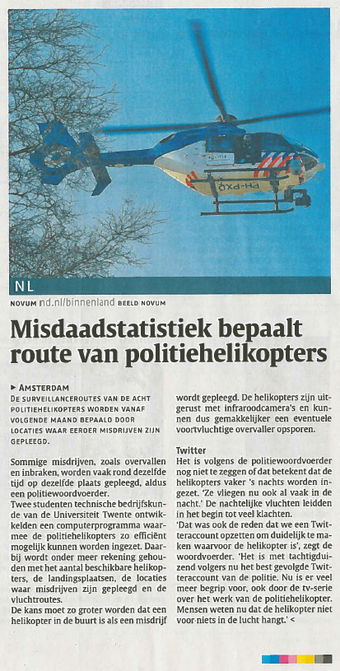
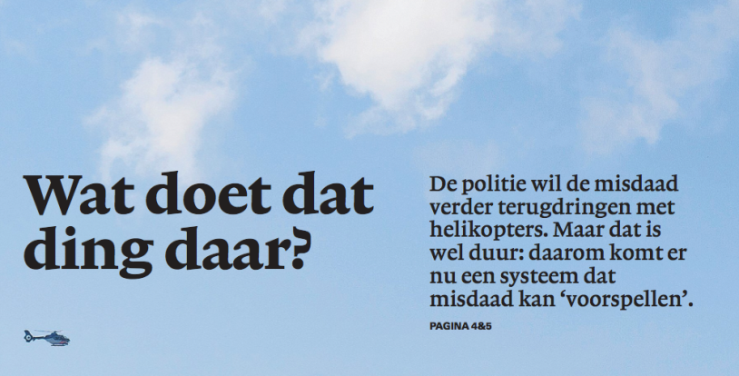
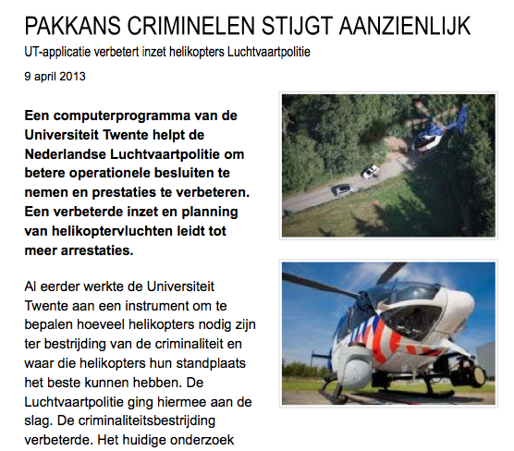
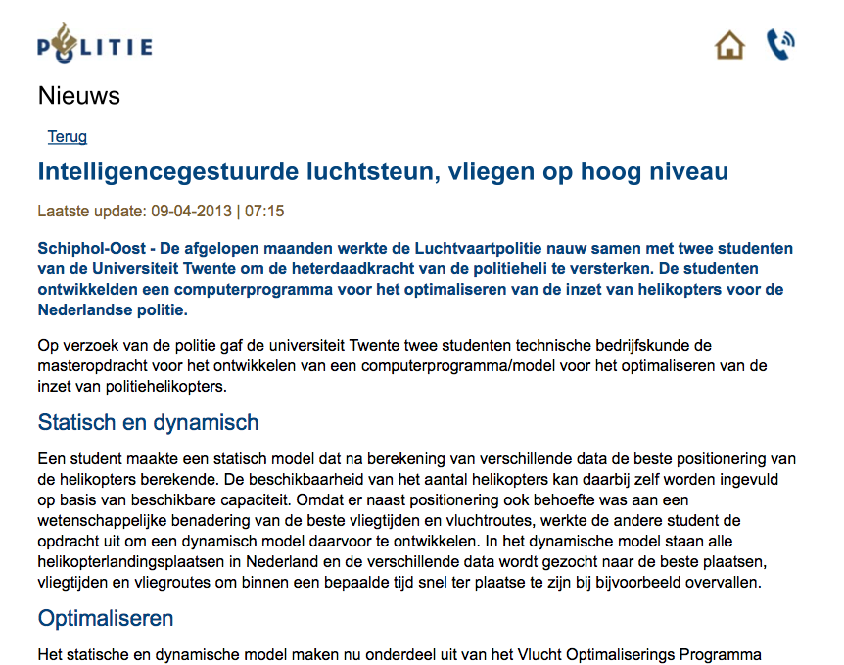

MEDIA

Slide 13
HOWEVER…
Not 9 times as good…
Benefits could also have been achieved with relatively simple policies
Effect of dynamic routing small compared to
  Setting the departure times
  Division of flight hours over the year
  Scheduling shift times
  Allocation of standby helicopters to various base stations
Tactical planning

Slide 14
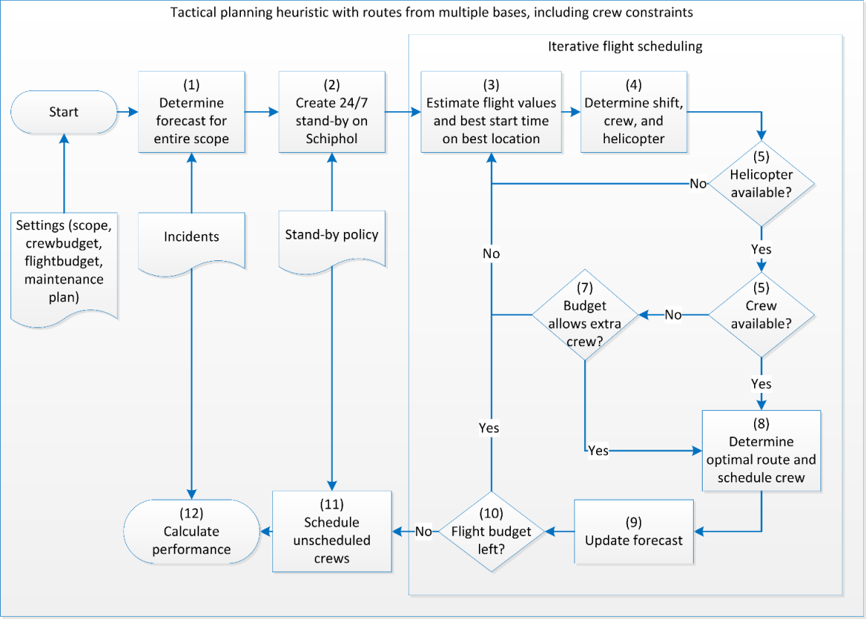
TACTICAL PLANNING MODEL
Notes:
Telefoon, fax, email
Alle partijen communiceren dus onderling en dat leidt tot problemen

Slide 15

THE IDEA
Crews
Flights
5
4
3
2
1
10
0
4
3
2
0
Schiphol (Amsterdam)
Rotterdam
Volkel
Notes:
Telefoon, fax, email
Alle partijen communiceren dus onderling en dat leidt tot problemen

Slide 16
HOWEVER…
Only 4% additional improvement
Further improvement possible
  Impact of standby is relatively large, so why start the heuristic with planning the surveillance flights?
  Many options with different types of helicopters at different base stations unexplored
Tactical model difficult to use by the police
Unnecessary level of forecast and routing detail in tactical plan

Slide 17
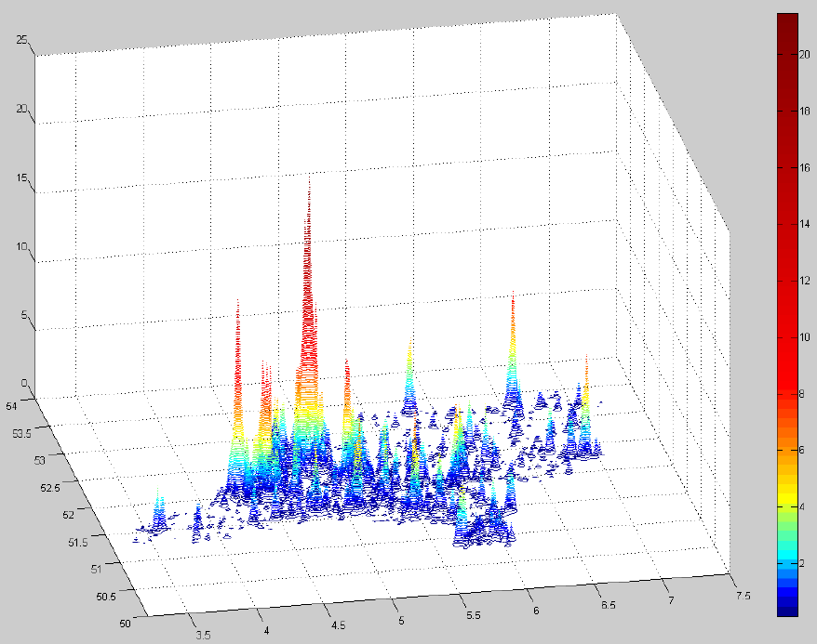
TACTICAL PLANNING MODEL – NEW FORECAST
Assumption: relative division of crime independent of time
  Time: 𝜆_{ℎ,𝑑,𝑤}=𝛼_{ℎ,𝑑}∗𝛾_{𝑤} using datasets of last 4 years, with heavier weight on more recent years
  Location: kernel density estimation (Silverman, 1986)
Automatically identify
hotspots
Formulate forecast in
terms of hotspots
(spots with intensity
above some threshold)

Slide 18
IMPROVED (?) TACTICAL PLANNING MODEL
Define hourly configurations:
  Nr of helicopters of each type flying
  Nr of helicopters of each type on standby
  The base station of each standby helicopter
Given various restrictions, we have a total of 55 possible configurations
Configurations with flights have predetermined routes
Calculate the expected coverage up front for each config.
Approach: for each point in time (hours in a year) choose the best configuration, taking into account several restrictions on sequences of configurations
Final results not yet available…
Notes:
Telefoon, fax, email
Alle partijen communiceren dus onderling en dat leidt tot problemen

Slide 19
CONCLUSIONS
Operational scheduling
  Combination of forecasting (generalization in time and space) and routing (MILP + heuristic)
Tactical planning
  Simultaneous planning, on an hourly basis for a year in advance, of shifts, flight hours, and standby hours/locations
Both models\applications:
    Validated with experts and a simulation study
  Currently used by the Dutch Aviation Police and Air Support
Our research pitfalls
  Unfair comparison with current practice
  Too much focus on routing\flights instead of shift planning

Slide 20
QUESTIONS?
Martijn Mes
Assistant professor
University of Twente
School of Management and Governance
Dept. Industrial Engineering and Business Information Systems
Contact
Phone: +31-534894062
Email: m.r.k.mes@utwente.nl
Web: http://www.utwente.nl/mb/iebis/staff/Mes/

