Slide 1















ANTICIPATORY LOGISTICS
MARTIJN MES

Slide 2

IN THIS PRESENTATION:
1.
2.
3.
4.
5.
INTRODUCTION
EXAMPLE 1:
WASTE COLLECTION
EXAMPLE 2:
AVIATION POLICE
EXAMPLE 3:
SYNCHROMODAL TRANSPORT
IMPACT

Slide 3
1. INTRODUCTION

Slide 4
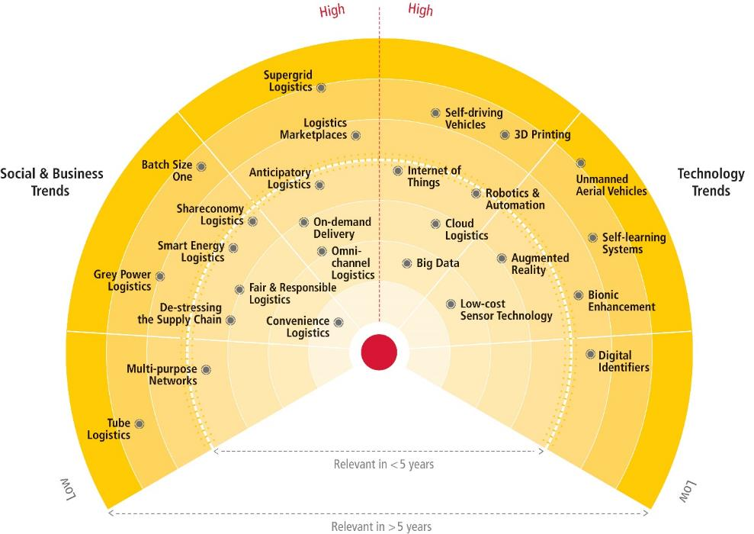
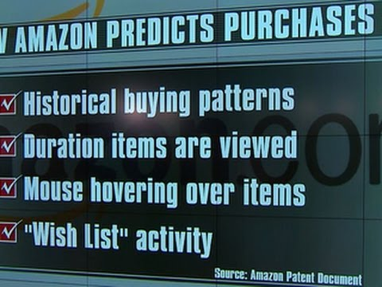
INTRODUCTION
TEACHING
My research:
  Sustainable logistics, city logistics, emergency logistics
  Increase transport efficiency through dynamic, real-time,
  and anticipatory planning, taking into account transport
  externalities (emissions, congestion, safety)
DHL (Logistics Trends Radar 2016) predicts 3 logistics trends:
  Self-driving and unmanned vehicle technology
  The Internet of Things (IoT)
  Logistics driven by AI and machine learning:
    Anticipatory logistics and self-learning systems (AL)
AL: predictive algorithms running on (big) data to enhance planning
and decision-making, process efficiency, service quality (delivery times)
AL examples in this presentation:
  Waste collection
  Aviation police
  Synchromodal transport
|
1

Slide 5



2. EXAMPLE 1:
WASTE COLLECTION

Slide 6
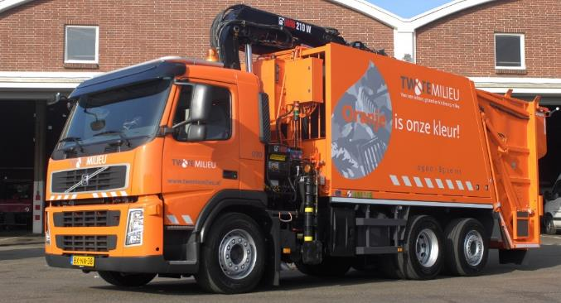
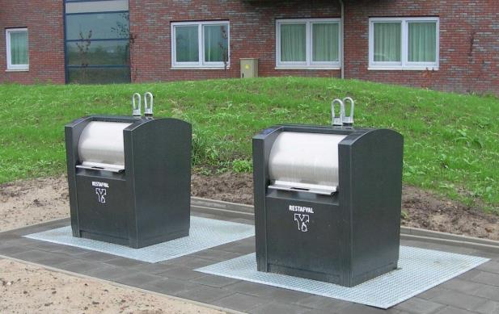
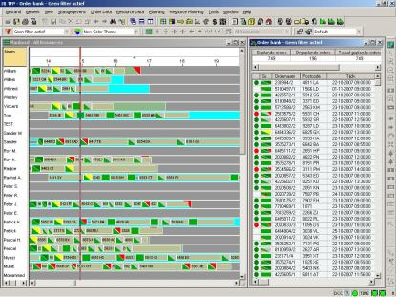
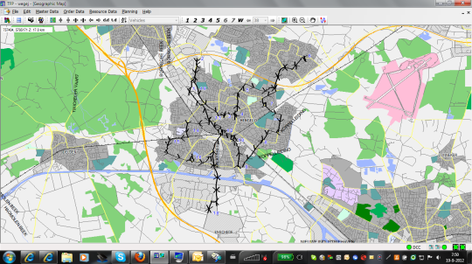
DYNAMIC WASTE COLLECTION
Twente Milieu:
  One of the largest waste collectors in the Netherlands
  Shift towards underground containers, equipped with motion sensors
  Shift from a static to a dynamic planning methodology: select containers based on their estimated fill levels
Inventory Routing Problem: when to deliver which customer?
Approach:
  Heuristic equipped with a number of tuneable parameters to anticipate changes in waste disposals
  Parameter settings may be time-dependent and might change
  over time
  Learn parameters through simulation (offline learning) or in
  practice (online learning)
Methodologies: heuristic methods; simulation optimization, Optimal Learning, Ranking & Selection, Bayesian Global Optimization (BGO)
|
2

Slide 7


3. EXAMPLE 2:
AVIATION POLICE

Slide 8
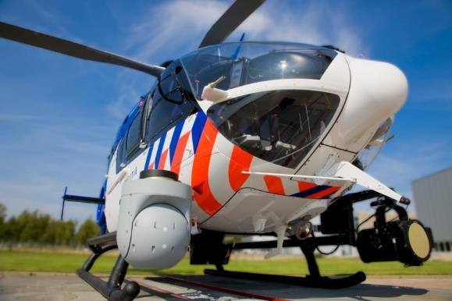
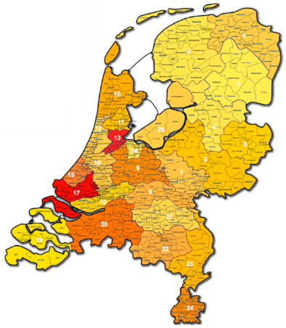
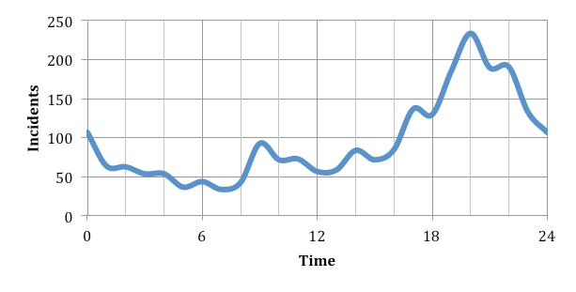
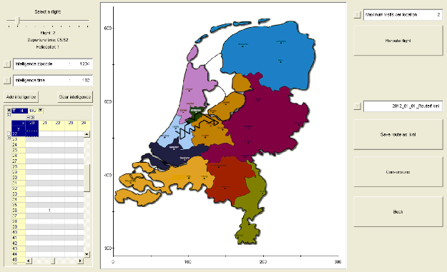
ANTICIPATORY PLANNING OF POLICE HELI’S
Integrated tactical and operational planning of police helicopters in
anticipation of unknown incidents to maximize the “coverage”
Forecast:
  Generalize historical incidents in time and space, put more emphasis on recent observations, and combine with intelligence
Operational decision - when and where to fly and standby:
  Matheuristic: exact solution for one helicopter with given departure time
Tactical decision - division of flight budget, personnel, and standby strategies
to days and shifts:
  Hourly configurations (#flying heli’s, #standby heli’s, standby locations)
  Configurations subject to various restrictions, predefined routes,
  and given coverage for each configuration per hour
  Shift configurations consisting of a given sequence of hourly
  configurations (several thousands of possible shift configurations)
  Solve ILP exactly to determine best shift configuration for each shift
|
3

Slide 9


4. EXAMPLE 3:
SYNCHROMODAL TRANSPORT

Slide 10
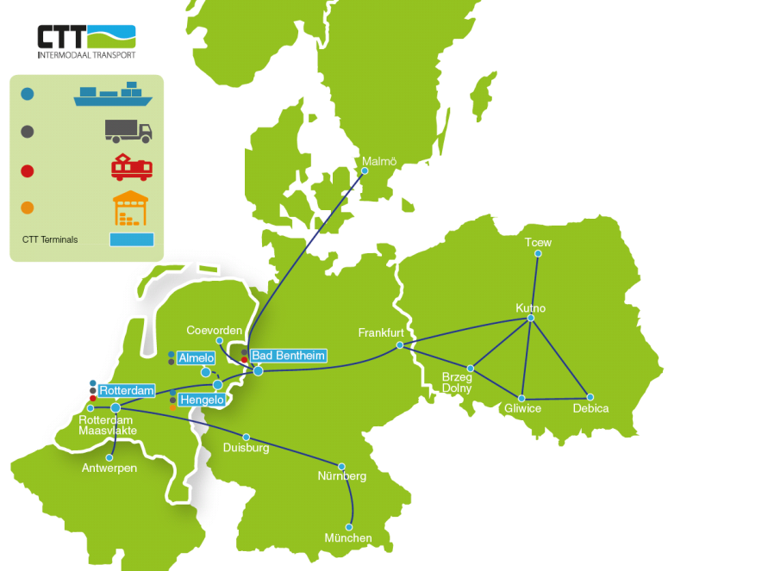



SYNCHROMODAL TRANSPORT
?
Today
Tomorrow
Day-after
|
4

Slide 11


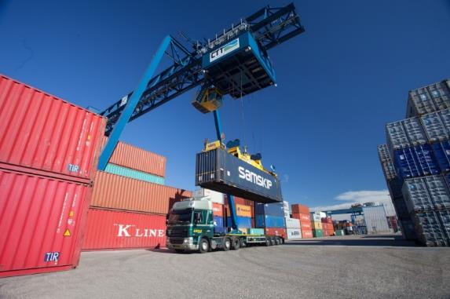
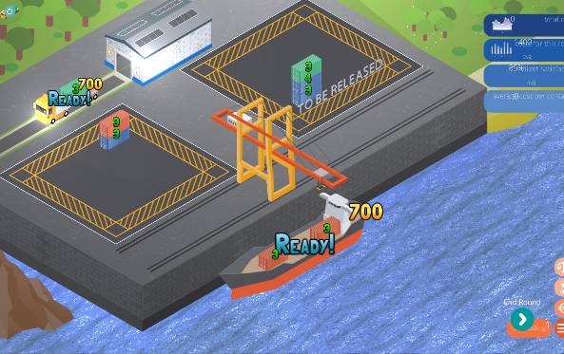
SYNCHROMODAL TRANSPORT
?
Today
Tomorrow
Day-after
Approach: Approximate Dynamic Programming combined with Optimal Learning techniques (efficient information collection), for offline and online learning
|
4

Slide 12
5. IMPACT

Slide 13
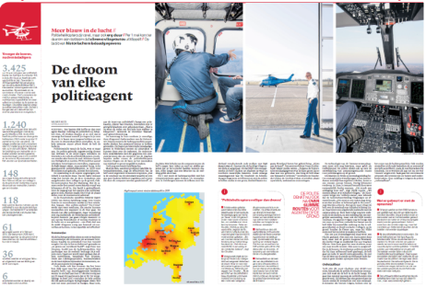
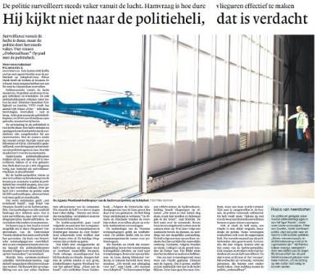
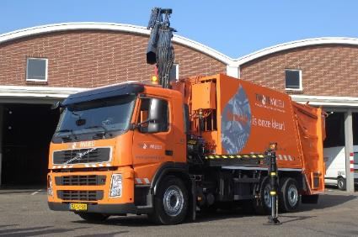
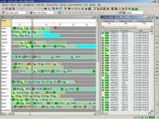
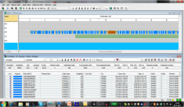
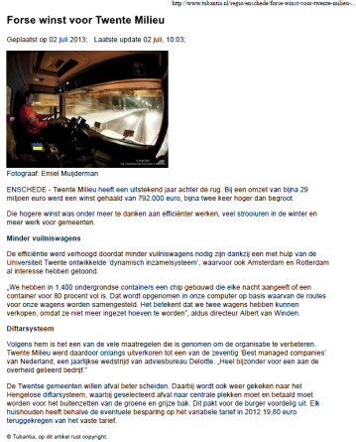
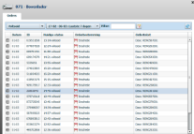

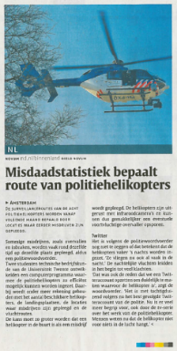
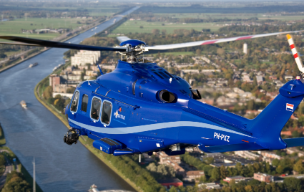
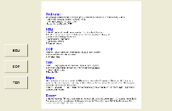
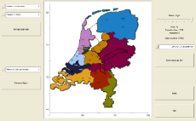

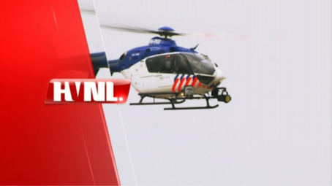
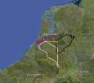


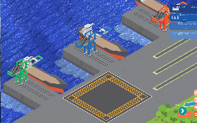
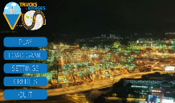

IMPACT
Illustration
Science
Practice
Anticipatory and dynamic planning
Adaptive systems and optimal learning
Gamification
20%
25%
Heuristics
Mathematical programming
Matheuristics
Approximate Dynamic Programming
Value Function Approximation
Bayesian Learning (VPI/KG)
Bayesian Global Optimization
?
|
5

Slide 14
QUESTIONS?

