Slide 1
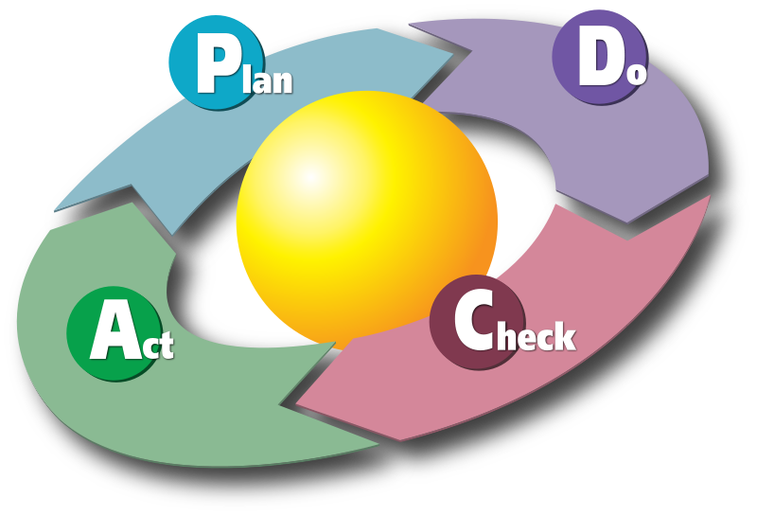
Change management
Plan a change
Involve shareholders
Identify problems
Predict resistance
Do it on a small scale
Inform shareholders
Acceptance
Promoters
Potential promoters
Hidden opponents
Positive
Positive
Opponents
Negative
Negative
Make a decision
Adopt, Abandon or change plan
Compare support vs. Resistance:
Study the results
List promoters and opponents
Identify reasons
Dis-satisfaction
X
Desirability
X
Practicality
>
Resistance

