Slide 1
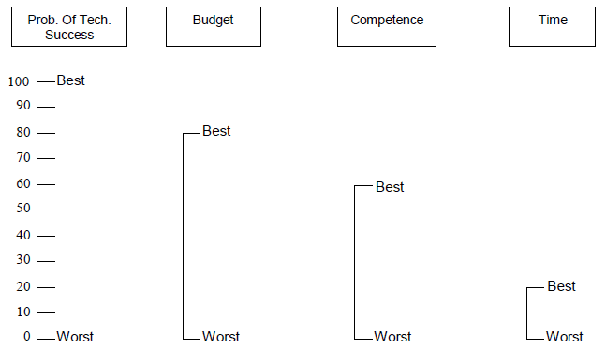
1. Rank the criteria
2. Compare swing weights
Compare one attribute with other attributes from the most-preferred to the least-preferred. The most preferred attribute gets a weight of 100. See the example.
3. Normalization
Divide each weight by the sum of the weights and multiplying it by 100.
Way 40 – Weighting of criteria
By Jose ter Steege (s1014005), E-strategizing (2010-2011)

