Slide 1
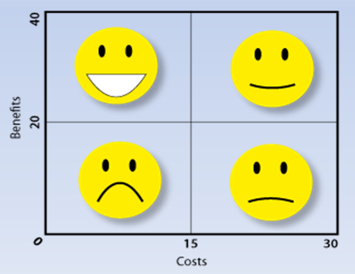
WAY 39
Creation
Benefit | Rating (1-10)
Fits information need
Fits organizational objectives
Fits overall strategy
Revenues
Total
Evaluation
Preparation
Approved by IT investment board
Project managers and stakeholders to inform:
-
-
-
-
-
-
-
Selection criteria review date:
__-__-____
Which procedures and policies are used?
-
-
-
-
-
Who is responsible?
-
-
-
-
-
-
Costs | Rating (1-10)
Resources
Project costs
Time required
Total

