Slide 1
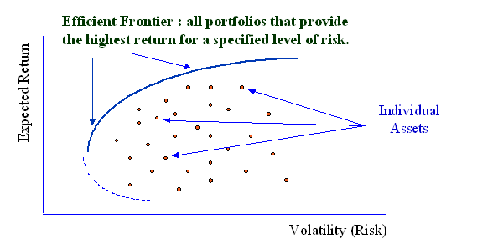
Way 34: Select the right project portfolio
Project | Value | Risk
A
B
C
D
Calculate the value and risk of all projects
Calculate and plot all possible portfolios, commonly used method: Monte Carlo simulation
The plot shows an efficient frontier; choose the portfolio on or close to this line
Way 34. Proposed IS/IT project portfolio
1

