Slide 1
Anticipatory Synchromodal Transportation Planning
Exploration in ADP + Serious Game
Martijn R.K. Mes
University of Twente
Hiring 6 assistant/associate profs in business analytics:
https://tinyurl.com/y6mdfx3a
INFORMS Annual Meeting 2019 | October 22, 2019

Slide 2

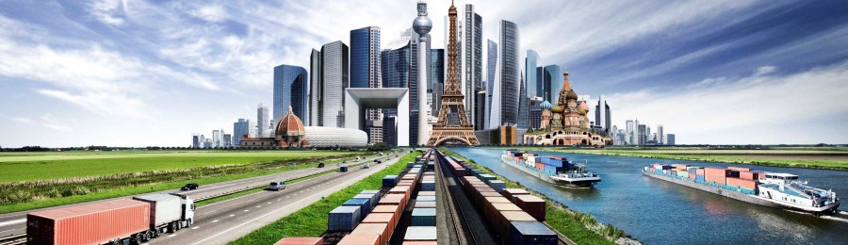
SYNCHROMODAL TRANSPORT
Source: European Gateway Services
In execution similar to intermodal transport, but essentially different in the (re)planning (made by the LSP):
  Dynamic mode choice for each incoming order (mode-free booking)
  Decisions can be made at all times, even during execution, based on real-time information, e.g., water levels and traffic information
Focus on network-wide performance over time

Slide 3
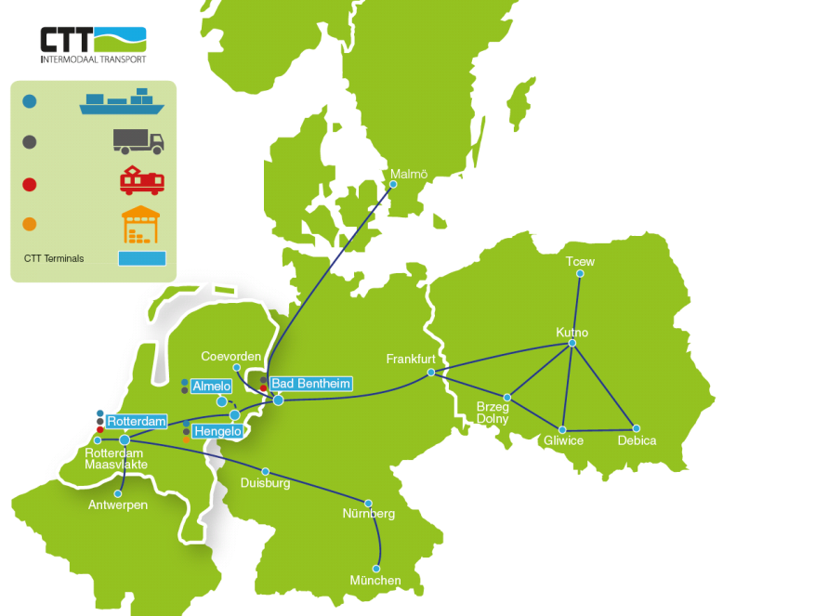
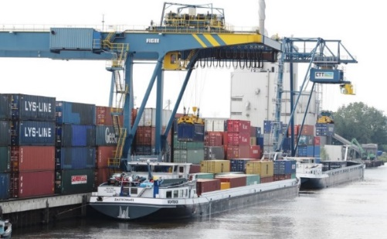
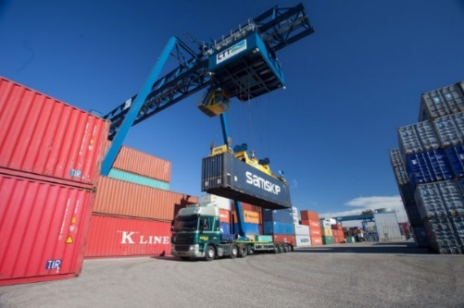
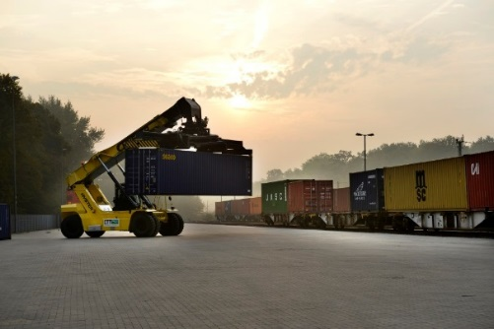
CASE STUDY: CTT NETWORK FROM PORT OF ROTTERDAM TO THE HINTERLAND

Slide 4
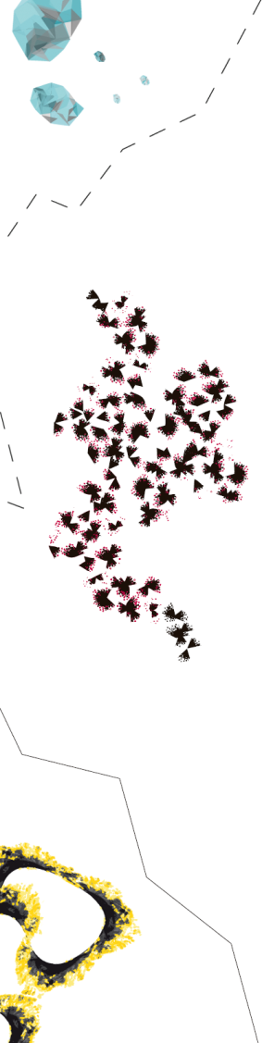

SYNCHROMODAL SCHEDULING: ANTICIPATORY ROUTING AND POSTPONEMENT DECISIONS
Train
Barge
Terminal
Origin
Destination
Assign to first train to 6 or postpone?
2
3
8
10
Or use even longer detour to combine with green till 7?
1
5
6
7
11
Use detour through 6 to combine with other reds?
0
4
9
12

Slide 5
THE OPTIMIZATION PROBLEM
Input:
  Current state of the transportation network: terminals, services, schedules, durations, capacity, costs, revenues, time-horizon
  Current freights and probability distributions for the arrival of freights and their characteristics, for each period of the horizon
Output:
  Expected profit for each state
  Policy: given the current state, which service to use for each freight
State at t: S_{t}=[F_{i,d,r,k,t} ]∀i,d,r,k:
  Number of orders at (or in transit to) i, having destination d, release day r (relative to t), and time-window k (relative to r)
Finite horizon

Slide 6
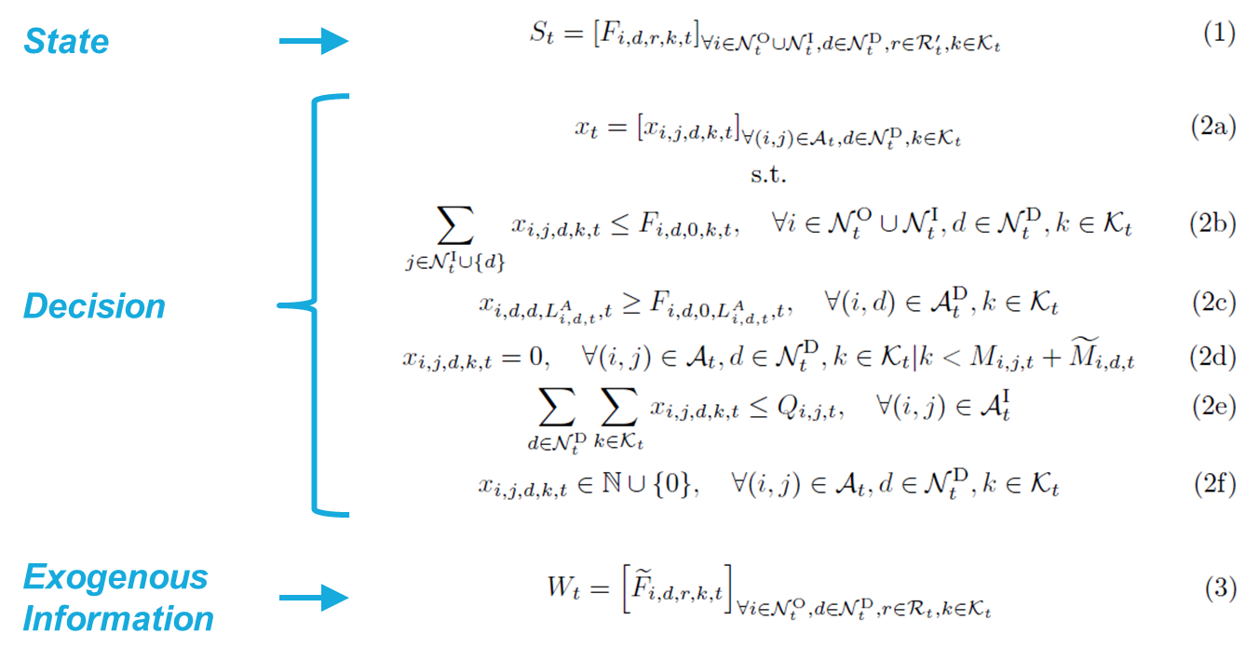
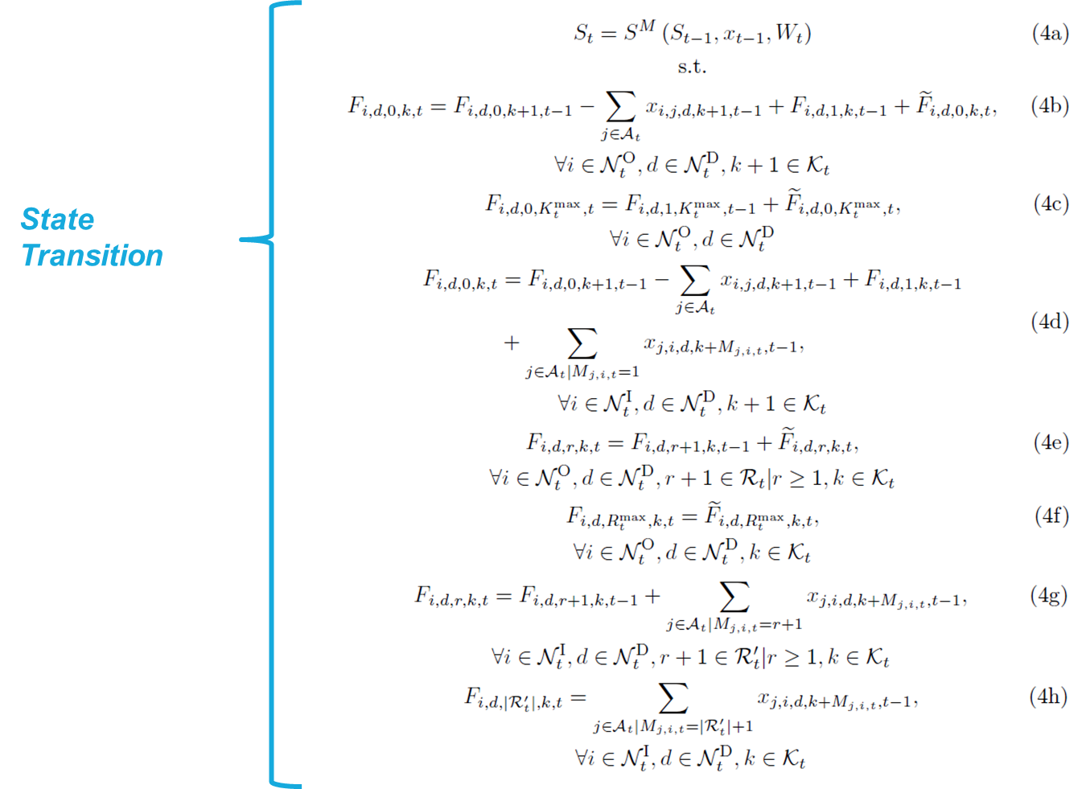
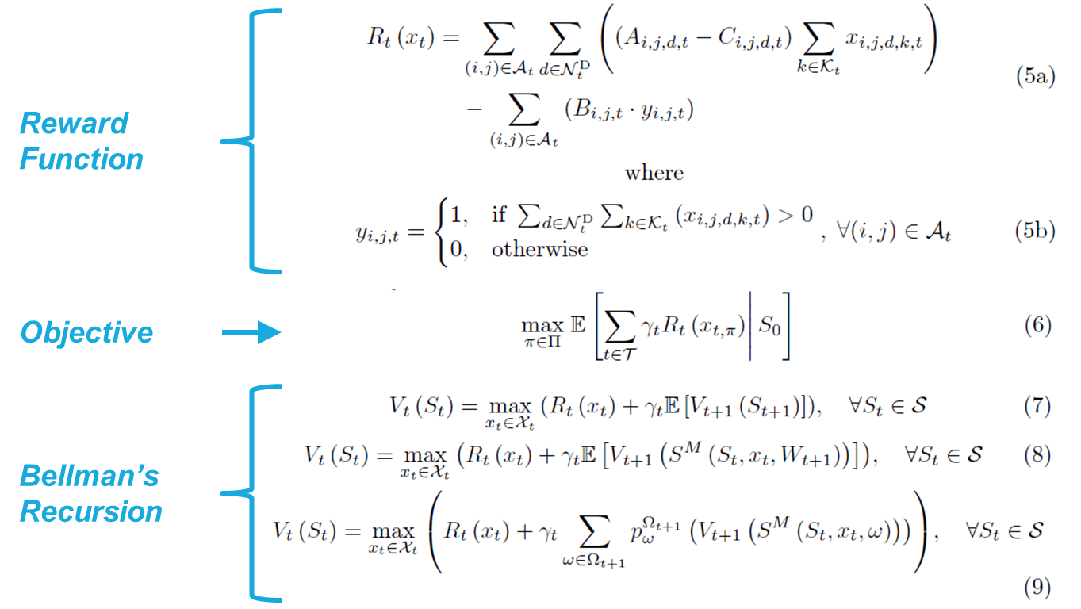
MARKOV DECISION PROCESS (MDP) MODEL
Solve with ADP

Slide 7
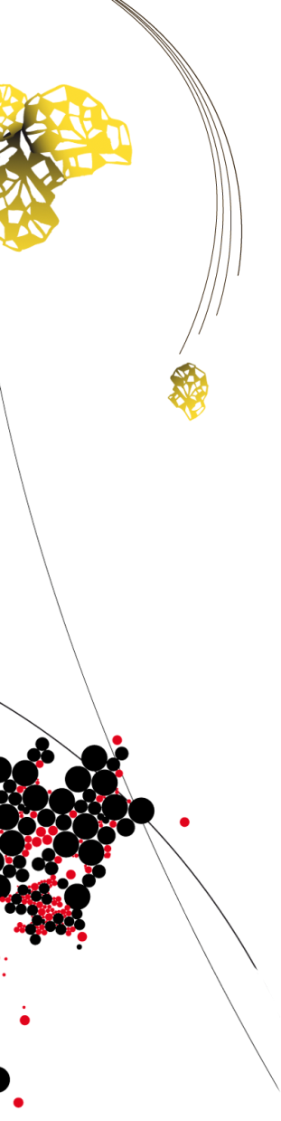
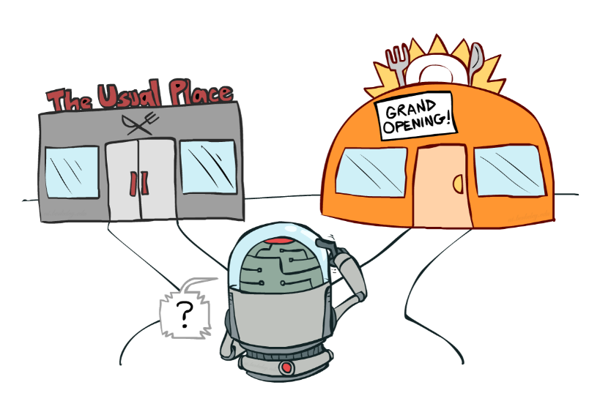
EXPLORATION VS EXPLOITATION
Finite horizon ADP, approximate value iteration, on-policy
Exploration vs exploitation dilemma due to delayed rewards and/or costs
Necessary to explore… but how? (when, what, how long?)
Incorporate the value of information: the expected improvement in future decision quality
  Dearden et al. (1999)
  Gupta, S. and Miescke, K. (1996)
  Frazier et al. (2008)
Source of artwork: Dan Klein and Pieter Abbeel – Reinforcement Learning (2013), University of California

Slide 8
PRINCIPLE VALUE OF PERFECT INFORMATION (VPI)
Assume you can make only one measurement, after which you have to make a final choice (the implementation decision). What choice would you make now to maximize the expected value of the implementation decision?
Values that produce a change in the decision.
Observation
Updated estimate of the value of option 5
≈ Knowledge gradient (KG): expected increase in knowledge
1
2
3
4
5

Slide 9
CHALLENGES
Difficult to apply the VPI concept due to the presence of a physical state (state dependent decisions):
  Decisions have impact on the value of states in the downstream path (we learn what we measure)
  Decisions have impact on the value of states in the upstream path (with on-policy control)
Need to learn the value of features/functions instead of states

Slide 10
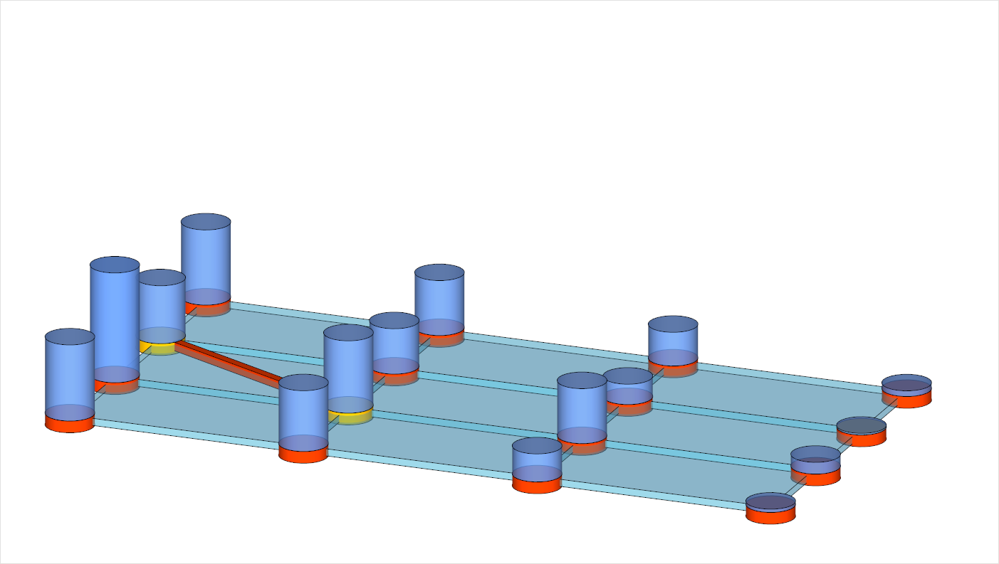
CHALLENGES
At time t-1 “present” in state B_{t-1}
Decision to “visit” state C_{t}
Decision move to state A,B,C,D
A
location →
B
t-1
time →
t
C
t+1
D
t+2

Slide 11
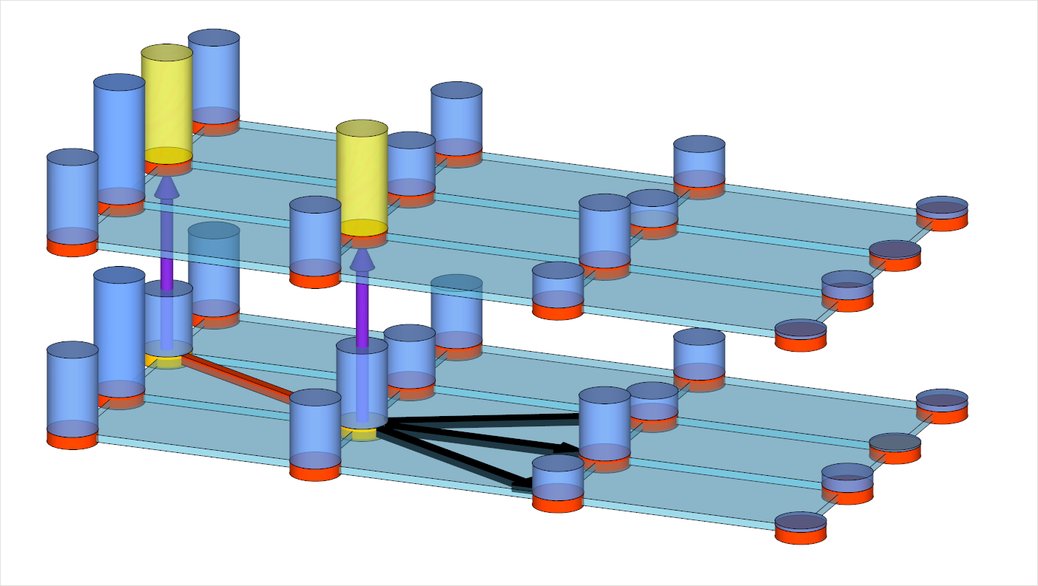
CHALLENGES
iteration →
Result in update of V(B_{t-1}) and eventually of V(C_{t})
n+1
n
A
location →
B
t-1
time →
t
C
t+1
D
t+2

Slide 12
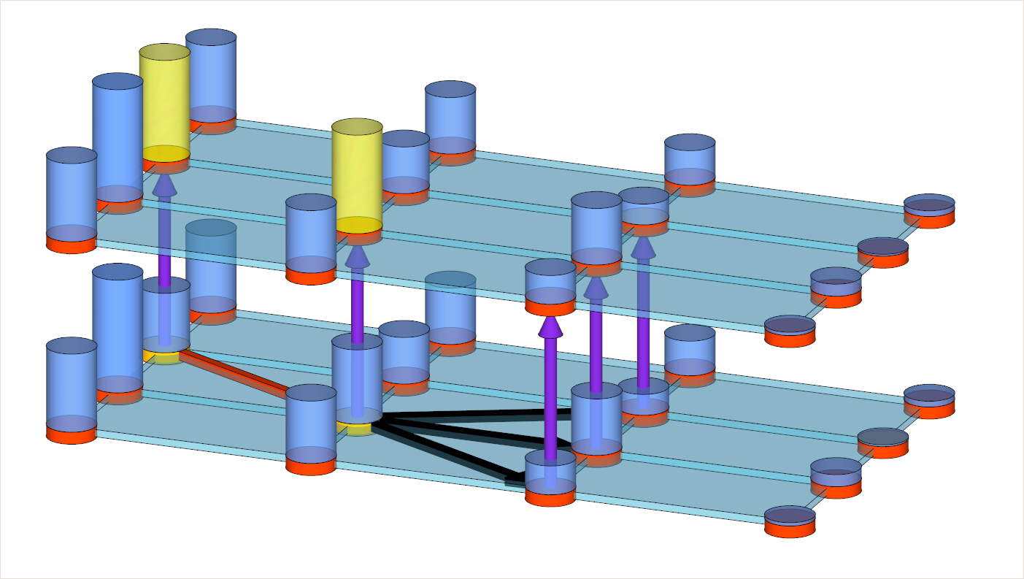
CHALLENGES
iteration →
Incorporate the value of Information
n+1
n
A
location →
B
t-1
time →
t
C
t+1
D
t+2

Slide 13
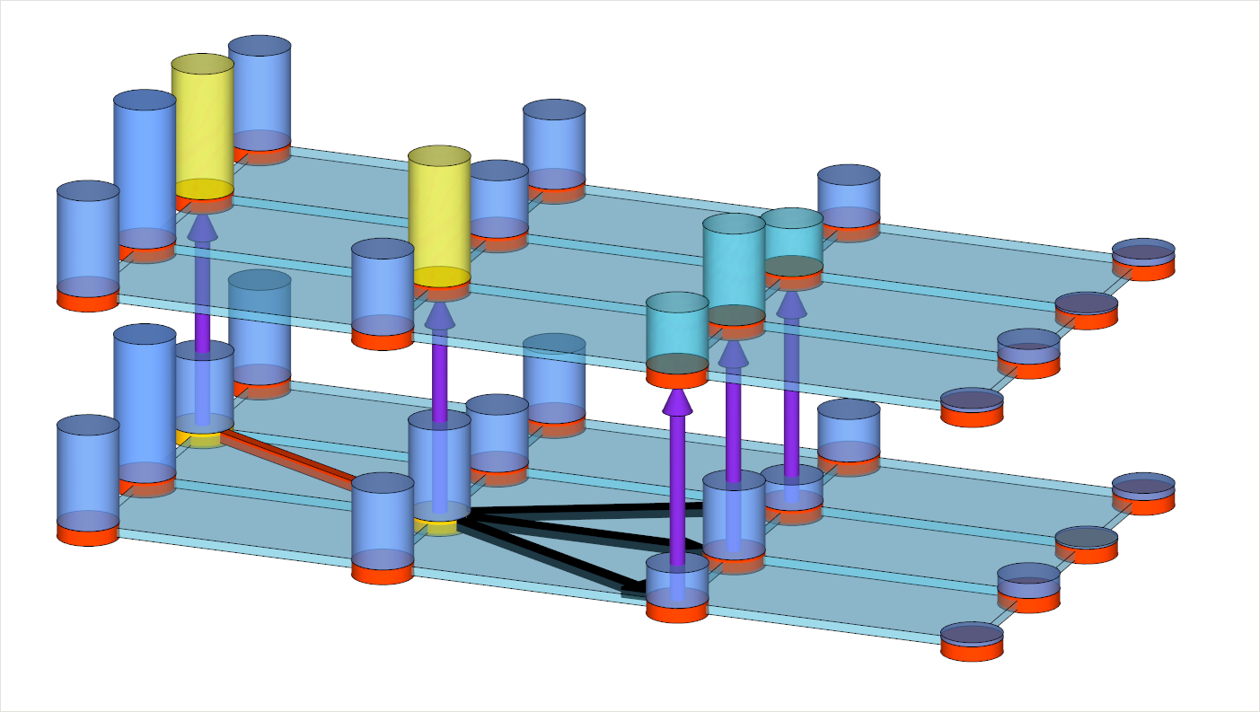
CHALLENGES
iteration →
Incorporate the value of Information
n+1
n
A
location →
B
t-1
time →
t
C
t+1
D
t+2

Slide 14
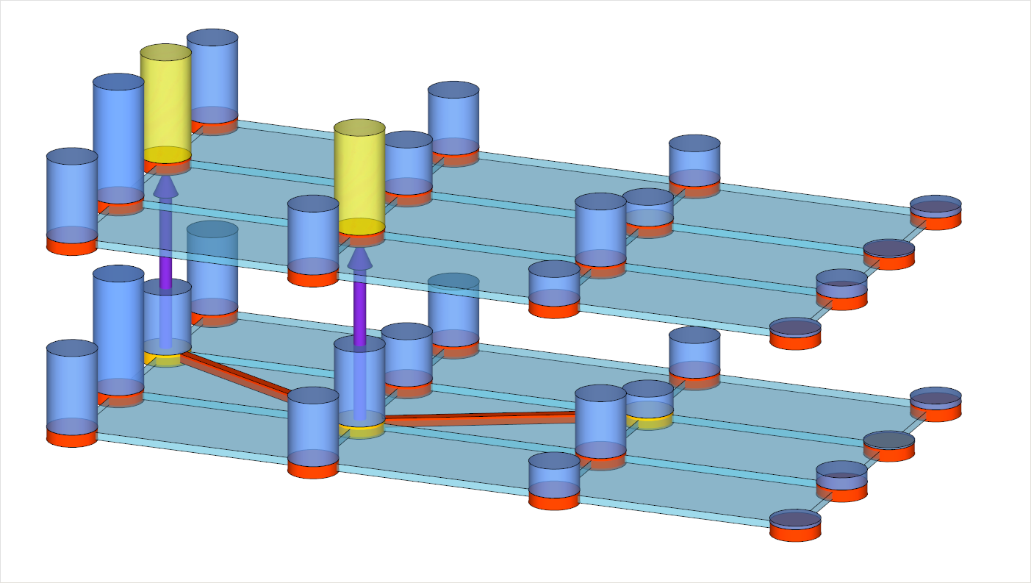
CHALLENGES
iteration →
Value of information might depend
on the direct costs of going there
n+1
n
A
location →
B
t-1
time →
t
C
t+1
D
t+2

Slide 15
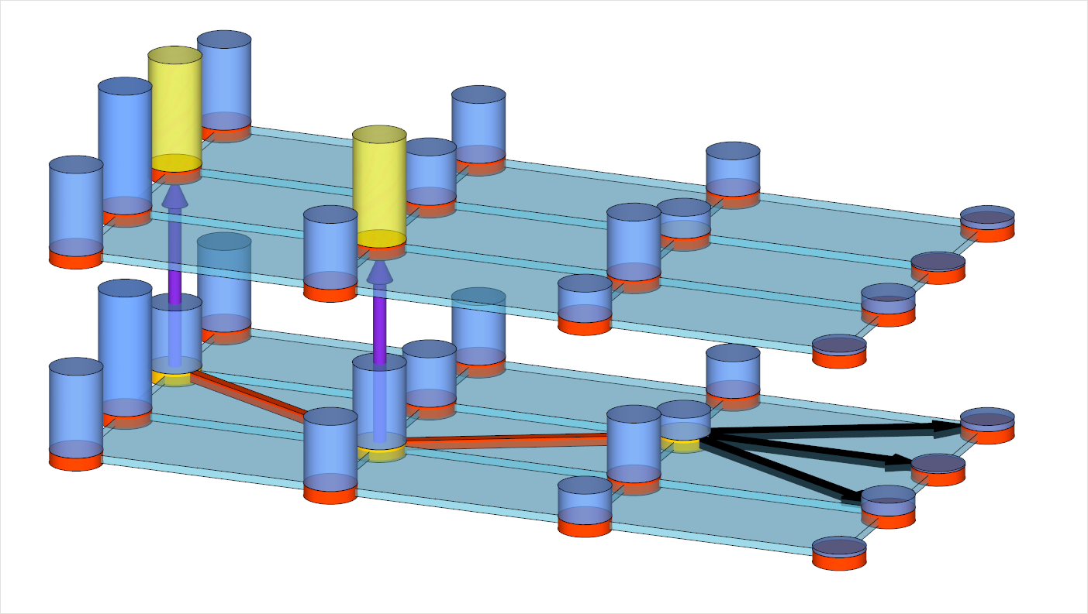
CHALLENGES
iteration →
Exploration decision might result
in deterioration of the VFA
n+1
n
A
location →
B
t-1
time →
t
C
t+1
D
t+2

Slide 16
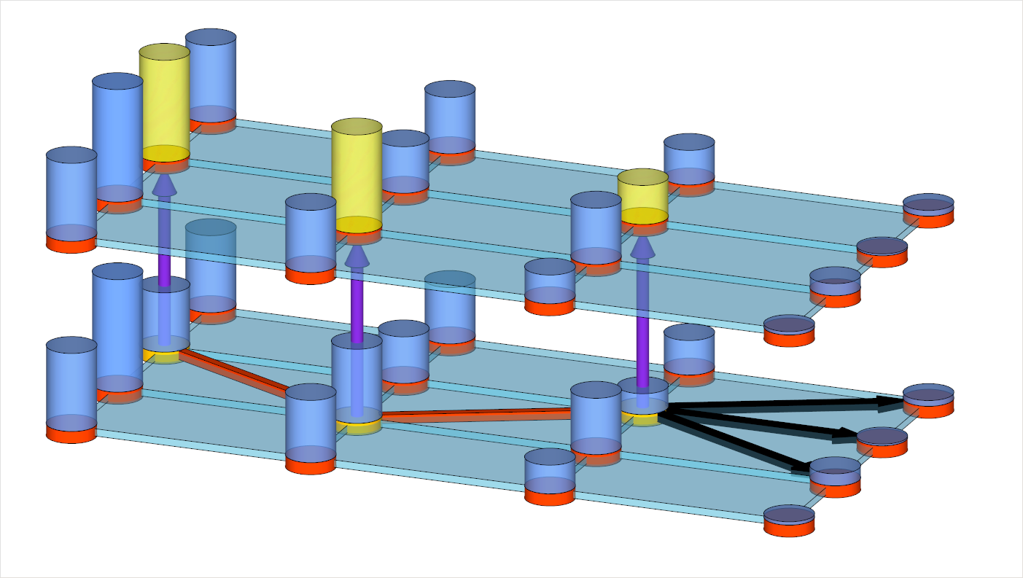
CHALLENGES
iteration →
Exploration decision might result
in deterioration of the VFA
n+1
n
A
location →
B
t-1
time →
t
C
t+1
D
t+2

Slide 17
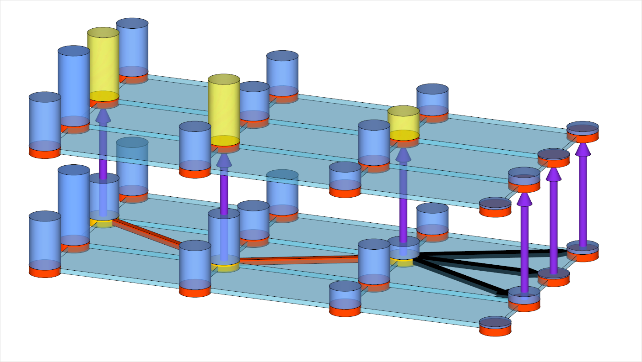
CHALLENGES
iteration →
Process continues till end of the horizon
n+1
n
A
location →
B
t-1
time →
t
C
t+1
D
t+2

Slide 18
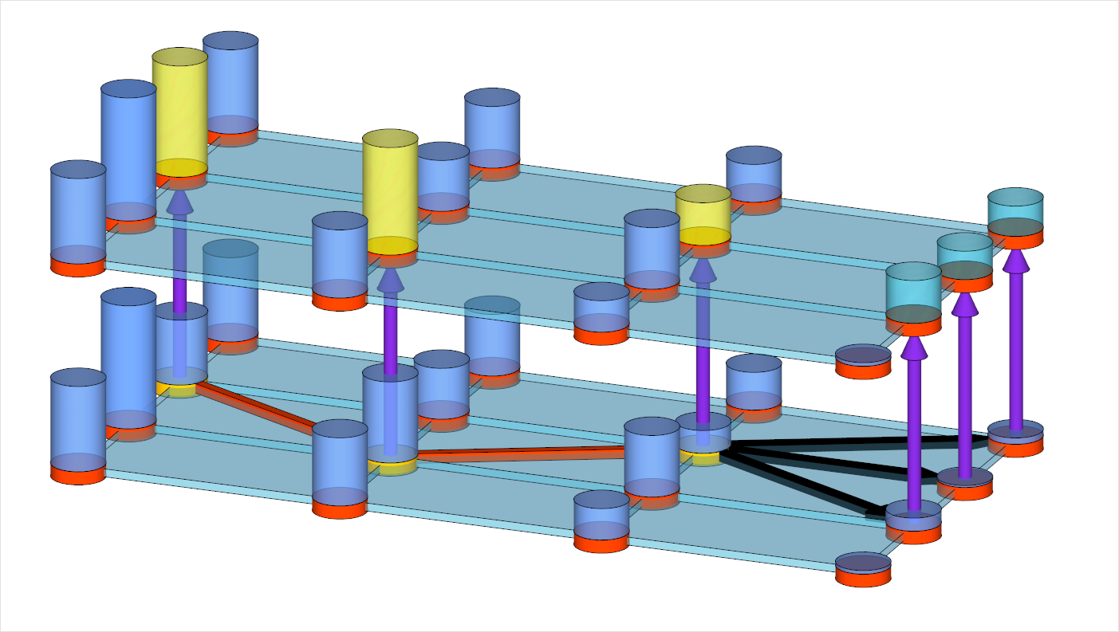
CHALLENGES
iteration →
Process continues till end of the horizon
n+1
n
A
location →
B
t-1
time →
t
C
t+1
D
t+2

Slide 19
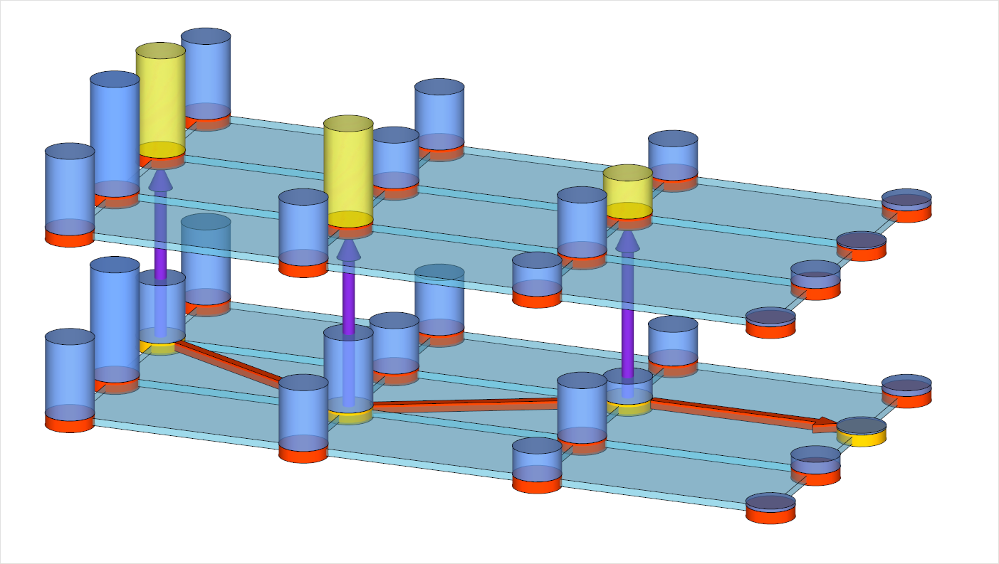
CHALLENGES
iteration →
Process continues till end of the horizon
n+1
n
A
location →
B
t-1
time →
t
C
t+1
D
t+2

Slide 20
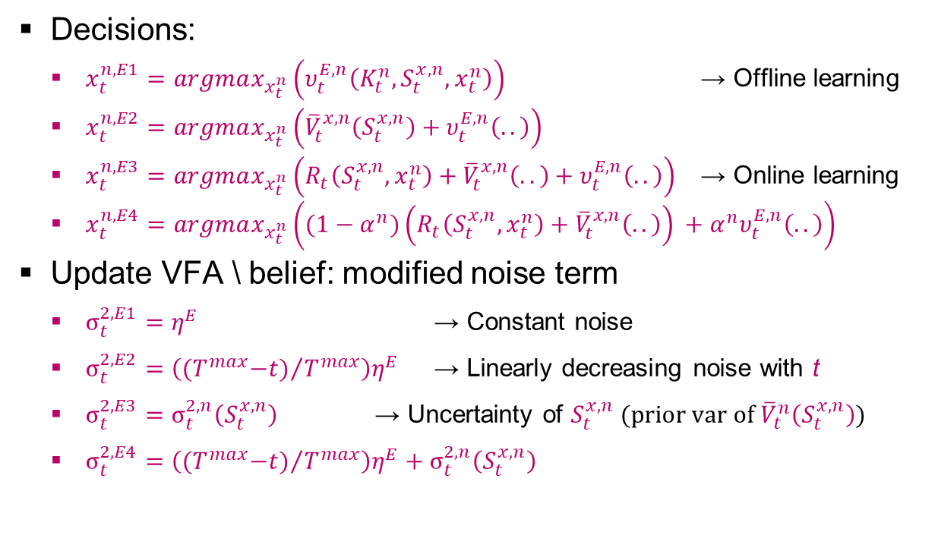
VPI MODIFICATIONS
Knowledge gradient given our current knowledge, current state and decision.
Decisions:
  $x_{t}^{n,E1}=argmax_{x_{t}^{n}}\left(υ_{t}^{E,n}\left(K_{t}^{n},S_{t}^{x,n},x_{t}^{n}\right)\right)$ → Offline learning
  $x_{t}^{n,E2}=argmax_{x_{t}^{n}}\left({\overline{V}}_{t}^{x,n}\left(S_{t}^{x,n}\right)+υ_{t}^{E,n}\left(..\right)\right)$
  $x_{t}^{n,E3}=argmax_{x_{t}^{n}}\left(R_{t}\left(S_{t}^{x,n},x_{t}^{n}\right)+{\overline{V}}_{t}^{x,n}\left(..\right)+υ_{t}^{E,n}\left(..\right)\right)$ → Online learning
  $x_{t}^{n,E4}=argmax_{x_{t}^{n}}\left((1−α^{n})\left(R_{t}\left(S_{t}^{x,n},x_{t}^{n}\right)+{\overline{V}}_{t}^{x,n}\left(..\right)\right) +α^{n}υ_{t}^{E,n}\left(..\right)\right)$
Update VFA \ belief: modified noise term
  $σ_{t}^{2,E1}=η^{E}$ → Constant noise
  $σ_{t}^{2,E2}={\left({{(T}^{max}−t)}/{T^{max}}\right)η}^{E}$ → Linearly decreasing noise with t
  $σ_{t}^{2,E3}=σ_{t}^{2,n}\left(S_{t}^{x,n}\right)$ → Uncertainty of $S_{t}^{x,n}$ (prior var of${\overline{V}}_{t}^{n}\left(S_{t}^{x,n}\right)$)
  $σ_{t}^{2,E4}={\left({{(T}^{max}−t)}/{T^{max}}\right)η}^{E}+σ_{t}^{2,n}\left(S_{t}^{x,n}\right)$

Slide 21
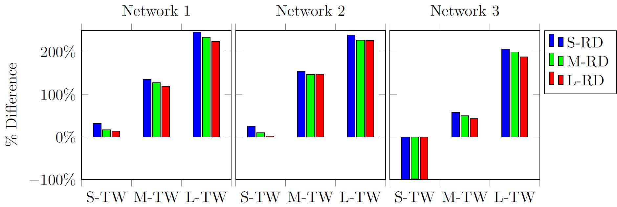

EXPERIMENTAL RESULTS
Our VPI modifications pay off:
  Exploration decision: include downstream rewards
  Update belief: use noise term equal to variance of ${\overline{V}}_{t}^{n}\left(S_{t}^{x,n}\right)$
  Without VPI, ADP always outperformed by a benchmark
Performance ADP+VPI compared to a benchmark:

Slide 22
AND NOW?
Implementation:
  Run finite horizon ADP every day using actual data (everything known and probabilities)
  Run times << 1 sec (50 iterations)
  Show “optimal” solution
  Provide planners with estimated future costs of any possible decision
But, are LSPs going to use this?

Slide 23
SERIOUS GAME: TRUCKS & BARGES
To stimulate a mental switch of LSPs and illustrate the benefits of anticipatory planning
The game can be used to educate logistics professionals as well as students on:
  the challenges involved in transportation planning
  the benefits of decision support and automated planning
  the way automated planning rules can be designed
Decision support in the game uses the ADP algorithm from this presentation…

Slide 24
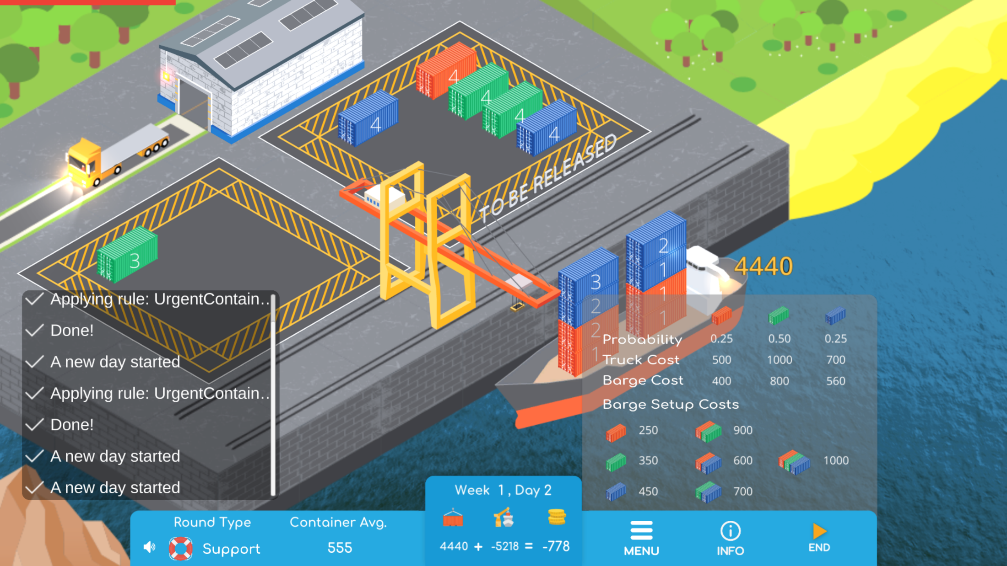
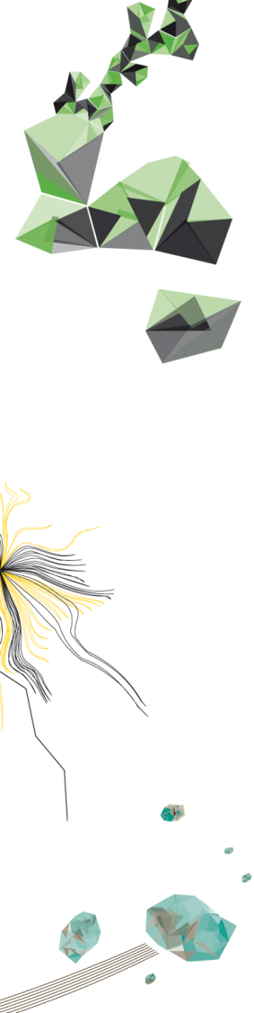

Slide 25
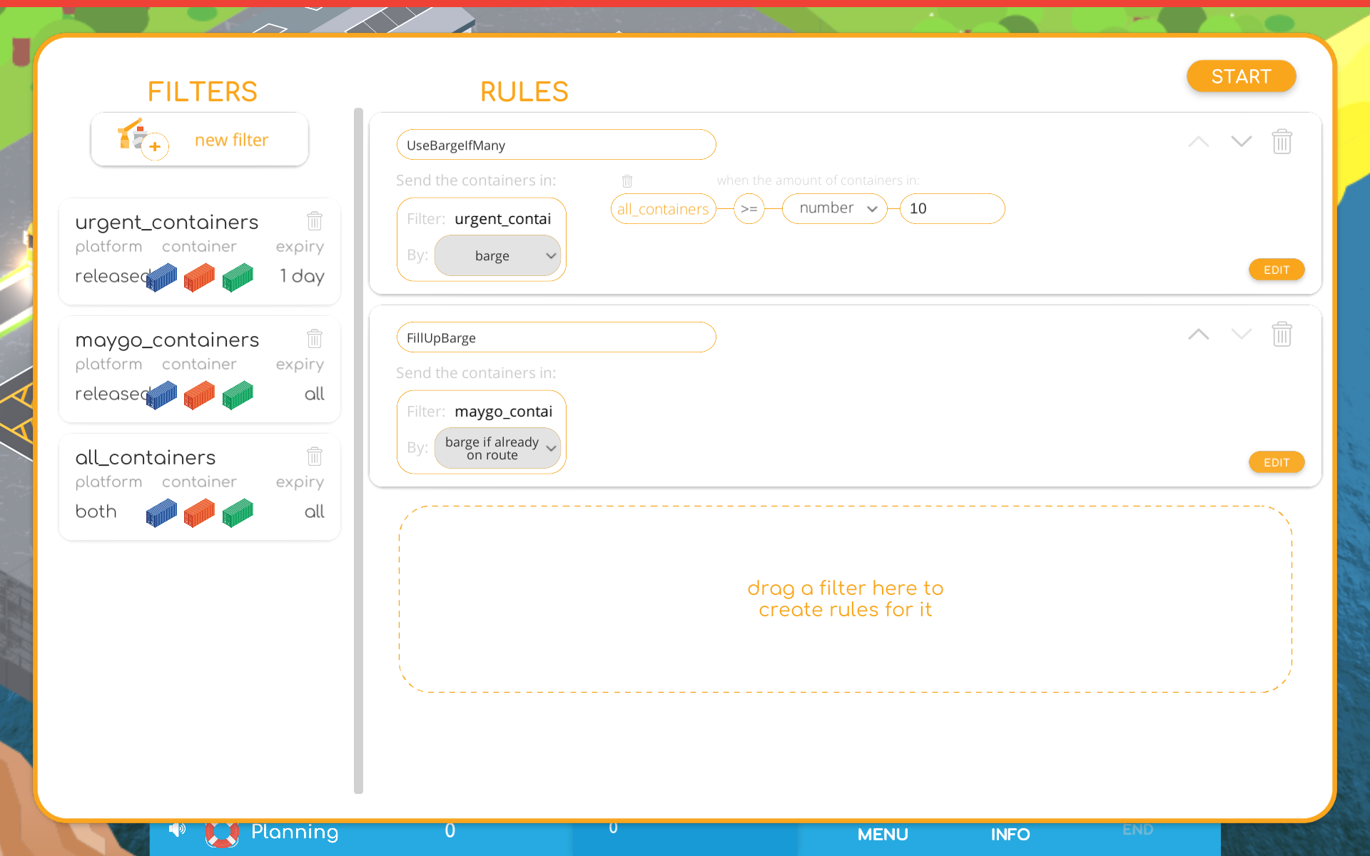

Slide 26
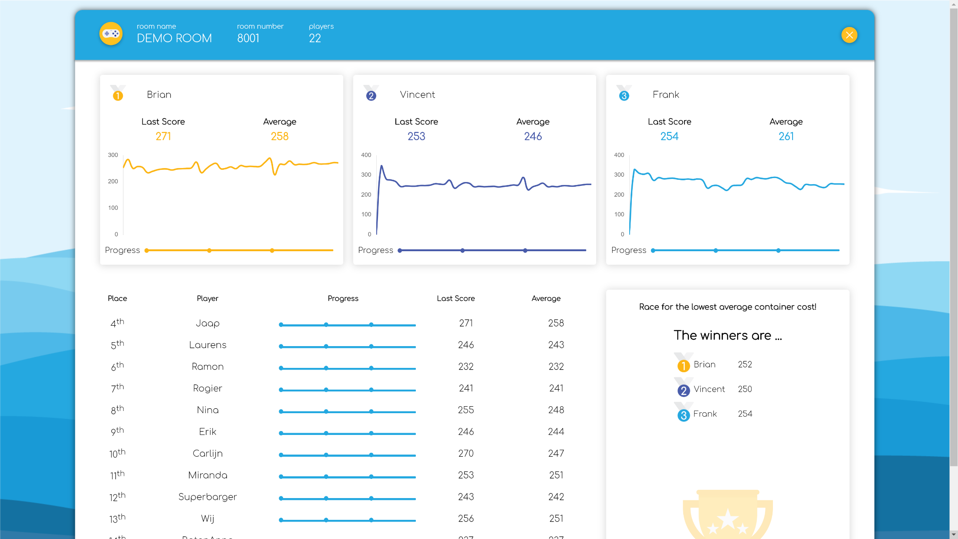

Slide 27
TRUCKS & BARGES V2.0 (APRIL 2020)
Freely available
Also for game masters (game management system)
Includes 4 algorithms:
  2 heuristics
  2 ADP versions: VFA-based & Neural Network-based ADP
Includes an extension of the algorithm creator with more flexibility (e.g., include own Python code)
Includes extra modality (train) and extra restrictions
Includes educational material

Slide 28
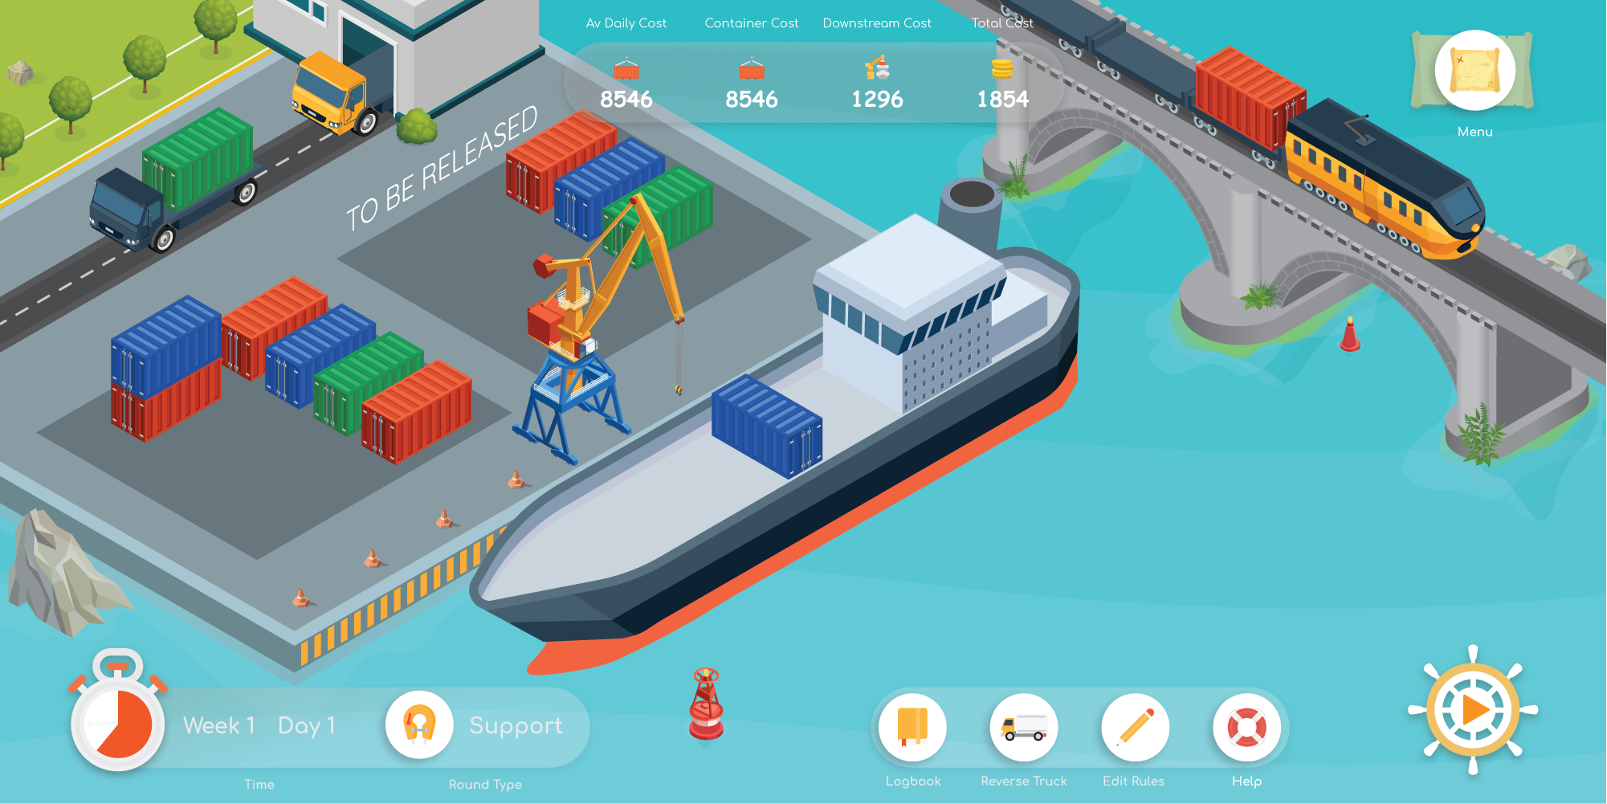

Slide 29

HOW DOES IT WORK?
Go to: www.trucksandbarges.nl and click play
Play serious using room 1022 (current month day)
Play 4 rounds:
  Practice: just to practice
  Normal: play serious
  Support: play serious with support
  Algorithm: create your own planning rules
Each round consists of 3 independent weeks, and each week has 5 “working” days.
Each day, drag “released” containers to the barge or trucks.

Slide 30
TO REMEMBER…
ADP+VFA for anticipatory planning
VPI significantly improves the performance of ADP
Exploring and updating with VPI should be done more conservative compared to “regular” VPI
Serious game to illustrate the benefits of anticipatory planning

Slide 31
QUESTIONS?
Martijn Mes
Associate professor
University of Twente
School of Management and Governance
Dept. Industrial Engineering and Business Information Systems
Contact
Phone: +31-534894062
Email: m.r.k.mes@utwente.nl
Web: https://www.utwente.nl/bms/iebis/staff/mes/

