Slide 1
Anticipatory Synchromodal Transportation Planning
Martijn R.K. Mes & Arturo E. Pérez Rivera
University of Twente
INFORMS | October 24, 2017

Slide 2

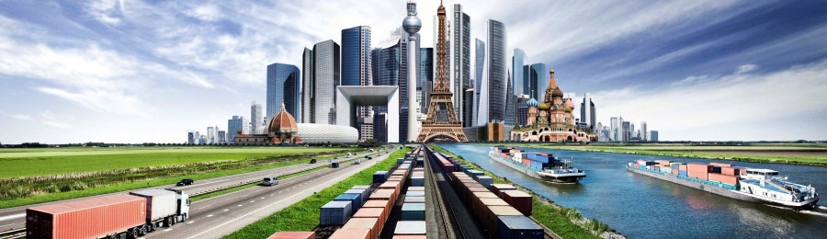
SYNCHROMODAL TRANSPORT
Source: European Gateway Services
In execution similar to multi-modal transport (or inter/co), but essentially different in the planning (made by the LSP):
  Dynamic mode choice for each incoming order (mode-free booking)
  Decisions can be made at all times, even during execution, based on real-time information, e.g., water levels and traffic information
Emphasis on logistics network instead of separate chains, focusing on network-wide performance over time

Slide 3
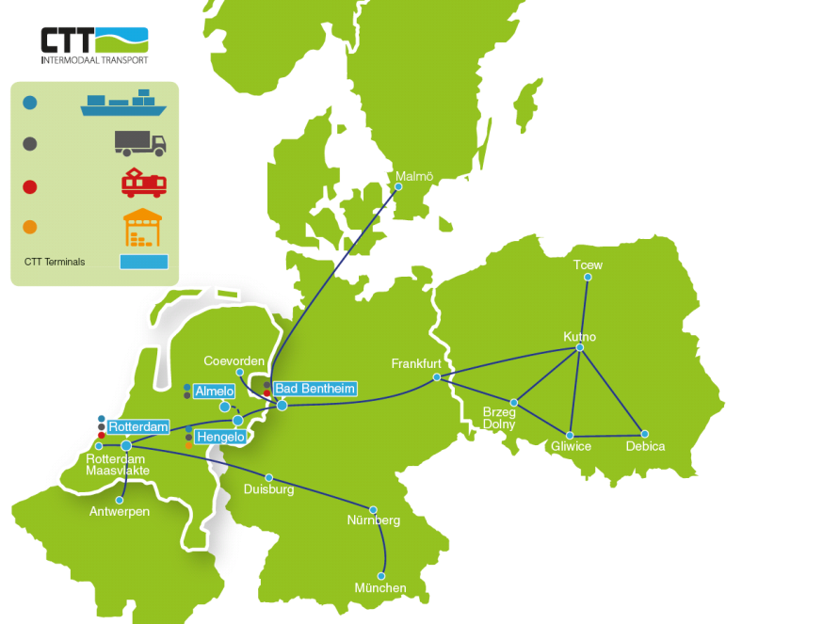
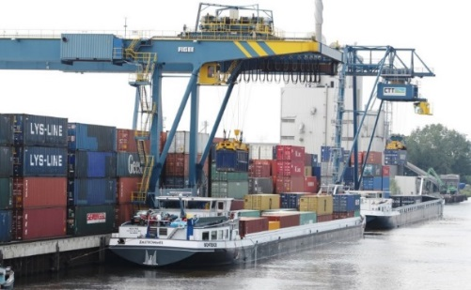
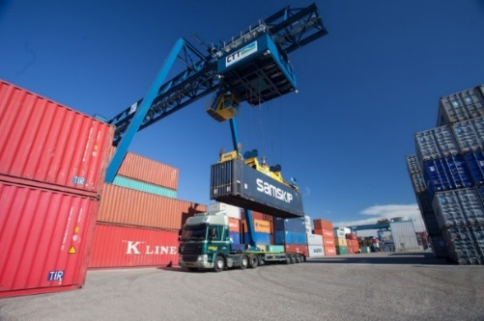
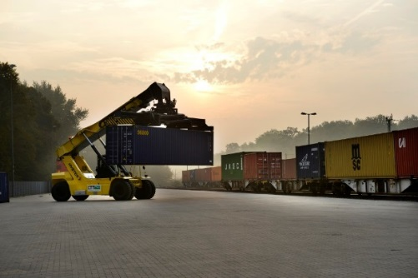
CASE STUDY: CTT NETWORK FROM PORT OF ROTTERDAM TO THE HINTERLAND

Slide 4
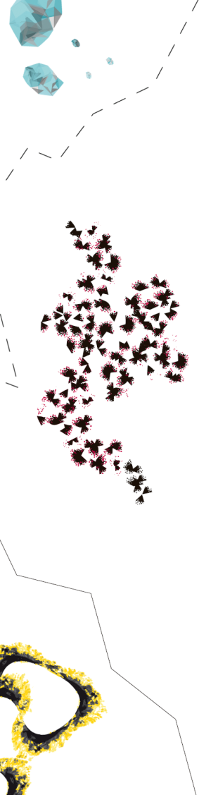
SYNCHROMODAL SCHEDULING: ANTICIPATORY ROUTING AND POSTPONEMENT DECISIONS

Slide 5
THE OPTIMIZATION PROBLEM
Input:
  Transport network: terminals, services, schedules, durations, capacity, costs, revenues, time-horizon
  Current freights and probability distributions for the arrival of freights and their characteristics, for each period of the horizon
Output:
  Expected profit for each state
  Scheduling policy: given the current state, which service to use for each freight for each period of the horizon
State at t: S_{t}=[F_{i,d,r,k,t} ]∀i,d,r,k:
  Number of orders at (or in transit to) i, having destination d, release day r (relative to t), and time-window k (relative to r)
Notes:
Telefoon, fax, email
Alle partijen communiceren dus onderling en dat leidt tot problemen

Slide 6
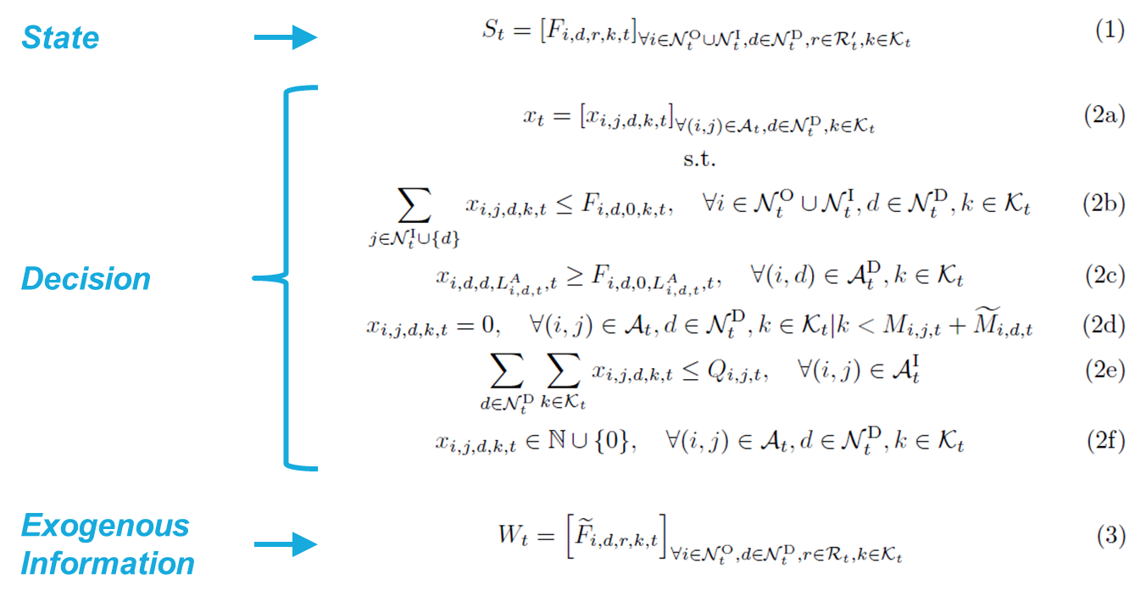
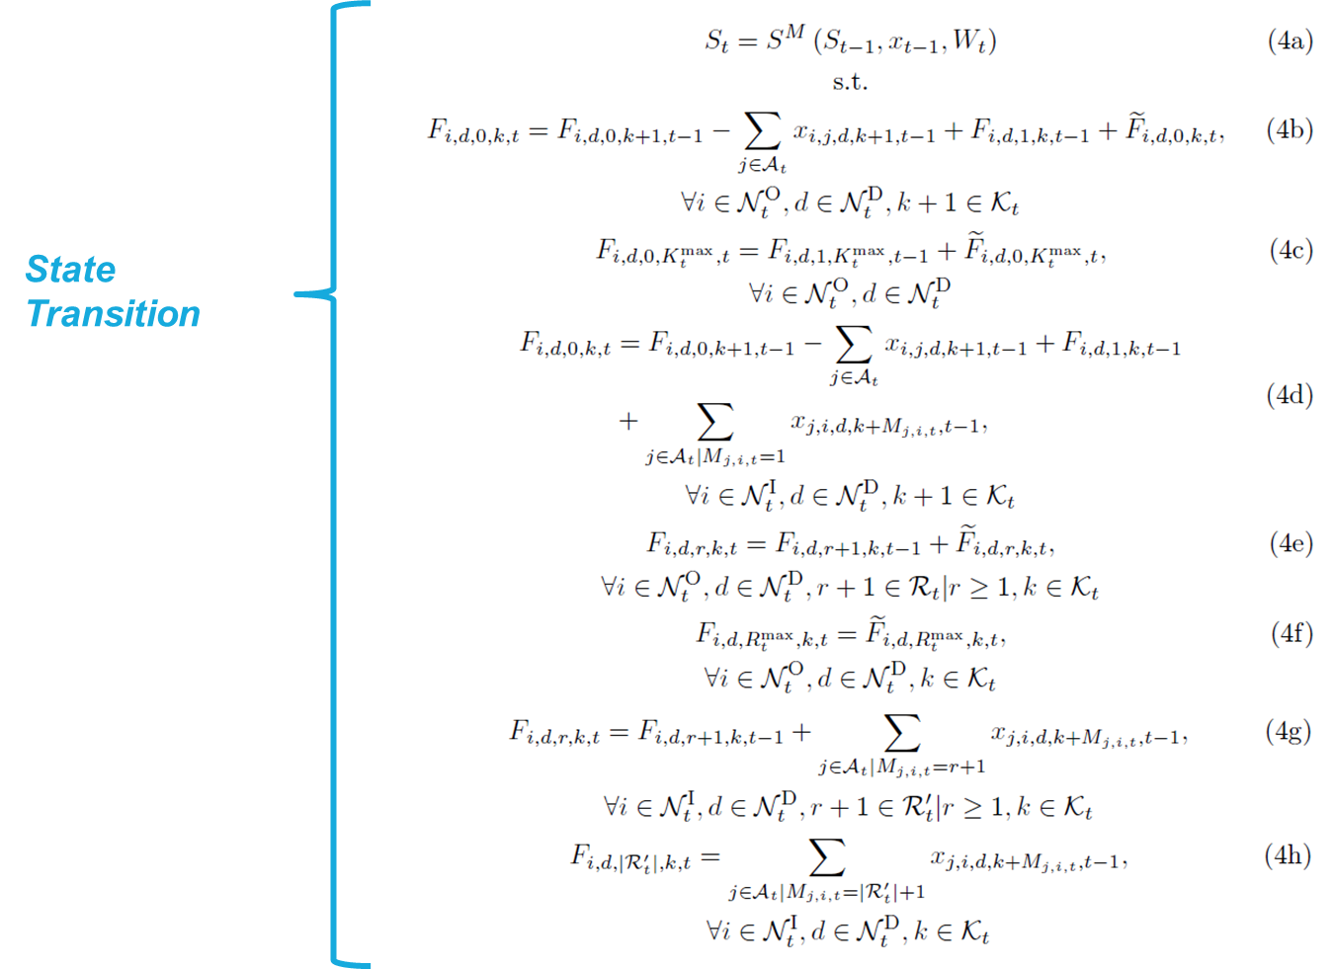
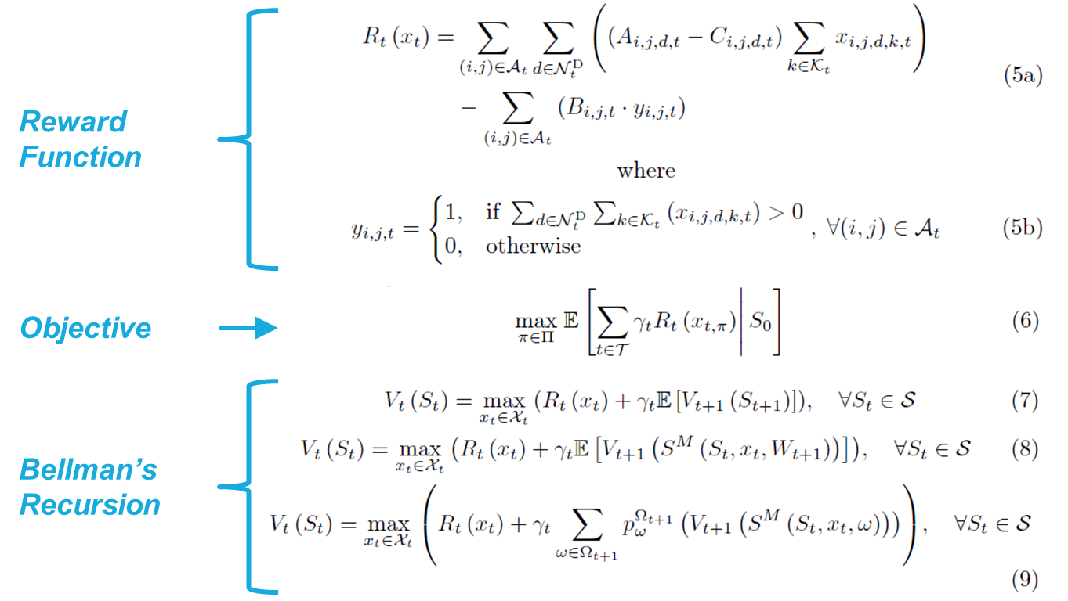
MARKOV DECISION PROCESS (MDP) MODEL
The three curses of dimensionality:
Many states
Many possible demand realizations
Many decisions
ADP
Notes:
Telefoon, fax, email
Alle partijen communiceren dus onderling en dat leidt tot problemen

Slide 7
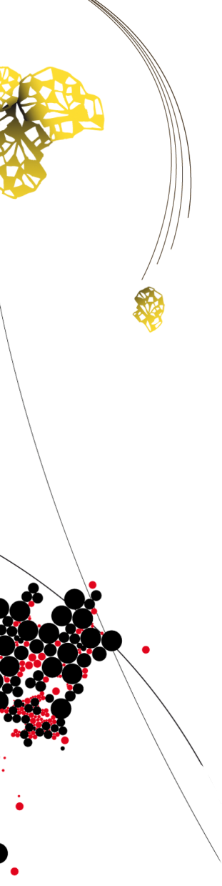
APPROXIMATE DYNAMIC PROGRAMMING
(basic structure, not what we use)
Pure exploitation
Deterministic optimization
Statistics
Simulation
Notes:
Telefoon, fax, email
Alle partijen communiceren dus onderling en dat leidt tot problemen

Slide 8
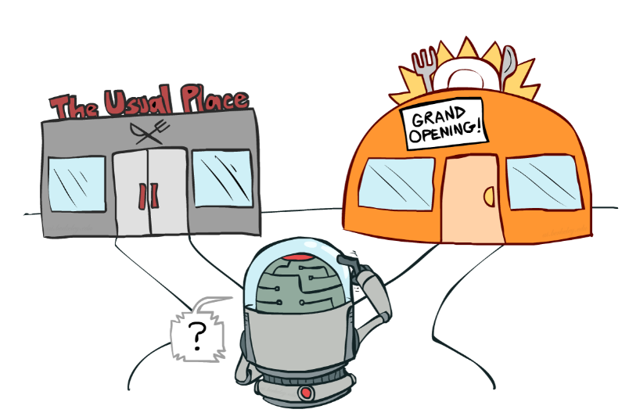
EXPLORATION VS EXPLOITATION
Result of pure exploitation: bring freight to nearest terminal and keep it there till it needs to be taken by truck to its dest.
Necessary to explore… but how? (when, what, how long?)
Techniques from Optimal Learning might help here…
Efficient collection of information - the value of information is the expected improvement in future decision quality:
  Dearden et al. (1999). Model based
  Bayesian exploration.
  Gupta, S. and Miescke, K. (1996). Bayesian
  look ahead one-stage sampling allocations
  for selection of the best population.
  Frazier et al. (2008). A Knowledge-Gradient
  Policy for Sequential Information Collection.
Source of artwork: Dan Klein and Pieter Abbeel – Reinforcement Learning (2013), University of California
Notes:
Telefoon, fax, email
Alle partijen communiceren dus onderling en dat leidt tot problemen

Slide 9
PRINCIPLE VALUE OF PERFECT INFORMATION (VPI)
Assume you can make only one measurement, after which you have to make a final choice (the implementation decision). What choice would you make now to maximize the expected value of the implementation decision?
Change which produces a change in the decision.
Observation
Updated estimate of the value of option 5
Change in estimated value of option 5 due to measurement of 5
1
2
3
4
5
Notes:
Telefoon, fax, email
Alle partijen communiceren dus onderling en dat leidt tot problemen

Slide 10
CHALLENGES
Optimal learning literature difficult to apply due to the presence of a physical state (state dependent decisions)
Need to learn the value of features\functions instead of states
Ryzhov, I.O., et al. (2017). Bayesian exploration for approximate dynamic programming.
Challenge for (time dependent) finite horizon setting:
  Decisions have impact on the value of states in the downstream path (we learn what we measure)
  Decisions have impact on the value of states in the upstream path (with on-policy control)
Notes:
Telefoon, fax, email
Alle partijen communiceren dus onderling en dat leidt tot problemen

Slide 11
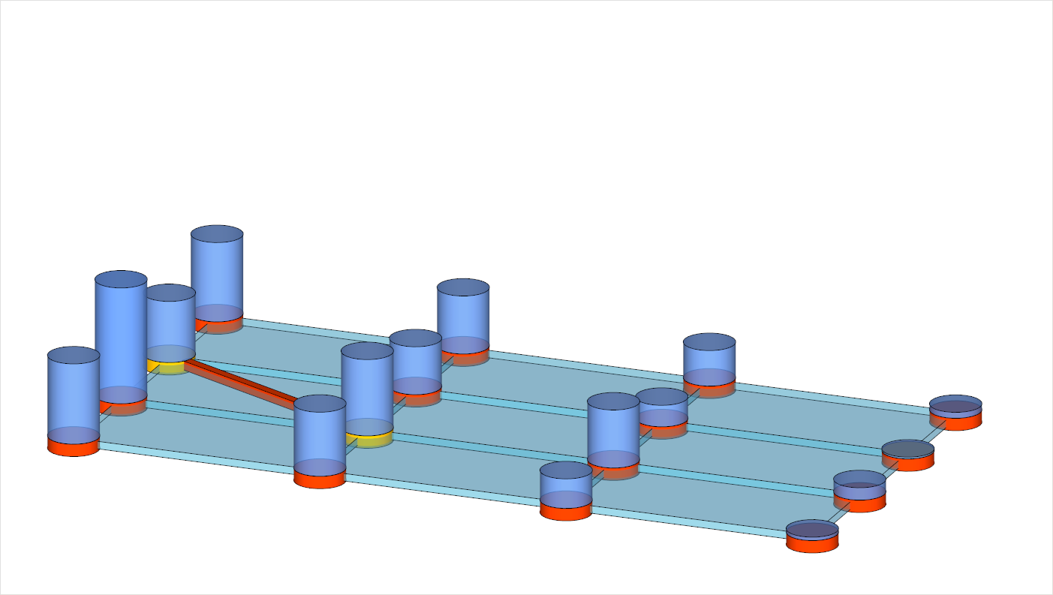
CHALLENGES
Decision to “visit” C_{t}
Decision move to state A,B,C,D
A
location →
B
t-1
time →
t
C
t+1
D
t+2
Notes:
Telefoon, fax, email
Alle partijen communiceren dus onderling en dat leidt tot problemen

Slide 12
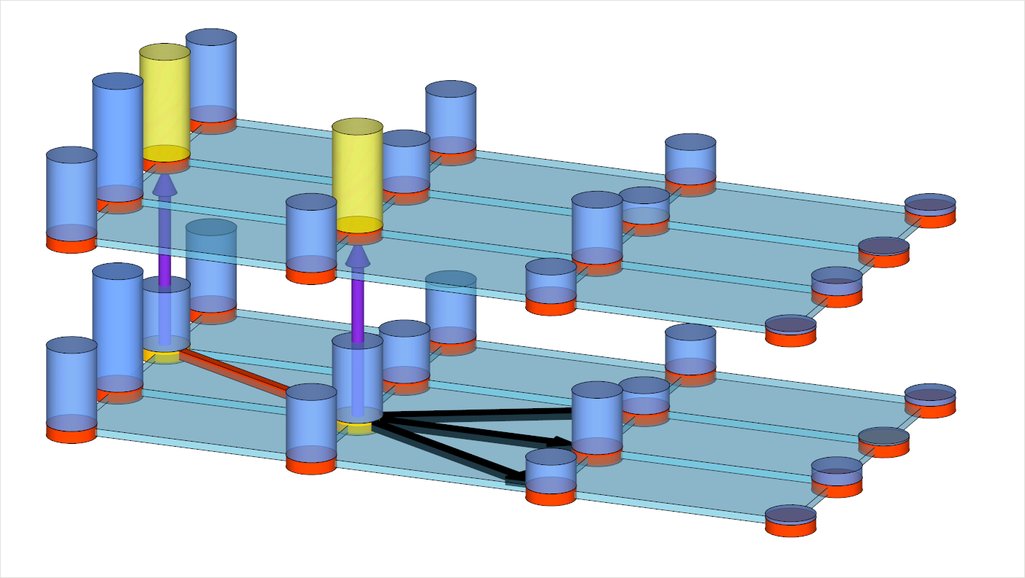
CHALLENGES
iteration →
Result in update of V(B_{t-1}) and eventually of V(C_{t})
n+1
n
A
location →
B
t-1
time →
t
C
t+1
D
t+2
Notes:
Telefoon, fax, email
Alle partijen communiceren dus onderling en dat leidt tot problemen

Slide 13
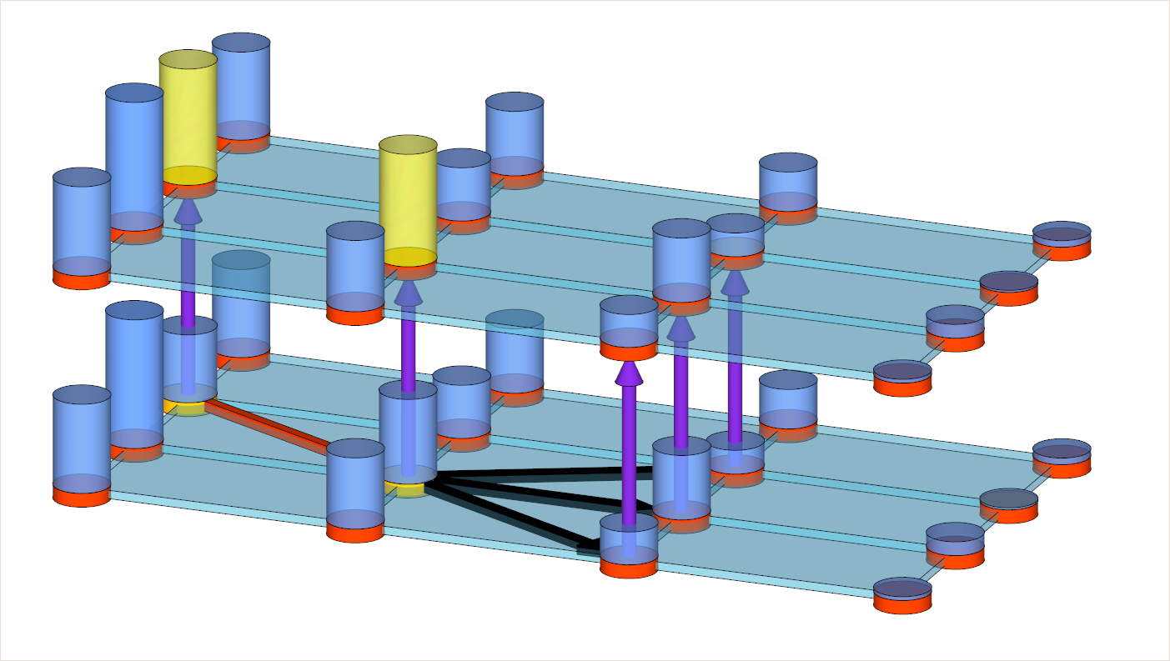
CHALLENGES
iteration →
Incorporate the value of Information
n+1
n
A
location →
B
t-1
time →
t
C
t+1
D
t+2
Notes:
Telefoon, fax, email
Alle partijen communiceren dus onderling en dat leidt tot problemen

Slide 14
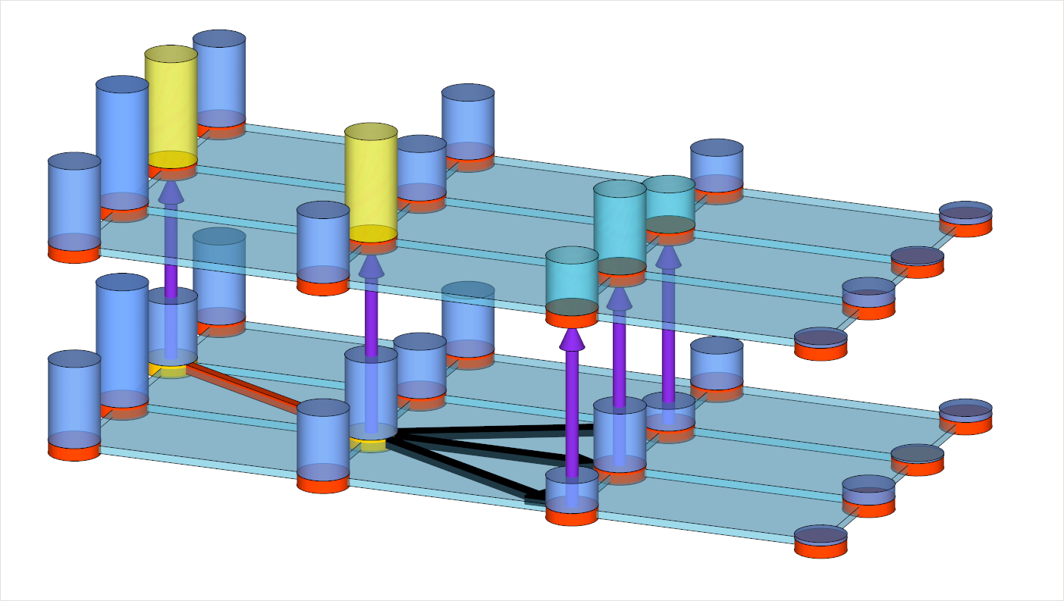
CHALLENGES
iteration →
Incorporate the value of Information
n+1
n
A
location →
B
t-1
time →
t
C
t+1
D
t+2
Notes:
Telefoon, fax, email
Alle partijen communiceren dus onderling en dat leidt tot problemen

Slide 15
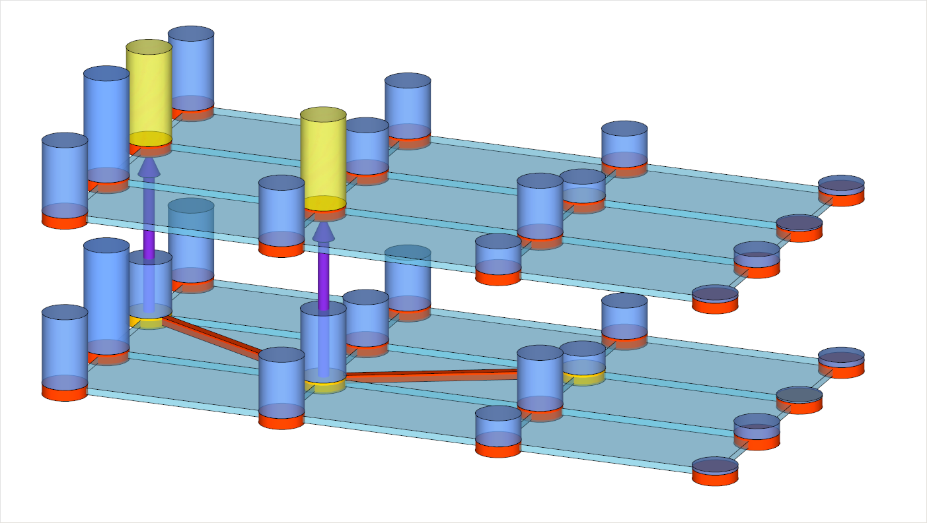
CHALLENGES
iteration →
Value of information might depend
on the direct costs of going there
n+1
n
A
location →
B
t-1
time →
t
C
t+1
D
t+2
Notes:
Telefoon, fax, email
Alle partijen communiceren dus onderling en dat leidt tot problemen

Slide 16
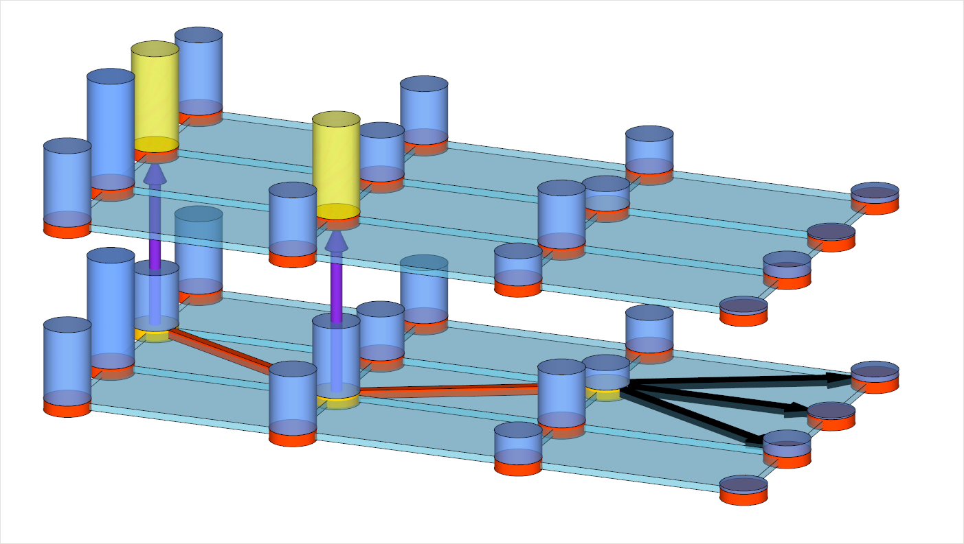
CHALLENGES
iteration →
Exploration decision might result
in deterioration of the VFA
n+1
n
A
location →
B
t-1
time →
t
C
t+1
D
t+2
Notes:
Telefoon, fax, email
Alle partijen communiceren dus onderling en dat leidt tot problemen

Slide 17
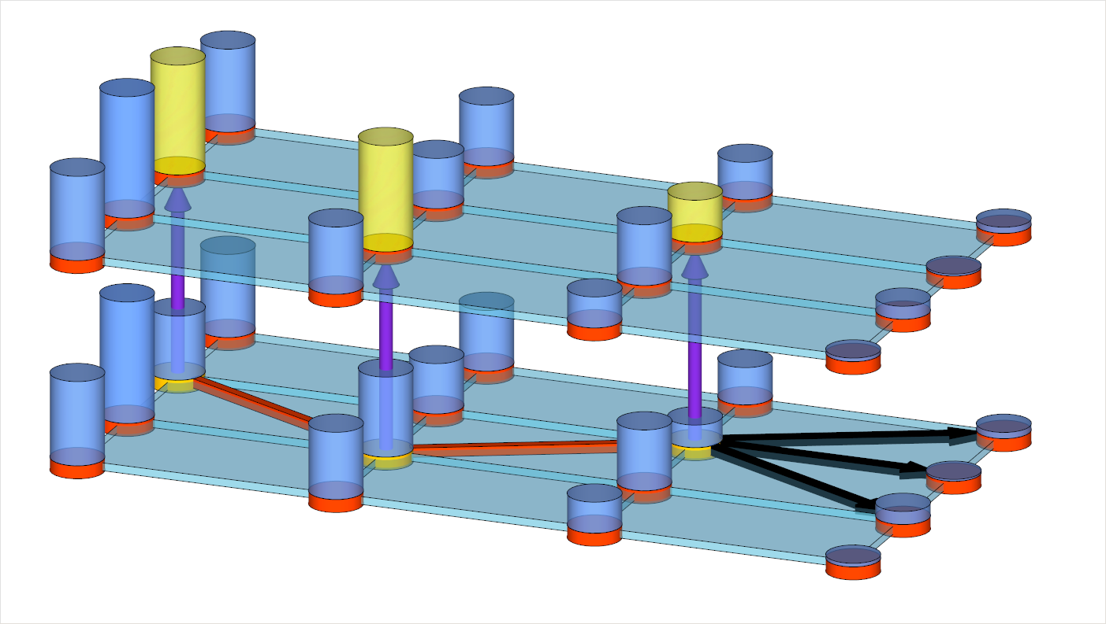
CHALLENGES
iteration →
Exploration decision might result
in deterioration of the VFA
n+1
n
A
location →
B
t-1
time →
t
C
t+1
D
t+2
Notes:
Telefoon, fax, email
Alle partijen communiceren dus onderling en dat leidt tot problemen

Slide 18
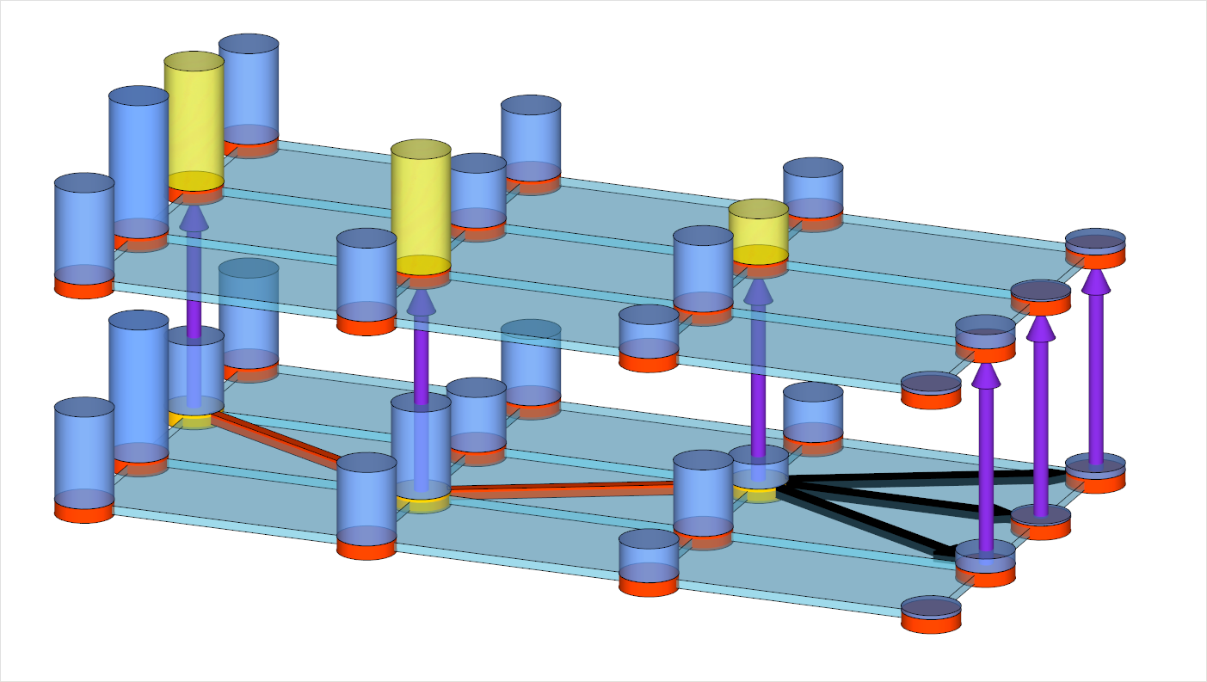
CHALLENGES
iteration →
Process continues till end of the horizon
n+1
n
A
location →
B
t-1
time →
t
C
t+1
D
t+2
Notes:
Telefoon, fax, email
Alle partijen communiceren dus onderling en dat leidt tot problemen

Slide 19
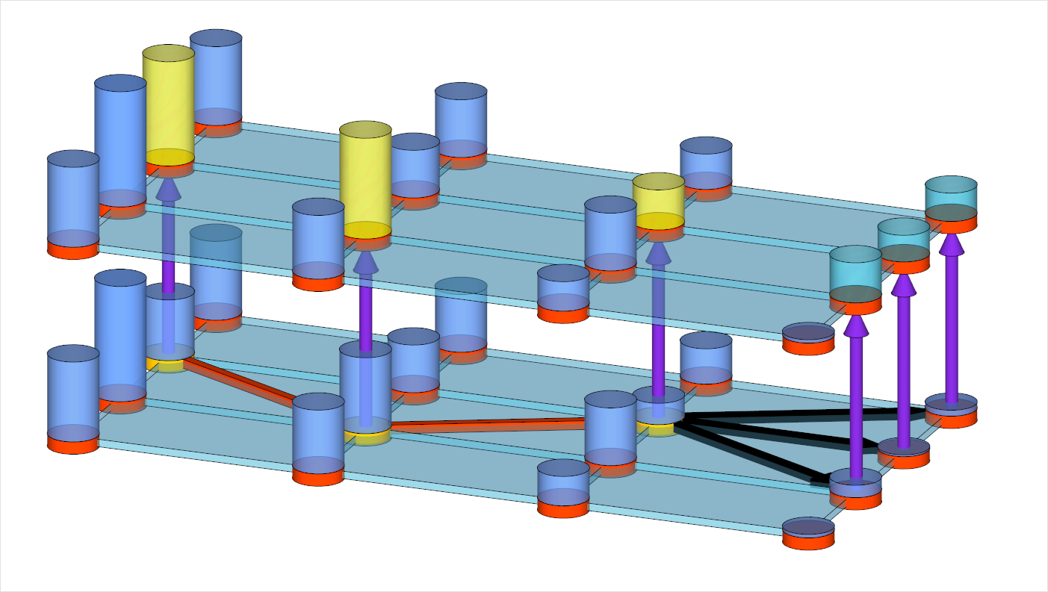
CHALLENGES
iteration →
Process continues till end of the horizon
n+1
n
A
location →
B
t-1
time →
t
C
t+1
D
t+2
Notes:
Telefoon, fax, email
Alle partijen communiceren dus onderling en dat leidt tot problemen

Slide 20
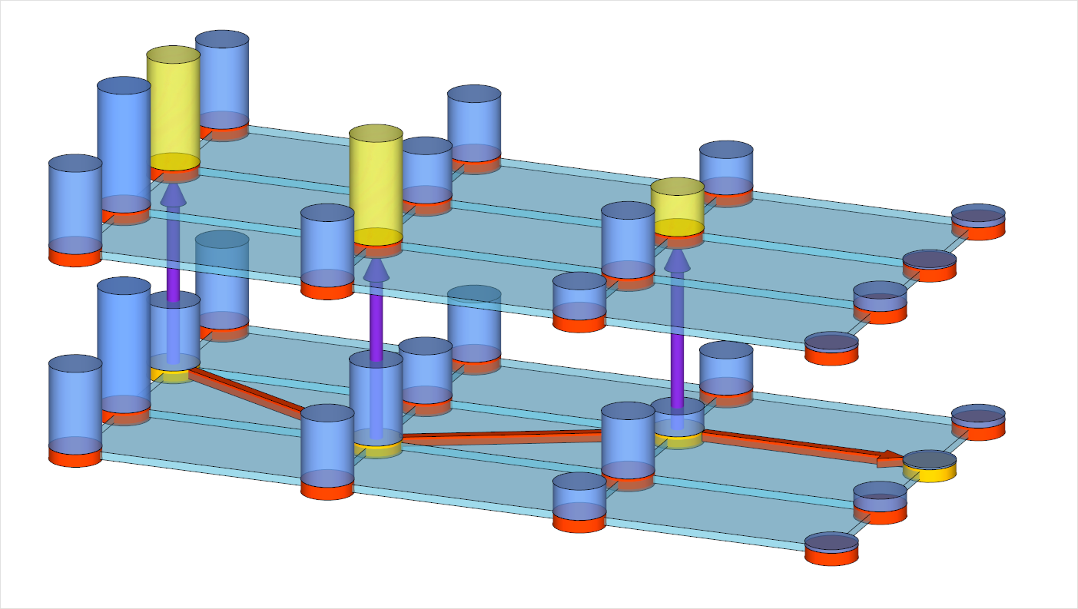
CHALLENGES
iteration →
Process continues till end of the horizon
n+1
n
A
location →
B
t-1
time →
t
C
t+1
D
t+2
Notes:
Telefoon, fax, email
Alle partijen communiceren dus onderling en dat leidt tot problemen

Slide 21
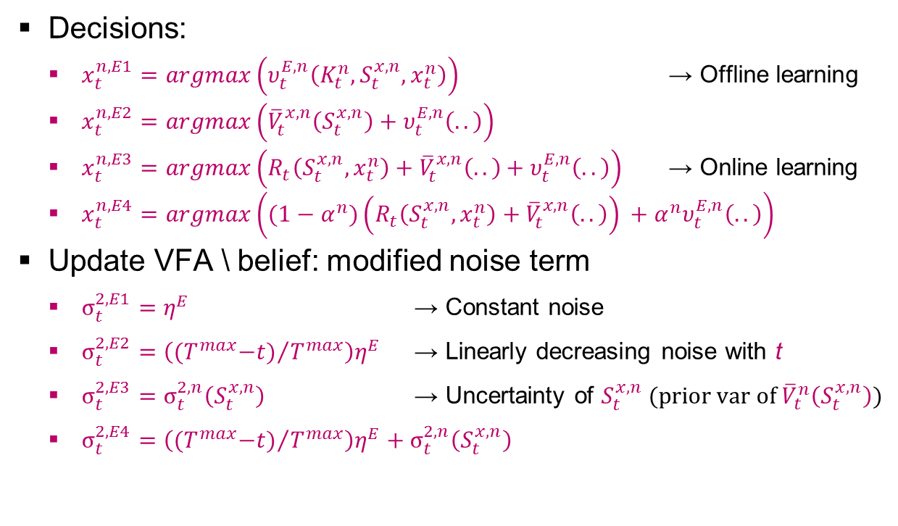
VPI MODIFICATIONS
Decisions:
  $x_{t}^{n,E1}=argmax\left(υ_{t}^{E,n}\left(K_{t}^{n},S_{t}^{x,n},x_{t}^{n}\right)\right)$ → Offline learning
  $x_{t}^{n,E2}=argmax\left({\overline{V}}_{t}^{x,n}\left(S_{t}^{x,n}\right)+υ_{t}^{E,n}\left(..\right)\right)$
  $x_{t}^{n,E3}=argmax\left(R_{t}\left(S_{t}^{x,n},x_{t}^{n}\right)+{\overline{V}}_{t}^{x,n}\left(..\right)+υ_{t}^{E,n}\left(..\right)\right)$ → Online learning
  $x_{t}^{n,E4}=argmax\left((1−α^{n})\left(R_{t}\left(S_{t}^{x,n},x_{t}^{n}\right)+{\overline{V}}_{t}^{x,n}\left(..\right)\right) +α^{n}υ_{t}^{E,n}\left(..\right)\right)$
Update VFA \ belief: modified noise term
  $σ_{t}^{2,E1}=η^{E}$ → Constant noise
  $σ_{t}^{2,E2}={\left({{(T}^{max}−t)}/{T^{max}}\right)η}^{E}$ → Linearly decreasing noise with t
  $σ_{t}^{2,E3}=σ_{t}^{2,n}\left(S_{t}^{x,n}\right)$ → Uncertainty of $S_{t}^{x,n}$ (prior var of ${\overline{V}}_{t}^{n}\left(S_{t}^{x,n}\right)$)
  $σ_{t}^{2,E4}={\left({{(T}^{max}−t)}/{T^{max}}\right)η}^{E}+σ_{t}^{2,n}\left(S_{t}^{x,n}\right)$
Notes:
Telefoon, fax, email
Alle partijen communiceren dus onderling en dat leidt tot problemen

Slide 22
NUMERICAL EXPERIMENTS
Various network instances
Restricted policies: RP 1\2
with size 0.01%\0.02% of
the original decision space)
2 freights at each terminal
results in 2.6x10⁸ decisions
Benchmark heuristic: use intermodal service for a freight if the cost difference between the cheapest and second cheapest intermodal path covers the setup costs of the first
Two experimental phases: tuning and benchmark experiments
Notes:
Telefoon, fax, email
Alle partijen communiceren dus onderling en dat leidt tot problemen

Slide 23
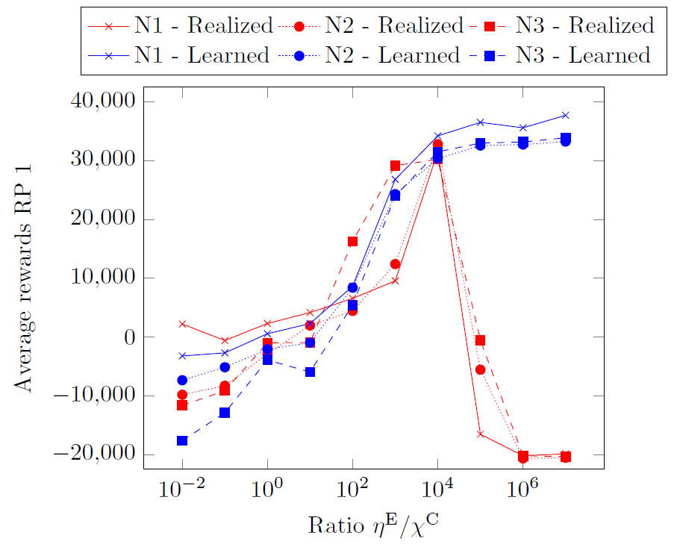
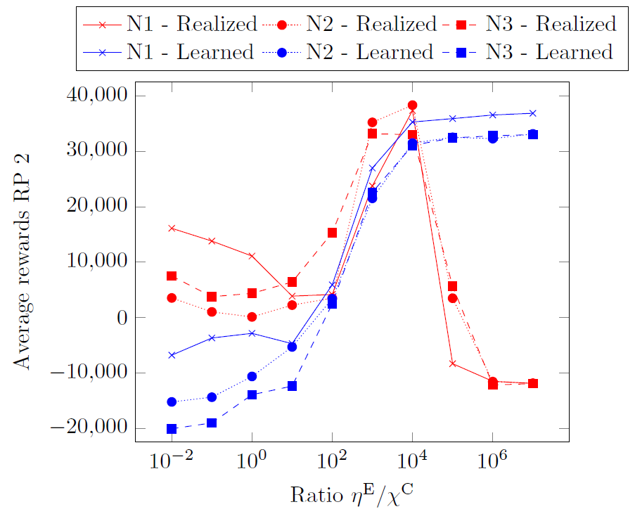
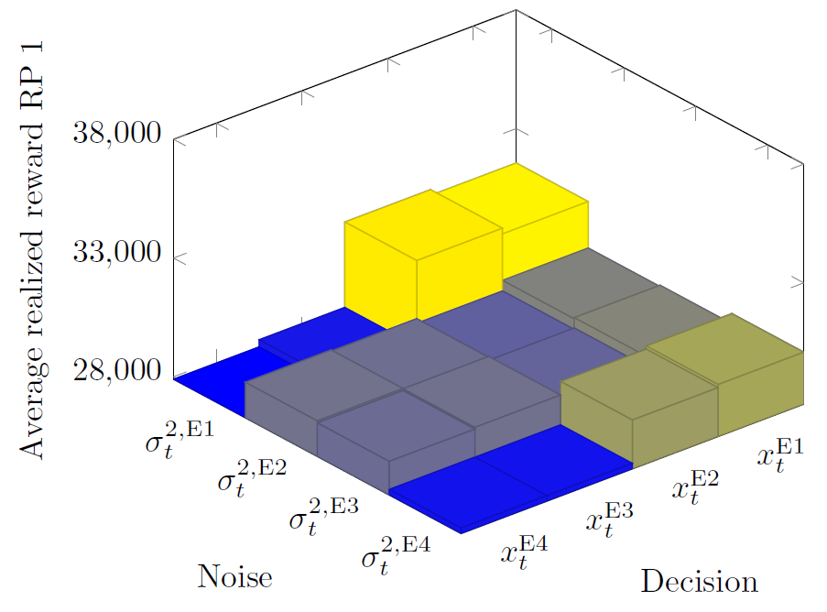
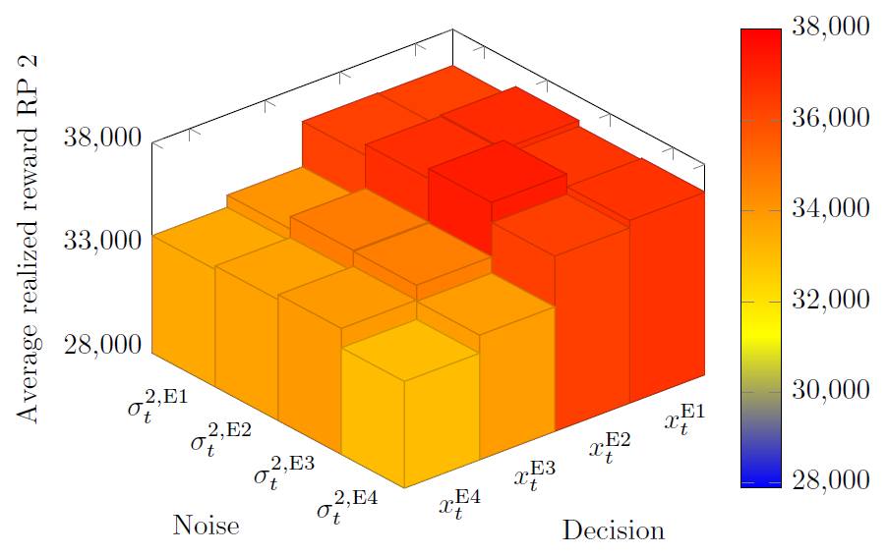

TUNING EXPERIMENTS [1/2]
Best ratio of two tunable
parameters (noise/(initial cov))
is 10⁴ (in line with literature)
Our VPI modifications pay off:
  Exploration decision: include downstream rewards
  Update belief: use noise term equal to variance of ${\overline{V}}_{t}^{n}\left(S_{t}^{x,n}\right)$
Notes:
Telefoon, fax, email
Alle partijen communiceren dus onderling en dat leidt tot problemen

Slide 24
TUNING EXPERIMENTS [2/2]
Learned rewards: estimated value of initial states (estimated performance of the resulting policy)
Realized rewards: actual rewards resulting from a simulation of the resulting policy.
Notes:
Telefoon, fax, email
Alle partijen communiceren dus onderling en dat leidt tot problemen

Slide 25
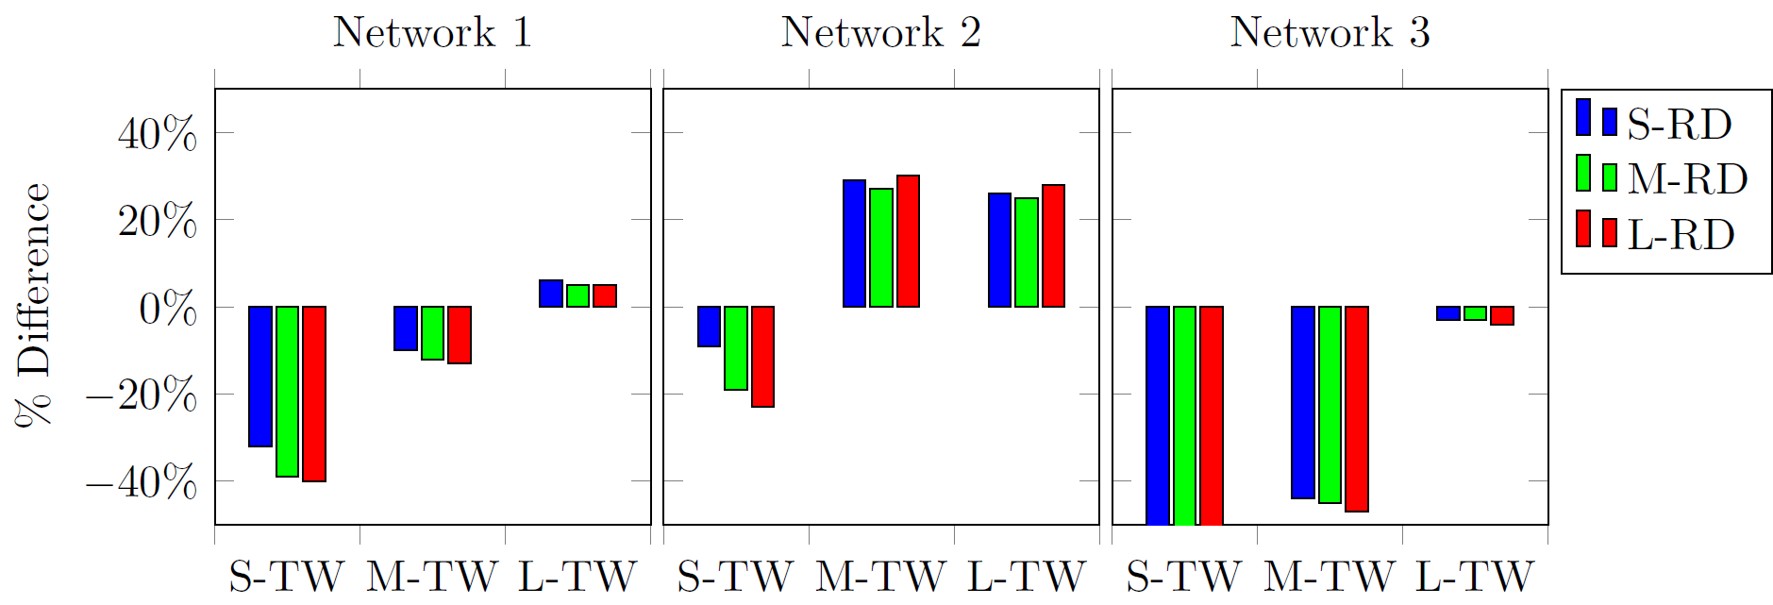
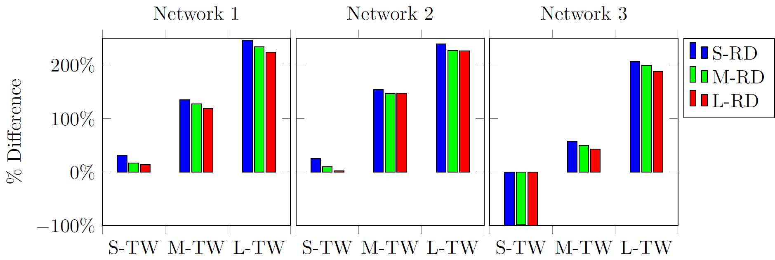
BENCHMARK EXPERIMENTS
Benchmark without
restricted decision space
Benchmark with restricted decision space
Notes:
Telefoon, fax, email
Alle partijen communiceren dus onderling en dat leidt tot problemen

Slide 26
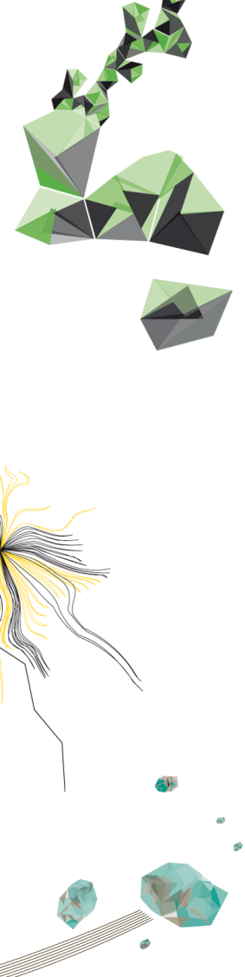
TO REMEMBER…
We designed an ADP algorithm and VFA to derive a policy that supports scheduling freight in synchromodal transport
VPI significantly improves the performance of ADP, both in terms of learned values and the resulting policy.
To apply VPI in a finite-horizon ADP with basis functions, exploring and updating should be done slightly more conservative than in conventional infinite-horizon VPI.
For larger networks, further research in the reduction of the decision space is necessary for ADP to achieve the largest gains over competing policies in synchromodal transport.
Notes:
Telefoon, fax, email
Alle partijen communiceren dus onderling en dat leidt tot problemen

Slide 27
QUESTIONS?
Martijn Mes
Associate professor
University of Twente
School of Management and Governance
Dept. Industrial Engineering and Business Information Systems
Contact
Phone: +31-534894062
Email: m.r.k.mes@utwente.nl
Web: https://www.utwente.nl/bms/iebis/staff/mes/

