Slide 1

Tactical Planning in Healthcare with Approximate Dynamic Programming
Martijn Mes & Peter Hulshof
Department of Industrial Engineering and Business Information Systems
University of Twente
The Netherlands
Sunday, October 6, 2013
INFORMS Annual Meeting 2013, Minneapolis, MN

Slide 2

OUTLINE
Introduction
Problem formulation
Solution approaches
  Integer Linear Programming
  Dynamic Programming
  Approximate Dynamic Programming
Our approach
Numerical results
Managerial implications
What to remember

Slide 3

INTRODUCTION
Healthcare providers face the challenging task to organize their processes more effectively and efficiently
  Growing healthcare costs (12% of GDP in the Netherlands)
  Competition in healthcare
  Increasing power from health insures
Our focus: integrated decision making on the tactical planning level:
  Patient care processes connect multiple departments and resources, which require an integrated approach.
  Operational decisions often depend on a tactical plan, e.g., tactical allocation of blocks of resource time to specialties and/or patient categories (master schedule / block plan).
Care process: a chain of care stages for a patient, e.g., consultation, surgery, or a visit to the outpatient clinic

Slide 4

CONTROLLED ACCESS TIMES
Tactical planning objectives:
  Achieve equitable access and treatment duration.
  Serve the strategically agreed target number of patients.
  Maximize resource utilization and balance the workload.
We focus on access times, which are incurred at each care stage in a patient’s treatment at the hospital.
Controlled access times:
  To ensure quality of care for the patient and to prevent patients from seeking treatment elsewhere.
  Payments might come only after patients have
  completed their health care process.

Slide 5
TACTICAL PLANNING AT HOSPITALS IN OUR STUDY
Typical setting: 8 care processes, 8 weeks as a planning horizon, and 4 resource types.
Current way of creating/adjusting tactical plans:
  In biweekly meeting with decision makers.
  Using spreadsheet solutions.
Our model provides an optimization step that supports rational decision making in tactical planning.

Slide 6
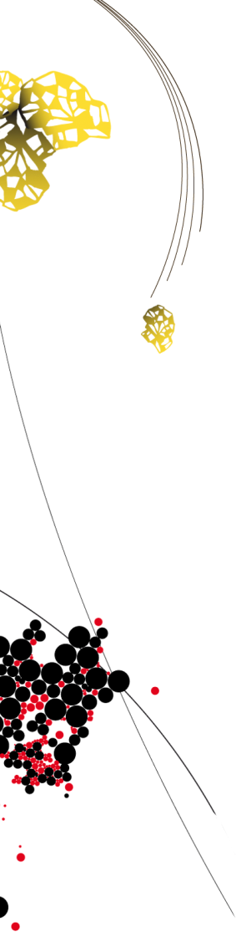
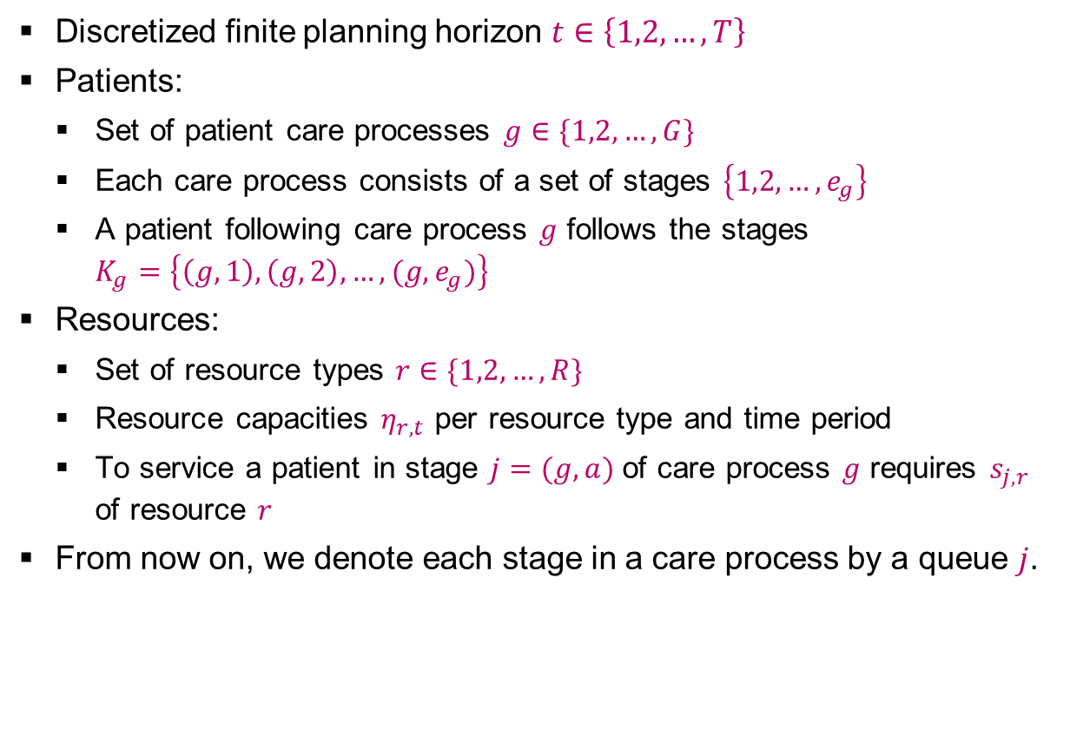
PROBLEM FORMULATION [1/2]
Discretized finite planning horizon $t∈\left\{1,2,…,T\right\}$
Patients:
  Set of patient care processes $g∈\{1,2,…,G\}$
  Each care process consists of a set of stages $\left\{1,2,…,e_{g}\right\}$
  A patient following care process $g$ follows the stages $K_{g}=\left\{\left(g,1\right),\left(g,2\right),…,(g,e_{g})\right\}$
Resources:
  Set of resource types $r∈\{1,2,…,R\}$
  Resource capacities $η_{r,t}$ per resource type and time period
  To service a patient in stage $j=(g,a)$of care process $g$ requires $s_{j,r}$ of resource $r$
From now on, we denote each stage in a care process by a queue $j$.

Slide 7
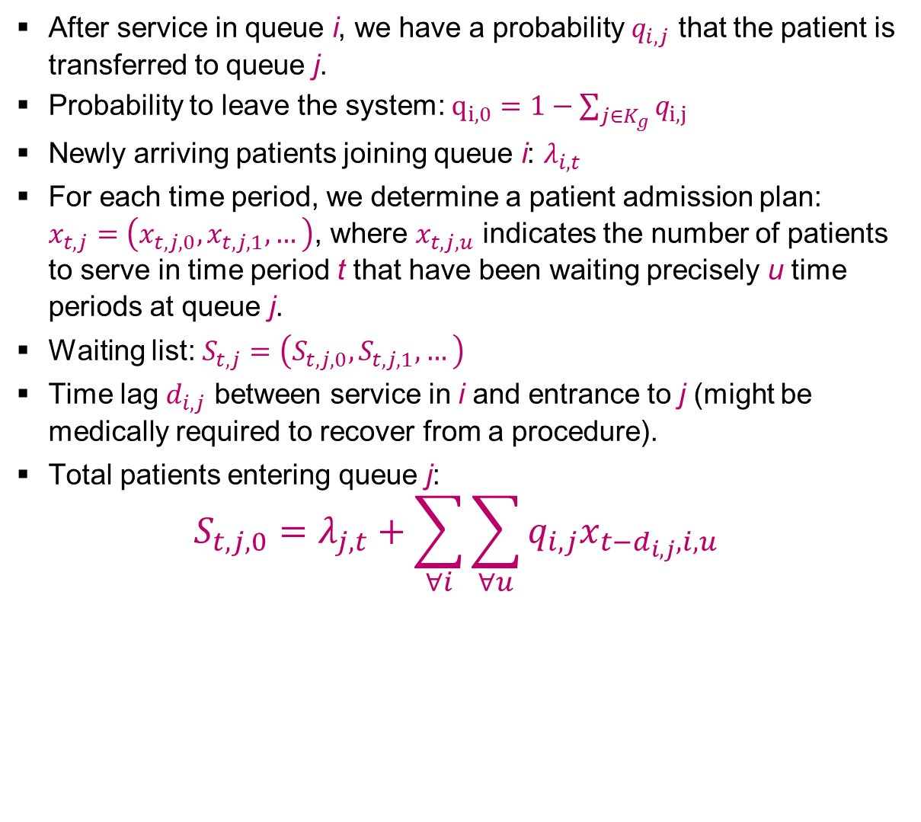
PROBLEM FORMULATION [2/2]
After service in queue i, we have a probability $q_{i,j}$ that the patient is transferred to queue j.
Probability to leave the system: $q_{i,0}=1−\sum_{j∈K_{g}}{q_{i,j}}$
Newly arriving patients joining queue i: $λ_{i,t}$
For each time period, we determine a patient admission plan: $x_{t,j}=\left(x_{t,j,0},x_{t,j,1},…\right)$, where $x_{t,j,u}$ indicates the number of patients to serve in time period t that have been waiting precisely u time periods at queue j.
Waiting list: $S_{t,j}=\left(S_{t,j,0},S_{t,j,1},…\right)$
Time lag $d_{i,j}$ between service in i and entrance to j (might be medically required to recover from a procedure).
Total patients entering queue j:
$$S_{t,j,0}=λ_{j,t}+\sum_{∀i}{\sum_{∀u}{q_{i,j}x_{t−d_{i,j},i,u}}}$$

Slide 8
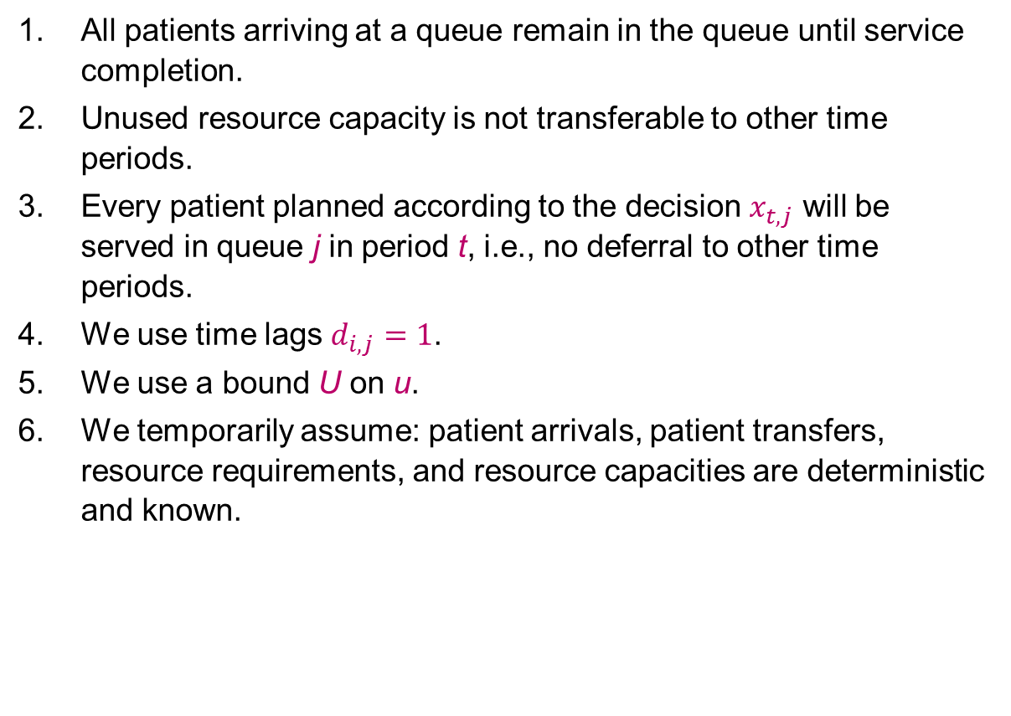
ASSUMPTIONS
All patients arriving at a queue remain in the queue until service completion.
Unused resource capacity is not transferable to other time periods.
Every patient planned according to the decision $x_{t,j}$ will be served in queue j in period t, i.e., no deferral to other time periods.
We use time lags $d_{i,j}=1$.
We use a bound U on u.
We temporarily assume: patient arrivals, patient transfers, resource requirements, and resource capacities are deterministic and known.

Slide 9

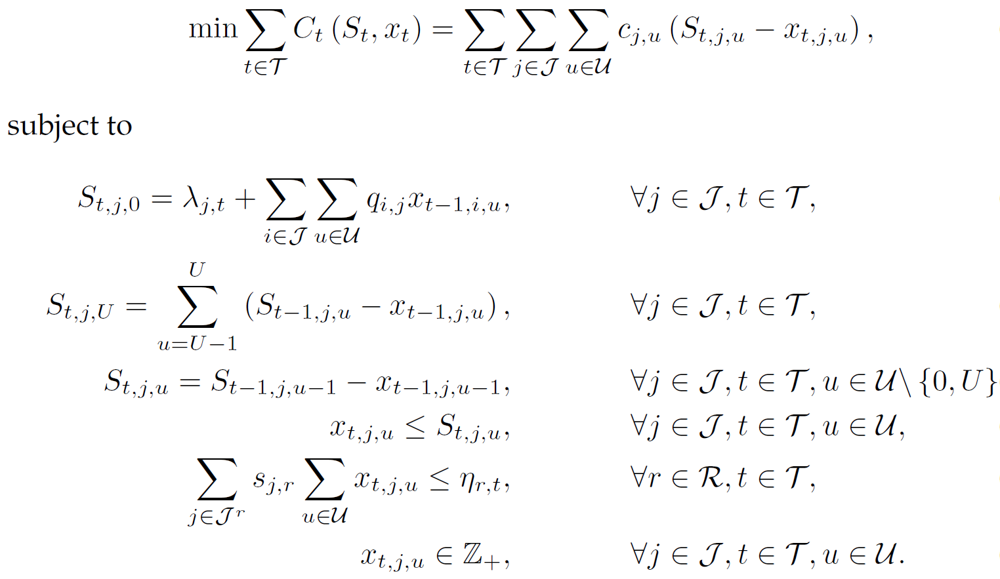
MIXED INTEGER LINEAR PROGRAM
Number of patients in queue j at time t with waiting time u
Number of patients to treat in queue j at time t with a waiting time u
[1]
Updating
waiting list &
bound on u
Limit on the decision space
[1] Hulshof PJ, Boucherie RJ, Hans EW, Hurink JL. (2013) Tactical resource allocation and elective patient admission planning in care processes. Health Care Manag Sci. 16(2):152-66.

Slide 10
PROS & CONS OF THE MILP
Pros:
  Suitable to support integrated decision making for multiple resources, multiple time periods, and multiple patient groups.
  Flexible formulation (other objective functions can easily be incorporated).
Cons:
  Quite limited in the state space.
  Model does not include any form of randomness.
  Rounding problems with fraction of patients moving from one queue to another after service.

Slide 11
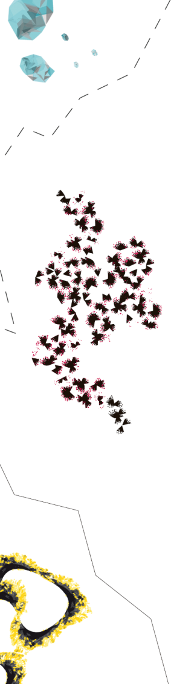


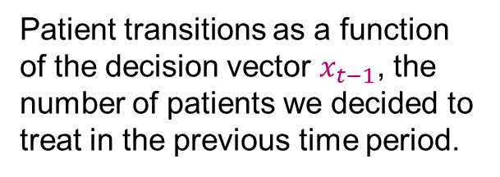
MODELLING STOCHASTICITY [1/2]
We introduce $W_{t}$: vector of random variables representing all the new information that becomes available between time t−1 and t.
We distinguish between exogenous and endogenous information:
Patient arrivals from outside the system
Patient transitions as a function of the decision vector $x_{t−1}$, the number of patients we decided to treat in the previous time period.

Slide 12

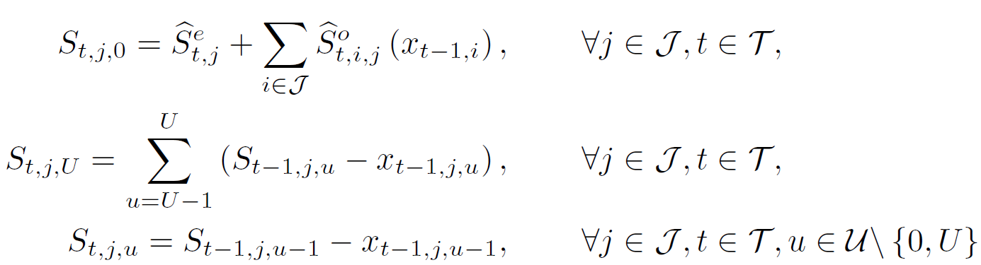
MODELLING STOCHASTICITY [2/2]
Transition function to capture the evolution of the system over time as a result of the decisions and the random information:
Where
Stochastic counterparts of the first three constraints in the ILP formulation.

Slide 13
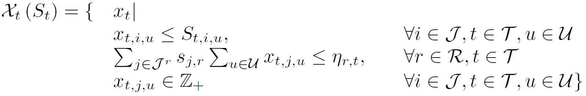
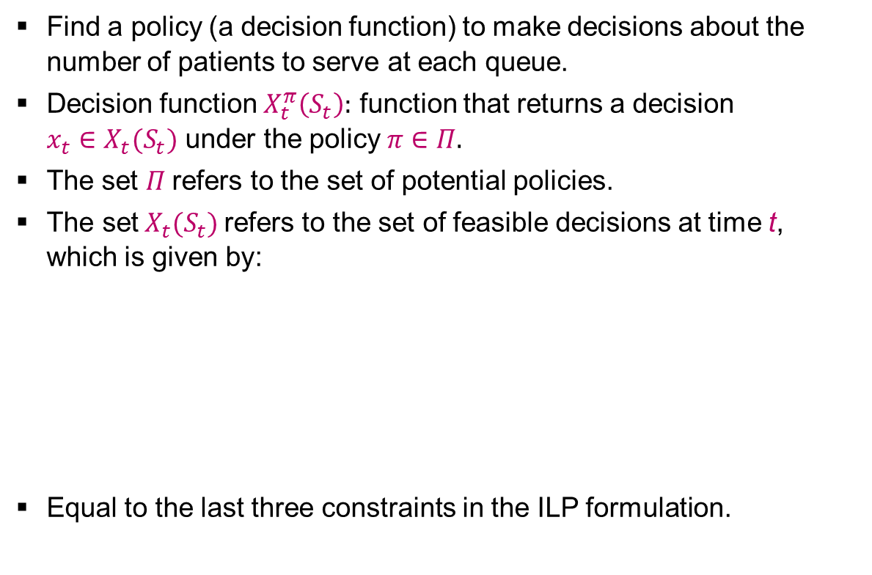
OBJECTIVE [1/2]
Find a policy (a decision function) to make decisions about the number of patients to serve at each queue.
Decision function $X_{t}^{π}\left(S_{t}\right):$ function that returns a decision $x_{t}∈X_{t}(S_{t})$ under the policy $π∈Π.$
The set $Π$refers to the set of potential policies.
$\text{The} \text{set} X_{t}(S_{t})$refers to the set of feasible decisions at time t, which is given by:
Equal to the last three constraints in the ILP formulation.

Slide 14
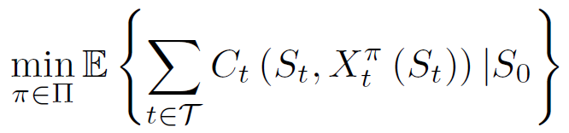
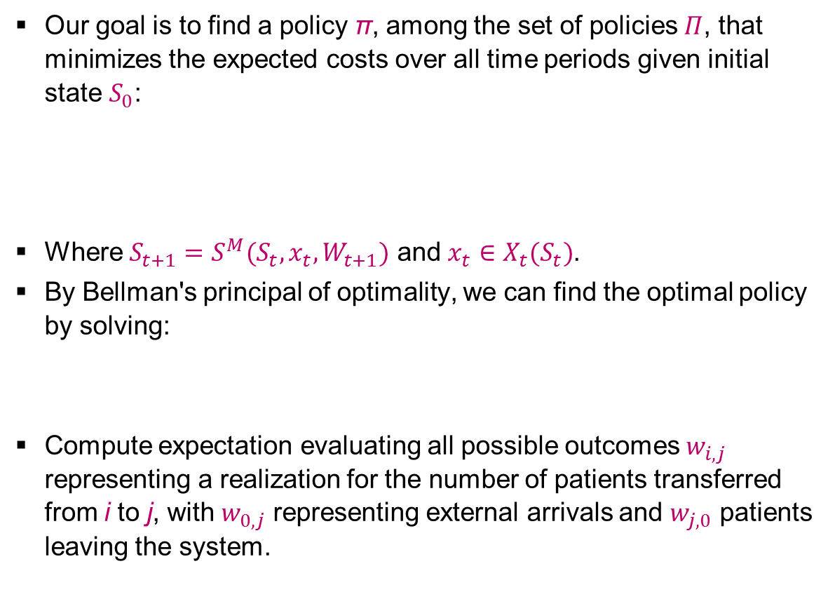
OBJECTIVE [2/2]
Our goal is to find a policy π, among the set of policies $Π$, that minimizes the expected costs over all time periods given initial state $S_{0}$:
Where $S_{t+1}=S^{M}(S_{t}, x_{t},W_{t+1})$ and $x_{t}∈X_{t}(S_{t})$.
By Bellman's principal of optimality, we can find the optimal policy by solving:
Compute expectation evaluating all possible outcomes $w_{i,j}$ representing a realization for the number of patients transferred from i to j, with $w_{0,j}$ representing external arrivals and $w_{j,0}$ patients leaving the system.

Slide 15
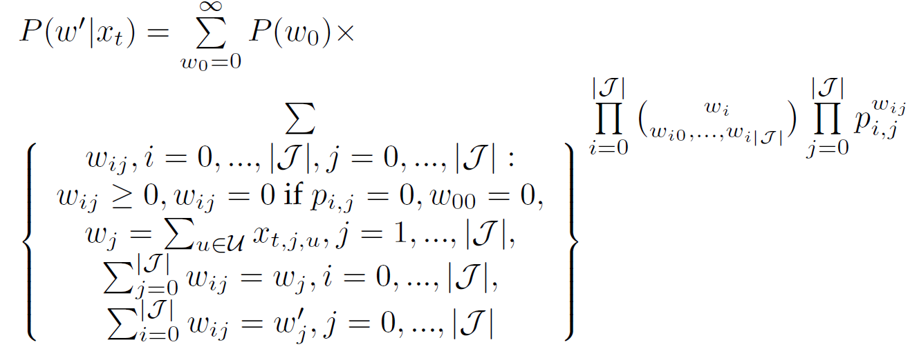
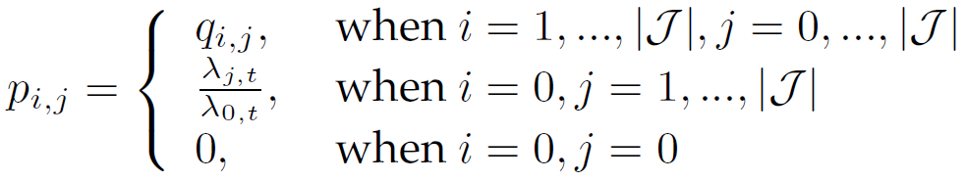
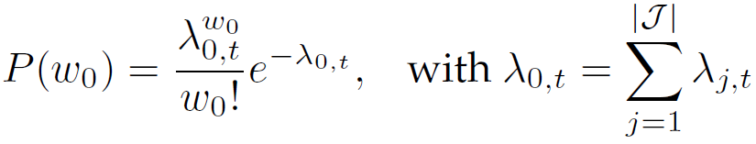
DYNAMIC PROGRAMMING FORMULATION
Solve:
Where
Solved by backward induction

Slide 16
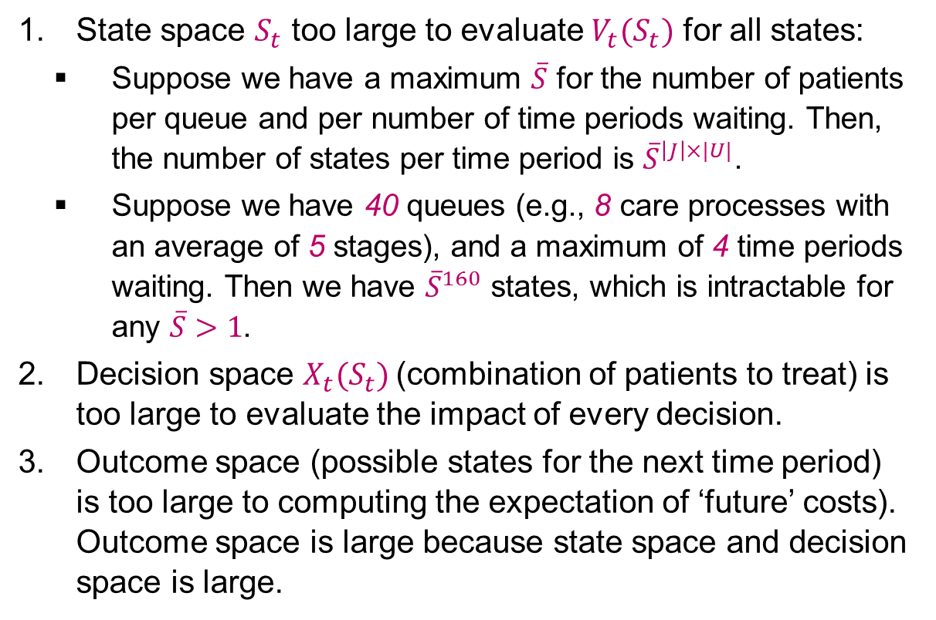
THREE CURSUS OF DIMENSIONALITY
State space $S_{t}$ too large to evaluate $V_{t}(S_{t})$ for all states:
  Suppose we have a maximum $\overline{S}$ for the number of patients per queue and per number of time periods waiting. Then, the number of states per time period is ${\overline{S}}^{\left|J\right|×|U|}$.
  Suppose we have 40 queues (e.g., 8 care processes with an average of 5 stages), and a maximum of 4 time periods waiting. Then we have ${\overline{S}}^{160}$ states, which is intractable for any $\overline{S}>1$.
Decision space $X_{t}(S_{t})$(combination of patients to treat) is too large to evaluate the impact of every decision.
Outcome space (possible states for the next time period) is too large to computing the expectation of ‘future’ costs). Outcome space is large because state space and decision space is large.

Slide 17
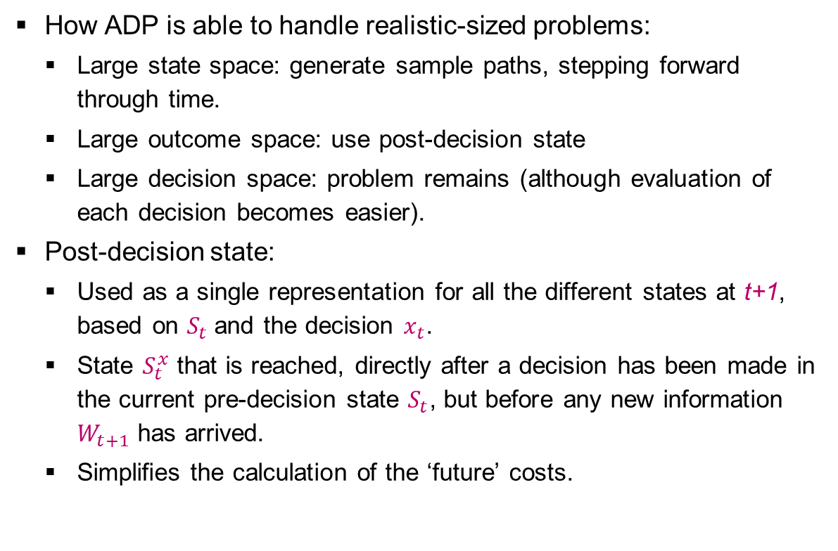
APPROXIMATE DYNAMIC PROGRAMMING (ADP)
How ADP is able to handle realistic-sized problems:
  Large state space: generate sample paths, stepping forward through time.
  Large outcome space: use post-decision state
  Large decision space: problem remains (although evaluation of each decision becomes easier).
Post-decision state:
  Used as a single representation for all the different states at t+1, based on $S_{t}$and the decision $x_{t}$.
  State $S_{t}^{x}$ that is reached, directly after a decision has been made in the current pre-decision state $S_{t}$, but before any new information $W_{t+1}$ has arrived.
  Simplifies the calculation of the ‘future’ costs.

Slide 18

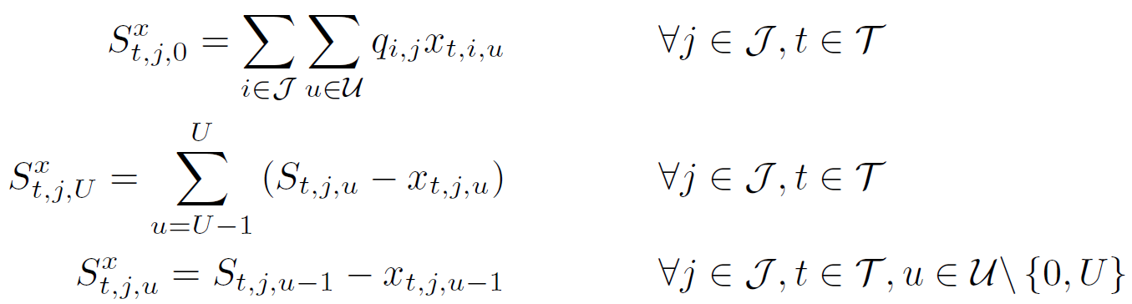

TRANSITION TO POST-DECISION STATE
Besides the earlier transition function, we now define a transition function from pre $S_{t}$ to post $S_{t}^{x}$.
With
Deterministic function of the current state and decision.
Expected results of our decision are included, not the new arrivals.
Expected transitions of the treated patients

Slide 19



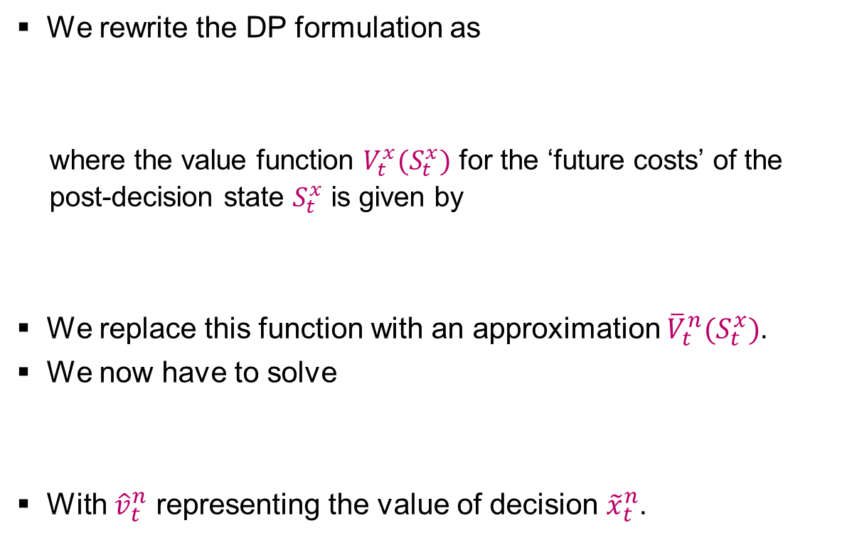
ADP FORMULATION
We rewrite the DP formulation as
  where the value function $V_{t}^{x}(S_{t}^{x})$ for the ‘future costs’ of the post-decision state $S_{t}^{x}$ is given by
We replace this function with an approximation ${\overline{V}}_{t}^{n}(S_{t}^{x})$.
We now have to solve
With ${\hat{v}}_{t}^{n}$ representing the value of decision ${\tilde{x}}_{t}^{n}$.

Slide 20
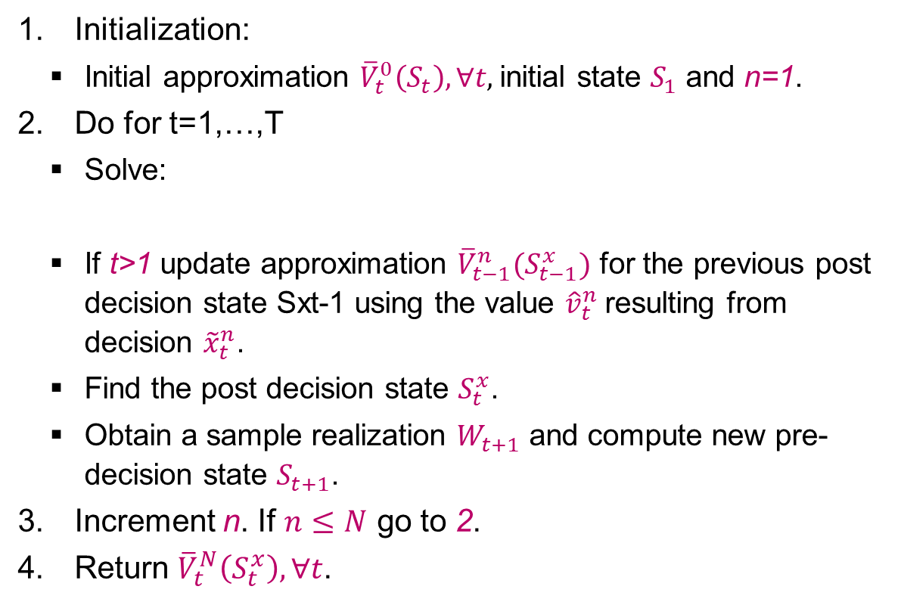
ADP ALGORITHM
Initialization:
  Initial approximation ${\overline{V}}_{t}^{0}\left(S_{t}\right), ∀t,$initial state $S_{1}$ and n=1.
Do for t=1,…,T
  Solve:
  If t>1 update approximation ${\overline{V}}_{t−1}^{n}(S_{t−1}^{x})$ for the previous post decision state Sxt-1 using the value ${\hat{v}}_{t}^{n}$resulting from decision ${\tilde{x}}_{t}^{n}$.
  Find the post decision state $S_{t}^{x}$.
  Obtain a sample realization $W_{t+1}$ and compute new pre-decision state $S_{t+1}$.
Increment n. If $n≤N$ go to 2.
Return ${\overline{V}}_{t}^{N}\left(S_{t}^{x}\right), ∀t$.

Slide 21
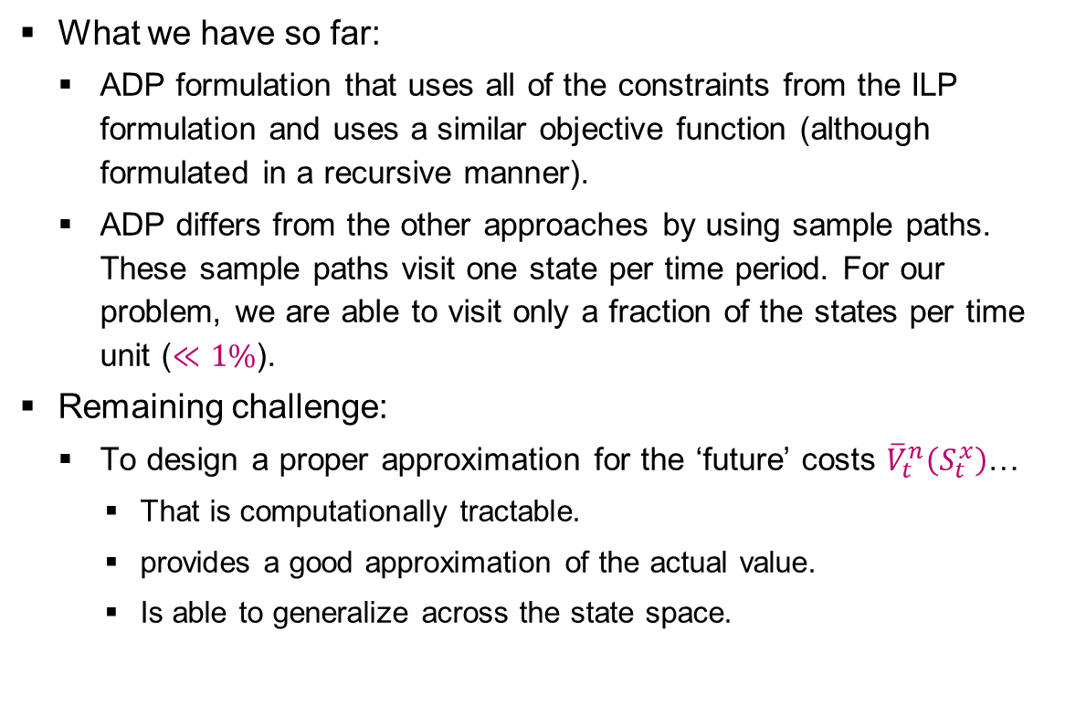
VALUE FUNCTION APPROXIMATION [1/3]
What we have so far:
  ADP formulation that uses all of the constraints from the ILP formulation and uses a similar objective function (although formulated in a recursive manner).
  ADP differs from the other approaches by using sample paths. These sample paths visit one state per time period. For our problem, we are able to visit only a fraction of the states per time unit ($≪1\%$).
Remaining challenge:
  To design a proper approximation for the ‘future’ costs ${\overline{V}}_{t}^{n}\left(S_{t}^{x}\right)$…
    That is computationally tractable.
    provides a good approximation of the actual value.
    Is able to generalize across the state space.

Slide 22
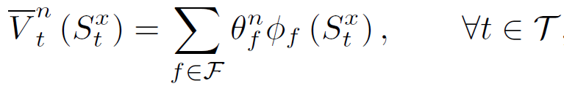
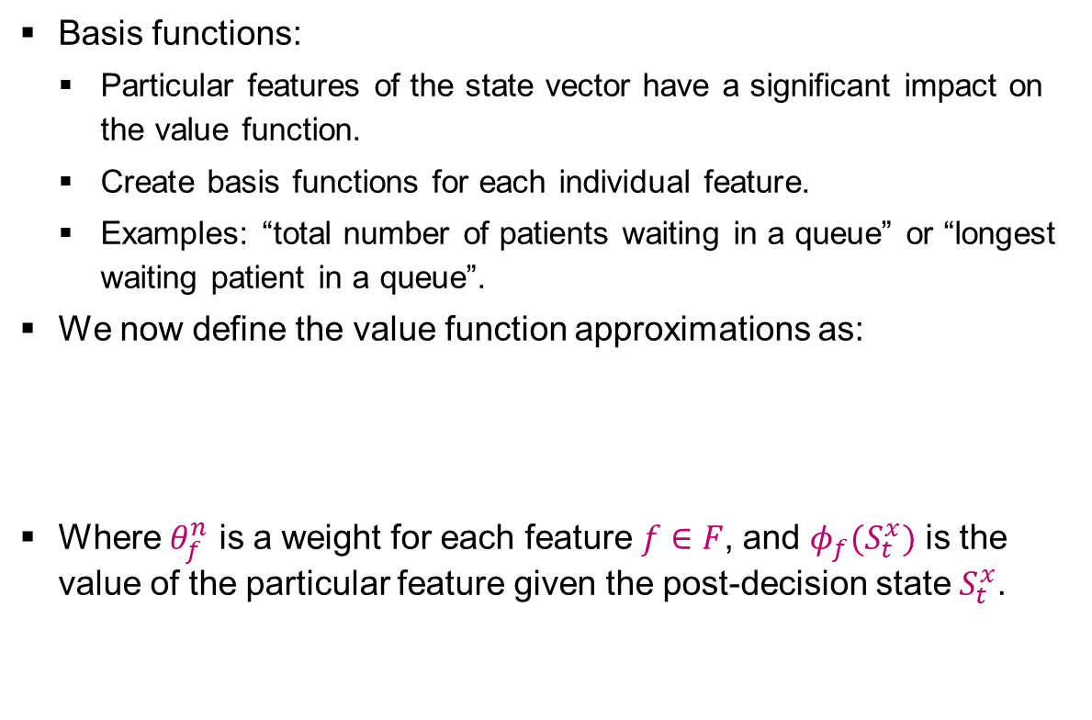
VALUE FUNCTION APPROXIMATION [2/3]
Basis functions:
  Particular features of the state vector have a significant impact on the value function.
  Create basis functions for each individual feature.
  Examples: “total number of patients waiting in a queue” or “longest waiting patient in a queue”.
We now define the value function approximations as:
Where $θ_{f}^{n}$ is a weight for each feature $f∈F$, and $φ_{f}(S_{t}^{x})$ is the value of the particular feature given the post-decision state $S_{t}^{x}$.

Slide 23
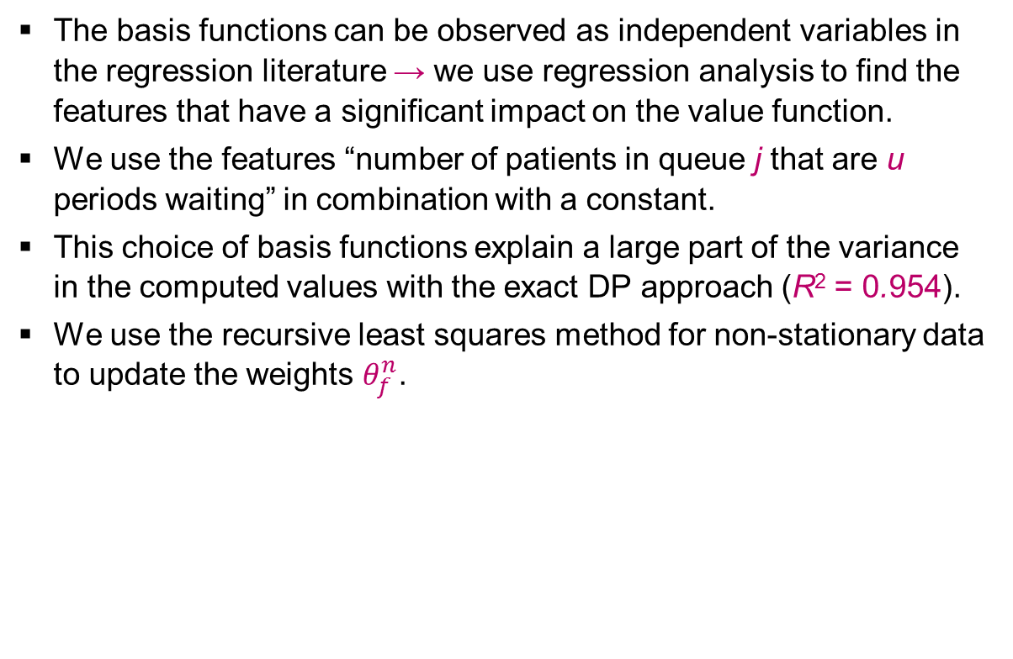
VALUE FUNCTION APPROXIMATION [3/3]
The basis functions can be observed as independent variables in the regression literature → we use regression analysis to find the features that have a significant impact on the value function.
We use the features “number of patients in queue j that are u periods waiting” in combination with a constant.
This choice of basis functions explain a large part of the variance in the computed values with the exact DP approach (R² = 0.954).
We use the recursive least squares method for non-stationary data to update the weights $θ_{f}^{n}$.

Slide 24
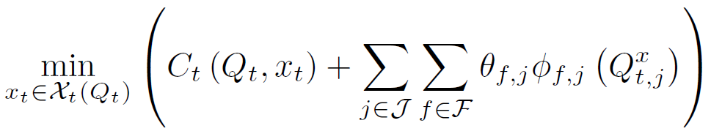
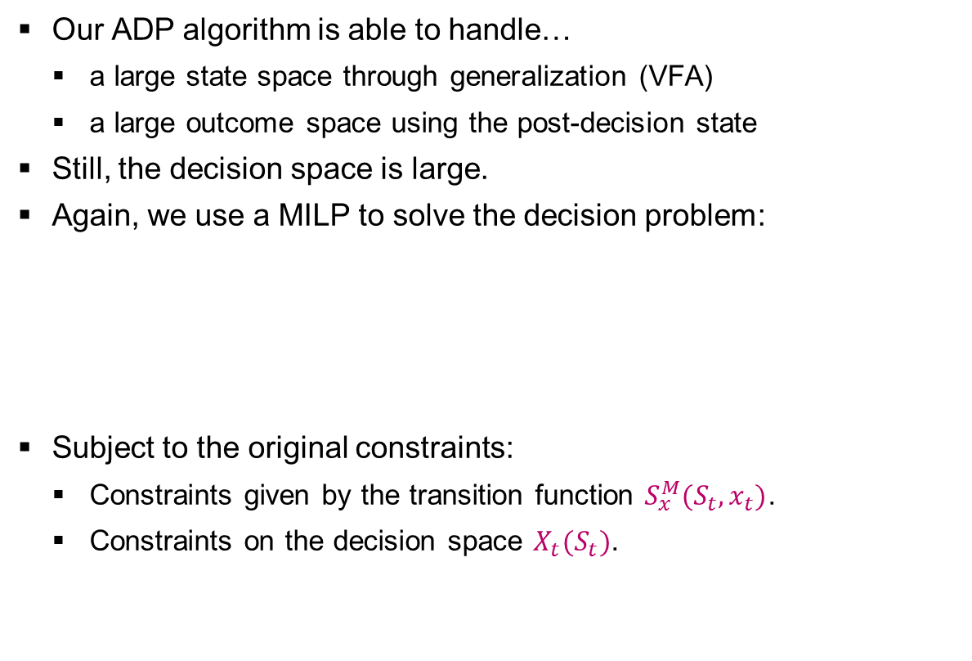
DECISION PROBLEM WITHIN ONE STATE
Our ADP algorithm is able to handle…
  a large state space through generalization (VFA)
  a large outcome space using the post-decision state
Still, the decision space is large.
Again, we use a MILP to solve the decision problem:
Subject to the original constraints:
  Constraints given by the transition function $S_{x}^{M}(S_{t},x_{t})$.
  Constraints on the decision space $X_{t}(S_{t})$.

Slide 25
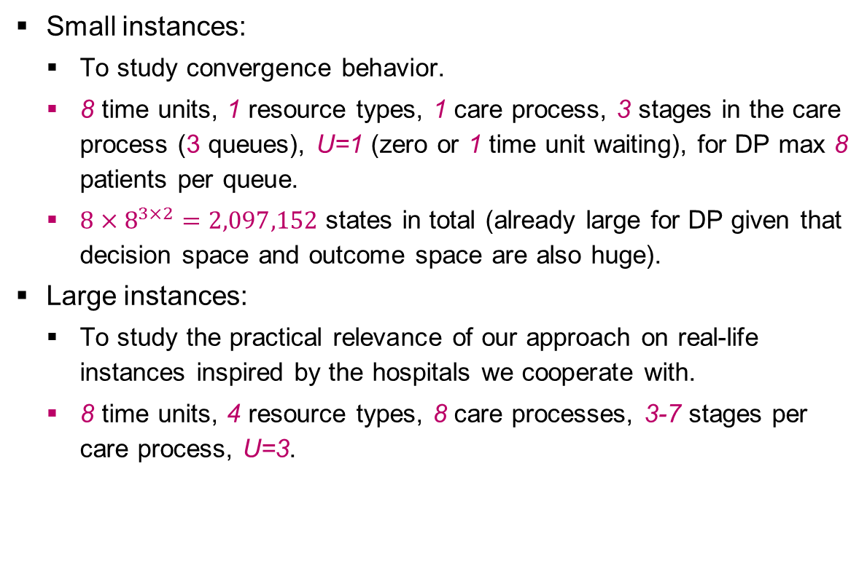
EXPERIMENTS
Small instances:
  To study convergence behavior.
  8 time units, 1 resource types, 1 care process, 3 stages in the care process (3 queues), U=1 (zero or 1 time unit waiting), for DP max 8 patients per queue.
  $8×8^{3×2}=2,097,152$ states in total (already large for DP given that decision space and outcome space are also huge).
Large instances:
  To study the practical relevance of our approach on real-life instances inspired by the hospitals we cooperate with.
  8 time units, 4 resource types, 8 care processes, 3-7 stages per care process, U=3.

Slide 26
CONVERGENCE RESULTS ON SMALL INSTANCES
Tested on 5000 random initial states.
DP requires 120 hours, ADP 0.439 seconds for N=500.
ADP overestimates the value functions (+2.5%) caused by the truncated state space.

Slide 27
PERFORMANCE ON SMALL AND LARGE INSTANCES
Compare with greedy policy: fist serve the queue with the highest costs until another queue has the highest costs, or until resource capacity is insufficient.
We train ADP using 100 replication after which we fix our value functions.
We simulate the performance of using (i) the greedy policy and (ii) the policy determined by the value functions.
We generate 5000 initial states, simulating each policy with 5000 sample paths.
Results:
  Small instances: ADP 2% away from optimum and greedy 52% away from optimum.
  Large instances: ADP results 29% savings compared to greedy.

Slide 28
MANAGERIAL IMPLICATIONS
The ADP approach can be used to establish long-term tactical plans (e.g., three month periods) in two steps:
  Run N iterations of the ADP algorithm to find the value functions given by the feature weights for all time periods.
  These value functions can be used to determine the tactical planning decision for each state and time period by generating the most likely sample path.
Implementation in a rolling horizon approach:
  Finite horizon approach may cause unwanted and short-term focused behavior in the last time periods.
  Recalculation of tactical plans ensures that the most recent information is used.
  Recalculation can be done using the existing value function approximations and the actual state of the system.

Slide 29
WHAT TO REMEMBER
Stochastic model for tactical resource capacity and patient admission planning to…
  achieve equitable access and treatment duration for patient groups;
  serve the strategically agreed number of patients;
  maximize resource utilization and balance workload;
  support integrated and coordinated decision making in care chains.
Our ADP approach with basis functions…
  allows for time dependent parameters to be set for patient arrivals and resource capacities to cope with anticipated fluctuations;
  provides value functions that can be used to create robust tactical plans and periodic readjustments of these plans;
  is fast, capable of solving real-life sized instances;
  is generic: object function and constraints can easily be adapted to suit the hospital situation at hand.

Slide 30
QUESTIONS?
Martijn Mes
Assistant professor
University of Twente
School of Management and Governance
Dept. Industrial Engineering and Business Information Systems
Contact
Phone: +31-534894062
Email: m.r.k.mes@utwente.nl
Web: http://www.utwente.nl/mb/iebis/staff/Mes/

