Slide 1
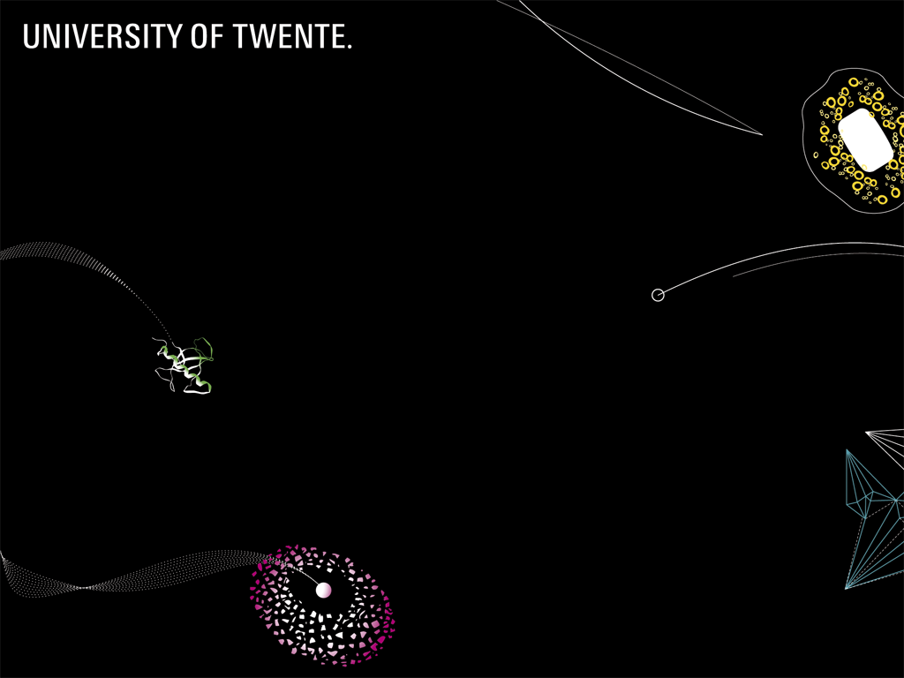


Barge Terminal Multi-Agent Network
Martijn Mes
Department of Industrial Engineering and Business Information Systems
University of Twente
The Netherlands
Wednesday, October 17, 2012
INFORMS Annual Meeting 2012, Phoenix, AZ

Slide 2
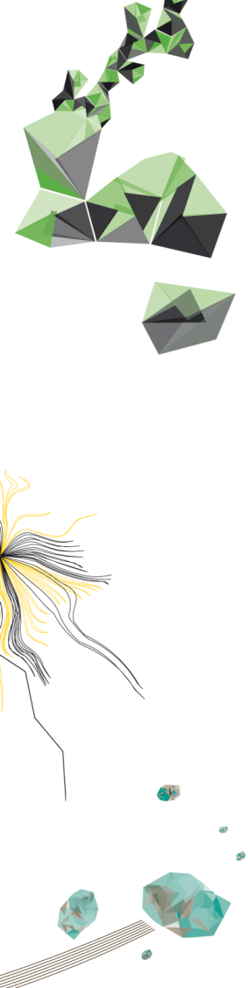

OUTLINE
Case: the Port of Rotterdam
Bottleneck: inland connections
Problem: poor alignment of barge and terminal activities
Our approach: multi-agent system
Application and game
What to remember

Slide 3

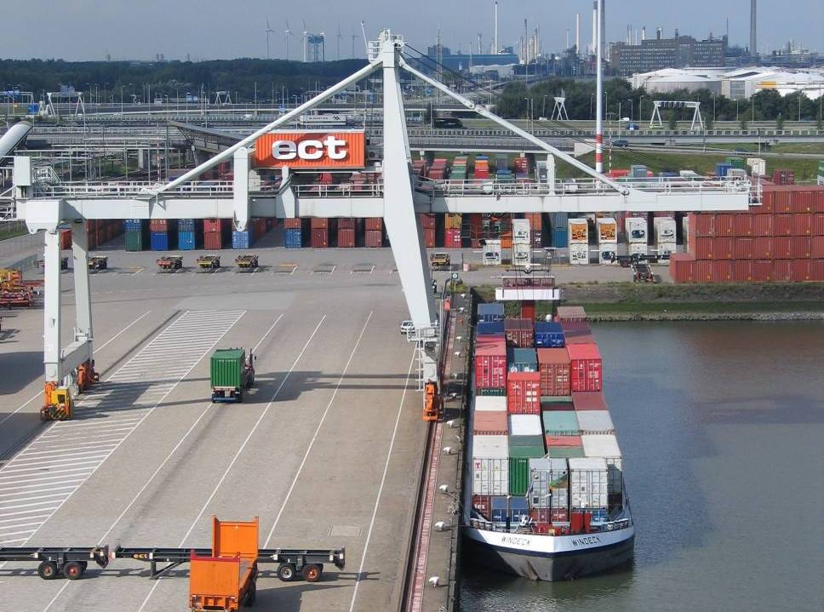
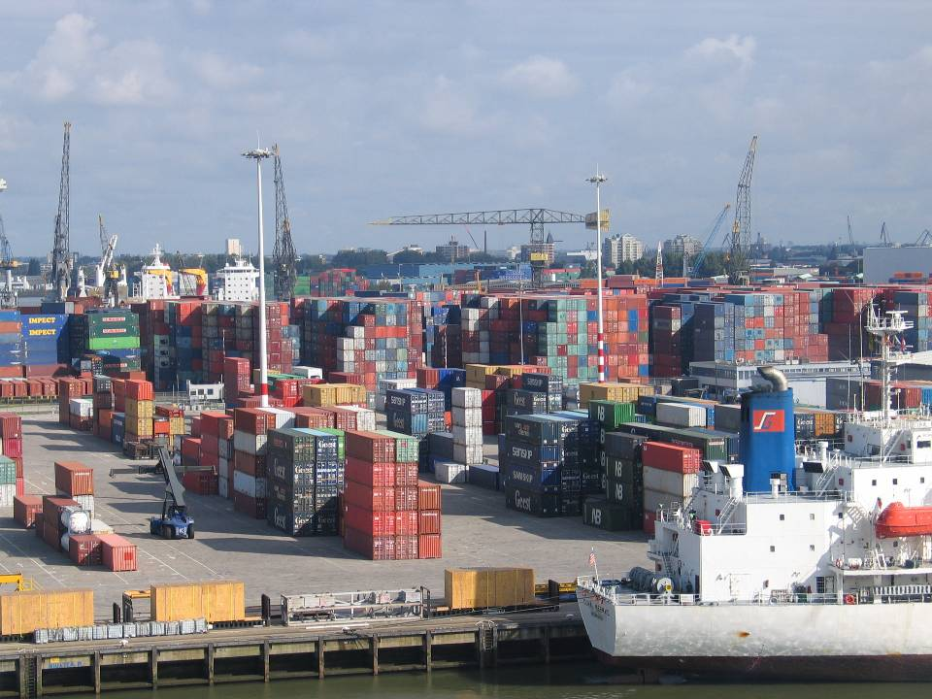
THE PORT OF ROTTERDAM
Largest port in Europe
Gateway to European market with more than 350 mil. consumers.
Nr 1 port regarding quality of port infrastructure (World Economic Forum).
Until 2004 the world’s busiest port, now the world’s fifth-largest port (tonnage)
Annual throughput is 435 mil. ton (2011)
Major increase expected in the coming years
Extension “Maasvlakte 2” of 2000 hectares (end 2014)

Slide 4
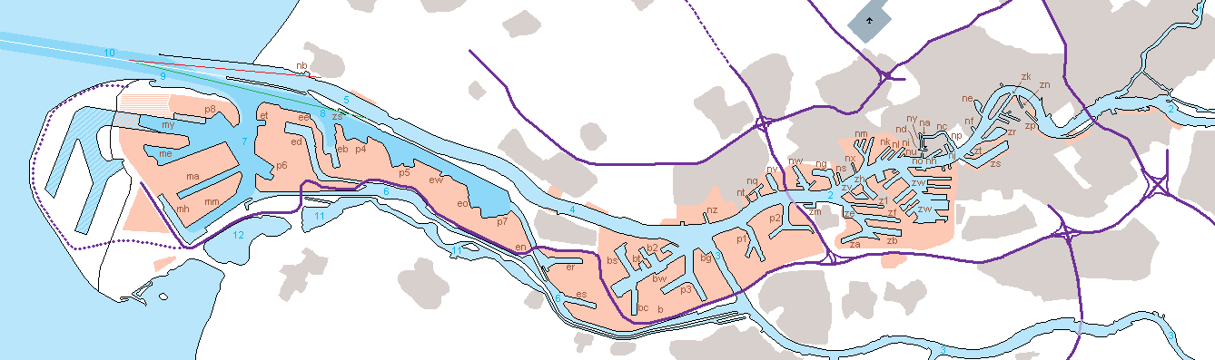
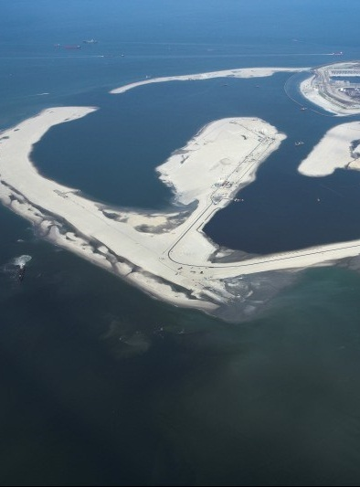
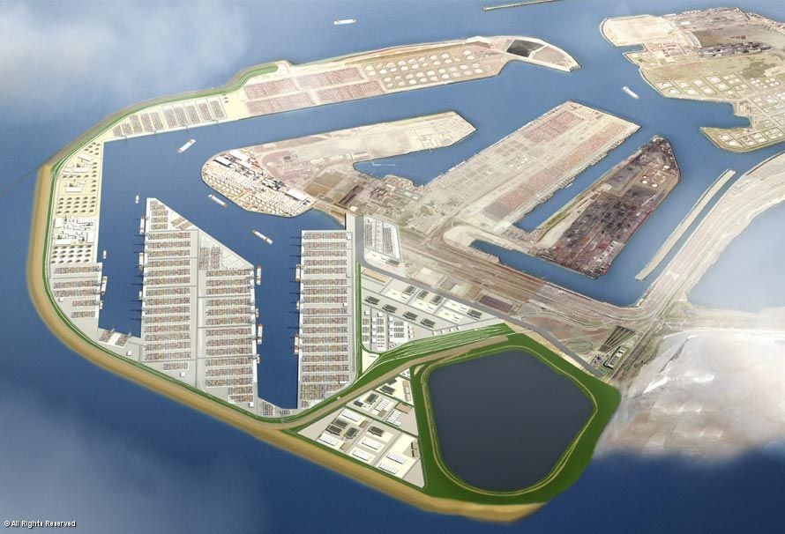
BOTTLE NECK
MAASVLAKTE 2
Inlandverbindingen
40 km / 25 mile

Slide 5
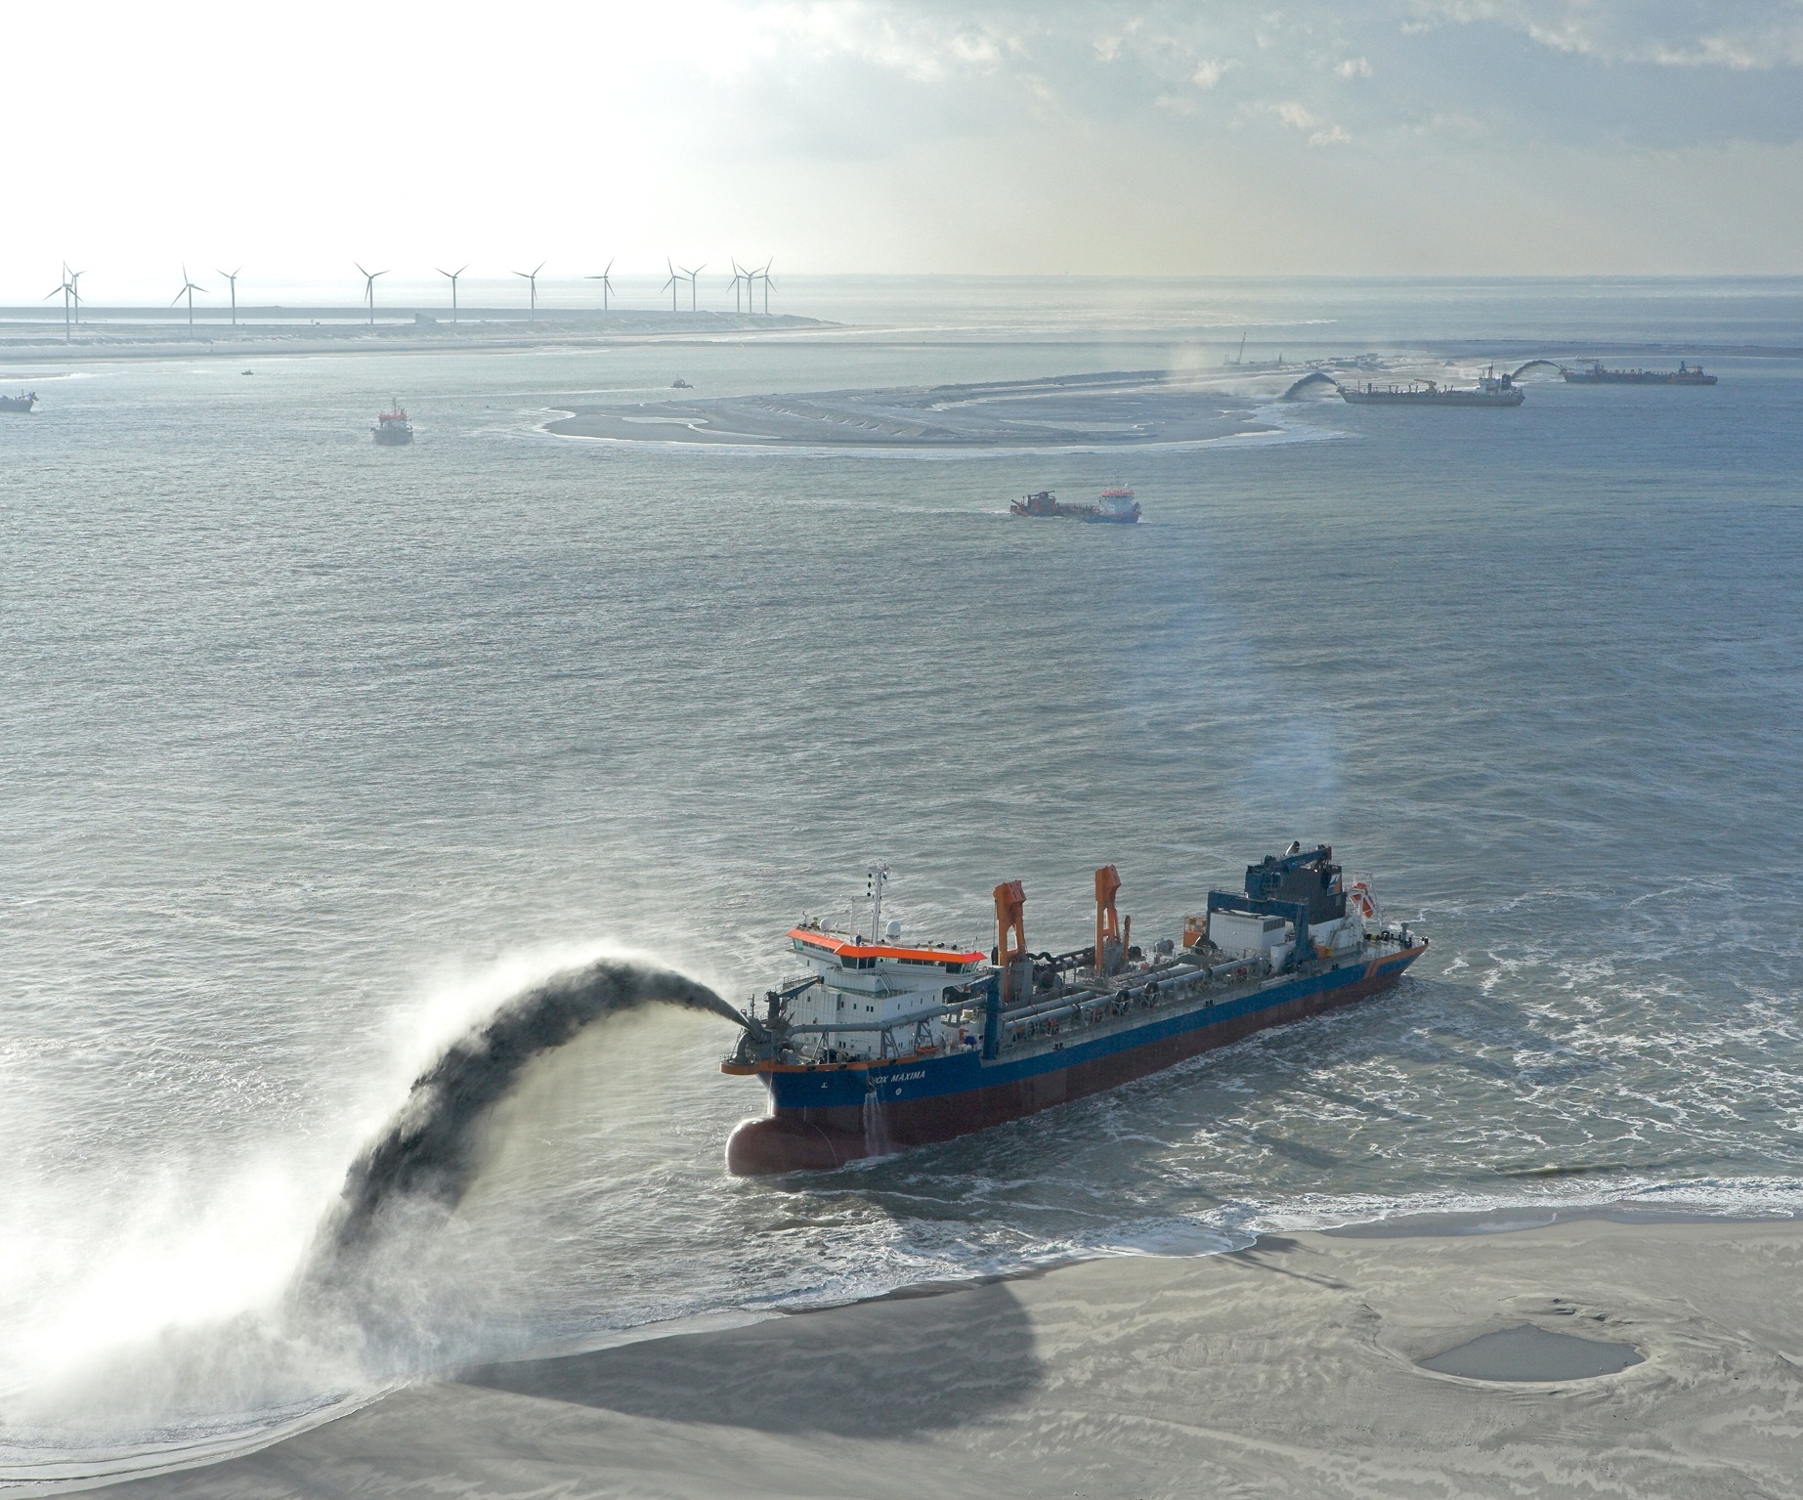

Slide 6
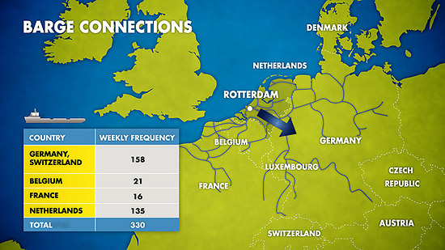
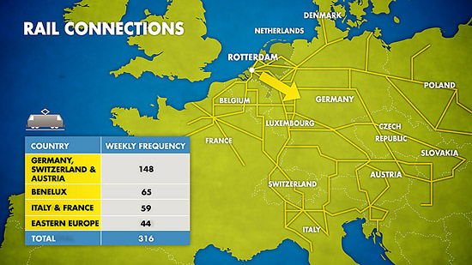
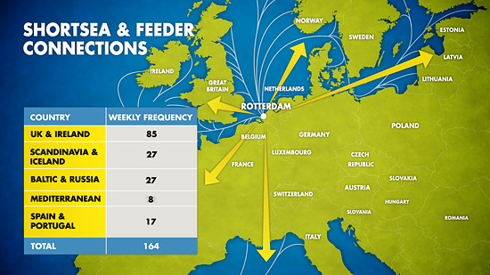
BOTTLENECK
Inland connections:
  Trains, trucks, vessels
Expected growth:
  From 12 to about 30
  mil. TEU till 2030.
Modal split:
Increase of 400% in container flows by inland shipping (7 mil. TEU)
 | 2010 | 2030
Road | 48% | 35%
Water | 40% | 45%
Rail | 12% | 20%

Slide 7
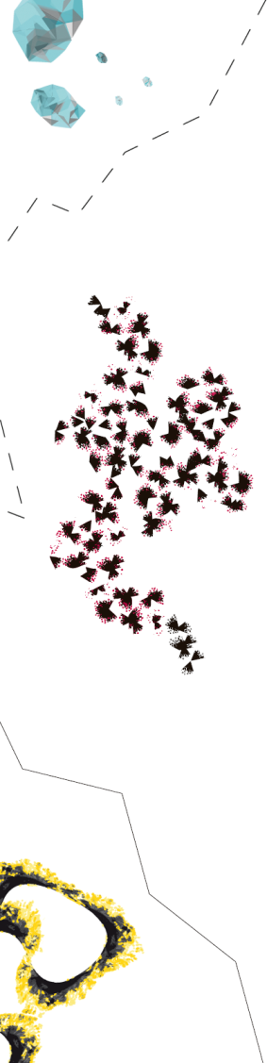
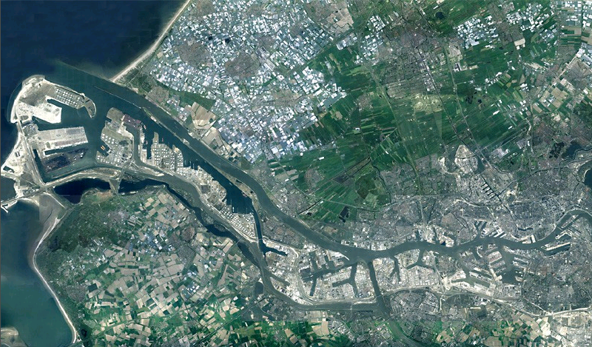
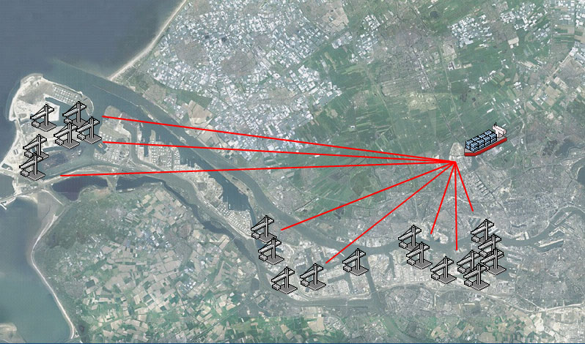
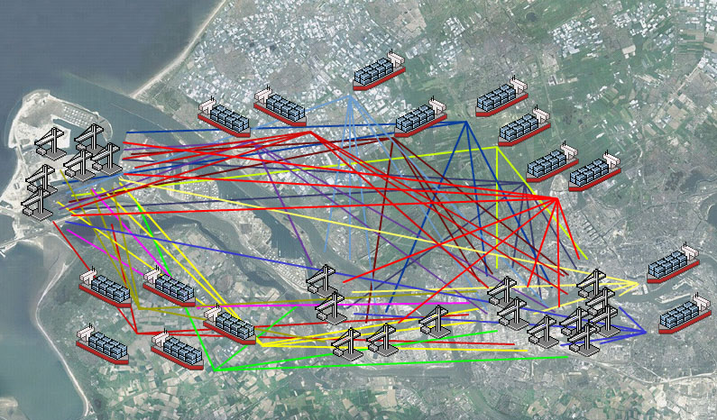
BARGE HANDLING PROBLEM [1/3]
North Sea
Barge
Terminals
Terminals
Terminals

Slide 8
BARGE HANDLING PROBLEM [2/3]
Poor alignment of barge and terminal activities
  Barges leave harbor too late
  Waiting time of barges at terminals
  Inefficient routes through the harbor
  Inefficient utilization of quay capacity
Number 1 problem in barge hinterland container transportation!
Shared problem, no single problem owner
Everyone can benefit when activities are aligned and appointments become reliable

Slide 9
BARGE HANDLING PROBLEM [3/3]
Highly complicating and restricting factors:
  Autonomy: players want to stay in control of their own operations
  Limited information sharing: players are competitors and reluctant to share information
  No contractual relationships: no performance can be enforced
Moreover:
  Different players have different interests
  Dynamic environment (lot of events and disturbances)
  Lowly structured – loosely coupled network

Slide 10
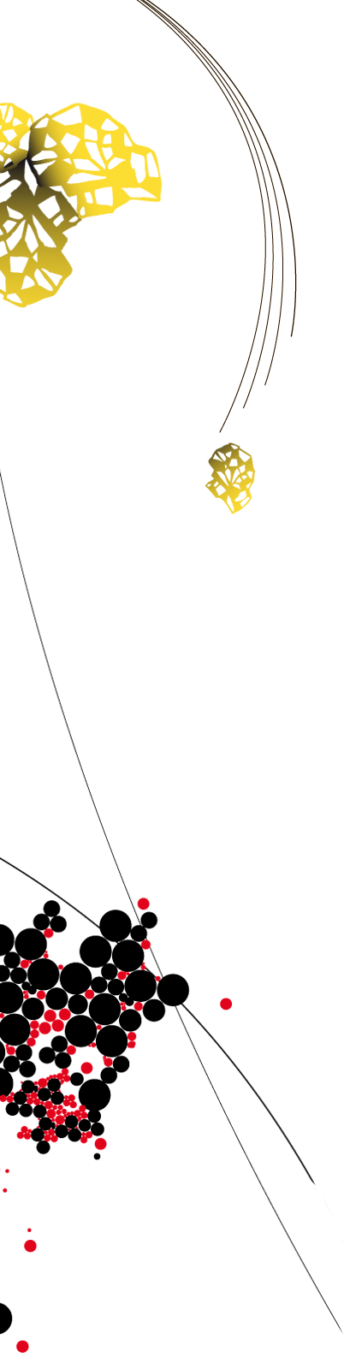
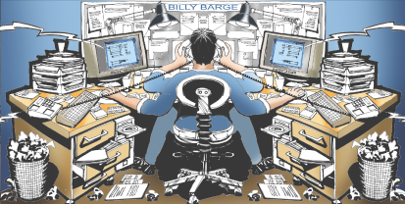
CURRENT SITUATION
Notes:
Telefoon, fax, email
Alle partijen communiceren dus onderling en dat leidt tot problemen

Slide 11



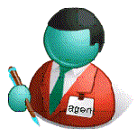
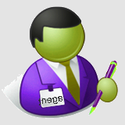
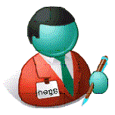
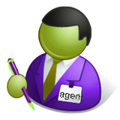
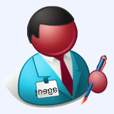
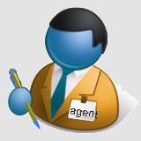
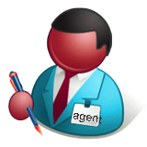

OUR SOLUTION: A MULTI-AGENT SYSTEM
An agent is a piece
of software and
company specific
Multi-Agent system
Terminal operator
Barge operator
011001110101
agent
planner
planner
agent
01100111
appointments
01100111
011001110101
planner
agent
agent
planner
Terminal operator
Barge operator
Notes:
De nieuwe situatie is de Planning Apart Together situatie
Zelfstandige bedrijven
Elk bedrijf een agent
Agents communiceren digitaal: effectievere communicatie, snelle besluitvorming
Agent is een stukje software
Idee is gelijk aan wat we kennen vna de verzekeringsagent en verzekeringsbedrijf
Agent is bedrijfsspecifiek

Slide 12
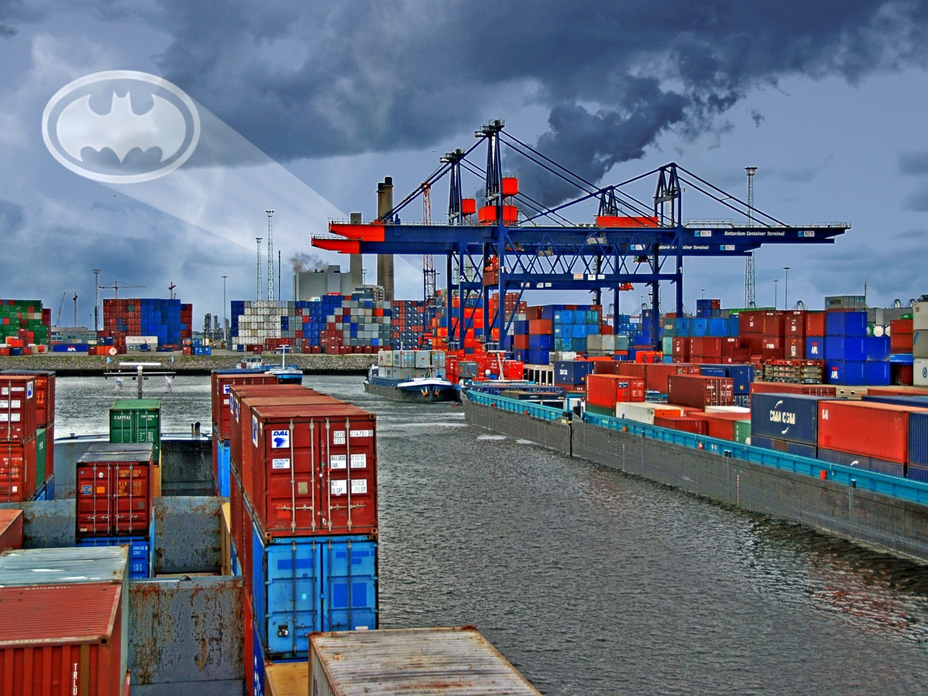
BATMAN: Barge Terminal Multi-Agent Network

Slide 13
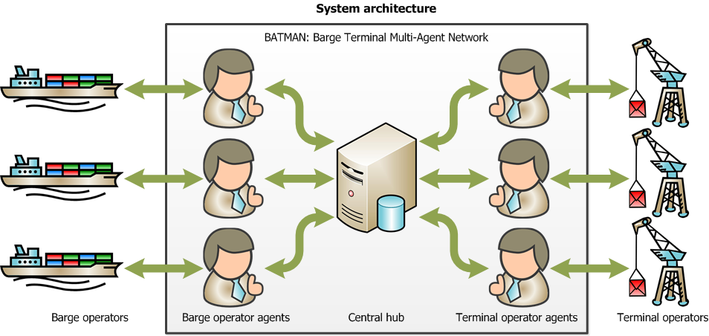
FUNCTIONALITY
Barge operator agent: supports the barge operator with planning the rotation (order of terminal visits, making appointments with the terminals, monitoring delays, replanning).
Terminal operator agent: supports the terminal operator with planning the loading/unloading times. Based on rules set by the terminal operator, the agent handles the barge requests on its own.

Slide 14
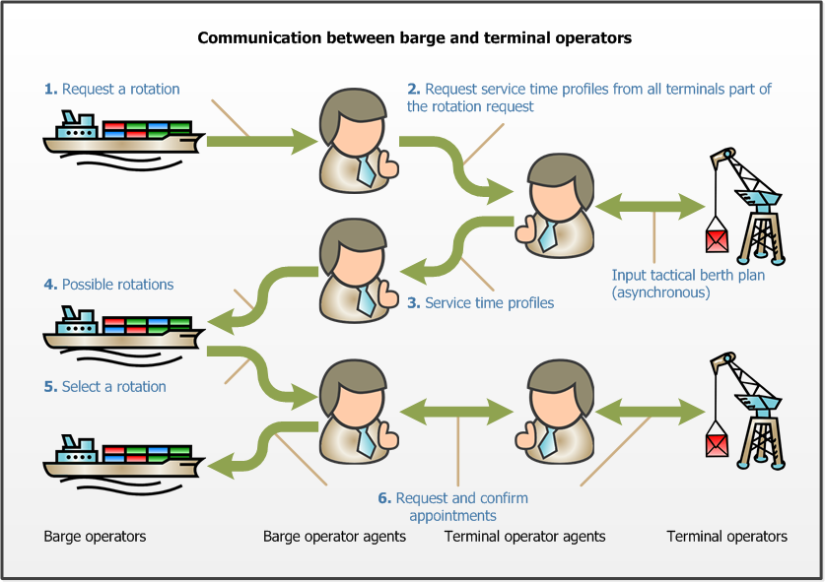
COMMUNICATION BETWEEN THE AGENTS

Slide 15
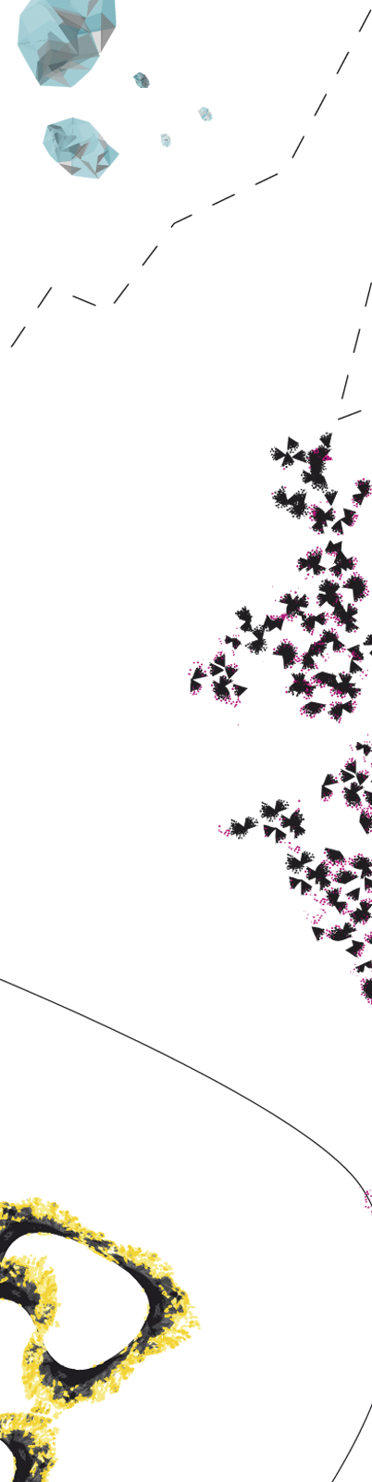

SERVICE-TIME PROFILES
Terminal operator 1
Terminal operator 1
Arrival time
Barge
operator
Terminal operator 2
Terminal operator 2
…
Terminal operator 3
Terminal operator 3
Stage 1: Terminal operators provide service-time profiles
Stage 2: Determine best sequence and announce arrival time to the terminals

Slide 16
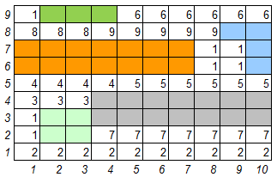

TERMINAL AGENT PROBLEM
Planning
Terminal info:
Planning horizon
Slack time
Slack buffer
Number of quays
Opening times
Info on all planned ships
New request:
Info on the new ship
Info for each ship:
Barge or sea vessel
Latest arrival time
Planned starting time
Actual starting time
Expected processing time
Latest departure time
Quay on which ship is planned
Arrived
Started
Service time profile:
Per time unit, a maximal guaranteed service time (waiting and handing time)
Berth Allocation Problem (BAP)
Quay Crane Assignment Problem (QCAP)
Quay Crane Scheduling Problem (QCSP)
Online Parallel Machine Scheduling
Maximum Empty Rectangle (MER)

Slide 17
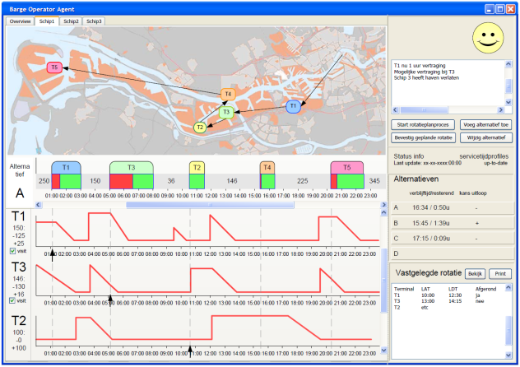
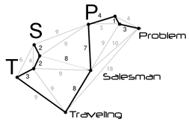
BARGE AGENT PROBLEM
User interface:
Routing
Barge info:
Terminals to visit
Stowage plan (restriction on visiting sequence)
Number of rotations
Expected time of arrival
Latest departure time
Point of entrance
Point of exit
Travel times
Info for each terminal to visit:
Name
Expected processing time (based on loading and unloading information)
Due date
Service time profile
Rotations:
A small set of efficient rotations, which can be evaluated based on various criteria.
Time Dependent Traveling Salesman Problem with Time-windows (TDTSP-TW)
Depth-First Branch-and-Bound Algorithm.
DP heuristic (Malandraki and Dial, 1996)
Objectives:
Waiting time?
Time in the port?
Emissions and fuel consumption?

Slide 18
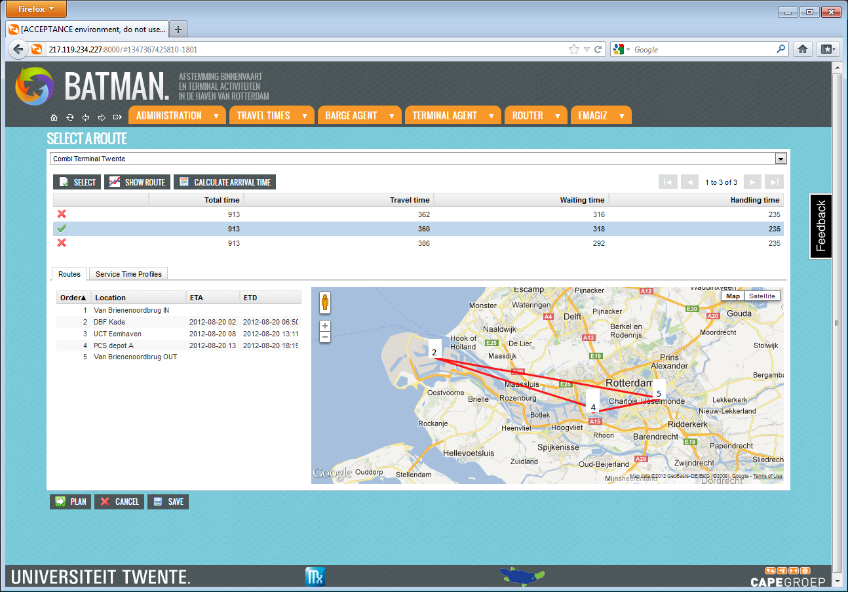
THE APPLICATION

Slide 19
IMPLEMENTATION?
We participate in a tender for “BREIN”: the development and implementation of decision support / optimization modules
How to convince the port authority to implement our system?
Using a game: demo of the application in a dynamic environment with multiple actors.
The idea:
  Two phases: planning and realization (re-planning)
  Multiple rounds: with/without appointments, with/without decision support by our application
  Performance evaluation:
    System-wide performance per round
    Individual performance per player (deviation from optimum, deviation from plan)

Slide 20

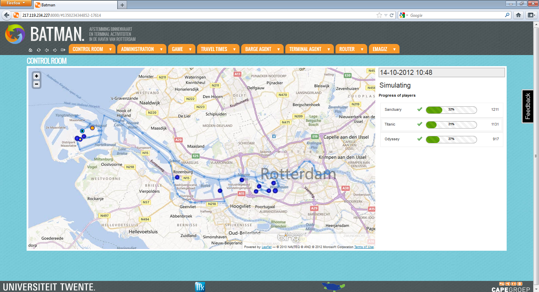
DE GAME

Slide 21
WHAT TO REMEMBER
Quality of a port heavily depends on the quality of its inland connections. For the port of Rotterdam the challenge is to enable a modal shift with increasing volumes
Our focus: alignment of barge and terminal activities by means of a decentralized approach to maintain autonomy.
Advantages:
  Terminal and barge operators need less time to plan their activities.
  Increase in terminal utilization through better appointment making with barges (efficient usage of slack).
  Reduction of barge waiting time with improved rotation planning resulting in a substantial increase in transport capacity and reduction of fuel consumption.
  A more realistic rotation planning increases the reliability of barge transportation and its competitiveness compared to other modalities
  Guaranteed service time makes it possible to sail at economical/sustainable speeds.
Use of a serious game to convince participants.

Slide 22
QUESTIONS?
Martijn Mes
Assistant professor
University of Twente
School of Management and Governance
Dept. Industrial Engineering and Business Information Systems
Contact
Phone: +31-534894062
Email: m.r.k.mes@utwente.nl
Web: http://www.utwente.nl/mb/iebis/staff/Mes/

