Slide 1
Preparation master assignment
December 5, 2024

Slide 2
Preparation master assignment
Organization
Assessment
During assignment

Slide 3
Master Assignment

Slide 4
Goal of master assignment
The main objective of the assignment is that the student learns and proves that (s)he is able to;
define,
perform,
complete,
reflect,
on research project in AP domain with a large degree of independence.
Notes:
Use knowledge of basic physics and mathematics
Gain more in-depth knowledge in one or more sub areas of physics
Knowledge about physics technology -> e.g. design and perform an experiment
Orientation in applicationon areas of physics
See the relation between science and socity and the reulting responsebilities
Multiple Skills -> e.g. aquiriing knowledge indipendently, communication with colleagues, contribue in a to the research (problem solving, creativity)

Slide 5
Master Assigment
Research performed in a
research group,
research institute or
company
Duration: 40 EC ≈ 28 weeks → 7 months
Research with a physics-oriented research question

Slide 6
Organization

Slide 8
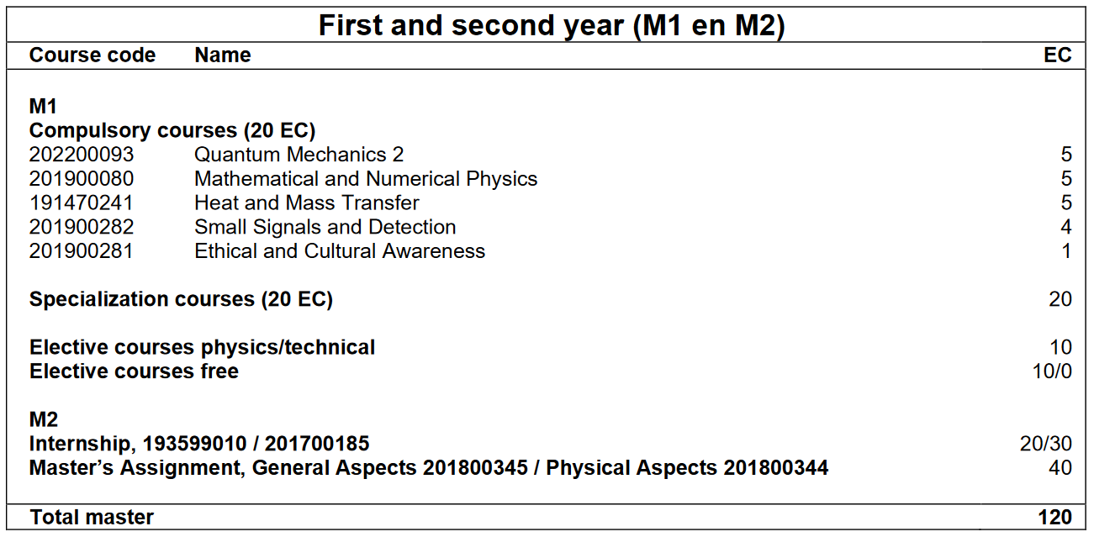
Admission Requirements
Completed ≥50 EC of M1 master’s programme
All other programme units are completed before the final examination

Slide 9
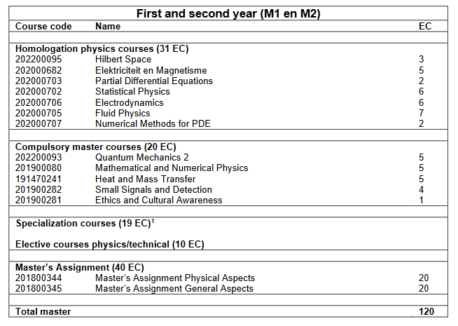
Admission Requirements – side entry hbo
Completed ≥70 EC of M1 master’s programme
All other programme units are completed before the final examination

Slide 10
organization
Approval course list
Enroll for the Master’s assignment in Osiris
Mobility Online
Start : Given start and end date
4 moths before end : Complete form
Questions to Anita Weise tn-tnw@utwente.nl
Notes:
If you enroll in Osiris you will be automatically added to the canvaspage

Slide 11
Organization - instuructions
https://www.utwente.nl/en/ap/education/graduate/

Slide 12
Courselist
Notes:
Need to fill in all information, If the courselist differ from standard explain why in the motivation. Let the courselist sign by the chair of your committee (this is not necessarily the head of the research group!!)

Slide 13
Mobility online - instructions

Slide 14
Master’s graduation committee
The graduation committee consist of at least 3 members having a PhD degree. The committee must meet the following requirements:
Chairman
Daily supervisor
Reference member from another AP research group
Both chairman and reference member should be from list approved Examinors for Applied Physics

Slide 15
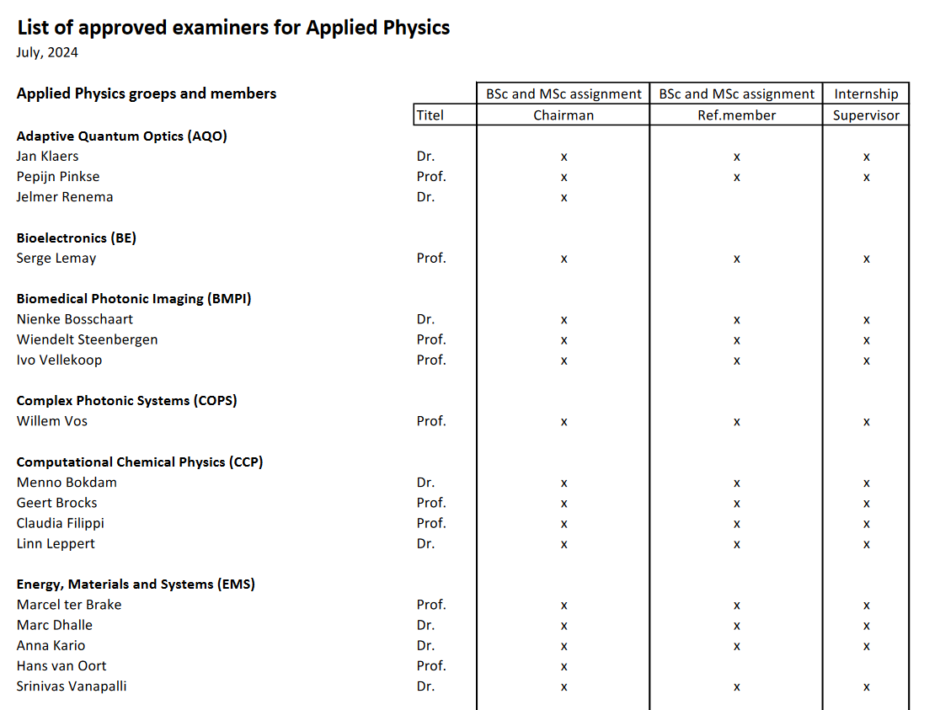
Applied physics staff
https://www.utwente.nl/en/ap/education/regulations/ → Overview Staff Applied Physics
Notes:
Every half year the list is updated.
The blue boxes give an example. So if you do your master assignement by CCP under supervision of Linn Leppert you could have Pepijn Pinkse as reference member

Slide 16
Master’s graduation committee
 | Chairman | Reference member
AP research group | Chairman* | Reference member*
Non-AP research group | Chairman from non-AP group | Reference member*
Company, other university or research institute | Reference member* (stricter rules than chairman) | Reference member*
* From list approved examiners AP

Slide 17
You are in the lead

Slide 18
Assessment

Slide 19
Products
Report
English
Presentation
30 min. presentation
10 min. discussion

Slide 20
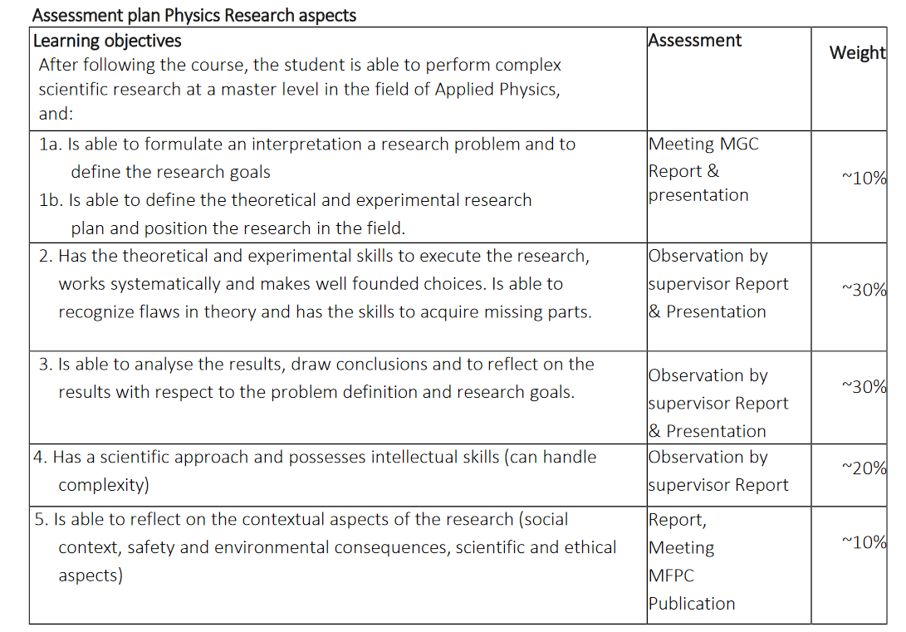
Physics aspects
Research plan and position
Theoretical and experimental skills
Analyzing skills
Scientific approach and handling of complexity
Reflective capabilities

Slide 21
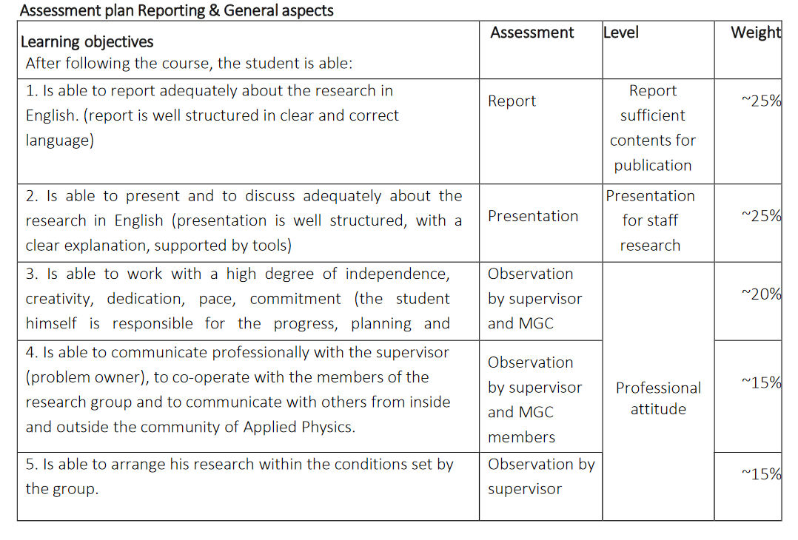
General aspects
Reporting
Oral presentation and discussion
Professional research attitude
Professional communication
https://www.utwente.nl/en/ap/education/regulations/#forms-applied-physics

Slide 22
Midterm evaluation
At least with daily supervisor and chairman
Discuss progress and feasibility
Discuss aspects all aspects of grading form
(Research) Attitude
Communication
Planning
……….

Slide 23
During assignment

Slide 24
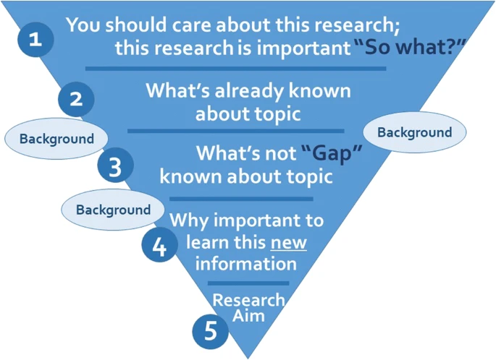
Literature review
A good research question is specific, relevant, answerable and anticipates new insights or knowledge.
Busse, C., August, E. How to Write and Publish a Research Paper for a Peer-Reviewed Journal. J Canc Educ 36, 909–913 (2021). https://doi.org/10.1007/s13187-020-01751-z

Slide 25
Planning
Know your goal → clear research question
Planning → activities with deliverables
Important to evaluate regularly

Slide 26
Clear communication
Expectations
Attendence
Guidance
……..
You are responsible for your own project!!!!

Slide 27
Writing
Start timely
Ask feedback from peers
Language center
AP Graduation Group?

Slide 28
Language center - workshops
https://www.utwente.nl/en/ces/language-centre/courses/?for=students
Notes:
If not available but you are interested -> course allert

Slide 29
Language center - Assistance
Open Hours
Monday, Wednesday – 13.00 – 17.00 hrs Kills Lab 3 at Vrijhof
Thusday, Thursday – 15.00 – 17.00 hrs on Canvas Confrence
https://www.utwente.nl/en/ces/language-centre/writingcentre/writing-centre-students/

Slide 30
Experience
Be part of the group
Group meetings
Colloquia
Group activities

Slide 31
Enjoy and have Fun !!

Slide 32
organization
Approval course list https://www.utwente.nl/en/ap/education/regulations/#forms-applied-physics
Enroll for the Master’s assignment in Osiris
Mobility Online
https://www.utwente.nl/en/education/student-services/step-by-step/educational-systems/#mobility-online
https://www.utwente.nl/en/ap/education/graduate/#before-the-start-of-the-masters-assignment
Questions to Anita Weise tn-tnw@utwente.nl

