Slide 1
Preparation master assignment
June 8, 2023

Slide 2
Preparation master assignment
Organization
Assessment
During assignment

Slide 3
Master Assignment

Slide 4
Goal of master assignment
The main objective of the assignment is that the student learns and proves that (s)he is able to;
define,
perform,
complete,
reflect,
on research project in AP domain with a large degree of independence.
Notes:
Use knowledge of basic physics and mathematics
Gain more in-depth knowledge in one or more sub areas of physics
Knowledge about physics technology -> e.g. design and perform an experiment
Orientation in applicationon areas of physics
See the relation between science and socity and the reulting responsebilities
Multiple Skills -> e.g. aquiriing knowledge indipendently, communication with colleagues, contribue in a to the research (problem solving, creativity)

Slide 5
Master Assigment
Research performed in a research group, research instituut or company
Duration: 40 EC ≈ 28 weeks → 7 months
Research with a physics-oriented research question

Slide 6
Organization

Slide 8
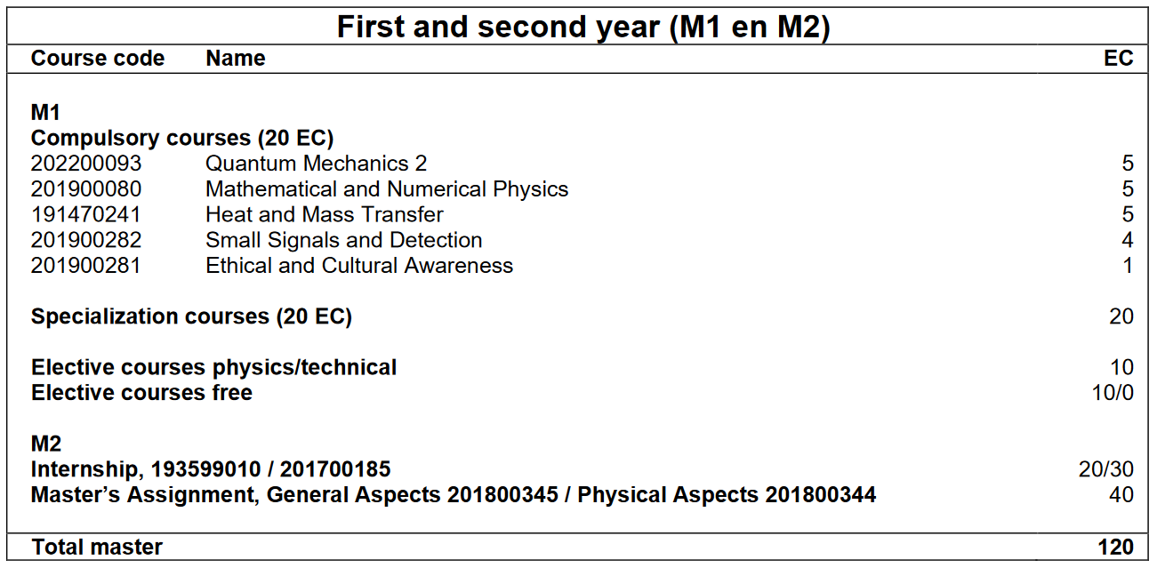
Admission Requirements
Completed ≥50 EC of M1 master’s programme
All other programme units are completed before the final examination
Notes:
For switching order of internship and master assignment -> send a request to BOZ (boz-ap@utwente.nl) with your request and argumentation.

Slide 9
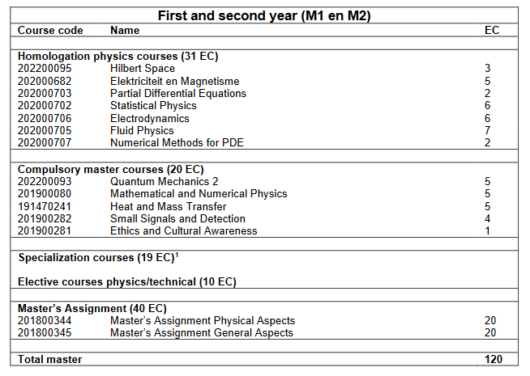
Admission Requirements – side entry hbo
Completed ≥50 EC of M1 master’s programme
All other programme units are completed before the final examination

Slide 10
Organization
https://www.utwente.nl/en/ap/education/graduate/

Slide 11
organization
Approval course list
Enroll for the Master’s assignment in Osiris
Mobility Online
Start : Given start and end date
After 4 months : Complete form
Questions to Anita Weise tn-tnw@utwente.nl
Notes:
In Osiris inschrijven op de master opdracht, dan krijgje automatisch toegang tot de Canvassite.

Slide 12
Research group
Supervision during assignment
Daily supervisor: PhD-student, Post-doc, lecturer (coach)
Final supervisor: Full, Assistant or Associate Proffessor (proces, level)
Research group is responsible for: daily supervisor, final supervisor, desk, office-/labspace and technical support

Slide 13
Master’s graduation committee
The graduation committee consist of at least 3 members having a PhD degree. The committee must meet the following requirements:
Chairman
Daily supervisor
Reference member from another AP research group
Both chairman and reference member should be from AP staff list

Slide 14
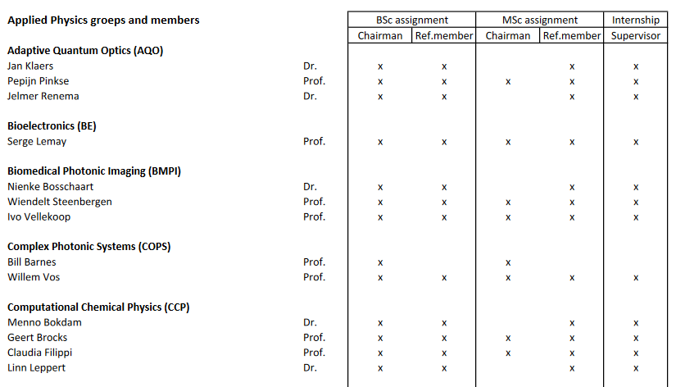
Applied physics staff
https://www.utwente.nl/en/ap/education/regulations/ → Overview Staff Applied Physics
Notes:
This list will be updated in October 2023

Slide 15
Master’s graduation committee
 | Chairman | Reference member
AP research group | Chairman* | Reference member*
Non-AP research group | Chairman from non-AP group | Chairman*
Company, other university or research institute | Chairman* | Reference member*
* From AP staff list

Slide 16
You are in the lead

Slide 17
Assessment

Slide 18
Products
Report
English
Presentation
30 min. presentation
10 min. discussion

Slide 19
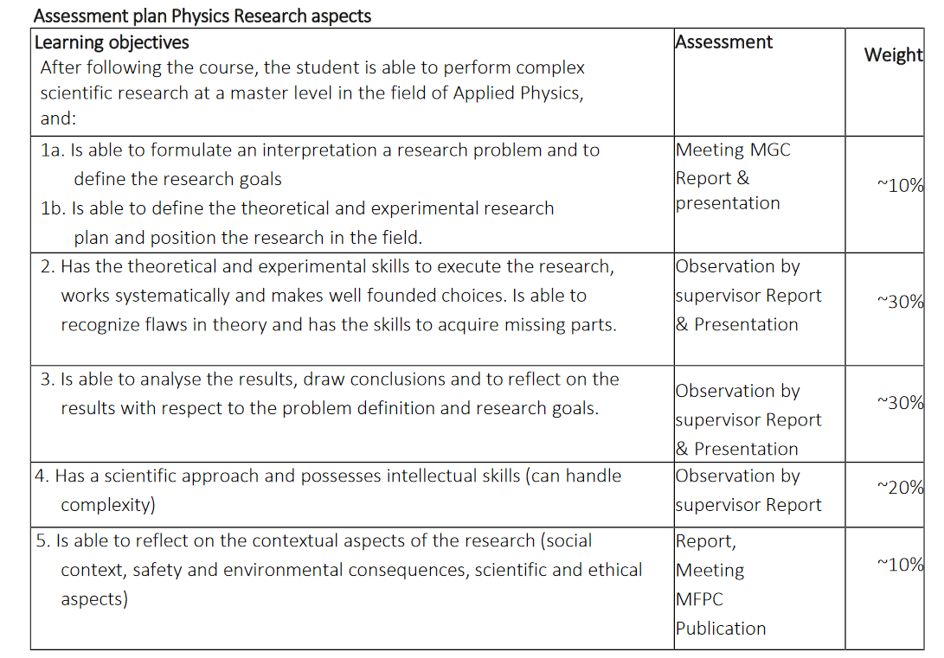
Physics aspects
Research plan and position
Theoretical and experimental skills
Analyzing skills
Scientific approach and handling of complexity
Reflective capabilities

Slide 20
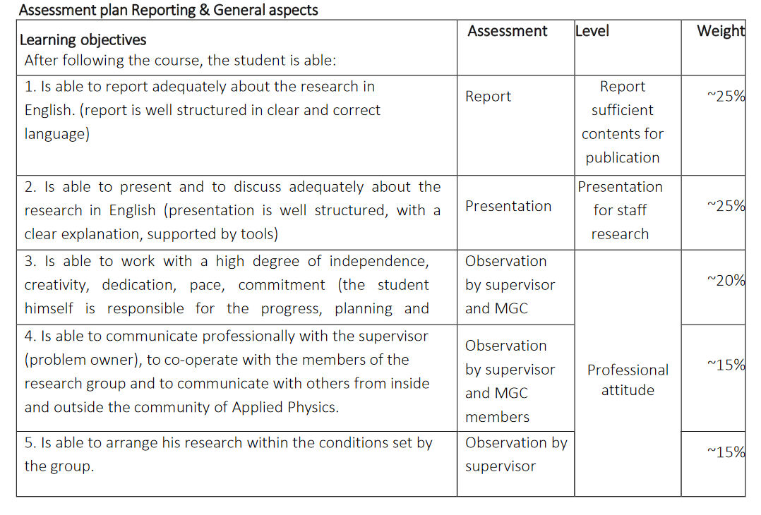
General aspects
Reporting
Oral presentation and discussion
Professional research attitude
Professional communication
Arrangement of own work within conditions of research group
https://www.utwente.nl/en/ap/education/regulations/#forms-applied-physics

Slide 21
During assignment

Slide 22
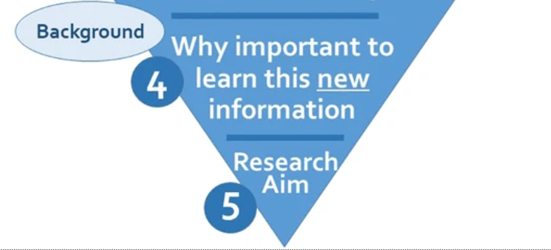
Busse, C., August, E. How to Write and Publish a Research Paper for a Peer-Reviewed Journal. J Canc Educ 36, 909–913 (2021). https://doi.org/10.1007/s13187-020-01751-z

Slide 23
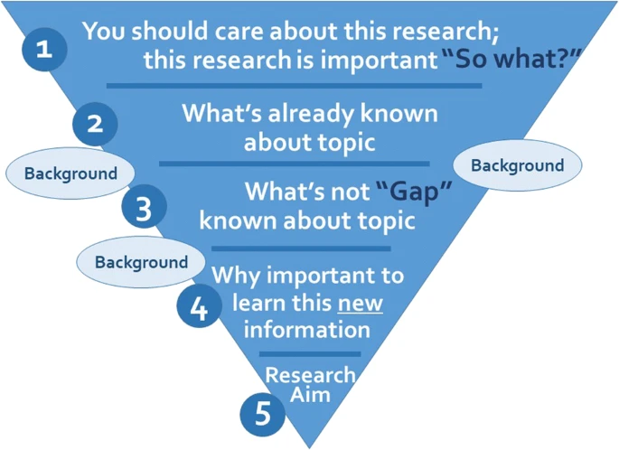
Literature review
A good research question is specific, relevant, answerable and anticipates new insights or knowledge.
Busse, C., August, E. How to Write and Publish a Research Paper for a Peer-Reviewed Journal. J Canc Educ 36, 909–913 (2021). https://doi.org/10.1007/s13187-020-01751-z

Slide 24
Planning
Know your goal → clear research question
Planning → activities with deliverables

Slide 25
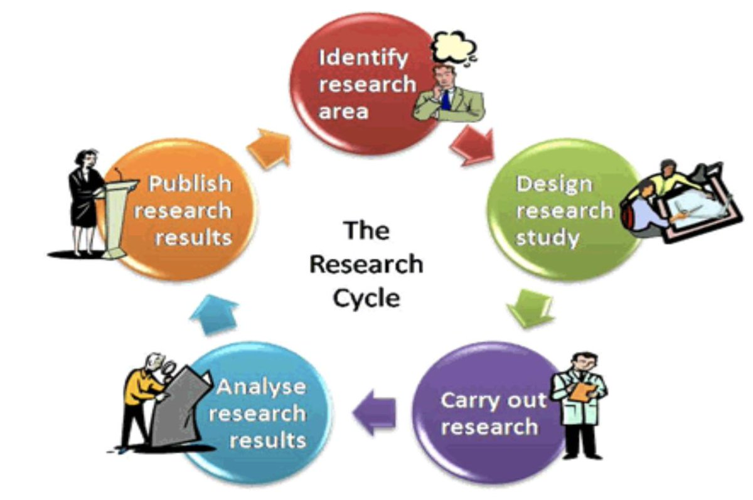
Clear communication
Expectations
Attendence
Guidance
……..
You are responsible for your own project!!!!

Slide 26
Writing
Start timely
Ask feedback from peers
Language center
AP Graduation Group

Slide 27
Language center - workshops
https://www.utwente.nl/en/ces/language-centre/courses/?for=students

Slide 28
Language center - Assistance
Open Hours
Monday, Wednesday – 13.00 – 17.00 hrs Kills Lab 3 at Vrijhof
Friday – 13.00 – 15.00 hrs on Canvas Confrence
Writing Encouragement Group
https://www.utwente.nl/en/ces/language-centre/writingcentre/writing-centre-students/

Slide 29
Experience
Be part of the group
Group meetings
Colloquia
Group activities

Slide 30
Enjoy and have Fun !!

Slide 31
organization
Approval course list https://www.utwente.nl/en/ap/education/regulations/#forms-applied-physics
Enroll for the Master’s assignment in Osiris
Mobility Online
https://www.utwente.nl/en/education/student-services/step-by-step/educational-systems/#mobility-online
https://www.utwente.nl/en/ap/education/graduate/#before-the-start-of-the-masters-assignment
Questions to Anita Weise tn-tnw@utwente.nl
Notes:
In Osiris inschrijven op de master opdracht, dan krijgje automatisch toegang tot de Canvassite.

