Slide 1
Instructions: READ ME!
Dear colleague,
Thank you for downloading the corporate presentation. This presentation will help you to present our UT story so that your audience will remember it.
Before you start, please consider:
The presentation has a basic set of slides (slide 1 up to and including slide 41)
We provided optional slides that you can use to tell your story. See slides 42-52.
After that, please browse through the different slide types the presentation offers. You can do that by clicking on the ‘new slide’ button above. Did you started with a slide, but do you want a different layout? Please click on the ‘layout’ button and select the slide type you prefer. You do not need to delete this slides as it is not visible in presentation mode; moreover, it might come in handy while building up your presentation.
Finally, please remember that the presentation should strengthen your story, not tell it.
Have fun sharing our story!
.

Slide 2
Corporate presentation
Department
Story University of Twente

Slide 3
Table of contents
01.
02.
03.
04.
05.
06.
07.
08.
09.
10.
Introduction
Our story
Key figures
Research vision
Our research
Research institutes
Partners and collaboration
Education vision
Educational programmes
Useful other slides

Slide 4
Introduction

Slide 5

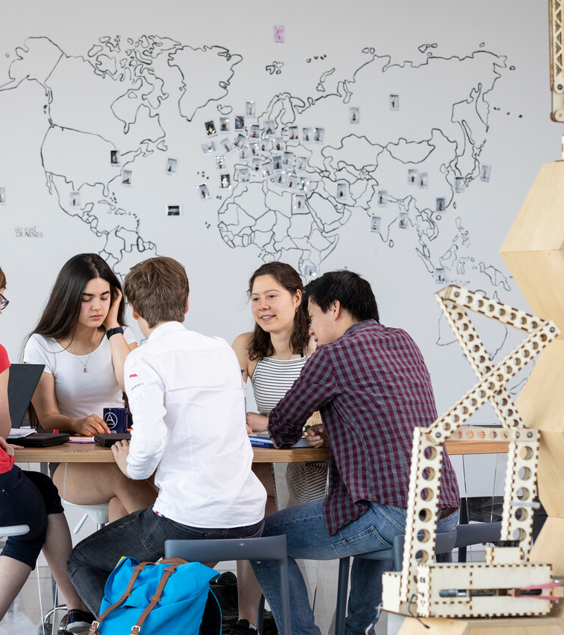
OUR STORY
THE UNIVERSITY OF TWENTE – HIGH TECH, HUMAN TOUCH
Global societal challenges do not just happen – they are the result of choices made by us human beings. That is why students and researchers at the University of Twente are coming up with cutting-edge solutions that will make our world fairer and more sustainable. In a joint effort, pooling their strengths and ever-growing expertise. With technology that takes us further, while looking out for each other. High-tech, human touch.

Slide 6

Shaping2030, University of Twente’s strategy
Notes:
How we contribute to the development of a digital, fair, and sustainable society between now and 2030 has been captured in shaping2030, the University of Twente's strategy.

Slide 7
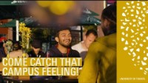
Catch that campus feeling
Notes:
Wondering what a day on campus at University of Twente would be like? There are two ways to find out: come over and experience it first-hand – or watch our campus video! Get ready for an experience packed with cool action, cool tech and very cool people… Check the video and catch that campus feeling! 🎶🎶 Composed with music specially written for the University of Twente. This track will be launched later this year by Tom Harisson ft. Diandra Faye - Sparks.

Slide 8
Key figures
03

Slide 9



University of Twente’s Key figures 2023
12,147
TOTAL NUMBER OF STUDENTS ENROLLED
2022: 12,493
NUMBER OF FIRST-YEAR STUDENTS (BSC + MSC)
2022: 4,024
PERCENTAGE OF INTERNATIONAL STUDENTS
2022: 34
NUMBER OF DIPLOMAS ISSUED
2022-2023: BACHELOR: 1,526 - MASTER: 1,592
3,215
35
3,118
.

Slide 10
Facts and figures 2023
208
NUMBER OF PHD GRADUATES 2022: 193
NUMBER OF ENGINEERING DOCTORATES
2022: 12
NUMBER OF REFEREED SCIENTIFIC PUBLICATIONS 2022: 2,431
NUMBER OF EMPLOYEES (FTE)
2022: 3,540 FTE
ANNUAL BUDGET (IN MILLION EUROS)
2022: 432.2 MILLION EUROS
22
2,570
3,729
481.5
.
Notes:
PDENG moet zijn ENGD

Slide 11
Research vision
04

Slide 12
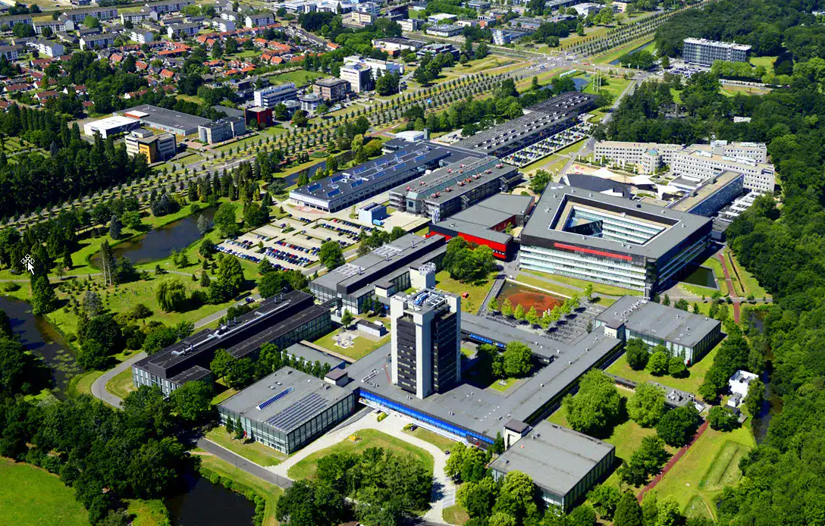
Research vision
The University of Twente is the place where science, technology, and engineering meet social sciences. Thanks to our high-tech with a human touch, over 16,000 UT students and researchers make an impact on society every day. On our campus, we are working on scientific breakthroughs that put us at the forefront of technology and the digital revolution. Our teaching and research, therefore, reach far beyond the boundaries of our campus. UT’s campus community is making a substantial contribution to a liveable world. Both for ourselves and for future generations.
We have dedicated ourselves to a broad range of societal issues: from environmental adaptability and resilience to the digitisation of society, and from improving and personalising healthcare to sustainability and smart systems of production.
.

Slide 13
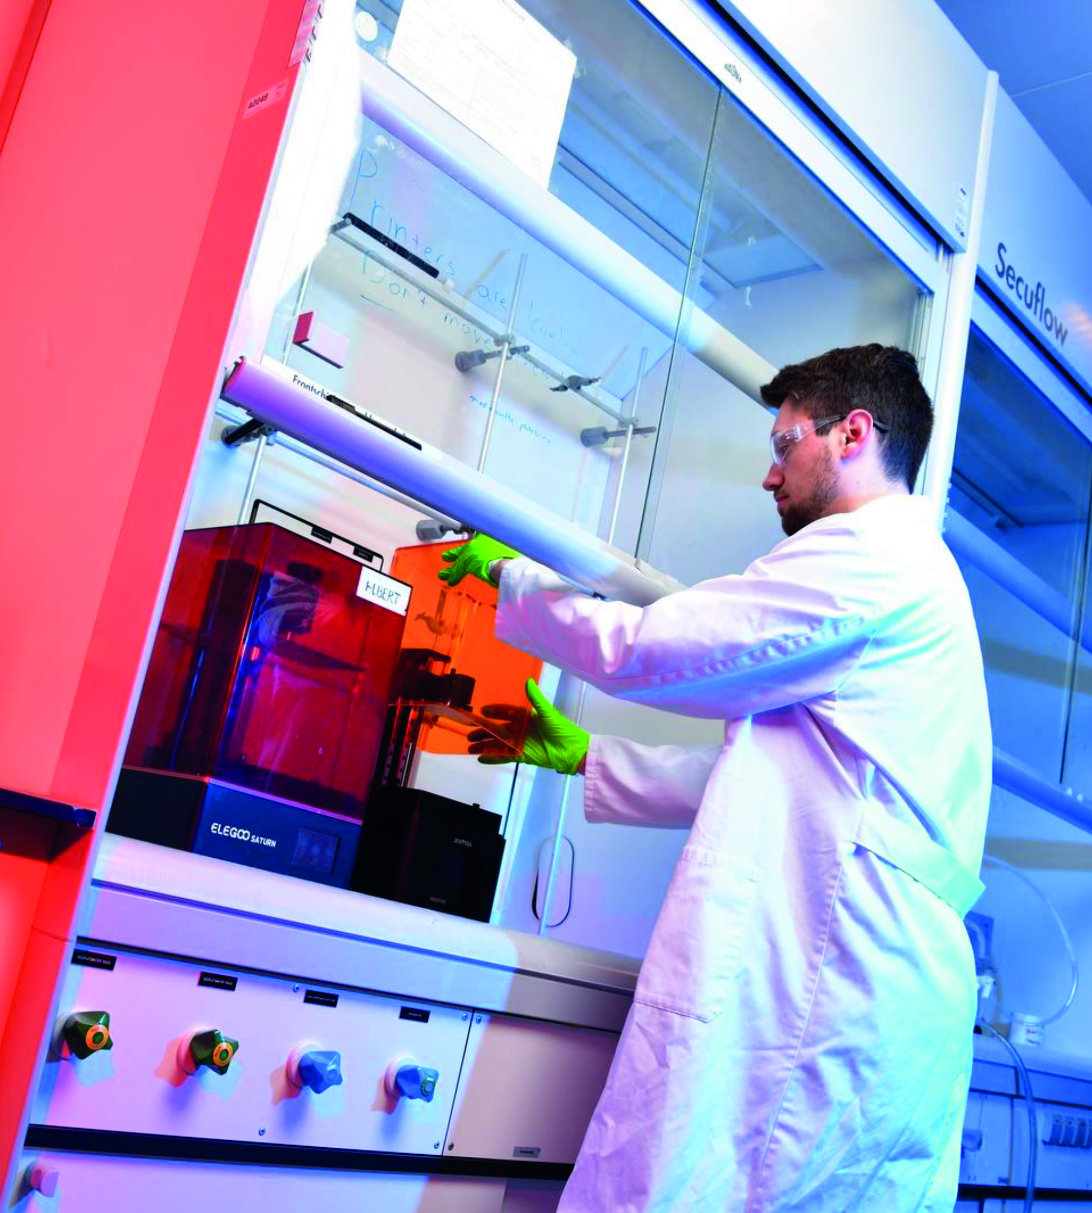
Impact domains
Scientists, teachers and students at the University of Twente feel a responsibility to develop societal relevant solutions, in order to be prepared for an unpredictable and highly changeable future. We focus on the following impact domains:
Health
Safety
Climate
Chip technology
.

Slide 14
Our research aims for societal impact
05

Slide 15
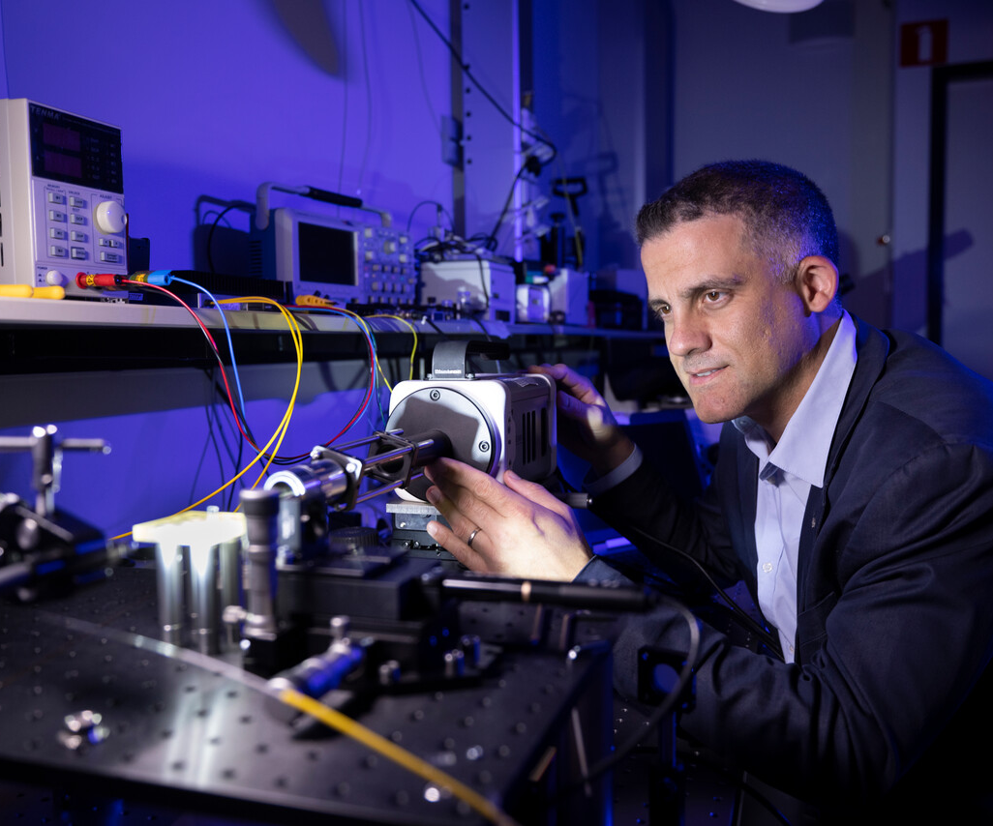
Enabling sustainable and personalised health by means of technology
In the famous science-fiction series Star Trek, Doctors Phlox and McCoy used a ‘hypospray’ to vaccinate a fellow space traveller: instead of a needle, the vaccination was performed with a jet of liquid. UT scientist David Fernandez Rivas wants to turn this fictional device into reality.

Slide 16
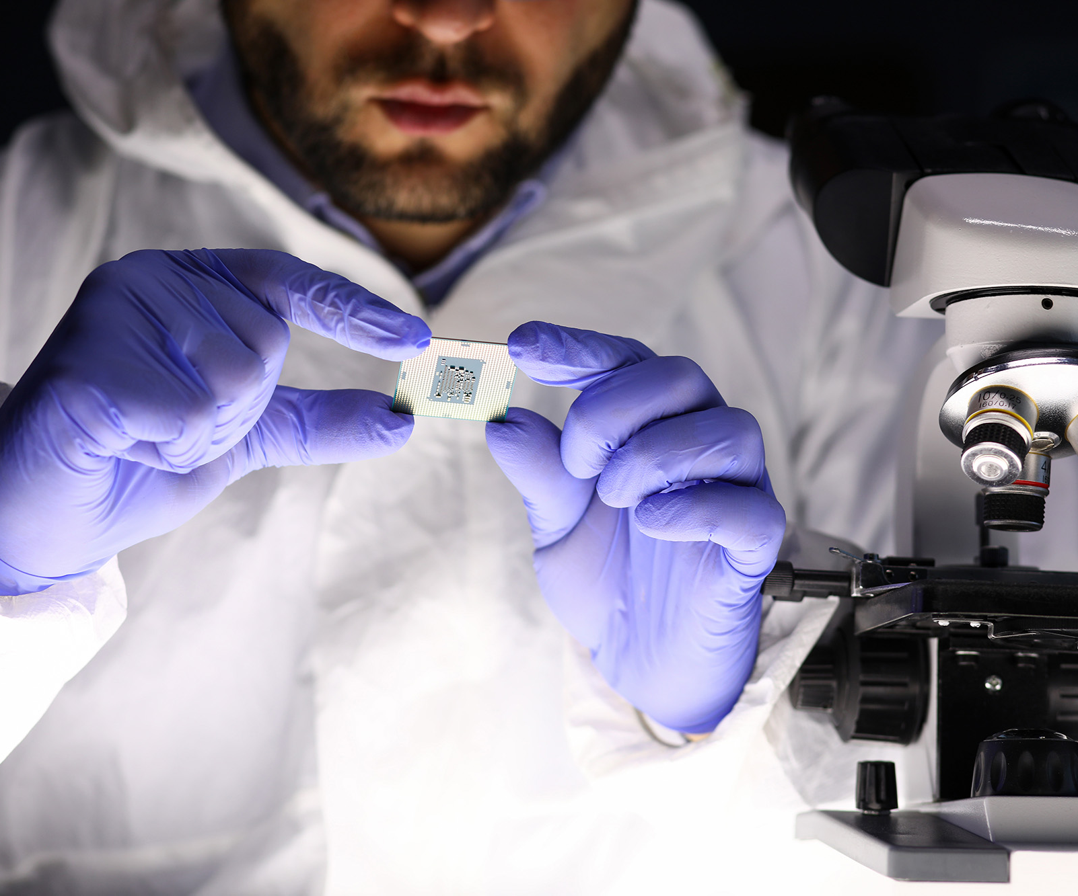
CHIPTECH TWENTE: A STRONG CLUSTER
Twente is on the national and international map as a hotspot for semicon and specifically for analogue chip design, photonics and as an important supplier to ASML. With a strong Integrated Circuit Design department at the University of Twente headed by Professor Bram Nauta, the MESA+ institute and around 50 semiconductor-related SMEs, customers worldwide benefit from the unique knowledge of Twente.
Needle-free injections with
the ‘bubble gun’

Slide 17
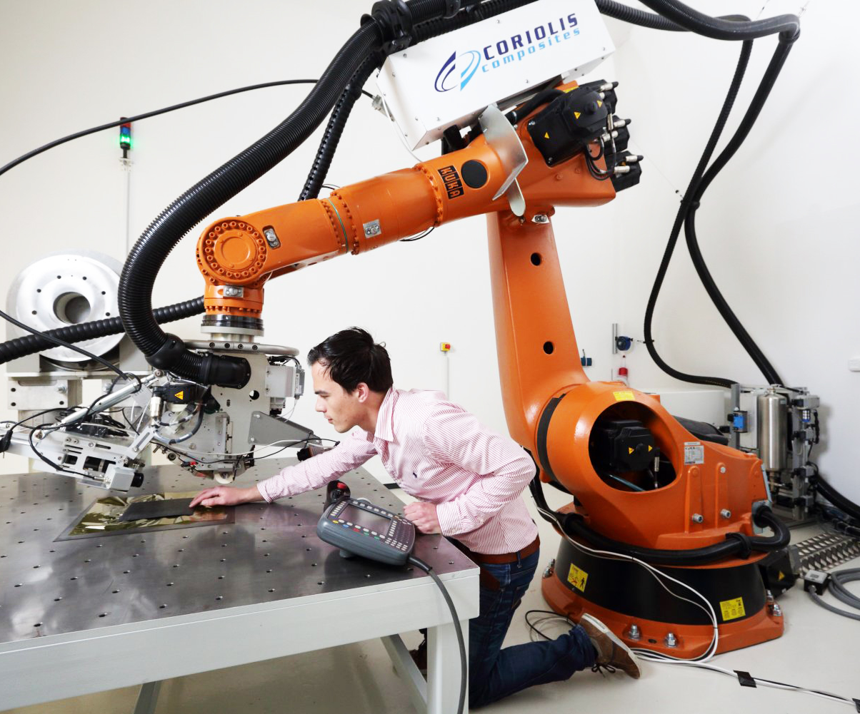
CLEANER FLYING WITH LIGHTER MATERIALS
With new, lighter materials the aeronautics, automotive and other industries can decrease fuel consumption and improve their environmental performance. At the Thermoplastic Composites Research Centre (TPRC.nl), companies like Boeing, Fokker and other global leaders work together with researchers from the UT on developing this up-and-coming material.
Needle-free injections with
the ‘bubble gun’

Slide 18

The Twente University Centre for Cybersecurity Research (TUCCR)
A public-private partnership where experts, professionals, entrepreneurs, researchers, and students from industry and knowledge partners collaborate to deliver talents, innovations, and know-how in the domain of cybersecurity. The mission of TUCCR is to strengthen the security and digital sovereignty of our society by performing top-level research on real-world data and network security challenges. .
Needle-free injections with
the ‘bubble gun’

Slide 19
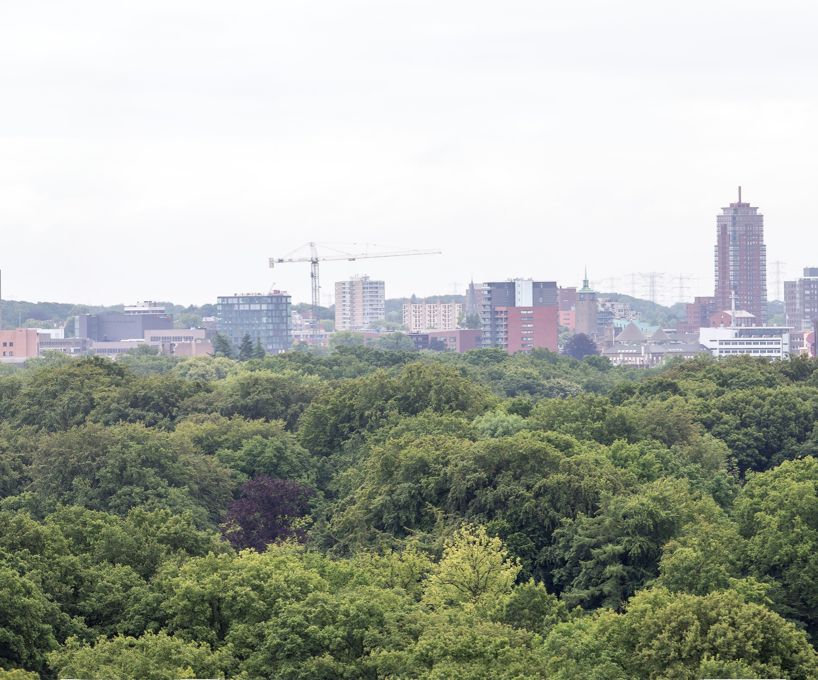
URBAN SUSTAINABILITY
Most local authorities are not sufficiently considering the needs of vulnerable people when planning for climate change, according to a UT led study.
The researchers developed a free Climate Change Adaptation Scoring tool. Local authorities can check whether their plans are covering the right topics to adapt their cities to the risks of climate change.
Notes:
A tool that calculates ‘ADAptation plan Quality Assessment’ (ADAQA) indices for individual cities. With the tool, local climate practitioners can check whether their plans are covering the right topics and benchmark against others.

Slide 20
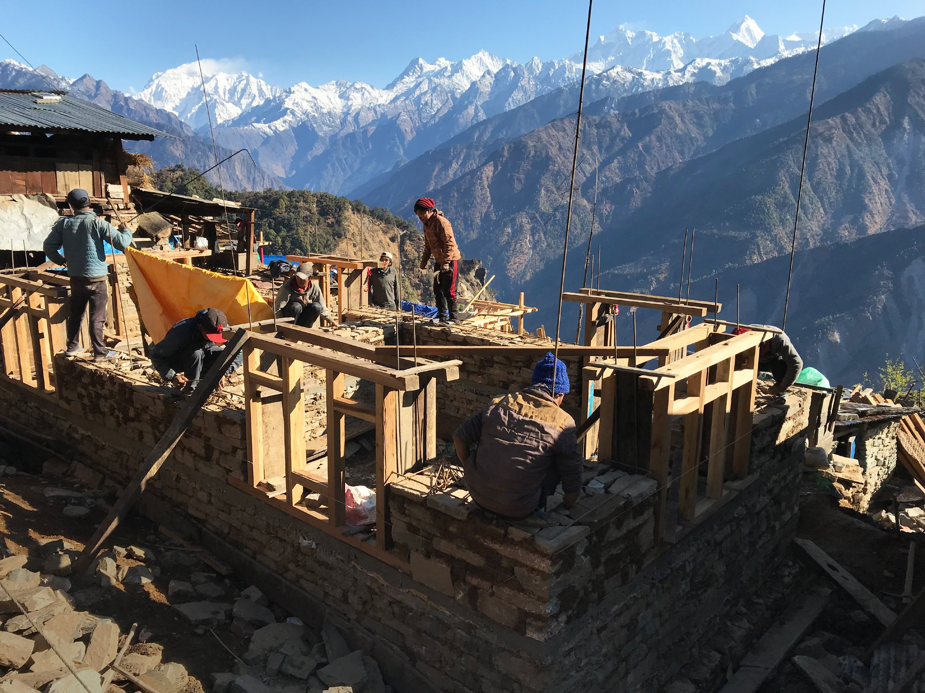
BUILDING RESILIENCE
To prevent buildings from collapsing due to natural disasters, technology is crucial. But despite technical knowledge and assistance, builders rarely rebuild disaster-resistant houses after a collapse.
Eefje Hendriks examines the decision-making processes, to increase self-reliance.
Notes:
Disasters are a growing problem. Yearly, 185 million lives are affected by natural hazards, primarily in low-income countries in poorly constructed houses. To fight disaster risks, resistant housing is crucial. Too often, essential construction techniques are not used by the most vulnerable, despite assistance from humanitarian organisations and governments. Choices made during reconstruction are still insufficiently understood. The new study of Dr. Eefje Hendriks will explore these choices to create effective targeted assistance and to enhance resilience of houses reconstructed after disasters. Hendriks is a member of the Disaster Reselience Centre of UT / ITC. This centre works across discipline and international boundaries to reduce disaster risk and promote global sustainable growth.

Slide 21

LIFELONG LEARNING
Facing the rapid changes in the world of work and society, continuous professional learning is vital for employees to keep up with and contribute to societal transformations and technological innovations.
Our researchers from Professional Learning & Technology study how employees develop themselves in the flow of work and how technology can support this. New lifelong learning solutions are developed and implemented to contribute to a skilled and resilient workforce.

Slide 22
Research institutes
06

Slide 23
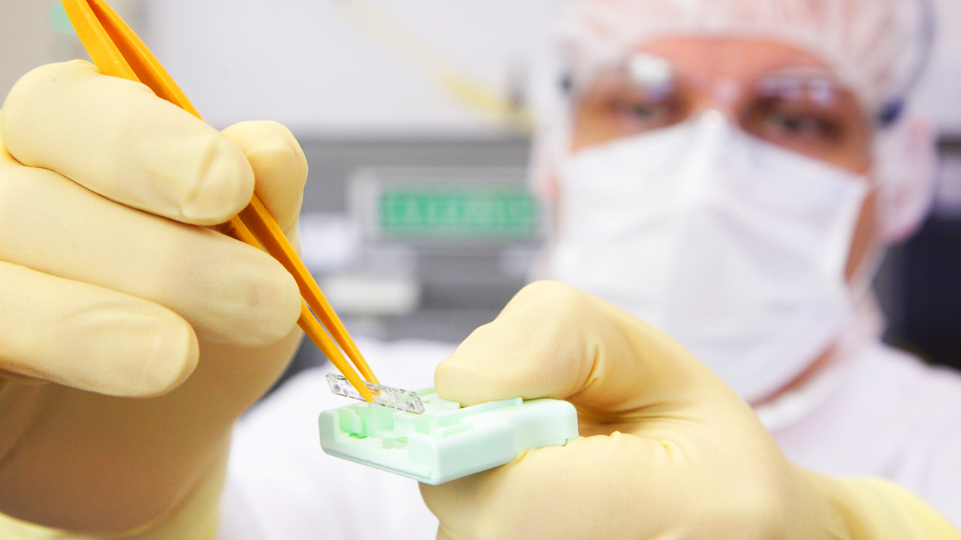
Research institutes
The University of Twente has three powerful research institutes that convert scientific excellence to economic activity and social applications.
Our strength lies in the collaboration between the various disciplines. In the research institutes the University of Twente connects technology (high tech) to human behaviour and societal relevance (human touch).
.

Slide 24
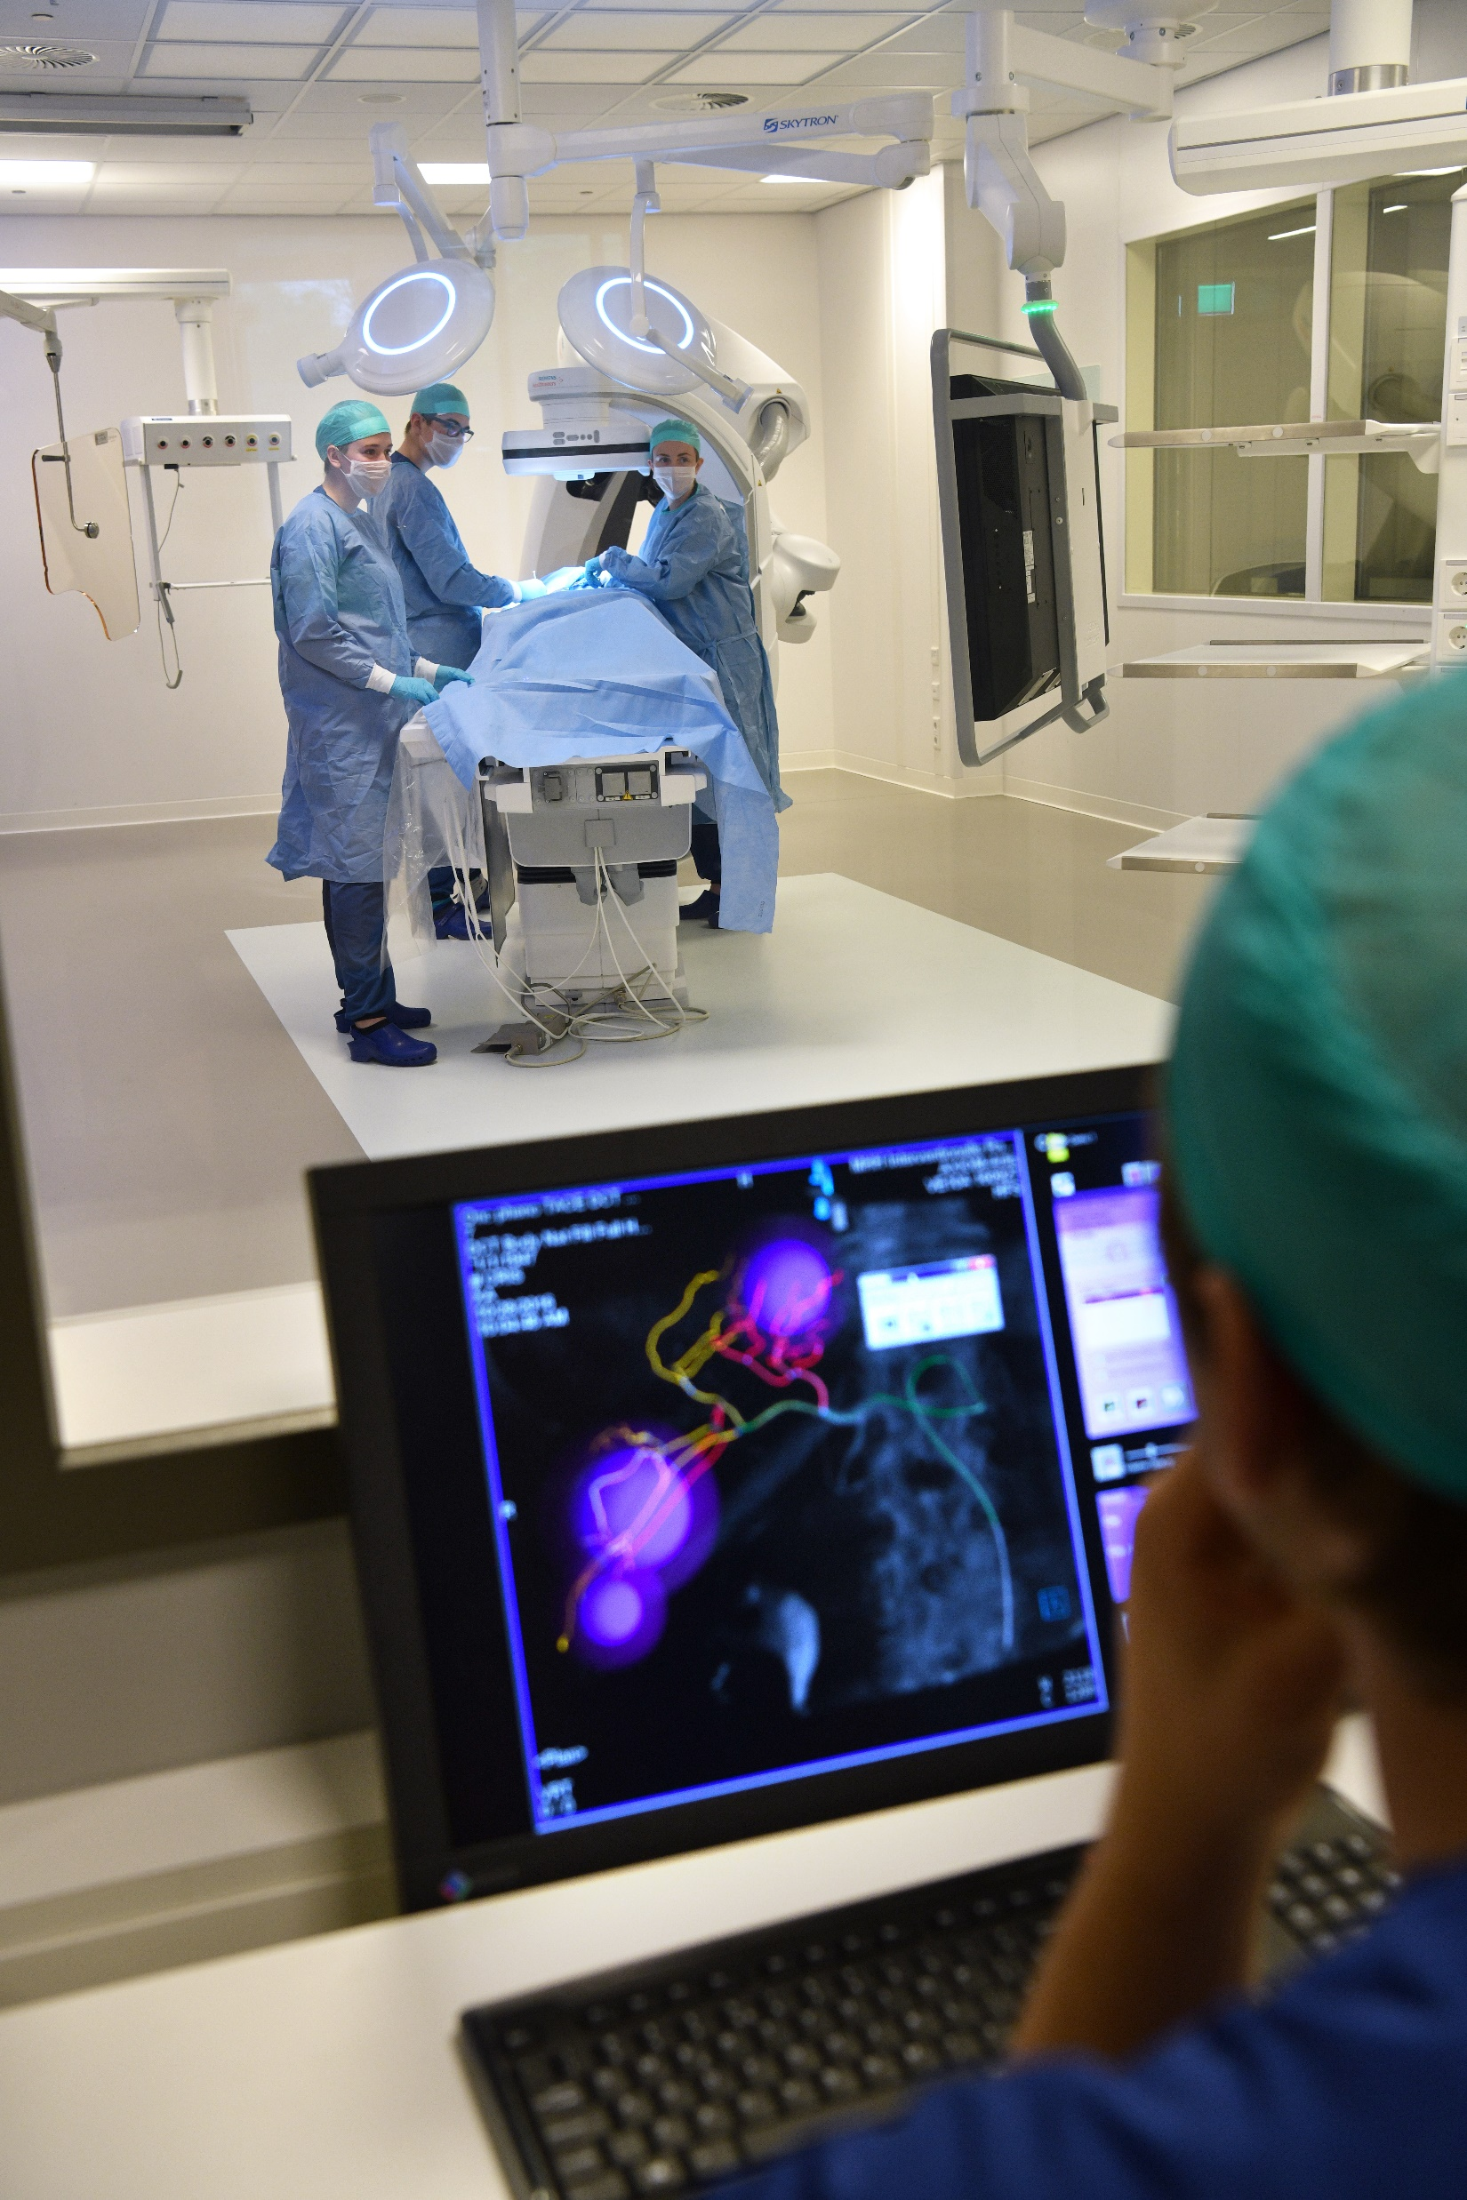
TECHMED CENTRE
TechMed Centre is a leading innovation hub focused on advancing healthcare through technology, research, and education.
Cutting-edge Facilities – Research labs, preclinical testing environments, and simulated hospital settings
Impactful Collaboration – Working with healthcare professionals, industry, and policymakers to drive change
Personalised & Sustainable Care – Developing innovative solutions for diagnosis, treatment, and patient well-being.
Boosting Entrepreneurship – Supporting startups and established companies in digital transformation and medical innovation.

Slide 25
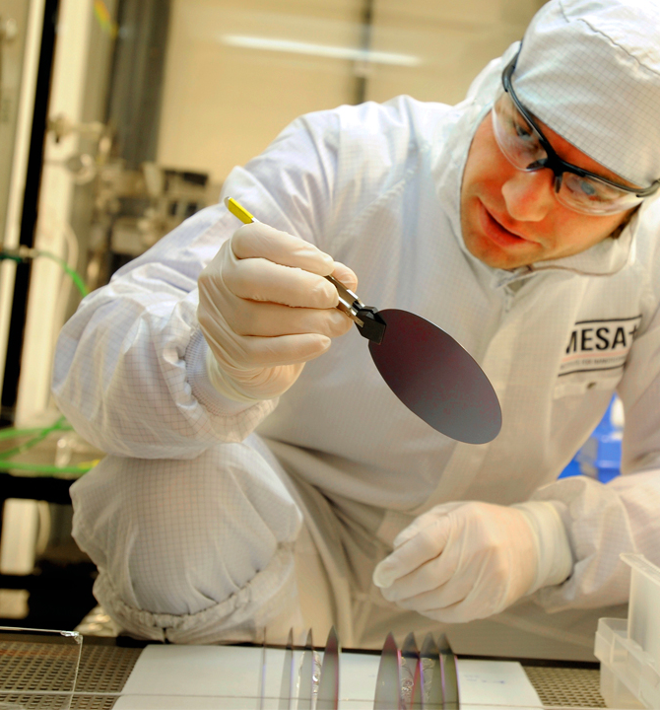
MESA+ INSTITUTE FOR NANOTECHNOLOGY
MESA+ is one of the world’s leading research institutes on nanostructures, nanomaterials, nanosystems and nanodevices. Embracing a cross-disciplinary approach and benefiting from the NanoLab - infrastructure that ranks among the very best on the globe - over 500 researchers deliver high quality, competitive and frequently ground-breaking research. The results are evident in our numerous publications as well as in various high-profile achievements.

Slide 26
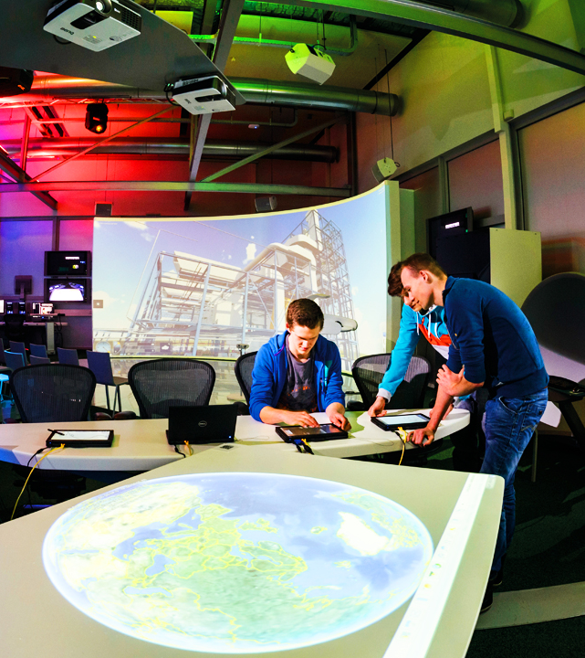
DIGITAL SOCIETY INSTITUTE
The Digital Society Institute performs scientific research in technology that is essential for digitalization, on methods and techniques for integrating digital technology in our environments, and in how we can come to intelligent, well-informed decision making. An important aspect of our mission is to conduct research that has an impact on society.

Slide 27
Partners and collaboration
07

Slide 28
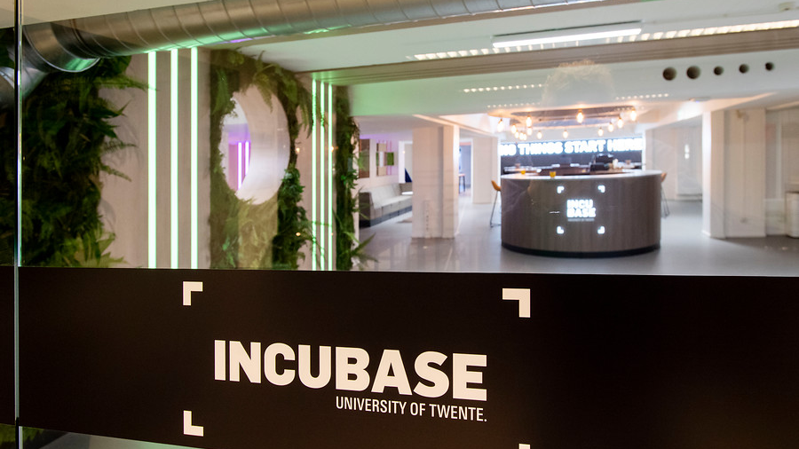
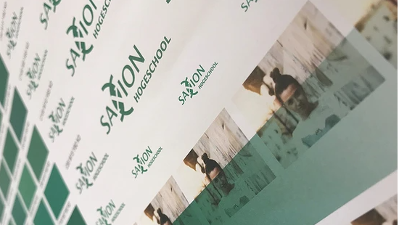
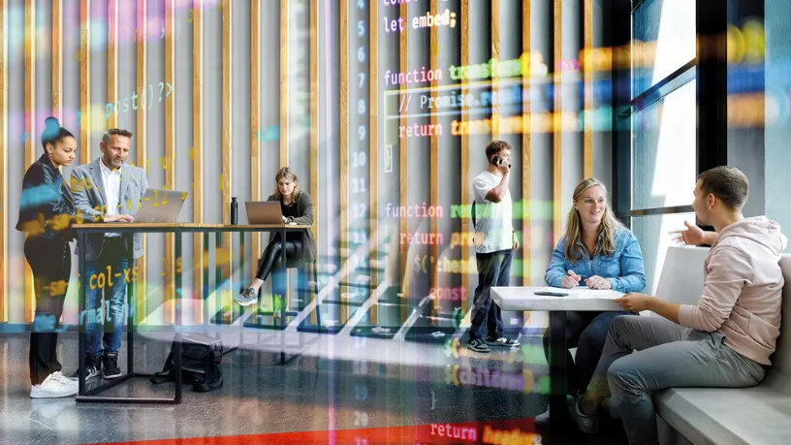
Collaboration in regional hotspots
Twente (e.g. Twente Board, Novel-T, Province of Overijssel)
Zwolle (e.g. Economic Board, Windesheim)
Apeldoorn (e.g. Centrum voor Veiligheid en Digitalisering, Sports Data)

Slide 29



Collaboration with scientific partners
International strategic partners
ECIU University
University of Munster, Germany, University of São Paulo, Brazil and University of Waterloo, Canada
National
4TU. Federation
VU
Notes:
We work together in one on one collaborations and in various networks. National/ International.

Slide 30
Education vision
08

Slide 31
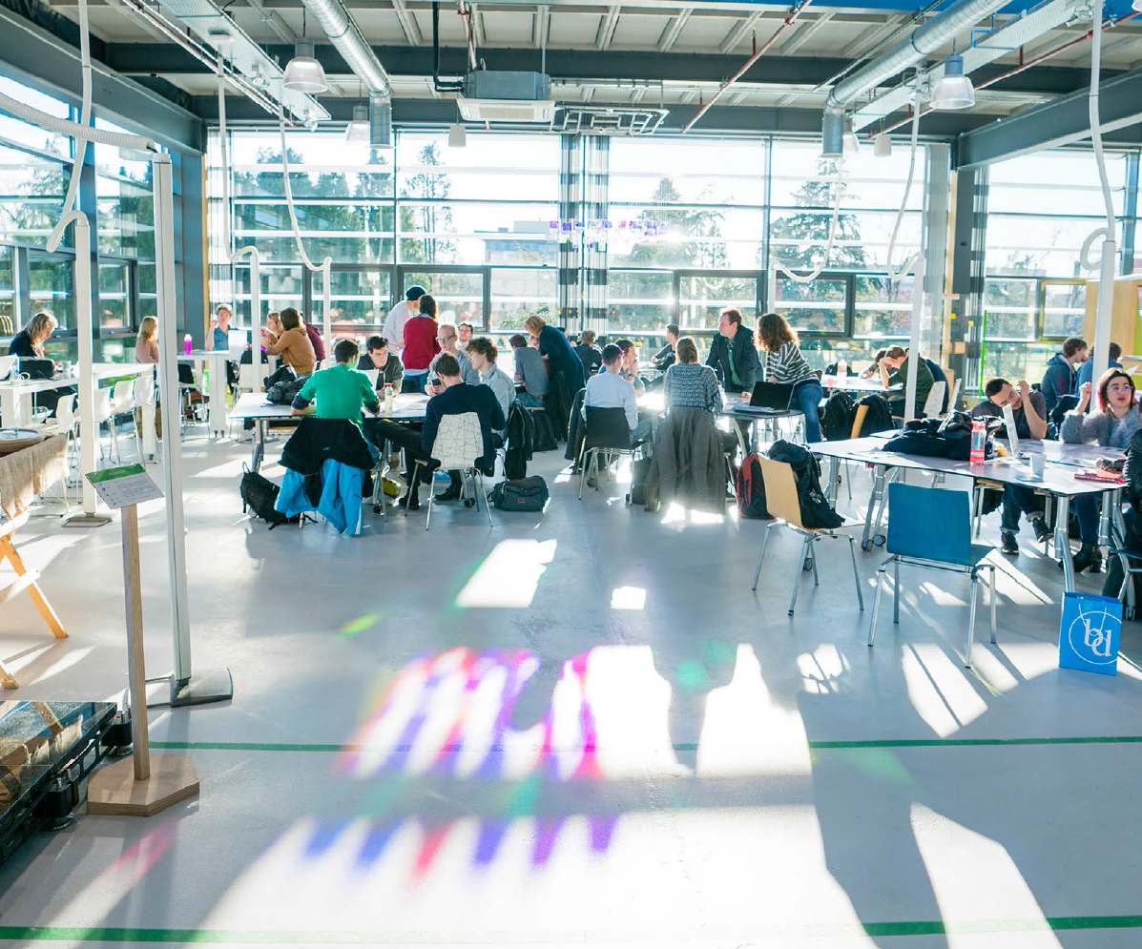
vision on Learning and Teaching
The ‘UT Vision on Learning and Teaching’ places three goals at the heart of our education:
Learning by-doing
Building inclusive communities
Self-development
Notes:
https://www.utwente.nl/.uc/f3145b2d001027ff14d01131455028e646c148554967700/Vision%20on%20Learning%20and%20Teaching.pdf
Erik/Myrna?
Challenged based learning
Kleinschaligheid
ECIU University
Vision on Learning and Teaching:
Learning-by-Doing
Building inclusive communities
Self-Development
Doel -> uitleg en impact overbrengen

Slide 32
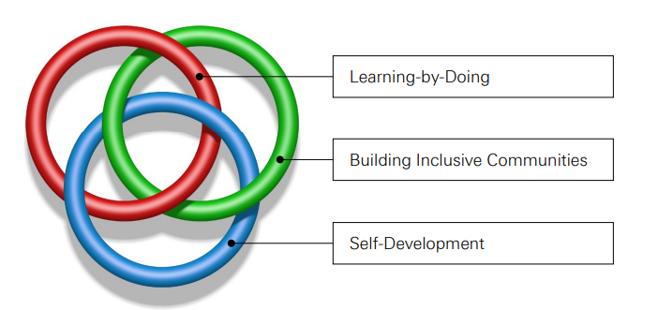
vision on Learning and Teaching - A BORROMEAN KNOT
UT enables students to develop professionally and academically in open High Tech, Human Touch learning communities and to choose learning trajectories that fit their personal talents. However, we believe that this is only possible if our education pursues all three goals. This belief will resonate in all our investments in learning and teaching.
Notes:
https://www.utwente.nl/.uc/f3145b2d001027ff14d01131455028e646c148554967700/Vision%20on%20Learning%20and%20Teaching.pdf
Erik/Myrna?
Challenged based learning
Kleinschaligheid
ECIU University
Vision on Learning and Teaching:
Learning-by-Doing
Building inclusive communities
Self-Development
Doel -> uitleg en impact overbrengen

Slide 33
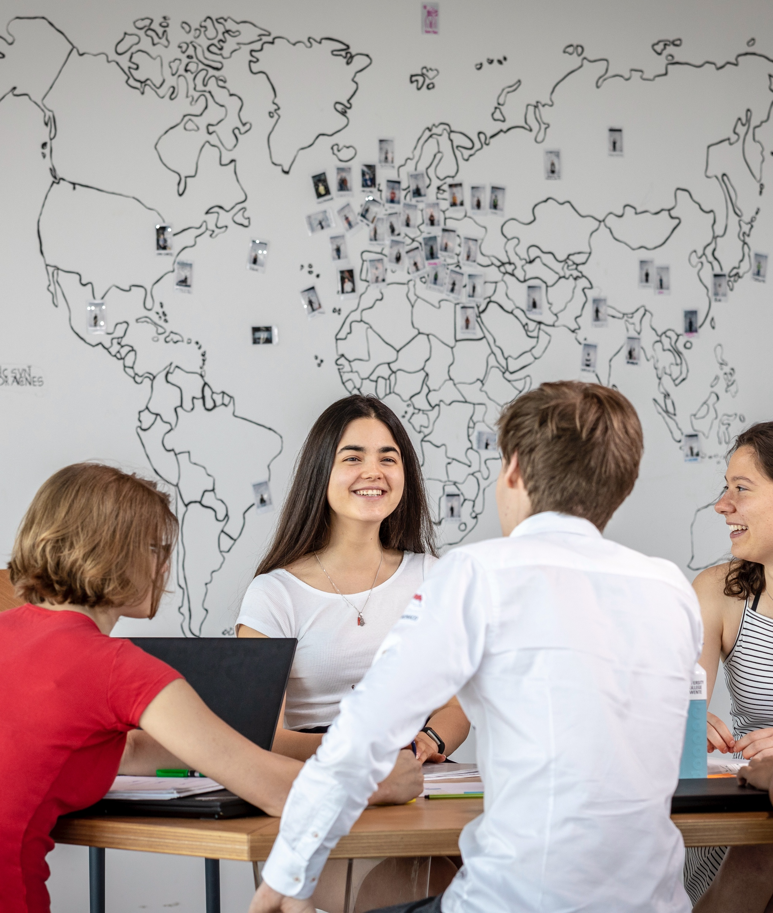
Why a study at the University of Twente?
Technical university that puts people and planet first
Benefit from a personal approach
The most entrepreneurial university
Gaining expertise while broadening your horizon
World renowned top-research universities
International community > 114 nationalities
The only ‘all-in’ campus in the Netherlands
Notes:
1. Do you want to contribute to a healthier, smarter, and more sustainable world? Then you are a perfect fit to be part of our ambitious community. All of our education and research is aimed to come up with solutions for today’s challenges. Whether it’s about improving food security in Africa, devising a smart app that can support patients with diabetes, or realising the transition to electric vehicles. You will learn to look beyond the boundaries of your own discipline and join forces with students and professors from all kinds of disciplines to tackle current issues. With a UT master’s degree, you can make a difference!
2. Got a question for your teachers outside lecture time? Just knock on their office doors! Our university is small-scale, meaning the lecturer knows your name and helps you personally. As a result, you do not only benefit from personalised teaching, you also quickly feel safe and at home.
3. At UT, you can turn your business idea into reality. Since its founding in 1961, UT has become an international platform for talent, attracting students who all share a curious, entrepreneurial spirit. With over 1,000 start-ups to our name, UT is recognised as the most entrepreneurial university in the Netherlands. We are keen to put your scientific knowledge to practical use in solutions that people and society need. Your innovative ideas, creativity and the courage to step out will be rewarded.
4. We know that problems cannot be solved from one discipline. That is why we highly value interdisciplinary collaboration. At the University of Twente, you will not only be able to gain in-depth expertise and become a specialist in your own field, you will also learn to look beyond the boundaries of your own discipline. So don’t be surprised to see that you can follow courses of other master’s programmes, or collaborate in a project with students from a different background!

Slide 34
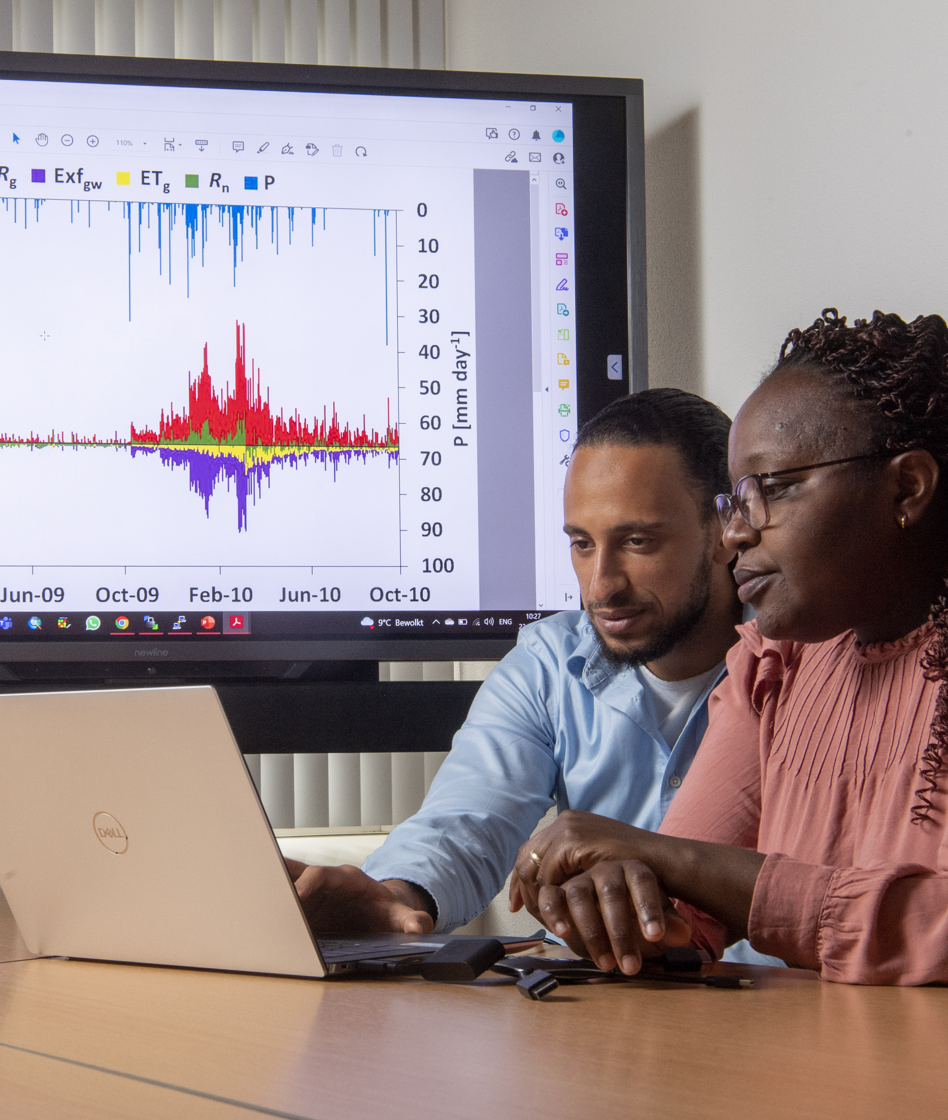
Lifelong learning (LLL) vision
A process of learning that can take place throughout life.
Initiatives are mono- or multi-disciplinary in nature
Various domains, for instance:
Health (TechMed), Spatial Sciences (ITC), IT, Management, Engineering, and Behaviour (PLD) & Society (Pro-U);
For whom: individuals, professionals and industrial markets from varying sectors;
Delivery mode: on-campus, on-site, online, hybrid;
Unit of delivery: from single-courses / modules to full degrees
Notes:
Leren stopt niet na afronding van je universitaire opleiding. Welk aanbod hebben we?
Lifelong learning is a process of learning that can take place throughout life.
Various domains for instance:
• Initiatives are mono- or multi-disciplinary in nature and cover different domains, amongst others: Health (TechMed), Spatial Sciences (ITC), IT, Management, Engineering, and Behaviour (PLD) & Society (Pro_U);
For whom:
Target groups: individuals (alumni, individuals with a specific profession, professionals with a certain interest) and industrial markets from varying sectors (company customized programmes and learning communities);
• Delivery mode: on-campus, on-site, online, hybrid; • Unit of delivery: from single-courses / modules to full degrees;

Slide 35
faculties
All research groups are embedded in one of our five faculties. Faculties are responsible for the educational programmes and the disciplinary research. The three Institutes stimulate interdisciplinary research and the societal impact in specific domains.
Our five faculties:
Engineering Technology (ET)
Electrical Engineering, Mathematics and Computer Science (EEMCS)
Science and Technology (S&T)
Behavioural, Management & Social Sciences (BMS)
Geo-Information Science and Earth Observation (ITC)

Slide 36
Our Educational programmes
09
Structured Per faculty

Slide 37
Engineering Technology (ET)
Bachelor programmes
Civil Engineering
Mechanical Engineering – VU
Mechanical Engineering – UT
Industrial Design Engineering
Master programmes
Industrial Design Engineering
Civil Engineering and Management
Construction Management and Engineering
Mechanical Engineering
Sustainable Energy Technology

Slide 38

Electrical Engineering, Mathematics and Computer Science (EEMCS)
Bachelor programmes
Electrical Engineering
Applied Mathematics
Creative Technology – VU
Creative Technology – UT
Business Information Technology
Technical Computer Science
Master programmes
Applied Mathematics
Business Information Technology
Computer Science
Robotics
Electrical Engineering
Interaction Technology
Embedded Systems

Slide 39

Science and Technology (S&T)
Bachelor programmes
Technische Natuurkunde
Chemical Science & Engineering
Advanced Technology
Biomedische Technologie
Technische Geneeskunde
Gezondheidswetenschappen
Master programmes
Water Technology
Technical Medicine
Chemical Science & Engineering
Biomedical Engineering
Applied Physics
Health Sciences
Nanotechnology

Slide 40
Behavioural, Management & Social Sciences (BMS)
Bachelor programmes
Industrial Eng. and Management
Communication Science
Psychology
International Business Administration
Management, Society and Technology
Master programmes
Educatie en Com. in de Bètawetensch.
Industrial Engineering and Management
Public Administration
Communication Science
Philosophy of Science, Tech. and Soc.
Psychology
European Studies
Business Administration
Educational Science and Techn.
Risicomanagement
Environment and Energy Management

Slide 41
Geo-Information Science and Earth Observation (ITC)
Bachelor programmes
UCT - ATLAS
Master programmes
Geoinformation Science and Earth Observation
Spatial Engineering

Slide 42
Other useful slides
10

Slide 43
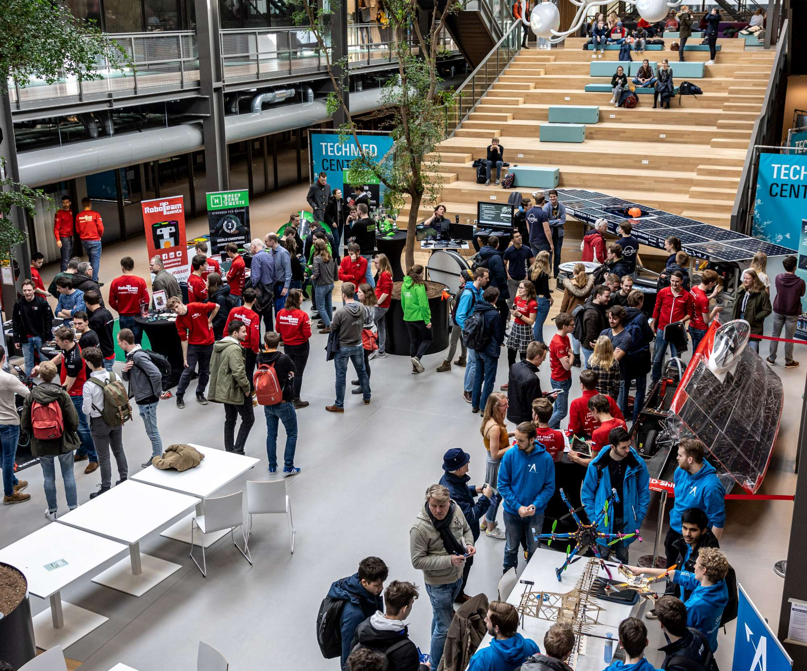
Student teams
Solar Team Twente
Green Team Twente
Drone Team Twente
Solar Boat Twente
RoboTeam Twente
Esports Team Twente
Electric Superbike Twente
RISE
Notes:
- Solar Team Twente
Green Team Twente
Drone Team Twente
Solar Boat Twente
RoboTeam Twente
E-sports Team Twente
Electric Superbike Twente
RISE

Slide 44

Meet the student teams
Notes:
Link: https://youtu.be/vrwfJ0KAdKA

Slide 45
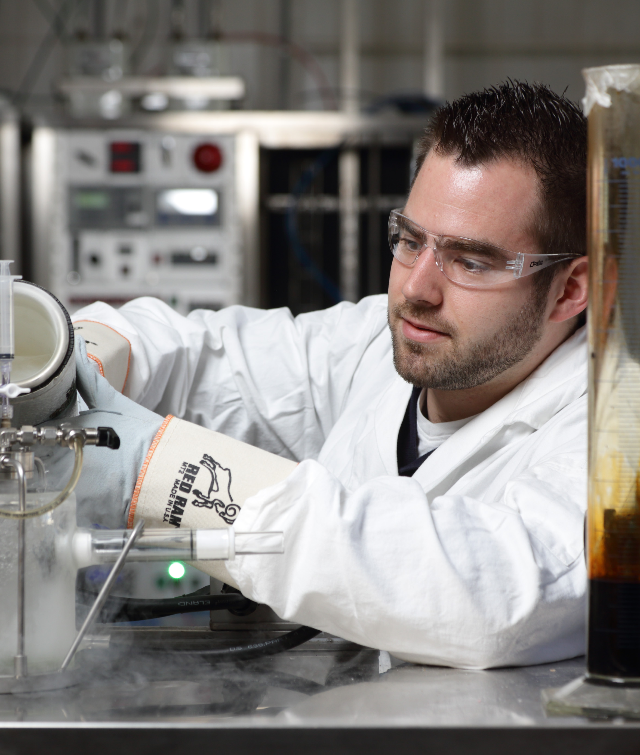
Meet our Scientists
UT Showcases their scientists as UT ambassadors: The Featured Scientists. On a special web page we make their talent more visible in a clear and convenient way. Would you like to know more?
Go to utwente.nl/featured-scientists

Slide 46
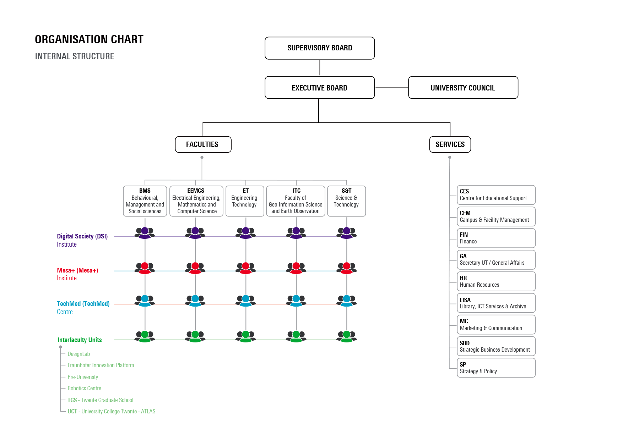
Notes:
(What is the organisation like?)

Slide 47
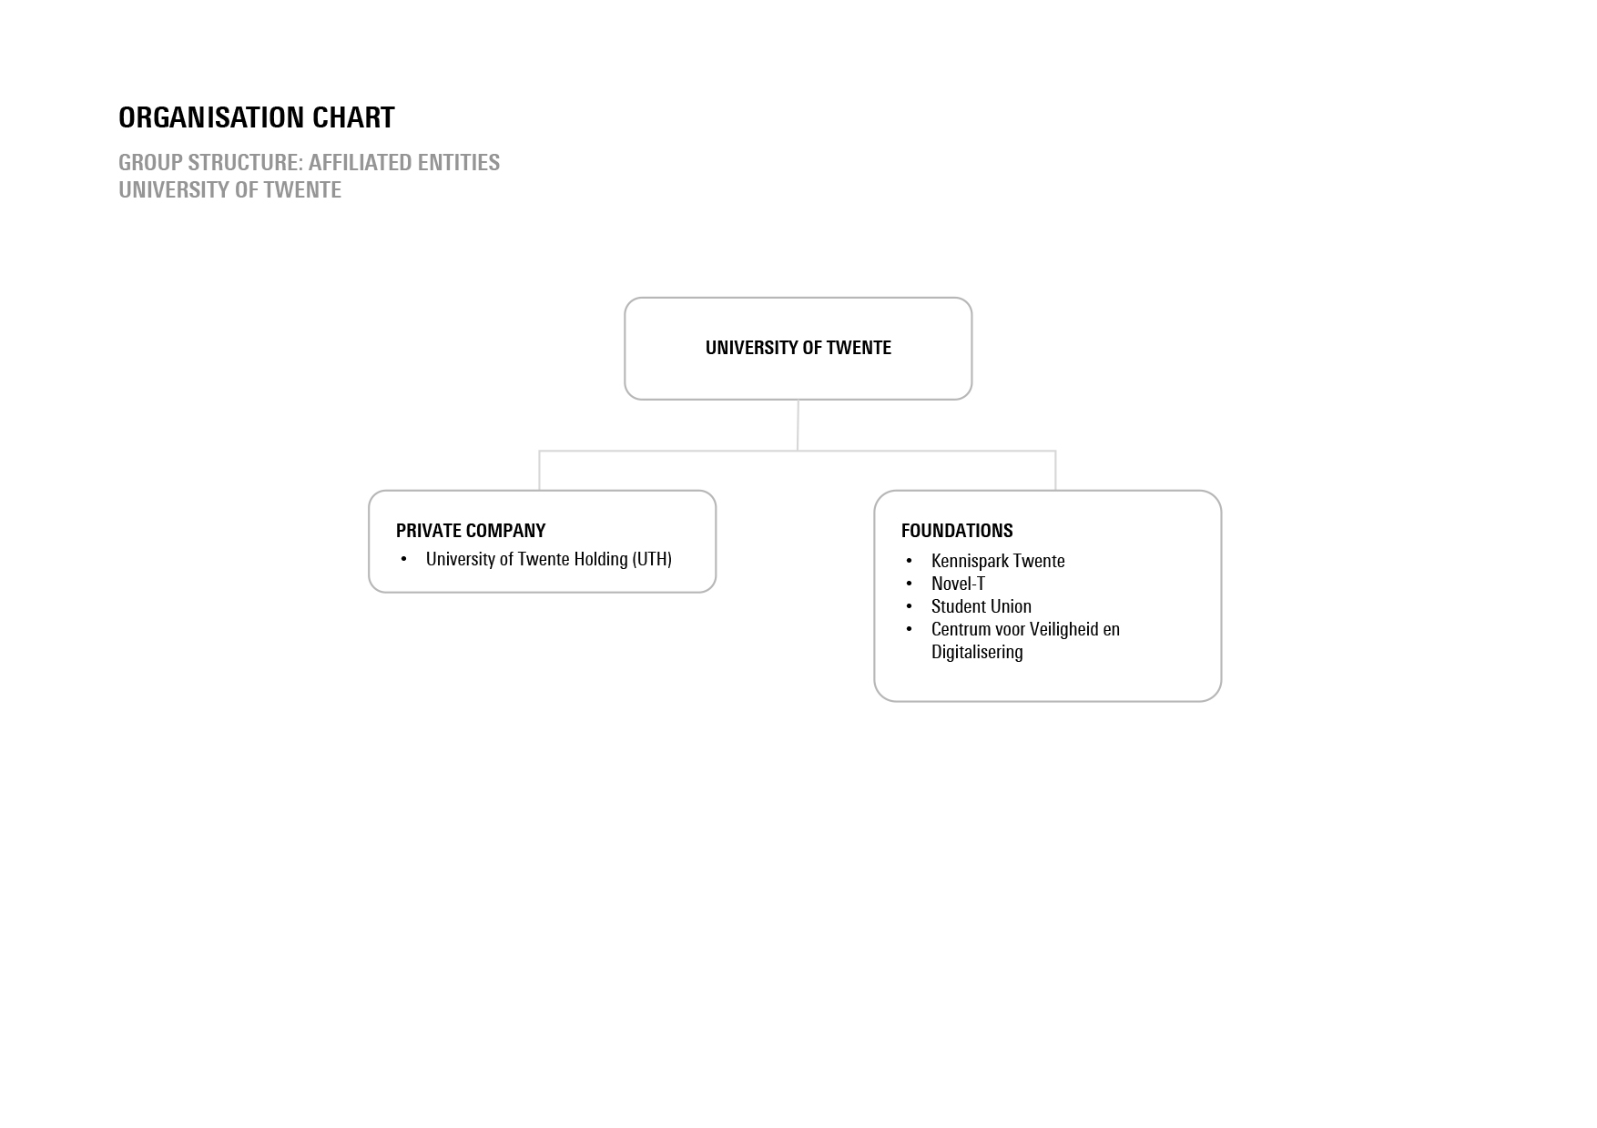
Notes:
(What is the organisation like?) Affiliated entities

Slide 48
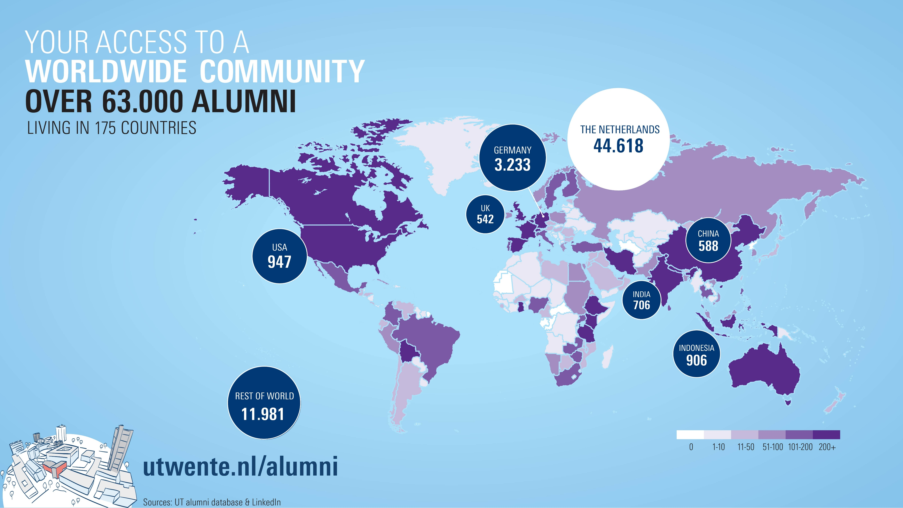

Slide 49
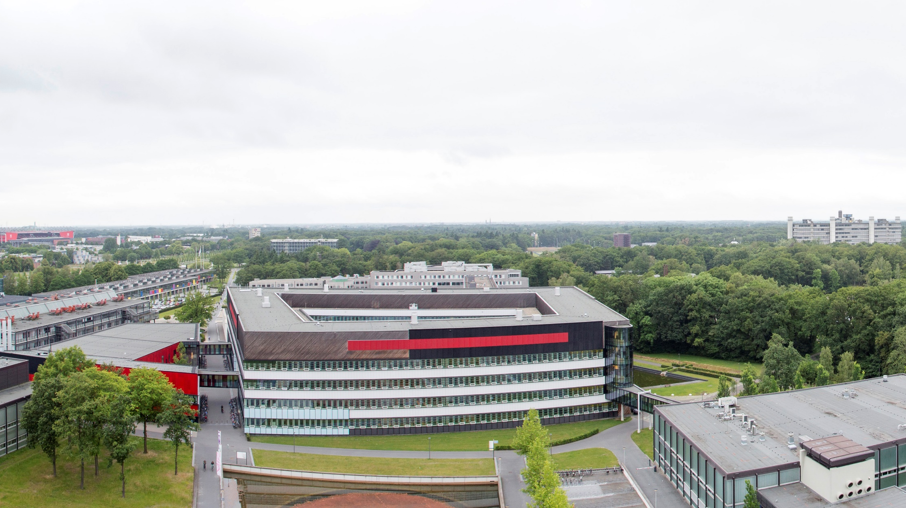
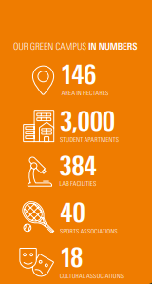
Our unique campus
Notes:
Our 1.5 square kilometres green campus is a breeding ground for talent and new ideas

Slide 50
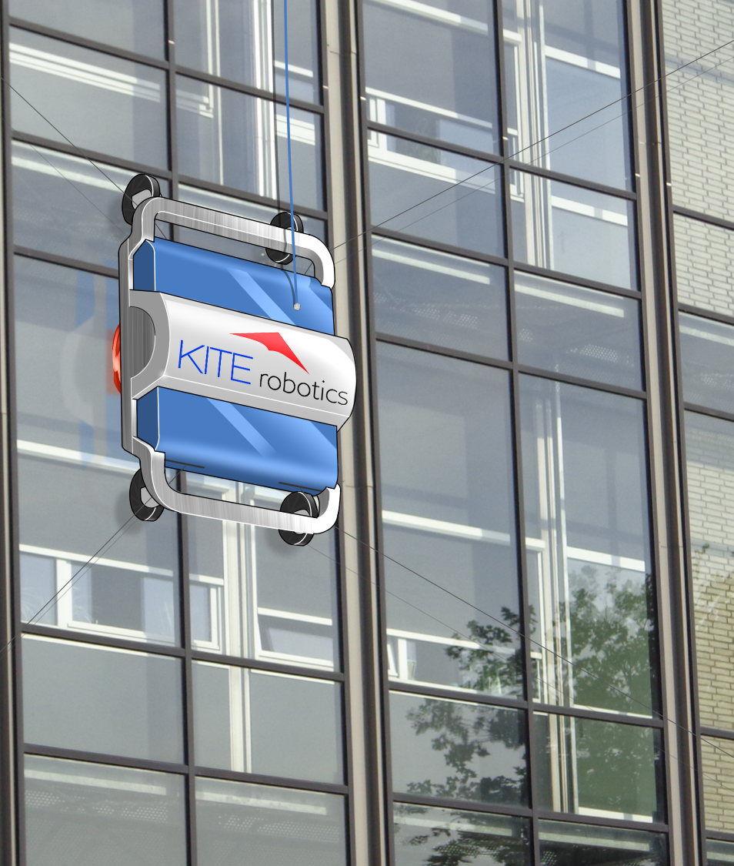
Entrepreneurship
UT is recognised as the most entrepreneurial university in our own country. We are strong in transforming knowledge into business in order to impact society in meaningful ways. More than 1,000 successful start-ups have been launched here.
Example:
KITE Robotics, a spin-off of the University of Twente, developed an autonomous window cleaning robot. Currently capable of cleaning medium to medium-high buildings up to 150 m, the Kite Robot covers the demands of the vast majority of (Western-) European market.
Notes:
HIGH-RISE WINDOW CLEANING
Window cleaning of high-rise buildings has long been a dangerous and labour-intensive task, the high risks and costs of this problem demand an inherent safe solution. KITE Robotics, a spin-off of the University of Twente, developed an autonomous window cleaning robot. Currently capable of cleaning medium to medium-high buildings up to 150 m, the Kite Robot covers the demands of the vast majority of (Western-) European market.

