Slide 1
opportunities Study abroad
29 september 2016

Slide 2
Today
Introduction
Overview opportunities study abroad
Procedures
Finances
Other information
Notes:
Moet overeenkomen met de slides

Slide 3
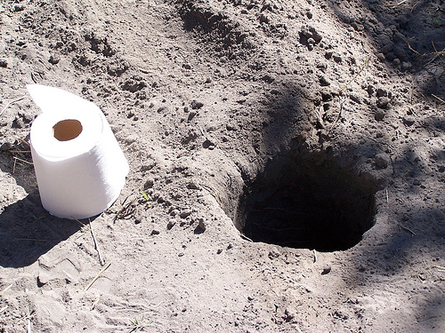
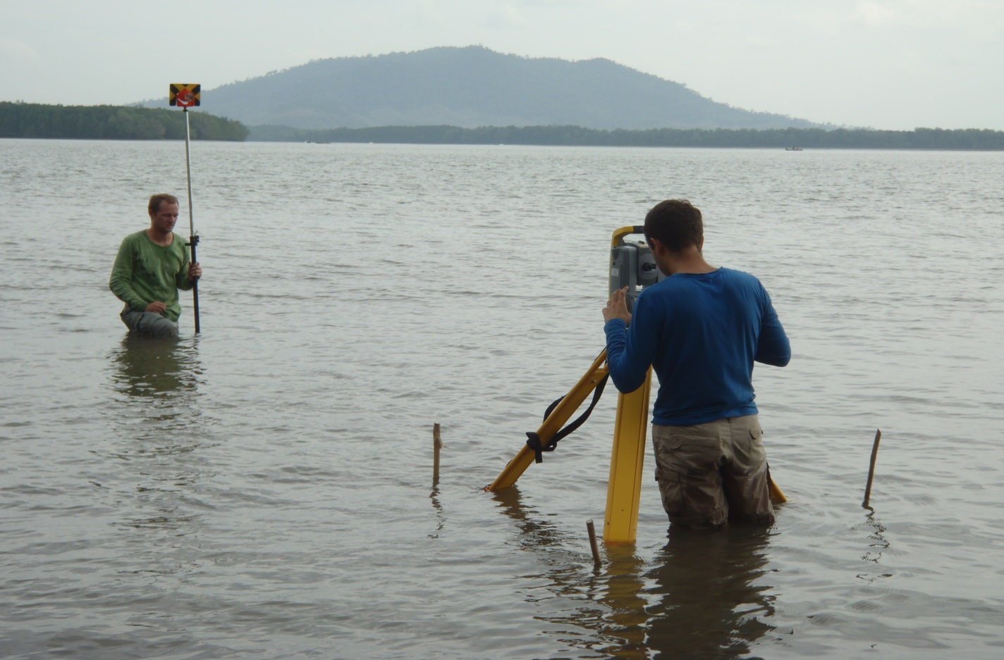
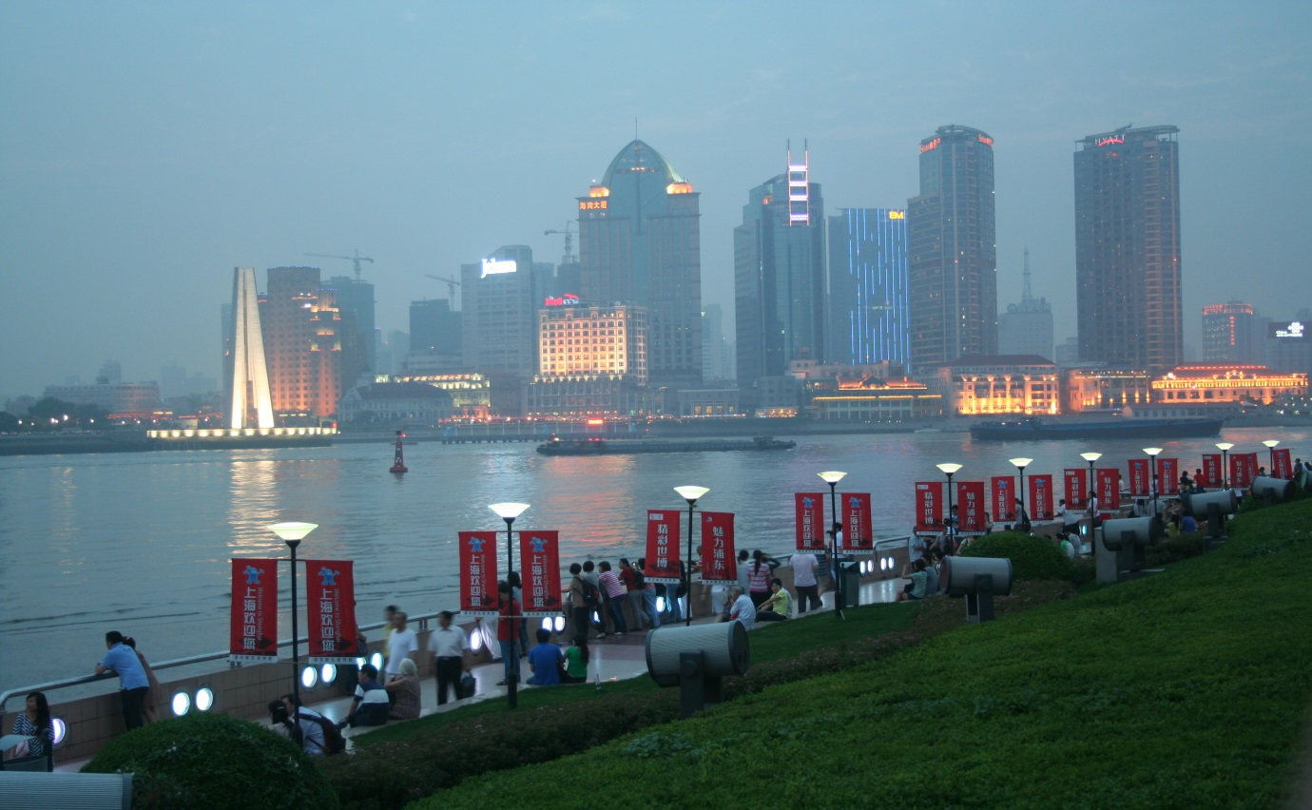
Why study abroad?
surroundings
Comfort zone?
Work experience
Culture
New friends
Notes:
Aanpassen?

Slide 4
Opportunities
Exchange semester for Bachelor (minor) & Master’s programme (30 EC)
Internship abroad(15-20 EC)
Bachelor assignment abroad (15 EC)
Master assignment abroad (30-45 EC)
Double Degree Master programme (60 EC)
Short term activities

Slide 5
Overview
 | minor | BSc thesis | MSc exch. | Intern ship | MSc thesis
CiT | B3 | B3
IO | B3 | B3
WB | B3
CEM |  |  | x | - | x
IDE |  |  | x | - | x
ME |  |  | x | x | x
CME |  |  | x | - | x
SET |  |  | x | x | x

Slide 6
Exchange minor / module 9 & 10
when: 3rd year bachelor
how much: 30 EC of subjects
where: university abroad
1st option: partner university of your programme
2nd option: partner university of other CTW / UT programme
3rd option: other university
approval: Bachelor coordinator

Slide 7
Bachelor thesis
when: end of 3rd year bachelor
where:
Foreign company, institute or university
Dutch company or institute with a project abroad
(UT) Research project abroad
Approval: UT supervisor

Slide 8
Exchange master subjects
when: 1st or 2nd year master
how much: usually 1 semester
where: university abroad
1st option: partner university of programme
2nd option: partner university of other CTW/UT programme
3rd option: other university
what: subjects in the field of the chosen specialisation (deepening/broadening)
approval: track coordinator

Slide 9
Internship
when: 2nd year master (ME/SET)
how much: appr. 15-20 EC (min. 11 weeks)
where: company, university, research institute; abroad (or Netherlands)
approval: UT supervisor & internship coordinator

Slide 10
Master thesis
when: 2nd year master
how much: 37,5 - 45 EC (ME, SET, CEM, CME, IDE)
where: company, university, research institute;
abroad (or Netherlands)
approval: track coordinator

Slide 11
Short term Activities
Summer school
Study tour
International competitions (BEST, ESA, …)

Slide 12
Procedure: assignments
See: Programme websites
All: registration in Mobility Online
Notes:
Procedure en partner-mogelijkheden laten zien via website
Ingangseisen van de opleidingen voor minor, profileringsruimte, stage, eindopdrachten

Slide 13
Procedure: course exchange
 | FOR STUDENTS:
1-jan | Application deadline @ Mobility Online
 | Programme specific requirements & selection procedure: see website
15-feb | Central selection & allocation UT-wide partners (by International Office)
End of Feb | Students receive allocation of UT-wide partners
15-mar | Students receive allocation of programme partners
31-mar | Application deadline for non-allocated students @ Mobility Online
15-apr | Students receive allocated of remaining programme partners
Selection procedure:
will be published on the website
based on: average mark, # EC’s
additional minor requirements (BSc course exchange)
Notes:
Procedure en partner-mogelijkheden laten zien via website
Ingangseisen van de opleidingen voor minor, profileringsruimte, stage, eindopdrachten

Slide 14
Partner universities CTW
Partners inside the EU
Partners outside the EU
https://www.utwente.nl/ctw/student-mobility/partners/
Notes:
Uitleggen via website

Slide 15
Finances
Internship compensation
UT: Erasmus (study/ placement) , TMF
outside UT: www.beursopener.nl
Fulbright, VSB, CV-beurzen
Other: compensation ‘OV’, housing

Slide 16
Insurance
Travel insurance
--> UT / private
Liability
Extra holiday after period of study?
Contact details insurance company
Report any incidents

Slide 17
Contact persons
Bachelor/master thesis:
Coordinator of thesis within programme
Internship / exchange / general questions:
CiT/CEM/CME | Judith Roos-Krabbenbos | HR Z-214
IO/IDE | Tineke Hoeksma | HR Z-210
WB/ME/SET | Dorien van de Belt | HR W-204
https://www.utwente.nl/ctw/student-mobility/contact/
Notes:
Uitleggen via website

Slide 18
Other Information
Website of International Office: www.utwente.nl/studyabroad/
Study abroad UT: https://www.utwente.nl/studyabroad/
Social Media: www.facebook.com/SMCCTW www.facebook.com/utwentestudyabroad www.facebook.com/esn.twente
Notes:
Flyers van Let’s go meenemen

Slide 19
Let’s GO!
Before you make your choice:
Visit the ‘Let’s go fair’!
Tuesday, 11th of October
10.00 – 13.30
Atrium Ravelijn
https://www.utwente.nl/ces/letsgo/fair/

