Slide 1

Tactical Planning in Healthcare using Approximate Dynamic Programming with Bayesian Exploration
Martijn Mes
Department of Industrial Engineering and Business Information Systems
University of Twente
The Netherlands
Joint work with: Ilya Ryzhov, Warren Powell, Peter Hulshof, Erwin Hans,
Richard Boucherie.
Wednesday, October 30, 2013
Cornell University – ORIE/SCAN Seminar Fall 2013, Ithaca, NY

Slide 2








OUTLINE
Introduction
Problem
Solutions
Function approximation
Bayesian exploration
Results
Conclusions
Case introduction
Problem formulation
Solution approaches:
  Integer Linear Programming
  Dynamic Programming
  Approximate Dynamic Programming
Challenges in ADP
  Value Function Approximation
  Bayesian Exploration
Results
Conclusions
This research is partly supported by the Dutch Technology Foundation STW, applied science division of NWO and the Technology Program of the Ministry of Economic Affairs.

Slide 3
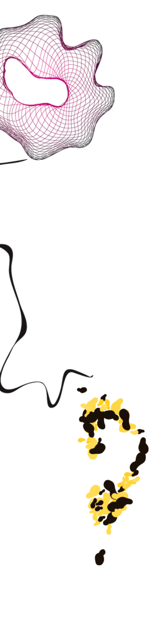
INTRODUCTION
Introduction
Problem
Solutions
Function approximation
Bayesian exploration
Results
Conclusions
Healthcare providers face the challenging task to organize their processes more effectively and efficiently
  Growing healthcare costs (12% of GDP in the Netherlands)
  Competition in healthcare
  Increasing power from health insures
Our focus: integrated decision making on the tactical planning level:
  Patient care processes connect multiple departments and resources, which require an integrated approach.
  Operational decisions often depend on a tactical plan, e.g., tactical allocation of blocks of resource time to specialties and/or patient categories (master schedule / block plan).
Care process: a chain of care stages for a patient, e.g., consultation, surgery, or a visit to the outpatient clinic

Slide 4

CONTROLLED ACCESS TIMES
Introduction
Problem
Solutions
Function approximation
Bayesian exploration
Results
Conclusions
Tactical planning objectives:
  Achieve equitable access and treatment duration.
  Serve the strategically agreed target number of patients.
  Maximize resource utilization and balance the workload.
We focus on access times, which are incurred at each care stage in a patient’s treatment at the hospital.
Controlled access times:
  To ensure quality of care for the patient and to prevent patients from seeking treatment elsewhere.
  Payments might come only after patients have
  completed their health care process.

Slide 5
TACTICAL PLANNING AT HOSPITALS IN OUR STUDY
Introduction
Problem
Solutions
Function approximation
Bayesian exploration
Results
Conclusions
Typical setting: 8 care processes, 8 weeks as a planning horizon, and 4 resource types (inspired by 7 Dutch hospitals).
Current way of creating/adjusting tactical plans:
  In biweekly meeting with decision makers.
  Using spreadsheet solutions.
Our model provides an optimization step that supports rational decision making in tactical planning.

Slide 6
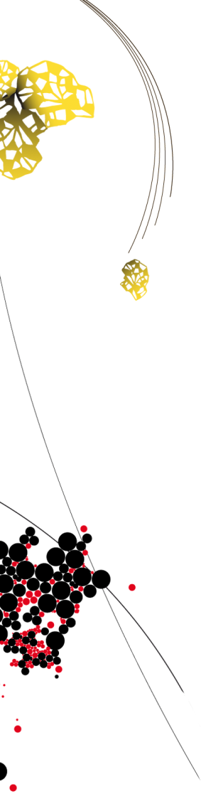
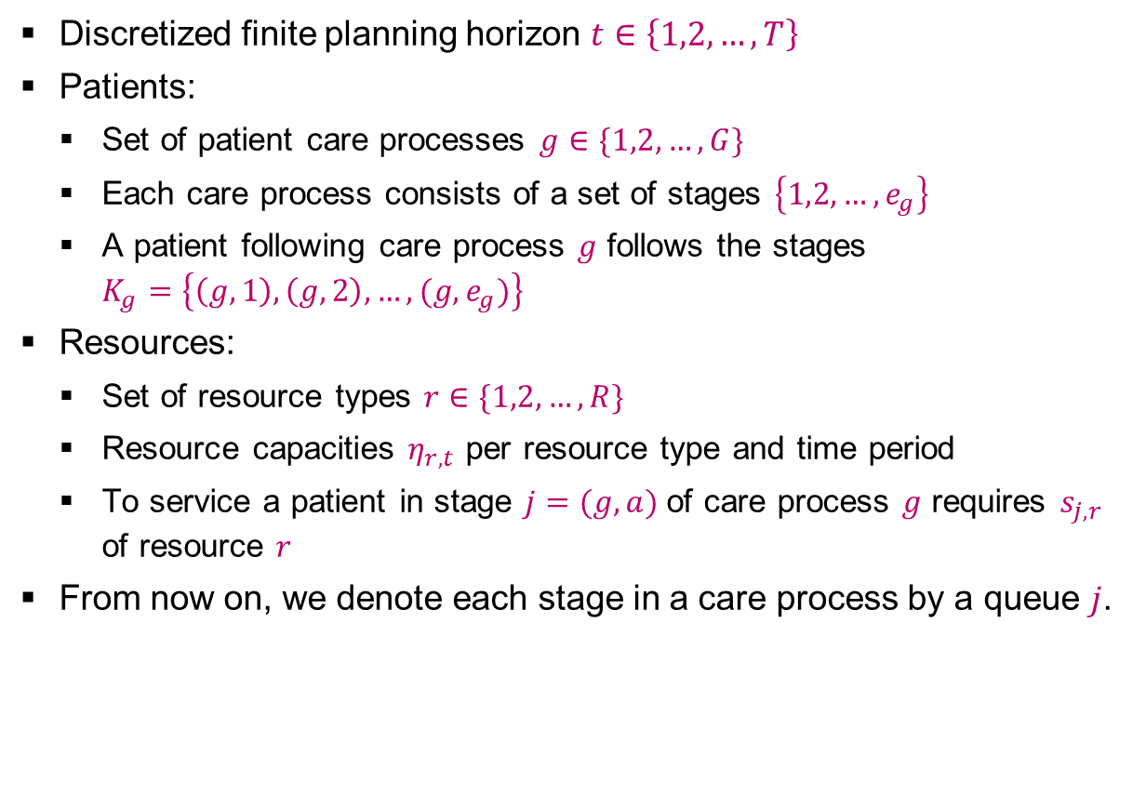
PROBLEM FORMULATION [1/2]
Introduction
Problem
Solutions
Function approximation
Bayesian exploration
Results
Conclusions
Discretized finite planning horizon $t∈\left\{1,2,…,T\right\}$
Patients:
  Set of patient care processes $g∈\{1,2,…,G\}$
  Each care process consists of a set of stages $\left\{1,2,…,e_{g}\right\}$
  A patient following care process $g$ follows the stages $K_{g}=\left\{\left(g,1\right),\left(g,2\right),…,(g,e_{g})\right\}$
Resources:
  Set of resource types $r∈\{1,2,…,R\}$
  Resource capacities $η_{r,t}$ per resource type and time period
  To service a patient in stage $j=(g,a)$of care process $g$ requires $s_{j,r}$ of resource $r$
From now on, we denote each stage in a care process by a queue $j$.

Slide 7
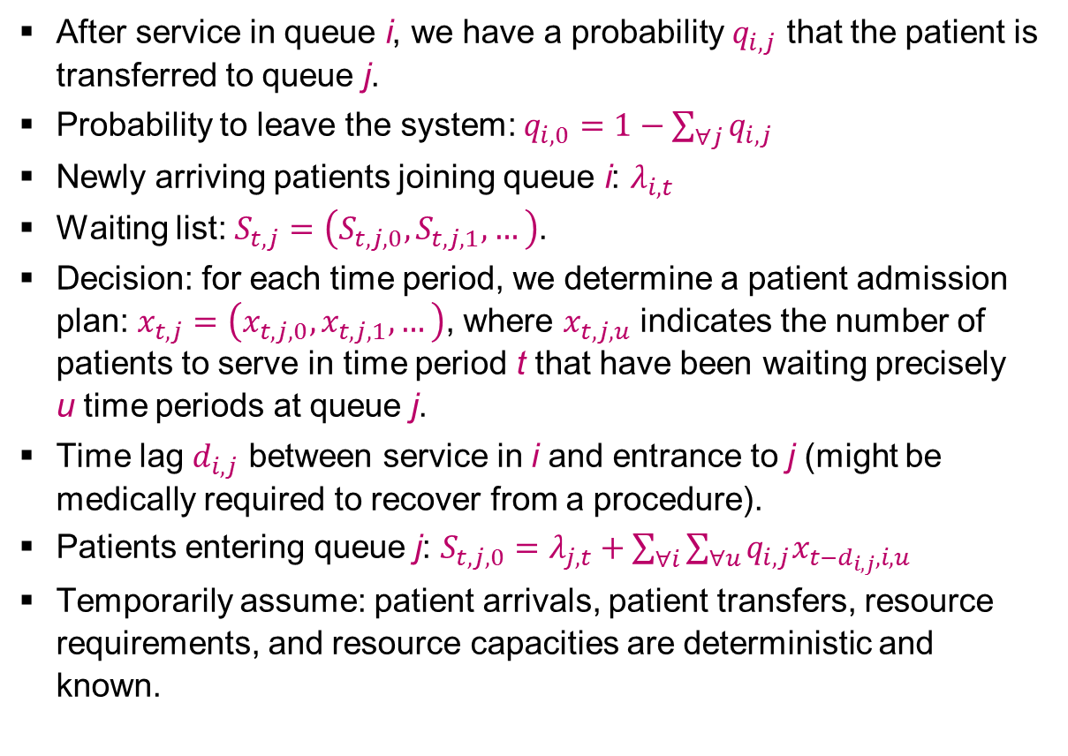
PROBLEM FORMULATION [2/2]
Introduction
Problem
Solutions
Function approximation
Bayesian exploration
Results
Conclusions
After service in queue i, we have a probability $q_{i,j}$ that the patient is transferred to queue j.
Probability to leave the system: $q_{i,0}=1−\sum_{∀j}{q_{i,j}}$
Newly arriving patients joining queue i: $λ_{i,t}$
Waiting list: $S_{t,j}=\left(S_{t,j,0},S_{t,j,1},…\right)$.
Decision: for each time period, we determine a patient admission plan: $x_{t,j}=\left(x_{t,j,0},x_{t,j,1},…\right)$, where $x_{t,j,u}$ indicates the number of patients to serve in time period t that have been waiting precisely
u time periods at queue j.
Time lag $d_{i,j}$ between service in i and entrance to j (might be medically required to recover from a procedure).
Patients entering queue j: $S_{t,j,0}=λ_{j,t}+\sum_{∀i}{\sum_{∀u}{q_{i,j}x_{t−d_{i,j},i,u}}}$
Temporarily assume: patient arrivals, patient transfers, resource requirements, and resource capacities are deterministic and known.

Slide 8

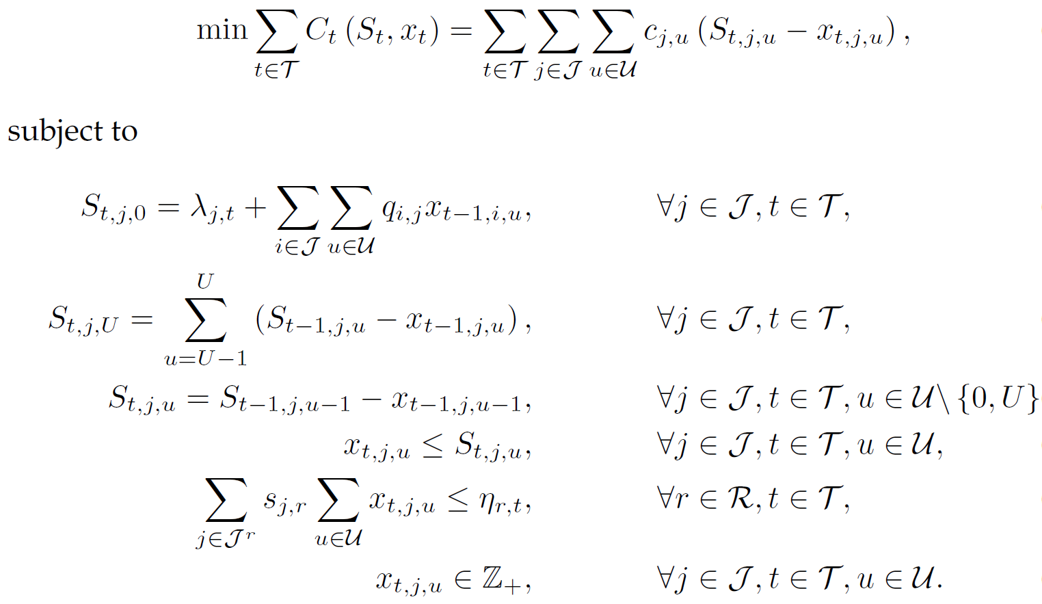

MIXED INTEGER LINEAR PROGRAM
Introduction
Problem
Solutions
Function approximation
Bayesian exploration
Results
Conclusions
Number of patients in queue j at time t with waiting time u
Number of patients to treat in queue j at time t with a waiting time u
[1]
Assume time lags $d_{i,j}=1$
Updating
waiting list &
bound on u
Assume upper bound U on u
Limit on the decision space
[1] Hulshof PJ, Boucherie RJ, Hans EW, Hurink JL. (2013) Tactical resource allocation and
elective patient admission planning in care processes. Health Care Manag Sci. 16(2):152-66.

Slide 9
PROS & CONS OF THE MILP
Introduction
Problem
Solutions
Function approximation
Bayesian exploration
Results
Conclusions
Pros:
  Suitable to support integrated decision making for multiple resources, multiple time periods, and multiple patient groups.
  Flexible formulation (other objective functions can easily be incorporated).
Cons:
  Quite limited in the state space.
  Rounding problems with fraction of patients moving from one queue to another after service.
  Model does not include any form of randomness.

Slide 10
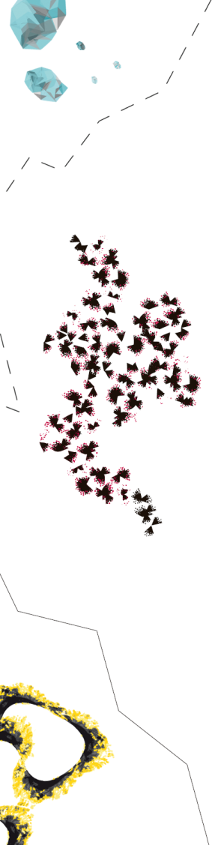


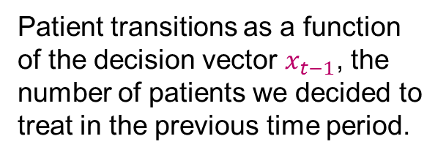
MODELLING STOCHASTICITY [1/2]
Introduction
Problem
Solutions
Function approximation
Bayesian exploration
Results
Conclusions
We introduce $W_{t}$: vector of random variables representing all the new information that becomes available between time t−1 and t.
We distinguish between exogenous and endogenous information:
Patient arrivals from outside the system
Patient transitions as a function of the decision vector $x_{t−1}$, the number of patients we decided to treat in the previous time period.

Slide 11
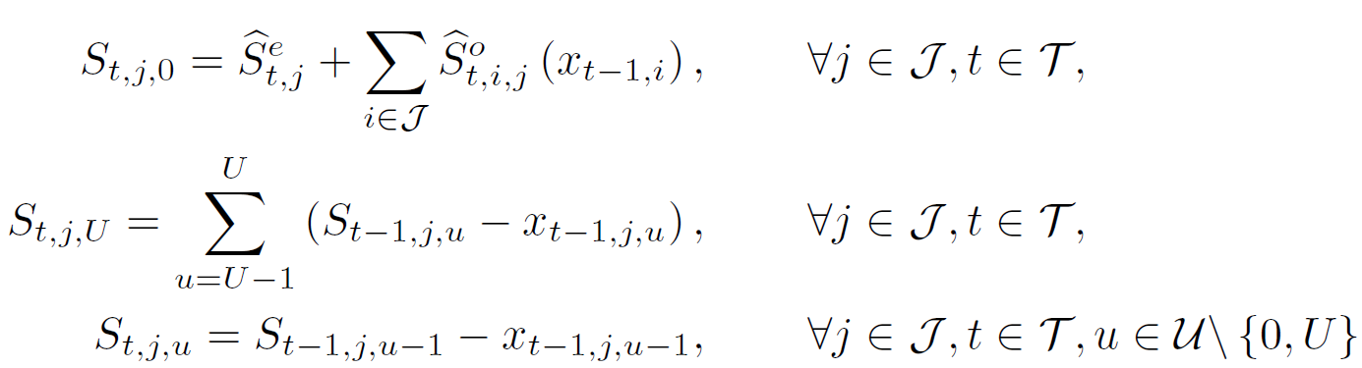

MODELLING STOCHASTICITY [2/2]
Introduction
Problem
Solutions
Function approximation
Bayesian exploration
Results
Conclusions
Transition function to capture the evolution of the system over time as a result of the decisions and the random information:
$$S_{t}=S^{M}\left(S_{t−1},x_{t−1},W_{t}\right)$$
Where
Stochastic counterparts of the first three constraints in the ILP formulation.

Slide 12
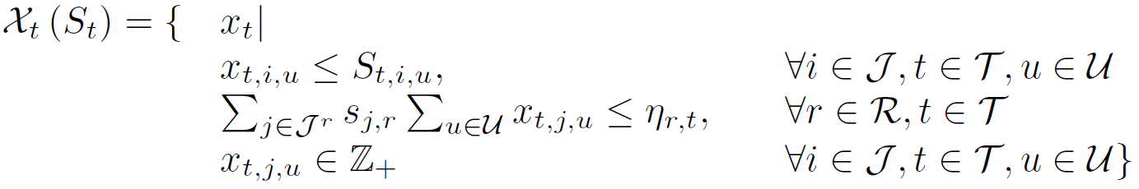
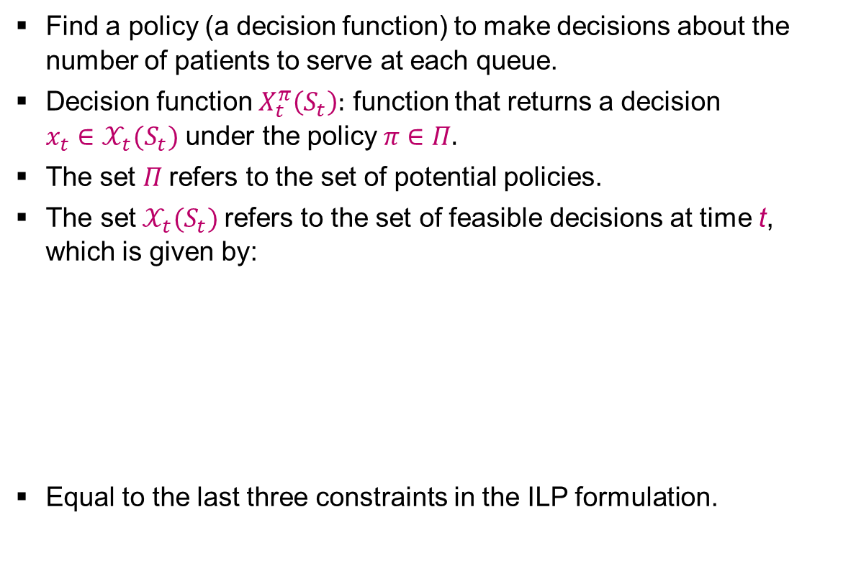
OBJECTIVE [1/2]
Introduction
Problem
Solutions
Function approximation
Bayesian exploration
Results
Conclusions
Find a policy (a decision function) to make decisions about the number of patients to serve at each queue.
Decision function $X_{t}^{π}\left(S_{t}\right):$ function that returns a decision $x_{t}∈𝒳_{t}(S_{t})$ under the policy $π∈Π.$
The set $Π$refers to the set of potential policies.
$\text{The} \text{set} 𝒳_{t}(S_{t})$refers to the set of feasible decisions at time t, which is given by:
Equal to the last three constraints in the ILP formulation.

Slide 13
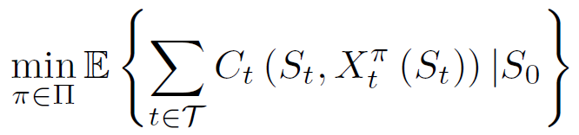
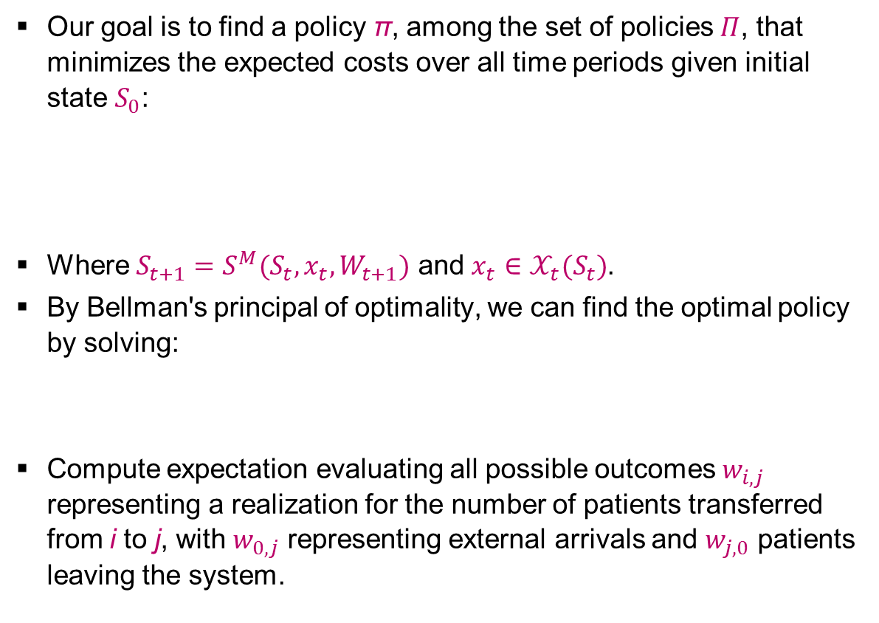
OBJECTIVE [2/2]
Introduction
Problem
Solutions
Function approximation
Bayesian exploration
Results
Conclusions
Our goal is to find a policy π, among the set of policies $Π$, that minimizes the expected costs over all time periods given initial state $S_{0}$:
Where $S_{t+1}=S^{M}(S_{t}, x_{t},W_{t+1})$ and $x_{t}∈𝒳_{t}(S_{t})$.
By Bellman's principal of optimality, we can find the optimal policy by solving:
Compute expectation evaluating all possible outcomes $w_{i,j}$ representing a realization for the number of patients transferred from i to j, with $w_{0,j}$ representing external arrivals and $w_{j,0}$ patients leaving the system.

Slide 14
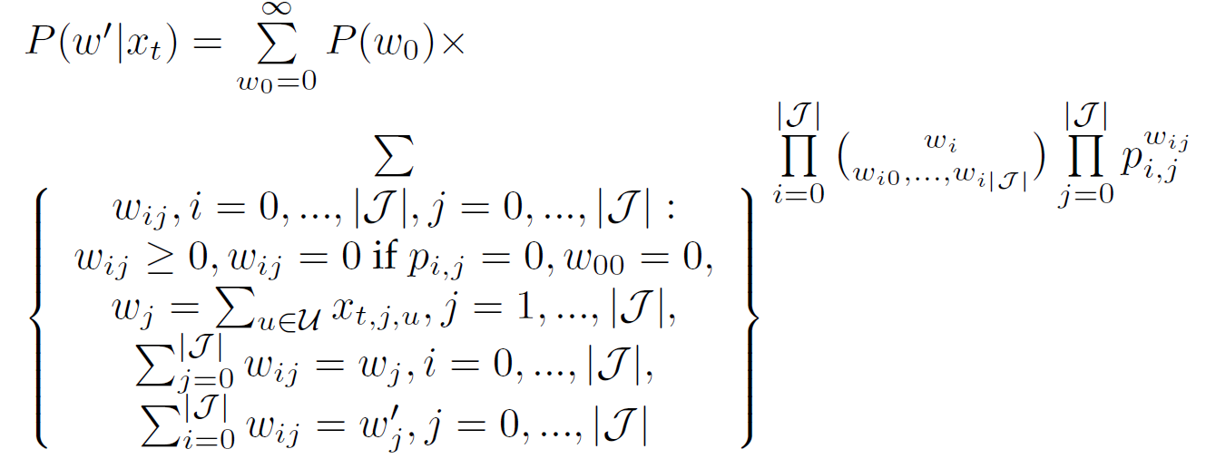
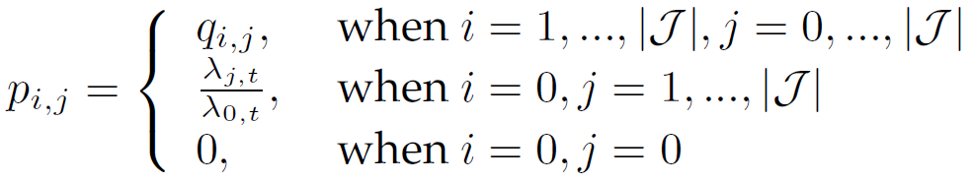
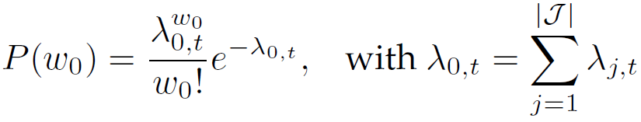
DYNAMIC PROGRAMMING FORMULATION
Introduction
Problem
Solutions
Function approximation
Bayesian exploration
Results
Conclusions
Solve:
Where
By backward induction.

Slide 15
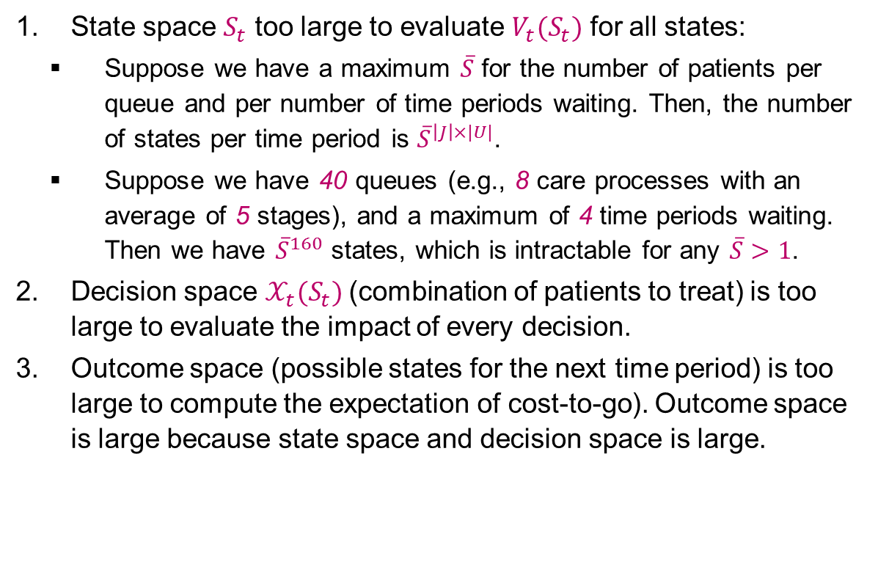
THREE CURSUS OF DIMENSIONALITY
Introduction
Problem
Solutions
Function approximation
Bayesian exploration
Results
Conclusions
State space $S_{t}$ too large to evaluate $V_{t}(S_{t})$ for all states:
  Suppose we have a maximum $\overline{S}$ for the number of patients per queue and per number of time periods waiting. Then, the number of states per time period is ${\overline{S}}^{\left|J\right|×|U|}$.
  Suppose we have 40 queues (e.g., 8 care processes with an average of 5 stages), and a maximum of 4 time periods waiting. Then we have ${\overline{S}}^{160}$ states, which is intractable for any $\overline{S}>1$.
Decision space $𝒳_{t}(S_{t})$(combination of patients to treat) is too large to evaluate the impact of every decision.
Outcome space (possible states for the next time period) is too large to compute the expectation of cost-to-go). Outcome space is large because state space and decision space is large.

Slide 16
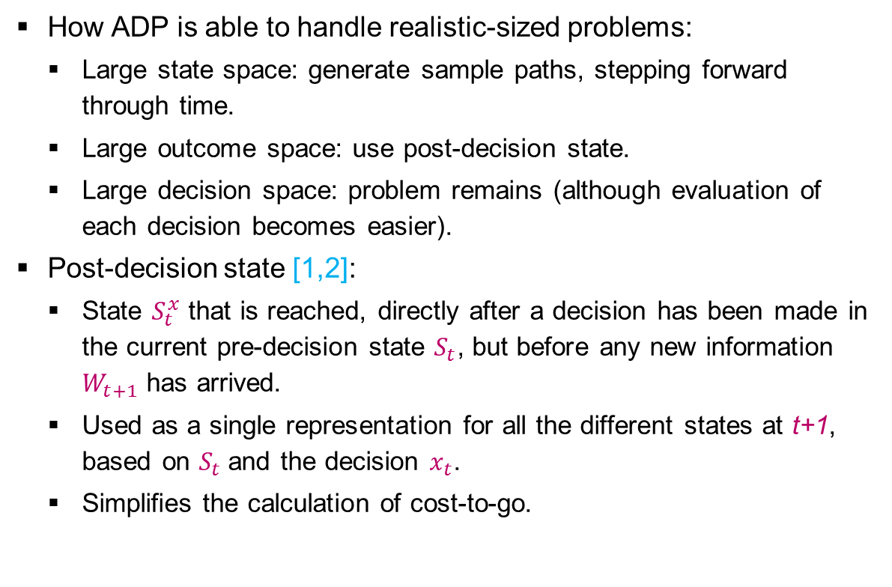
APPROXIMATE DYNAMIC PROGRAMMING (ADP)
Introduction
Problem
Solutions
Function approximation
Bayesian exploration
Results
Conclusions
How ADP is able to handle realistic-sized problems:
  Large state space: generate sample paths, stepping forward through time.
  Large outcome space: use post-decision state.
  Large decision space: problem remains (although evaluation of each decision becomes easier).
Post-decision state [1,2]:
  State $S_{t}^{x}$ that is reached, directly after a decision has been made in the current pre-decision state $S_{t}$, but before any new information $W_{t+1}$ has arrived.
  Used as a single representation for all the different states at t+1, based on $S_{t}$and the decision $x_{t}$.
  Simplifies the calculation of cost-to-go.
[1] Van Roy B, Bertsekas D, Lee Y, Tsitsiklis J (1997) A neuro-dynamic programming approach to retailer inventory management, Proc. of the 36th IEEE Conf. on Decision and Control, pp. 4052-4057.
[2] Powell WB (2011) Approximate Dynamic Programming: Solving the Curses of Dimensionality, 2nd Edition, Wiley.

Slide 17
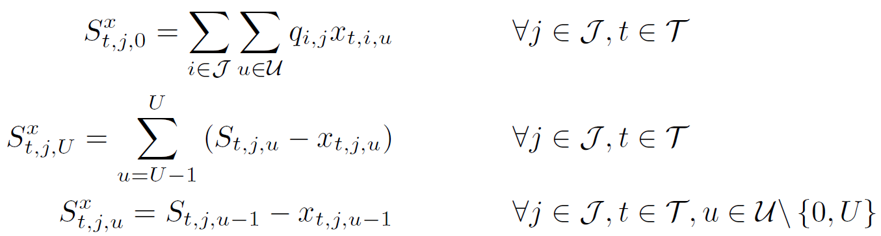


TRANSITION TO POST-DECISION STATE
Introduction
Problem
Solutions
Function approximation
Bayesian exploration
Results
Conclusions
Besides the earlier transition function, we now define a transition function from pre $S_{t}$ to post $S_{t}^{x}$.
With
Deterministic function of the current state and decision.
Expected results of our decision are included, not the new arrivals.
$$S_{t}^{x}=S^{M,x}\left(S_{t},x_{t}\right)$$
Expected transitions of the treated patients

Slide 18
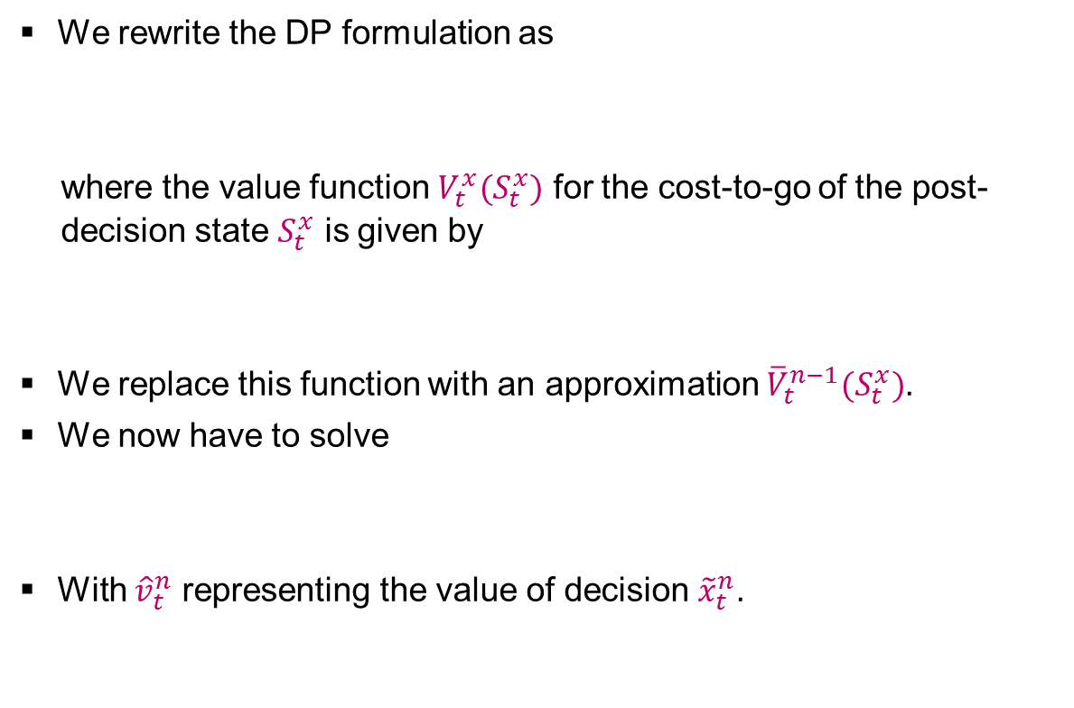
ADP FORMULATION
Introduction
Problem
Solutions
Function approximation
Bayesian exploration
Results
Conclusions
We rewrite the DP formulation as
  where the value function $V_{t}^{x}(S_{t}^{x})$ for the cost-to-go of the post-decision state $S_{t}^{x}$ is given by
We replace this function with an approximation ${\overline{V}}_{t}^{n−1}(S_{t}^{x})$.
We now have to solve
With ${\hat{v}}_{t}^{n}$ representing the value of decision ${\tilde{x}}_{t}^{n}$.
$$V_{t}\left(S_{t}\right)=\min_{x_{t}∈𝒳_{t}\left(S_{t}\right)}\left(C_{t}\left(S_{t},x_{t}\right)+V_{t}^{x}\left(S_{t}^{x}\right)\right)$$
$$V_{t}^{x}\left(S_{t}^{x}\right)=𝔼\left[V_{t+1}\left(S_{t+1}\right)|S_{t}^{x}\right]$$
$${\tilde{x}}_{t}^{n}=arg\min_{x_{t}∈𝒳_{t}\left(S_{t}\right)}\left(C_{t}\left(S_{t},x_{t}\right)+{\overline{V}}_{t}^{n−1}\left(S_{t}^{x}\right)\right)$$

Slide 19
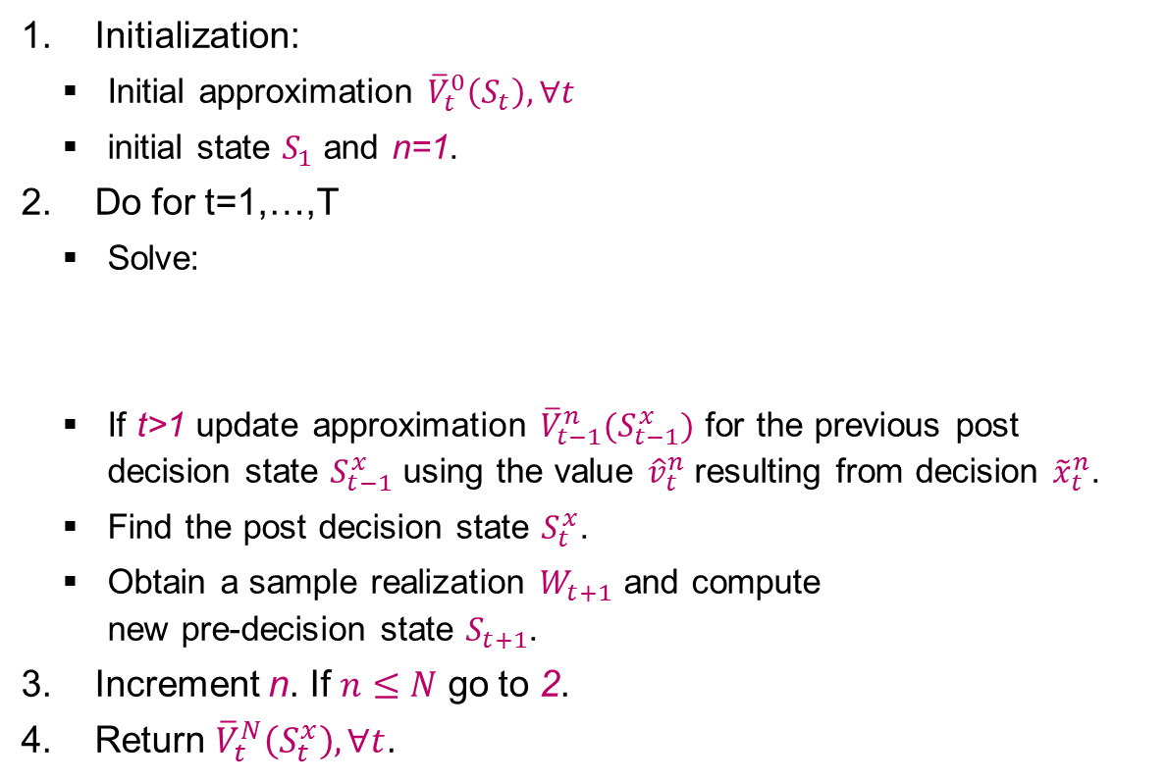
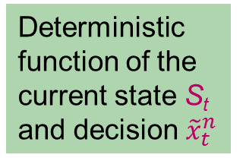
ADP ALGORITHM
Introduction
Problem
Solutions
Function approximation
Bayesian exploration
Results
Conclusions
Initialization:
  Initial approximation ${\overline{V}}_{t}^{0}\left(S_{t}\right), ∀t$
  initial state $S_{1}$ and n=1.
Do for t=1,…,T
  Solve:
  If t>1 update approximation ${\overline{V}}_{t−1}^{n}(S_{t−1}^{x})$ for the previous post decision state $S_{t−1}^{x}$ using the value ${\hat{v}}_{t}^{n}$resulting from decision ${\tilde{x}}_{t}^{n}$.
  Find the post decision state $S_{t}^{x}$.
  Obtain a sample realization $W_{t+1}$ and compute
  new pre-decision state $S_{t+1}$.
Increment n. If $n≤N$ go to 2.
Return ${\overline{V}}_{t}^{N}\left(S_{t}^{x}\right), ∀t$.
Value function approx. allows us to step forward in time.
Deterministic optimization
$${\tilde{x}}_{t}^{n}=arg\min_{x_{t}∈𝒳_{t}\left(S_{t}\right)}\left(C_{t}\left(S_{t},x_{t}\right)+{\overline{V}}_{t}^{n−1}\left(S_{t}^{x}\right)\right)$$
Statistics
Deterministic function of the current state S_{t} and decision ${\tilde{x}}_{t}^{n}$
Simulation

Slide 20
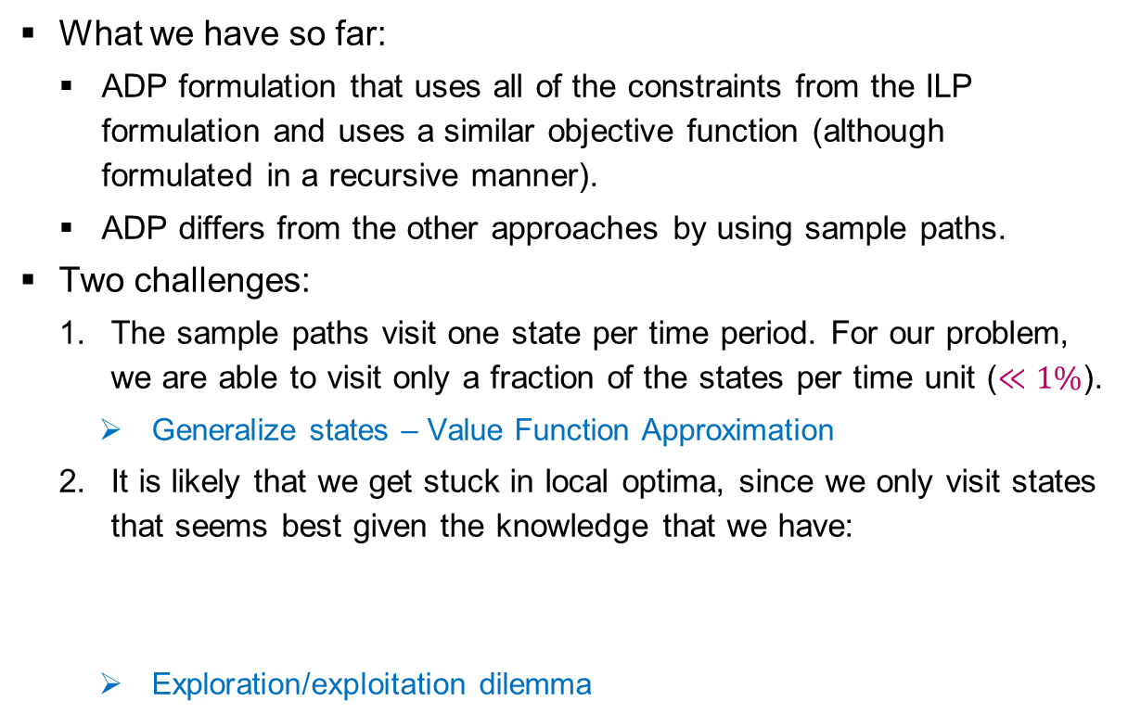
REMAINING CHALLENGES
Introduction
Problem
Solutions
Function approximation
Bayesian exploration
Results
Conclusions
What we have so far:
  ADP formulation that uses all of the constraints from the ILP formulation and uses a similar objective function (although formulated in a recursive manner).
  ADP differs from the other approaches by using sample paths.
Two challenges:
  The sample paths visit one state per time period. For our problem, we are able to visit only a fraction of the states per time unit ($≪1\%$).
    Generalize states – Value Function Approximation
  It is likely that we get stuck in local optima, since we only visit states that seems best given the knowledge that we have:
    Exploration/exploitation dilemma
$${\tilde{x}}_{t}^{n}=arg\min_{x_{t}∈𝒳_{t}\left(S_{t}\right)}\left(C_{t}\left(S_{t},x_{t}\right)+{\overline{V}}_{t}^{n−1}\left(S_{t}^{x}\right)\right)$$

Slide 21
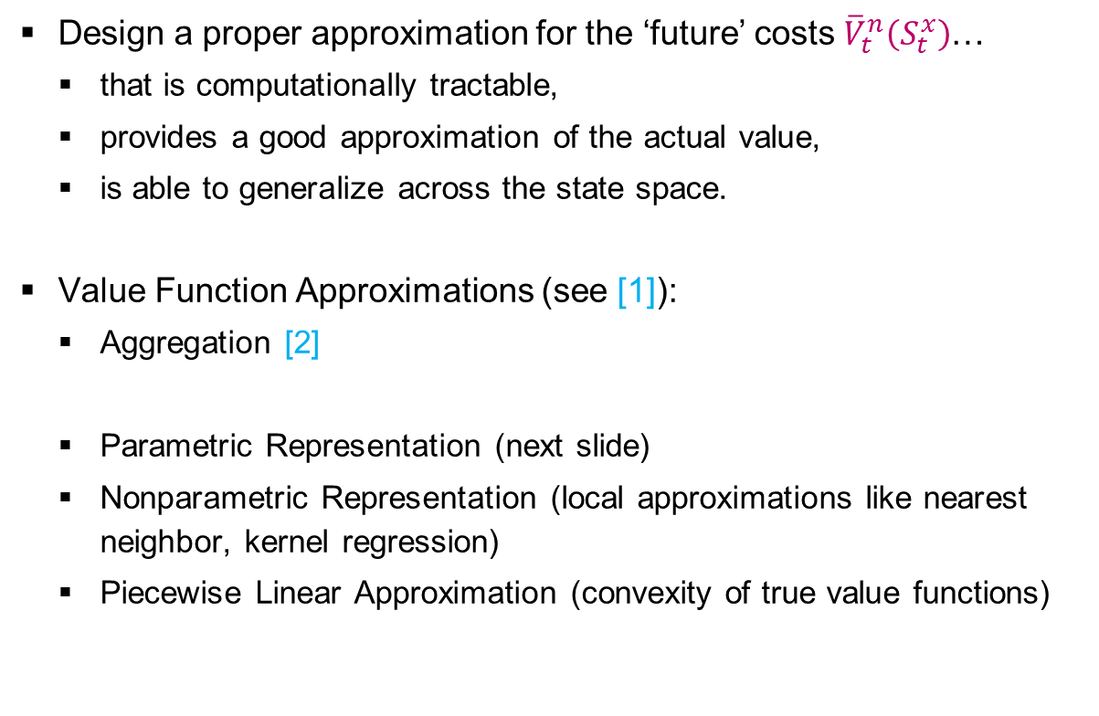
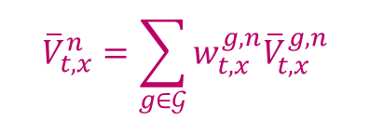
VALUE FUNCTION APPROXIMATION
Introduction
Problem
Solutions
Function approximation
Bayesian exploration
Results
Conclusions
Design a proper approximation for the ‘future’ costs ${\overline{V}}_{t}^{n}\left(S_{t}^{x}\right)$…
  that is computationally tractable,
  provides a good approximation of the actual value,
  is able to generalize across the state space.
Value Function Approximations (see [1]):
  Aggregation [2]
  Parametric Representation (next slide)
  Nonparametric Representation (local approximations like nearest neighbor, kernel regression)
  Piecewise Linear Approximation (convexity of true value functions)
$${\overline{V}}_{t,x}^{n}=\sum_{g∈𝒢}{w_{t,x}^{g,n}{\overline{V}}_{t,x}^{g,n}}$$
[1] Powell WB (2011) Approximate Dynamic Programming: Solving the Curses of Dimensionality, 2nd Edition, Wiley.
[2] George A, Powell WB, Kulkarni SR (2008) Value Function Approximation using Multiple Aggregation for Multiattribute Resource Management, JMLR 9, pp. 2079-2111.

Slide 22
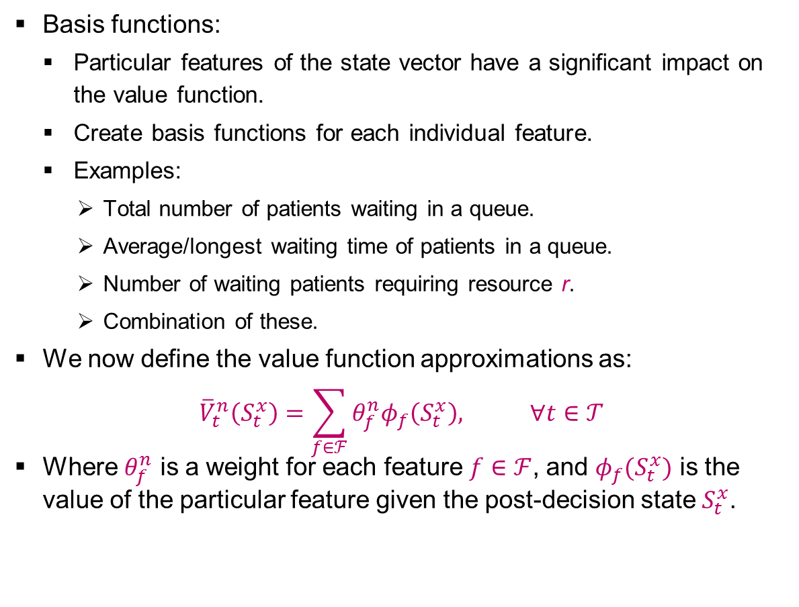
PARAMETRIC VFA [1/2]
Introduction
Problem
Solutions
Function approximation
Bayesian exploration
Results
Conclusions
Basis functions:
  Particular features of the state vector have a significant impact on the value function.
  Create basis functions for each individual feature.
  Examples:
    Total number of patients waiting in a queue.
    Average/longest waiting time of patients in a queue.
    Number of waiting patients requiring resource r.
    Combination of these.
We now define the value function approximations as:
$${\overline{V}}_{t}^{n}\left(S_{t}^{x}\right)=\sum_{f∈ℱ}{θ_{f}^{n}φ_{f}\left(S_{t}^{x}\right), ∀t∈𝒯}$$
Where $θ_{f}^{n}$ is a weight for each feature $f∈ℱ$, and $φ_{f}(S_{t}^{x})$ is the value of the particular feature given the post-decision state $S_{t}^{x}$.

Slide 23
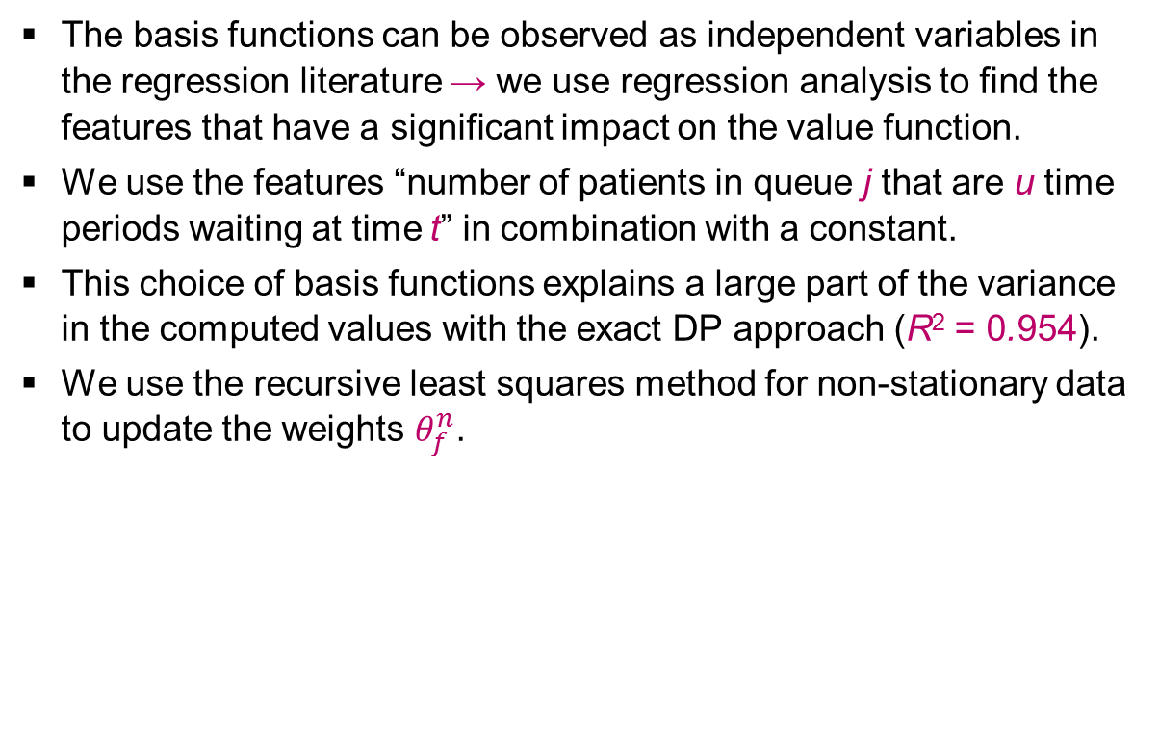
PARAMETRIC VFA [2/2]
Introduction
Problem
Solutions
Function approximation
Bayesian exploration
Results
Conclusions
The basis functions can be observed as independent variables in the regression literature → we use regression analysis to find the features that have a significant impact on the value function.
We use the features “number of patients in queue j that are u time periods waiting at time t” in combination with a constant.
This choice of basis functions explains a large part of the variance in the computed values with the exact DP approach (R² = 0.954).
We use the recursive least squares method for non-stationary data to update the weights $θ_{f}^{n}$.

Slide 24
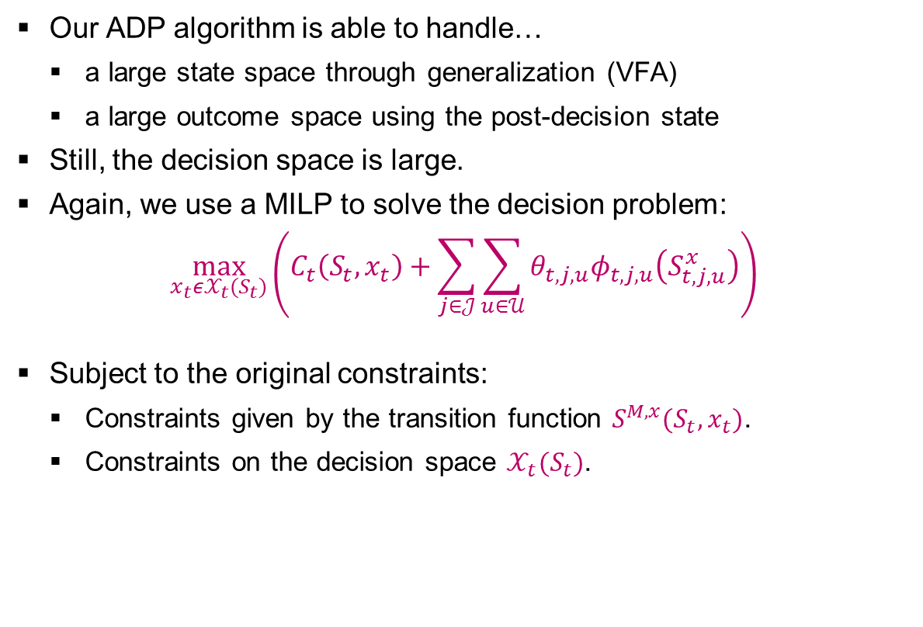
DECISION PROBLEM WITHIN ONE STATE
Introduction
Problem
Solutions
Function approximation
Bayesian exploration
Results
Conclusions
Our ADP algorithm is able to handle…
  a large state space through generalization (VFA)
  a large outcome space using the post-decision state
Still, the decision space is large.
Again, we use a MILP to solve the decision problem:
$$\max_{x_{t}ε𝒳_{t}(S_{t})}\left(C_{t}\left(S_{t},x_{t}\right)+\sum_{j∈𝒥}{\sum_{u∈𝒰}{θ_{t,j,u}φ_{t,j,u}\left(S_{t,j,u}^{x}\right)}}\right)$$
Subject to the original constraints:
  Constraints given by the transition function $S_{}^{M,x}(S_{t},x_{t})$.
  Constraints on the decision space $𝒳_{t}(S_{t})$.

Slide 25

EXPLORATION/EXPLOITATION DILEMMA
Introduction
Problem
Solutions
Function approximation
Bayesian exploration
Results
Conclusions
Exploration/exploitation dilemma
  Exploitation: we do we currently think is best.
  Exploration: we choose to try something and learn more (information collection).
Techniques from Optimal Learning might help here
  Undirected exploration. Try to randomly explore the whole state space. Examples: pure exploration and epsilon greedy (explore with probability ε^{n} and exploit with probability 1- ε^{n})
  Directed exploration. Utilize past experience to execute efficient exploration (costs are gradually avoided by making more expensive actions less likely). Examples: Boltzmann exploration, Interval estimation, Knowledge Gradient.
  Our focus: The Knowledge Gradient Policy

Slide 26
THE KNOWLEDGE GRADIENT POLICY [1/2]
Introduction
Problem
Solutions
Function approximation
Bayesian exploration
Results
Conclusions
Basic principle:
  Assume you can make only one measurement, after which you have to make a final choice (the implementation decision)
  What choice would you make now to maximize the expected value of the implementation decision?
Observations that might produce a change in the decision.
Observation
Updated estimate of the value of option 5
Change in estimated value of option 5 due to measurement of option 5
1
2
3
4
5

Slide 27
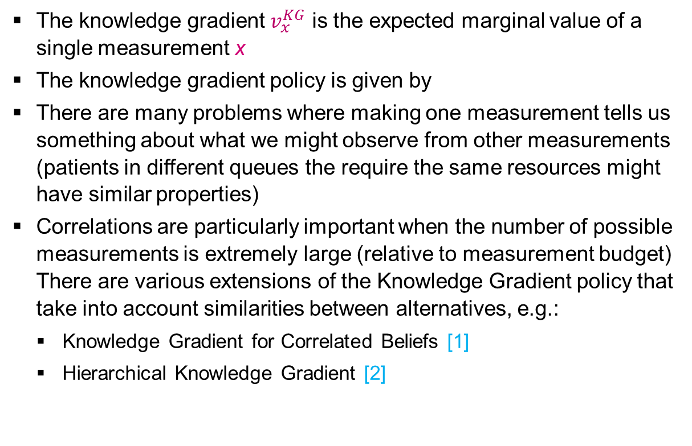
THE KNOWLEDGE GRADIENT POLICY [2/2]
Introduction
Problem
Solutions
Function approximation
Bayesian exploration
Results
Conclusions
The knowledge gradient $v_{x}^{KG}$ is the expected marginal value of a single measurement x
The knowledge gradient policy is given by
There are many problems where making one measurement tells us something about what we might observe from other measurements (patients in different queues the require the same resources might have similar properties)
Correlations are particularly important when the number of possible measurements is extremely large (relative to measurement budget) There are various extensions of the Knowledge Gradient policy that take into account similarities between alternatives, e.g.:
  Knowledge Gradient for Correlated Beliefs [1]
  Hierarchical Knowledge Gradient [2]
[1] Frazier PI, Powell WB, Dayanik S (2009 The Knowledge-Gradient Policy for Correlated Normal Beliefs, Informs Journal on Computing 21(4), pp. 585-598.
[2] Mes, MRK, Frazier PI, Powell WB (2011) Hierarchical Knowledge Gradient for Sequential Sampling, JMLR 12, pp. 2931-2974.

Slide 28

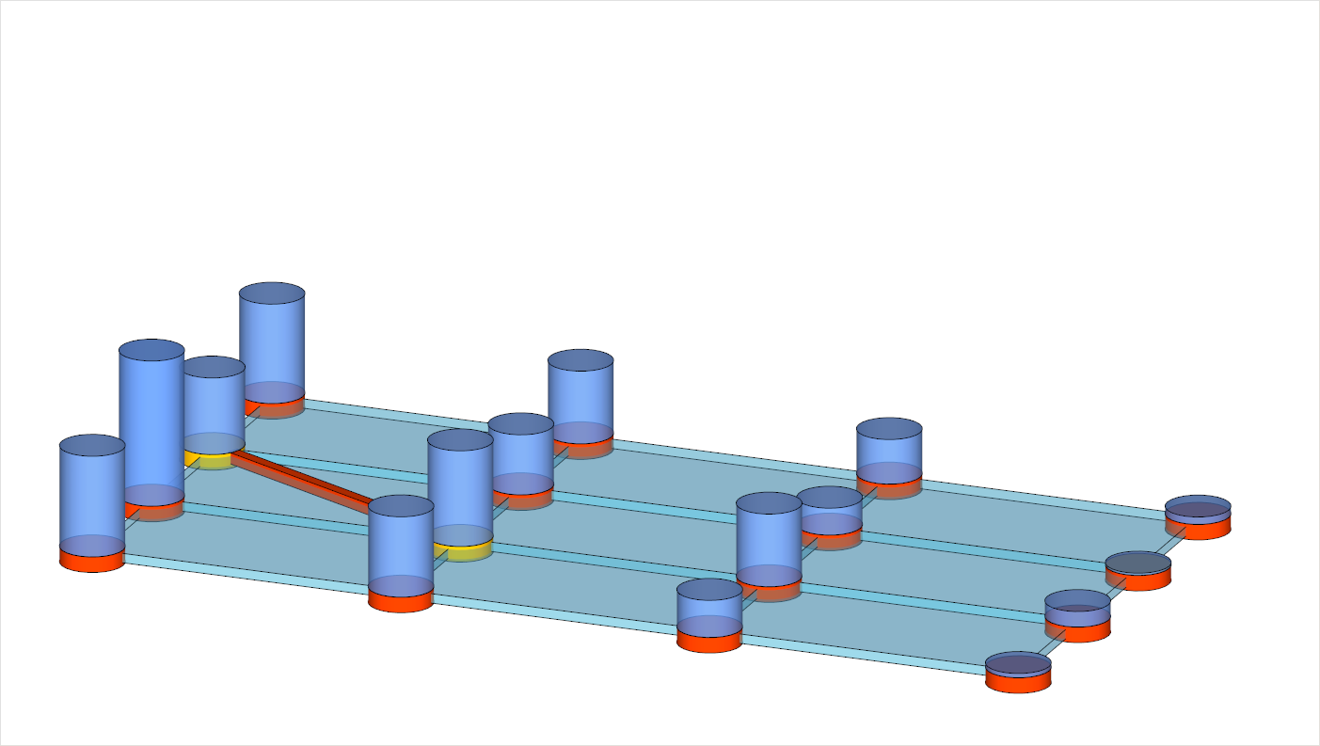





BAYESIAN EXPLORATION FOR ADP [1/7]
Introduction
Problem
Solutions
Function approximation
Bayesian exploration
Results
Conclusions
Illustration of exploration in finite horizon ADP.
4 states.
Our decision $x_{t−1}$ brought us to $S_{t−1}^{x,n}$.
A
state →
B
$$\left(S_{t−2}^{x,n},S_{t−1}^{n}\right)$$
C
time →
$$\left(S_{t−1}^{x,n},S_{t}^{n}\right)$$
$$x_{t−1}$$
$$\left(S_{t}^{x,n},S_{t+1}^{n}\right)$$
D

Slide 29
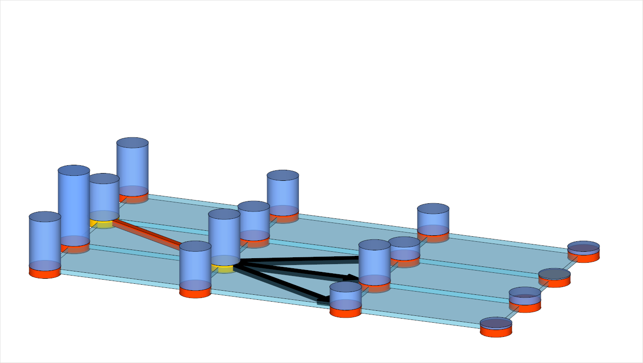



BAYESIAN EXPLORATION FOR ADP [2/7]
Introduction
Problem
Solutions
Function approximation
Bayesian exploration
Results
Conclusions
New information $W_{t}$ takes us to $S_{t}^{n}$.
Decision $x_{t}$ to visit state B, C, or D depends on ${\overline{V}}^{n−1}\left(S_{t}^{x,n}\right)$ and has an effect on…
  the value ${\overline{V}}^{n}\left(S_{t−1}^{x,n}\right)$ (with on-policy control),
  the state $S_{t}^{x,n}$ we are going visit in the next time unit,
  the value ${\overline{V}}^{n}\left(S_{t}^{x,n}\right)$ that we are going to update next.
A
state →
B
$$\left(S_{t−2}^{x,n},S_{t−1}^{n}\right)$$
C
time →
$$\left(S_{t−1}^{x,n},S_{t}^{n}\right)$$
$$\left(S_{t}^{x,n},S_{t+1}^{n}\right)$$
D
$$W_{t}$$
$$x_{t}$$

Slide 30
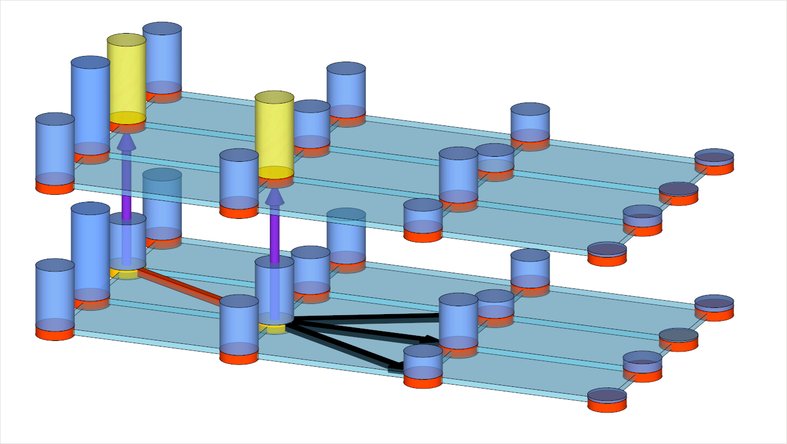

BAYESIAN EXPLORATION FOR ADP [3/7]
Introduction
Problem
Solutions
Function approximation
Bayesian exploration
Results
Conclusions
After decision $x_{t}$ we update ${\overline{V}}^{n}\left(S_{t−1}^{x,n}\right)$.
iteration →
n+1
n
A
state →
B
$$\left(S_{t−2}^{x,n},S_{t−1}^{n}\right)$$
C
time →
$$\left(S_{t−1}^{x,n},S_{t}^{n}\right)$$
$$\left(S_{t}^{x,n},S_{t+1}^{n}\right)$$
D
$$x_{t}$$

Slide 31
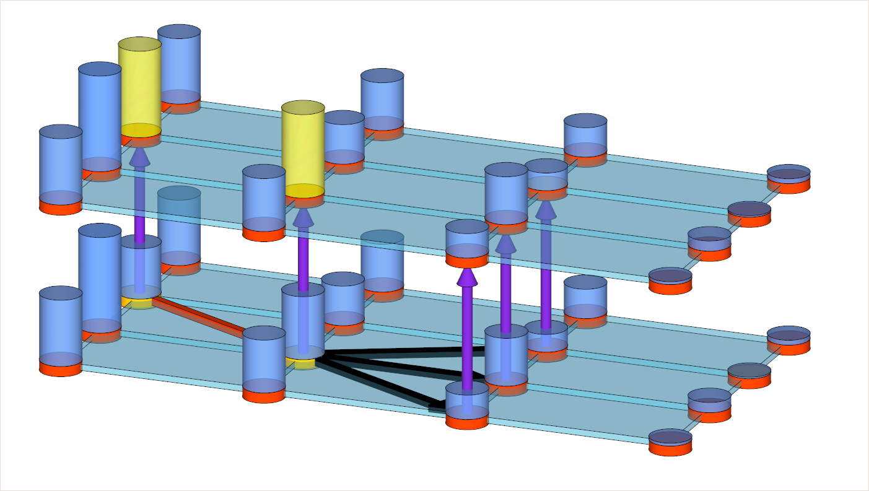

BAYESIAN EXPLORATION FOR ADP [4/7]
Introduction
Problem
Solutions
Function approximation
Bayesian exploration
Results
Conclusions
Decision $x_{t}$ will determine which state $S_{t}^{x,n}$ we are going to update next.
iteration →
n+1
n
A
state →
B
$$\left(S_{t−2}^{x,n},S_{t−1}^{n}\right)$$
C
time →
$$\left(S_{t−1}^{x,n},S_{t}^{n}\right)$$
$$\left(S_{t}^{x,n},S_{t+1}^{n}\right)$$
D
$$x_{t}$$

Slide 32
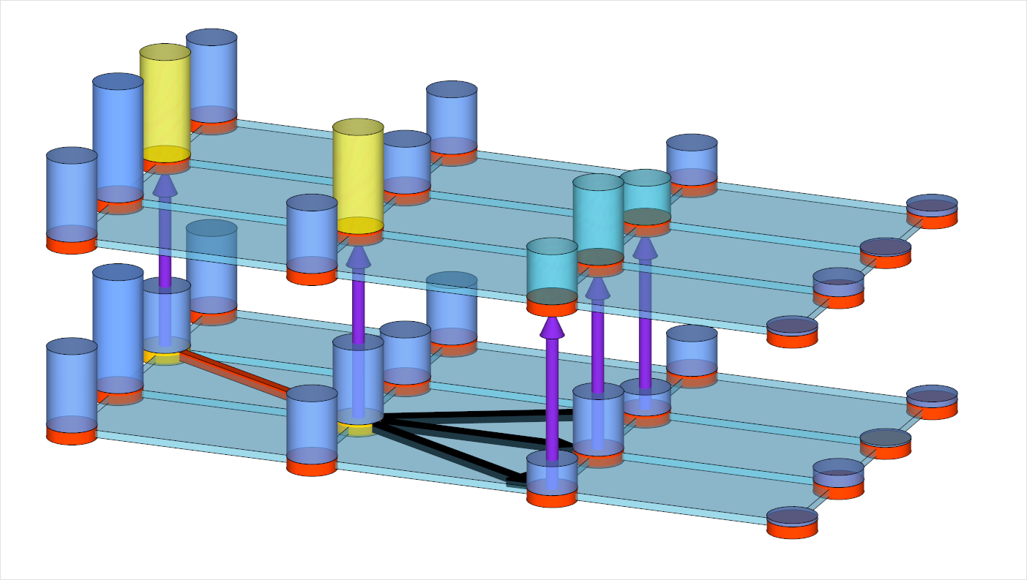

BAYESIAN EXPLORATION FOR ADP [5/7]
Introduction
Problem
Solutions
Function approximation
Bayesian exploration
Results
Conclusions
Question: can we account for the change from ${\overline{V}}^{n−1}\left(S_{t}^{x,n}\right)$ to ${\overline{V}}^{n}\left(S_{t}^{x,n}\right)$ before we choose to go to $S_{t}^{x,n}$?
iteration →
n+1
n
A
state →
B
$$\left(S_{t−2}^{x,n},S_{t−1}^{n}\right)$$
C
time →
$$\left(S_{t−1}^{x,n},S_{t}^{n}\right)$$
$$\left(S_{t}^{x,n},S_{t+1}^{n}\right)$$
D
$$x_{t}$$

Slide 33
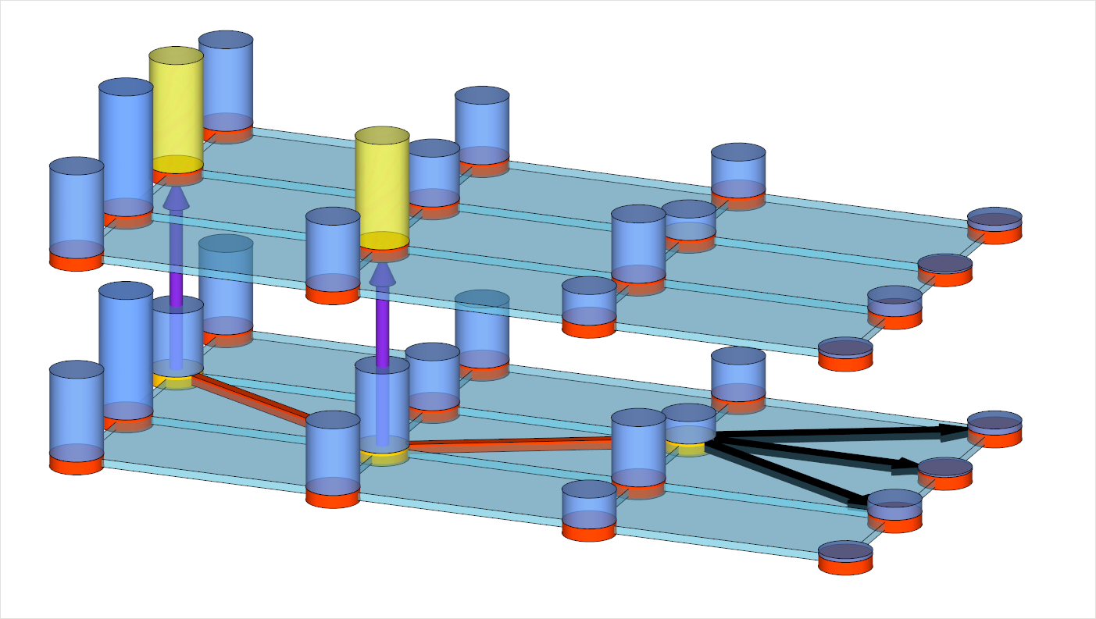


BAYESIAN EXPLORATION FOR ADP [6/7]
Introduction
Problem
Solutions
Function approximation
Bayesian exploration
Results
Conclusions
Basic idea: for each possible decision $x_{t}$, we generate possible realizations of the new information $W_{t+1}$…
iteration →
n+1
n
A
state →
B
$$\left(S_{t−2}^{x,n},S_{t−1}^{n}\right)$$
C
time →
$$\left(S_{t−1}^{x,n},S_{t}^{n}\right)$$
$$\left(S_{t}^{x,n},S_{t+1}^{n}\right)$$
D
$$x_{t}$$
$$W_{t+1}$$

Slide 34
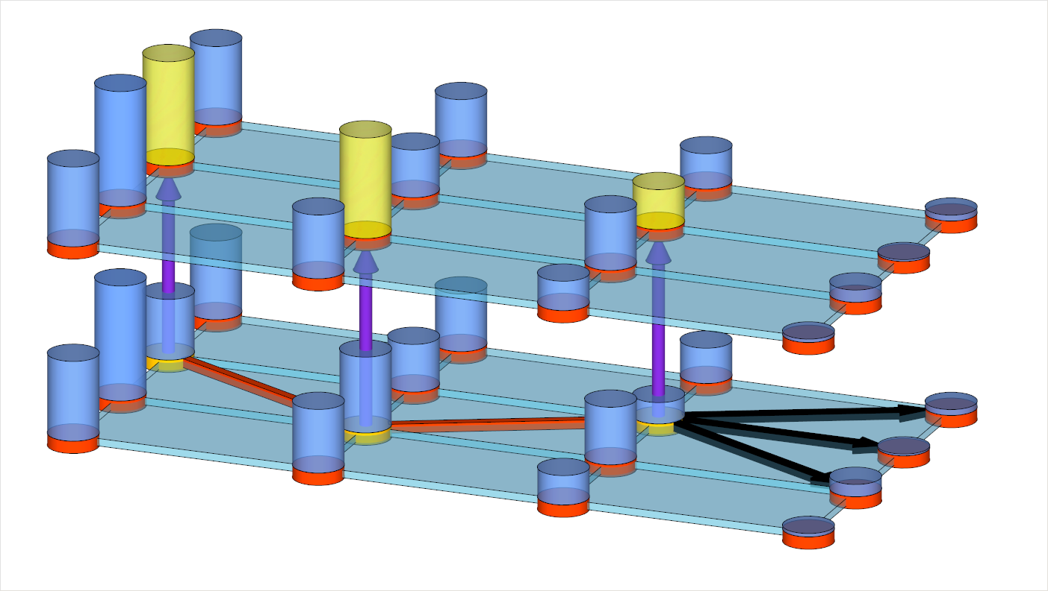


BAYESIAN EXPLORATION FOR ADP [7/7]
Introduction
Problem
Solutions
Function approximation
Bayesian exploration
Results
Conclusions
…and calculate the knowledge gain (knowledge gradient) to $S_{t}^{x,n}$ given the best decision $x_{t+1}$.
iteration →
n+1
$$x_{t+1}$$
n
A
state →
B
$$\left(S_{t−2}^{x,n},S_{t−1}^{n}\right)$$
C
time →
$$\left(S_{t−1}^{x,n},S_{t}^{n}\right)$$
$$\left(S_{t}^{x,n},S_{t+1}^{n}\right)$$
D
$$x_{t}$$

Slide 35
BIASED OBSERVATIONS IN ADP
Introduction
Problem
Solutions
Function approximation
Bayesian exploration
Results
Conclusions
Common issue in ADP in general.
  The decision to measure a state will
  change its value, which in turn
  influences our decisions in the next
  iteration.
  Measuring states more often might
  increase their estimated values,
  which in turn makes them more
  attractive to measure next time
  (transient bias due to smoothing), less visible in infinite ADP.
But of particular important when also learning is involved.
  A proper VFA could help here: when measuring one state, we also update the value of other (similar) states.
  Another solution would be to use projected value functions [1].
[1] Frazier PI, Powell WB, Simao HP, (2009) Simulation Model Calibration with Correlated Knowledge-Gradients, Winter Simulation Conference, pp. 339-351.

Slide 36
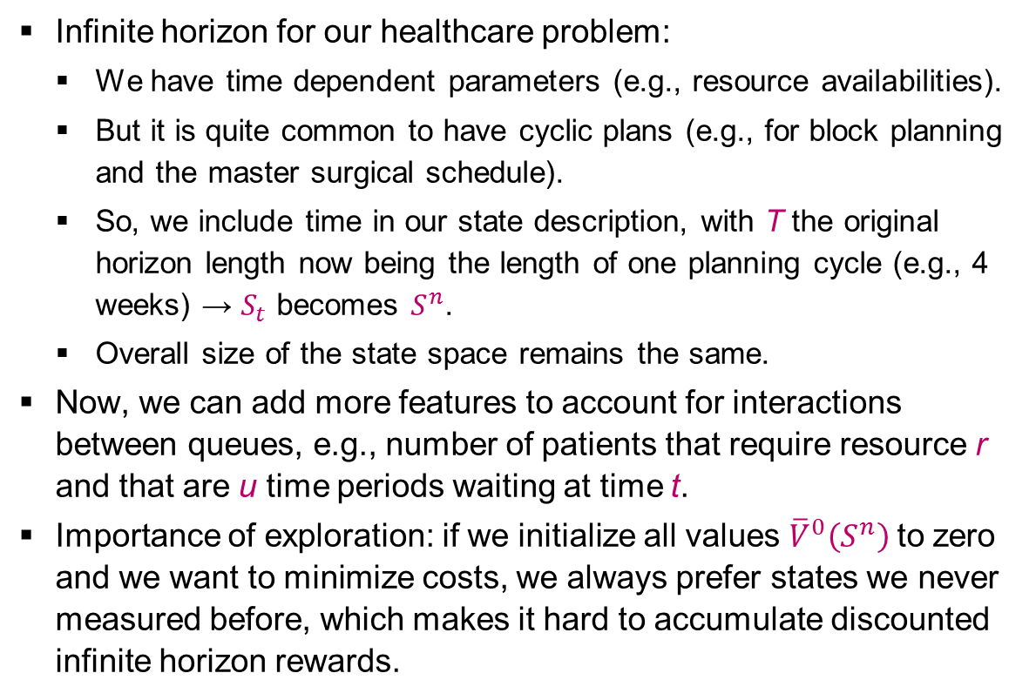
BAYESIAN LEARNING IN INFINITE HORIZON ADP
Introduction
Problem
Solutions
Function approximation
Bayesian exploration
Results
Conclusions
Infinite horizon for our healthcare problem:
  We have time dependent parameters (e.g., resource availabilities).
  But it is quite common to have cyclic plans (e.g., for block planning and the master surgical schedule).
  So, we include time in our state description, with T the original horizon length now being the length of one planning cycle (e.g., 4 weeks) → $S_{t}$ becomes $S^{n}$.
  Overall size of the state space remains the same.
Now, we can add more features to account for interactions between queues, e.g., number of patients that require resource r and that are u time periods waiting at time t.
Importance of exploration: if we initialize all values ${\overline{V}}_{}^{0}\left(S^{n}\right)$to zero and we want to minimize costs, we always prefer states we never measured before, which makes it hard to accumulate discounted infinite horizon rewards.

Slide 37
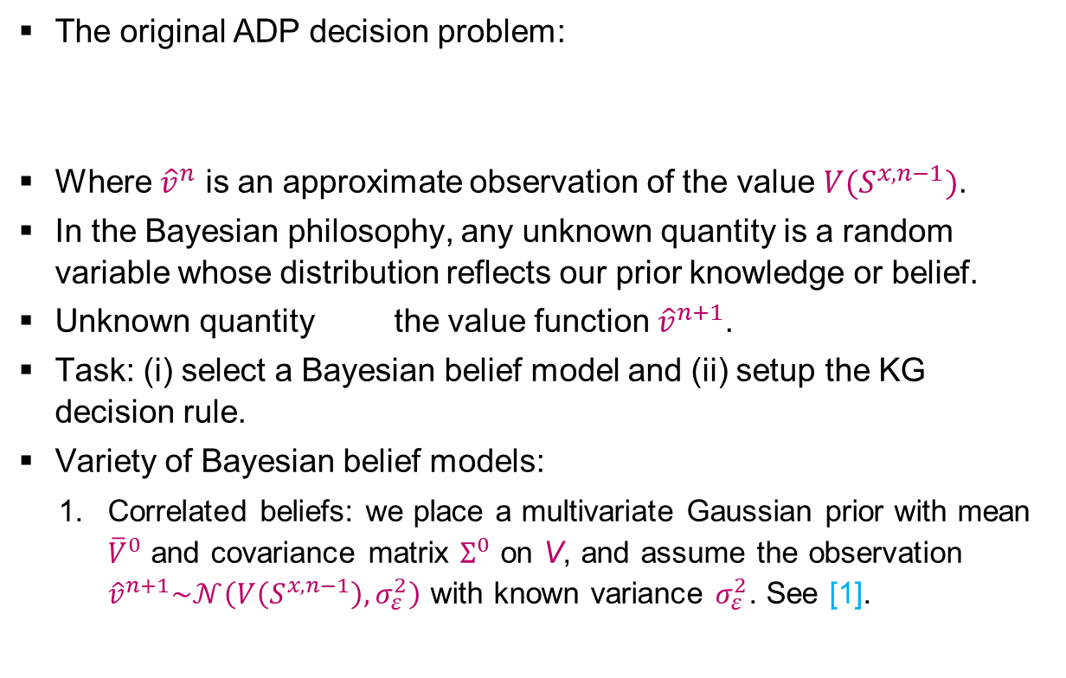

BAYESIAN LEARNING IN INFINITE HORIZON ADP [1/2]
Introduction
Problem
Solutions
Function approximation
Bayesian exploration
Results
Conclusions
Switched to max notation
The original ADP decision problem:
Where ${\hat{v}}^{n}$ is an approximate observation of the value $V(S^{x,n−1})$.
In the Bayesian philosophy, any unknown quantity is a random variable whose distribution reflects our prior knowledge or belief.
Unknown quantity the value function ${\hat{v}}^{n+1}$.
Task: (i) select a Bayesian belief model and (ii) setup the KG decision rule.
Variety of Bayesian belief models:
  Correlated beliefs: we place a multivariate Gaussian prior with mean ${\overline{V}}^{0}$ and covariance matrix $Σ^{0}$ on V, and assume the observation
  ${\hat{v}}^{n+1}\sim 𝒩\left(V\left(S^{x,n−1}\right),σ_{ε}^{2}\right)$ with known variance $σ_{ε}^{2}$. See [1].
$${\hat{v}}^{n}=\max_{x}{C\left(S^{n},x\right)+γ{\overline{V}}^{n−1}\left(S^{x,n}\right)}$$
[1] Frazier PI, Powell WB, Dayanik S (2009 The Knowledge-Gradient Policy for Correlated Normal Beliefs, Informs Journal on Computing 21(4), pp. 585-598.

Slide 38
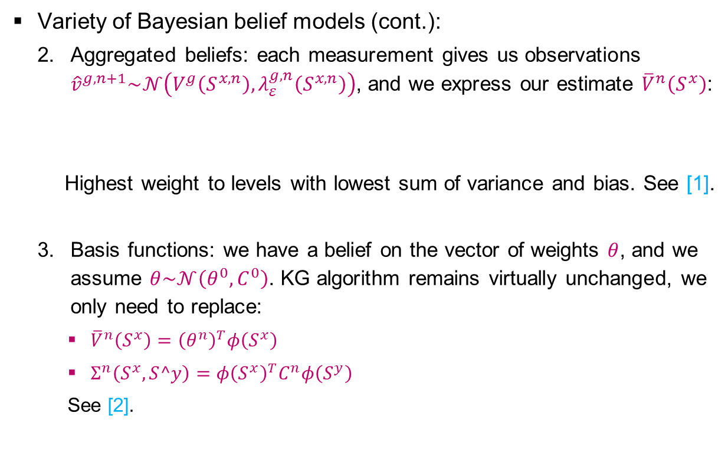
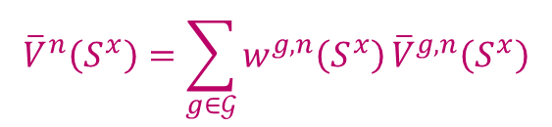
BAYESIAN LEARNING IN INFINITE HORIZON ADP [2/2]
Introduction
Problem
Solutions
Function approximation
Bayesian exploration
Results
Conclusions
Variety of Bayesian belief models (cont.):
  Aggregated beliefs: each measurement gives us observations ${\hat{v}}^{g,n+1}\sim 𝒩\left(V^{g}\left(S^{x,n}\right),λ_{ε}^{g,n}\left(S^{x,n}\right)\right)$, and we express our estimate ${\overline{V}}^{n}\left(S^{x}\right)$:
  Highest weight to levels with lowest sum of variance and bias. See [1].
  Basis functions: we have a belief on the vector of weights $θ$, and we assume $θ\sim 𝒩\left(θ^{0},C^{0}\right)$. KG algorithm remains virtually unchanged, we only need to replace:
    ${\overline{V}}^{n}\left(S^{x}\right)={\left(θ^{n}\right)}^{T}φ\left(S^{x}\right)$
    $Σ^{n}\left(S^{x},S^y\right)=$ $φ{\left(S^{x}\right)}^{T}C^{n}φ\left(S^{y}\right)$
    See [2].
$${\overline{V}}^{n}\left(S^{x}\right)=\sum_{g∈𝒢}{w^{g,n}\left(S^{x}\right)}{\overline{V}}^{g,n}\left(S^{x}\right)$$
Demo Hierarchical Knowledge Gradient policy
[1] Mes, MRK, Frazier PI, Powell WB (2011) Hierarchical Knowledge Gradient for Sequential Sampling, JMLR 12, pp. 2931-2974.
[2] Ryzhov IO, Powell WB (2011) Bayesian Active Learning With Basis Functions, 2011 IEEE Symposium on Adaptive Dynamic Programming And Reinforcement Learning (ADPRL).

Slide 39


KG DECISION RULE [1/2]
Introduction
Problem
Solutions
Function approximation
Bayesian exploration
Results
Conclusions
One-period look ahead policy:
So, we do not only look forward to the next physical state $S^{x,n}$, but also to the next knowledge state ${\overline{V}}^{n+1}$.
It can be shown that [1]:
$$x^{KG,n}=arg\max_{x}{C\left(S^{n},x\right)+γ𝔼_{x}^{n}\left[{\overline{V}}^{n+1}\left(S^{x,n}\right)\right]}$$
$$x^{KG,n}=arg\max_{x}{C\left(S^{n},x\right)+γ{\overline{V}}^{n}\left(S^{x,n}\right)+}γ\sum_{S^{n+1}}{P\left(S^{n+1}|S^{n},x\right)ν^{KG,n}\left(S^{x,n},S^{n+1}\right)}$$
[1] Ryzhov IO, Powell WB (2010) Approximate dynamic programming with correlated Bayesian beliefs, In proceeding of: 2010 48th Annual Allerton Conference on Communication, Control, and Computing (Allerton).

Slide 40


KG DECISION RULE [2/2]
Introduction
Problem
Solutions
Function approximation
Bayesian exploration
Results
Conclusions
Repeat:
Balance between exploration and exploitation is evident: preference to high immediate rewards and high value of information.
The transition probabilities are difficult to compute, but we can simulate K transitions from $S^{x,n}$ to $S^{n+1}$, and compute the average knowledge gradient.
Offline learning: only use the value of information. Might need off-policy control: use greedy action to update ${\overline{V}}^{n−1}\left(S^{x,n−1}\right)$.
$$x^{KG,n}=arg\max_{x}{C\left(S^{n},x\right)+γ{\overline{V}}^{n}\left(S^{x,n}\right)+}γ\sum_{S^{n+1}}{P\left(S^{n+1}|S^{n},x\right)ν^{KG,n}\left(S^{x,n},S^{n+1}\right)}$$
Bellman’s equation
(immediate rewards)
Value of information

Slide 41

EXPERIMENTS
Introduction
Problem
Solutions
Function approximation
Bayesian exploration
Results
Conclusions
On ADP with basis functions without KG.
Small instances:
  To study convergence behavior.
  8 time units, 1 resource types, 1 care process, 3 stages in the care process (3 queues), U=1 (zero or 1 time unit waiting), for DP max 8 patients per queue.
  $8×8^{3×2}=2,097,152$ states in total (already large for DP given that decision space and outcome space are also huge).
Large instances:
  To study the practical relevance of our approach on real-life instances inspired by the hospitals we cooperate with.
  8 time units, 4 resource types, 8 care processes, 3-7 stages per care process, U=3.

Slide 42
CONVERGENCE RESULTS ON SMALL INSTANCES
Introduction
Problem
Solutions
Function approximation
Bayesian exploration
Results
Conclusions
Tested on 5000 random initial states.
DP requires 120 hours, ADP 0.439 seconds for N=500.
ADP overestimates the value functions (+2.5%) caused by the truncated state space.

Slide 43
PERFORMANCE ON SMALL AND LARGE INSTANCES
Introduction
Problem
Solutions
Function approximation
Bayesian exploration
Results
Conclusions
Compare with greedy policy: fist serve the queue with the highest costs until another queue has the highest costs, or until resource capacity is insufficient.
We train ADP using 100 replication after which we fix our value functions.
We simulate the performance of using (i) the greedy policy and (ii) the policy determined by the value functions.
We generate 5000 initial states, simulating each policy with 5000 sample paths.
Results:
  Small instances: ADP 2% away from optimum and greedy 52% away from optimum.
  Large instances: ADP results 29% savings compared to greedy (higher fluctuations in resource availability or patient arrivals results in larger differences between ADP and greedy).

Slide 44
MANAGERIAL IMPLICATIONS
Introduction
Problem
Solutions
Function approximation
Bayesian exploration
Results
Conclusions
The ADP approach can be used to establish long-term tactical plans (e.g., three month periods) in two steps:
  Run N iterations of the ADP algorithm to find the value functions given by the feature weights for all time periods.
  These value functions can be used to determine the tactical planning decision for each state and time period by generating the most likely sample path.
Implementation in a rolling horizon approach:
  Finite horizon approach may cause unwanted and short-term focused behavior in the last time periods.
  Recalculation of tactical plans ensures that the most recent information is used, can be done with existing value functions.
Our extension towards infinite horizon ADP with learning can be used to improve the plans (taking into account interaction effects) and to establish cyclic plans.

Slide 45
WHAT TO REMEMBER
Introduction
Problem
Solutions
Function approximation
Bayesian exploration
Results
Conclusions
Stochastic model for tactical resource capacity and patient admission planning.
Our ADP approach with basis functions…
  allows for time dependent parameters to be set for patient arrivals and resource capacities to cope with anticipated fluctuations;
  provides value functions that can be used to create robust tactical plans and periodic readjustments of these plans;
  is fast, capable of solving real-life sized instances;
  is generic: objective function and constraints can easily be adapted to suit the hospital situation at hand.
Our ADP approach can be extended with the KG decision rule to overcome the exploration/exploitation dilemma in larger problems.
The KG in ADP approach can be combined with the existing parametric VFA (basis functions) as well as with KGCB and HKG.

Slide 46
QUESTIONS?
Martijn Mes
Assistant professor
University of Twente
School of Management and Governance
Dept. Industrial Engineering and Business Information Systems
Contact
Phone: +31-534894062
Email: m.r.k.mes@utwente.nl
Web: http://www.utwente.nl/mb/iebis/staff/Mes/

