Slide 1
Educational Applications at UT
CES
Version 10.4 Juli 2022
As used for Bachelor of science students

Slide 2
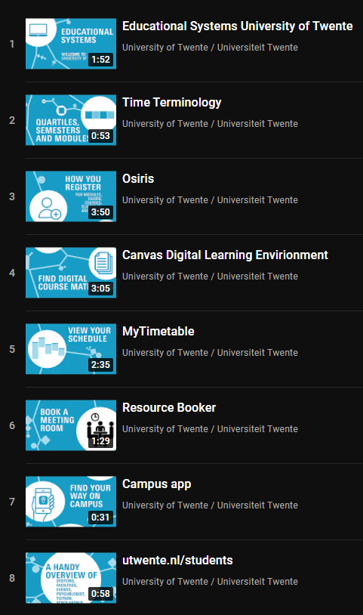
Educational Systems
What they are used for
Course enrolment
Course information and materials
Personal timetables
Booking a study or meeting room
Educational announcements
Registering results
Education!
Contact with your instructors
Handing in your assignments
YouTube Playlist: utwente.nl/yteducationalsystems

Slide 3
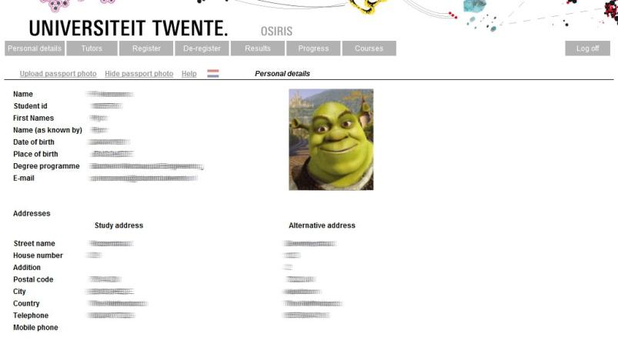
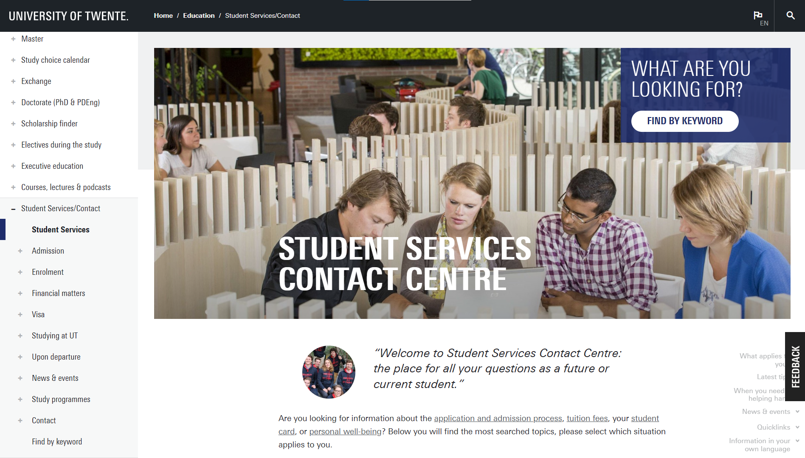
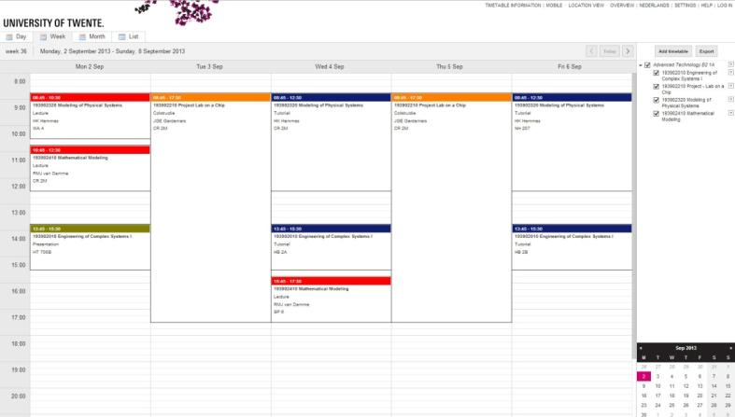
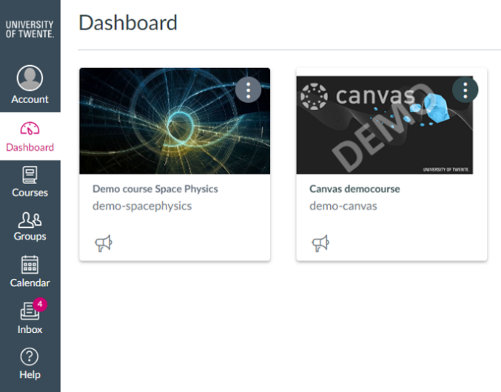
Educational Systems
Which systems are in use at UT?
utwente.nl/students: website for easy access to educational systems, news/events and Student Services Contact Centre
utwente.nl/lisa/newstudents: answers to common technical support questions
Campus app & Mazemap app
Navigation
To do list for new students
Timetabling systems
Personal timetable (MyTimetable)
Booking study rooms (Resource Booker)
Osiris
Enrolment
Study progress
Canvas
Educational materials

Slide 4
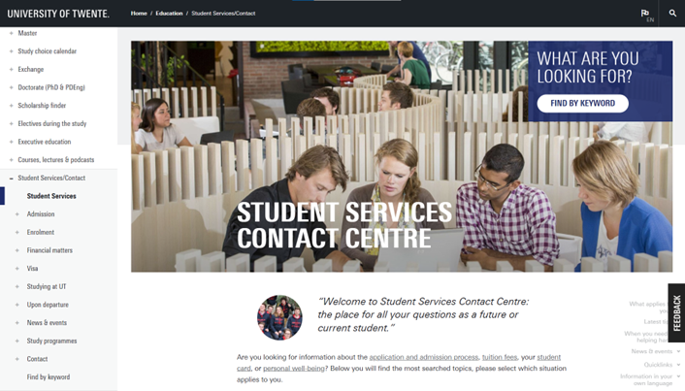
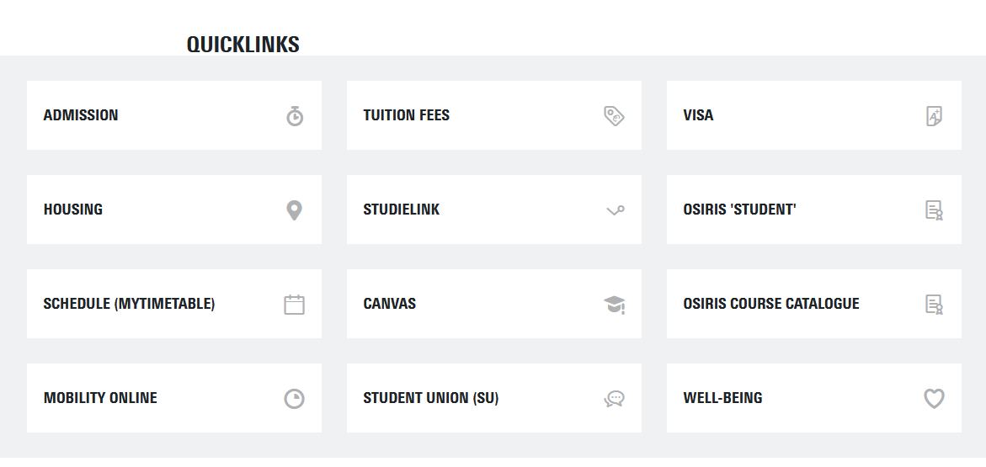
utwente.nl/students
EASY Access to educational systems and news/Events
Educational announcements
News and events for students
Quicklinks to all educational systems and services
List of study programme websites for all BSc and MSc programmes
Tip: bookmark utwente.nl/students in your browser

Slide 5
ICT Customer support
Services for students
Checklist ICT-services for new students: this checklist includes everything necessary for your ICT facilities at the University of Twente (e.g. account setup, resetting your password, VPN setup, accessing printers, etc.).
Eduroam (education roaming) enables students, researchers and other members of staff to use their education or research institute’s wireless (wifi) network in a safe manner. In addition, using your own login codes, eduroam enables you to use other education or research institutes’ eduroam networks in the Netherlands and abroad without any problems.
ict Customer support

Slide 6
ICT customer support
Notebook options
A notebook is almost indispensable for every student at the University of Twente. You will need your notebook for communication with others, collecting information, making calculations and drawings, performing simulations and even taking exams. There are different options for purchasing a notebook:
Notebook Service Centre (NSC): The University of Twente offers you the possibility to purchase a notebook via the Notebook Service Centre at a very attractive price and high quality. The NSC also offers excellent service. In case of problems, we supply an identical spare notebook within the hour. Check the link for more information and prices.
Requirements for other notebooks: if you prefer to use a notebook that you don’t purchase through the NSC, please make sure it meets the minimum requirements listed on our website. The software that you will need for your study will function guaranteed on an NSC notebook. We cannot guarantee this for notebooks that have been purchased elsewhere.
You can find information about all the above options at utwente.nl/nsc.
ict Customer support

Slide 7
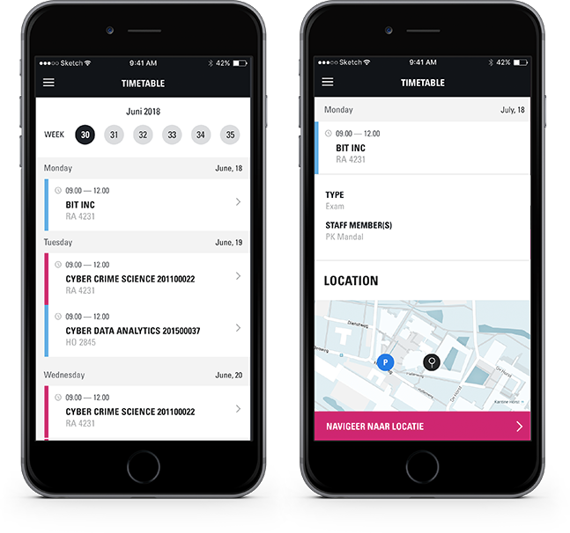
Campus app
FIND YOUR WAY AROUND THE UNIVERSITY OF TWENTE CAMPUS
Personal timetable & event schedules
Navigation on campus (outside from building to building)
Discover the campus: an overview of the Points of Interest around the campus
Overview of events taking place on campus.
To-do list for new students, that will help to jump-start your college life
Or visit utwente.nl/campusapp

Slide 8
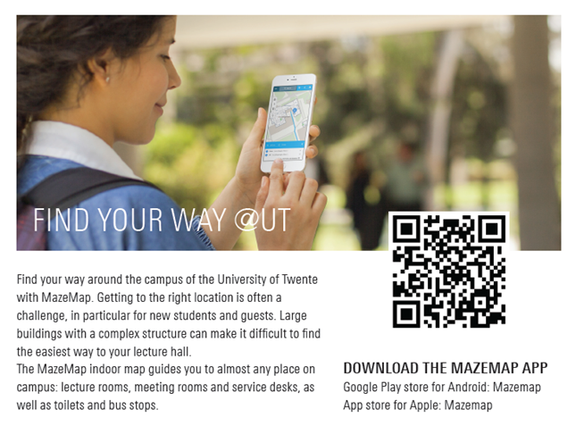
MAZEmap app
Indoor navigation for UT buildings

Slide 9
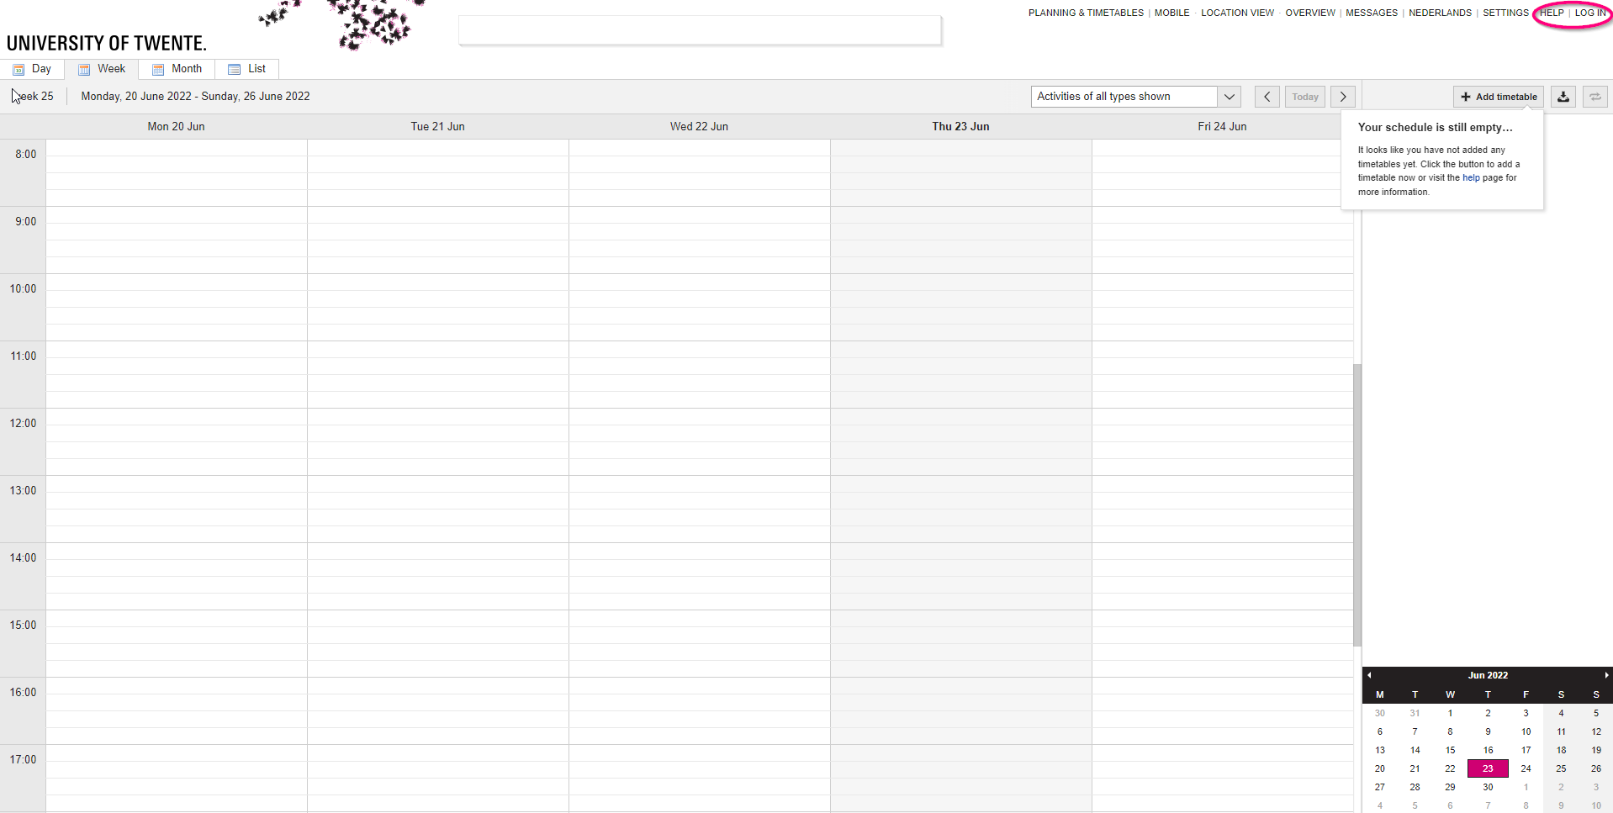
MyTimeTable
Personal Timetable
Create a personal timetable
Timetable can be exported (PDF, CSV, iCal)
Subscription is also possible!
Via utwente.nl/timetable
Log in with your student account
Mobile webpage available as well

Slide 10
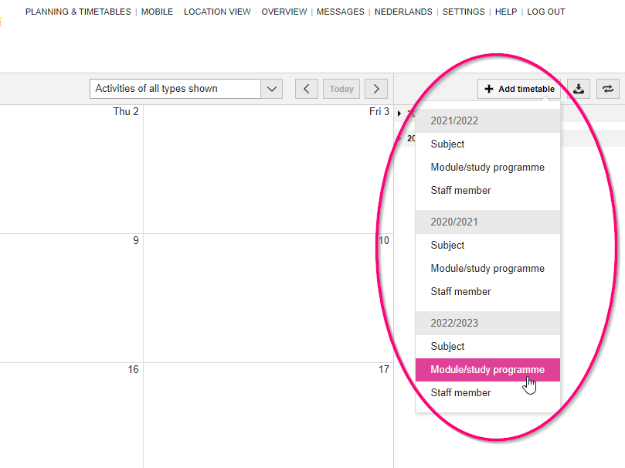
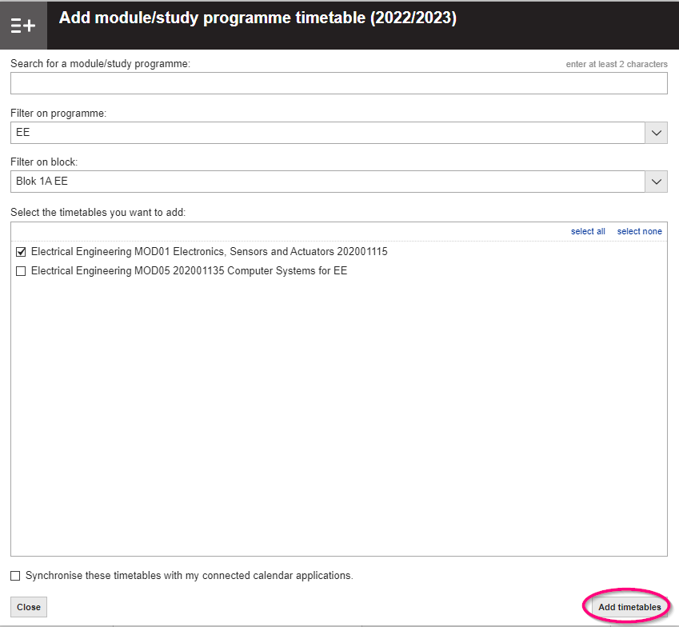
Mytimetable
Adding a timetable
Add modules or module components
Make sure to select the right academic year
Search for a module by its name or filter by study programme/block
Display only the schedule for your own study group (or select them all)
MyTimetable

Slide 11
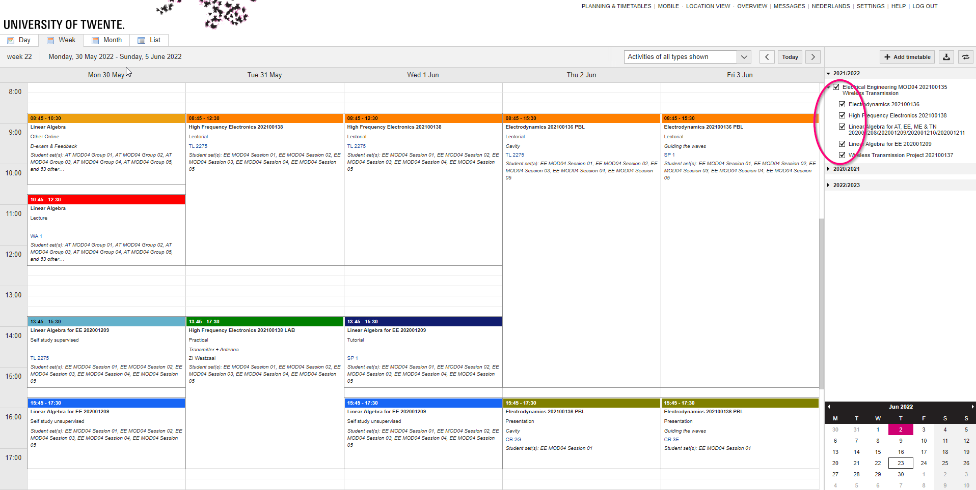
MYtimetable
Personalise
Turn on or off modules or subjects
Use the checkboxes to show or hide parts of the schedule

Slide 12
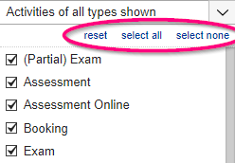
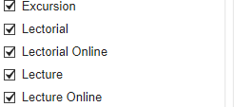
MYtimetable
Personalise
Turn on or off activity types:
Click “Activities of all types shown”
Uncheck unwanted activity types
Or “Select none”; then check only specific activity types
This way, you can e.g. filter for only exams

Slide 13
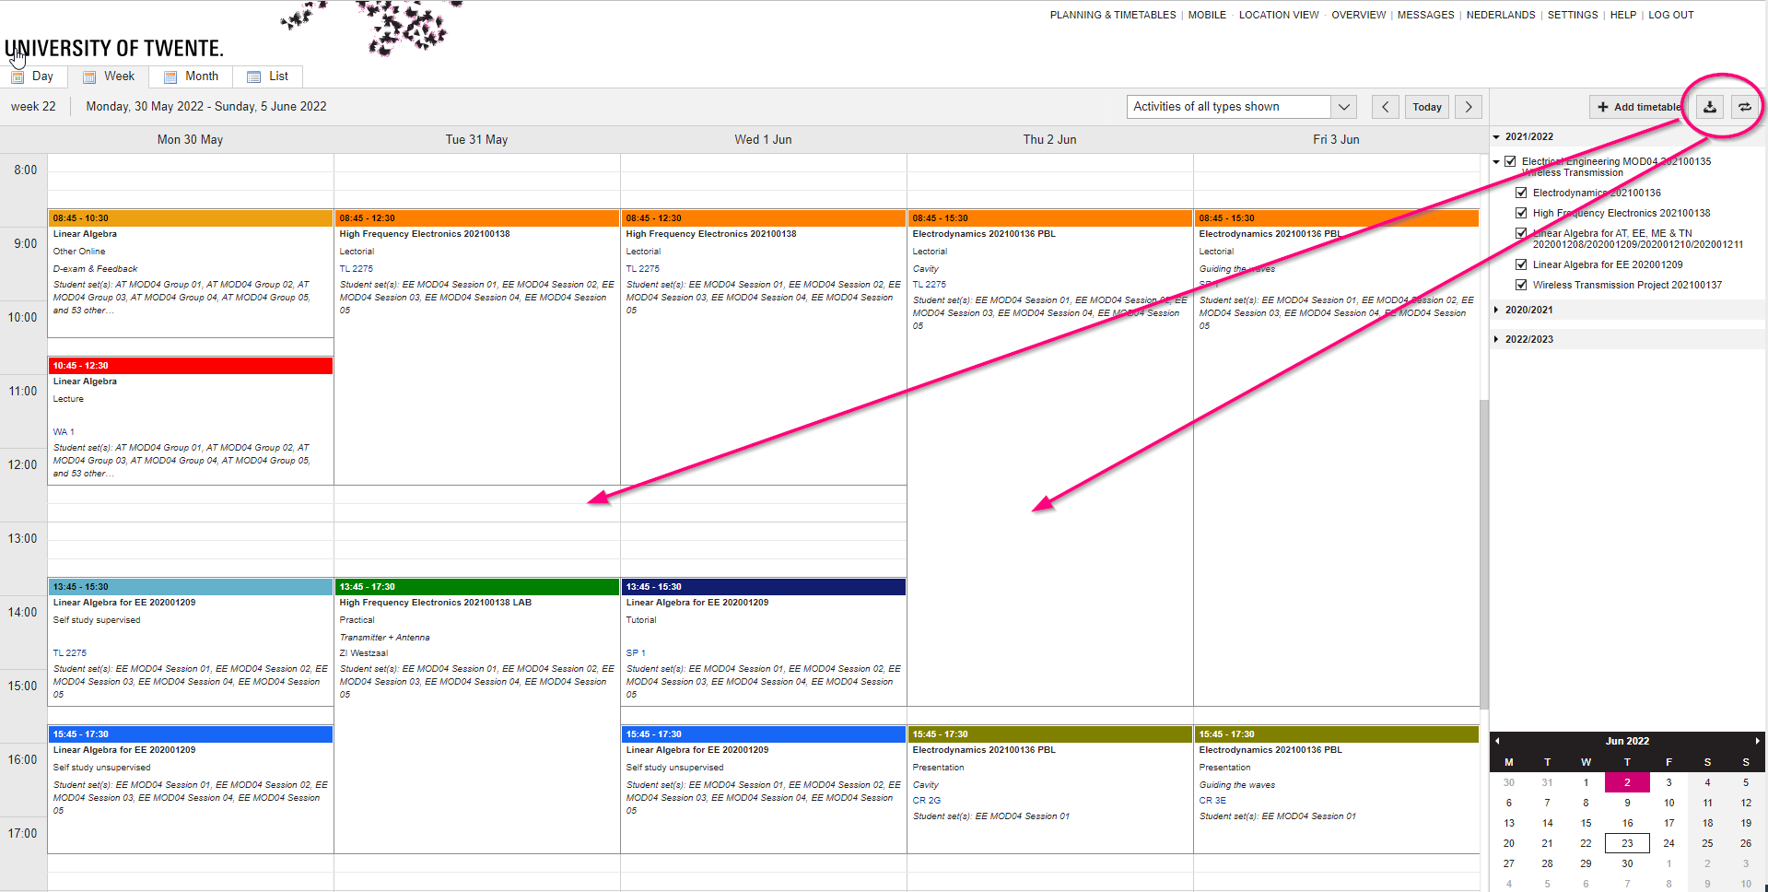
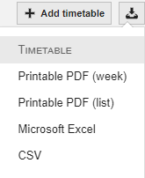
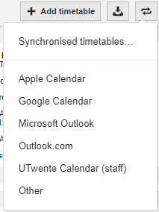
MYtimetable
Subscribing and exporting
Subscription in
Microsoft Outlook
Google Calendar
Apple Calendar
Other programme (using iCal link)
UT Campus app
Export as
PDF
CSV
Excel

Slide 14
MYtimetable
Functionality
Mobile version available
Calendar can be tweaked to your own demands
Filter by subjects
Filter by activity types
When subscribed to a timetable, changes are made automatically within 15 minutes
Questions?
Check the built-in HELP functionality
Contact SNT (www.snt.utwente.nl)
MyTimetable

Slide 15
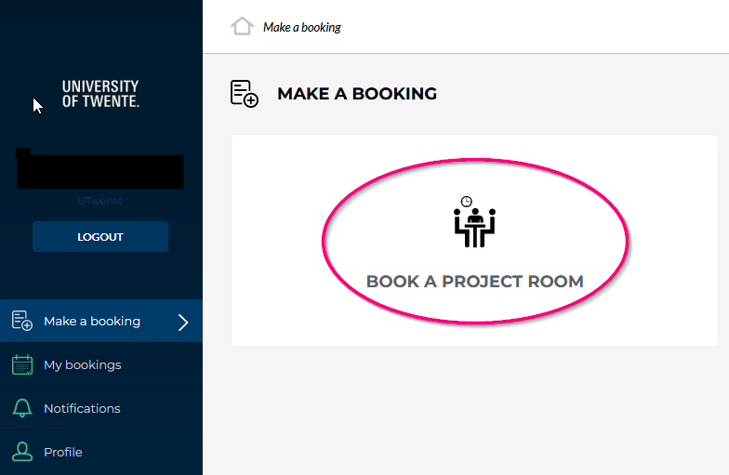
Room booking system
Login
Meant for booking of rooms for e.g. group work
Via rb.utwente.nl
Log in with your student account
Click ‘Book A Project Room’

Slide 16
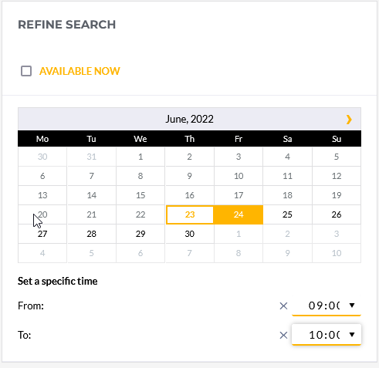
Rook booking system
Refine your search
On the right, refine your search
Choose a date and timeslot

Slide 17
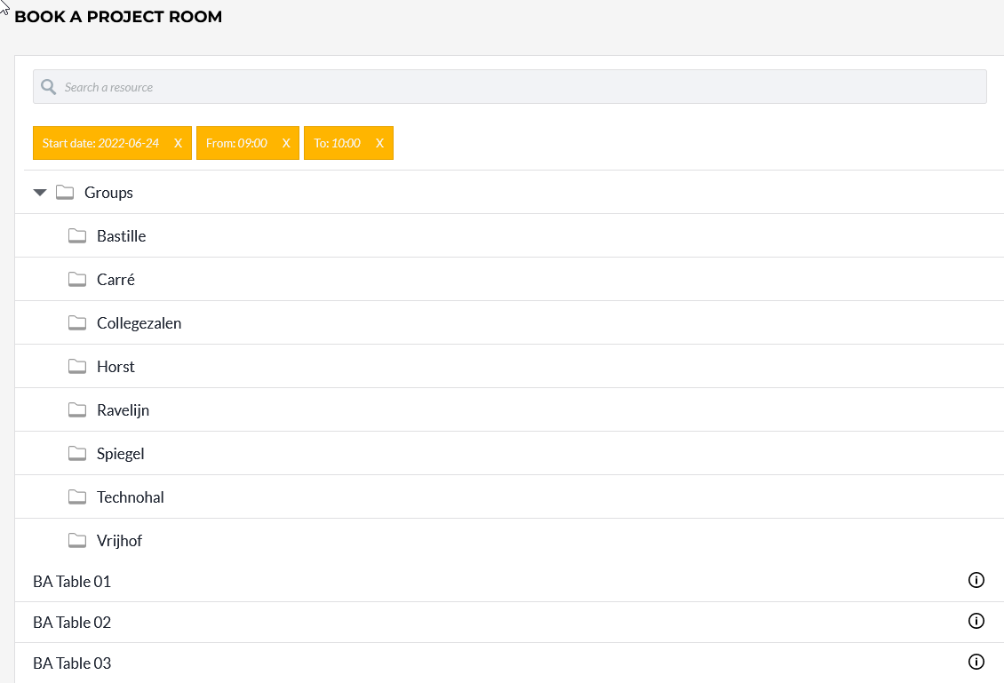
Room Booking system
Choose a room
On the left of the screen, the available rooms will be displayed
Choose your preferred room
Please note: There are some rules concerning maximum time for a booking, number of bookings per week, how many days in advance bookings are allowed

Slide 18
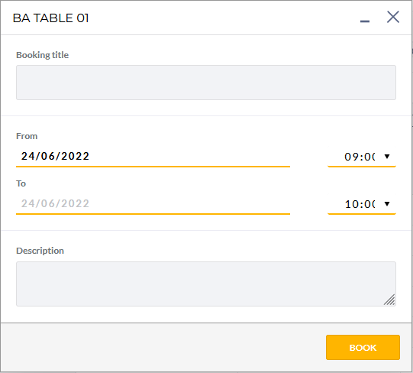
Room booking system
Confirm
Type a Booking title
Click BOOK and the booking has been made

Slide 19
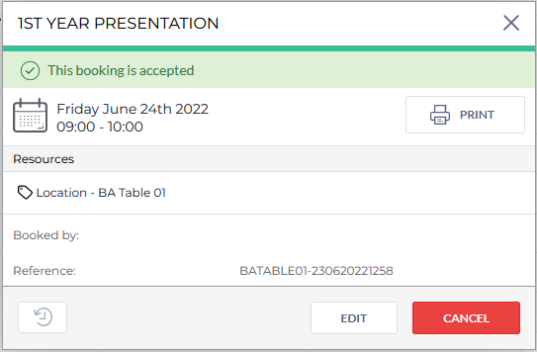
Room booking system
EDIT & CANCEL
You can edit the booking by clicking the Edit button
Click Cancel to cancel the booking

Slide 20
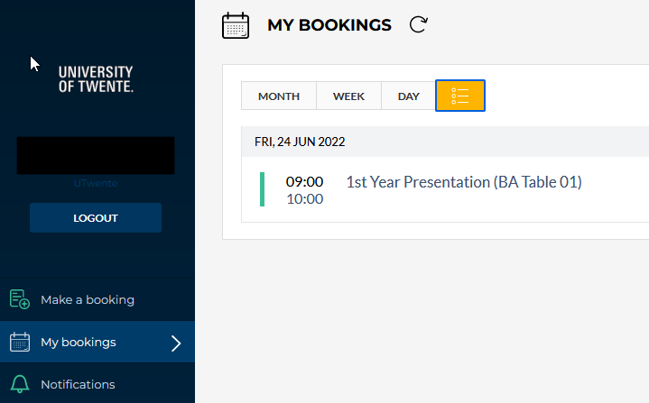
Room booking system
My bookings
In ‘My Bookings’, all your current bookings can be viewed
Click a booking to edit or cancel the booking

Slide 21
Osiris
Summary
Is used for
Study counselling
Registering and deregistering for modules
Checking recent study results
An overview of the study progress
Checking information about the content of courses
OSIRIS

Slide 22
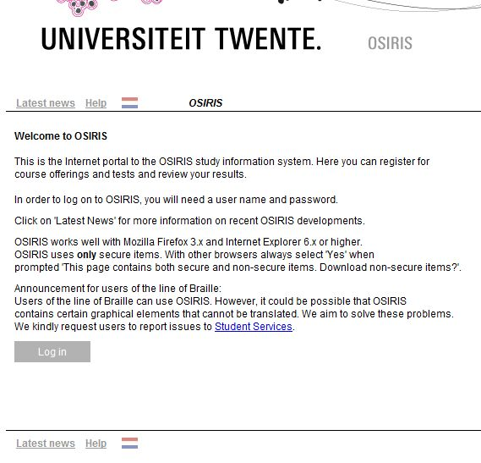
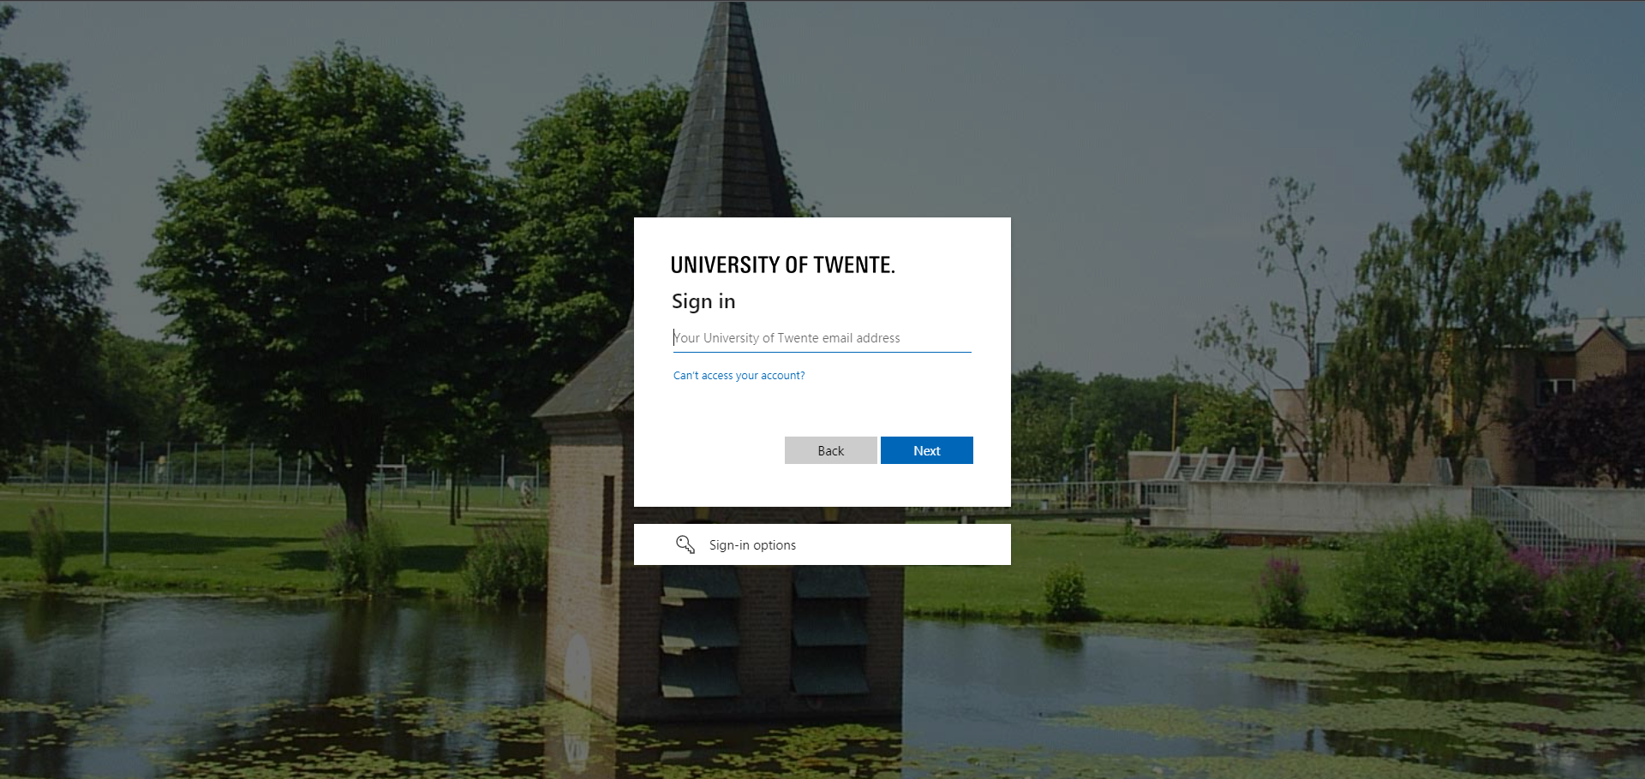
Osiris
Logging in
Via osiris.utwente.nl/student
Log in with your student account

Slide 23
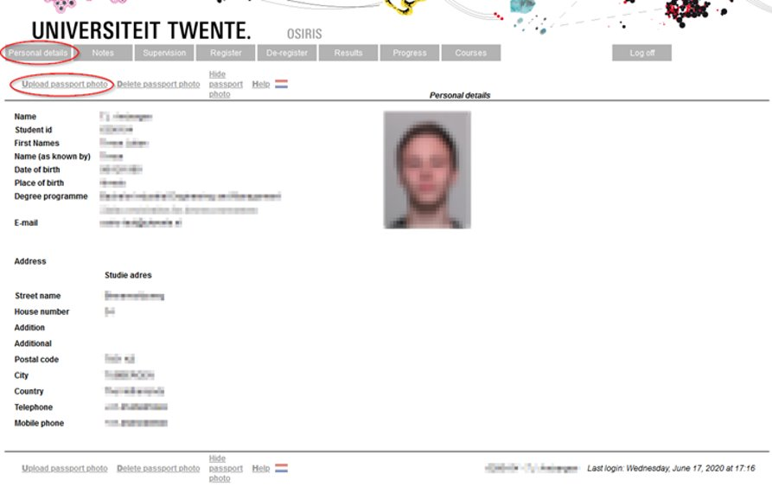
OSIris
Personal details
Your personal details as they are known to the UT
Something wrong? Contact Student Services
You can change your photo yourself

Slide 24
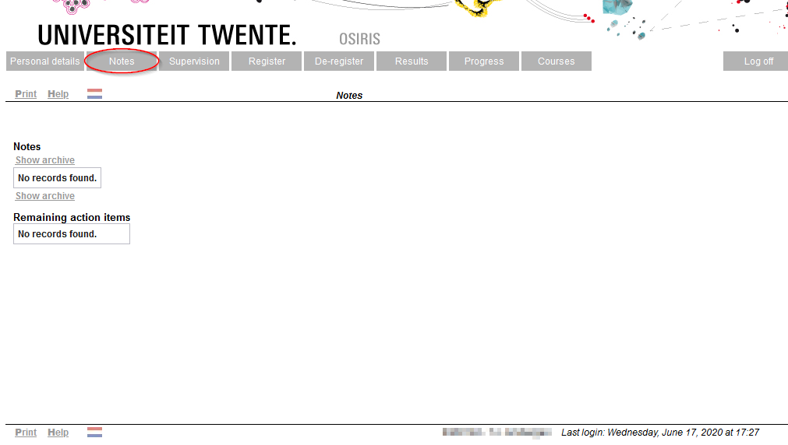
Osiris
Tutors
Your tutor can keep notes of conversations and appointments here

Slide 25
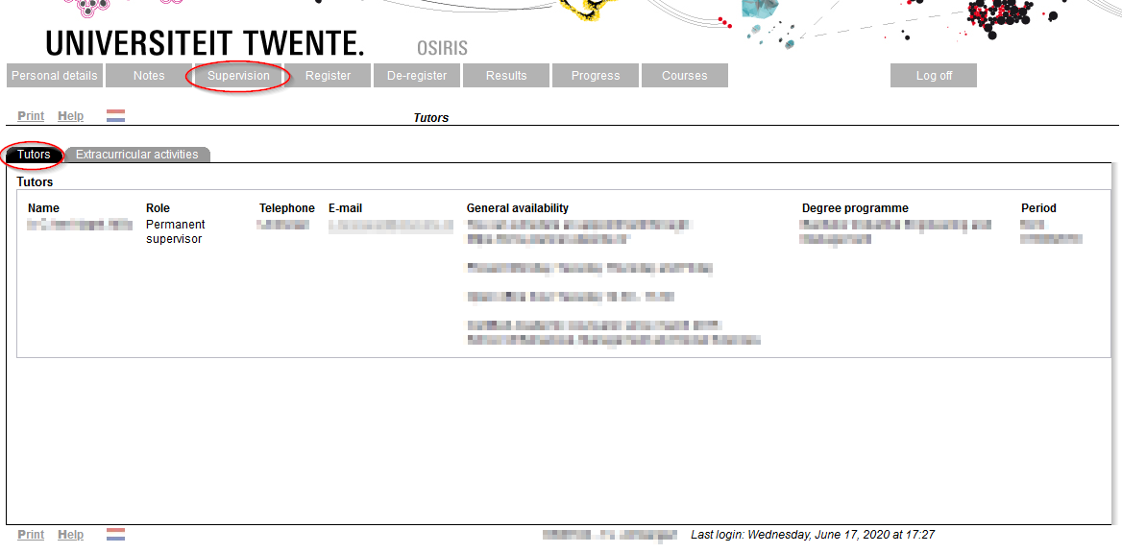
Osiris
Tutors
Information about your tutors can be found here:

Slide 26
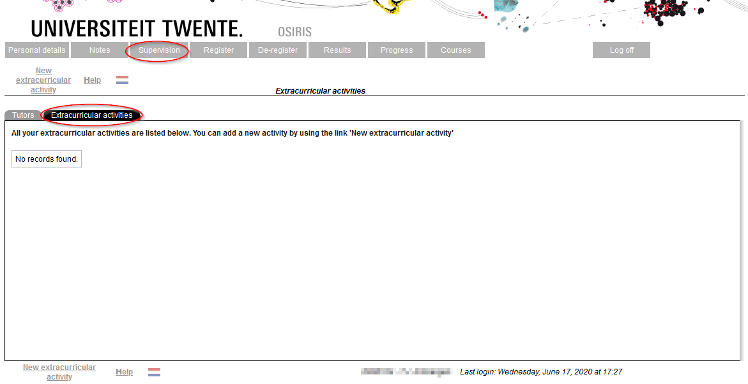
Osiris
Tutors
You can keep track of your extracurricular activities (such as a job/your own company, committees, a board membership, volunteer aid or top-class sport/culture), to keep your tutor informed

Slide 27
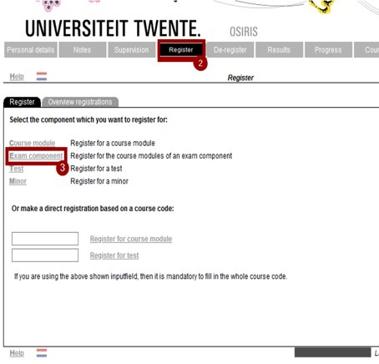
Osiris
Register
Register for the courses of an exam component​:
Log in on ‘Osiris Student’ (use your UT log in): osiris.utwente.nl/student/​
Go to ‘Register’​
Click ‘Exam component’​
Select your study programme
Click the module (exam component), you want to enroll for​
Click ‘Next’ ​
Click ‘Register’
You are now registered for all the study units (including instructional modes and the first attempt of tests) which are part of that module.

Slide 28
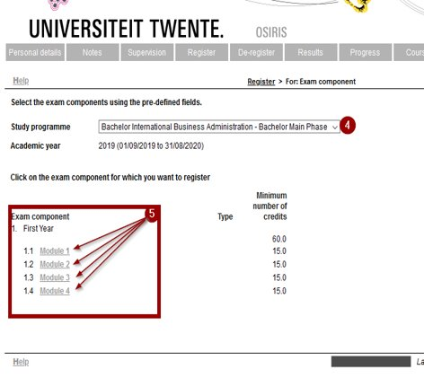
Osiris
Register
Register for the courses of an exam component​:
Log in on ‘Osiris Student’ (use your UT log in): osiris.utwente.nl/student/​
Go to ‘Register’​
Click ‘Exam component’​
Select your study programme
Click the module (exam component), you want to enroll for​
Click ‘Next’ ​
Click ‘Register’
You are now registered for all the study units (including instructional modes and the first attempt of tests) which are part of that module.

Slide 29
Osiris
Register
Registration for courses can be done up to one day before the start of the quartile
Deregistration for a course or test can be done up to one day before the start of the quartile, and after that only after consultation with your study programme (e.g. the study adviser)
Information about (de)registering: https://www.utwente.nl/register
Osiris

Slide 30
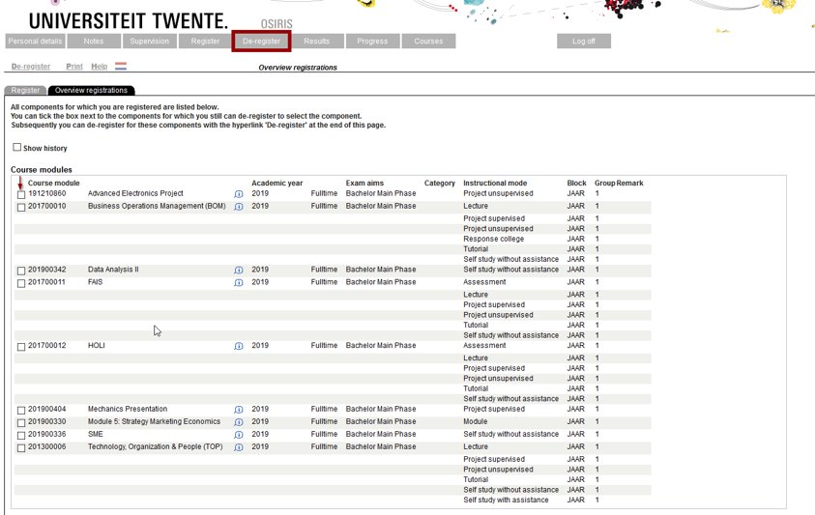
Osiris
Deregister
You can use the possibility to deregister until the last day before the start of the quartile; ​
You can only deregister for a test, after consultation with your study programme (e.g. the study adviser);​
Deregistration for a course in OSIRIS automatically leads to unenrollment for the accompanying Canvas course.

Slide 31
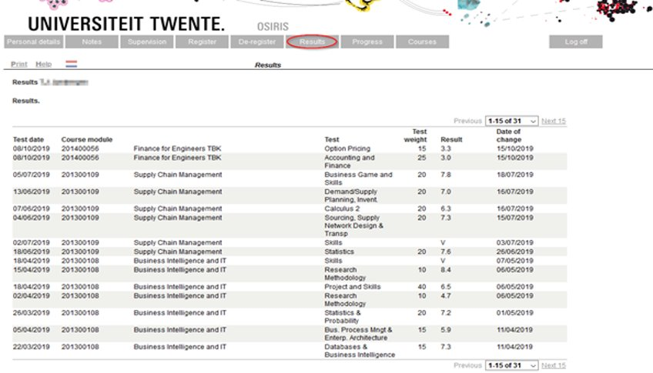
Osiris
Results

Slide 32
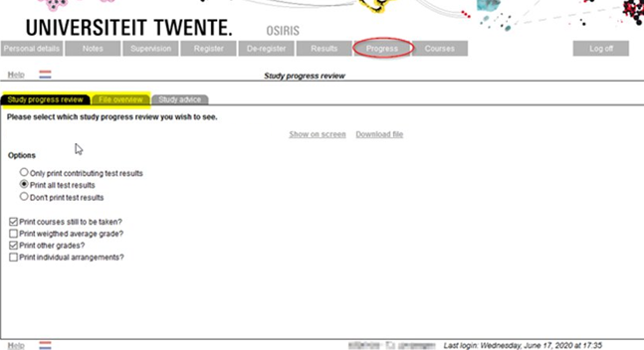
Osiris
Progress
You can create a study progress review and a file overview here:
Study progress review: a list of all courses you have passed or failed
File overview: a list of your grades

Slide 33
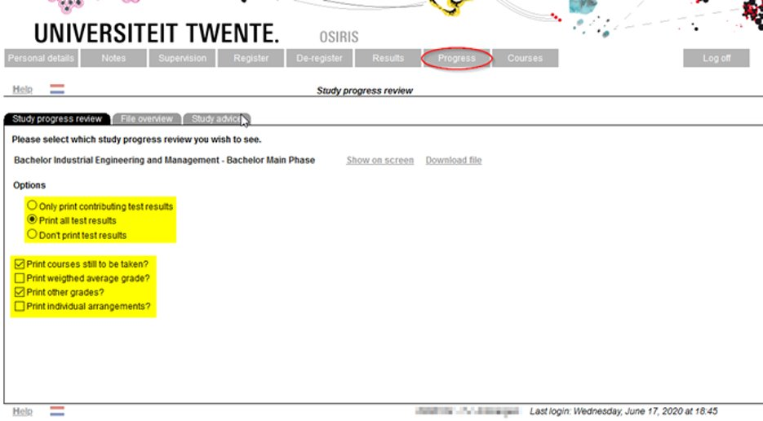
Osiris
Study progress review
Printing options for test results and courses still to be taken

Slide 34
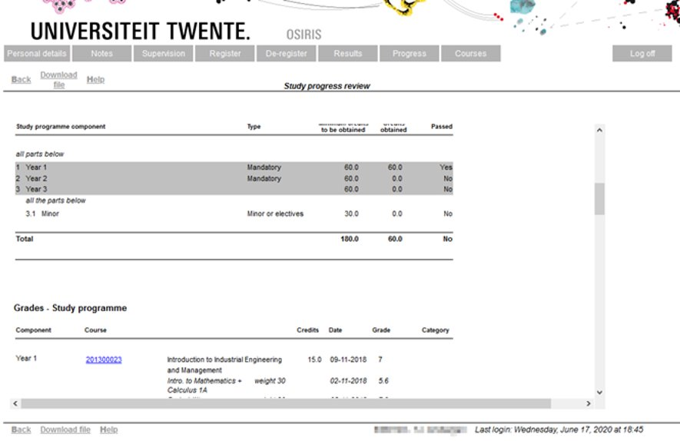
Osiris
Study progress review: show test results/courses
OSIRIS

Slide 35
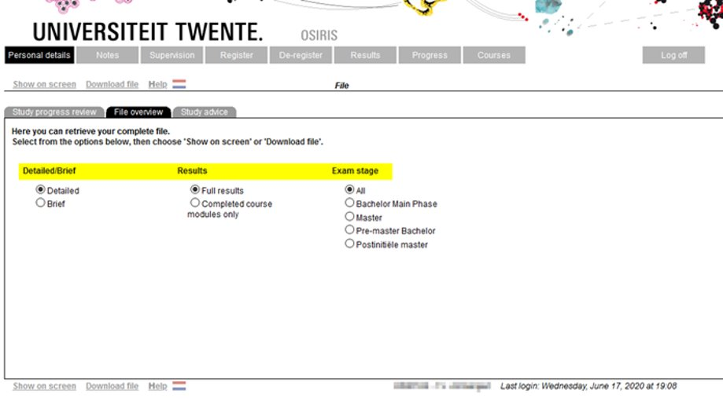
Osiris
File overview
Choice in detail, type of results, exam stage

Slide 36
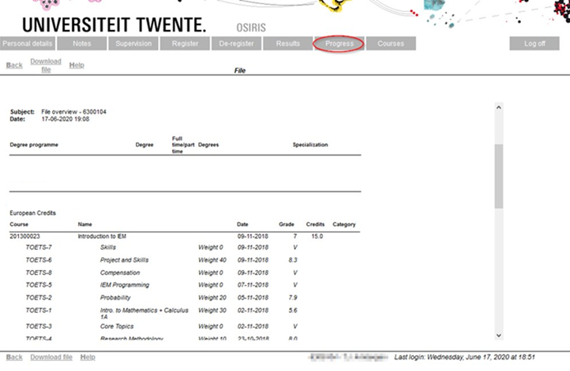
Osiris
File overview
OSIRIS

Slide 37
Osiris
Binding recommendation
Norm: 45 EC = 3 modules
Introductory meeting, temporary recommendation, final recommendation
Personal circumstances should be stated as soon as possible
For detailed information: utwente.nl/recommendation
Canvas

Slide 38
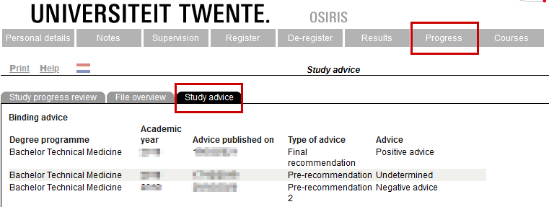
Osiris
Binding recommendation
Recommendation letters are sent per mail to your student e-mail address
The recommendations are also available in OSIRIS:
OSIRIS

Slide 39
Canvas
Overview
Canvas is our Learning Management System at the University of Twente. You use Canvas to:
Access module content (for example lecture slides)
See announcements and messages from teachers
Sign up for groups
Collaborate with your group
View and submit assignments
Take online (practice) quizzes
Check feedback and (partial) grades
Login to Canvas: canvas.utwente.nl, enter your UT email and password
Canvas

Slide 40
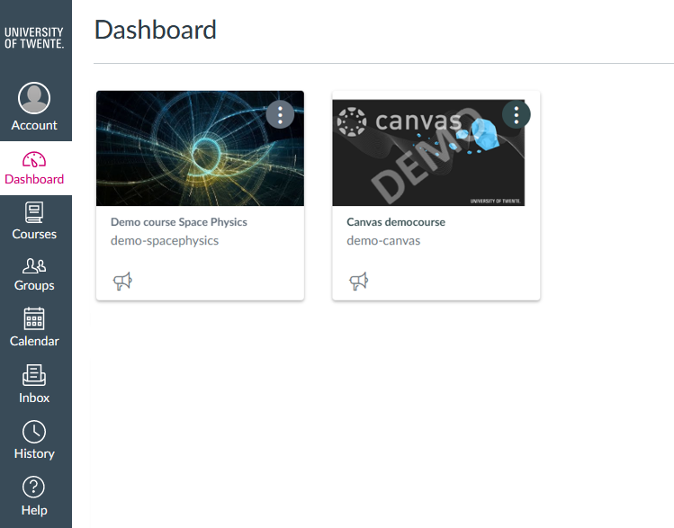
Canvas
Access to courses
The first thing you see when you log in, is the Dashboard with (some of) your courses.
Click a course card to enter the course.

Slide 41
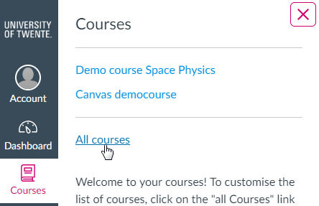
Canvas
Access to courses
You can also click Courses to view All courses. This list can contain courses that are not displayed on the Dashboard (for example Future enrollments).
To favorite a course, click the star next to a course. Course favorites will display in the Dashboard.

Slide 42
Canvas
Access to Courses from your study program
For modules from your study programme, you first have to register for the module in OSIRIS.
After that, you will automatically be enrolled in the corresponding course in Canvas.
From two weeks before the start of the quartile, the course will be accessible from the Dashboard. Before that, the course will be listed under ‘Future enrolments’ in Courses and is not accessible yet.
Registration (in OSIRIS) can be done up until the last day before the start of a quartile
Canvas

Slide 43
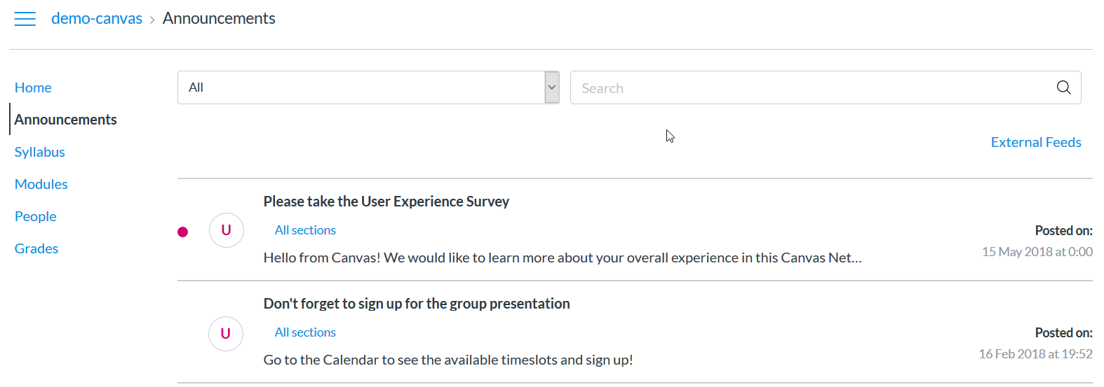
Canvas
Navigate your course
Once you are in a course, click Announcements in the Course Navigation to keep yourself updated on your course.

Slide 44
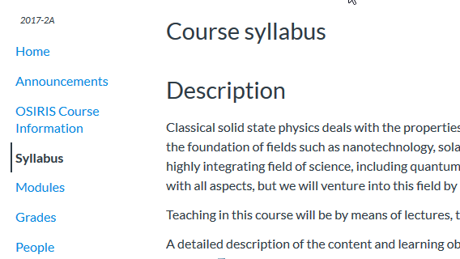
Canvas
Navigate your course
View information about the course (set up) in Syllabus and OSIRIS course information
Syllabus also contains an overview of all assignments and events from the course calendar

Slide 45
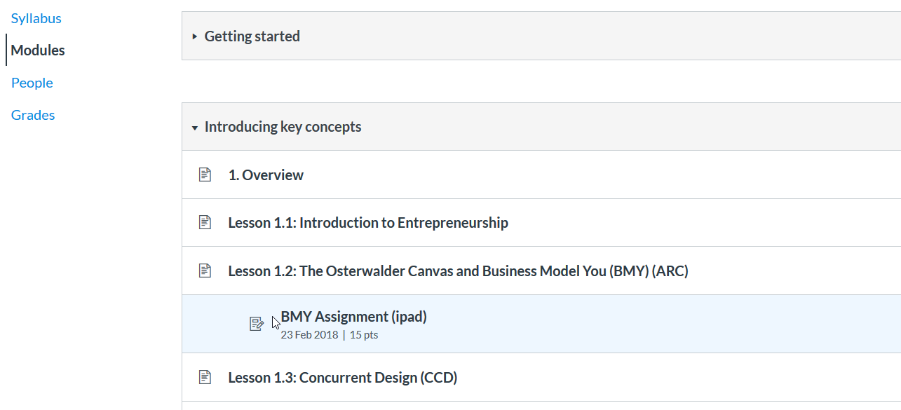
Canvas
Navigate your course
Click Modules to see an overview of the entire course/module. Here, you can access all the course materials and assignments.

Slide 46
Canvas
Navigate your course
Canvas modules can be filled with different types of content. Each module item also includes an icon with its type:
Page [1]: a page of content to read
Discussion [2]: a course discussion
Quiz [3]: a course quiz
Assignment [4]: a course assignment
Link or External Tool [5]: an external link or tool to view outside of the course
File [6]: a file to download or view

Slide 47
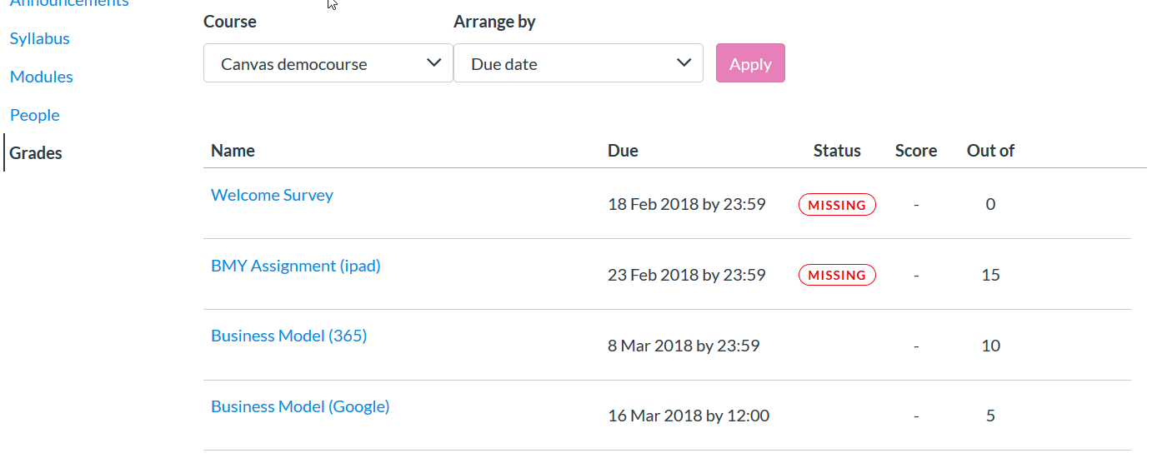
Canvas
Navigate your course
Use Grades to view the status of your submissions and your scores and feedback.

Slide 48
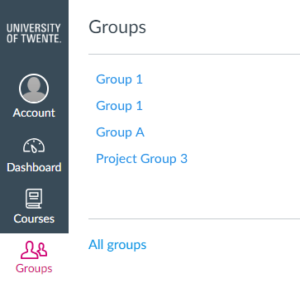
Canvas
Access to your groups
If you are enrolled in a group, you can access your group page via Groups
If you click All groups, you will see the groups arranged by course
The group page is also accessible from the Home page in a course, or from the People page in a course.

Slide 49
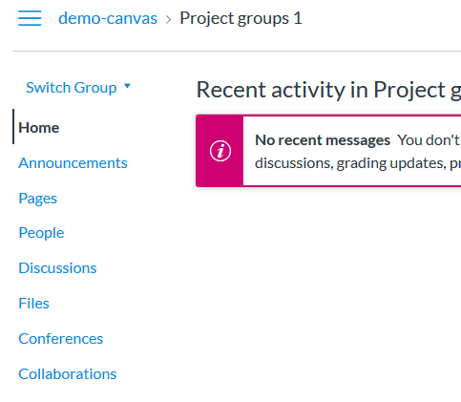
Canvas
Collaborate in groups
You can use the group page to collaborate on group projects:
Share ideas in group Discussions
Work together on documents: Files or Collaborations (integration with Google Drive and Office365)

Slide 50
Canvas
Teacher access to groups
Be aware that teachers and TA’s in the course also have access to the group pages.
We advise not to use the Announcements in a group page, because Teachers and TA’s also will receive a notification about announcements in a group pages. Instead, you can use the Canvas Inbox to send messages to your group members.
canvas

Slide 51
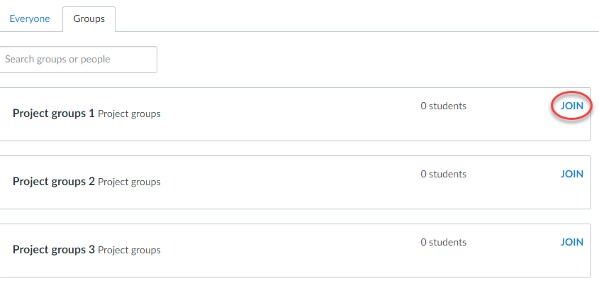
Canvas
Sign up for a group
It’s possible that the teacher asks you to self sign up for a group
To do so: go to People in the course, click the Groups tab and click Join for the group you want to sign up for.

Slide 52
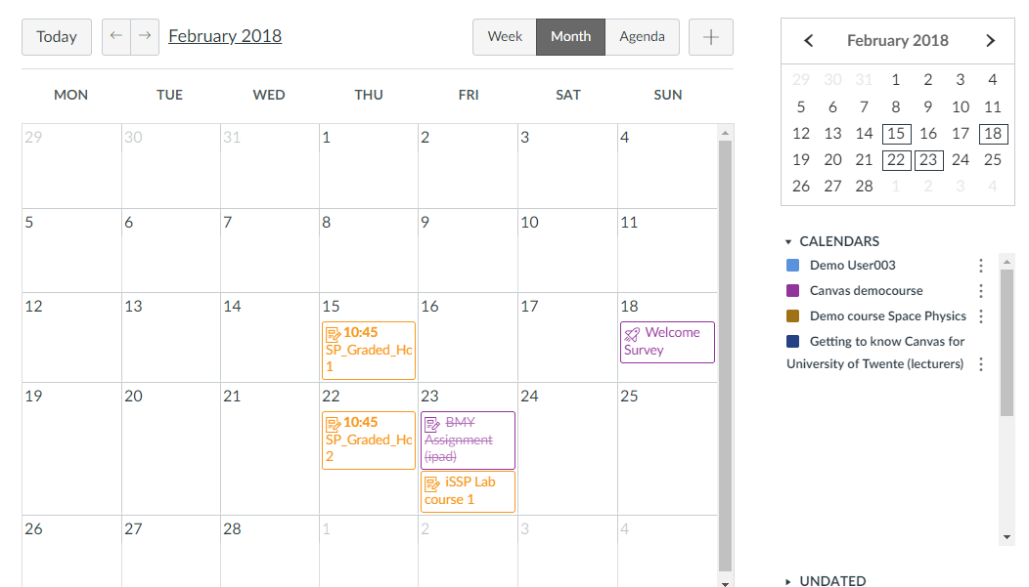
Canvas
Calendar
Check the Calendar to stay ahead of due dates and events for all your courses.
Each course calendar is identified by a separate color that populates the calendar view.

Slide 53
Canvas
Calendar
To hide a calendar, click the box next to the name of the calendar
Assignments are crossed out in the calendar once the assignment has been submitted.
Use the Calendar feed to import the Canvas Calendar in your preferred personal Calendar tool, such as Google or Outlook.

Slide 54
Canvas
Calendar: Sign up for an appointment
It may happen that a teacher asks you to sign up for a certain activity in the Calendar
Click the button Find Appointment on the right.
Select the appropriate course.
Click the time slot you want to sign up for.
If necessary, add a comment in the Comments field and click ‘Reserve’.
In case you want to cancel your reservation at a later moment: click the reserved time slot and click ‘Unreserve’.

Slide 55
Canvas
BigBlueButton
Your teacher may use BigBlueButton to offer online lectures or office hours if presence on campus is not possible.
As soon as a teacher has started a BigBlueButton conference, you can join it. If you don’t see the Join button after the communicated start time, you may need to refresh the page

Slide 56
Canvas
BigBlueButton interface
The Presentation Window displays the presentation that has been uploaded by the moderator/presenter, or the external video/screen that has been shared.
To open the Options menu, click the options icon.
From the User Menu, you can view all the users in the conference. You can also chat with another participant.
Canvas

Slide 57
Canvas
Bigbluebutton
Important: check the Technical requirements and advice for using BigBlueButton
canvas

Slide 58
Canvas
Mytimetable
Events from the UT application MyTimetable can’t be listed in the Canvas Calendar
However, if you have added timetables for your courses in MyTimetable, you can see the next five events from your schedule in Canvas: 1. Go to Account, 2. Click Profile, 3. Click MyTimetable.

Slide 59
Canvas
Receive and send messages
Inbox/Conversations allows you to see messages from teachers and classmates
You can send messages yourself as well (to teachers, members from your group or other students in the course)
You can filter the Inbox by course or by group

Slide 60
Canvas
Customise your account
If you want, you can add a picture under Account > Profile
In Account > Settings you can add other email addresses (handy if you want to receive notifications in your private mailbox)
In Account > Notifications you can set your preferences on how you want to be notified about course activities.
Advise: do not switch off notifications for Announcements and Conversation messages, otherwise you will miss important messages from teachers

Slide 61
Canvas
Download all course materials
It’s possible to download all materials from a course to a zip file. First you have to ask the lecturer of your course to enable the ePub exporting option for the course. Once that is done, you can:
Go to Account
Click Settings
Click Download course content
Click Generate ePub next to a course.

Slide 62
Canvas
Download all course materials
When the process is finished, you will see a ‘Download ePub’ and a ‘Download associated files’. The ePub file can only be viewed with an ePub reader and doesn’t contain any files. With ‘Download associated files’ you can download all files to a zip file.

Slide 63
Canvas
Download all submitted assignments
It’s also possible to download all your assignment submissions from all your courses:
Go to Account
Click Settings
Click Download submissions
Click Create export
When the export is finished, you will see a link ‘New export’. Click the link to download the zip file

Slide 64
Canvas
Self enrolment courses
Canvas also has course pages for things that do not have an OSIRIS course code. For example:
Information from your study program
Non-regular courses
Pages for internships/graduation/study trips
These courses may be open for self enrolment. You may receive a URL to self enrol, or you may find the course in Courses:
Click All courses
Click Browse more courses
Select the checkbox ‘Open enrolment courses only’ and use the search field to search for the course.
When you’ve found the course, click + Join this course.
Canvas

Slide 65
Canvas
Mobile app
Download and run the Canvas Student app (for Android and iOS devices).
Once you installed the app, you can log in in two ways:
Click QR code. You can generate a QR code from your Canvas web browser.
Click the button Find my school (fill in ‘University of Twente’), and log in with your ICT account.

Slide 66
Canvas
Where can I go if I need help or want to learn more?
Click the Help icon.

Slide 67
Summary
Important notes
All important links can be found via utwente.nl/students
Do not forget to register for courses
Keep track of the announcements in Canvas (canvas.utwente.nl) and on utwente.nl/students
Summary

Slide 68
Summary
Where to go for Help
For questions about Student Services Contact Centre: email studentservices@utwente.nl
For questions about MyTimetable: check the built-in HELP
Manuals for the educational systems can be found at utwente.nl/educationalsystems/, as well as this presentation. And in the Youtube playlist ‘educational systems University of Twente’ you can find short instruction videos.
You can contact Student Services for questions about Canvas or OSIRIS:
utwente.nl/students
The desk in the Boerderij
Summary

