Slide 1
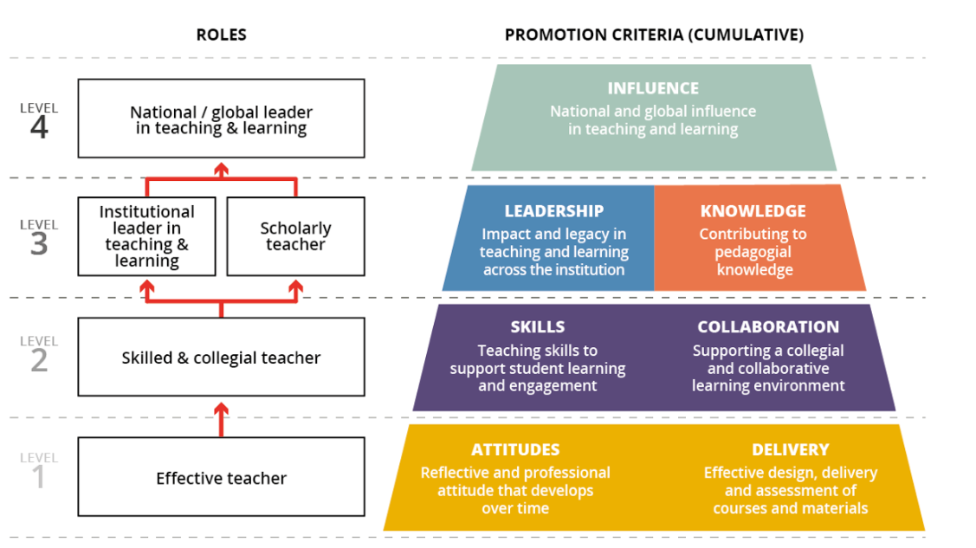
4TU Centre for Engineering Education (CEE)
SUTQ, SUEQ
Educational leadership programme
Masterclasses
UTQ, Taste of Teaching
Notes:
We use the Career Framework for University Teaching. This is a global collaboration to improve the rewarding and recognition of university teaching.
Masterclasses: activate the learning brain, blended learning, CBL, formative assessment, Microlectures etc.
SUTQ: The SUTQ is the follow-up trajectory of the University Teaching Qualification (UTQ), for teachers who want to develop themselves further into an evidence-informed educational (research combined with practice and people experiencing the practice) innovator. The SUTQ offers the opportunity to develop as a scholarly teacher by working on an educational innovation project. Through this project, teachers will develop competencies in using evidence-informed approaches in education and participating in a community of practice where ideas and experiences are shared with peers.
ELP: Developments like the rapid social (research in educational science, psychology and neuroscience) and technological developments (ITC), lead to a greater need for academics who can take a leading role in education. People who can formulate a vision and who can direct innovation and improvements in education. Formal and informal leaders who have profound insight into the processes of teaching, learning and curriculum development. This is meant for teachers who have management positions.
SUEQ (senior university examination qualification): more in-depth knowledge about all the aspects of assessment. Relevant for example teachers who are a member of the examination board.

