Slide 1
First draft Personalised
Lifelong learning / lifelong developing; from young adults to experienced professionals
Student-driven learning (including student activism or extra-curricular learning opportunities
Online education & virtual campus
Equipping students and staff with 21st century skills and competencies
Katja Haijkens
Frank Snels
Anneke Sools
Sander Lotze
Sebastiaan Waanders
Dennis Reidsma

Slide 2
Personalisation, basic assumption:
Being able to steer your own development and learning, is a meta-competence that includes self confidence, reflection skills, self-knowledge and insight in personal values, ability to steer own behavior, ….
this meta-competence does not develop automatically but needs crafting, time and an (physical, social and virtual) environment that is both supporting and challenging.
Personalisation will therefore differ for different groups of learners

Slide 3
Personalised essentials
Needs of individual
learners
Value driven
Ownership of own
learning
Personal development in
relation to professional
development
Reflection is essential
Slow spaces

Slide 4
Aim Personalised
enable our students and staff to become value-driven professionals with an intrinsic motivation to learn, teach, research
who acquire the meta-competence to steer their own learning process during and after their time at the UT;
who feel at home and flourishing in the UT community.
Work with commitment to creating a better, more humane and sustainable world

Slide 5
Value and intrinsic motivation driven
Including:
Teach UT-learners the meta-competence of value-driven learning.
Create space for reflection on identity development (who am I, where do I want to go, and what is my unique contribution and talent?)
Acknowledge informal and formal learning beyond checking boxes

Slide 6
Self governance (Ownership)
Including:
Teach learners how to steer their own learning and development process.
Taking risks, failing and making mistakes is pivotal to learning and should be appreciated as positive learning experiences (also for staff)
Offer meaningful learning trajectories, in which learners are challenged and supported to shape their own learning process and trajectories;

Slide 7
Personal well-being
Including:
Strengthen physical, virtual and social homebases where learners feel safe, happy and belonging to a community
Stimulate building (temporary and flexible) online and offline communities around specific challenges
Teach learners to reflect on their own social, emotional, psychological and digital well-being

Slide 8
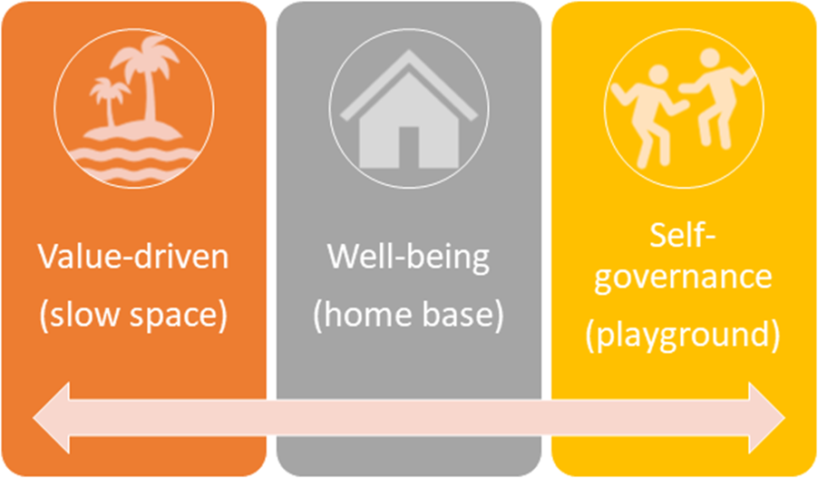
Community
Notes:
Create a virtual, social and physical environment to support the required competence building (combination of home base, playground and slow spaces)
Develop a monitoring system in which learners can track their own personal and professional development in observable and measurable ways; blended

Slide 9
Personalisation as a strategy
Innovating existing educational programmes
Experiments parallel to the existing educational programmes
In the professional context
Coping with learning outside the community
Role of the campus and broader community

Slide 10
Highlights: in 2022
All faculties have evaluated pilots concerning intervision, coaching, tutoring to stimulate value driven learning and working (meta-competence)
Recommendations of Home Base Report are implemented
The university has created slow spaces in all curricula and in the physical environment
Formal and informal learning is acknowledged (e.g. micro-credentials, facilitate gap year, flexible registration,…..)

Slide 11
Highlights: in 2022
Reward commitment to develop, including taking risks, for both students and staff (include successful failures in FJUT; more emphasis on process assessment in education)
Develop LLL programmes that share the same personalised core values; clear infrastructure is needed
Challenge based UT initiatives (such as Curious U) will be clustered and profiled as European institute of challenges
Steps have been made to redesign all one-year master programmes to two-years.

Slide 12
Organisational conditions
Innovations in education need a flexible and supporting organisation
Innovation cannot happen at the expense of the quality of current education and the well-being of staff
Funding needs to be allocated to support these innovations; especially to provide temporary staff.

