Slide 1
title
presenter
Generated by DALL-E

Slide 2
Title
Headings font: Daytona Condensed
Body font: Bahnschrift
Thumb logo OoCCT
Footer: University of Twente
Slide numbers

Slide 3
colors
On the ribbon select ‘Design’ > Theme ‘Circuit’
On the ribbon select ‘Design’ > unfold ‘Variants’ and select “OoCCT” in ‘colors’ and ‘fonts’
Used for large areas or lettering: OoCCT dark teal: R0 G153 B153 HEX #009999
Used for accents: OoCCT pink: R255 G51 B153 HEX #FF3399

Slide 4
Logos
Full color logo
Thumb color logo
Black & white logos

Slide 5
Highlight slide

Slide 6
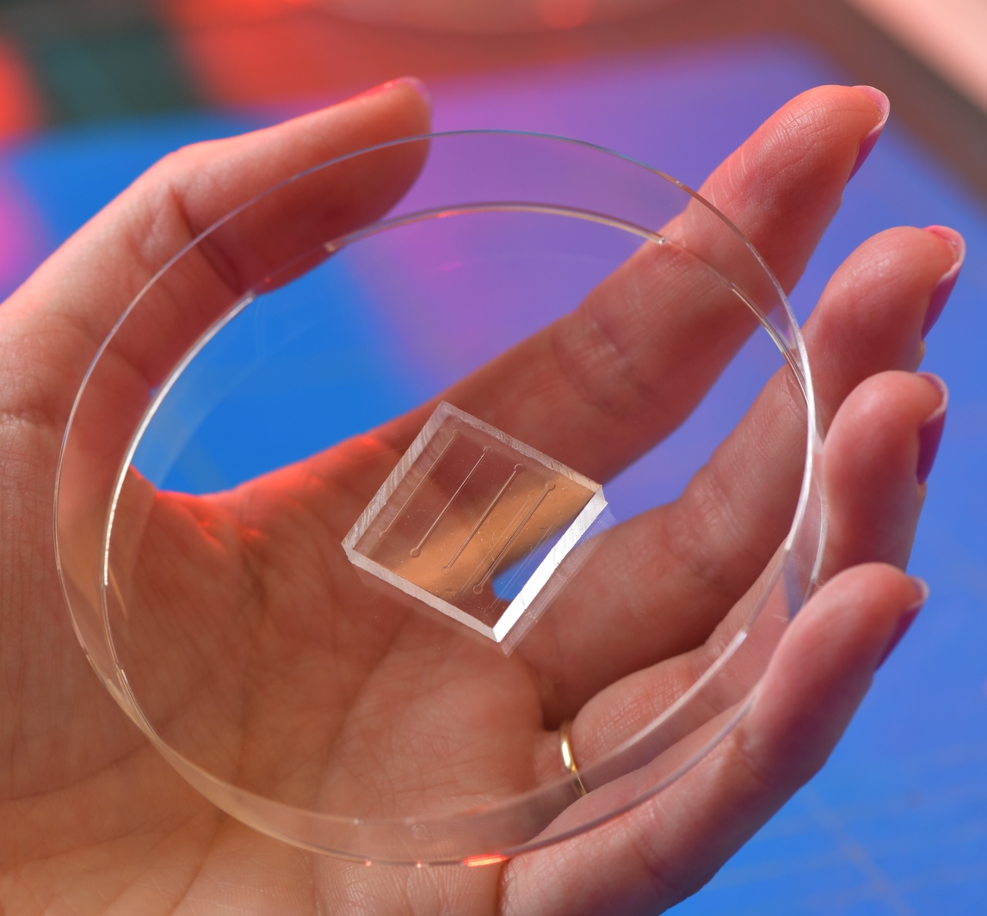
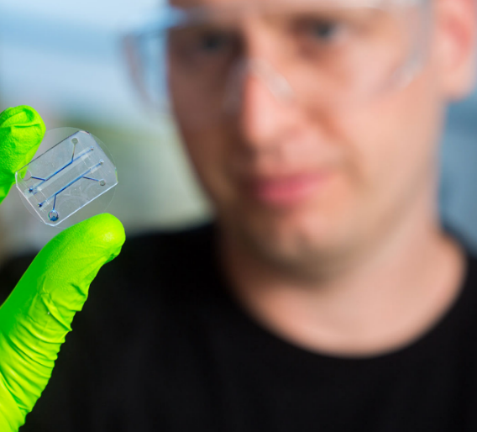
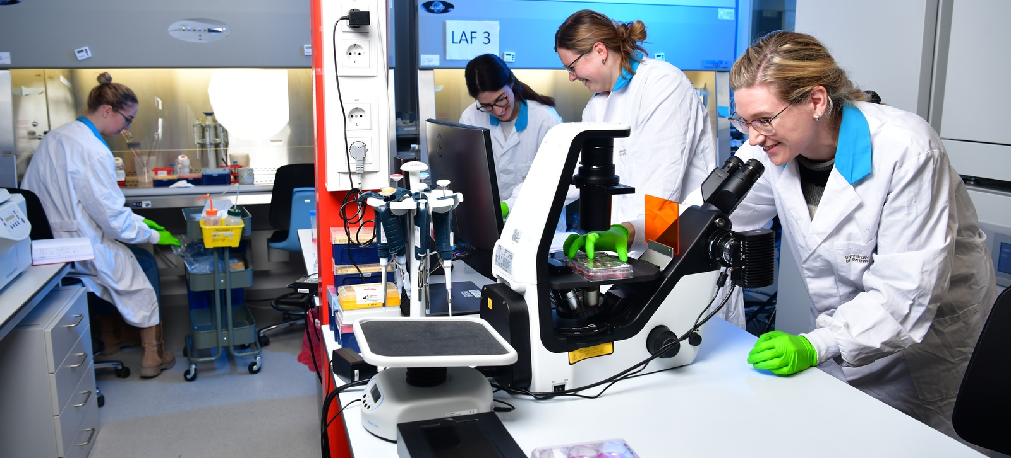
Highlight slide
6

Slide 7
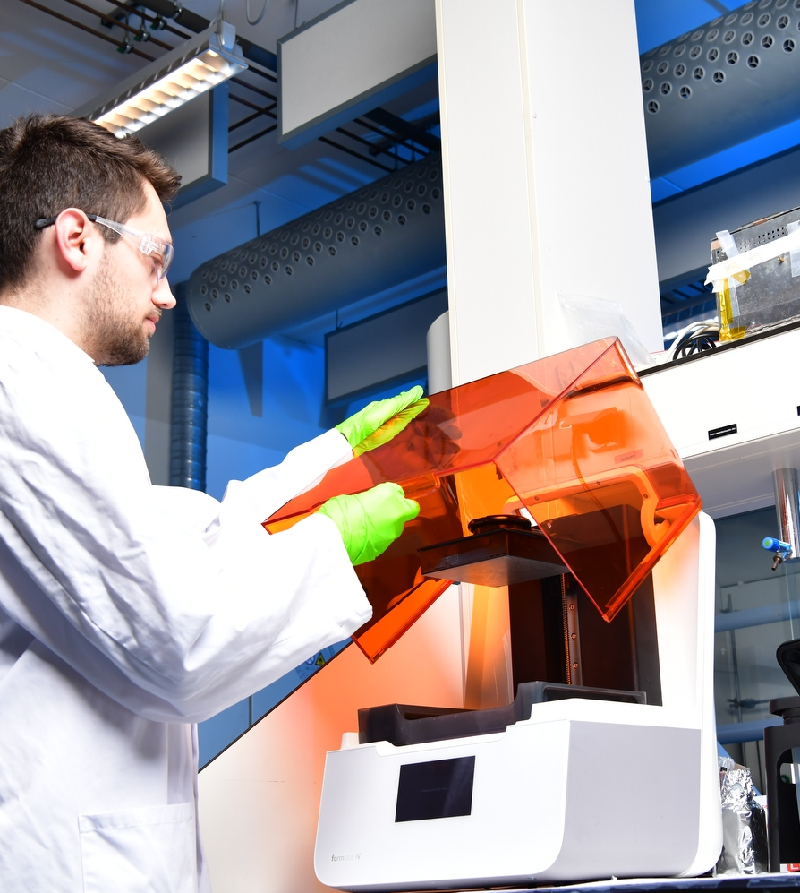
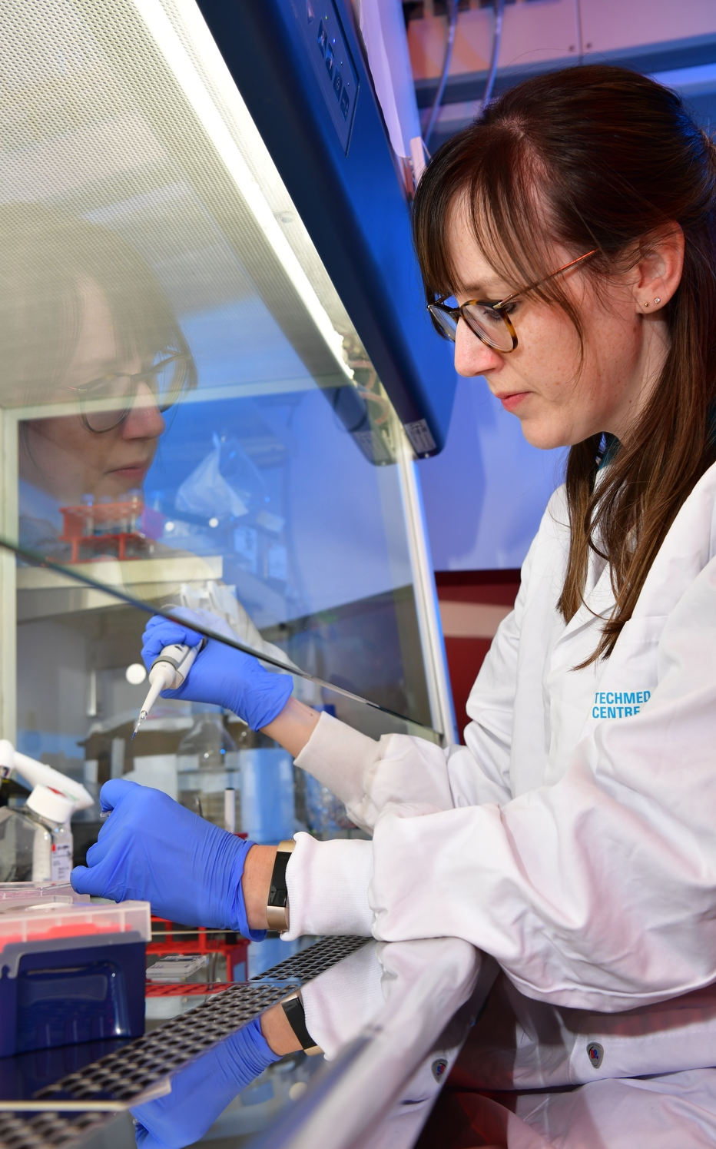
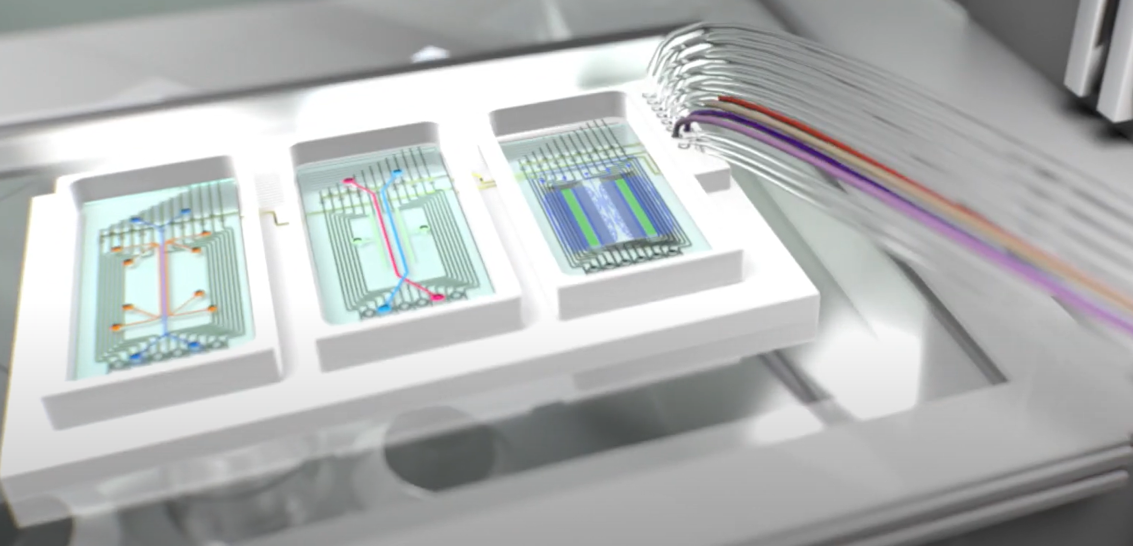
Highlight slide
7
7

Slide 8
oocct@utwente.nl
www.utwente.nl/oocct

