Slide 1
personal development plan
Tia den hartog

Slide 2
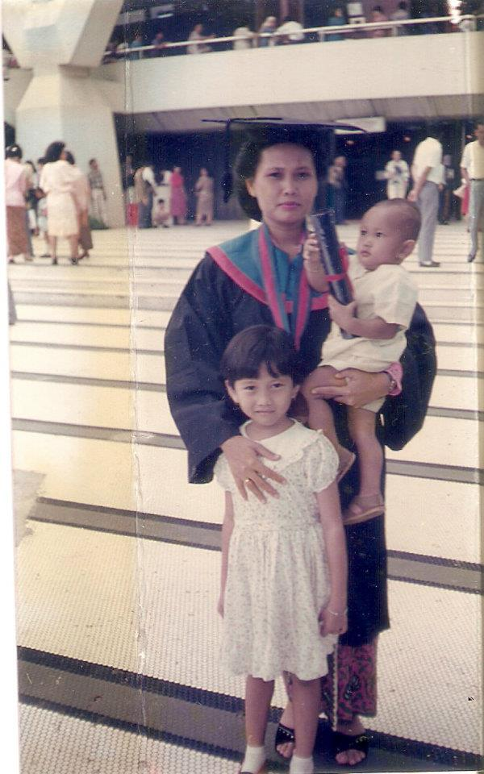
Who is tia den Hartog?
Murtiti Setiasih Muharamiah (Tia) den Hartog
Born and raised in Indonesia → moved to NL in 2011
Always been inspired by my mother
Background in urban and regional planning
A wife and a mother of 1-year old

Slide 3
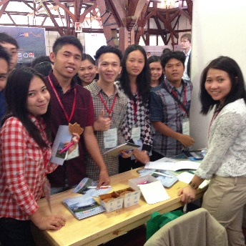
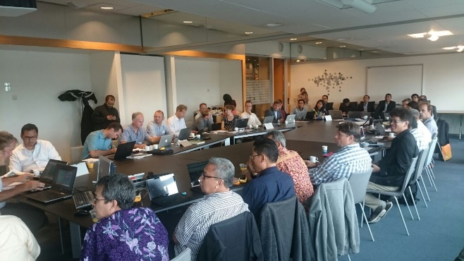
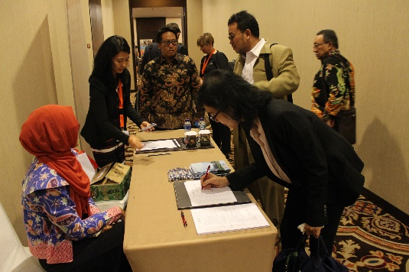
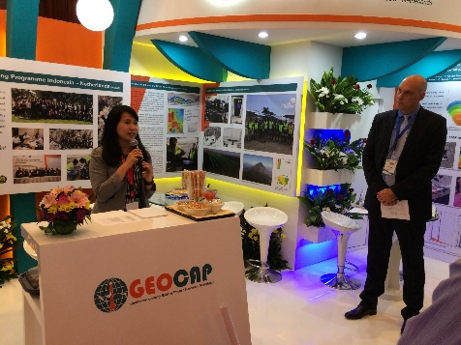
My tasks at Itc
Project management of two projects: (i) GEOCAP and (ii) SEALAN
Assisting and advising the project leaders in various aspects in the project
To write project reports
Arrange meetings/seminars/workshops/exhibition
Communication with internal and external stakeholders
To be the spin web in the project

Slide 4
Journey
Start the Career Development trajectory
Received the opportunity to develop my own development plan
February 2017
Personal Assessment by De Wijngaert (June 2017)
Maternity leave (July 2017)
Resume working (Jan 2018)
Applied for internal vacancy
(Project Officer)
November 2016
Start at ITC
As project manager
September 2014

Slide 5
development plan
Wrote a Development Plan Proposal
Based on the Personal assessment and
Discussed with HR then proposed to the Managing Director
Main questions for my Development Plan
What are the development points I need to reach to become a project officer which will support ITC capacity development in the future?
What do I need to do to reach those development points?
When can I reach them?

Slide 6
development Trajectory
Development points | Activities | Expected outcome | Deliverables | Activities realized
DP 1. Entrepreneurship skills and collaboration development | Partnership Brokering training Contribute to the discussion in the entrepreneurship in the OKP | Participation in the partnership brokering training Also contributes to the negotiation skills Understanding in entrepreneurship in research and education, improve the entrepreneurship attitude. | Training certificate AND Help facilitating partnership development Adding business partner to ITC activity/project | Training followed
DP 2. Negotiation skill and successful proposal | To be involved in the development of OKP call and contribute to the OKP call proposal writing Training on Proposal writing Planning for 2019 To be involved in the OKP Calls that will come in first half of 2019 To continue the involvement in H2020 proposal writing | Contribution to a successful proposal writing Participation in the proposal writing training Applying the skills for the proposal writing | Project proposal submitted to EP NUFFIC Certificate AND Skills to be applied in the proposal writing for the OKP call | Following the seminar and workshop on the Theory of Change → this can be applied in OKP proposal writing Help LE in the TMT application for the StuNed. Involved in the CPI analysis (Indonesia and Vietnam) – contribute to the analysis table format Involved in the TMT Application – Indonesia (Joan Looijen and Valia Drakou) Involved in the proposal writing with Wilma Bobbink: H2020 – Diana Reckien NWA – Johannes Flacke Followed a training Grant Writing Proposal: Contribute to the proposal H2020 (ToC of the call and ToC of the proposal)
DP 3. Vision about UT and ITC development | Contribute to the capacity building workflow evaluation based on the knowledge in the current project and looking the future of the project workflow Planning for 2019 Continue involvement in the WG Workflow To be involved in the development of the Theory of Change of ITC | Contribution to the Capacity Building Plan at ITC Knowledge and contribution to ITC capacity development in the coming 5 years. | Recommendation document on the project workflow | Co-creating the work processes workshop held on February 6th → no follow up yet Involve in the WG ITC workflow to improve the workflow in the faculty
Followed trainings on:
partnership brokering
Proposal writing
Contributes to project acquisition process
Contributes to the ITC workflow evaluation
Monthly mentoring sessions to revisit and evaluate the plan

Slide 7
Important aspects
Clear vision on the future of your career
Time availability
Both within and outside working hours
Clear agreement with your supervisor and HR
Balance between private and work

Slide 8
Thank you!
QUESTIONS?

