Slide 1
WORKSHOP
PRACTICAL MATTERS
Notes:
Welcome all students to this workshop

Slide 2
Programme today
NOW: Practical Matters workshop
Master’s programme today:
(pre-)master’s programme today:
11:45 – 12:30hrs: Lunch provided by the study programme of Psychology
12:30 – 12.40hrs: Information from study association Dimensie about studying Psychology at the UT. Location: Spiegel 1
12:45– 13:45hrs: Presentation about specific information about the master Psychology by the study adviser. Information will be given about the build-up of the programme, the internship and the master thesis. This session is also relevant for students who did their bachelor’s at the UT. Location: UT campus: Spiegel 1
13:35 – no end: Campus Tour / Games/ Winter afeternoon by Dimensie. Location: Rubix building Langezijds LA 25025
11:45 – 12:30hrs: Lunch provided by the study programme of Psychology
12:30 – 12.40hrs: Information from study association Dimensie about studying Psychology at the UT. Location: Spiegel 1
12:40 – 13:45hrs: Campus Tour / Games. Location: Rubix building Langezijds LA 2505
14:00 – 15:00hrs: Presentation specific information about the pre-master (/transfer minor) Psychology by the study adviser. You will take a look at your individual study plan and there is room to ask questions and to see if you still need to arrange some things to start of well. Location: Spiegel 1
15:00 – no end: Winter afternoon by Dimensie
Notes:
As mentioned please make sure to have a working internet connection, either at home or at the university. This is your first to do for today in order to take part in this session. When going to the website (utwente.nl/en/service-portal) follow the tabs as can be seen in the first picture (so first go to hardware, software & network > Network (eduroam VPN, etc) > Wireless network).
This is how to connect to Eduroam, the UT wifi network. At home, for the online lectures you are expected to also have a good, stable internet connection. Always make sure to test this connection before the start of an online meeting. For all devices (MAC, Windows, iPhone, Android) there are websites with information:
MAC: https://www.utwente.nl/en/service-portal/hardware-software-network/network-eduroam-vpn-etc/wireless-network/eduroam/eduroam-wireless-network-for-mac-os-x
Windows 10: https://www.utwente.nl/en/service-portal/hardware-software-network/network-eduroam-vpn-etc/wireless-network/eduroam/forget-eduroam-network-windows-10
Give students some time to do this, as they will need it for later to do’s in the workshop. Ask whether it is working out. In order to help more efficiently it can be helpful to have checked the information on the website yourself as well. If it is not working out, tell students they can still take care of some things later this week. However, it may be good to mention the following, as not having internet for on campus tutorials will not be acceptable:
If you do not have a working WIFI internet connection on campus yet, please make sure to arrange this ultimately before the first meeting on campus (see timetable). If you do not have internet during the meetings, you cannot participate in a way that is required.

Slide 3
TOPICS OF THIS WORKSHOP
Website PSY
Practical matters
& TO DO
Osiris
Canvas
Timetable
MyUT app
Notes:
These are the main topics for this workshop: website PSY, Osiris, Canvas, Timetable, Campus app and the final to do list. During this meeting you will get the opportunity to take care of some to do’s. During this part, the To do list can also be handed out.

Slide 4
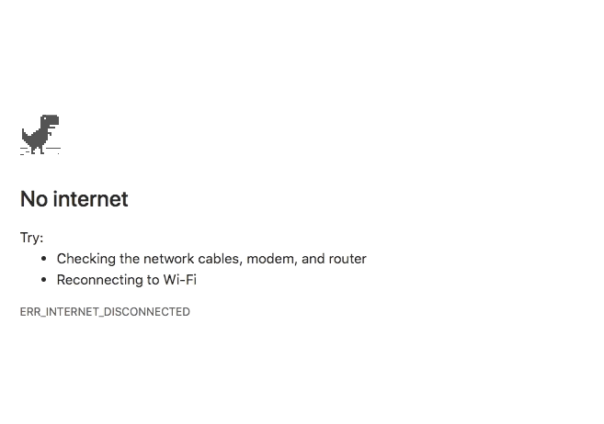
HAVE A WORKING LAPTOP + INTERNET CONNECTION
ON CAMPUS WIFI: EDUROAM
New laptop? https://www.utwente.nl/en/nsc/
Notes:
But first, let’s arrange a working internet connection for this workshop, as you will need it during this session. The WIFI network on campus is called EDUROAM.
For those who are interested in a new laptop, you can check this website for offers from the university, this link has also been provided in the email you received from the programme last week. Please note that you can work with a Windows as well as an Apple laptop. Remember however that when working with other students or submitting assignments programmes such as Word (and not Pages) are still most common to use.

Slide 5
Get connected to Wifi @UT
1. Click on Wifi-Sign (right bottom on laptop)
2. Click on Eduroam
3. LOG IN: UT e-mail address and your password
Notes:
As mentioned please make sure to have a working internet connection, either at home or at the university. This is your first to do for today in order to take part in this session. When going to the website (utwente.nl/en/service-portal) follow the tabs as can be seen in the first picture (so first go to hardware, software & network > Network (eduroam VPN, etc) > Wireless network).
This is how to connect to Eduroam, the UT wifi network. At home, for the online lectures you are expected to also have a good, stable internet connection. Always make sure to test this connection before the start of an online meeting. For all devices (MAC, Windows, iPhone, Android) there are websites with information:
MAC: https://www.utwente.nl/en/service-portal/hardware-software-network/network-eduroam-vpn-etc/wireless-network/eduroam/eduroam-wireless-network-for-mac-os-x
Windows 10: https://www.utwente.nl/en/service-portal/hardware-software-network/network-eduroam-vpn-etc/wireless-network/eduroam/forget-eduroam-network-windows-10
Give students some time to do this, as they will need it for later to do’s in the workshop. Ask whether it is working out. In order to help more efficiently it can be helpful to have checked the information on the website yourself as well. If it is not working out, tell students they can still take care of some things later this week. However, it may be good to mention the following, as not having internet for on campus tutorials will not be acceptable:
If you do not have a working WIFI internet connection on campus yet, please make sure to arrange this ultimately before the first meeting on campus (see timetable). If you do not have internet during the meetings, you cannot participate in a way that is required.

Slide 6
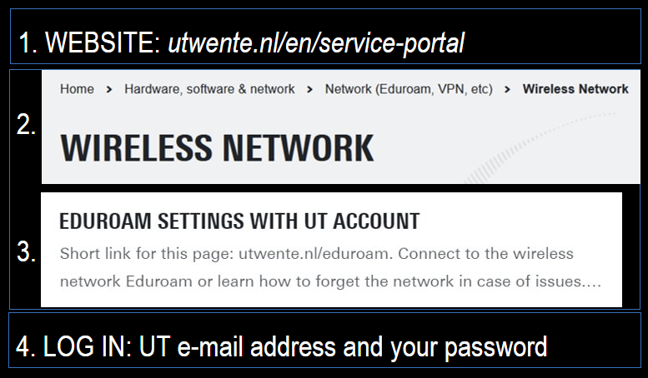
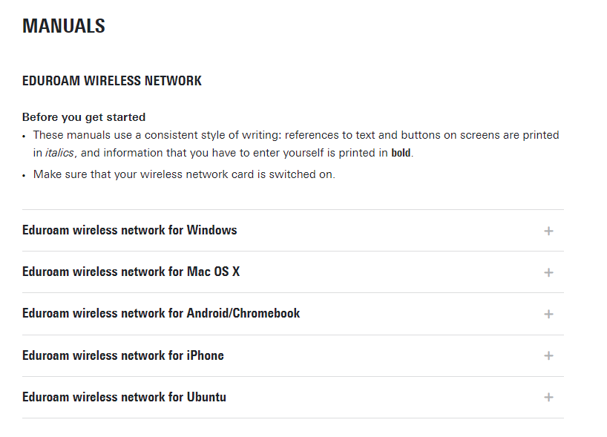
HOW TO CONNECT WITH YOUR PHONE!
Explanation how to connect to the WiFi
Notes:
When visiting the website to connect to Eduroam, this is what you should see. Click on the information that suits the characteristics of your device and follow the instructions.

Slide 7
WEBSITE PSY

Slide 8
WEBSITE PSY: utwente.nl/psy
Notes:
The Psychology programme has a website for students and employees of Psychology. On this site you can get a lot of information about the programme, contact details and rules & regulations. As this is also the website where you will be able to find the presentation, this is a good moment to take a picture of this slide for the link to the website.
Click on the link to go to the Psychology website. Show where some information can be found on the website, by clicking on the left-hand tabs (also see next sheet). Of course bachelor PSY→ first year is interesting, Rules & Regulations and Organization & Support. Let students safe this website in their bookmarks?
@Iris, where can the presentation be found on this website?

Slide 9
Psychology website: utwente.nl/psy
Relevant information: Overview programme, rules pre-master, master Internship & thesis
Rules and regulations:
Cum Laude, Student’s Charter, transitional arrangements
Who’s who:
PSY staff and committees
Notes:
The Psychology programme has a website for students and employees of Psychology. On this site you can get a lot of information about the programme, contact details and rules & regulations. As this is also the website were you will be able to find the presentation, this is a good moment to take a picture of this slide for the link to the website.
Click on the picture to go to the Psychology website. Show where some information can be found on the website, by clicking on the left hand tabs (also see next sheet). Of course bachelor PSY→ first year is interesting, Rules & Regulations and Organization & Support.
If there is time, you can go to the website yourself and show for example the overview of year 1, 2 or 3, and/or Organization and Contact (PSY staff or Dimensie for example).

Slide 10
TO DO 1 - OSIRIS
LOG IN TO OSIRIS
1.

Slide 11
osiris
WHAT IS IT FOR?
OVERVIEW STUDY PROGRESS
(ECTS SO FAR)
COURSE CATALOGUE
GRADES COURSES
ENROLMENT & UNENROLMENT COURSES
STUDY COUNSELLING
|
2
Notes:
Osiris is one of the systems the university uses for information about your study progress and (final) grades. These are a few of the purposes the system is used for. I will not elaborate on all of the topics today, but they will be covered in the first weeks of the year.

Slide 12
Osiris log in
WHERE? OSIRIS.UTWENTE.NL/STUDENT
HOW? LOG IN WITH STUDENT EMAIL AND PASSWORD
Student email: …@student.utwente.nl
Password: ******
Notes:
How do you login? Go to Osiris.utwente.nl > go to Osiris Student and fill in your student number and password. When logging in, you should add an ‘s’ before your student number.

Slide 13
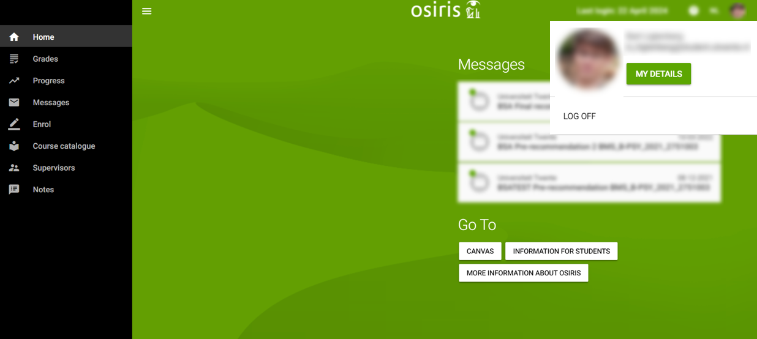
Osiris
PERSONAL DETAILS
Notes:
This is the first page you will see on your screen: your personal details, such as your name and address. This information is the exact information you provided yourself via Studielink and is the information also visible to the university. This means that, if you move to another address, you should change this so that the university is informed as well. You also have to upload a picture of yourself, you can change this picture.

Slide 14
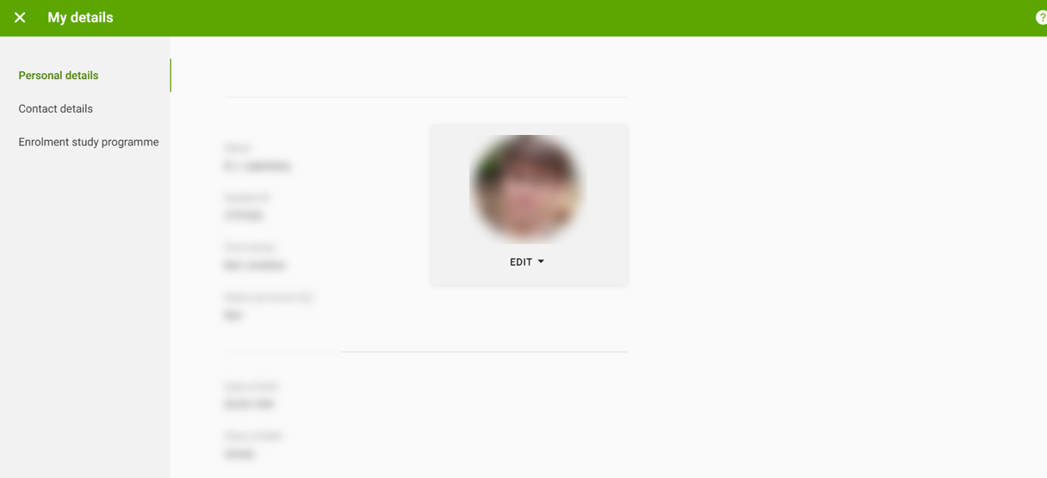
Osiris
PERSONAL DETAILS
You can change your photo
Your personal details, provided by you in Studielink and visible for UT
Details incorrect/changed? Contact Student Services and/or change in Studielink
Notes:
This is the first page you will see on your screen: your personal details, such as your name and address. This information is the exact information you provided yourself via Studielink and is the information also visible to the university. This means that, if you move to another address, you should change this so that the university is informed as well. You also have to upload a picture of yourself, you can change this picture.

Slide 15
TO DO 2 - Osiris
Enrol for COURSES BLOCK 2a
PRE-MASTER
-Introduction to Psychology (202000440) or History of Psychology DSM TP (202000445)
-Research Methodology and Descriptive Statistics (202001402)
-Academic Writing Pre-master MPS (202000443)
MASTER
Find your courses via: utwente.nl/psy/master
Scroll to ‘study programme’
Click on Study programme master PSY 2024/2025 (start Feb 2025)
Scroll to your track
2.
Please note: if your university enrolment has not been completed, registration is not possible yet → take care of: documents, payments, etc. Not possible to register? Try it again every day! More information about registering: www.utwente.nl/ces/studentservices/en/osiris/Osiris
Notes:
As I said, this is the first TO DO of this workshop: enroll for module 1. It is important to mention that if you have not completed your enrolment at the university yet, you will not be able to enroll for a module. So in order to arrange this as soon as possible, take care of any missing documents, payments, etc.
Give the students a few minutes to enroll for the module and mention that if you have been able to enroll. In the meantime they can ask questions if they don’t succeed. When the few minutes have passed, mention that If some students cannot enroll, they can (and must) try it in the upcoming days.

Slide 16
osiris
WHAT IS IT FOR?
OVERVIEW STUDY PROGRESS
(ECTS SO FAR)
COURSE CATALOGUE
(FINAL) AVERAGE GRADES COMPONENTS & MODULES
ENROLMENT & UNENROLMENT MODULES
STUDY COUNSELLING
ENROLMENT & UNENROLMENT MODULES
|
2
Notes:
One of the things Osiris is used for, is enrolling for modules and this will also be the next thing to do during this workshop.

Slide 17
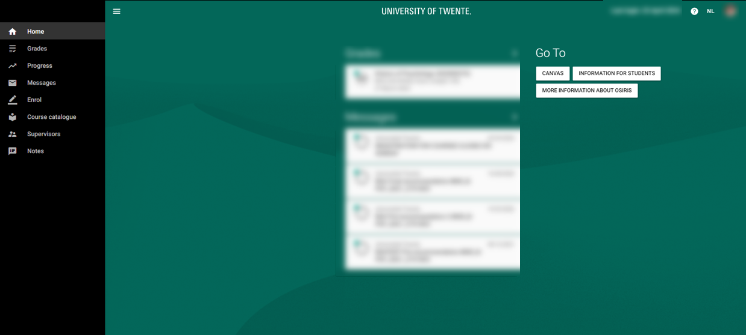
Osiris
ENROLMENT MODULES
Go to ‘Enrol’
Notes:
How do you enroll for a module? Go to the tab REGISTER, click on Exam Component, select your study programme, click on the module (this is called an exam component in Osiris), you want to enroll for, klick ‘next’, click ‘register.

Slide 18
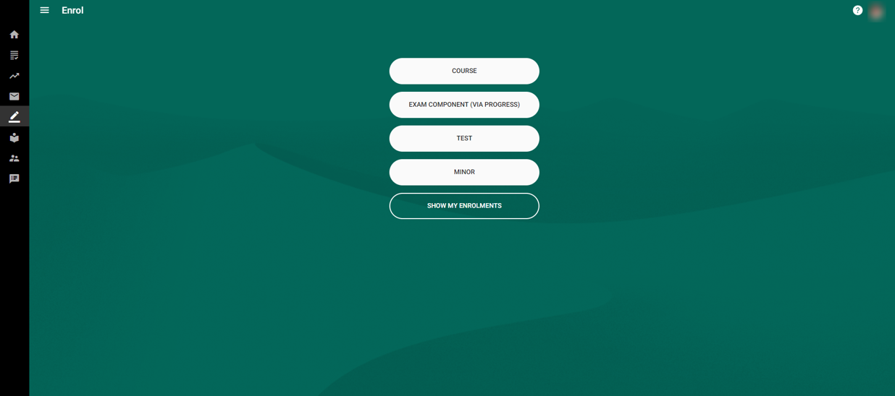
Osiris
ENROLMENT MODULES
Click on ‘course’
Notes:
How do you enroll for a module? Go to the tab REGISTER, click on course, search for a course name/course code, click on the course you want to follow and click confirm enrolment

Slide 19
TO DO 2 - Osiris
Enrol for COURSES BLOCK 2a
PRE-MASTER
-Introduction to Psychology (202000440) or History of Psychology DSM TP (202000445)
-Research Methodology and Descriptive Statistics (202001402)
-Academic Writing Pre-master MPS (202000443)
MASTER
Find your courses via: utwente.nl/psy/master
Scroll to ‘study programme’
Click on Study programme master PSY 2024/2025 (start Feb 2025)
Scroll to your track
2.
Please note: if your university enrolment has not been completed, registration is not possible yet → take care of: documents, payments, etc. Not possible to register? Try it again every day! More information about registering: www.utwente.nl/ces/studentservices/en/osiris/Osiris
Notes:
As I said, this is the first TO DO of this workshop: enroll for module 1. It is important to mention that if you have not completed your enrolment at the university yet, you will not be able to enroll for a module. So in order to arrange this as soon as possible, take care of any missing documents, payments, etc.
Give the students a few minutes to enroll for the module and mention that if you have been able to enroll. In the meantime they can ask questions if they don’t succeed. When the few minutes have passed, mention that If some students cannot enroll, they can (and must) try it in the upcoming days.

Slide 20
TO DO 2 - Osiris
Enrol for COURSES BLOCK 1a
PRE-MASTER
-Introduction to Psychology (202000440) or History of Psychology DSM TP (202200262)
-Research Methodology and Descriptive Statistics (202001402)
-Academic Writing Pre-master MPS (202000443)
MASTER
Find your courses via: utwente.nl/psy/master
Click on Master’s Programme
Click on Study programme master PSY start September 2024
Scroll to your track
Not able to register yourself?
Send e-mail to boz-psy@utwente.nl and include your student number, course names and course codes
2.
Please note: if your university enrolment has not been completed, registration is not possible yet → take care of: documents, payments, etc. Not possible to register? Try it again every day! More information about registering: www.utwente.nl/ces/studentservices/en/osiris/Osiris
Notes:
As I said, this is the first TO DO of this workshop: enroll for module 1. It is important to mention that if you have not completed your enrolment at the university yet, you will not be able to enroll for a module. So in order to arrange this as soon as possible, take care of any missing documents, payments, etc.
Give the students a few minutes to enroll for the module and mention that if you have been able to enroll. In the meantime they can ask questions if they don’t succeed. When the few minutes have passed, mention that If some students cannot enroll, they can (and must) try it in the upcoming days.

Slide 21
Osiris
ENROLMENT cOURSES
REGISTRATION IN OSIRIS IS MANDATORY → automatically registered for first and second exam attempt & Canvas page.
Do you not want to use the 1st attempt? → de-register timely from the exam via Osiris! (i.e. till 1 day before the exam date = till 24:00h. of the day prior to the exam date).
Did you not pass/attend the 1st attempt? → registration for resit is automatic
Still have to register for master courses? → Email Anneke Laarhuis from BOZ (boz-psy@utwente.nl) student number, course + coursecode
Error message when you enrol for a course in OSIRIS? Ignore and proceed!
.
Notes:
The enrolment for modules is mandatory and very important, as this is necessary for you to get access to the module’s specific information in a system called CANVAS (more information later) as well as for the university to be able to process your grades. Once you are enrolled for the module in Osiris, you are automaticallyy registered for all tests that are part of the module, so there is no need to sign up at a later stage.
Please note
When you are registered for a study unit, you are automatically registered for the first test opportunity and the resit.
Once you obtain a sufficient grade for the first test opportunity, you will be automatically de-registered from the resit. If you still wish to take the resit, you will have to register for the resit again.

Slide 22
TO DO 3 - OSIRIS
ADD IN CASE OF EMERGENCY (ICE) INFORMATION
3.

Slide 23
Osiris
Add your Ice information
Notes:
This is the first page you will see on your screen: your personal details, such as your name and address. This information is the exact information you provided yourself via Studielink and is the information also visible to the university. This means that, if you move to another address, you should change this so that the university is informed as well. You also have to upload a picture of yourself, you can change this picture.

Slide 24
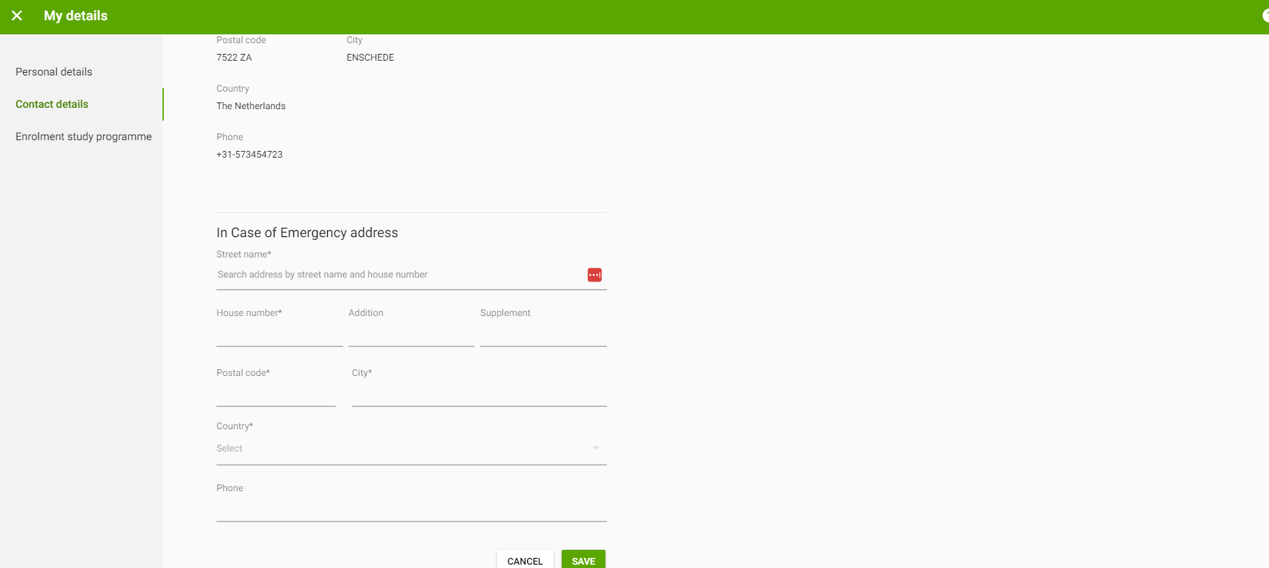
Osiris
Add your Ice information
Fill in the ICE address details
Click on ‘Save’
Notes:
How do you add ICE (In case of emergency) information? 1. Click on ‘update addres’
2. Fill in info and click on ‘save’
3. Click on ‘update address’
4. Give permission right below and fill in the additional info and click on ‘save’ again.

Slide 25
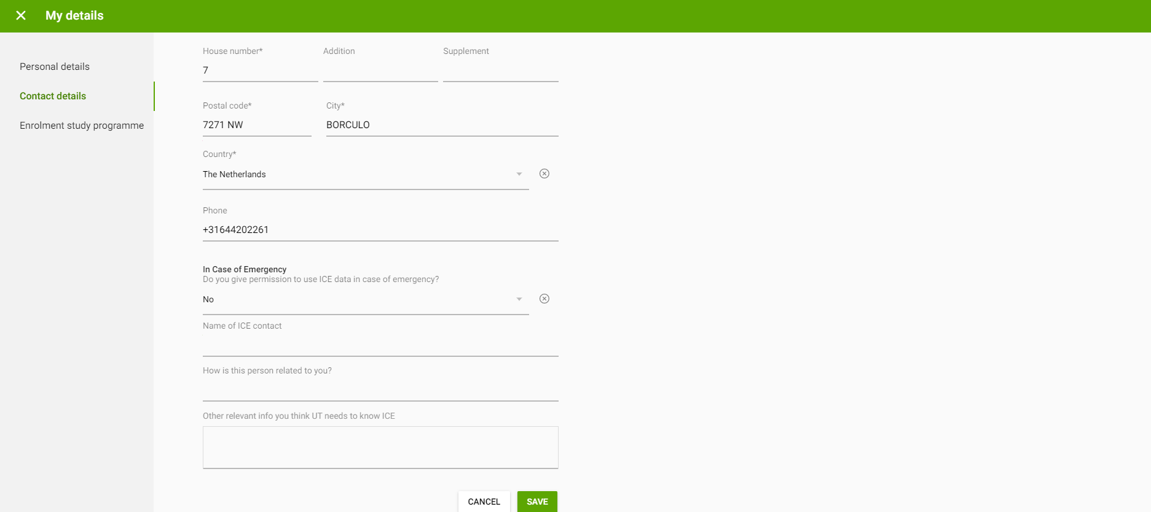
Osiris
Add your Ice information
Give permission and fill in the rest
Click on ‘Save’ again
Notes:
How do you add ICE (In case of emergency) information? 1. Click on ‘update addres’
2. Fill in info and click on ‘save’
3. Click on ‘update address’
4. Give permission right below and fill in the additional info and click on ‘save’ again.

Slide 26
CANVAS
WHAT IS IT FOR?
CONTACT WITH AND ANNOUNCEMENTS FROM TEACHERS
GROUP ALLOCATION
POSSIBLE (SUB/PARTIAL) RESULTS/GRADES FOR EXAMS AND ASSIGNMENTS
PER COURSE CORRESPONDING SITE WITH INFORMATION
COMMUNICATION GENERAL RELEVANT INFORMATION STUDY PROGRAMME
|
3
Notes:
Canvas is the system the university uses to provide more detailed day-to-day information about a specific module, (sub)grades for subtests. Also: collaborate with your group, take online (practice) quizzes, check feedback.

Slide 27
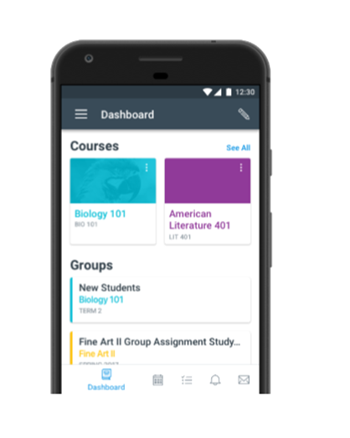
CANVAS
WHERE? CANVAS STUDENT APP OR CANVAS.UTWENTE.NL
HOW? ENTER THE LOGIN WITH STUDENTMAIL AND PASSWORD
(APP?→ FILL IN ‘UNIVERSITY OF TWENTE’ AS SCHOOL)
Be aware of the
TWO-FACTOR-AUTHENTIFICATION
|
3
Notes:
CHANGE: ADD how to log in with phone by calling yourself
To log in you can either download the Canvas application or go to the website. Logging in is the same as in Osiris: with your student number and password.

Slide 28
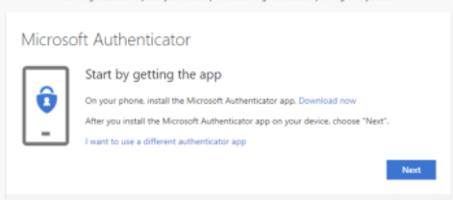
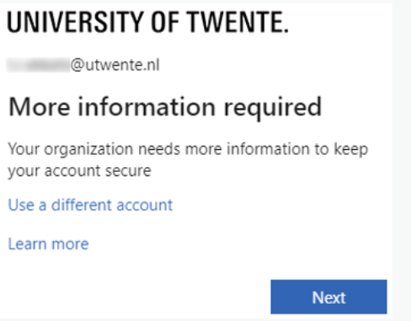
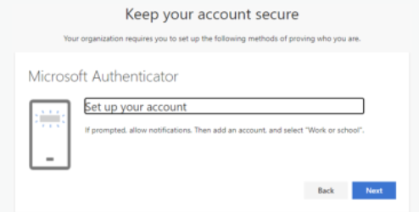
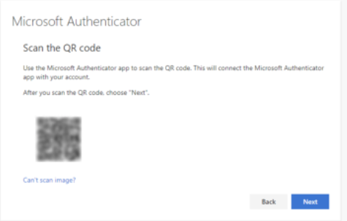
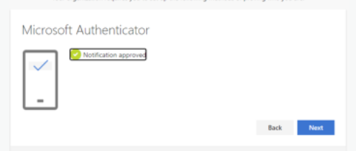
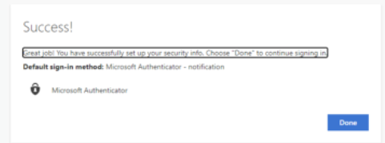
CANVAS Log-In on Your Laptop
TWO-FACTOR authentification
1 | Login with your Laptop at CANVAS.UTWENTE.NL with ICT account. Next you will see the following message:
2 | Click Next and download and install the Microsoft Authenticator app on your phone
3 | Open the Microsoft Authenticator app on your phone and click Next on the pc. Allow the app to access the camera and add an account. Select School 'University of Twente' and click Next on the pc
4 | Scan the QR code displayed on the pc with your phone and click Next.
5 | A test notification is sent, please unlock your phone with fingerprint, face, or PIN and approve.
6 | Click Next, the Microsoft Authenticator app is configured. Click Done in the next screen to continue signing in.
|
More information can be found here: https://www.utwente.nl/en/service-portal/workplace-support/accounts-passwords/multi-factor-authentication-mfa#manuals
3
Notes:
To log in you go to the website. Logging in is the same as in Osiris: with your student number and password.
Follow the steps of the two factor authentication

Slide 29
CANVAS
OVERVIEW
DASHBOARD=HOME PAGE:
OVERVIEW OF ALL ENROLED SITES
CLICK TO ACCESS COURSE SITE
Registration in Osiris is linked to enrolment for course page in Canvas
Notes:
What does Canvas look like? On the left-hand side you see a few icons: account, courses, calendar… When you are looking for an overview of the modules you are registered for, this can be found under the tab DASHBOARD. When you want to go to the module specific information site, you click on the folder corresponding to the module. When you have successfully enrolled for module 1, you can see the folder in this overview, like on this picture.

Slide 30
CANVAS
MODULE PAGE
‘COURSES’= COURSE SPECIFIC PAGE
Notes:
When you have clicked on the module specific folder under DASHBOARD, you will be landed in the tab COURSES. All information that is relevant to the module can be found under the tabs on the right-hand side.

Slide 31
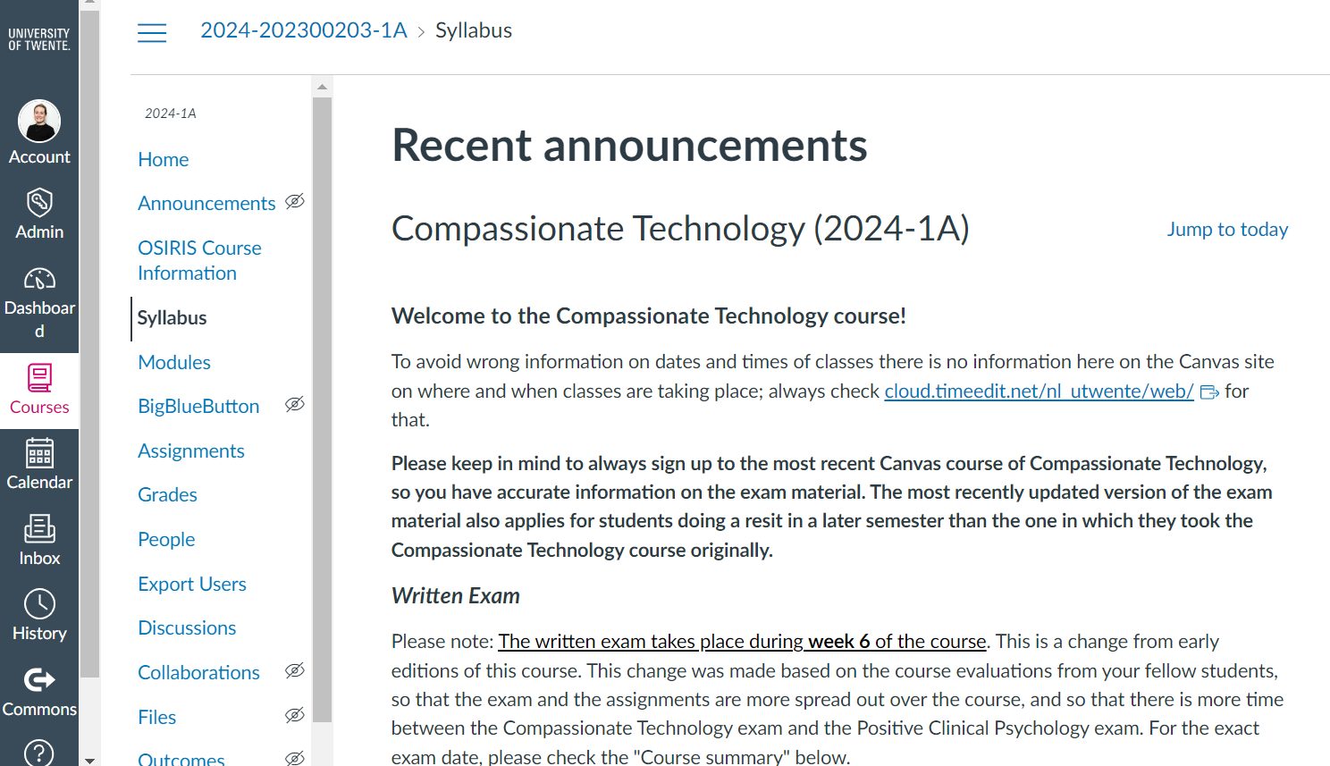
CANVAS
OVERVIEW
Keep up to date with ANNOUNCEMENTS
Messages from teachers
Notes:
For example, to be informed about the last updates, you can go to ANNOUNCEMENTS. This is where teachers post important messages about the module, such as to let you know that the grades of the latest test have been published, to provide you with additional information about a specific lecture.

Slide 32
CANVAS
OVERVIEW
Check your sub/partial results with
GRADES
All grades per sub exam or assignment → Some will also only be uploaded in OSIRIS
Notes:
Once the first test has taken place or the first assignment has been handed in, and the teacher(s) have graded it, they will publish your grade under GRADES. Please note that for some components, the grades will not be published via Canvas, but directly via Osiris, the teacher will inform you about this via an Annoucement.

Slide 33
CANVAS
WHAT IS IT FOR?
CONTACT WITH AND ANNOUNCEMENTS FROM TEACHERS
GROUP ALLOCATION
MODULE INFORMATION
(SUCH AS SYLLABUS, LECTURE SHEETS, ETC)
(SUB) RESULTS/GRADES FOR EXAMS AND ASSIGNMENTS
COMMUNICATION GENERAL RELEVANT INFORMATION STUDY PROGRAMME
|
3
Notes:
Besides providing information about a module, Canvas is also used as a platform for the study programme to inform you about more general study related matters. For example: meetings for the student mentor programme, information about the star-programme (that is our excellence programme), information about the elective modules in year 2, etc. Enrolling for this site is mandatory.

Slide 34
TO DO 4. - CANvAS
REGISTER for CANVAS COURSE
CANVAS NAME:
(Pre-)Master’s programme PSY
4.
Notes:
This is your fourth to do for today. Take a moment to enroll for Bachelor’s programme PSY year 1 2023-2024
Just as for the enrolment for the module in Osiris, give the students a moment to enroll. In the meantime they can ask questions if they don’t succeed. After a few minutes, continue and mention again that students can also do this in the following days, but emphasize it should be taken care of before the start of the year.

Slide 35
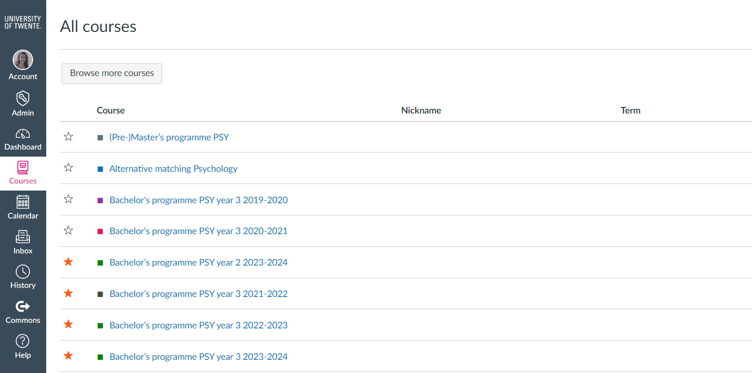
CANVAS
Register for ‘(pre-)master’s programme PSY’
Click on ‘Courses’, then click on ‘all courses’
NOT LINKED TO OSIRIS (AS IT IS NOT A MODULE)
Notes:
For this page you have to enroll yourself, as it is not a module, so it is not linked to Osiris. Just as for the Bachelor’s programme PSY year 1 2023-2024 you can enroll as following: go to the tab COURSES and click in the right-hand corner to search for the Course/page: BROWSE MORE COURSES. When you fill in (even a fraction) of the name of the folder, it will show.

Slide 36
CANVAS
OVERVIEW
Click to search
NOT LINKED TO OSIRIS (AS IT IS NOT A MODULE)
Notes:
For this page you have to enroll yourself, as it is not a module, so it is not linked to Osiris. Just as for the Bachelor’s programme PSY year 1 2023-2024 you can enroll as following: go to the tab COURSES and click in the right-hand corner to search for the Course/page: BROWSE MORE COURSES. When you fill in (even a fraction) of the name of the folder, it will show.

Slide 37
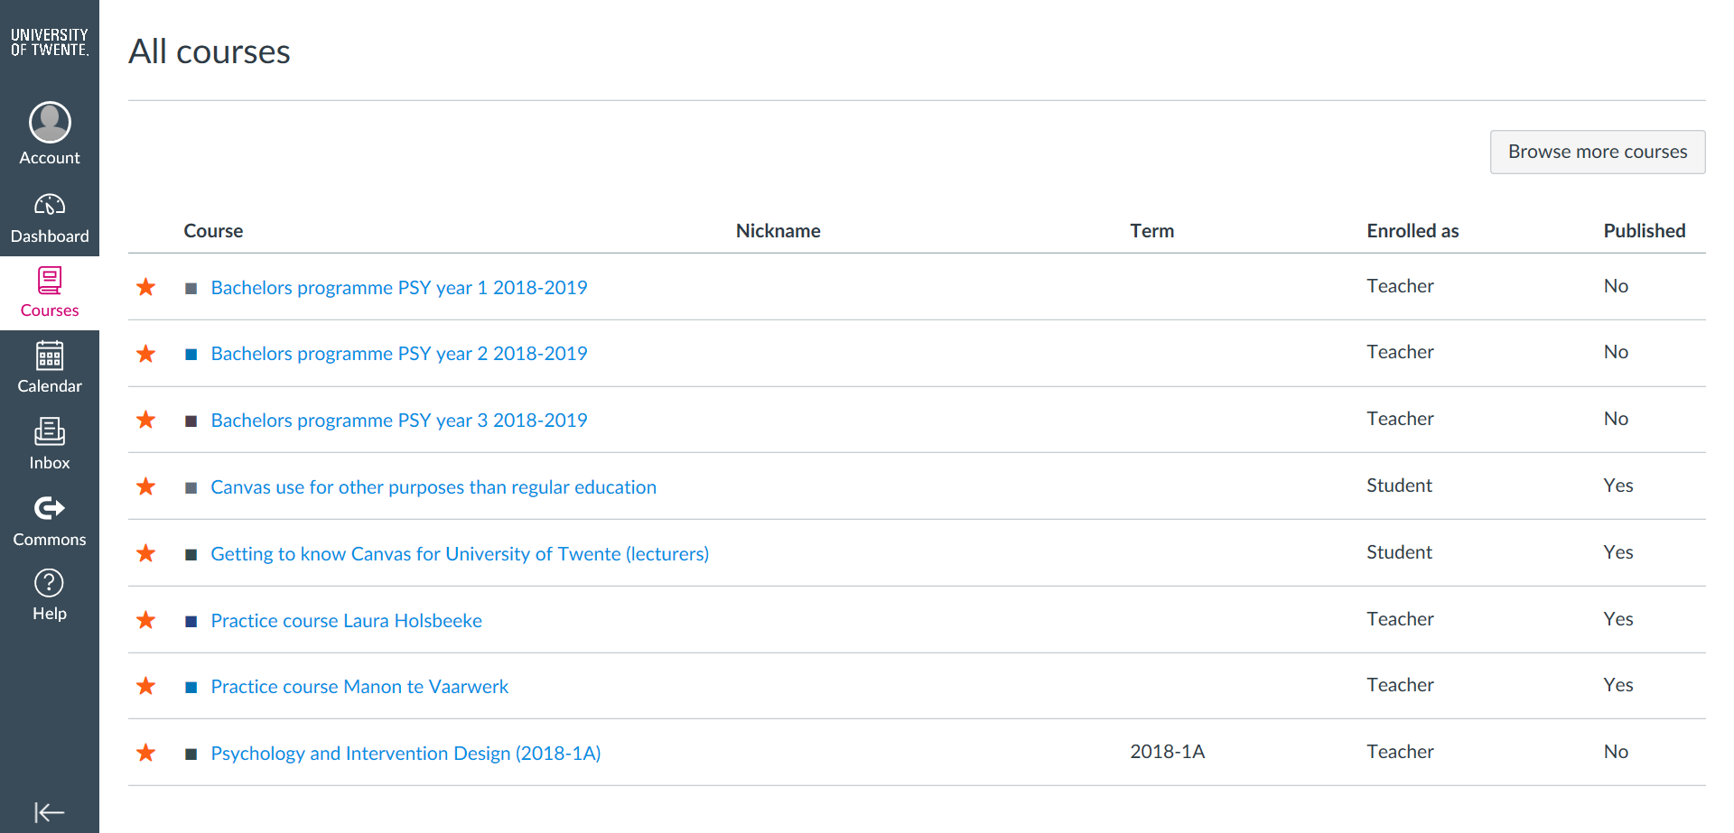
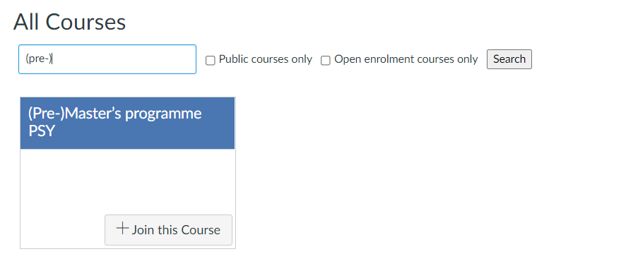
CANVAS
OVERVIEW
Fill in name
Click to search for site
NOT LINKED TO OSIRIS (AS IT IS NOT A MODULE)
Notes:
For this page you have to enroll yourself, as it is not a module, so it is not linked to Osiris. Just as for the Kick In Faculty Days page you can enroll as following: go to the tab COURSES and click in the right-hand corner to search for the Course/page: BROWSE MORE COURSES. When you fill in (even a fraction) of the name of the folder, it will show.

Slide 38
CANVAS
OVERVIEW
Fill in name
Click to search for site
Click to join
NOT LINKED TO OSIRIS (AS IT IS NOT A MODULE)

Slide 39
TO DO 5 - TIMETABLE
YOUR PERSONAL TIMETABLE
5.

Slide 40
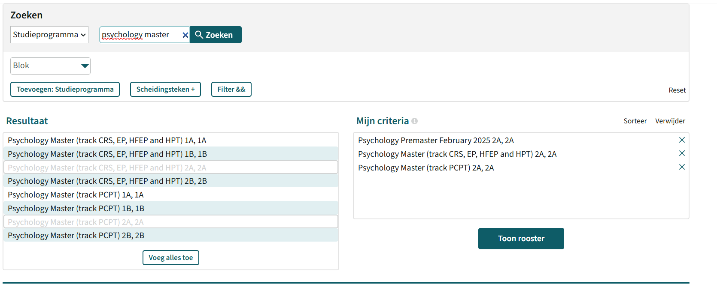
timetable
WHERE? TIMETABLE.UTWENTE.NL
HOW? SUBSCRIBE TO OWN TIMETABLE Google calendar, apple calendar
TimeEdit | Home EDU systems (utwente.nl)
Notes:
Share the live websites
As a student it is important to know when and where you have to attend a lecture, tutorial or other meeting. Your timetable can be found via rooster.utwente.nl. You can also login and subscribe to have a personalized timetable. It is important to check the timetable regularly, as lectures might be subject to change, although in the past rarely, in these times we are uncertain whether it has to. In the timetable you can see whether a lecture or tutorial is online or on campus.
Show them the timetable yourself as well. Click on the picture in the sheet. On the website, click on ADD TIMETABLE and type Psychology and intervention design (or a part of the name). When an overview of all the groups is shown, just pick one to show them an example of what a week might look like. Also show how it shows whether a lecture or tutorial is online or on campus (states online or the building/room). This is week 3 of the study programme, as you can see, on Monday 18 Sept you will have your first exam.

Slide 41
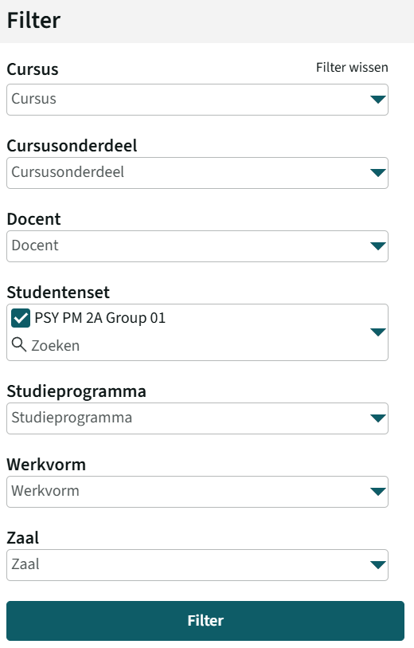
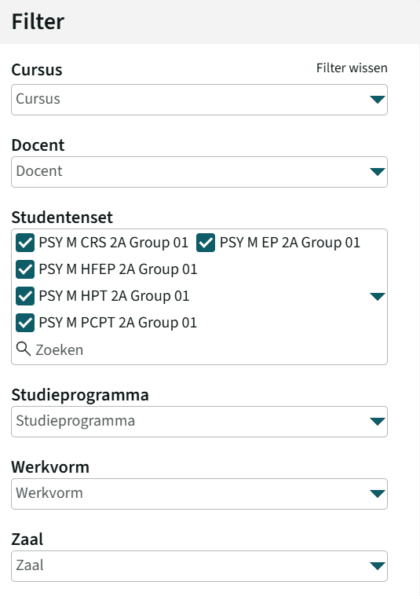
timetable
WHERE? TIMETABLE.UTWENTE.NL
HOW? SUBSCRIBE TO OWN TIMETABLE Google calendar, apple calendar
TimeEdit | Home EDU systems (utwente.nl)
Notes:
Share the live websites
As a student it is important to know when and where you have to attend a lecture, tutorial or other meeting. Your timetable can be found via rooster.utwente.nl. You can also login and subscribe to have a personalized timetable. It is important to check the timetable regularly, as lectures might be subject to change, although in the past rarely, in these times we are uncertain whether it has to. In the timetable you can see whether a lecture or tutorial is online or on campus.
Show them the timetable yourself as well. Click on the picture in the sheet. On the website, click on ADD TIMETABLE and type Psychology and intervention design (or a part of the name). When an overview of all the groups is shown, just pick one to show them an example of what a week might look like. Also show how it shows whether a lecture or tutorial is online or on campus (states online or the building/room). This is week 3 of the study programme, as you can see, on Monday 18 Sept you will have your first exam.

Slide 42
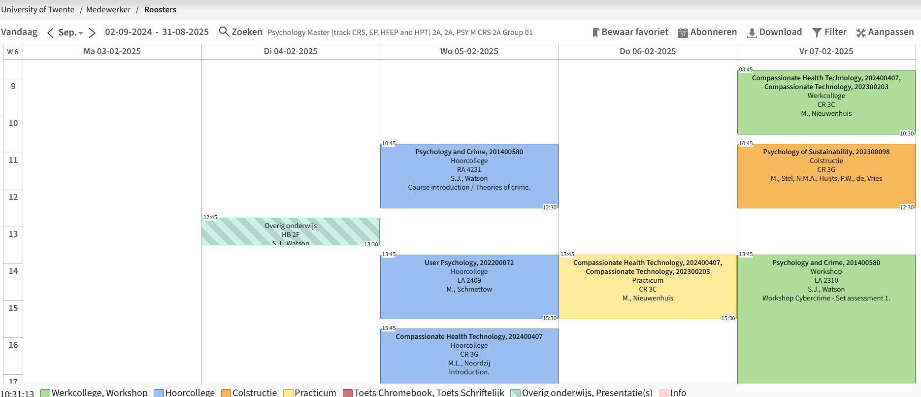
timetable
WHERE? TIMETABLE.UTWENTE.NL
HOW? SUBSCRIBE TO OWN TIMETABLE Google calendar, apple calendar
TimeEdit | Home EDU systems (utwente.nl)
Notes:
Share the live websites
As a student it is important to know when and where you have to attend a lecture, tutorial or other meeting. Your timetable can be found via rooster.utwente.nl. You can also login and subscribe to have a personalized timetable. It is important to check the timetable regularly, as lectures might be subject to change, although in the past rarely, in these times we are uncertain whether it has to. In the timetable you can see whether a lecture or tutorial is online or on campus.
Show them the timetable yourself as well. Click on the picture in the sheet. On the website, click on ADD TIMETABLE and type Psychology and intervention design (or a part of the name). When an overview of all the groups is shown, just pick one to show them an example of what a week might look like. Also show how it shows whether a lecture or tutorial is online or on campus (states online or the building/room). This is week 3 of the study programme, as you can see, on Monday 18 Sept you will have your first exam.

Slide 43
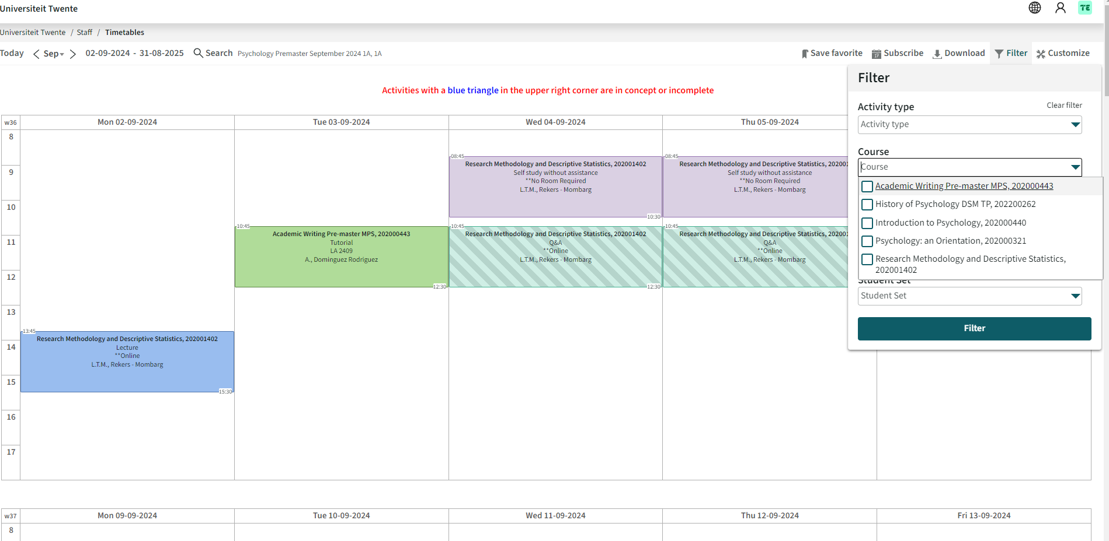
timetable
WHERE? TIMETABLE.UTWENTE.NL
HOW? SUBSCRIBE TO OWN TIMETABLE Google calendar, apple calendar
TimeEdit | Home EDU systems (utwente.nl)
Filter the courses that are part of your (pre)-master’s programme
Notes:
Share the live websites
As a student it is important to know when and where you have to attend a lecture, tutorial or other meeting. Your timetable can be found via rooster.utwente.nl. You can also login and subscribe to have a personalized timetable. It is important to check the timetable regularly, as lectures might be subject to change, although in the past rarely, in these times we are uncertain whether it has to. In the timetable you can see whether a lecture or tutorial is online or on campus.
Show them the timetable yourself as well. Click on the picture in the sheet. On the website, click on ADD TIMETABLE and type Psychology and intervention design (or a part of the name). When an overview of all the groups is shown, just pick one to show them an example of what a week might look like. Also show how it shows whether a lecture or tutorial is online or on campus (states online or the building/room). This is week 3 of the study programme, as you can see, on Monday 18 Sept you will have your first exam.

Slide 44
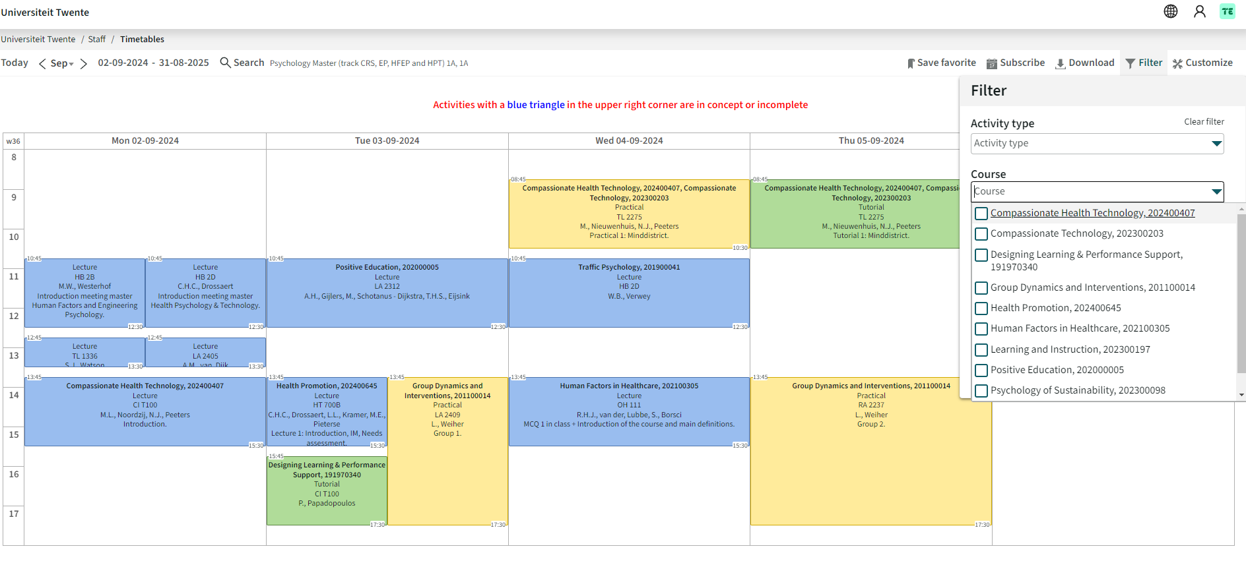
timetable
WHERE? TIMETABLE.UTWENTE.NL
HOW? SUBSCRIBE TO OWN TIMETABLE Google calendar, apple calendar
TimeEdit | Home EDU systems (utwente.nl)
Filter the courses that are part of your master’s programme
Notes:
Share the live websites
As a student it is important to know when and where you have to attend a lecture, tutorial or other meeting. Your timetable can be found via rooster.utwente.nl. You can also login and subscribe to have a personalized timetable. It is important to check the timetable regularly, as lectures might be subject to change, although in the past rarely, in these times we are uncertain whether it has to. In the timetable you can see whether a lecture or tutorial is online or on campus.
Show them the timetable yourself as well. Click on the picture in the sheet. On the website, click on ADD TIMETABLE and type Psychology and intervention design (or a part of the name). When an overview of all the groups is shown, just pick one to show them an example of what a week might look like. Also show how it shows whether a lecture or tutorial is online or on campus (states online or the building/room). This is week 3 of the study programme, as you can see, on Monday 18 Sept you will have your first exam.

Slide 45
timetable
WHERE? TIMETABLE.UTWENTE.NL
HOW? SUBSCRIBE TO OWN TIMETABLE Google calendar, apple calendar
TimeEdit | Home EDU systems (utwente.nl)
Filter the courses that are part of your master’s programme
Notes:
Share the live websites
As a student it is important to know when and where you have to attend a lecture, tutorial or other meeting. Your timetable can be found via rooster.utwente.nl. You can also login and subscribe to have a personalized timetable. It is important to check the timetable regularly, as lectures might be subject to change, although in the past rarely, in these times we are uncertain whether it has to. In the timetable you can see whether a lecture or tutorial is online or on campus.
Show them the timetable yourself as well. Click on the picture in the sheet. On the website, click on ADD TIMETABLE and type Psychology and intervention design (or a part of the name). When an overview of all the groups is shown, just pick one to show them an example of what a week might look like. Also show how it shows whether a lecture or tutorial is online or on campus (states online or the building/room). This is week 3 of the study programme, as you can see, on Monday 18 Sept you will have your first exam.

Slide 46
timetable
Individual schedule
Abbreviation | Building
RA | Ravelijn
ZI | Zilverling
WA | Waaier
HB | Hal B
CR | Carré
HR | Horstring
CU | Cubicus
VR | Vrijhof
BA | Bastille
SC | Sportcentrum
SP | Spiegel
CI | Citadel
ACADEMIC CALENDAR :
www.utwente.nl/ces/planning-roosters/en/academic-calendar/calendars
Notes:
This is a short explanation again on how to find your timetable. On the right-hand side you can find an overview of all the buildings and their abbreviations.
Important: Latest next week on Monday you will know your group number for module 1.
@Mentors: it’s not sure yet whether the students will already be in their projectgroup, so if not, they will be informed about group number on Monday 4th of September. We will let you know before the meeting whether the groups are already the projectgroups or not.

Slide 47
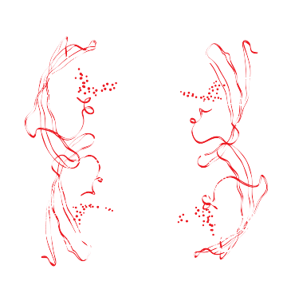
CAMPUS APP

Slide 48
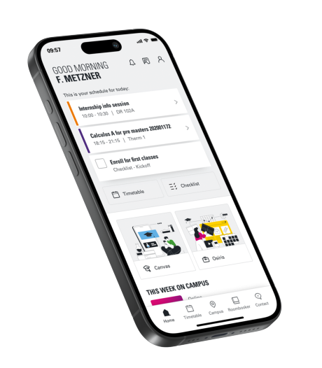
MY UT APP
FIND YOUR WAY
PERSONAL TIMETABLE
NAVIGATION ON CAMPUS (BUILDING TO BUILDING)
DISCOVER THE CAMPUS WITH POINTS OF INTEREST
EVENTS ON CAMPUS
TO DO’S
CONTACT
Notes:
There is a solution to this ‘problem’. If you wish to know where you need to be and how you are going to get there, you can download the CAMPUS APP. This gives you more information about each building on campus and also the estimated time it takes to get there. It also offers other things that might be interesting.
Appstore: Campus/universityoftwente

Slide 49
HOW TO FIND YOUR WAY AROUND? USE MAZEMAPP APP
MOST COMMON LECTURE HALLS
WAAIER, CARRE, RAVELIJN, SPIEGEL
Notes:
You might have been on a (virtual) campus tour already, so hopefully by now you’re a little familiar with the campus. Still, in the first week or weeks you will perhaps wander around to find the exact location of a lecture or tutorial.
These will most of the time take plasce in the buildings mentioned on the sheet. But as you have probably already noticed it might take some time to get from one building to another, especially when you do not know where it is. Besides the (virtual) campus tour that showed you around and which you can find on the Kick In Faculty Days Canvas page, there is also an application to get around on the campus.

Slide 50
PSY STAFF
WELCOMES YOU.
Notes:
Thank you for your attention!

