Slide 1
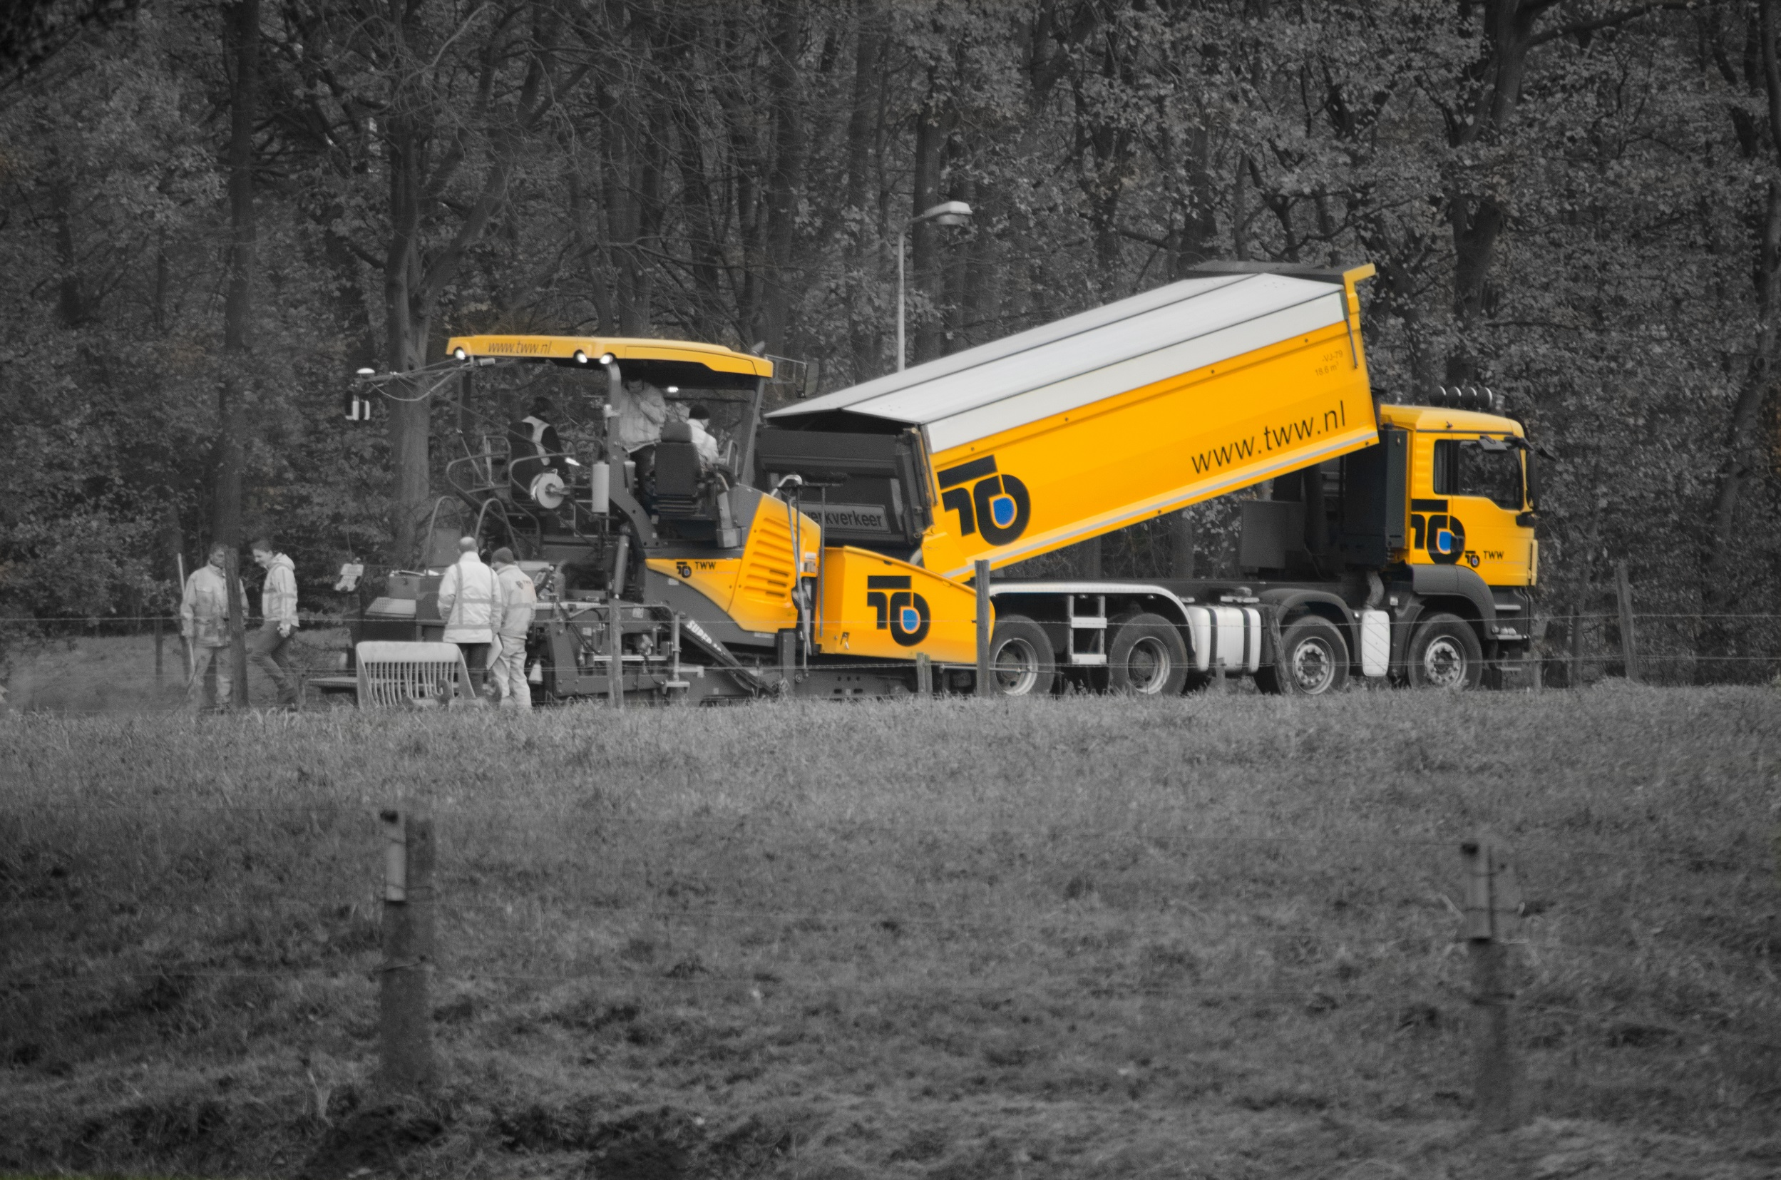
Implementing a health condition monitoring system for asphalt roads on the UT Campus
Seirgei Miller
ASPARi

Slide 2
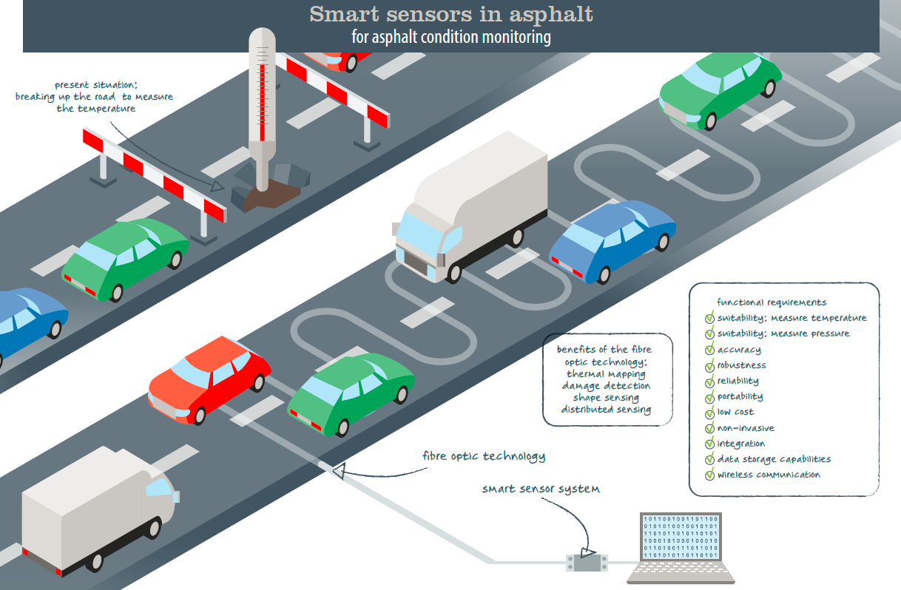
Fibre optic sensors

Slide 3
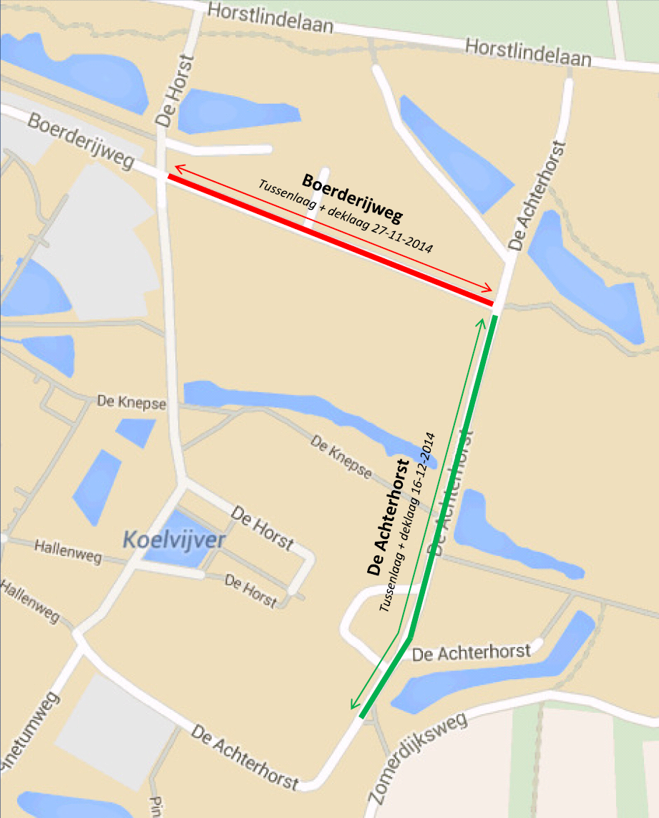
Reconstruction of the Boerderijweg & de Achterhorst in Nov & Dec 2014
TWW reconstructed 2 asphalt layers (bind & surfacing)
ASPARi conducted a full Process Quality Improvement (PQi) monitoring exercise
Temperature homogeneity
Compaction consistency
Asphalt cooling behaviour
Asphalt density progression

Slide 4
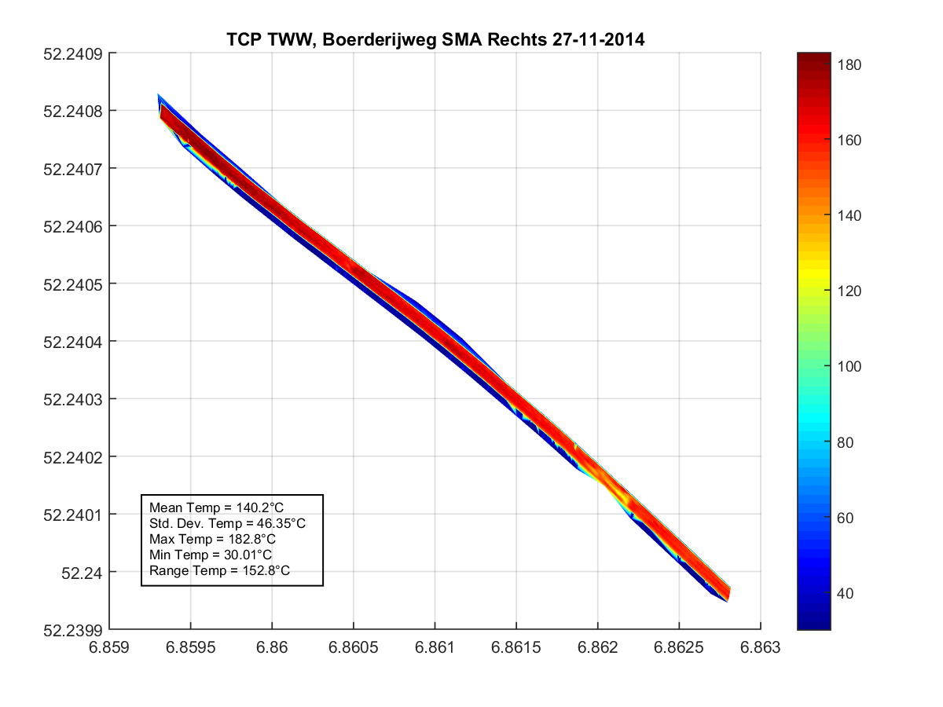

Slide 5
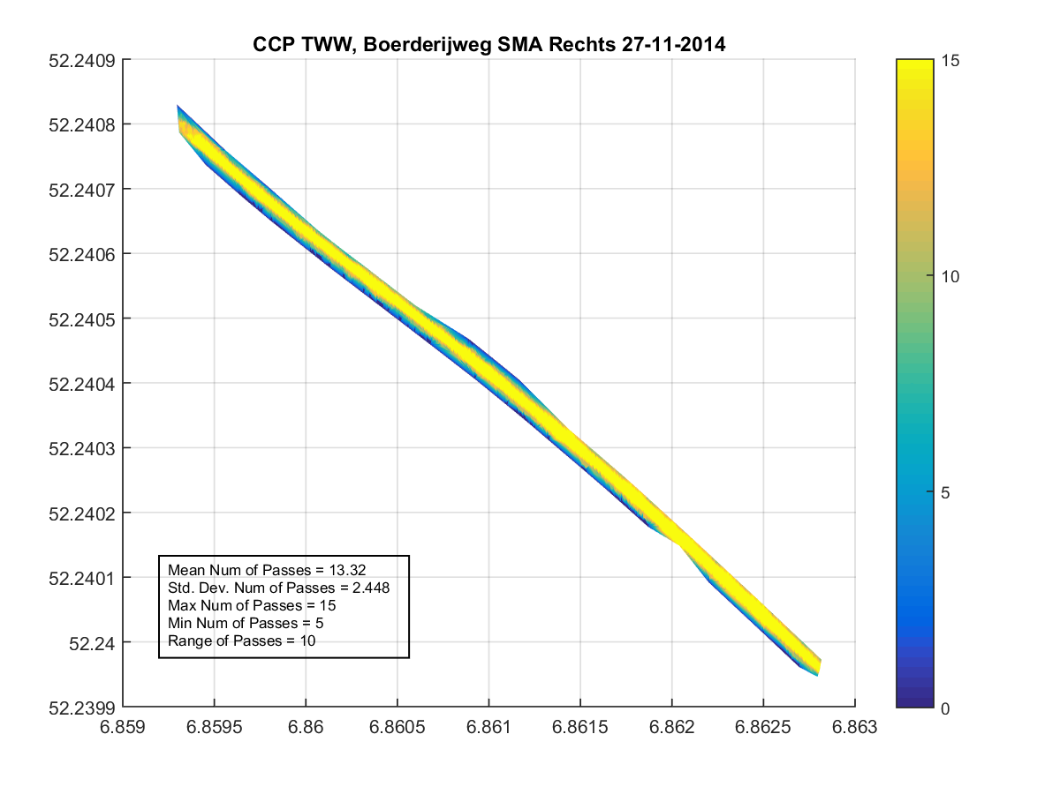

Slide 6
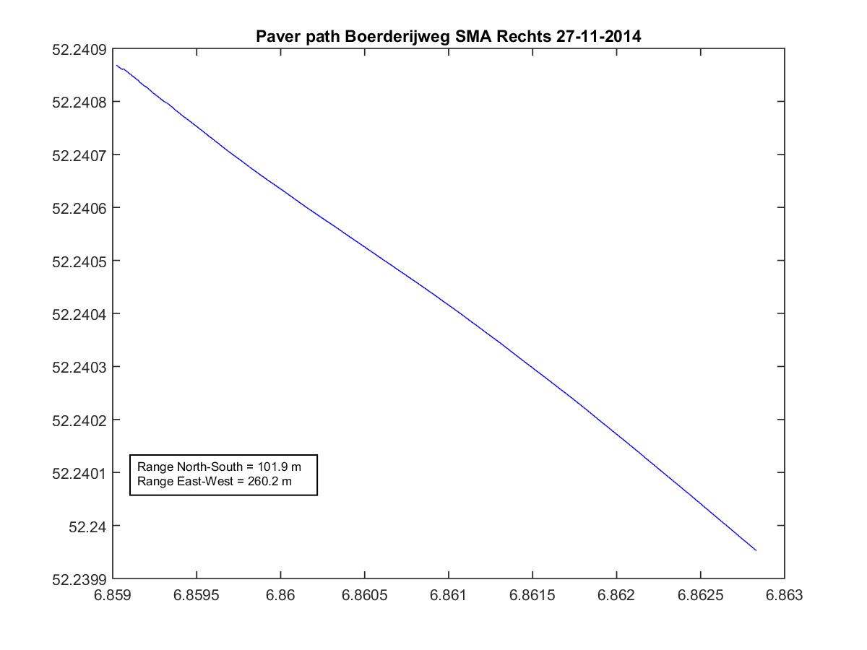
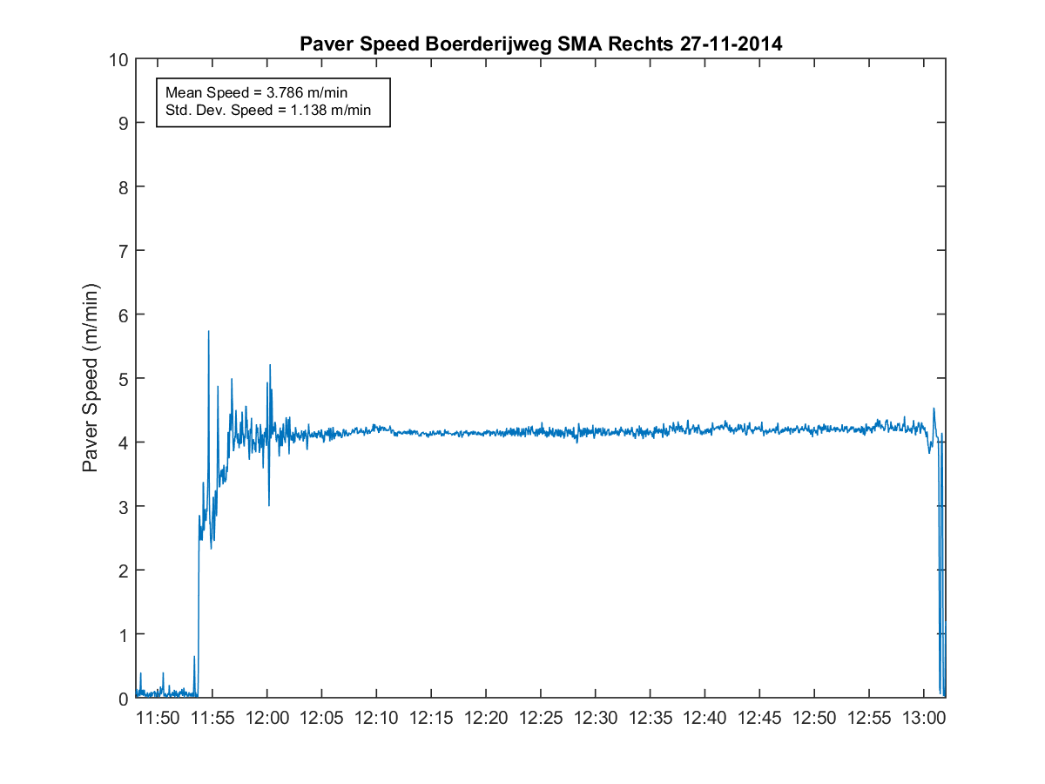

Slide 7
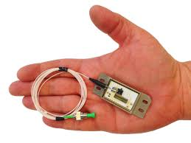
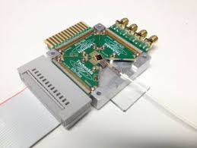
What are we proposing to do?
Cut groove into the 2 asphalt layers
Different depths viz. 30mm & 50mm
Install Fibre Bragg Grating sensors in the asphalt layers
Measure temperature and strain
Monitor asphalt pavements life cycle

Slide 8
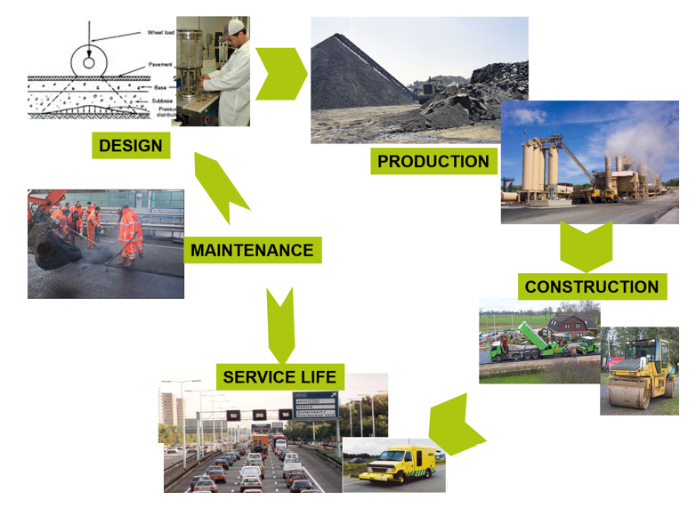
There is much to be learnt and gained …

Slide 9


Thank you for listening … are there any questions?

