Slide 1
Technical Physician at work
Innovate, Implement & Impact
@DrJonneDoorduin #TechMedEvent

Slide 2
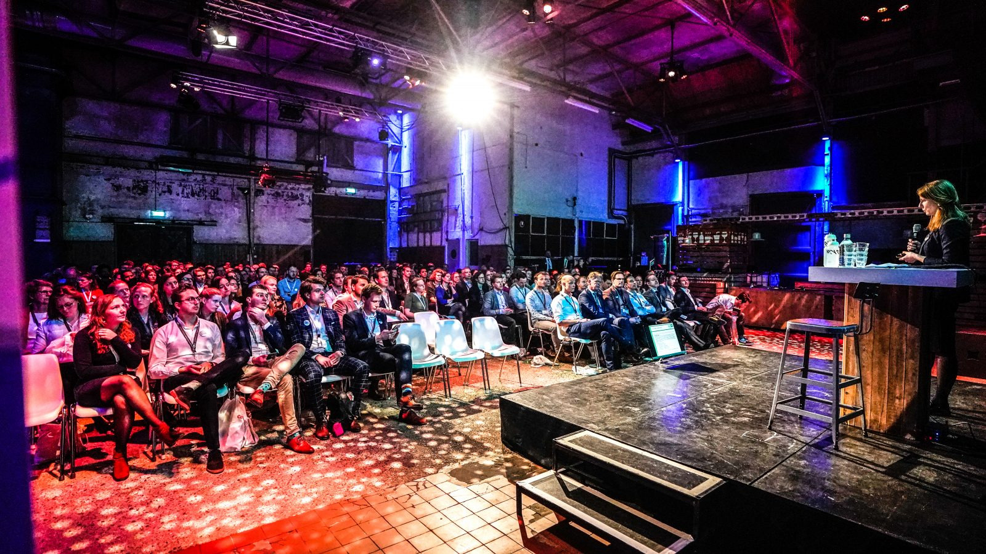

Slide 3
Innovate
Neurally controlled diaphragm pacing

Slide 4
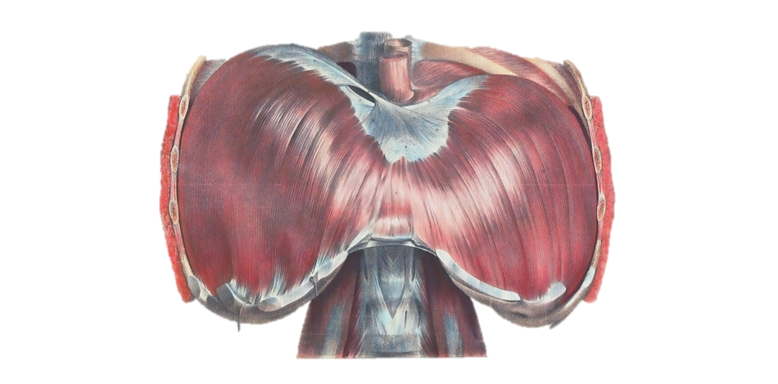

Slide 5
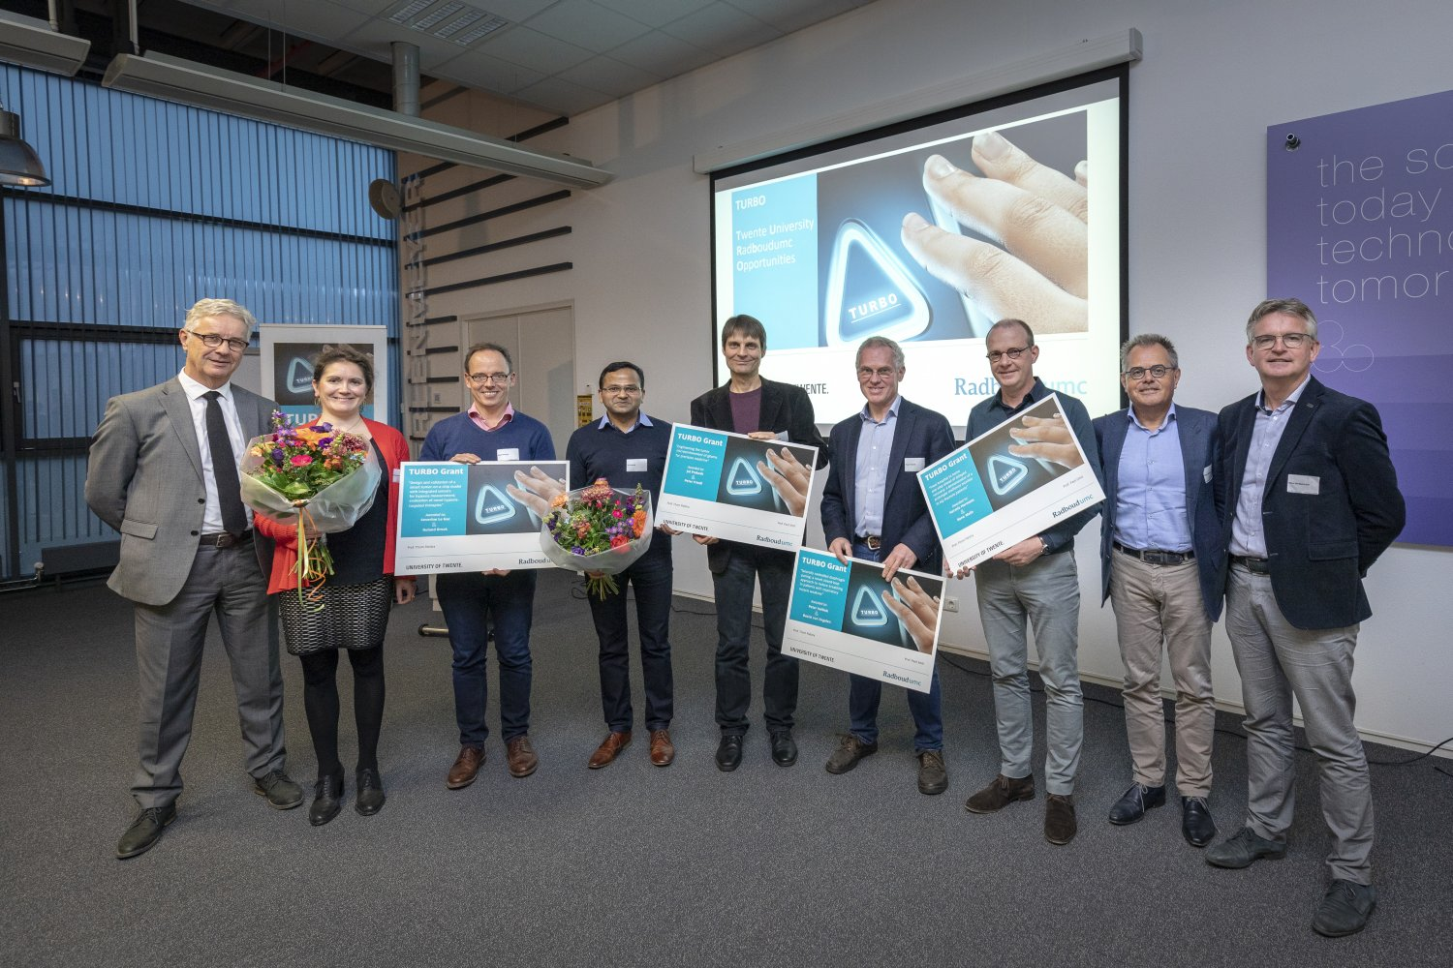

Slide 6
Implement & Impact
Diaphragm dysfunction in critically ill patients

Slide 7
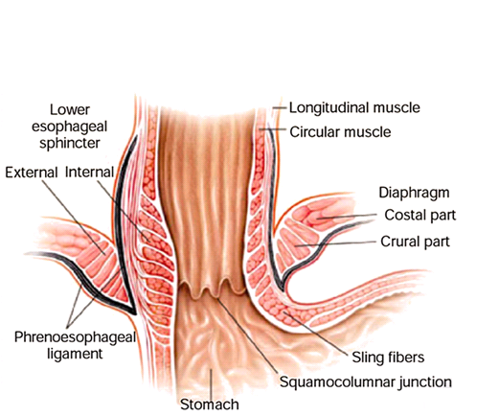
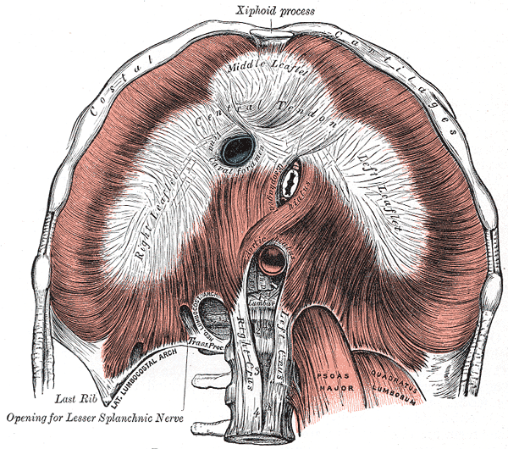
latex balloon
9 electrodes
EMG
latex balloon

Slide 9
Implement & Impact
Intra-operative neuromonitoring

Slide 10
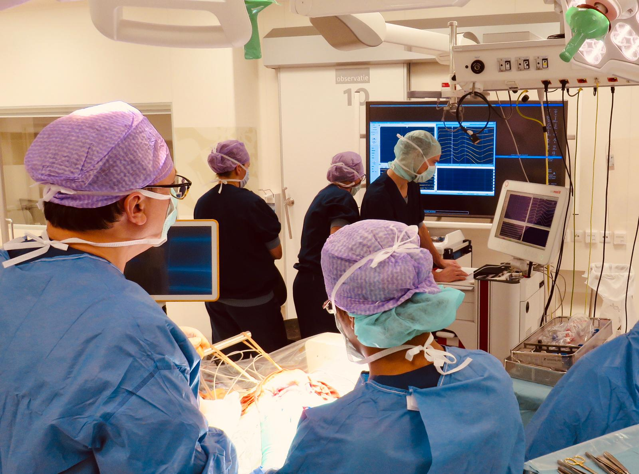

Slide 11
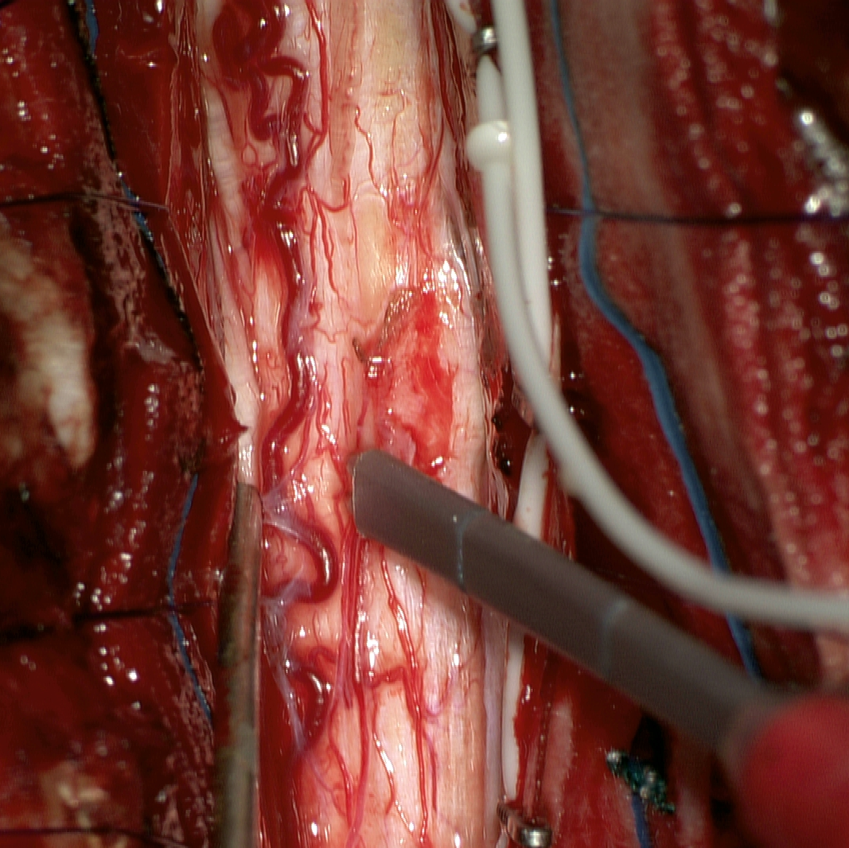
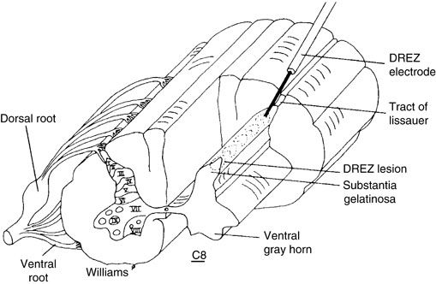
electrodes
2 mm
stimulator

Slide 12
Clinical Neurophysiology - Neurology
Jeroen van Doorn
Nens van Alfen
Baziel van Engelen
Neurosurgery
Erkan Kurt
Intensive Care
Lisanne Roesthuis
Hans van der Hoeven
Eline Oppersma
Peter Veltink
Leo Heunks

Slide 13
