Slide 1
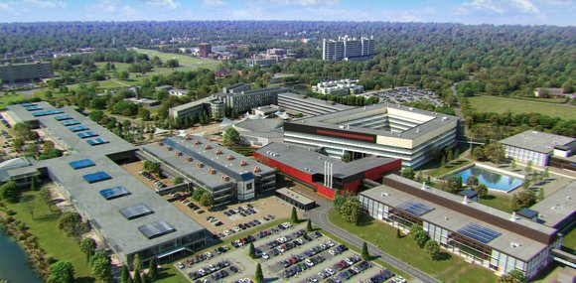
U_{T}maintain: improving Campus livability
(www.utwente.nl/utmaintain)
Dr. Ir. Alberto Martinetti
Ir. Roberto Reyes Garcia
Dr. Wilbert Samuel Rossi
|
|
LIVING SMART
CAMPUS
1

Slide 2
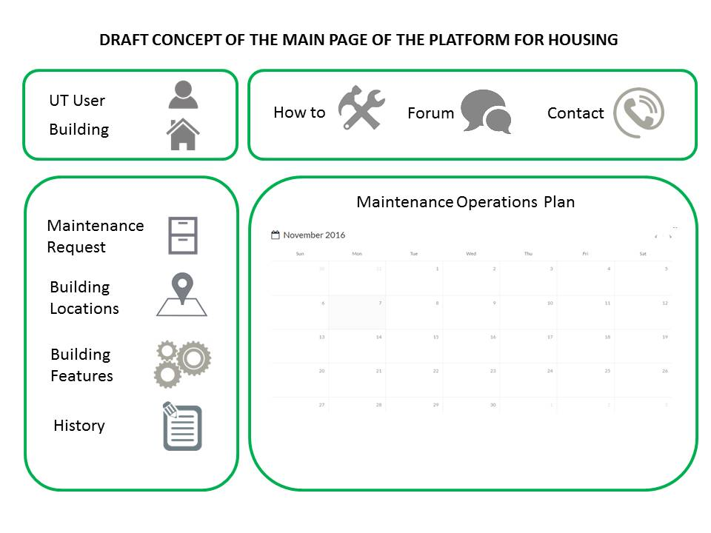
OUR PROJECT – IN SHORT
Involve the campus community in a new concept of “participated maintenance”.
An ONLINE PLATFORM that enables people to point out existing problems,
submit maintenance requests and monitor the repair progresses.
an improved livability of the Campus
renewed sense of community and responsibility
THE PROPOSAL WILL FOCUS ON THE HOUSING OF THE CAMPUS
|
|
LIVING SMART
CAMPUS
2

Slide 3
PLANNING
REDUCE IT TO THE NEXT FIVE MONTHS
All maintenance activities in the Campus facilities take place in two different contexts:
· the educational buildings, sport and cultural facilities etc.(from now on: the facilities)
· the students and staff housing in the campus (from now on: the housing)
|
|
LIVING SMART
CAMPUS
3

Slide 4
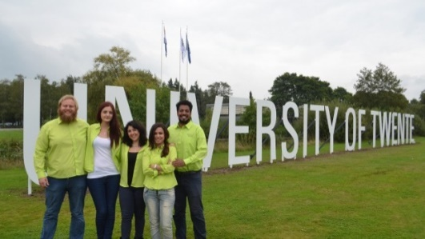
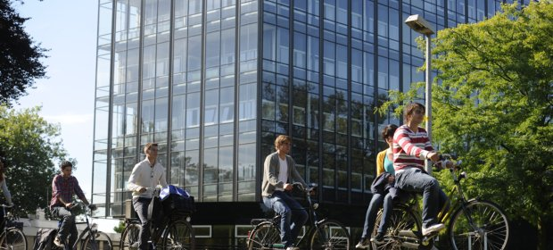
A VALUE FOR EXTERNAL STAKEHOLDERS
A Win (user) - Win (maintenance company) – Win (UT) solution
The user will have the opportunity to request for maintenance interventions, upload pictures of the problem, check the status of the request, be informed on future maintenance actions in his/her place;
The UT will benefit in terms of reliability, maintainability and safety of the Campus structures;
The maintenance companies will be able to communicate easily and immediately with the users, scheduling interventions or asking for further monitoring actions.
|
|
LIVING SMART
CAMPUS
4

Slide 5
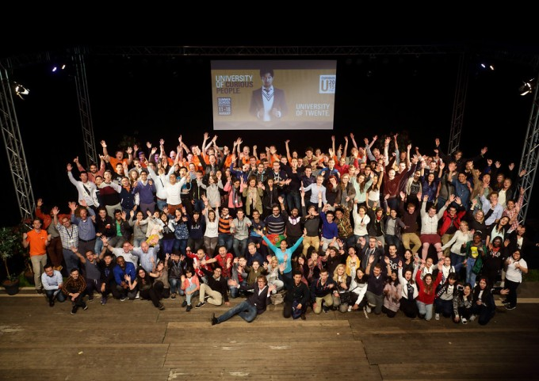
WHO & WHAT WE NEED
Participation of stakeholders
De Veste
Maintenance companies involved in maintenance tasks
Staff/students living on campus
Fund for student assistants, PDEng / Phd or postdoc to create the platform, the app and the promotion
Bachelor/Master graduation assignments or capita selecta
student union/student association
ICT resources
Brainstorming meetings with PhDs, researchers and stakeholders for shaping the project
|
|
LIVING SMART
CAMPUS
5

Slide 6
PROJECT PROMOTION AND AWARENESS OF LSC
1. Transfer the message that people have to be responsible and part of a community
2. 6 months before the end of the project UT has to promote the action involving the community.
STOP catching Pokemon!
START catching Failures!
3. Flyers with QR code explaining the platform and the app with example and opportunities.
4. Rewarding opportunities to get “maintenance points” for free lunch/dinner at the canteen, t-shirts, gadgets…
|
|
LIVING SMART
CAMPUS
6

Slide 7
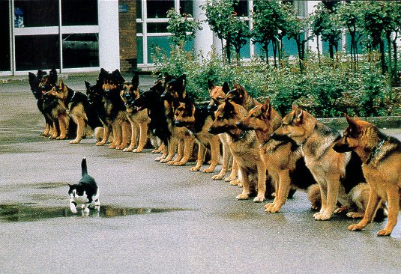
THANKS FOR YOUR ATTENTION
|
|
LIVING SMART
CAMPUS
7

