Slide 1
The relationship between gender and leadership: threats and opportunities
Prof. dr. Janka Stoker
Faculty of Economics and Business
19 April 2012

Slide 2
Washington Post, ‘On Leadership’
Leadership is one of those magic things that's hard to define but pretty easy to identify when you see it. And in recent years, it seems to have been in short supply.
Bradlee and Pearlstein, dec. 2008

Slide 3
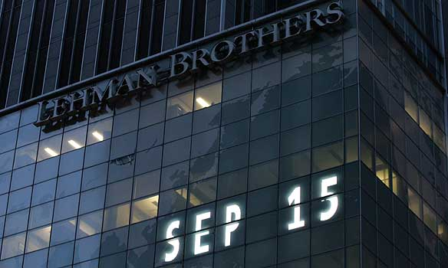
Would we be in this mess today if it had been Lehman Sisters?

Slide 4
Content
Is there a difference between male and female leaders?
What kind of ideal leaders do ‘we’ look for?
Confronting 1 and 2 -> What can be done?

Slide 5
What is leadership?
Leadership involves a process whereby intentional influence is exerted by one person over other people to guide, structure, and facilitate activities and relationships in a group or organization (Yukl, 2006).
This can be done by leadership styles/behaviors, traits, motives, activities, etc.
Today, we focus on styles of leaders

Slide 6
The romance of leadership
James Meindl: “… we may have developed highly romanticized, heroic views of leadership.”
So…
If performance of an organization is either very good or very bad, it is all because of leadership.

Slide 7
1. Is there a difference between male and female leaders?

Slide 8
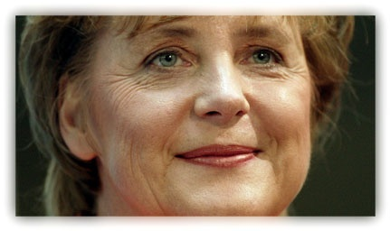
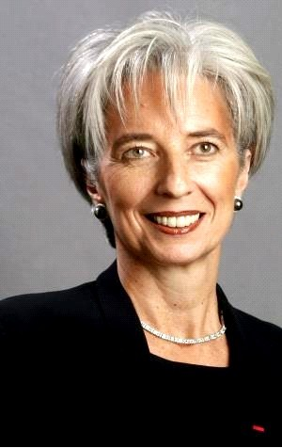
The feminine advantage (Gary Yukl)

Slide 9
Do women and men indeed differ in leadership?
Meta-analysis, 45 studies (Eagly, Johannesen-Schmidt & Van Engen, 2003)
Transformational, transactional, and laissez-faire:
Transformational = inspiring, be a role model, state future goals, individualized consideration (mentor and empower followers)
Transactional = appeal to self-interest, calrifying responsibilities, reward for performance
Laissez-faire = non-leadership
Results:
Female leaders are more transformational
Male leaders show more laissez-faire leadership
Differences are small
Conclusion Eagly et al (2003): leadership styles on which women exceeded men relate positively to leader’s effectiveness
So: Yukl is right??

Slide 10
Two dutch studies on observed leadership
Intermediair 2005: 3200 subscribers describe their own (current) manager, in terms of masculinity and femininity:
Masculine leadership = taking risks, result and task oriented, dominant, strong personality
Feminine leadership = caring, human orientend, communicative, sensitive
Leads to four different types of leaders (Bem, 1973):
Undifferentiated (no strong personality, unsensitive, unconsiderate) -> relates to laissez-faire
Masculine (powerfull, independent, dominant and willing to take risks)
Feminine (warm, sensitive, considerate to others, communicative)
Androgynous (powerful, strong personality, communicative, sensitive) -> relates to transformational
(M&O, 2007, 1, pp 5-17)

Slide 11
Results Intermediair-study 2005
Is there a ‘the feminine advantage’?
No: male and female leaders are alike in the feminine and masculine category.
However, there is a striking difference between undifferentiated and androgynous (cf Eagly et al!).
 | Undifferentiated |  | Feminine |  | Masculine |  | Androgynous
Male mgr |  | 32% |  | 25% |  | 22% |  | 21%
Female mgr |  | 22% |  | 27% |  | 20% |  | 31%
Notes:
Eerst cijfers toelichten.
Dan:
Hoort onze minister bij die 31%?
Dit is gebaseerd op het oordeel van mensen die hun eigen directe manager beschrijven, en dat bent u niet voor mij.
Maar u bent het natuurlijk wel voor ons allemaal hier, zij het op hele verre afstand, dus laat ik toch een poging wagen.
Als ik ga afstrepen leidt dat tot een aantal conclusies:
ongedifferentieerde leiders doen weinig, en dat kan u niet verweten worden, denk aan uw standvastige opstelling met de vorige staatssecretaris.
feminien lijkt mij ook niet aan de orde: volgens mij bent u behoorlijk no-nonsens, en laat u zich niet alleen door gevoelens leiden.
Masculien, tja, ik kan me ministers voorstellen die daar stukken hoger op scoren.
Dus blijft er een over, en dat is androgyn. Maar als echte androgyne leider zou u wellicht wat meer kunnen doen aan het realiseren van de streefcijfers voor vrouwelijke hoogleraren. Ik geef u aan het eind graag een aantal adviezen.

Slide 12
Results 2005 (continued)
Undifferentiated leaders get the lowest ratings, androgynous leaders are ranked highest:
So: female leaders get high grades, but not because of their femininity: they seem to be able to combine both masculine and feminine characteristics.
 | Satisfaction with manager (grade) | Job satisfaction | Perceived team effectiveness
Undifferentiated | 5,6 | 3,5 | 3,4
Feminine | 7,1 | 3,7 | 3,5
Masculine | 6,7 | 3,7 | 3,7
Androgynous | 7,8 | 4,0 | 3,8

Slide 13
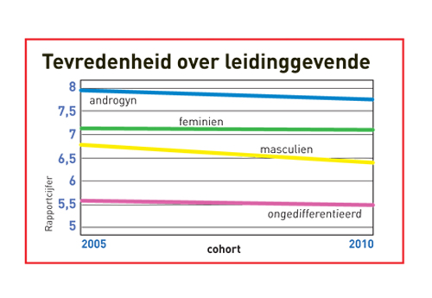
Results 2010: same direction
Again, employees are not specifically happy with masculine leaders.
People still prefer leaders that combine both feminine and masculine characteristics.

Slide 14
Conclusions: differences in leadership?
Although differences are small, results do point into the direction that females show somewhat different leader behaviors than men
Be aware: this does NOT imply in anyway a ‘nature’ difference
These behaviors are also strongly related to effectiveness
So… why are there then still so little female leaders?
Two often heard explanations were also studied in the 2005 Intermediair-study:

Slide 15
Results 2005:
‘Women are less ambitious’, but results show:
No differences in ambitions between highly-educated men and women
Participating female managers even indicate that they consider their private life less inportant tham male managers
‘Women are less self-confident’, but results show:
No differences in self-confidence between highly-educated men and women
So again… why then so little female managers?

Slide 16
2. What kind of ideal leaders do ‘we’ look for?

Slide 17
What is this?
Notes:
Wat is dit?
Alle franse mannen hebben een snor, een alpinopet, en drinken wijn met stokbrood.
De volgende is iets moeilijker...

Slide 18
Notes:
De oude, vrijgezelle, brildragende, enigszins verzuurde, seksloze blibliothecaresse.
De volgende is voor u minder lastig...

Slide 19
And how does the stereotype of the ideal leader look like?

Slide 20
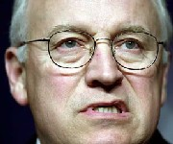
The ideal leader…

Slide 21
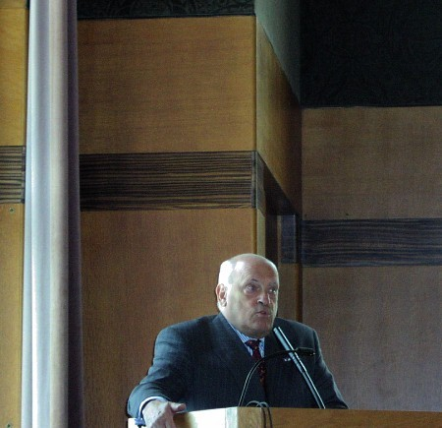
…is still masculine

Slide 23
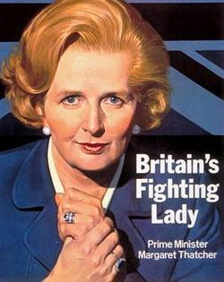
This creates a ‘double bind’ for female leaders
The stereotypical ideal leader is masculine
The stereotypical ideal woman is feminine
SO:
Being a female leader always creates a problem: you are either seen as a ‘good’ leader, but a ‘bad’ (hard, tough) woman
OR you are seen as a ‘good’ (warm, nurturing) woman, but a bad leader
So, in the past at least, female leaders had to chose
the first option in order to be successful…

Slide 24
And after the financial crisis?
The ideal leader in 2010 is indeed …

Slide 25
Results Dutch studies in 2005 and 2010
Respondents: my ideal leader is masculine
2010 with crisis salient: the ideal leader is masculine, and particularly less feminine!
And be aware: especially male managers have these strong assumptions about ideal leadership…

Slide 27
Conclusions on ideal leaders ‘we’ look for
Stereotypes are quite persistent, among males and females
The financial crisis seems to strengthen the need for leadership that was at the root of this crisis…
There is a strong gap between:
actual experiences of people when assessing/rating their own leader, and
Their description of an ideal leader
There is hope for academia: a meta-study of Koenig et al (2011): in ediucational organizations, stereotypes of leaders are LESS masculine
But there is also a downer in academia…

Slide 28
Stereotypes in recommendation letters (Madera et al, 2009)
Study on differences in masculine (agentic) and feminine (communal) characteristics in letters of recommendation, for men and women, applying for academic positions
Results:
women were described as more feminine/communal and less masculine/agentic than men
communal characteristics have a negative relationship with hiring decisions in academia that are based on letters of recommendation
And it is known that letters of recommendation continue to be heavily weighted and commonly used selection tools, particularly in academia

Slide 29
And current times of crisis amplify this…
Henriette Harman (Leader House of Commons, UK) states that there are more and more Boards that are becoming ‘men-only’. Argument:
‘because the economy is in difficulty we should put equality on the backburner. It is a luxury we cannot afford right now’ (Sealy, Vinnicombe & Dolder, 2009).

Slide 30
3. So confronting 1 and 2:
…What can be done?

Slide 31
Let’s be realistic: it is difficult to change!
http://www.youtube.com/watch?feature=player_detailpage&v=FSIkjNaICsg

Slide 32
So just ‘wait and see’ is not an option
Dissertation of Marieke van den Brink (2010): Behind the Scenes of Science. Gender practices in the recruitment and selection of professors in the Netherlands. She advices:
Be aware of the ‘similar-to-me’ effect and stereotypes
Monitor and stimulate female talent
Organise mentoring, networking and support
Recruit in open procedures
Have clear selection procedures and have a significant amount of females in the selection committee
Comply or explain after selection

Slide 33
‘20 in 2020’ (LNVH): indeed, action is needed

Slide 34
How? Some input for the discussion café
Quota: pressure from outside (Neelie Kroes: “I am proud to be quota’ed”)
Special programmes for females, such as at RUG: Rosalind Franklin programme
The Rosalind Franklin Fellowship Programme offers a career path that will eventually lead to a professorship. The Rosalind Franklin Fellowship Programme is an initiative of the University of Groningen that opens the way to professorships for talented female academics. At the start of their research, the Fellows immediately receive a budget to cover the costs of a PhD position and related facilities. If the programme is completed successfully, the Fellow will be appointed an Associate Professor within five years. After another period of five years, she will be appointed a Full Professor.
The University’s requirements for participation in the Rosalind Franklin Fellowship Programme are accordingly high. The programme searches for young female academics who are internationally considered exceptionally talented in their field of study. They must already have published research in top academic journals and have successfully raised external funding.
All three rounds have turned out to be very successful. Nearly all of the first twenty Fellows have in the meantime been appointed as Associate Professors.

