Slide 1

Dynamic Routing of Police Helicopters, Waste Trucks and Container Vessels
Martijn Mes
Department of Industrial Engineering and Business Information Systems
University of Twente
The Netherlands
Joint work with: Albert Douma, Maria Iacob, Marco Schutten,
Arturo Pérez Rivera, Rick van Urk, and Erwin Hans.
Friday, November 1, 2013
University of Maryland, College Park, MD

Slide 2

OUTLINE
Dynamic planning of…
Waste trucks
  Case: Twente Milieu.
  Approach: dynamic collection policy, inventory routing, heuristic, simulation optimization.
Police helicopters
  Case: Dutch Aviation Police and Air Support.
  Approach: anticipatory routing to forecasted incidents, MILP, heuristic.
Container vessels
  Case: Port of Rotterdam.
  Approach: multi-agent system, decision support application, and serious game.

Slide 3
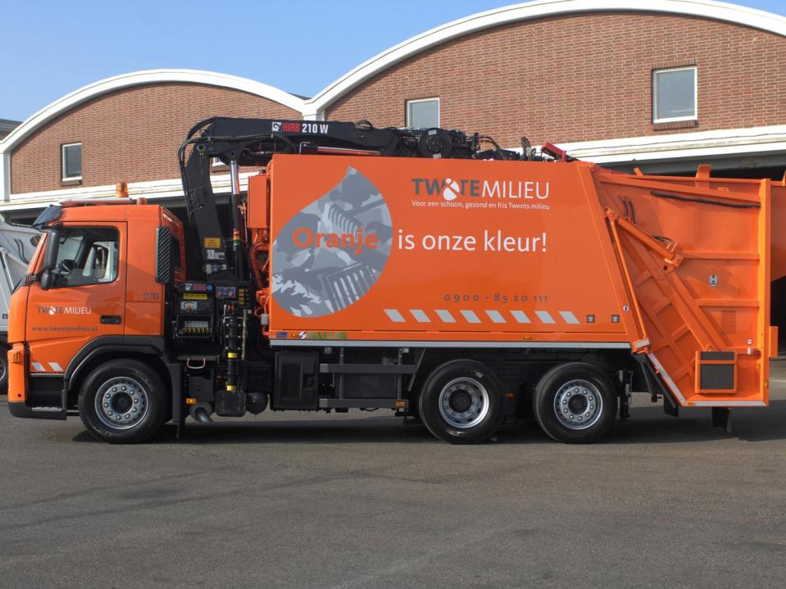
PART 1: WASTE TRUCKS

Slide 4


THE COMPANY
Twente Milieu: a waste collection
company located in the Netherlands.
Main activity: collection and
processing of waste.
But also: cleaning of streets and
sewers, mowing of verges, road ice
control, and the control of plague
animals.
One of the largest waste collectors in the Netherlands when it comes to the #households connected to their network.
Yearly collection of around 225,000,000 kg of waste from a population of around 400,000 inhabitants.

Slide 5
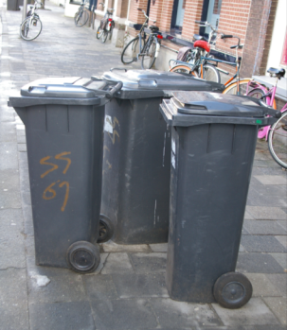
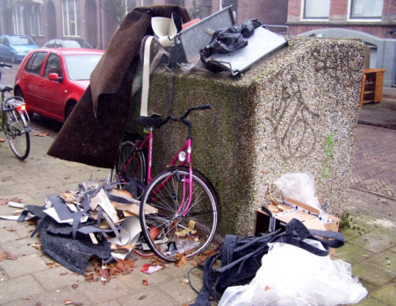
TYPE OF CONTAINERS
Mini containers
Block containers
One per household; have to be put along the side of the road on pre-defined days.
One for multiple households; mostly located at apartment buildings; freely accessible.

Slide 6
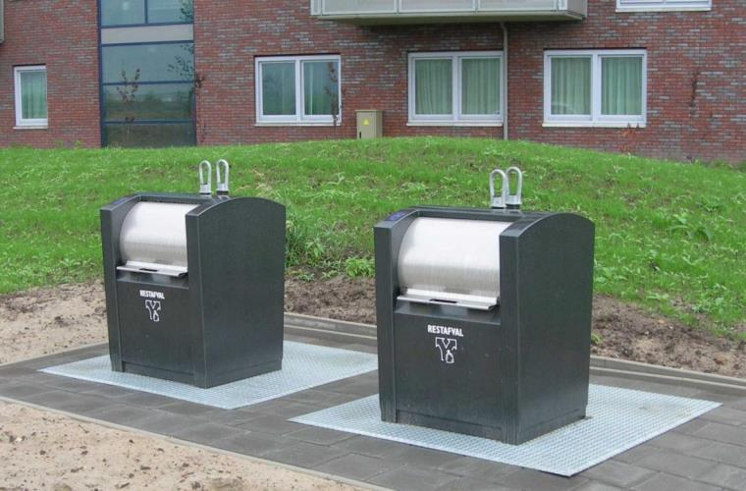
UNDERGROUND CONTAINERS

Slide 7
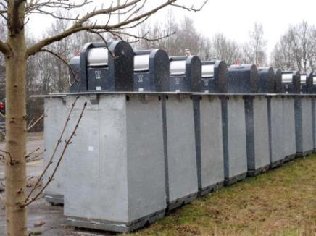
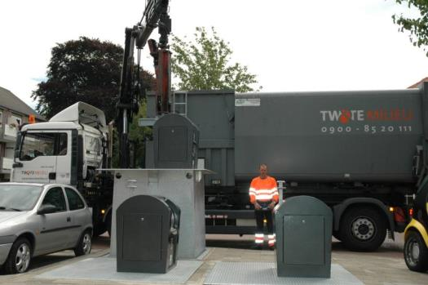
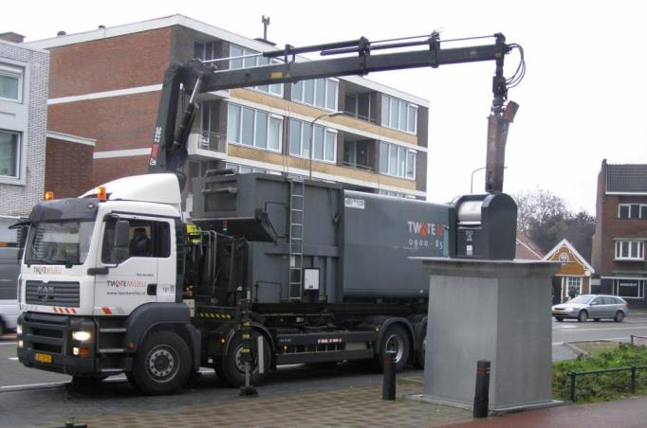
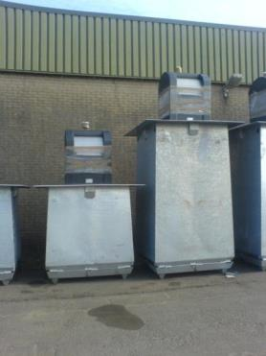

Slide 8
ADVANTAGES UNDERGROUND CONTAINERS
Can be used at all places: apartments, houses, business parks, within the city centre etc. (≠ mini containers)
Don’t have to be emptied on pre-defined days (≠ mini containers)
Much larger then the block containers (typically 5m³ which is 5 times the volume of a block container)
Only accessible with a personal card
  Avoids illegal waste deposits (≠ block containers)
  Enables the introduction of ‘Diftar’: charging waste disposal at different rates per kg depending on the type of garbage
Less odour nuisance due to solid locking (≠ block containers)
Contributes to an attractive environment (≠ block containers)

Slide 9
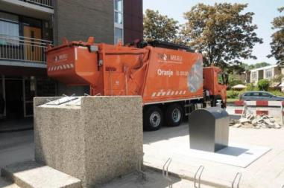

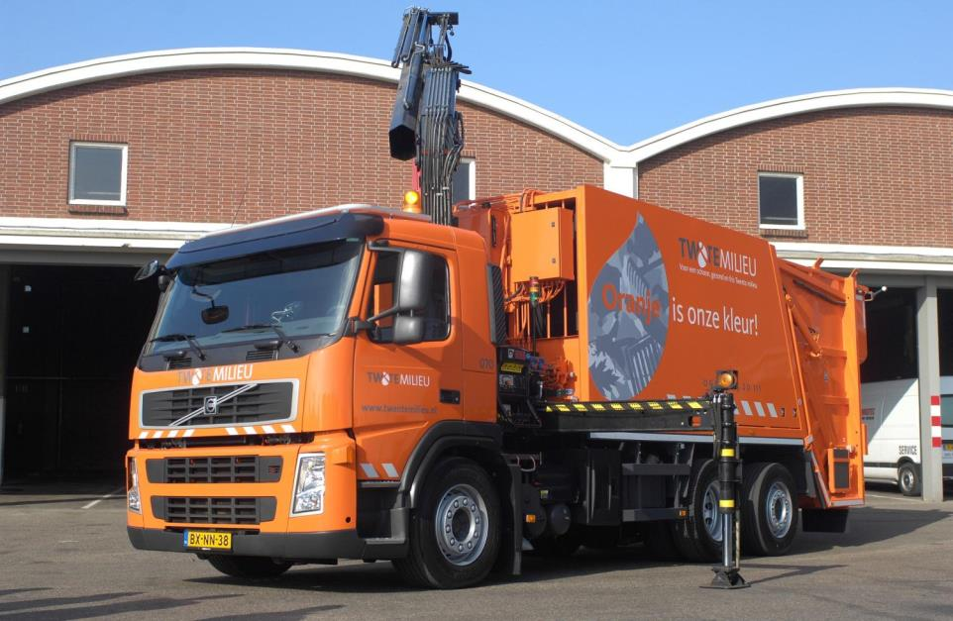

Slide 10
USING THE UNDERGROUND CONTAINERS
Between 2009 and 2011, around 700 underground containers have been installed; expected to increase to 2000 containers.
Containers are equipped with a motion sensor: the number of lid openings are communicated to Twente Milieu.
There is a static cyclic schedule that states which containers have to be emptied on what day. For example: container X has to be emptied every Tuesday and container Y has to be emptied on Friday once in the two weeks.
Why not using this sensor information for the whole selection process?
Dynamic planning methodology: each day, select the containers to be emptied based on their estimated fill levels (using sensor information).

Slide 11

INVENTORY ROUTING PROBLEM
In the literature, our problem is known as a Inventory Routing Problem (IRP) which combines:
  The vehicle routing problem (VRP)
  Inventory Management \ Vendor Managed Inventory (VMI)
Trade-off decisions:
  When to deliver a customer?
  How much to deliver to a customer?
  Which delivery routes to use?

Slide 12


ILLUSTRATION OF THE IRP
Basic question for IRPs: which customers to serve today and how to route our trucks?
Enough empty space left
Depot
Empty space needs to be delivered soon
Parking

Slide 13
OUR SOLUTION METHODOLOGY
Some characteristics of our problem:
  Multi-vehicle: up to 7 trucks.
  Multi-depot: 2 parking areas and 1 waste processing center.
  Large-scale: expanding to 2000 customers (containers), which requires > 300 visits per day.
  Long planning horizon: a short-term planning approach will postpone deliveries to the next period.
  Dynamic environment: stochastic travel times and waste disposals → we have to be able to do replanning.
  Changing environment: seasonal patters and special days.
To cope with these characteristics, we use a fast heuristic.
To anticipate changes in waste disposal, we equip our heuristic with a number of tunable parameters and optimize over these parameters.

Slide 14

BASIC IDEA OF THE HEURISTIC
Create initial routes based on MustGo’s (seed customers and workload balancing) and extend these routes with MayGo’s.
MayGo
MustGo
Seed
Depot
Depot
Depot
Depot
Depot
Depot
Depot
Depot
Parking
Parking
Parking
Parking
Parking
Parking
Parking
Parking
Extended with MayGo’s

Slide 15
ALGORITHM OUTLINE
1. Start
Initial planning in the morning and replanning during the day.
Empty schedules in a non-preemtive way and keep them feasible. Estimate the days left; MustGo’s (days left < MustGoDay); trucks to use; lower bound on the number of routes to use.
One seed per truck to (i) spread trucks across the area, (ii) realize container insertions both close and far from the depot, and (iii) balance the workload per route to anticipate later MayGo insertions.
Plan MustGo’s based on cheapest insertion, possibly in a balanced way (in anticipation of MayGo insertions).
Plan MayGo’s: see next sheet.
Execute planning and perform replanning when needed.
2. Initialize values
3. Prepare routes
4. Plan MustGo’s
5. Plan MayGo’s
6. End

Slide 16
ADDING MAYGO CONTAINERS
MayGo’s: days left < MustGoDay+MayGoDay.
Planning extremes:
  Wait first: MayGoDay=0
  Drive first: MayGoDay=∞
The best option would be somewhere in between.
Selection of MayGo’s depend on the additional travel time (insertion costs) as well as on the inventory.
Options:
  Ratio insertion costs / inventory.
  Relative improvement of this ratio compared to a smoothed historical ratio. A large positive value indicates an opportunity we should take.
Use (optional) limit on the number of containers to empty.

Slide 17
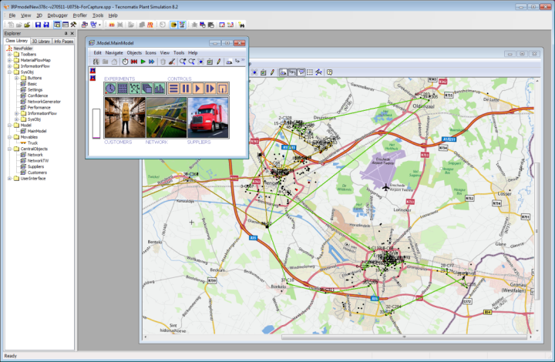
WILL IT WORK? A SIMULATION STUDY
Benchmark the current way of working and gain insight in the performance of our heuristic

Slide 18
NUMERICAL RESULTS
Based on current deposit volumes and truck capacity, savings of 14.6% can be achieved, which consists of 40% reduction of penalty costs and 18% less travel distance.
Savings increase with decreasing truck capacities.
Truck capacity

Slide 19
OBSERVATIONS
Performance heavily depends on the parameter settings:
  MustGoDay
  MayGoDay
  MaxPerDay (to limit MayGo’s)
  NrTrucks
  Slack capacity in trucks (to avoid replanning)
  Etc.
Moreover, the “right settings” for these parameters heavily depend on the day of the week.
We could learn these parameters
  Through experimentation in practice (online learning)
  Through simulation experiments (offline learning)

Slide 20

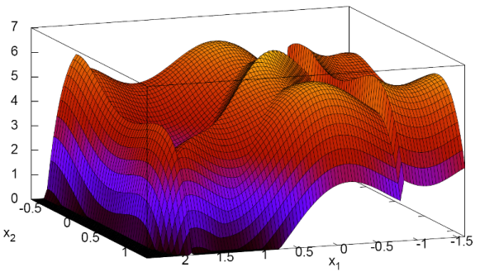
STOCHASTIC SEARCH
Where is the min\max of some multi-dimensional function when the surface is measured with noise?
In our case: at least a 15 dimensional function (using the parameters MustGoDay, MayGoDay, and MaxPerDay).

Slide 21
SIMULATION OPTIMIZATION
The optimization problem:
  The measurements follow from a simulation run, hence these measurements are expensive.
  We aim to minimize the expected value of the objective function after performing N experiments
Approaches: Heuristic methods (genetic algorithms, simulated annealing, tabu search etc.); Response Surface Methods (RSM); Stochastic Approximation (SA) methods; Bayesian Global Optimization (BGO).
Unknown function (no closed-form formulation)
We can measure it
Measurement will not be exact (we measure with noise y=f(x)+ε)
Vector of parameters to be adjusted (MustGoDay, MayGoDay, MaxPerDay)
Set of all parameter combinations

Slide 22
BAYESIAN GLOBAL OPTIMIZATION
Bayesian optimization involves three stages:
  Designing the prior distribution (belief about f(x))
  Updating this distribution using Bayes' rule
  Deciding what values to sample next
Often, the belief about f(x) conforms to a Gaussian process.
A Gaussian process is a collection of random variables {y_{x1}, y_{x2},…} for which any finite subset has a joint multivariate Gaussian (Normal) distribution:
Measurements
Kernel function (covariance between two variables)
Mean

Slide 23
OPTIMIZATION POLICIES WE CONSIDER
Sequential Kriging Optimization (SKO) by Huang et al. (2006)
  Extension of Efficient global optimization (EGO) by Jones et al. (1998) for noisy measurements.
  EGO: new points to be measured are selected based on “expected improvement” which strikes a balance between exploitation and exploration.
Hierarchical Knowledge Gradient (HKG) by Mes et al. (2011)
  Extension of the knowledge-gradient policy for correlated normal beliefs (KGCB) from Frazier et al. (2009).
  HKG: hierarchical aggregation technique that uses the common features shared by alternatives to learn about many alternatives from even a single measurement.

Slide 24
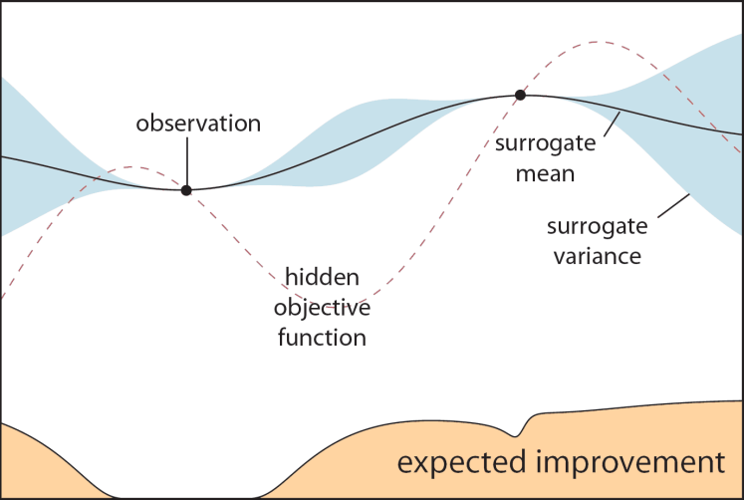
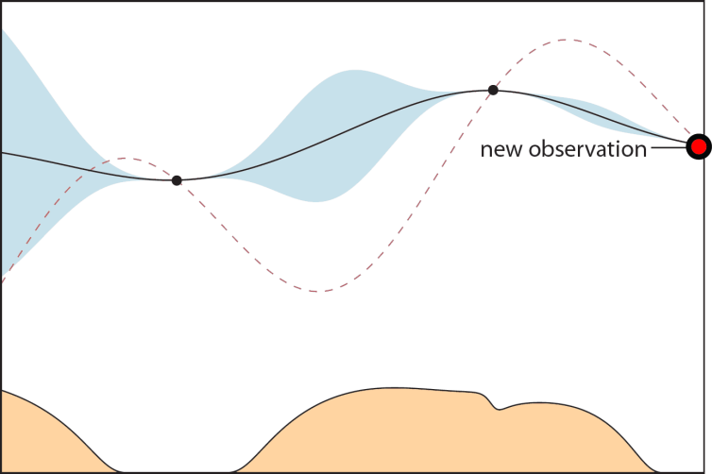
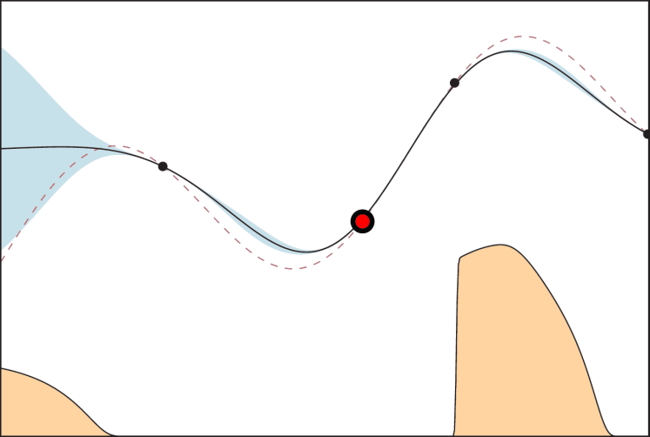
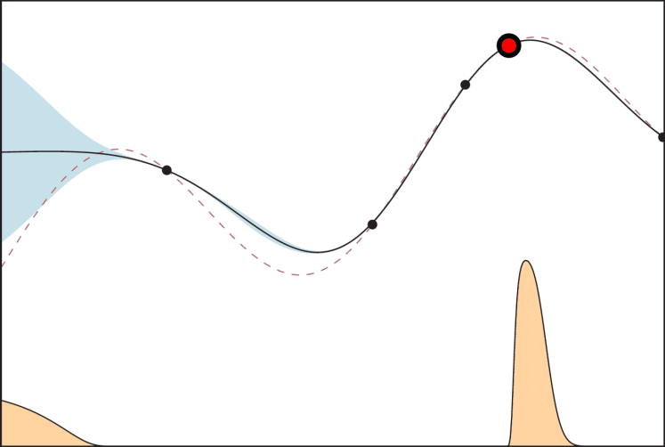
ILLUSTRATION OF EGO
Source: Brochu et al. (2009)

Slide 25
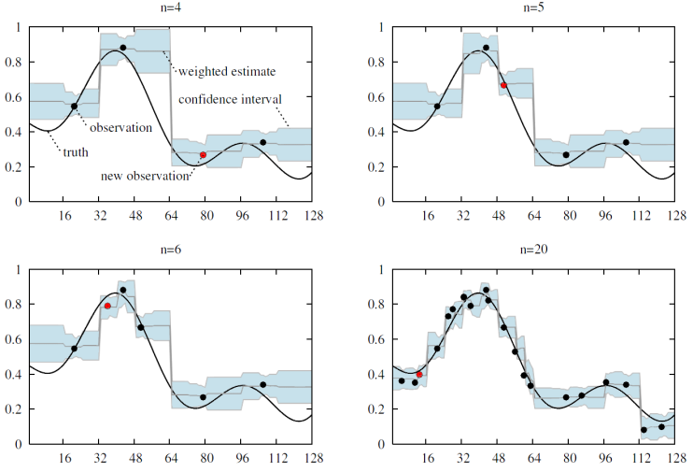
ILLUSTRATION OF HKG [EXCEL DEMO]

Slide 26
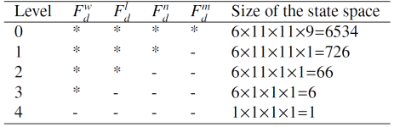
NUMERICAL EXPERIMENTS
Several network instances
  Real network: 378 containers (2010 setting), 30x30 min.
  Small virtual network: 500 containers, 30x30 min.
  Large virtual network: 100/500 containers, 150x150 min.
Policy SKO: continuous domain [0,4]x[0,4]x[0,1] for parameters MustGoDay, MayGoDay, MaxPerDay.
Policy HKG:
  Discretization
  Additional param.
  for #working days
Experiments:
  Parameter dependency
  Convergence results
  Optimized parameter settings (see paper)

Slide 27
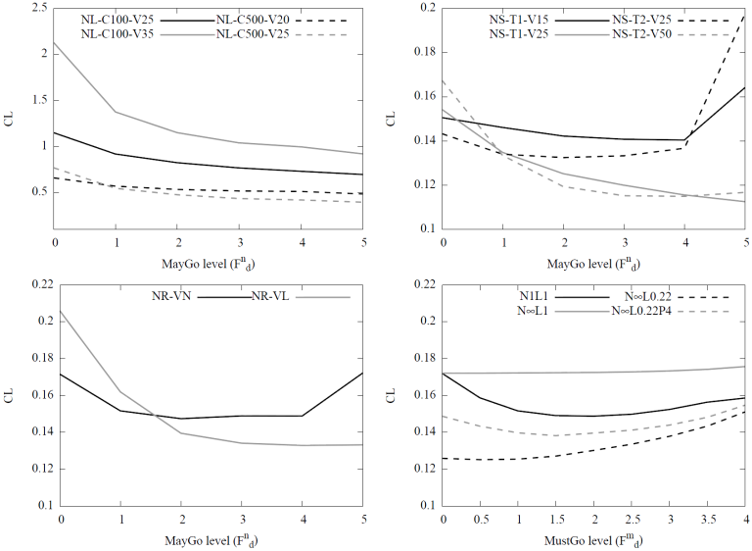
PARAMETER DEPENDENCY

Slide 28
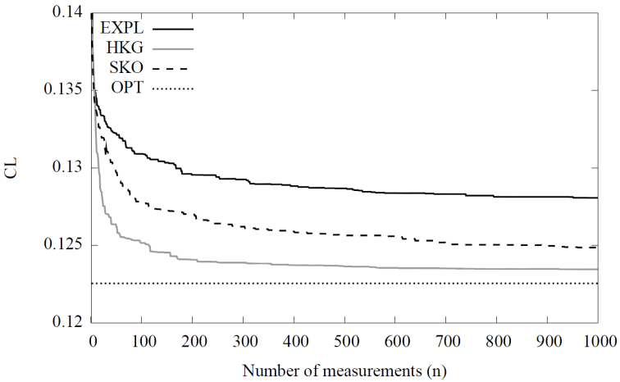
CONVERGENCE RESULTS
(found with SKO for large n)

Slide 29
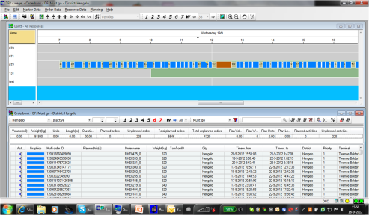
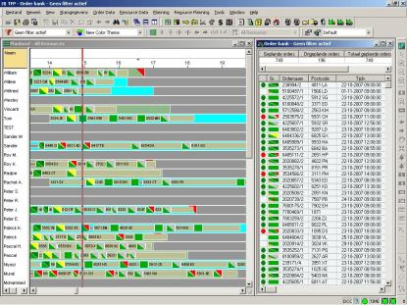
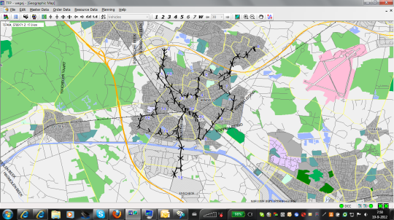
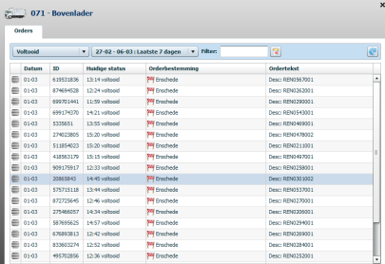
THE APPLICATION

Slide 30
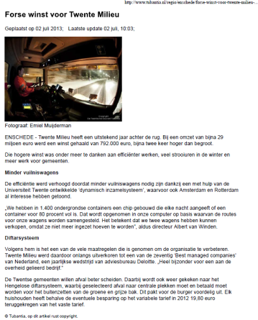
WHAT TO REMEMBER [1/2]
We proposed a fast heuristic suitable for Inventory Routing Problems involving a large number of customers.
The dynamic collection policy results in a reduction of 18% in travel costs and 40% in penalty costs (due to overflow).
Major savings have been reported by the waste collection company due to the use of this dynamic collection policy.

Slide 31
WHAT TO REMEMBER [2/2]
Performance heavily depends on the parameter settings. So, at start of a holiday season or at changing weather conditions, the parameters have to be adjusted.
An optimization approach is preferred to anticipate changes in waste disposals. To enable this, we equipped our heuristic with several tunable parameters.
To optimize over these parameters we used techniques from Simulation Optimization and Bayesian Global Optimization (SKO, HKG).
In most cases a few hundred measurements would be sufficient to find near optimal parameter settings, making the approach suitable for daily planning purposes.
Additional costs reductions up to 40% are possible by changing the parameters from their default settings to an optimized setting.

Slide 32
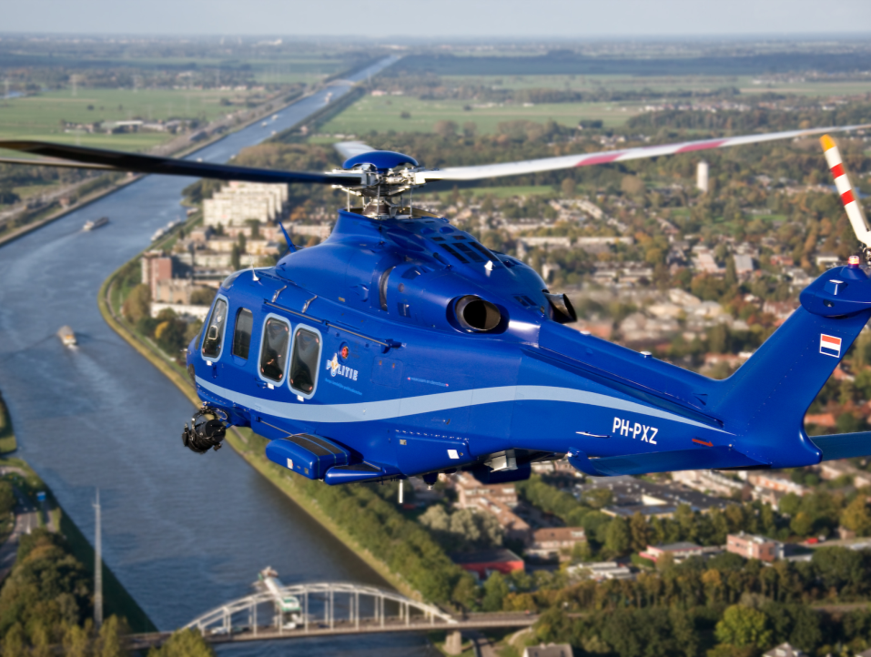
PART 2: POLICE HELICOPTERS

Slide 33
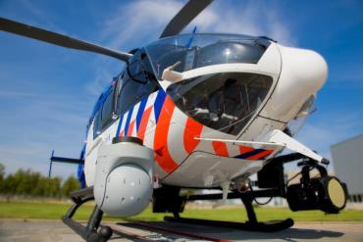

INTRODUCTION [1/2]
Dutch Aviation Police and Air
Support
Renewed fleet of helicopters
with state-of-the-art equipment.
Decision making regarding positioning, routing and scheduling of the helicopters:
  Strategic: base stations for the helicopters
  Tactical: division of flight budget to days
  Operational: when and where to fly
Focus of this talk…
  decision support system for routing of police helicopters,
  in anticipation of unknown future incidents,
  to maximize the weighted expected number of covered incidents.

Slide 34
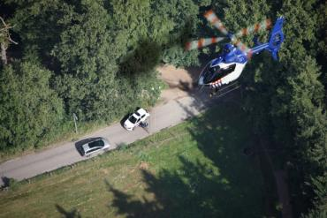
INTRODUCTION [2/2]
Routing problem applies to
any type of emergency
vehicle or, e.g., taxis in New
York City.
Combination of the research fields:
  Dynamic and Anticipatory Vehicle Routing Problem (vehicles driving around in anticipation of future demand).
  Location Covering Problem (LCP, LSCP, MCLP, MEXCLP, AMEXCLP, TIMEXCLP).
  We have a DVRP with soft time windows where we want to maximize our coverage to incidents.
We split the problem in (i) forecasting and (ii) routing.

Slide 35

PROBLEM FORMULATION [1/2]
Objective:
i_{wt} is the forecasted intensity of criminal behavior in area w at time t
G_{wt} is the fraction of coverage received by area w at time t

Slide 36




PROBLEM FORMULATION [2/2]
Coverage received
Airborne constraint
Movement restriction
Intelligence
Fuel consumption
Maximum visits

Slide 37

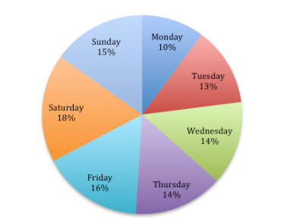
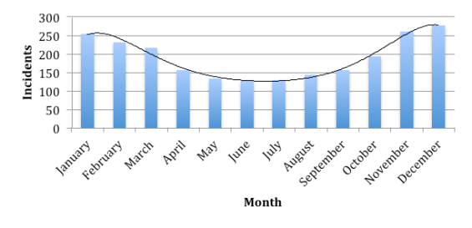
FORECASTING (i_{wt}) [1/3]
Forecast area: hexagonal tiling with hexagons having 2 nautical miles inner radius.
For each forecast day, translate each historic incident to a forecasted incident on the forecast day, using a month-of-the-year and day-of-the-week transformation.
Factor calculated for each hour.

Slide 38
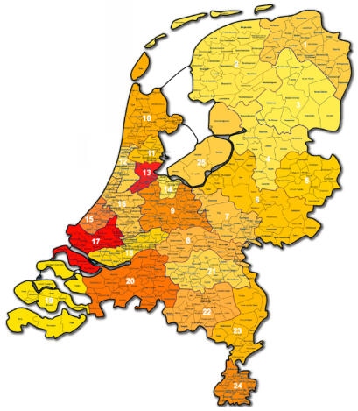
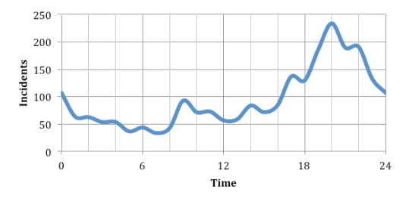
FORECASTING (i_{wt}) [2/3]
Generalize in time and space.
Space: hexagons surrounding a
historic incident also ‘borrow’ a
fraction of the incident intensity.
Time: time units around the
occurrence of a historic incident
also ‘borrow’ a fraction of the
incident intensity.

Slide 39
FORECASTING (i_{wt}) [3/3]
Intuitive idea:
  Add each historic incident to each time unit and each forecast area
  Multiply each of these incidents with a weight depending on
    Age (more weight on recent observations)
    Month (high weight if the incident is within the same month as the forecast day)
    Weekday (high weight if the incident is on a same weekday as the forecast day)
    Space (more weight if the forecast area is close to the area the incident actually occurred, many weights equal to zero)
    Time (more weight if the time-of-the-day is close to the time the incident actually occurred, many weights equal to zero)

Slide 40
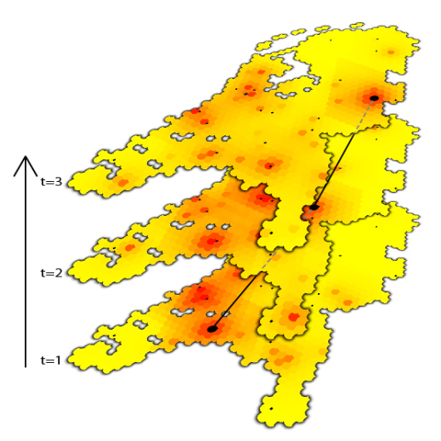
ROUTING
The challenge (see animation):

Slide 41





MIXED INTEGER LINEAR PROGRAMMING
Hexagonal grid, scheduling one helicopter at a time, with given departure and arrival time and location.
Coverage received
Movement
restriction
Movement restriction
Maximum visits

Slide 42
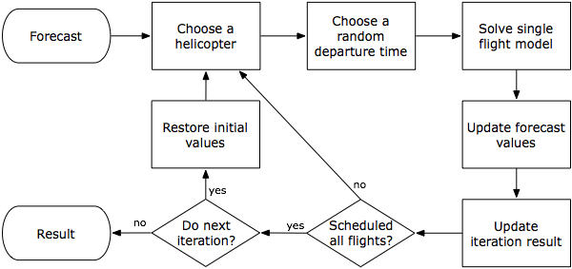
RDDT HEURISTIC
Choosing a random departure time

Slide 43
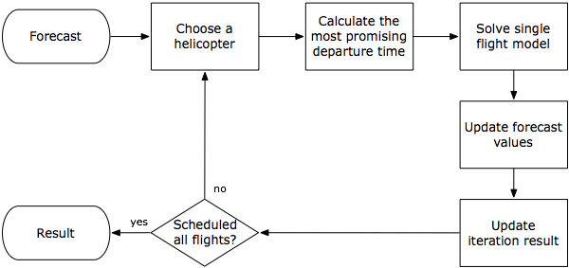
MPDT HEURISTIC
Choosing the most promising departure time

Slide 44
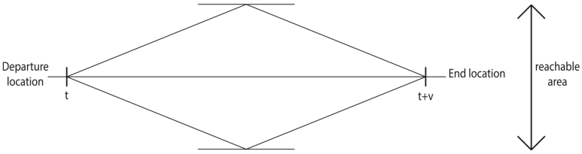

MOST PROMISING DEPARTURE TIME

Slide 45

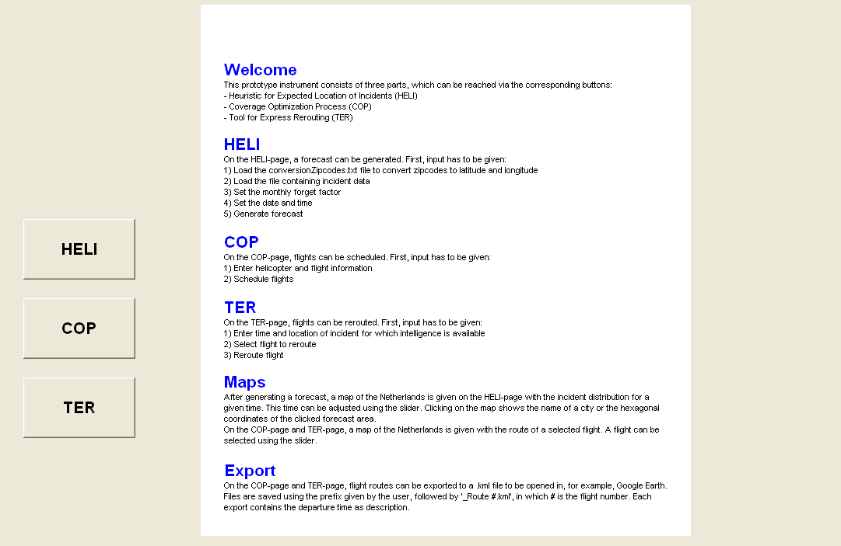
APPLICATION [1/4]
Heuristic for Expected Location
of Incidents
Coverage Optimization Process
Tool for Express Rerouting

Slide 46
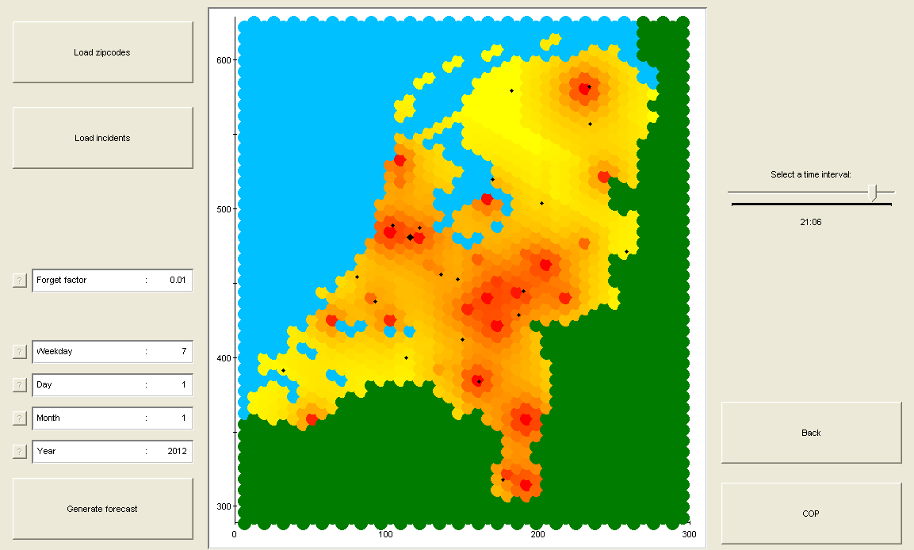
APPLICATION [2/4]

Slide 47
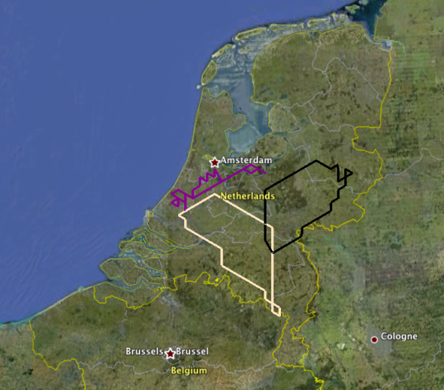
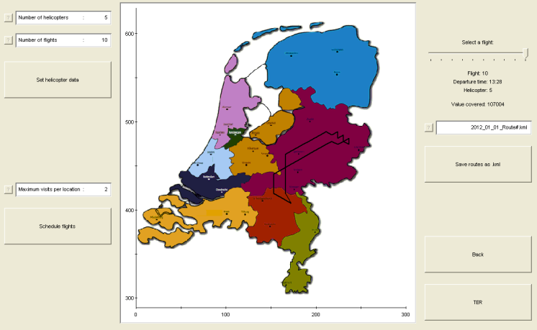
APPLICATION [3/4]

Slide 48
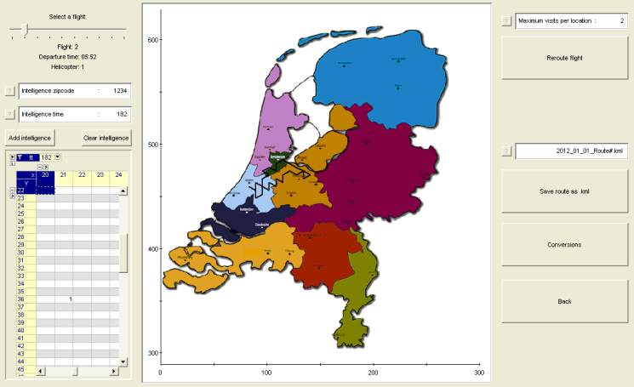
APPLICATION [4/4]

Slide 49

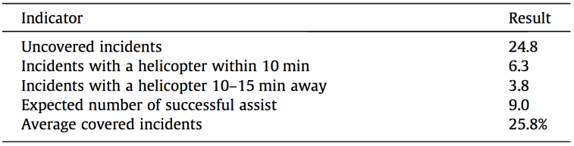
RESULTS
Historic data set of incidents for 2 years.
Use year 1 for learning only.
Use year 2 to simulate and learn.
Results:
Normalized such that the number of successful assist of the Dutch Aviation Police & Air Support equals 1.

Slide 50
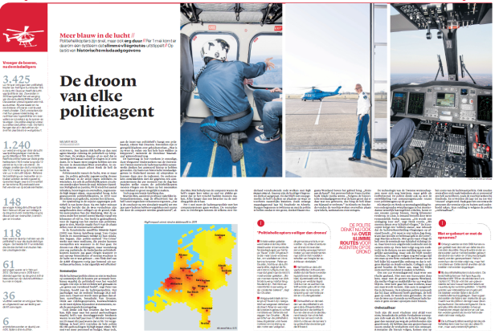
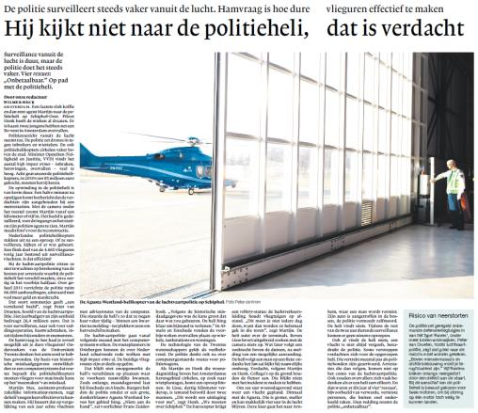
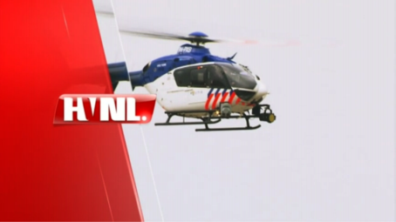
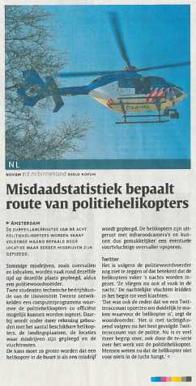


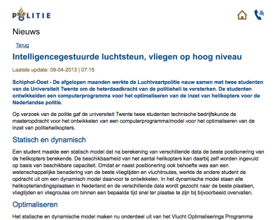
MEDIA

Slide 51
CONCLUSIONS
Anticipatory Emergency Vehicle Routing Problem: a combination of the Location Covering Problem and the Dynamic Vehicle Routing Problem.
Combination of…
  forecasting (generalization in time and space),
  routing (MILP + heuristic for one helicopter at a time).
Validation with experts and a simulation study.
Improvement over practice with a factor 9.
No additional resources required.
Can be used to reroute helicopters in real time.
Application currently used by the Dutch Aviation Police and Air Support.

Slide 52
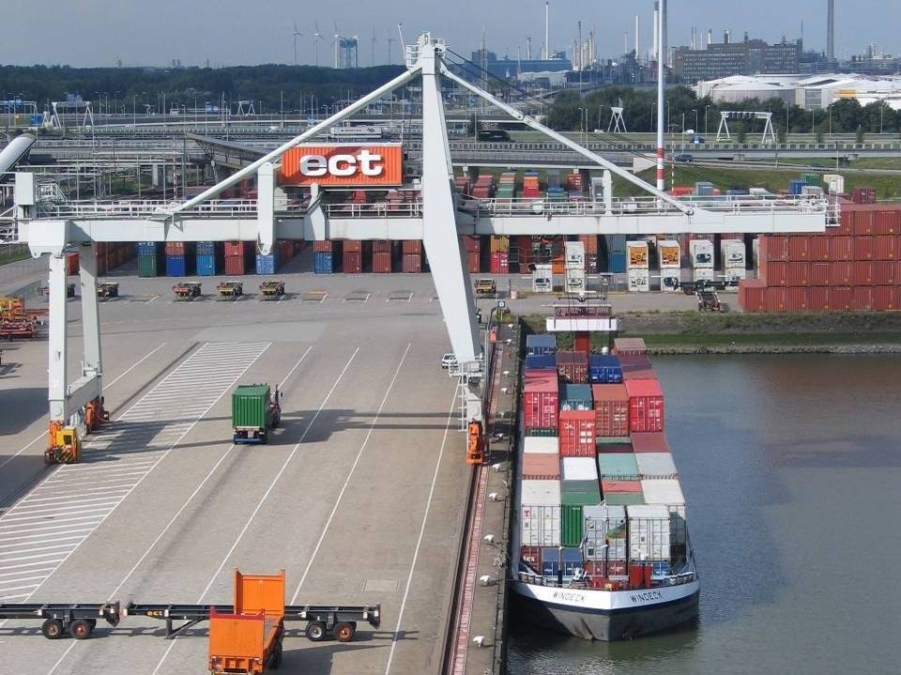
PART 3: CONTAINER VESSELS

Slide 53
THE PORT OF ROTTERDAM
Largest port in Europe and a gateway to the European market with more than 350 mil. consumers.
Nr 1 port regarding quality of port infrastructure (World Economic Forum).
Until 2004 the world’s busiest port, now the world’s fifth-largest port (tonnage).
Annual throughput is 435 mil. ton (2011).
Major increase expected in the coming years.
Extension “Maasvlakte 2” of 2000 hectares (2014).

Slide 54
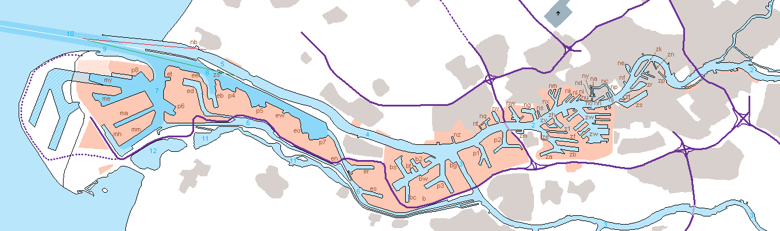
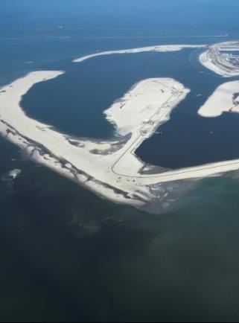

BOTTLE NECK
MAASVLAKTE 2
Inlandverbindingen
40 km / 25 mile

Slide 55


Slide 56



BOTTLENECK
Inland connections:
  Trains, trucks, vessels
Expected growth:
  From 12 to about 30
  mil. TEU till 2030.
Modal split:
Increase of 400% in container flows by inland shipping (7 mil. TEU)
 | 2010 | 2030
Road | 48% | 35%
Water | 40% | 45%
Rail | 12% | 20%

Slide 57



BARGE HANDLING PROBLEM [1/2]
North Sea
Barge
Terminals
Terminals
Terminals

Slide 58
BARGE HANDLING PROBLEM [2/2]
Poor alignment of barge and terminal activities
  Barges leave harbor too late due to waiting time of barges at terminals and inefficient routes through the harbor.
  Inefficient utilization of quay capacity.
Number 1 problem in barge hinterland container transportation!
Everyone can benefit when activities are aligned and appointments become reliable
However:
  Shared problem, no single problem owner, players want to stay in control of their own operations
  Limited information sharing: players are competitors and reluctant to share information
  No contractual relationships.

Slide 59

CURRENT SITUATION
Notes:
Telefoon, fax, email
Alle partijen communiceren dus onderling en dat leidt tot problemen

Slide 60










OUR SOLUTION: A MULTI-AGENT SYSTEM
An agent is a piece
of software and
company specific
Multi-Agent system
Terminal operator
Barge operator
011001110101
agent
planner
planner
agent
01100111
appointments
01100111
011001110101
planner
agent
agent
planner
Terminal operator
Barge operator
Notes:
De nieuwe situatie is de Planning Apart Together situatie
Zelfstandige bedrijven
Elk bedrijf een agent
Agents communiceren digitaal: effectievere communicatie, snelle besluitvorming
Agent is een stukje software
Idee is gelijk aan wat we kennen vna de verzekeringsagent en verzekeringsbedrijf
Agent is bedrijfsspecifiek

Slide 61

BATMAN: Barge Terminal Multi-Agent Network

Slide 62

FUNCTIONALITY
Barge operator agent: supports the barge operator with planning the rotation (order of terminal visits, making appointments with the terminals, monitoring delays, replanning).
Terminal operator agent: supports the terminal operator with planning the loading/unloading times. Based on rules set by the terminal operator, the agent handles the barge requests on its own.

Slide 63

COMMUNICATION BETWEEN THE AGENTS

Slide 64


SERVICE-TIME PROFILES
Terminal operator 1
Terminal operator 1
Arrival time
Barge
operator
Terminal operator 2
Terminal operator 2
…
Terminal operator 3
Terminal operator 3
Stage 1: Terminal operators provide service-time profiles
Stage 2: Determine best sequence and announce arrival time to the terminals

Slide 65


TERMINAL AGENT PROBLEM
Planning
Terminal info:
Planning horizon
Slack time
Slack buffer
Number of quays
Opening times
Info on all planned ships
New request:
Info on the new ship
Info for each ship:
Barge or sea vessel
Latest arrival time
Planned starting time
Actual starting time
Expected processing time
Latest departure time
Quay on which ship is planned
Arrived
Started
Service time profile:
Per time unit, a maximal guaranteed service time (waiting and handing time)
Berth Allocation Problem (BAP)
Quay Crane Assignment Problem (QCAP)
Quay Crane Scheduling Problem (QCSP)
Online Parallel Machine Scheduling
Maximum Empty Rectangle (MER)

Slide 66


BARGE AGENT PROBLEM
User interface:
Routing
Barge info:
Terminals to visit
Stowage plan (restriction on visiting sequence)
Number of rotations
Expected time of arrival
Latest departure time
Point of entrance
Point of exit
Travel times
Info for each terminal to visit:
Name
Expected processing time (based on loading and unloading information)
Due date
Service time profile
Rotations:
A small set of efficient rotations, which can be evaluated based on various criteria.
Time Dependent Traveling Salesman Problem with Time-windows (TDTSP-TW)
Depth-First Branch-and-Bound Algorithm.
DP heuristic (Malandraki and Dial, 1996)
Objectives:
Waiting time?
Time in the port?
Emissions and fuel consumption?

Slide 67

THE APPLICATION

Slide 68
IMPLEMENTATION?
Public tender for “BREIN”: the development and implementation of decision support / optimization modules
How to convince the port authority to implement our system?
Using a game: demo of the application in a dynamic environment with multiple actors.
The idea:
  Two phases: planning and realization (re-planning)
  Multiple rounds: with/without appointments, with/without decision support by our application
  Performance evaluation:
    System-wide performance per round
    Individual performance per player (deviation from optimum, deviation from plan)

Slide 69

DE GAME

Slide 70
WHAT TO REMEMBER
Alignment of barge and terminal activities by means of a decentralized approach to maintain autonomy.
Advantages:
  Terminal and barge operators need less time to plan their activities.
  Increase in terminal utilization through better appointment making with barges (efficient usage of slack).
  Reduction of barge waiting time with improved rotation planning resulting in a substantial increase in transport capacity and reduction of fuel consumption.
  A more realistic rotation planning increases the reliability of barge transportation and its competitiveness compared to other modalities
  Guaranteed service time makes it possible to sail at economical/sustainable speeds.
Use of a serious game to convince participants.

Slide 71
MORE INFORMATION
Dynamic planning of…
Waste trucks:
  M.R.K. Mes, J.M.J. Schutten, A.E. Pérez Rivera (2013). Inventory routing for dynamic waste collection. Under review (working paper available at http://beta.ieis.tue.nl/node/2120).
Police helicopters:
  R. van Urk, M.R.K. Mes, and E.W. Hans (2013). Anticipatory Routing of Police Helicopters. Expert Systems with Applications 40(17), pp. 6938–6947.
Container vessels:
  M.R.K. Mes, M.E. Iacob, and J. van Hillegersberg (2013). A distributed barge planning game. To appear in: Proceedings ISAGA 2013, Springer Lecture Notes in Computer Science.

Slide 72
QUESTIONS?
Martijn Mes
Assistant professor
University of Twente
School of Management and Governance
Dept. Industrial Engineering and Business Information Systems
Contact
Phone: +31-534894062
Email: m.r.k.mes@utwente.nl
Web: http://www.utwente.nl/mb/iebis/staff/Mes/

